Slide 1
A Framework of Belief Propagation and Game Theory for Cognitive Radio Security and Routing
Ph.D. Defense
Zhou Yuan
06/27/2012
Wireless Networking, Signal Processing and Security Lab
Electrical and Computer Engineering Department
University of Houston

Slide 2
Outline
Introduction
  Dynamic spectrum access and cognitive radio
  Security issues in cognitive radio systems
  Routing in cognitive radio networks
  Belief propagation
Accomplishments
  Defense primary user emulation (PUE) attack in cognitive radio networks
  Routing-toward-primary user (RPU) attack in cognitive radio networks and corresponding defense strategy
  Interference minimization routing algorithm in cognitive radio networks
Summary
Future work

Slide 3
Outline
Introduction
  Dynamic spectrum access and cognitive radio
  Security issues in cognitive radio systems
  Routing in cognitive radio networks
  Belief propagation
Accomplishments
  Defense primary user emulation (PUE) attack in cognitive radio networks
  Routing-toward-primary user (RPU) attack in cognitive radio networks and corresponding defense strategy
  Interference minimization routing algorithm in cognitive radio networks
Summary
Future work

Slide 4
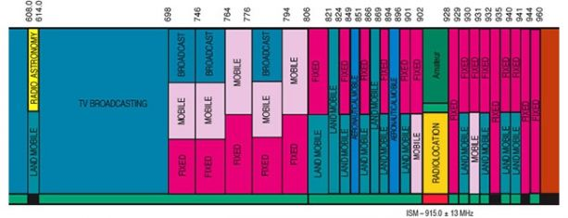
Spectrum Is A Natural Resource
Finite
Renewable
Administered
  Licensed/ primary
  Unlicensed/ secondary
Notes:
1.Today’s technology can only operate on certain frequencies; commercially usable frequencies are a scarce commodity.
2.Airwaves used to broadcast any transmission can be reused after the broadcast is completed.
4. To avoid interference from competing broadcast transmissions, frequency assignments are managed by recognized authorities.

Slide 5
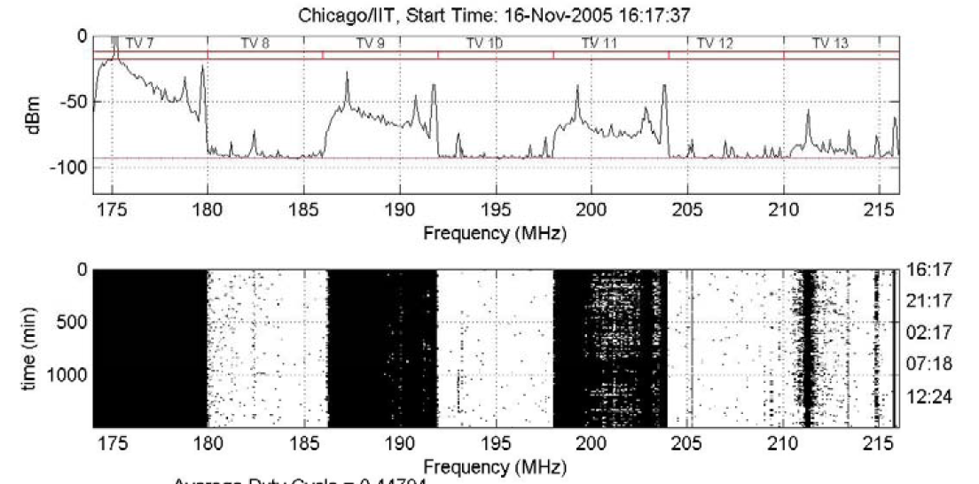
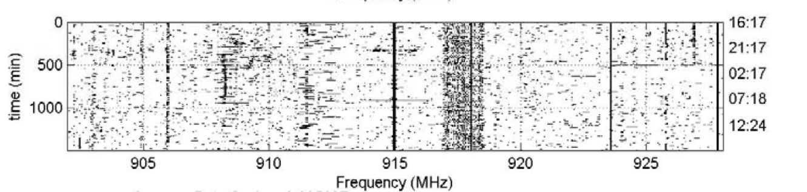
Dynamic Spectrum Access
Less than 5% of prime spectrum is used EVERYWHERE and ALL THE TIME → these “white spaces” change with time and location!
Need mechanisms that promote spectrum reuse and sharing
Policy makers need to work with technologists to enable better spectrum policies
  Dynamic spectrum access!
Notes:
Underlay, overlay

Slide 6
Cognitive Radio (CR)
Cognitive radio=software defined radio + cognitive engine
Definition of cognitive radio:
  “A radio frequency transceiver designed to intelligently detect whether a particular segment of the radio spectrum is in use, and to jump into (and out of) the temporarily unused spectrum very rapidly, without interfering with the transmission of other authorized users.”
Notes:
Software-defined radio (SDR): A radio transmitter and/or receiver employing a technology that allows the RF operating parameters like frequency range, modulation type, or output power to be set or altered by software

Slide 7
Characteristics of Cognitive Radio
Three CR technical features
  Obtain the knowledge of radio operational and geographical environment;
  Dynamically adjust operational parameters and protocols according to this knowledge;
  Learn from the results of its actions to further improve its performance.

Slide 8
Outline
Introduction
  Dynamic spectrum access and cognitive radio
  Security issues in cognitive radio systems
  Routing in cognitive radio networks
  Belief propagation
Accomplishments
  Defense primary user emulation (PUE) attack in cognitive radio networks
  Routing-toward-primary user (RPU) attack in cognitive radio networks and corresponding defense strategy
  Interference minimization routing algorithm in cognitive radio networks
Summary
Future work

Slide 9
Security Issues in Cognitive Radio Systems
CR systems face unique security challenges.
Existing attacks for CR networks
  Physical layer
  MAC layer
  Network layer
Security in CR systems is not fully studied yet.
Notes:
Physical layer: PUE/ Reporting false sensing data (RFSD) attack
MAC layer: Common Control Channel (CCC) Attack/ Reporting False Selection Frame/ False Evacuation
Network layer: Blackhole, greyhole, wormhole. The goal of the various attacks is mainly to reduce the network throughput.
However, all of these attacks above are discovered in wireless mesh/sensor/ad hoc networks, without considering much about the cognitive radio system model and existence of the primary users.
Many of the security challenges are due to the fact that the networks inherently rely on cooperation among distributed entities. Cooperation can be fragile under malicious attacks.

Slide 10
Outline
Introduction
  Dynamic spectrum access and cognitive radio
  Security issues in cognitive radio systems
  Routing in cognitive radio networks
  Belief propagation
Accomplishments
  Defense primary user emulation (PUE) attack in cognitive radio networks
  Routing-toward-primary user (RPU) attack in cognitive radio networks and corresponding defense strategy
  Interference minimization routing algorithm in cognitive radio networks
Summary
Future work

Slide 11
Routing in Cognitive Radio Networks
Existing routing algorithms
  Graph-based routing
  Power-based routing
  Delay-based routing
  Throughput-based routing
  Link quality/stability-based routing
However, still some aspects not investigated
  Aggregate interference from SUs to PUs
  Game theory
Notes:
Routing based on game theory has not been investigated

Slide 12
Outline
Introduction
  Dynamic spectrum access and cognitive radio
  Security issues in cognitive radio systems
  Routing in cognitive radio networks
  Belief propagation
Accomplishments
  Defense primary user emulation (PUE) attack in cognitive radio networks
  Routing-toward-primary user (RPU) attack in cognitive radio networks and corresponding defense strategy
  Interference minimization routing algorithm in cognitive radio networks
Summary
Future work

Slide 13
Markov Random Field
y₁
y₂
y_{i}: observed nodes
x_{i}: hidden nodes
Local function,
Compatibility function,
Joint probability:
Marginal probability:
x₁
x₂
y_{i}
x_{i}
y_{n}
x_{n}
Notes:
Local function: Phi
Compatibility function: Psi (s ai)

Slide 14
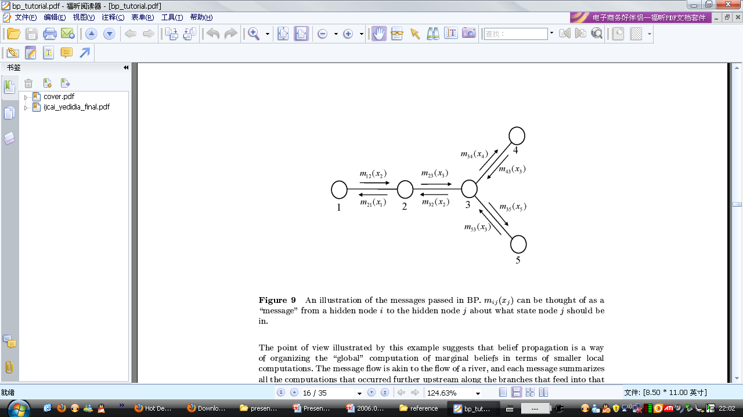
Message in Belief Propagation
Message: m_{ij}(x_{j})
  From a hidden node i to the hidden node j
  About what state node j should be in.

Slide 15
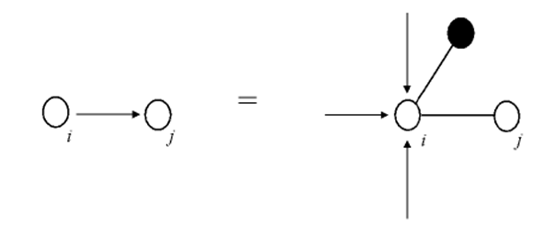

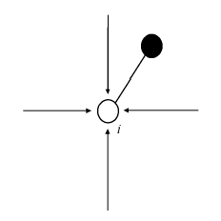
Belief Propagation (BP)
Message update rule:
Message from i to j
Message from k to i
Local Function
Compatibility Function
Belief calculation:

Slide 16
Belief Propagation Example
4
1
3
Local Function
Compatibility Function
5

Slide 17
Outline
Introduction
  Dynamic spectrum access and cognitive radio
  Security issues in cognitive radio systems
  Routing in cognitive radio networks
  Belief propagation
Accomplishments
  Defense primary user emulation (PUE) attack in cognitive radio networks
  Routing-toward-primary user (RPU) attack in cognitive radio networks and corresponding defense strategy
  Interference minimization routing algorithm in cognitive radio networks
Summary
Future work

Slide 18
Main Contributions
Belief propagation based defense against PUE attack
  Converges fast
  Effective and efficient to find the attacker
Flexible for modification and simplification
  Easily extended to detect various other kinds of attacks
No additional cost for new hardware
  Avoid deployment of expensive hardware for TOA and FOA
Related publication
  Major revision, IEEE Journal on Selected Areas in Communications (JSAC): Cognitive Radio Series.

Slide 19
Primary User Emulation (PUE) Attack
Attacker mimic PU TX signal characteristics.
Other SUs erroneously identify the attacker as a PU.
The attacker can access the spectrum,
while other Sus waiting for the idle licensed spectrum.
Simple simulation results show
  PUE attack can increase spectrum access failure probability from 10% to 60% when there are 5 channels.

Slide 20
Detect PUE Attacker By Interaction Between Neighboring Users
Assumptions:
  Each secondary user is equipped with a localization unit.
  Locations of PUs are fixed (TV towers), also known to SUs.
  A PUE attacker is a SU
    Able to change its modulation mode, frequency, location and transmission output power.
A transmitter verification scheme by calculating the location of PUE attacker is proposed
  Received signal strength (RSS) measurement
  Determine the location of the attacker by interactions between neighboring users.

Slide 21
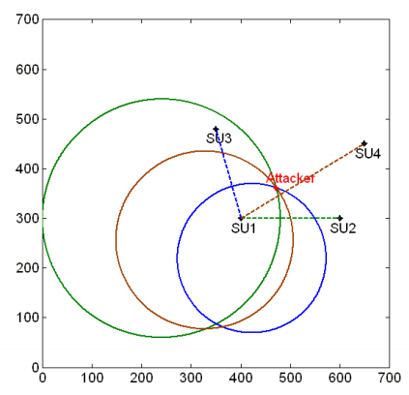
Detect PUE Attacker By Interaction Between Neighboring Users
Each SU can plot a circle based on the RSS from the attacker.
Three circles can determine the location of the attacker, which is different from the PUs’ locations.
In practical there is no common intersection point between three circles.
  Due to noise and shadowing fading
location detection strategies by interactions between neighboring users.

Slide 22
Detect PUE Attacker Using BP
Single user detection can be inaccurate and noisy.
  To improve accuracy, joint detections from different users are required.
How to efficiently combine the joint detections?
  Belief propagation is a mathematical tool
    Fast calculation of marginal probabilities
    Computation complexity grows only linearly with the increasing number of users
Notes:
Local function, compatibility function
Phi, Psi
Honest, belief > threshold
Malicious, belief < threshold

Slide 23
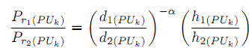
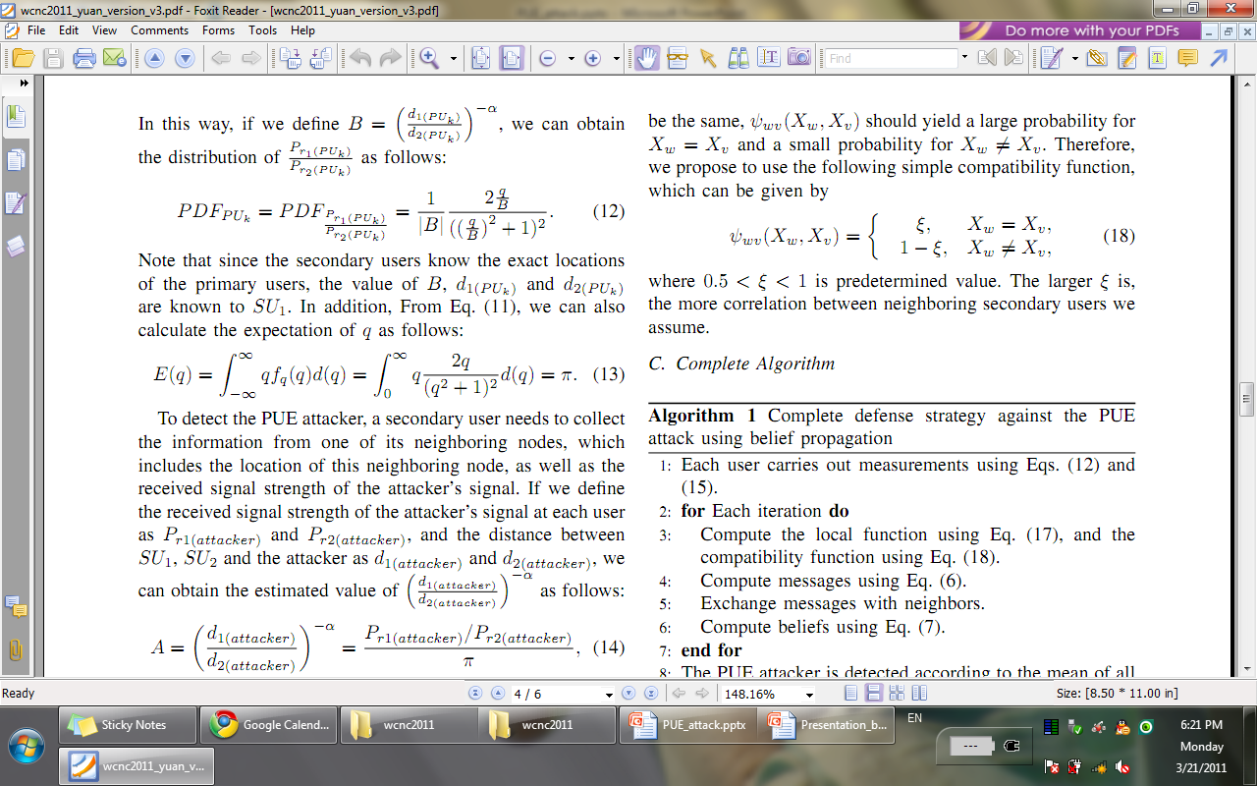
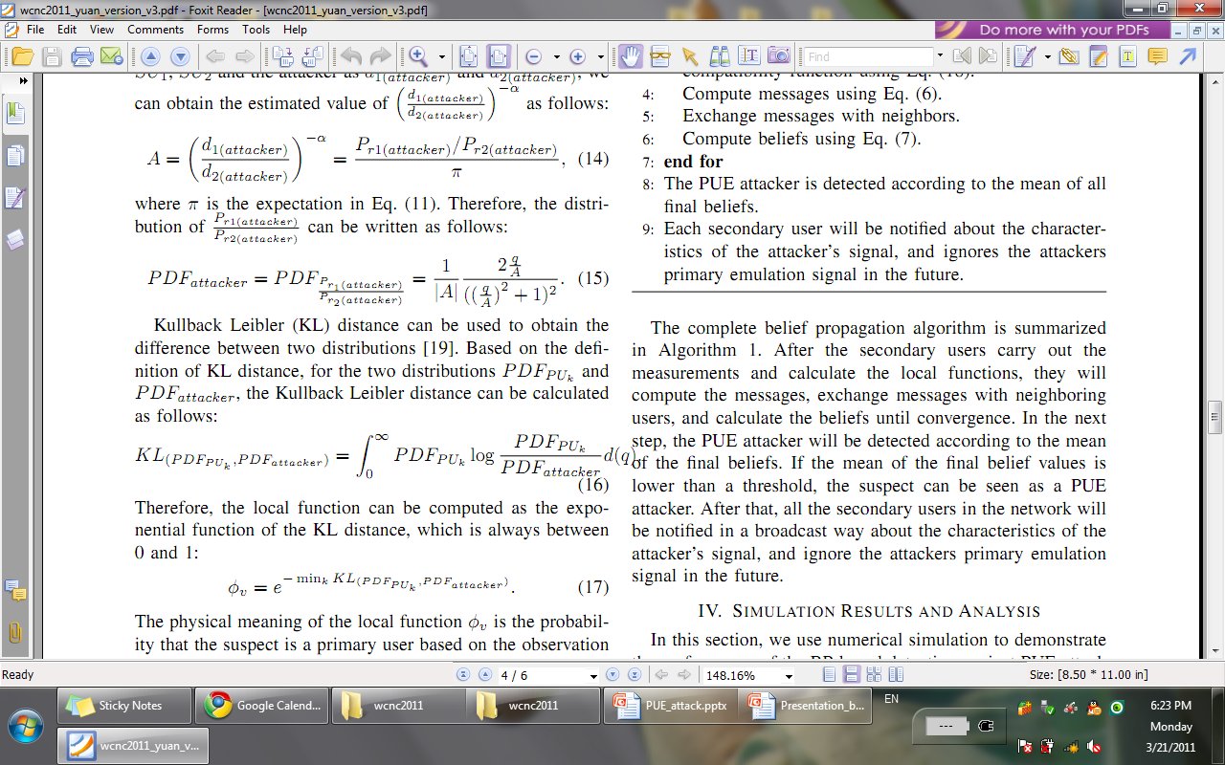
Local Function
Ratio of RSS from PU
If we define
We can get
where
We can also calculate
where
Ratio of RSS from attacker
The local function can be defined as the exponential function of
Kullback Leibler distance:
Notes:
Phi
When the value of KL distance is high, which means large difference between the two distributions, we can obtain a low value of ϕ
, which represents a high probability that the suspect is a PUE attacker.

Slide 24
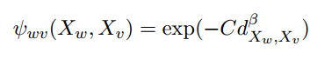
Compatibility Function
Difficult to find an explicit expression for the compatibility function.
The compatibility function is dependent on the correlation between the two neighboring nodes.
Proposed exponential compatibility function:
Notes:
C and β are two constants
When the distance is large, the value of compatibility function is low. The exponential function guarantees that the compatibility value is always between 0 and 1. Also the proposed compatibility function is symmetric for both random variables

Slide 25
Complete Algorithm
Each user carries out measurements about the RSSs from the suspect and the primary user.
for each iteration do
  Compute the local function and the compatibility function
  Compute messages
  Exchange messages with neighbors
  Compute beliefs
end for
PUE attacker is detected according to mean of all final beliefs
Notify other SUs to avoid PUE attack
Notes:
Honest, belief > threshold
Malicious, belief < threshold
Our advantage:
Do not need to deploy additional sensor networks
Do not need to calculate the exact location of the attacker
Avoid the deployment of expensive hardware for TOA and FOA

Slide 26
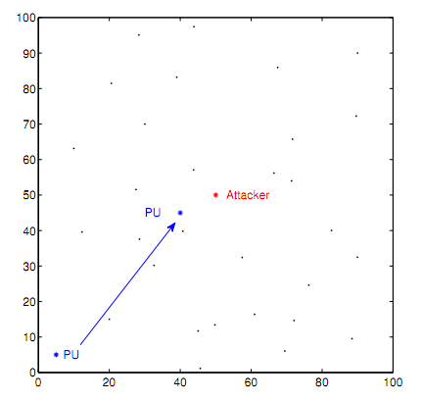
Simulation Setting
Different locations
of PU.

Slide 27
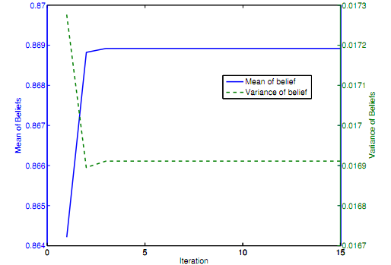
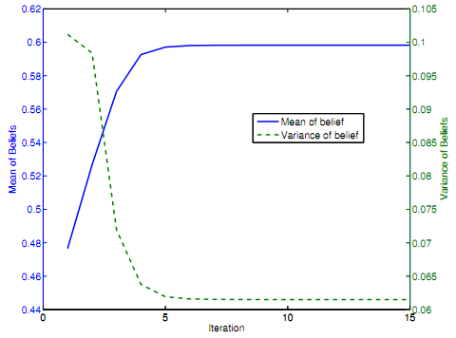
Simulation Results
Belief over iterations given two different locations.
Left figure provides a lower belief than the right one.

Slide 28
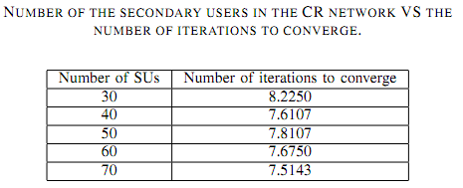
Simulation Results
Number of iterations does not change with the increasing number of SUs.

Slide 29
Outline
Introduction
  Dynamic spectrum access and cognitive radio
  Security issues in cognitive radio systems
  Routing in cognitive radio networks
  Belief propagation
Accomplishments
  Defense primary user emulation (PUE) attack in cognitive radio networks
  Routing-toward-primary user (RPU) attack in cognitive radio networks and corresponding defense strategy
  Interference minimization routing algorithm in cognitive radio networks
Summary
Future work

Slide 30
Main Contributions
Routing-toward-primary-user (RPU) attack
  New
  Powerful
  Network layer
Belief propagation based defense strategy against RPU attack
  Converges very fast
  Effective and efficient to find the attacker
Major publication
  Accepted to IEEE Transactions on Mobile Computing.

Slide 31
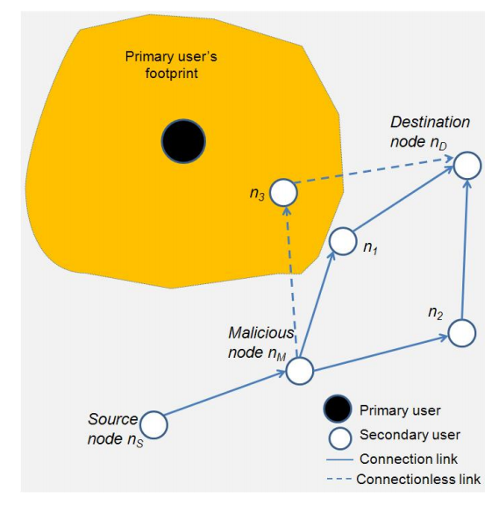
RPU Attack Model
Malicious node n_{M} sends fake information, claiming that it has optimum route with low costs to the destination.
Source node or other intermediate nodes will forward all the packets to n_{M}.
n_{M} will forward the data to those secondary users which are closer to primary users.
It is hard to detect which node is a malicious node.
RPU attack model
Notes:
Even if the interference from a single CR device is not severe, the aggregative effects can be significant.
Malicious nodes intentionally route a large amount of packets toward or around the PUs, aiming to cause interference to the primary users, and to increase delay.
the interference to the primary users is not directly generated by the malicious nodes. Instead, the interference is from the honest nodes that received the packets from the malicious nodes. Therefore, it is difficult to detect the malicious nodes.

Slide 32
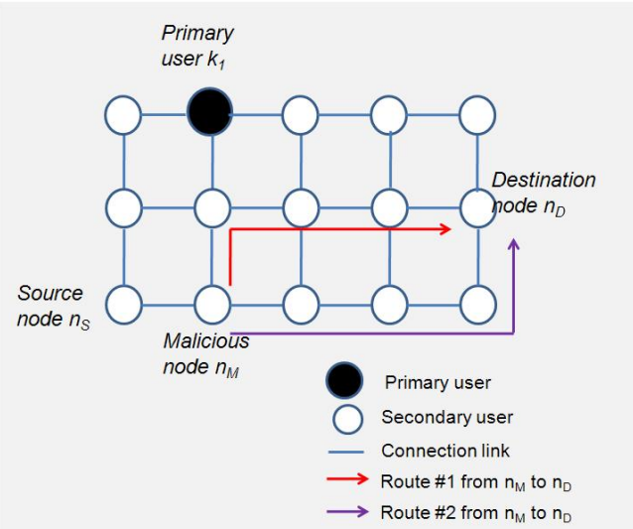
Strength of RPU Attack: A Toy Example

Slide 33
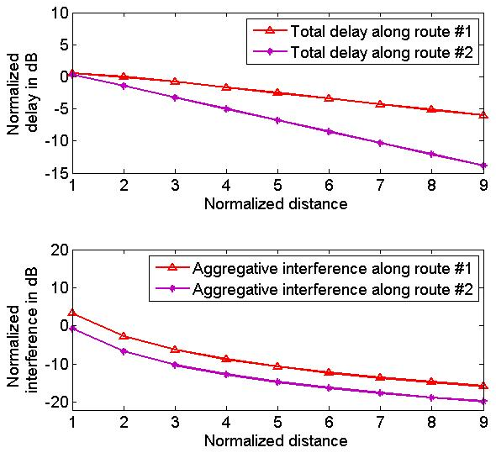

Strength of RPU Attack: A Toy Example
Red: route #1
Purple: route #2
Red route provides much higher delay than the purple route, as well as interference to the PU.

Slide 34
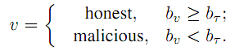
Defense Against RPU Attack
Find an initial route from source to destination
Each node collects the feedback information from the other nodes
Nodes use belief propagation to exchange messages
  Based on conditional probabilities, calculate marginal probability
Final detection criterion
Notes:
Each node on the initial route keeps a table recording feedbacks from other nodes.

Slide 35
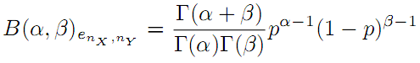
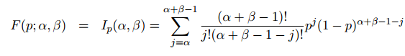
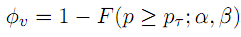
Local Function
α: Number of success
Beta distribution
  Describe link quality
  CDF of Beta distribution
Local function
β: Number of failure
Notes:
Link quality between two nodes can be described as a trust value, which can be represented in the form of Beta distribution.
Beta distribution is often used in the scenarios where the subject has collected binary observation.
Beta distribution is a family of continuous probability distributions defined on the interval (0, 1) parameterized by two positive shape parameters, typically denoted by α and β.
P is the interval between 0 and 1
The physical meaning of the local function is the probability that the node who sends back the feedback is an honest node or not.

Slide 36
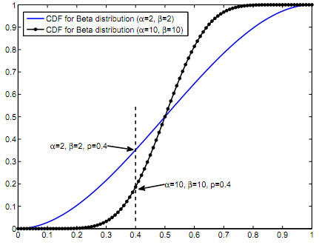
Local Function Example
CDF(α=2,β=2) > CDF(α=4,β=4), which means the value of the local function of (α=4,β=4) is bigger than the value of the local function of (α=2,β=2).

Slide 37
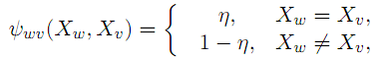
Compatibility Function
Dependent on the correlation between the states of two users
Difficult to find an explicit expression for the compatibility function
  A heuristic one is proposed
Notes:
eta

Slide 38
Complete Algorithm
Obtain an initial route from source to destination.
Each node on the initial route keeps a table recording feedbacks from other nodes.
for each iteration do
  Compute location function and compatibility function.
  Compute messages, and exchange messages.
  Compute belief values.
end for
The source node detects the malicious nodes according to final beliefs.

Slide 39
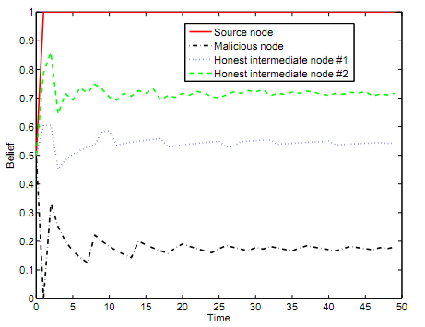
Simulation Results
Belief of the malicious node is clearly much smaller than that of the other nodes.

Slide 40
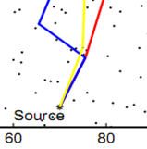
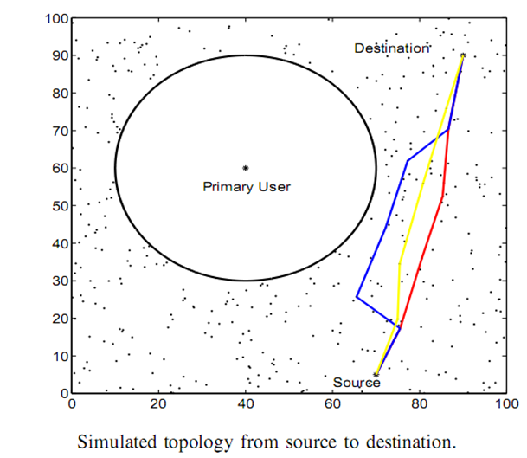
Simulation Results
Malicious node
The red line represents the route if the malicious behaves honestly.
The blue line is the route if the malicious node attacks.
The yellow line represents the new route after finding the malicious node.

Slide 41
Outline
Introduction
  Dynamic spectrum access and cognitive radio
  Security issues in cognitive radio systems
  Routing in cognitive radio networks
  Belief propagation
Accomplishments
  Defense primary user emulation (PUE) attack in cognitive radio networks
  Routing-toward-primary user (RPU) attack in cognitive radio networks and corresponding defense strategy
  Interference minimization routing algorithm in cognitive radio networks
Summary
Future work

Slide 42
Main Contributions
Consider aggregate interference for routing problem
Avoid high delay along transmission
Network formation game model for distributed algorithm
  Practically implementable
A centralized algorithm is also developed
  Simulation verifies that the performance of the proposed distributed approach is very close to centralized one.
Major publication
  Submitted to IEEE Journal on Selected Areas in Communications (JSAC): Cognitive Radio Series.

Slide 43
Introduction
Traditional wireless networks
  require centralized access points to mediate the wireless connection
Wireless mesh network
  Each node can communicate directly with one or more peer nodes
  Each node operates not only as a host but also as a router
Cognitive radio based wireless mesh network (CR-WMN)
Notes:
wireless mesh routers work as secondary users (SUs) that can opportunistically and intelligently access the idle licensed spectrum.

Slide 44
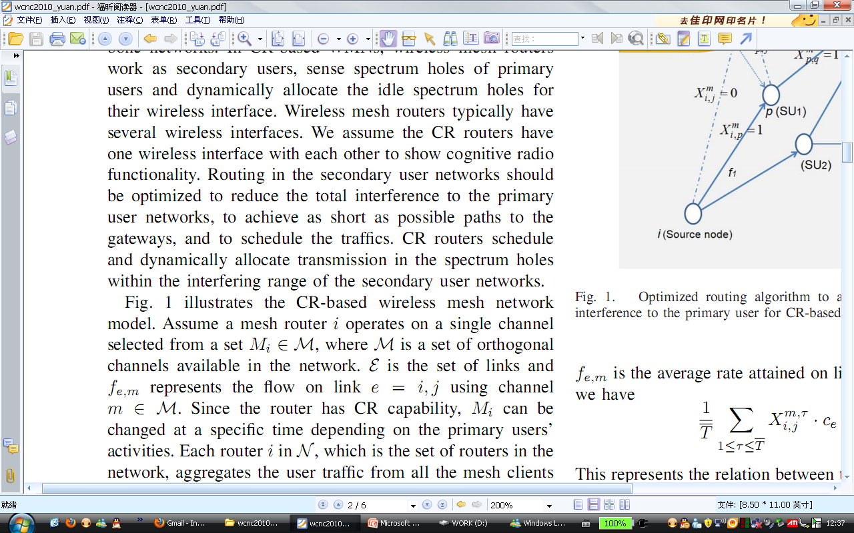
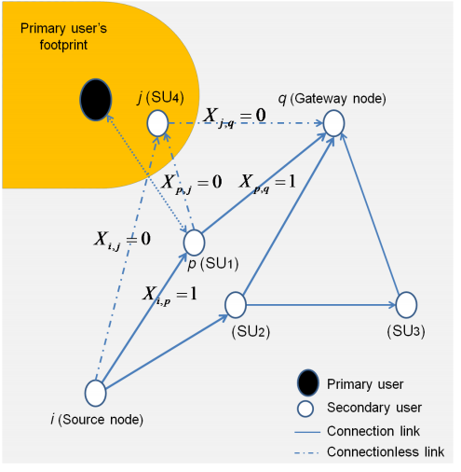
CR-WMN Model
represents the set of edges and f_{e} is the flow on link e=(i,j) .
X_{i,j} is an indicator variable which is assigned to 1 only if link e=(i,j) is active.
Notes:
epslon

Slide 45
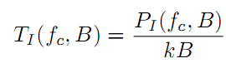
Interference
Interference from single SU
  Low enough when distance is long
Aggregate interference from a large number of SUs that are transmitting at the same time
  Huge, and this will significantly interfere with the PUs’ transmission.
Interference temperature model:
Notes:
P is average interference power with the Pus in watts centered at frequency f_c and covering bandwidth of B. k is Boltzman’s constant.

Slide 46
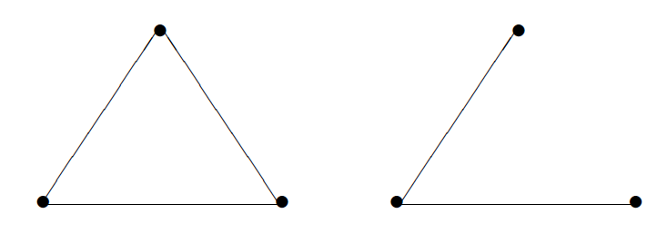
Distributed Routing Algorithm Using Network Formation Game
Why distributed algorithm?
What is network formation game?
Why network formation game?
Utility not only depends on the groups of players that are connected, but also how they are connected.
Notes:
A prominent feature of wireless mesh networks is highly decentralized nature. Full information needs to be gathered at a centralized coordinate node in centralized algorithm, considering the number of nodes and dynamics of channels, which is unreliable because of high computation complexity and delay.
Game theory attempts to mathematically capture behavior in strategic situations, in which an individual's success in making choices depends on the choices of others.
Networks of relationships play a role, or we can say the network structures play an important role, and their importance in determining the outcome the interaction.
To model the interactions among the SU nodes seeking to form the routes, network formation games provide a suitable framework.

Slide 47
Game Formulation
Players: secondary mesh nodes
Players interact in order to form a network graph. The result of interactions among players will be a directed graph G(N,L), where N denotes the set of all mesh nodes and L denotes the set of all edges.
Strategy space of node i: the mesh nodes in the set N that i wants to connect to in CR-WMNs.
Strategy: select the link that the mesh node wants to form from the concurrently available strategy space.
Depending on the goals of each player, a final network graph forms resulting from individual player’s decisions.

Slide 48
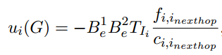
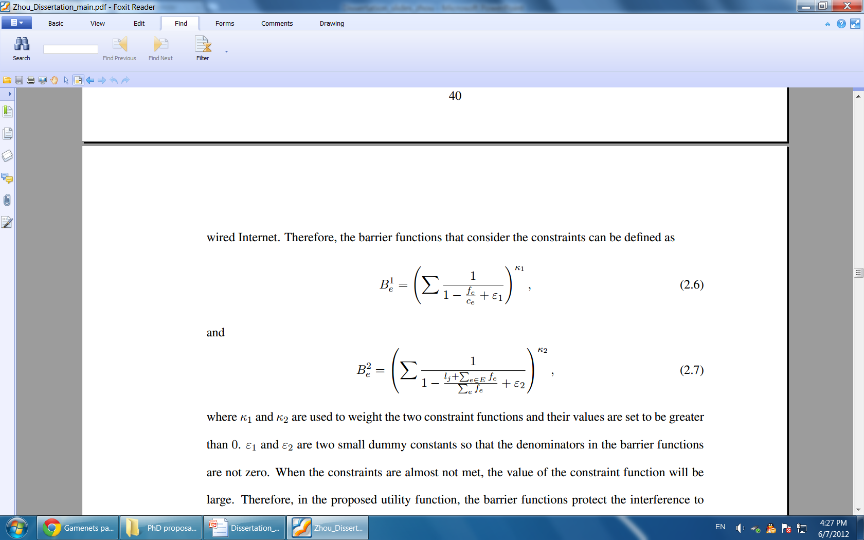
Utility
Interference
The utility of any node i can be expressed as
Barrier functions can be expressed as:
  When constraints are almost not met, barrier function value is high.
The physical meaning of the utility is the accumulative interference with the PUs and congestion protected by barrier functions to ensure that the constraints are satisfied.
flow
capacity
Notes:
Fi1 and fi2 are small dummy constants to ensure that the denominators are not zero
K1 and k2 are used for weighting different constraints and they must be bigger than 0
The SU nodes calculate their utility functions for all their edges with their neighbor nodes and select the maxmimum utility.

Slide 49
Network Formation Algorithm
Phase I – Prioritization
  Prioritize the nodes based on their interference to the PUs.
Phase II – Myopic Network Formation
  By order of priority, the wireless mesh nodes begin the network formation process
    a) Each mesh node i engages in pair-wise negotiations with the other nodes to access its utility in its turn.
    b) Following the negotiations, each mesh node i plays its best response, maximizing its utility. The best response is a replace link operation.
Multiple rounds are run until convergence to a final Nash network G
  Where no player can improve its utility by a unilateral change of strategy.
  The stability of the final graph G can be given using the concept of Nash network.
Notes:
For network formation, we propose a best response algorithm that allows a distributed formation of the network graph. The proposed dynamics assume that each node is myopic, which means that each aims at improving it own payoff considering only the current state of the network without taking into account the future evolution of the network.

Slide 50
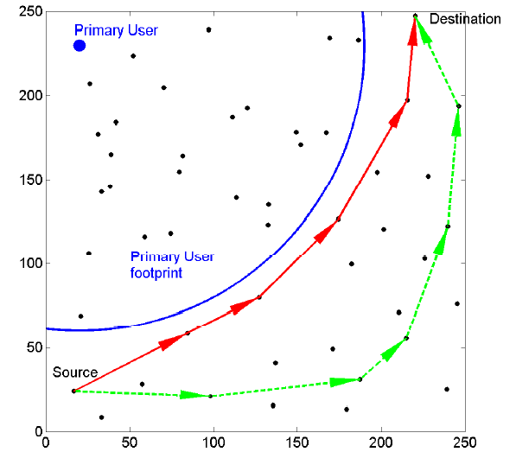
Simulation Results
Green route is route from source to destination considering interference to PU.
Red route is the route without considering interference.

Slide 51

Centralized Algorithm
The objective function is interference temperature multiplying system resource.
flow
Interference
capacity
load
Notes:
The first represents that the flow on each link cannot exceed the link rate.
The second one describes that a common channel must be available when nodes i and j want to communicate with each other.
The last constraint represents flow conservation constraints. Here l_j represents the load of the node may be due to outgoing or incoming traffic. The sum of incoming flow and generated traffic must be the same as the out going flow.

Slide 52
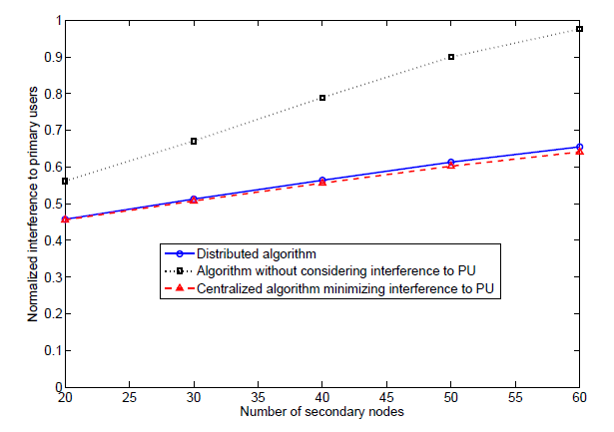
Simulation Results
Number of secondary users vs interference to the primary user.
Proposed distributed algorithm performs very close to the upper bound.

Slide 53
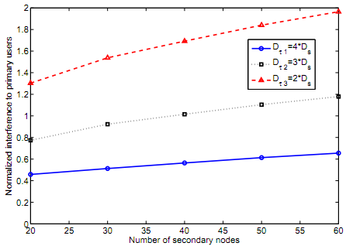
Simulation Results
Comparison of aggregate interference given different delay thresholds.

Slide 54
Outline
Introduction
  Dynamic spectrum access and cognitive radio
  Security issues in cognitive radio systems
  Routing in cognitive radio networks
  Belief propagation
Accomplishments
  Defense primary user emulation (PUE) attack in cognitive radio networks
  Routing-toward-primary user (RPU) attack in cognitive radio networks and corresponding defense strategy
  Interference minimization routing algorithm in cognitive radio networks
Summary
Future work

Slide 55
Summary
Defense primary user emulation attack
  Belief propagation based defense strategy
  Fast convergence and effective detection
Routing-toward-primary user (RPU) attack
  Power network layer attack
  Belief propagation based defense
Interference minimization routing algorithm
  Aggregate interference from SUs to PUs
  Network formation game for distributed algorithm
  Performs close to optimum

Slide 56
Outline
Introduction
  Dynamic spectrum access and cognitive radio
  Security issues in cognitive radio systems
  Routing in cognitive radio networks
  Belief propagation
Accomplishments
  Defense primary user emulation (PUE) attack in cognitive radio networks
  Routing-toward-primary user (RPU) attack in cognitive radio networks and corresponding defense strategy
  Interference minimization routing algorithm in cognitive radio networks
Summary
Future work

Slide 57
Future Work
Extend for cross-layer defense for various attacks
  Use belief propagation framework
  Weighing different attacks
Collaborative spectrum sensing using space-time Kalman filter
  We consider a vehicular communication network
  Each vehicle is equipped with CR functionality, and is able to use Kalman filter to estimate the channel based on observations
  When two vehicles are close to each other on highway, they can choose to exchange the estimations

Slide 58
Future Work
Incorporate cognitive pilot channel and medial axis
  Medial axis with a relaxation factor can be used
Extend for dynamic game framework for routing
  Hierarchical structure
  A multi-stage fictitious play learning can also be employed
Real-world implementation and test
  USRP
  GNU Radio

Slide 59
Publications
Journal publications:
  Zhou Yuan, Zhu Han, Yan Sun, Husheng Li, and Ju Bin Song, ”Routing-Toward-Primary-User Attack and Defense by Belief Propagation in Cognitive Radio Networks," to appear, IEEE Transactions on Mobile Computing (TMC).
  Zhou Yuan, Dusit Niyato, Husheng Li, Ju Bin Song, and Zhu Han, “Defeating Primary User Emulation Attacks Using Belief Propagation in Cognitive Radio Networks”, major revision, IEEE Journal on Selected Areas in Communications (JSAC): Cognitive Radio Series.
  Quanyan Zhu, Zhou Yuan, Ju Bin Song, Zhu Han, and Tamer Basar, “Interference Aware Routing Game for Cognitive Radio Multihop Networks”, major revision, IEEE Journal on Selected Areas in Communications (JSAC): Cognitive Radio Series.
  Zhou Yuan, Ju Bin Song, and Zhu Han, “Interference Aware Routing Using Network Formation game in Cognitive Radio Mesh Networks”, submitted to IEEE Journal on Selected Areas in Communications (JSAC): Cognitive Radio Series.
Conference publications:
  Zhou Yuan, Ju Bin Song, and Zhu Han, “Network Formation Game for Interference Minimization Routing in Cognitive Radio Mesh Networks”, in proceedings of the International Conference on Game Theory for Networks (GameNets), Vancouver, Canada, May 2012.
  Zhou Yuan, Dusit Niyato, Husheng Li, and Zhu Han, “Defense against primary user emulation attacks using belief propagation of location information in cognitive radio networks," in proceedings of the IEEE Wireless Communications and Networking Conference (WCNC), Cancun, Mexico, March 2011.
  Quanyan Zhu, Zhou Yuan, Ju Bin Song, Zhu Han, and Tamer Basar, “Dynamic interference minimization routing game for on-demand cognitive pilot channel”, in proceedings of the IEEE Globe Communication Conference (Globecom), Miami, Florida, December 2010.
  Zhou Yuan, Ju Bin Song, and Zhu Han, “Interference minimization routing and scheduling in cognitive radio wireless mesh networks”, in proceedings of the 2010 IEEE Wireless Communications & Networking Conference (WCNC), Sydney, Australia, March 2010.

Slide 60

Thank you!

