Slide 1

Cooperative Game Theory for Cognitive Radio
Zhu Han
Department of Electrical and Computer Engineering
University of Houston, Houston, TX, USA
Thanks for US NSF Career Award and Dr. Walid Saad

Slide 2
Outline
Cognitive Radio Networks
  Spectrum Sensing
  Dynamic Spectrum Access
  Exploration and Exploitation
Overview of Game Theory
Coalitional Games
  Class I: Canonical Coalitional Games
  Class II: Coalition Formation Games
  Class III: Coalition Graph Games
Conclusions
Quick View of Our Research Lab

Slide 3
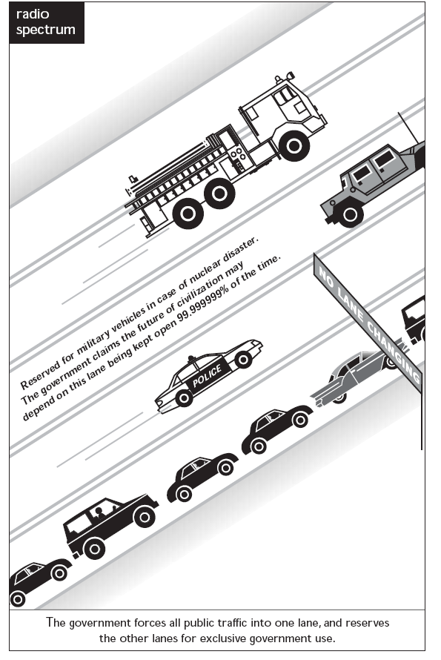
Cognitive Radio Overview
Lane: spectrum
Car: mobile user
Public Traffic
Lane congested
for
Unlicensed Spectrum
Or
Secondary Users
Lane seldom used but reserved for
Licensed Spectrum
Or
Primary
Users

Slide 4
Cognitive Radio Block Diagram
A cognitive radio is a radio that is able to sense, adapt and learn from its operating environment
Decision making
3
Learning/
knowledge extraction
Learn
2
4
Channel
estimation
Wireless
transmitter
Perceive
1
Control
Wireless
receiver
Channel
1
Noisy channel information
3
Knowledge of transmission environment
2
Noise-removed channel status
4
Decision on transmission parameters

Slide 5
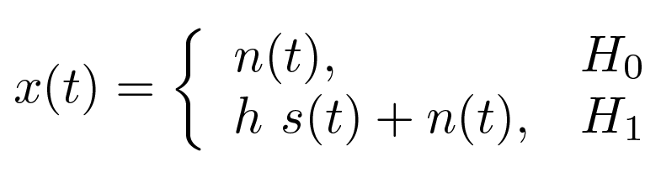
Problem 1: Spectrum Sensing
Secondary users must sense the spectrum to
  Detect the presence of the primary user for reducing interference on primary user
  Detect spectrum holes to be used for dynamic spectrum access
Spectrum sensing is to make a decision between two hypotheses
  The primary user is present, hypothesis H₁
  The primary user is absent, hypothesis H₀
Possible approaches
  Matched Filter Detectors
  Energy Detectors
  Cyclostationary Detectors
Channel gain
Noise
Primary User
Signal

Slide 6
Collaborative Spectrum Sensing
Overcome hidden terminal problem
Multiple cognitive radio observe together
3- Fusion Center makes final decision: PU present or not
2- the SUs send their Local Sensing bits to a common fusion center
1- the SUs perform Local Sensing of PU signal

Slide 7
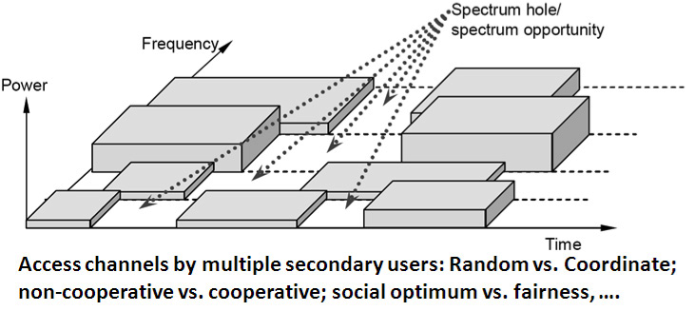
Problem 2: Dynamic Spectrum Access
Adjust spectrum resource usage in the near-real-time manner in response to changes in the users’ objectives, changes of radio states, and changes in the environment and external constraints.

Slide 8
Dynamic Spectrum Access (DSA)
Dynamic spectrum access allows different wireless users and different types of services to utilize radio spectrum
Spectrum Access Model
Command
and control
Exclusive-use
Shared-use of
primary licensed
spectrum
Commons-use
Long-term
exclusive-use
Dynamic
exclusive-use
Spectrum
overlay
Spectrum
underlay

Slide 9
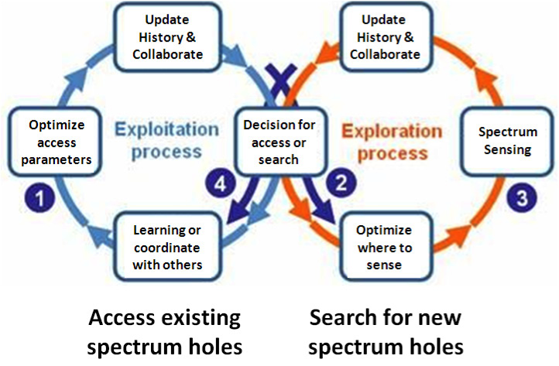
Problem 3: Exploration and Exploitation
Exploitation: the immediate benefit gained from accessing the channel with the estimated highest reward
Exploration is the process by which the cognitive users tend to probe more channels to discover better channel opportunities.
Example: should find new topics or study the current topics

Slide 10
Game Theory Overview
What is game theory?
  The formal study of conflict or cooperation
  Modeling mutual interaction among rational decision makers
  Widely used in economics
Components of a “game”
  Rational players with conflicting interests or mutual benefit
  Strategies or actions
  Utility as a payoff of player’s and other players’ actions
  Outcome: Nash Equilibrium
Many types
  Non-cooperative game theory
  Cooperative game theory
  Dynamic game theory
  Stochastic game
  Auction theory

Slide 11
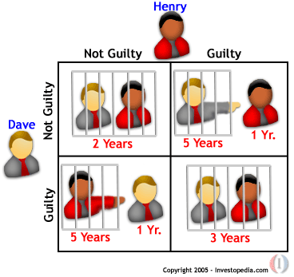
Rich Game Theoretical Approaches
Non-cooperative static
game: play once
  Mandayam and Goodman (2001)
  Virginia tech
Repeated game: play multiple times
  Threat of punishment by repeated game. MAD: Nobel prize 2005.
  Tit-for-Tat (infocom 2003):
Dynamic game: (Basar’s book)
  ODE for state
  Optimization utility over time
  HJB and dynamic programming
  Evolutional game (Hossain and Dusit’s work)
Stochastic game (Altman’s work)
Prisoner Dilemma
Payoff: (user1, user2)
Notes:
John Edwards

Slide 12

Auction Theory
  Book of Myerson (Nobel Prize 2007), J. Huang, H. Zheng, X. Li

Slide 13
Cooperative Game Theory
Players have mutual benefit to cooperate
  Startup company: everybody wants IPO, while competing for more stock shares.
  Coalition in Parlement
Namely two types
  Nash bargaining problems
  Coalitional game
We will focus on coalitional game theory
  Definition and key concepts
  New classification
  Applications in wireless networks
Walid Saad, Zhu Han, Merouane Debbah, Are Hjorungnes, and Tamer Basar, ``Coalitional Game Theory for Communication Networks", IEEE Signal Processing Magazine, Special Issue on Game Theory, p.p. 77-97, September 2009.

Slide 14
Coalitional Games: Preliminaries
Definition of a coalitional game (N,v)
  A set of players N, a coalition S is a group of cooperating players ( subset of N )
  Worth (utility) of a coalition v
    In general, v(S) is a real number that represents the gain resulting from a coalition S in the game (N,v)
    v(N) is the worth of forming the coalition of all users, known as the grand coalition
  User payoff x_{i} : the portion of v(S) received by a player i in coalition S
Characteristic form
  v depends only on the internal structure of the coalition
  Most common form of coalitional games
Partition form
  v depends only on the whole partition currently in place
  Hard to solve, still under thorough research in game theory
Graph form
  The value of a coalition depends on a graph structure that connects the coalition members

Slide 15

Coalitional Games: Utility
Transferable utility (TU)
  The worth v(S) of a coalition S can be distributed arbitrarily among the players in a coalition hence,
  v(S) is a function from the power set of N over the real line
  Example: Money, Euro/dollar/RMB…
Non-transferable utility (NTU)
  The payoff that a user receives in a coalition is pre-determined, and hence the value of a coalition cannot be described by a function
  v(S) is a set of payoff vectors that the players in S can achieve
  Example: channel

Slide 16
Payoff division
Equal fair
  Each user guarantees its non-cooperative utility
  The extra worth is divided equally among coalition users
Proportional fair
  Each user guarantees its non-cooperative utility
  A proportional fair division, based on the non-cooperative worth, is done on the extra utility available through cooperation
Other fairness
  Shapley value
  Nucleolus
  Market Fairness

Slide 17
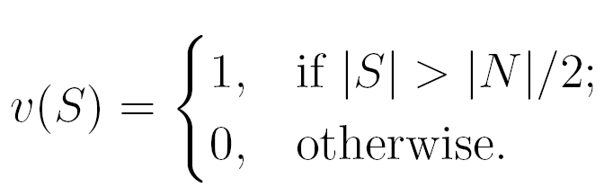
An example coalitional game
Example of a coalition game: Majority Vote
  President is elected by majority vote
  A coalition consisting of a majority of players has a worth of 1 since it is a decision maker
  Value of a coalition does not depend on the external strategies of the users
    This game is in characteristic function form
  If the voters divide the value as money
    Transferable utility

Slide 18
Outline
Cognitive Radio Networks
  Spectrum Sensing
  Dynamic Spectrum Access
  Exploration and Exploitation
Overview of Game Theory
Coalitional Games
  Class I: Canonical Coalitional Games
  Class II: Coalition Formation Games
  Class III: Coalition Graph Games
Conclusions
Quick View of Our Research Lab

Slide 19
A new classification
- Players’ interactions are governed by a communication graph structure.
Key question “How to stabilize the grand coalition or form a network structure taking into account the communication graph?”
Solutions are complex, combine concepts from coalitions, and non-cooperative games
- The network structure that forms depends on gains and costs from cooperation.
Key question “How to form an appropriate coalitional structure (topology) and how to study its properties?”
More complex than Class I, with no formal solution concepts.
- The grand coalition of all users is an optimal structure.
Key question “How to stabilize the grand coalition?”
- Several well-defined solution concepts exist.

Slide 20
Class I: Canonical Coalitional Games
Main properties
  Cooperation is always beneficial
    The grand coalition is guaranteed to form
  The game is superadditive
  The most famous type of coalitional games!
Main Objectives
  Study the properties and stability of the grand coalition
    How can we stabilize the grand coalition?
  How to divide the utility and gains in a fair manner ?
    Improper payoff division => incentive for players to leave coalition

Slide 21
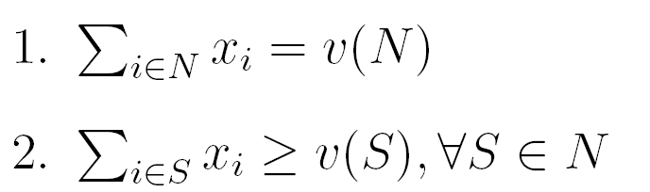
Canonical games: Solution concepts
The Core: the most renowned concept
  For a TU game, the core is a set of payoff allocation (x₁, . . ., x_{N}) satisfying two conditions
  The core can be empty
    A non-empty core in a superadditive game => stable grand coalition
The drawbacks of the core
  The core is often empty.
  When the core is non-empty it is often a large set.
  The allocations that lie in the core are often unfair.

Slide 22

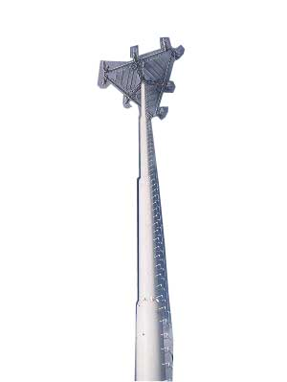
Ex: Cooperative Transmission
New communication paradigm
  Exploring broadcast nature of wireless channel
  Relays can be served as virtual antenna of the source
  MIMO system
  Multi-user and multi-route diversity
  Most popular research in current wireless communication
  Industrial standard: IEEE WiMAX 802.16J
Destination
Destination
Phase 1
Phase 2
Sender
Sender
Relay
Relay
Notes:
22

Slide 23





Cooperative Transmission Model
No cooperation (direct transmission), primary user needs power
Cooperative transmission
  Stage one: direct transmission. s, source; r, relay; d, destination
  Stage two: relay retransmission using orthogonal channels, amplified-and-forward
  Maximal ration combining at the receiver of backbone node
  To achieve same SNR, power saving for primary user P0<Pd
Notes:
23

Slide 24
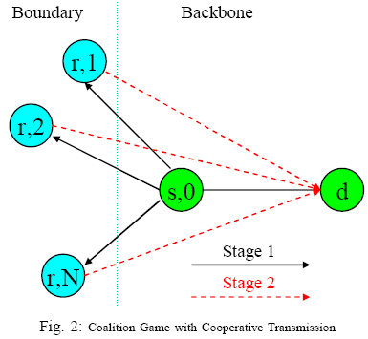

Main Idea
To get a good position, try to volunteer first
CR users PR transmission
CR nodes help the PU node reduce transmission power using cooperative transmission, for future rewards of transmission.
The idea can be formulated by a coalition game.
Notes:
24

Slide 25
Applications of canonical games
Rate allocation in a Gaussian multiple access channel (La and Anantharam, 2003)
  The grand coalition maximizes the channel capacity
  How to allocate the capacity in a fair way that stabilizes the grand coalition?
Mathur et al., group from WINLAB, worked on receivers and ideal transmitters cooperation using canonical games (Asilomar 2006, IEEE JSAC, 2008)
Curse of the boundary nodes (packet forwarding application) (Z. Han and V. Poor, IEEE Trans. Comm. 2009)
Slepian-Wolf source coding game
Any application where
  The grand coalition forms (no cost for cooperation)
  Stability and fairness are key issues

Slide 26
Class II: Coalition Formation Games
Main Properties
  The game is NOT superadditive
  Cooperation gains are limited by a cost
    The grand coalition is NOT guaranteed to form
  Cluster the network into partitions
  New issues: network topology, coalition formation process, environmental changes, etc
Key Questions
  How can the users form coalitions?
  What is the network structure that will form?
  How can the users adapt to environmental changes such as mobility, the deployment of new users, or others?
  Can we say anything on the stability of the network structure?

Slide 27


Coalition Formation: Merge and Split
Merge rule: merge any group of coalitions where
Split rule: split any group of coalitions where
A decision to merge (split) is an agreement between all players to form (break) a new coalition
  Socialist (social well fare improved by the decision)
  Capitalist (individual benefit improved)

Slide 28
Merge and Split: Properties
Any merge and split iteration converges and results in a final partition.
Merge and split decision
  Individual decision
  Coalition decision
  Can be implemented in a distributed manner with no reliance on any centralized entity
Using the Pareto order ensures that no player is worse off through merge or split
  Other orders or preference relations can be used

Slide 29
Stability Notions
D_{hp} stable
  No users can defect via merge/split
  Partition resulting from merge and split is D_{hp} stable
D_{c} stable
  No users can defect to form a new collection in N
  A D_{c} stable partition is socially optimal
  When it exists, it is the unique outcome of any merge and split iteration
  Strongest type of stability

Slide 30
Merge and Split algorithm
Initial Network State
Merge
Split
Self organize network
After mobility
Arbitray iterations until it terminates
D_{hp} stability guaranteed
Conditional D_{c} stability
Resulting partition

Slide 31
Distributed Collaborative Sensing
Coalition head
Distributed collaborative sensing between the users with no centralized fusion center
Which groups will form?
  Coalitional games!

Slide 32
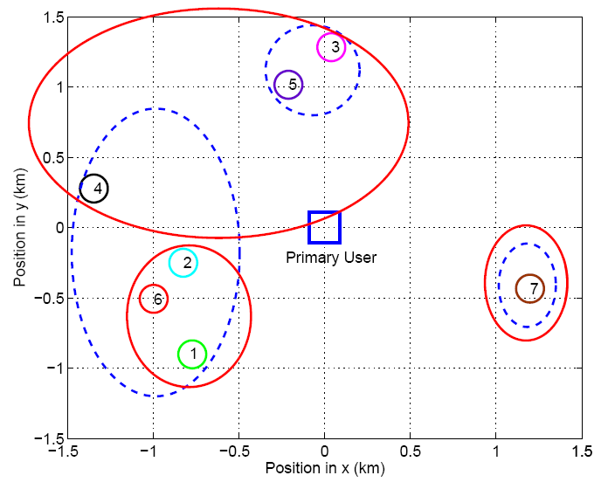
Simulation Results
When allowed to make distributed decisions, SU 4 prefers to stay with {2,1,6}

Slide 33
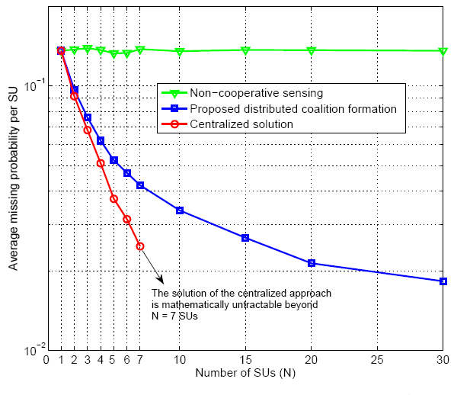
Simulation Results (1)

Slide 34
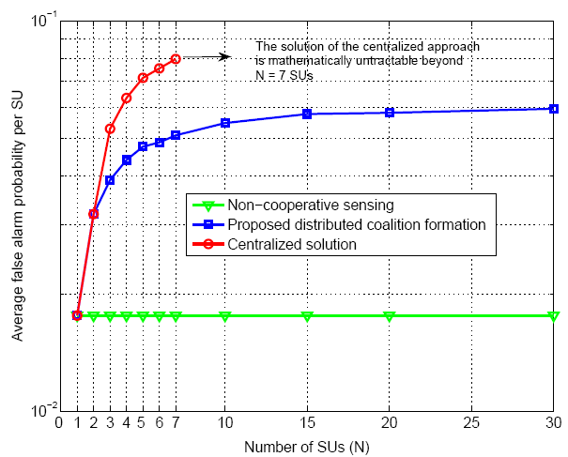
Simulation Results (2)
The gap with the optimal solution in probability of miss performance is compensated by a lower false alarm

Slide 35
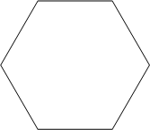
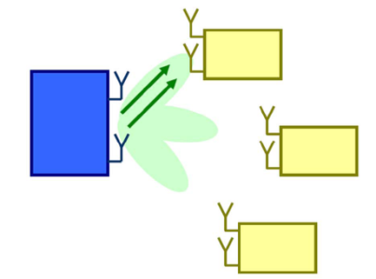
Summary of Applications
C^{d}
Ce
Small cell and femtocell networks
  Assignment (JSAC, March 2011)
  Spectrum leasing (JSAC, March 2011)
  Interference Alignment and cooperation (TWC, May 2011)
  Cooperative FAPs, IEEE WCNC 2011
Physical layer security
  Users cooperation Best paper award Wiopt 2009 + ACM MONET 2011
  Eavesdroppers cooperation and routing (CAMSAP 2009, Gamecomm 2008, MILCOM 2011)
Virtual MIMO
  IEEE ICC 2008
  IEEE TWC, 2009

Slide 36
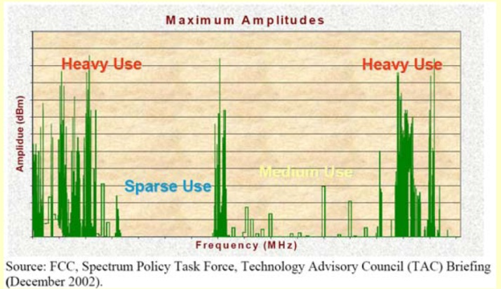
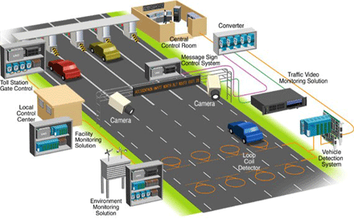
Summary of Applications
Cognitive radio
  Spectrum sensing (INFOCOM 2009,
  IEEE TVT 2011)
  Secondary BS cooperation (WCNC 2010)
  Joint sensing and access (submitted
  March 2011, IEEE JSTSP)
  Bayesian Nonparametric Learning (submitted to
  JSAC, Feb 2011)
Vehicular networks
  IEEE TWC, December 2010, IEEE GLOBECOM’10
  IEEE JSAC, January 2011
Others: Wireless agents (TMC 2011), Smart Grids, Security risk management , P2P networks (GLOBECOM 2010), More to come ☺

Slide 37
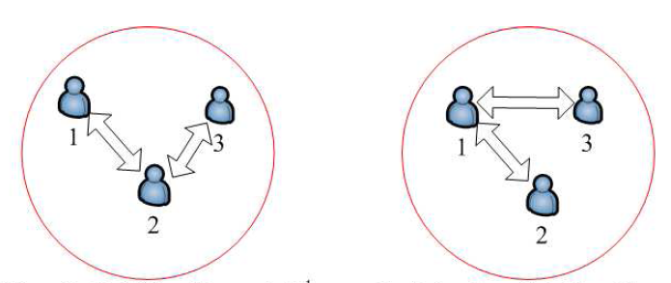
Class III: Coalition Graph Games
Main properties
  The game is in graph form
    May depend on externalities also
  There is a graph that connects the players of every coalition
  Cooperation with or without cost
  A Hybrid type of games: concepts from classes I and II, as well as non-cooperative games

Slide 38
Coalition Graph Games
First thought of by Myerson, 1977, called “Coalitional games with communication structure”
  Axiomatic approach to find a Shapley-like value for a coalitional game with an underlying graph structure
  Coalition value depends on the graph
  The dependence is only based on connections
Key Questions
  How can the users form the graph structure that will result in the network?
  If all players form a single graph (grand coalition with a graph), can it be stabilized?
  How can the users adapt to environmental changes such as mobility, the deployment of new users, or others?
  What is the effect of the graph on the game?

Slide 39
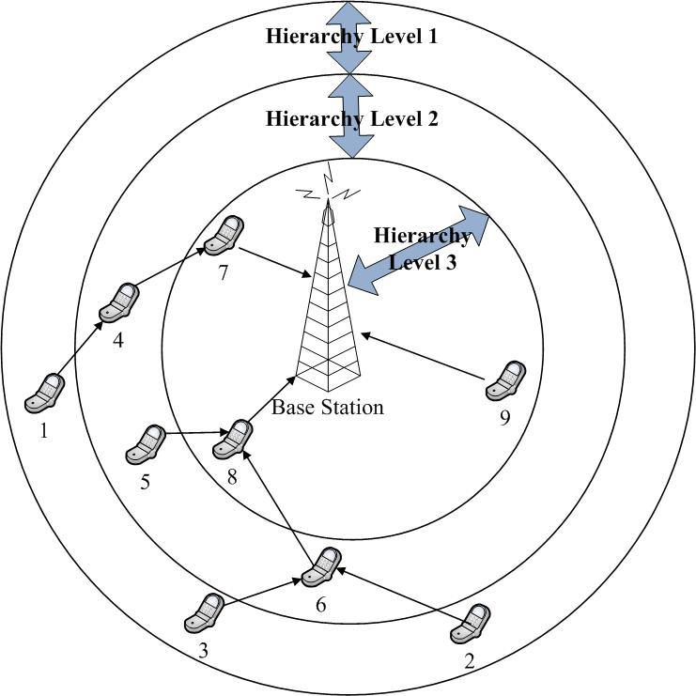
Hierarchical Network Formation
Multi-hop hierarchical networks
  LTE and WiMAX 802.16j
We consider uplink transmission
How to determine the hierarchies?
  We assume a fixed distance-based
  hierarchy division
  Others divisions can be
  accommodated
How to form the tree topology?
  Network formation games
  New concept of hierarchial Nash
  equilibrium
Routing in communication networks
  See the work by Johari (Stanford)
Many future possibilities
  The formation of graphs is ubiquitous in the context of networks
Notes:
- Ingredients/Channel quality

Slide 40
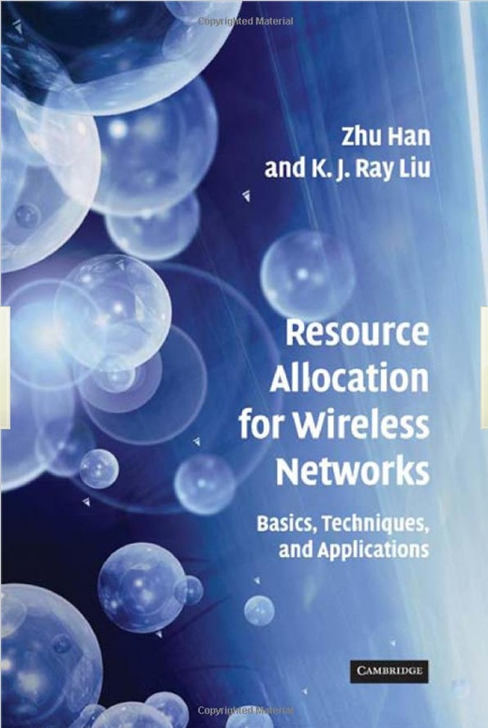
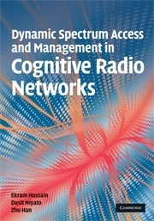
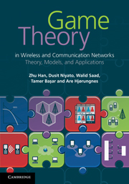
Summary of coalitional game
Cognitive radio network and its basic problems
Coalitional games are a strong tool for different models in wireless and communication networks
A novel classification that can help in identifying potential applications
A tool for next generation self-organizing networks
  Especially through coalition formation and network formation games
Try to find collaboration among experts here
Try to sell books

Slide 41
Overview of Wireless Amigo Lab
Lab Overview
  7 Ph.D. students, 2 joint postdocs (with Rice and Princeton)
  supported by 5 concurrent NSF,1 DoD, and 1 Qatar grants
Current Concentration
  Game theoretical approach for wireless networking
  Compressive sensing and its application
  Smartgrid communication
  Bayesian nonparametric learning
  Security: trust management, belief network, gossip based Kalman
  Physical layer security
  Quickest detection
  Cognitive radio routing/security
  Sniffing: femto cell and cloud computing
USRP2 Implementation Testbed

Slide 42

Questions?
Thank you very much
Notes:
Thank you very much and any questions?

