Slide 1
Department of Electrical and Computer Engineering
Bayesian Nonparametric Classification and Applications
Zhu Han
Department of Electrical and Computer Engineering
University of Houston.
Thanks to Nam Nguyen, Guanbo Zheng, and Dr. Rong Zheng

Slide 2
Content
Bayesian Nonparametric Classification
Department of Electrical and Computer Engineering
Introduction
Problem statement
Basic concepts
Dirichlet distribution/process
Bayesian nonparametric classification
Generative model
Inference model
Performance bounds
Simulation results
Applications in wireless security with device finger printing
Device finger print
Masquerade attack and Sybil attack detection
Primary user emulation attack
Overview of wireless amigo lab

Slide 3
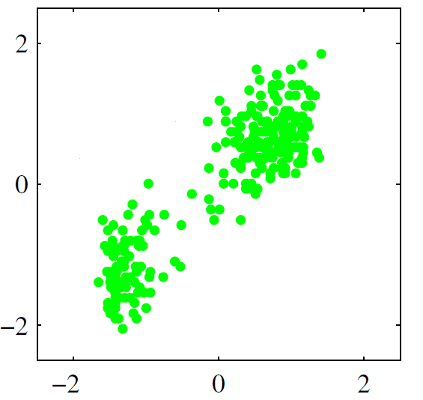
Introduction: problem statement
Bayesian Nonparametric Classification
Department of Electrical and Computer Engineering
Model selection: How many clusters are there?
What’s the hidden process created the observations?
What are the latent parameters of the process?
The questions can be solved by using Nonparametric Bayesian Inference!
Nonparametric: Number of clusters (or classes) can grow as more data is observed and need not to be known as a priori.
Bayesian Inference: Use Bayesian rule to infer about the latent variables.

Slide 4
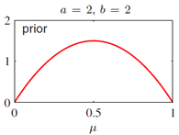
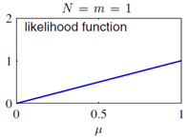
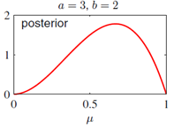
Examples of Bayesian inference used for parameter update
Bayesian Nonparametric Classification
Department of Electrical and Computer Engineering
A Beta distribution is chosen to be prior:
Example: a=2, b=2 (head and tail prob. are equal)
A Binomial distribution is the conjugate likelihood:
One trial (N=1) and the result is one head (m=1)
Lead to the Posterior:
Update of parameters given the observations
The probability of head happening is higher

Slide 5
Key idea
Bayesian Nonparametric Classification
Department of Electrical and Computer Engineering
Need to choose a conjugate prior and likelihood distributions
Posterior Likelihood Prior
If we are able to choose the conjugate distributions, we can update our posterior like the example before.
Want to sample the posterior distribution P(μ|Observations), and get values of the parameters, μ. μ can be any parameter.

Slide 6
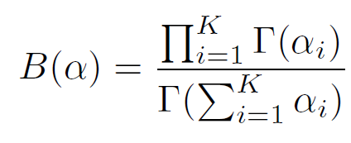
Dirichlet distribution
Bayesian Nonparametric Classification
An extension of the Beta distribution to multiple dimensions.
K: number of clusters
πi: weight with marginal distribution
αi: prior

Slide 7
Dirichlet process
Bayesian Nonparametric Classification
A random distribution G on Θ is Dirichlet process distributed with base distribution H and concentration parameter α, written as G ∼ DP(α,H), if for every finite measurable partition A1, . . .,AK of Θ
H(·), the mean of the DP,
α, strength of the prior

Slide 8
Bayesian nonparametric update
Bayesian Nonparametric Classification
Have t observation x1,…,xt. Define
The posterior distribution on Θ
The posterior Dirichlet process
Small number of observation t, the prior dominates
When t increases, the prior has less and less impact
α controls the balance between the impact of prior and trials
Can be used to learn and combine any distributions

Slide 9
Applications
Bayesian Nonparametric Classification
Distribution estimation
Cognitive radio spectrum bidding
Estimate the aggregated effects from all other CR users
Primary user spectrum map
Different CR users see the spectrum differently
How to combine the others’ sensing (as a prior) with own sensing.
Clustering for wireless security
Infinite Gaussian mixture model

Slide 10
Content
Bayesian Nonparametric Classification
Department of Electrical and Computer Engineering
Introduction
Problem statement
Basic concepts
Dirichlet distribution/process
Bayesian nonparametric classification
Generative model
Inference model
Performance bounds
Simulation results
Applications in wireless security with device finger printing
Device finger printing
Masquerade attack and Sybil attack detection
Primary user emulation attack
Overview of wireless amigo lab

Slide 11
Generative model vs Inference algorithm
Bayesian Nonparametric Classification
In the generative model, we start with the parameters and end up creating observations.
On the other hand, in the inference algorithm, we start with observations and end up inferring about the parameters.

Slide 12
Generative model: A general idea
Bayesian Nonparametric Classification
Dir(1/6,1/6, 1/6,1/6,1/6,1/6):
If we sample the above distr.,
we will obtain the weights, or the
probabilities
for each
face.
1
2
3
4
5
6
7
∞
π₁
π₂
π₃
π₄
π₅
π₆
Question: If we have a dice with infinite number of faces, then how to deal with the situation? Dir() does not support infinite case.

Slide 13
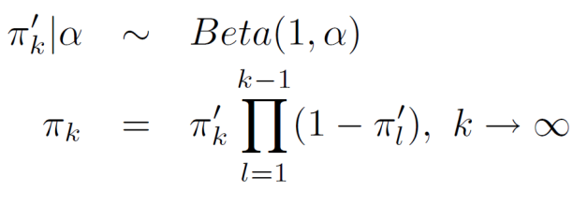
Generative model: Stick breaking process:
Bayesian Nonparametric Classification
Department of Electrical and Computer Engineering
Generate an infinite number of weights which sum up to 1.
_{Sample a breaking point:}
_{Calculate the weight:}
1
π₁’
1-π₁’
π₂’ (1-π₁’)
(1-π₂’ )(1-π₁’)

Slide 14
Generative model
Bayesian Nonparametric Classification
Stick(α)
π₁
π∞
1
π₂
2
3
4
5
6
7
∞
Infinite number of faces/classes
Indicators are created according to multinomial distribution.
z₁, z₂ .. = 1
z₂₀, z₂₁ .. = 2
X_{1:N}
The observations follows a distribution such as Gaussian.
µ₁
Σ₁
µ₂
Σ₂
µ∞
Σ∞

Slide 15
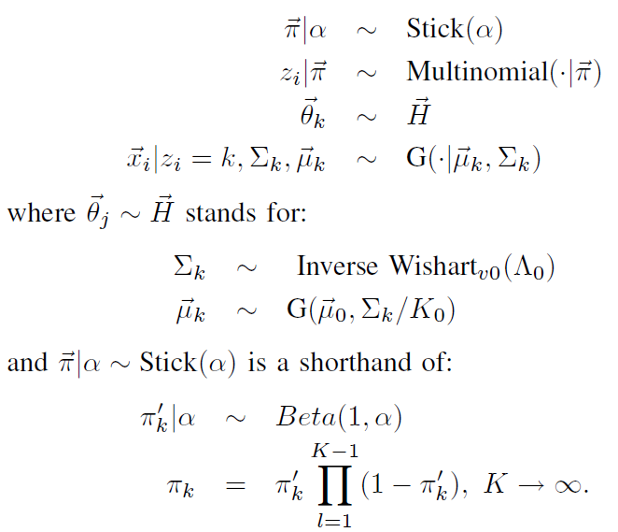
Generative model: A graphical representation
Bayesian Nonparametric Classification
Department of Electrical and Computer Engineering
α
π₁
π∞
π
H
1
2
3
4
5
6
7
∞
π₂
N
∞
z_{i}
ѳ_{i}
x_{i}
µ₁
Σ₁
µ₂
Σ₂
µ∞
Σ∞

Slide 16
Inference model: Nonparametric Bayesian Classification algorithm – Gibbs sampler approach
Bayesian Nonparametric Classification
Finding the posterior of the multivariate distribution P(Z|X)
Given the observation X, what are the probability that it belongs to cluster Z
In other word, which cluster a sample belongs to?
Painful due to the integrations needed to carry out.
Instead, finding a univariate distribution is more easily to implement
For new observation, want to know the distribution of indicator
In other word, find the marginal distribution of Zi given the other indicators.
Given the distribution, we can implement the Gibbs sampling method to sample a value for a variable given all the other variables.
The process is repeated and proved to be converged after a few iterations.
Purpose:
Find
Then use Gibbs sampler to sample values for the indicators.

Slide 17
Nonparametric Bayesian Classification inference
Bayesian Nonparametric Classification
Department of Electrical and Computer Engineering
Goal:
is the set of all other labels except the current one, i^{th}
Posterior
Likelihood
(e.g. given as Gaussian)
Prior
(Chinese Restaurant Process)
Probability assigned to a represented class
Probability assigned to an unrepresented class
is the number of observations in the same class, k, excluding the current one, i^{th}
?
?
Chinese Restaurant Process

Slide 18
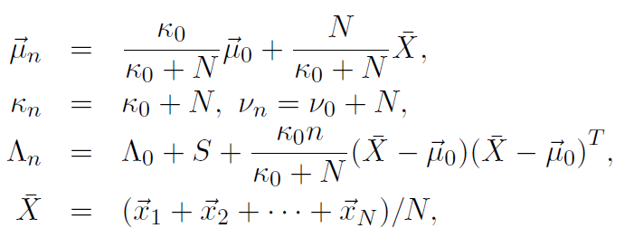
Inference model: Posterior distributions
Bayesian Nonparametric Classification
Department of Electrical and Computer Engineering
Given the prior and the likelihood, we come up with the posterior:
Probability of assigning to a unrepresented cluster:
Probability of assigning to a represented cluster:
(1)
t is the student-t distribution
(2)

Slide 19
Inference model: Gibbs sampler
Bayesian Nonparametric Classification
Department of Electrical and Computer Engineering
Start with random indicator for each observation.
Remove the current i^{th} observation from its cluster
Update the indicator z_{i} according to (1) and (2) given all the other indicators
No
Converge?
Yes
STOP

Slide 20
Performance bounds for clustering
Bayesian Nonparametric Classification
Consider the scenario of two cluster in a D-dimensional space, what is the bounds of the probability of assigning a point to its correct cluster.
Bhattacharyya Upper bound for the hit rate in assigning a point to its original cluster:
where
Hoeffding Lower bound for the hit rate in assigning a point to its original cluster:
where

Slide 21
Kullback-Leibler divergence
Bayesian Nonparametric Classification
We use the Kullback-Leibler Divergence (KLD) to measure the difference between two multivariate distribution, defined as below:

Slide 22
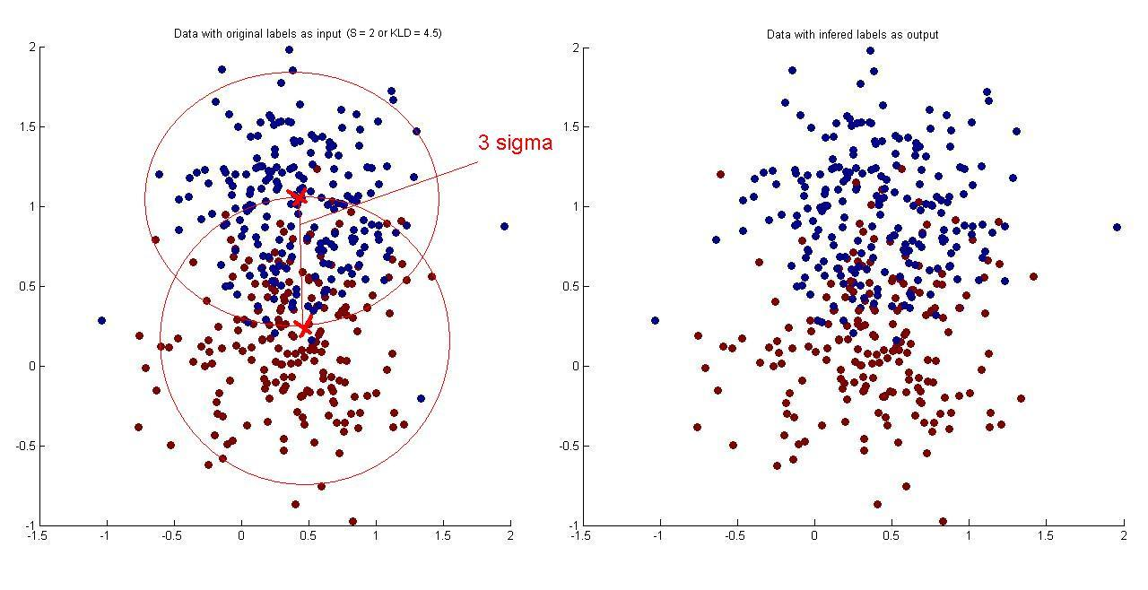
Simulation results
Bayesian Nonparametric Classification
Department of Electrical and Computer Engineering
KLD = 4.5
Original Data
KLD = 4.5
Clustered Result
Intuition why it works so well
Not the boundary or threshold. But clustering so that each cluster looks more like the distribution (Gaussian).

Slide 23
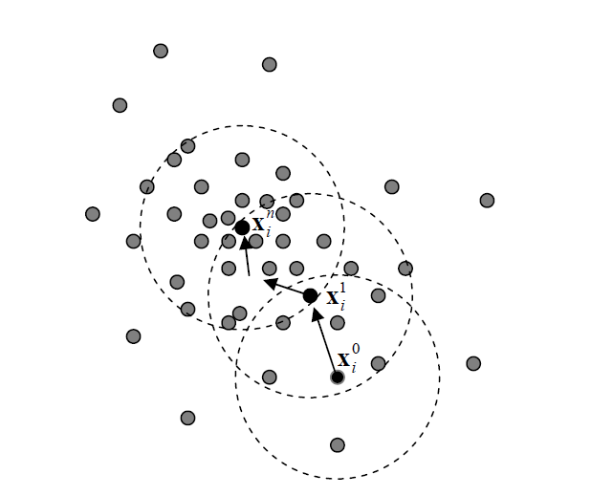
A victim nonparametric classification: Mean-Shift Clustering Method
Nonparametric Bayesian Classification
Used as a baseline nonparametric algorithm to compare with the Nonparametric Bayesian Classification method.
Determine the means of the observations:
Based on a kernel with diameter h
to count the number of points inside
a circle around an observation→
estimate the density.
Take the derivative of the density
and move toward the 0 gradient (means).
Repeat the actions for all observations.
Observations which move toward the same
mean are in the same cluster.

Slide 24
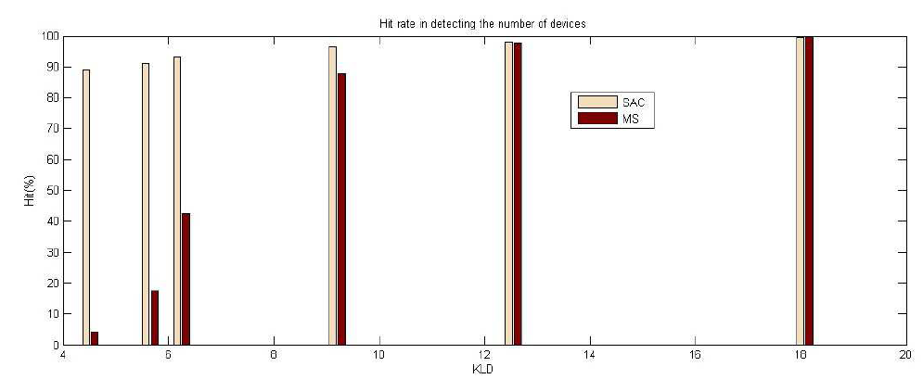
Two clusters, detection of correct number of clusters
Bayesian Nonparametric Classification
NBC
S

Slide 25
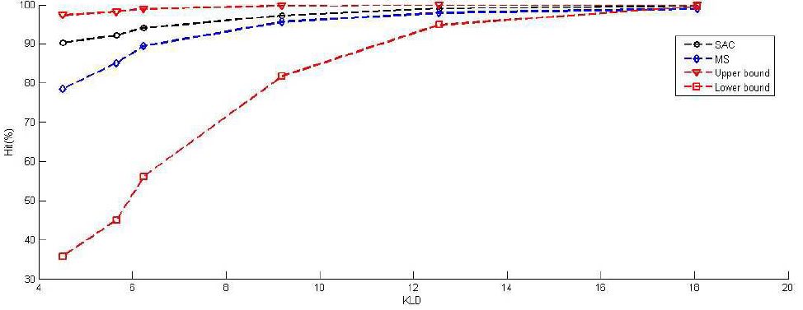
Two cluster, correct clustering performance
Bayesian Nonparametric Classification
NBC

Slide 26
Content
Bayesian Nonparametric Classification
Department of Electrical and Computer Engineering
Introduction
Problem statement
Basic concepts
Dirichlet distribution/process
Bayesian nonparametric classification
Generative model
Inference model
Performance bounds
Simulation results
Applications in wireless security with device finger printing
Device finger printing
Masquerade attack and Sybil attack detection
Primary user emulation attack
Overview of wireless amigo lab

Slide 27
Device Fingerprint: Literature review
[S. Bratus, 2008]: Uses information about the chipset, the firmware or the driver of an 802.11 wireless device. Active detection methods require extra message exchanges. Furthermore, responses that are firmware, driver, OS dependent can be spoofed as well.
[J. Hall, 2005]: Uses the transient signals at the start of transmissions. Basic drawback is transient signal is difficult to capture since it lasts on the order of only several hundreds of nanoseconds.
[V. Brik, 2008]: The authors proposed a Passive RAdio-metric Device Identification System (PARADIS) with an accuracy of detection over 99%. The results shows convincingly that radiometric can be used effectively to differentiate wireless devices.
Nonetheless, all the above methods require a training phase to collect and extract fingerprints of legitimate devices. Our method, in contrast, is an unsupervised approach. Users do not need to register first.

Slide 28
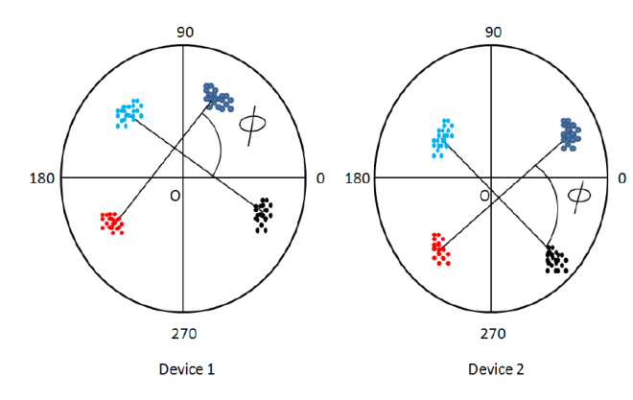
Device finger printing
Bayesian Nonparametric Classification
Extracted Features:
Clustering over those dimension of features
The Carrier Frequency Difference: defined as the difference between the carrier frequency of the ideal signal and that of the transmitted signal.
The Phase Shift Difference: defined as the phase shift from one symbol to the one next to it:

Slide 29
Device finger printing
Bayesian Nonparametric Classification
3. The Second-Order Cyclostationary Feature:
Utilize the Cyclic Autocorrelation Function (CAF):
Find CAF values at (for OFDM)
α is the cyclic frequency
4. The Received Signal Amplitude (location dependent):
d is distance from a transmitted device to the sensing device.
|h| is the fading component, then A_{p} is defined as:

Slide 30
Applications: Masquerade and Sybil attack detection
Bayesian Nonparametric Classification
Department of Electrical and Computer Engineering
Key: Use device dependent radio-metrics as fingerprints
Approaches:
Features selected are channel invariant.
Passive detection method.
Unsupervised clustering approach.
Masquerade attack
Sybil attack
Device1
00-B0-D0-86-BB-F7
Device2
00-0C-F1-56-98-AD
Device1
00-B0-D0-86-BB-F7
00-0C-F1-56-98-AD
Device2
00-A0-C9-14-C8-29
Device3
00-0C-F1-56-98-AD

Slide 31
Masquerade and Sybil attack detection: Algorithm
Bayesian Nonparametric Classification
Data Collection
Device feature space
Unsupervised
clustering
K clusters and M MAC addresses
No
K ≠ M?
K > M
Yes
K < M
Masquerade attack
Sybil attack
Determine the number of attackers
Update the “black” list with the MAC address

Slide 32
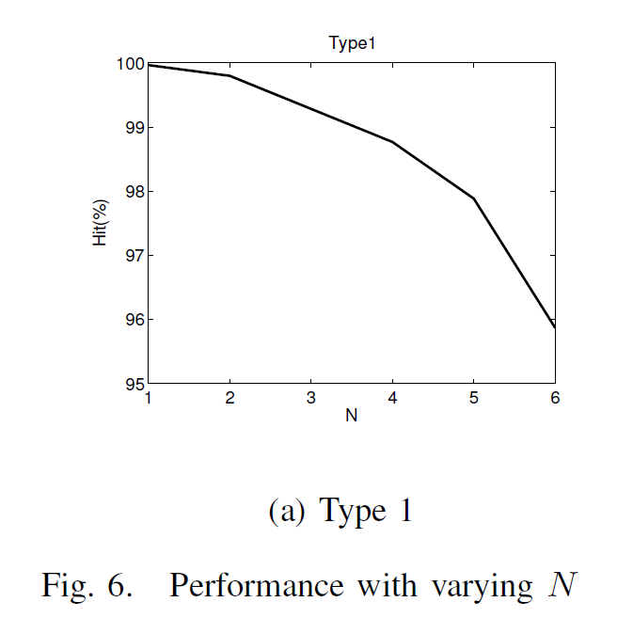
Masquerade and Sybil attack detection: Simulation result in the case of N devices
Bayesian Nonparametric Classification
The number of devices is varied from 1 to 6
The diameter of each corresponding cluster is about 1
The feature space is chosen to be 40x40
As the number of devices (N) increases, performance decreases since the overlapping chance is bigger

Slide 33
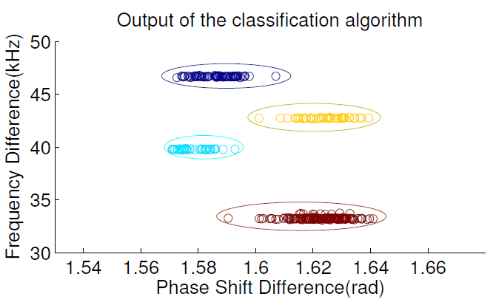
Masquerade and Sybil attack detection: Preliminary USRP2 experiment
Bayesian Nonparametric Classification
We collected the fingerprints from some WiFi devices by the USRP2 and tried the algorithm, below is the result:

Slide 34
Applications: PUE attack detection
Bayesian Nonparametric Classification
In Cognitive radio, a malicious node can pretend to be a Primary User (PU) to keep the network resources (bandwidth) for his own use.
How to detect that? We use the same approach, collect device dependent fingerprints and classify the fingerprints.
We limit our study to OFDM system using QPSK modulation technique.

Slide 35
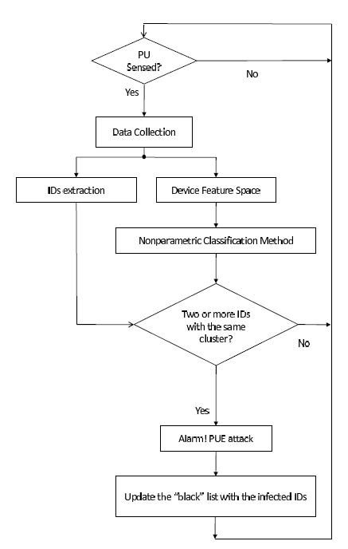
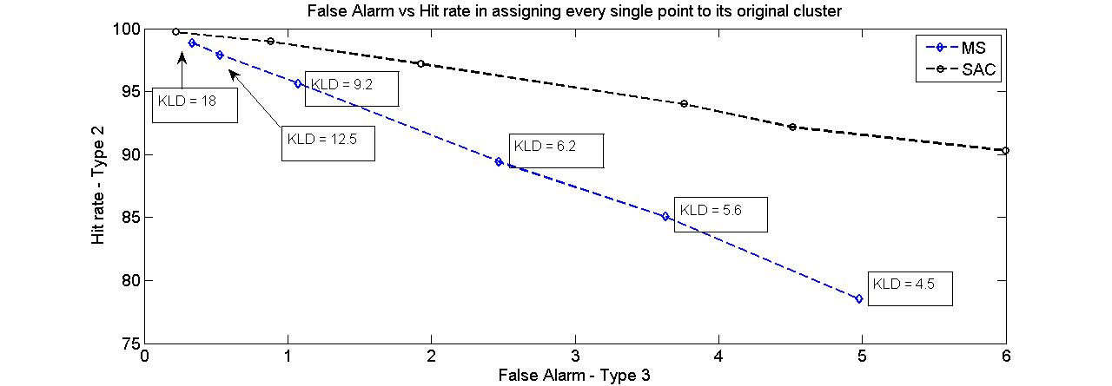
PUE attack detection
Bayesian Nonparametric Classification
DECLOAK algorithm
ROC curve

Slide 36
Conclusions
Bayesian Nonparametric Classification
Department of Electrical and Computer Engineering
Dirichlet distribution/process
Can study and combine any distribution with any prior distribution
Application: Auction of spectrum, CPC to combine heterogeneous information
Other applications?
Infinite Gaussian mixture model
Clustering with unknown number of clusters
Device finger printing
Security applications
Beyond Gaussian?
Other applications?
Find possible future collaborations

Slide 37
References
Bayesian Nonparametric Classification
Yee Whye Teh videos
Dirichlet Processes: Tutorial and Practical Course
Hierarchical Dirichlet Processes
Zhu Han, Rong Zheng, and Vincent H. Poor, “Repeated Auctions with Bayesian Nonparametric Learning for Spectrum Access in Cognitive Radio Networks," IEEE Transactions on Wireless Communications, vol.10, no.3, pp.890-900, March 2011.
Walid Saad, Zhu Han, H. Vincent Poor, Tamer Basar, and Ju Bin Song, “A Cooperative Bayesian Nonparametric Framework for Primary User Activity Monitoring in Cognitive Radio Networks," accepted, IEEE Journal on Selected Areas in Communications, special issue on Cooperative Network.
Nam Tuan Nguyen, Guanbo Zheng, Zhu Han and Rong Zheng, ``Device Fingerprinting to Enhance Wireless Security using Nonparametric Bayesian Method,“ INFOCOM 2011.
Nam Tuan Nguyen, Rong Zheng, and Zhu Han, “On Identifying Primary User Emulation Attacks in Cognitive Radio Systems Using Nonparametric Bayesian Classification," revision IEEE Transactions on Signal Processing.

Slide 38
References
[Bishop, 2006]: Pattern Recognition and Machine Learning
[S. Bratus, 2008]: Active behavioral Fingerprinting of Wireless Devices.
[J. Hall, 2005]: Radio frequency fingerprinting for Intrusion Detection in Wireless Networks.
[V. Brik, 2008]: Wireless Device Identification with Radiometric Signatures

Slide 39
Overview of Wireless Amigo Lab
Lab Overview
7 Ph.D. students, 2 joint postdocs (with Rice and Princeton)
supported by 5 concurrent NSF,1 DoD, and 1 Qatar grants
Current Concentration
Game theoretical approach for wireless networking
Compressive sensing and its application
Smartgrid communication
Bayesian nonparametric learning
Security: trust management, belief network, gossip based Kalman
Physical layer security
Quickest detection
Cognitive radio routing/security
Sniffing: femto cell and cloud computing
USRP2 Implementation Testbed

Slide 40
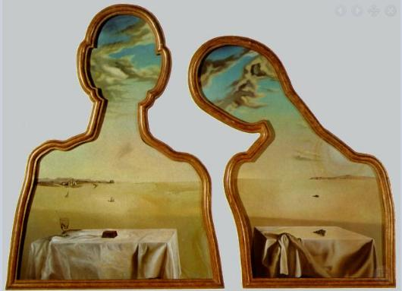
Questions?
Thank you very much

