Slide 1
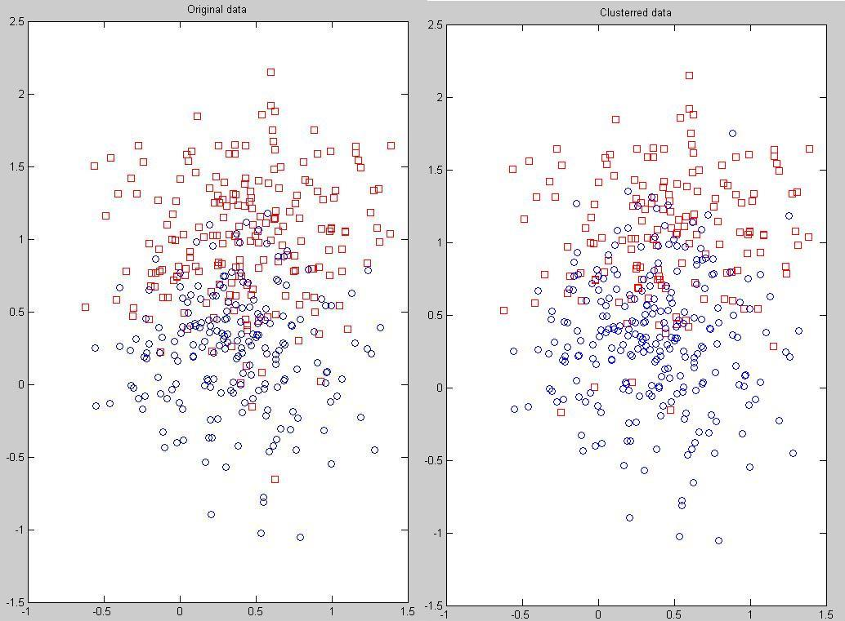
Simulation results
Bayesian Nonparametric Classification
Department of Electrical and Computer Engineering
Intuition why it works so well
Not the boundary or threshold. But clustering so that each cluster looks more like the distribution (Gaussian).

