Slide 1
Department of Electrical and Computer Engineering
Case Study of Big Data Analysis for Smart Grid
Zhu Han
Department of Electrical and Computer Engineering
University of Houston
Supported by Centerpoint, LLC and Direct Energy, LLC
through electric power analytics consortium
Supported by NSF CMMI-1434789
Students: Dr. Nam Nguyen, Erte Pan and Lanchao Liu

Slide 2
Overview
Introduction
  Big Data
  Smart Grid
Case 1: Load profiling and smart pricing by smart meter big data
  Basics and problems
  Bayesian nonparametric learning
  Sublinear Algorithm
Case 2: SCOPF for smart grid security
  Sparse optimization
  Alternating direction method of multipliers (ADMM).
  Security-constrained Optimal Power Flow Problem
Conclusion
Other research activities of our group

Slide 3
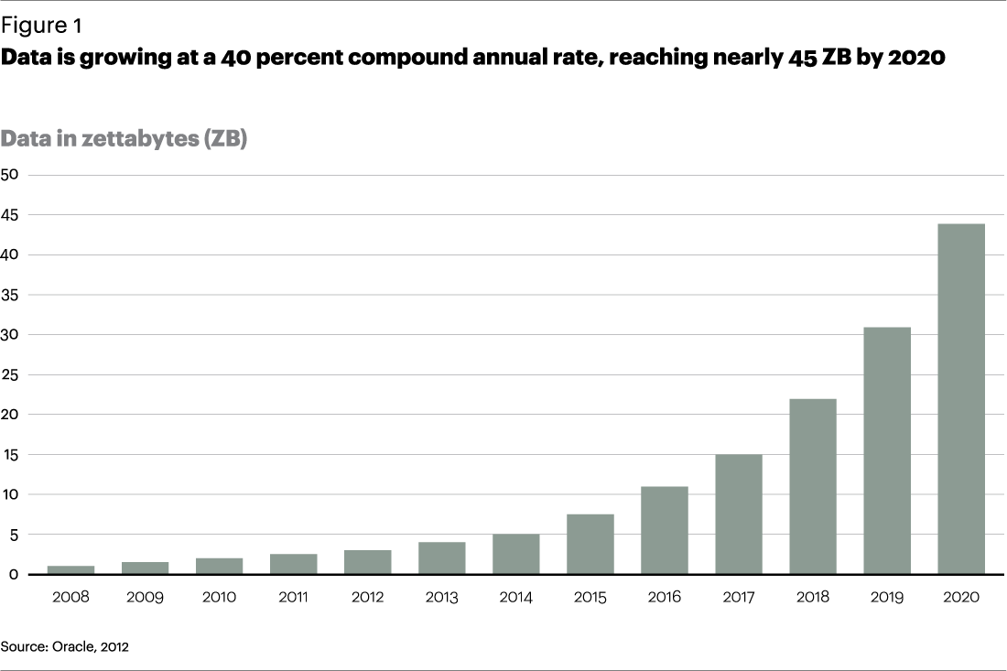
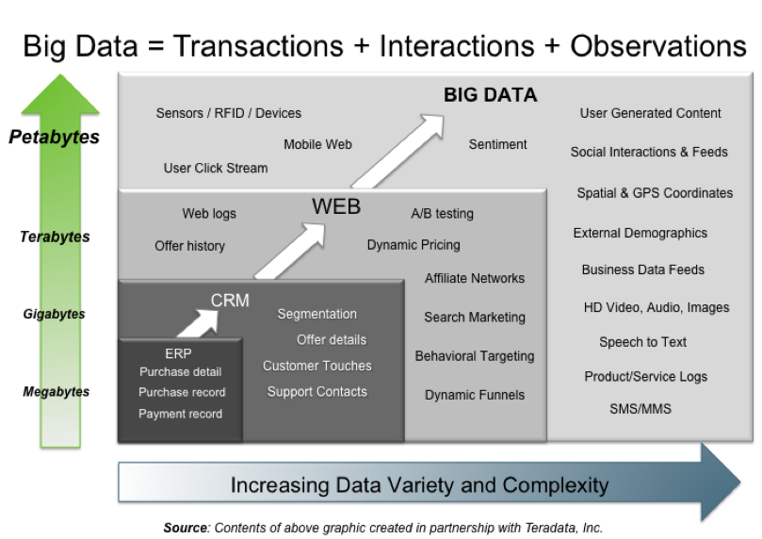
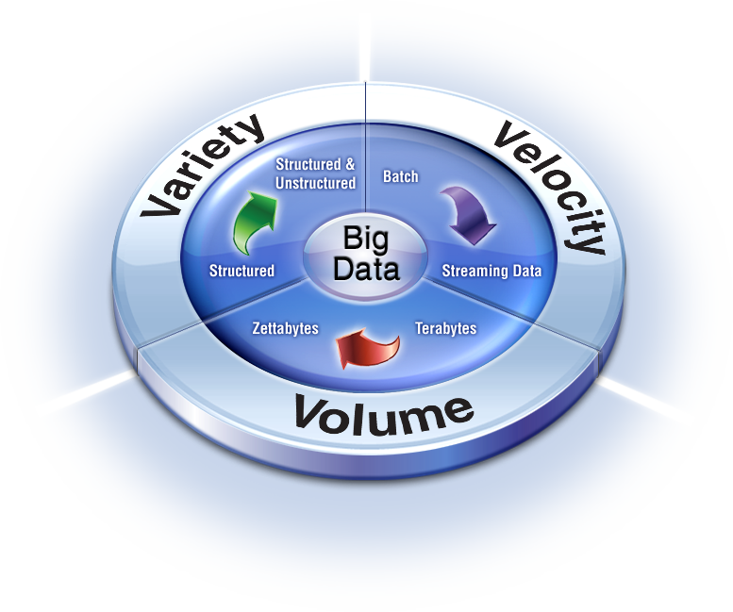
Big Data
Size of data increases exponentially
Types of data are very heterogeneous
  Technology makes it possible to analyze ALL available data
Key dimensions
  Volume, Velocity and Variety

Slide 4
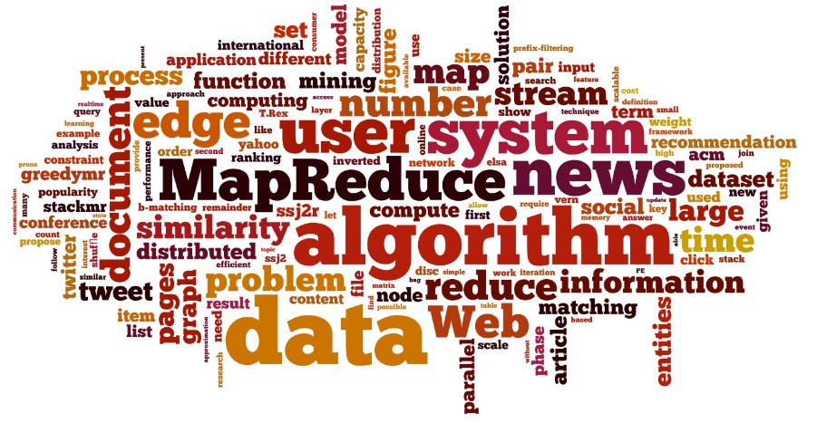
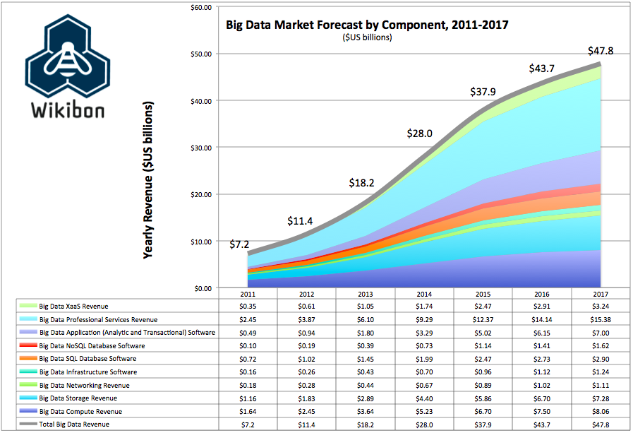
Big Data Business

Slide 5
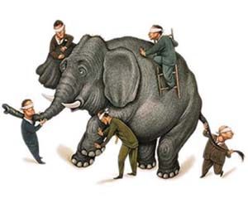
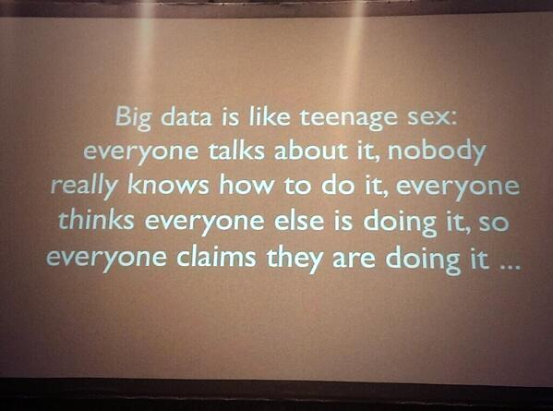
However
Nobody knows exactly how to handle big data
We zoom in smart grid bid data
  Further zoom in smart meters and sensors

Slide 6
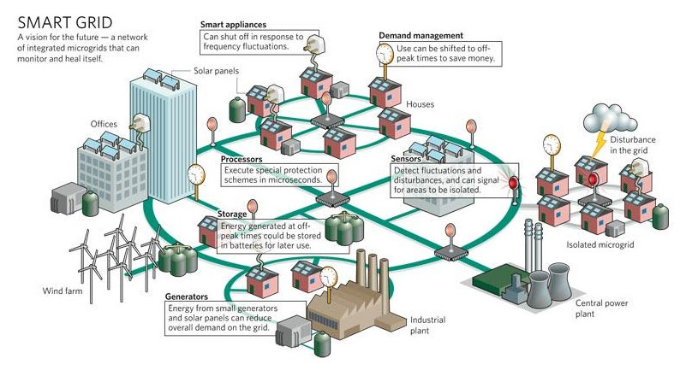
Smart Grid
In 2009, “American Recovery and Reinvestment Act”
  $3.4 billion for SG investment grant program
  $615 million for SG demonstration program
  It leads to a combined investment of $8 billion in SG capabilities.

Slide 7
Overview
Introduction
  Big Data
  Smart Grid
Case 1: Load profiling and smart pricing by smart meter big data
  Basics and problems
  Bayesian nonparametric learning
  Sublinear Algorithm
Case 2: SCOPF for smart grid security
  Sparse optimization
  Alternating direction method of multipliers (ADMM).
  Security-constrained Optimal Power Flow Problem
Conclusion
Other research activities of our group

Slide 8
Smart Pricing for Maximizing Profit
The profit = sum of utility bill – cost to buy power
  Different shape of loads cost different
  Incentive using pricing to change the loads
  The cost reduction is greater than loss of bills

Slide 9
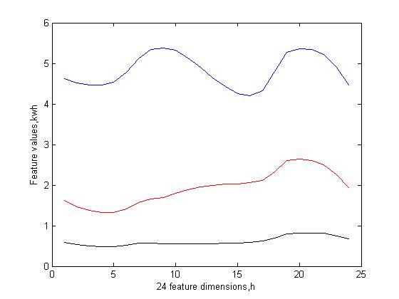
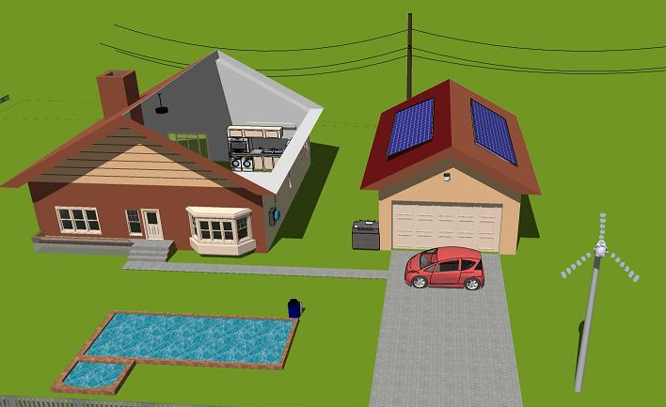
Load Profiling
From smart meter data, try to tell users’ usage behaviors
  CEO, 1%, UH Computer Science people
  Worker, middle class, professor
  Homeless, slave, Ph.D. students

Slide 10
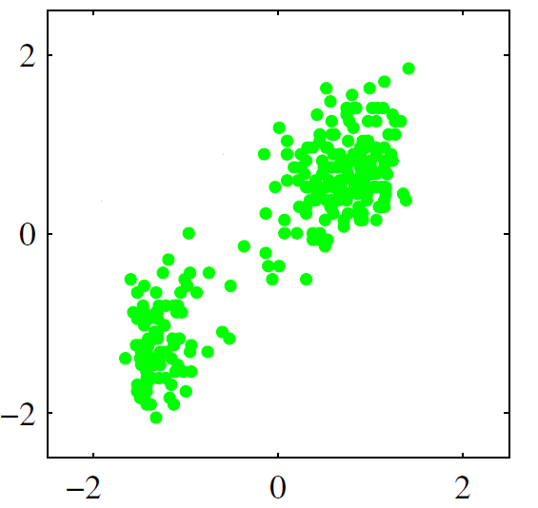
Question: How to cluster smart meter big data
Bayesian Nonparametric Classification
Department of Electrical and Computer Engineering
For multi-dimension data
  Model selection: How many clusters are there?
  What’s the hidden process created the observations?
  What are the latent parameters of the process?
Classic parametric methods (e.g. K-Means)
  Need to estimation the number of clusters
  Can have huge performance loss with poor model
  Cannot scale well
The questions can be solved by using Nonparametric Bayesian Learning!
Nonparametric: Number of clusters (or classes) can grow as more data are observed and need not to be known as a priori.
Bayesian Inference: Use Bayesian rule to infer about the latent variables.
[10]

Slide 11
Key Idea
Main Objective
Department of Electrical and Computer Engineering
Bayesian rule
    Posterior Likelihood Prior
  μ contains information such as how many clusters, and which sample belongs to which cluster
  μ should be nonparametric and can be any value
Sample the posterior distribution P(μ|Observations), and get values of the parameter μ.
p(μ|Observation)=p(Observation|μ)p(μ)/p(Observation)
[11]

Slide 12
Generative model vs. Inference algorithm
Bayesian Nonparametric Classification
Generative model
  Start with the parameters and end up creating observations
  Concept and framework
Inference algorithm
  Start with observations and end up inferring about the parameters
  Practical applications
[12]

Slide 13

Generative model: A general idea
A Dice with Infinite Number of Faces
If sample the distribution of each
face, we will obtain the weights, or
the probabilities for each face
(Dirichlet process)
1
2
3
4
5
6
7
∞
π₁
π₂
π₃
π₄
π₅
π₆
Question: If we have a dice with infinite number of faces, then how to deal with the situation?
[13]

Slide 14
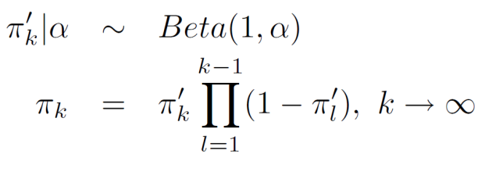
Generative model: Stick breaking process:
Model for Infinite Number of Faces
Department of Electrical and Computer Engineering
Generate an infinite number of faces, and their weights which sum up to 1.
_{Sample a breaking point:}
_{Calculate the weight:}
1
π₁’
1-π₁’
π₂’ (1-π₁’)
(1-π₂’ )(1-π₁’)
[14]

Slide 15
Generative model
Infinite Gaussian Mixture Model
Stick(α)
π₁
π∞
1
π₂
2
3
4
5
6
7
∞
Infinite number of faces/classes
Indicators are created according to multinomial distribution.
z₁, z₂ .. = 1
z₂₀, z₂₁ .. = 2
X_{1:N}
The observations follows a distribution such as Gaussian.
µ₁
Σ₁
µ₂
Σ₂
µ∞
Σ∞
[15]

Slide 16

Inference model: Nonparametric Bayesian Classification algorithm
– Gibbs sampler approach
Inference Model
Finding the posterior of the multivariate distribution P(Z|X)
  Given observation X, what are the probability that it belongs to cluster Z
  Which cluster a sample belongs to?
  Painful due to the integrations needed to carry out.
Finding a univariate distribution is more easily to implement
  For new observation, can get marginal distribution of indicator
  In other word, find the marginal distribution of Zi given the other indicators.
  Gibbs sampling method to sample a value for a variable given all other variables.
  The process is repeated and proved to be converged after a few iterations.
[16]

Slide 17
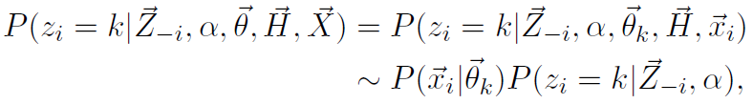


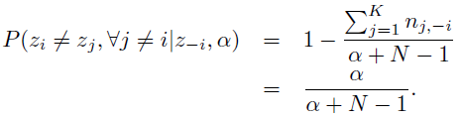

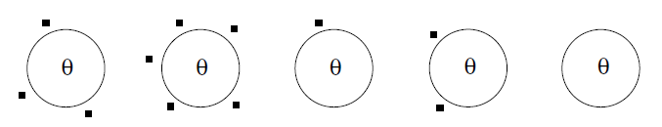
Nonparametric Bayesian Classification inference
Chinese Restaurant Process
Department of Electrical and Computer Engineering
Goal:
is the set of all other labels except the current one, i^{th}
Posterior
Likelihood
(e.g. given as Gaussian)
Prior
(Chinese Restaurant Process)
Probability assigned to a represented class
Probability assigned to an unrepresented class
is the number of observations in the same class, k, excluding the current one, i^{th}
?
?
[17]

Slide 18
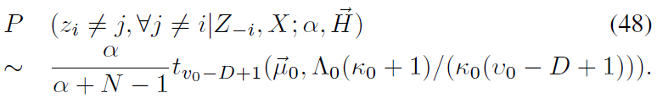
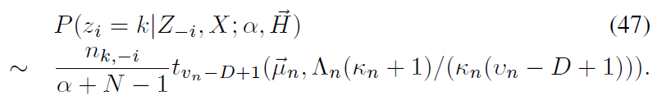
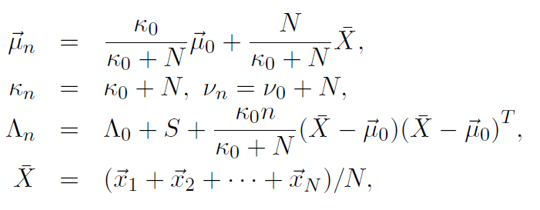
Inference model: Posterior distributions
Student t Distribution
Department of Electrical and Computer Engineering
Given the prior and the likelihood, we come up with the posterior:
  Probability of assigning to a unrepresented cluster:
  Probability of assigning to a represented cluster:
(1)
t is the student-t distribution
(2)
Intuitive:
Provide a stochastic
gradient!
[18]

Slide 19
Inference model: Gibbs sampler
Gibbs Sampler
Department of Electrical and Computer Engineering
Start with random indicator for each observation.
Remove the current i^{th} observation from its cluster
Update the indicator z_{i} according to (1) and (2) given all the other indicators
No
Converge?
Yes
STOP
[19]

Slide 20
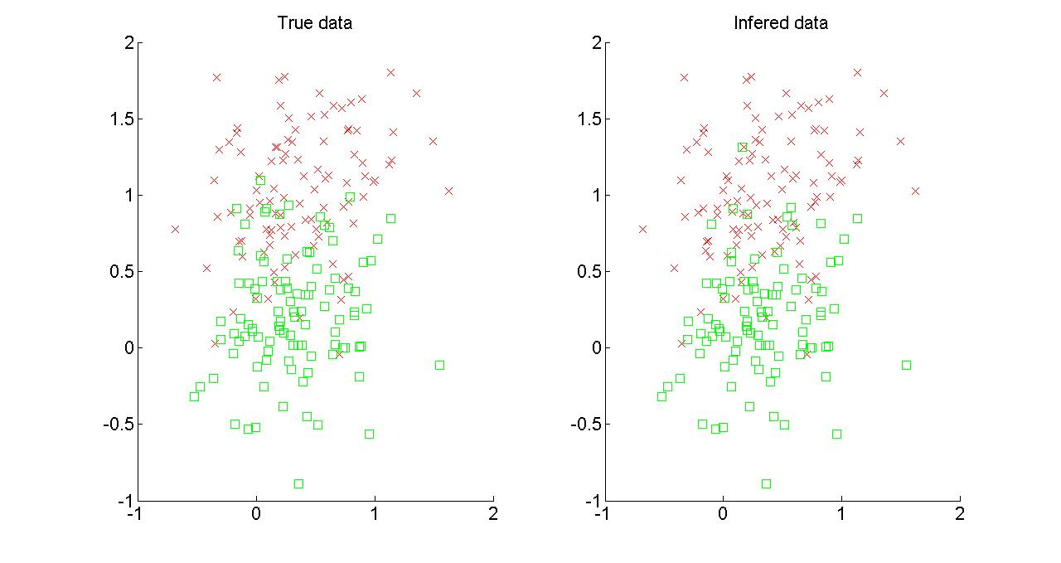
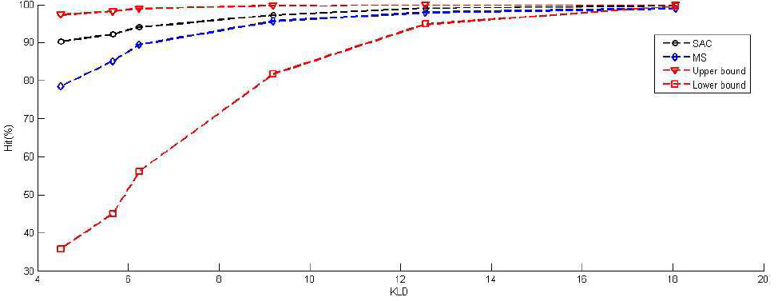
Two Gaussian distributed clusters with KL divergence (KLD) 4.5
Amazing Clustering Results
Department of Electrical and Computer Engineering
Intuition why it works so well
  Not the boundary or threshold. But clustering so that each cluster looks more like the distribution (Gaussian).
  No prior information on probabilities of the green or red
[20]

Slide 21
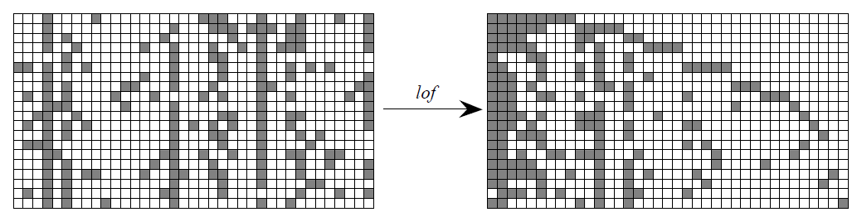
Indian Buffet Process (IBP)
Chinese restaurant problem: one point only belongs to one cluster
Indian buffet process: Multiple assignment clustering, in which, one observation can be caused by multiple hidden sources:
Binary matrix rep. of IBP:

Slide 22
Load Profiling Results
Utility company wants to know benchmark distributions
  Nonparametric: do not know how many benchmarks
  Bayesian: posterior distribution might be time varying
  Scale: Daily, weekday, weekend, monthly, yearly.
But need online algorithm
  Sublinear algorithm

Slide 23
Sublinear Algorithm Basics
Examples:
  Genome project, world-wide web
  Smart meter data, 2.2M in Houston
In many cases, hardly fit in storage
Are traditional notions of an efficient algorithm sufficient?
  i.e., is linear time good enough?
Sublinear algorithm
  Don’t look at entire data…
  Sample according to a certain distribution
  Clever use of approximate solutions to subproblems yields sufficient accurate result

Slide 24
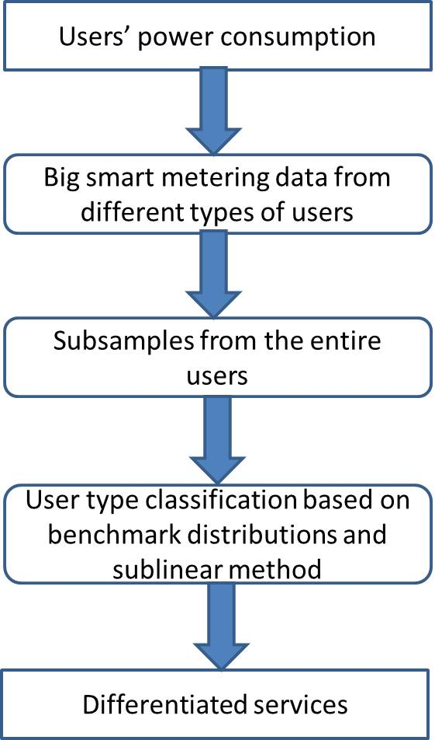
Application in Smart Grid
Goal
  Profile distribution p
  User’s distribution q
  Test closeness between p and q
Given є and δ, subsampling at least (-logδ/(2є^2)) number of users will guarantee:
  α percentage of specific type of users
Sublinear method:
  Repeatedly subsampling from entire distributions
  Run time is sublinear

Slide 25
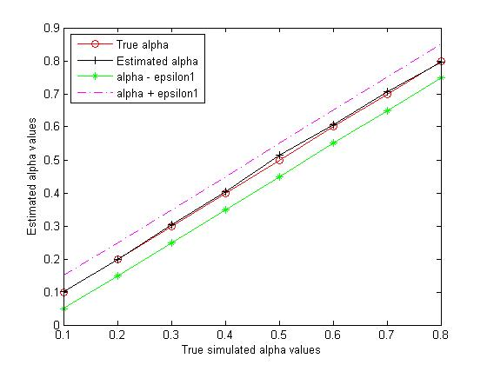
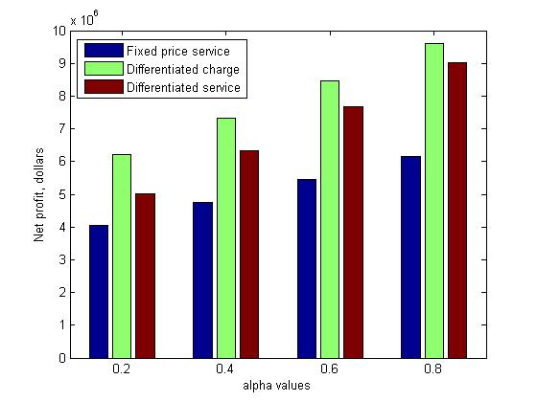
Smart Pricing Performance
Close to true data with 1% subsampling
Smart pricing
  Fix price for all hours
  Differentiate charge: peak hour and off peak hour
  Differentiated service: user selection for either fix or differentiate price.

Slide 26
Overview
Introduction
  Big Data
  Smart Grid
Case 1: Load profiling and smart pricing by smart meter big data
  Basics and problems
  Bayesian nonparametric learning
  Sublinear Algorithm
Case 2: SCOPF for smart grid security
  Sparse optimization
  Alternating direction method of multipliers (ADMM).
  Security-constrained Optimal Power Flow Problem
Conclusion
Other research activities of our group

Slide 27

Sparse Optimization
Data dimension >> useful information dimension
  Number of buses >> number of attacked places
Compressive sensing open a new SP paradigm
Many algorithms developed for sparse optimization
  Alternating direction method of multipliers (ADMM)

Slide 28

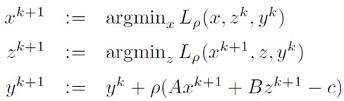
ADMM Basics
ADMM problem form (f and g are convex closed proper)
  Divide one problem into multiple subproblems
  Augmented Lagrangian function
ADMM:
Each iteration is not feasible, but converge O(1/k) speed

Slide 29
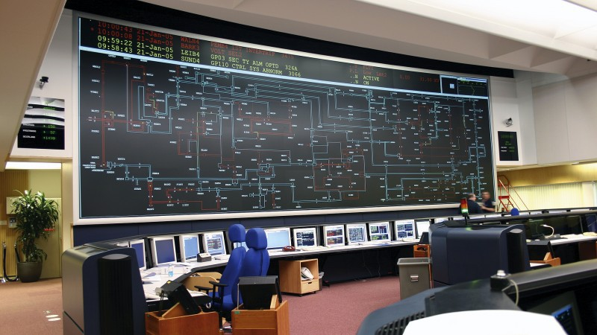
Contingency Analysis in Power Grid
Contingency analysis
  Assess the ability of the power grid to sustain component failures.
  Currently focused on mostly select “N-1” scenarios.
Security-constrained Optimal Power Flow Problem (SCOPF)
  Determines the optimal control of power systems under constraints arising from a set of postulated contingencies

Slide 30
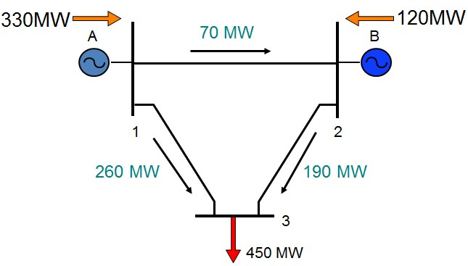
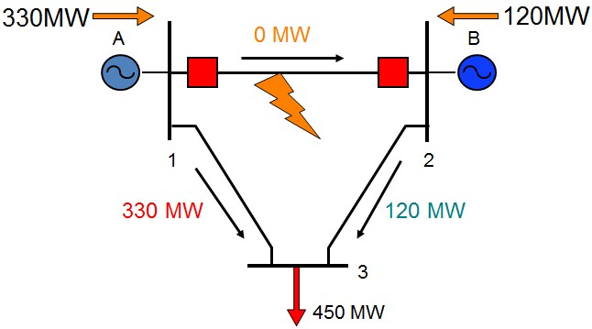
Security-constrained Optimal Power Flow
Example
Base Case
Contingency Case
Unacceptable because overload of line 1-3 could lead to
a cascade trip and a system collapse

Slide 31
Security-constrained Optimal Power Flow
Scheduling Objective
Power flow equations for
base case, Kirchoff's law
Subject to:
Operating limits for
the base case
Power flow equations
for contingency k
Operating limits
for contingency k
Security constrained
Subscript 0 indicates value of variables in the base case
Subscript k indicates value of variables for contingency k

Slide 32
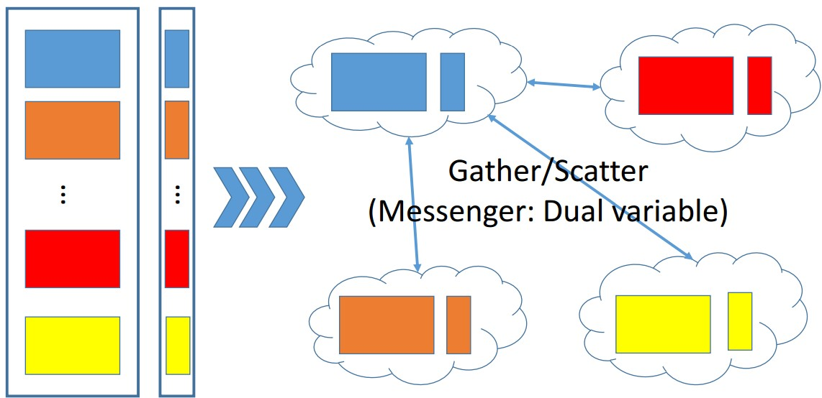
SCOPF Using ADMM
Base Case
Contingency 1
Contingency 2
Contingency K
Implemented on HPC in UH using MPI

Slide 33
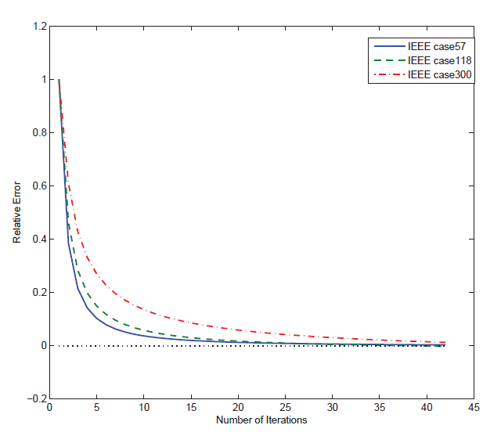
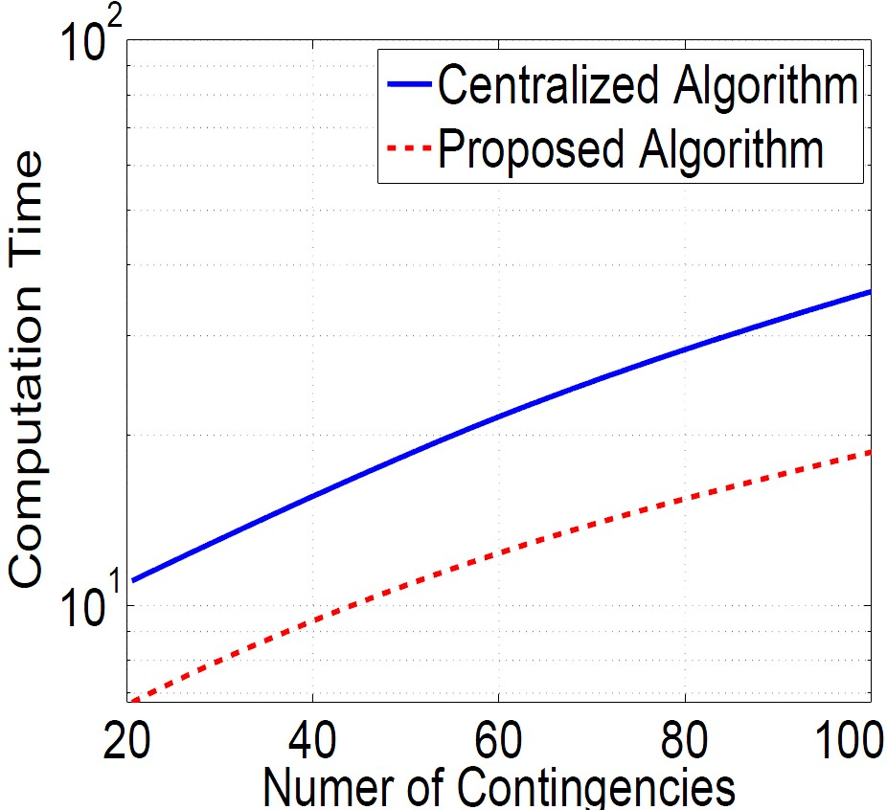
Results
Converge to the optimal solution
Speed up the computation of the optimization problem
Even faster for a sufficiently accurate solution

Slide 34
Conclusion
Big data is a very hot topic today
  but ill defined problem
Smart grid is another hot topic, with a lot of big data
  But the utility companies do not know how to use
Zoom in two topics
  Loading profiling and smart pricing
  SCOPF
Study three techniques
  Machine learning: Bayesian nonparametric learning
  Sublinear algorithm
  ADMM
Only touch trivial parts of the whole picture

Slide 35
Reason and Benefit
Motivation for applying joint CS position
  Need coding ability from CS department
  Need to find more collaboration
Benefit
  Ph.D. student supervision
  Courses such as game theory, smart grid, big data…
  Joint proposals
  ACM citations

Slide 36

Funding Summary
Total Funding Since Joining UH in 2008
  $2,562,670 with 100% credit , more than 1.7 million after tenure
  Total collaboration $8,221,483
9 NSF PI Award (6 concurrent now) include Career Award 2010
  Others: Air Force Office of Scientific Research, Qatar National Research Fund, Gulf of Mexico Research Initiative, Department of Interior
Founder of Electric Power Analytics Consortium, 2012.
  Featured on Houston Business Journal, KUHF, and Chronicle
  Current members: Centerpoint and Direct Energy. Osaka gas will join
  Big data analysis for smart grid

Slide 37
Award Summary
IEEE Fellow 2014 (<0.1%), highest recognition in the field
  Contributions on resource allocation and security in wireless networks
2011 IEEE Communications Society Fred W. Ellersick Prize
7 IEEE conference best paper awards with students
  IEEE Wireless Communication and Networking Conference, 2013.
  IEEE International Conference on Smart Grid Communications, 2012.
  International Conference on Wireless Communications and Signal Processing (WCSP), 2012.
  Two in IEEE Wireless Communication and Networking Conference, 2012.
  IEEE International Conference on Communications, 2009.
  7th International Symposium on Modeling and Optimization in Mobile, Ad Hoc, and Wireless Networks, (WiOpt09), 2009.
Award for Excellence in Research, Scholarship or Creative Activity

Slide 38
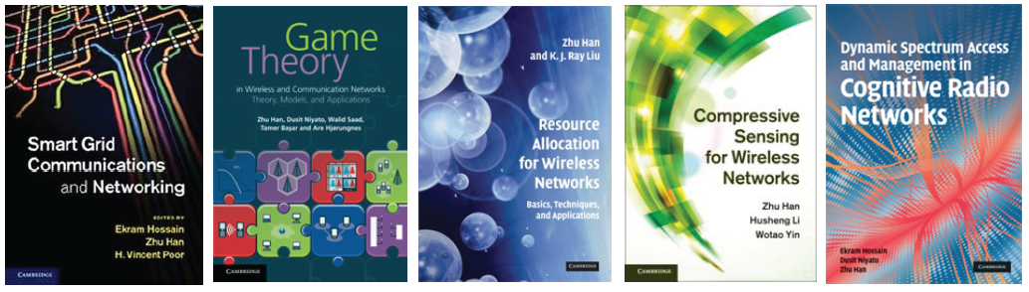
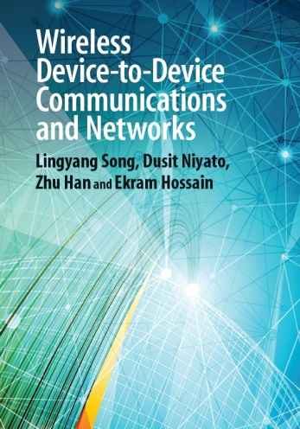
Publication Summary
127 published/accepted journals, 247 conference papers
  >95% are IEEE/ACM journals and conferences
  Collaborate with 4 NAE and 1 National Academy of Sciences members
3 brief books, 13 book chapters, and 2 patents.
5 published textbooks/1 edited book, all by Cambridge University Press
Citation: Google >9000, H-index 46, Web of Science >2000, h-index 23

Slide 39
Overview of Wireless Amigo Lab
Lab Overview
  Currently: 12 Ph.D. students,
  Alumni: 7 Ph.D. and 3 joint postdocs.
  Currently supported by 9 NSF funding, DOD, Gulf of Mexico Research Initiative, Power consortium and Qatar grants
Current Concentration
  Game Theoretical Approach
    Spectrum sensing; UAV; Vehicular network; Physical layer security; MIMO/Relay network; Social network; Context aware network; Femtocell; Device to device network
  Compressive Sensing and Big Data
  Machine Learning
      Bayesian nonparamentric learning: IGMM, Gibbs sampling
      Deep learning
      Multiarm Bandit: Exploration and exploitation

Slide 40
Research Lab Summary
  Security
    Device identification by Baysian nonparametric method
    Trust management and belief network/propagation
    Quickest detection
    Physical layer security
    Primary user emulation attack
  Smart Grid
    False data injection attack
    PHEV optimization
    Distributed microgrid control
    Renewable energy
    Smart meter
    Demand side management
Summary from my student’s facebook
  Theory is something we know why, but it does not work.
  Practice is something works, but we do not know why.
  In our research lab, we have both: nothing works and we do not know why.

Slide 41
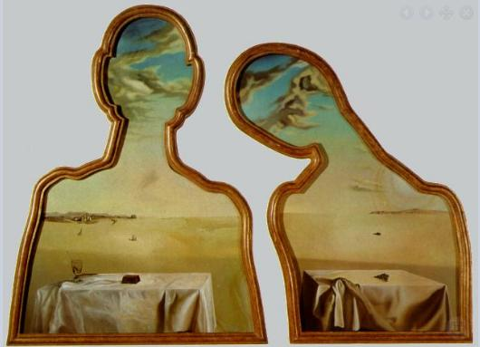
Thanks

