Slide 1
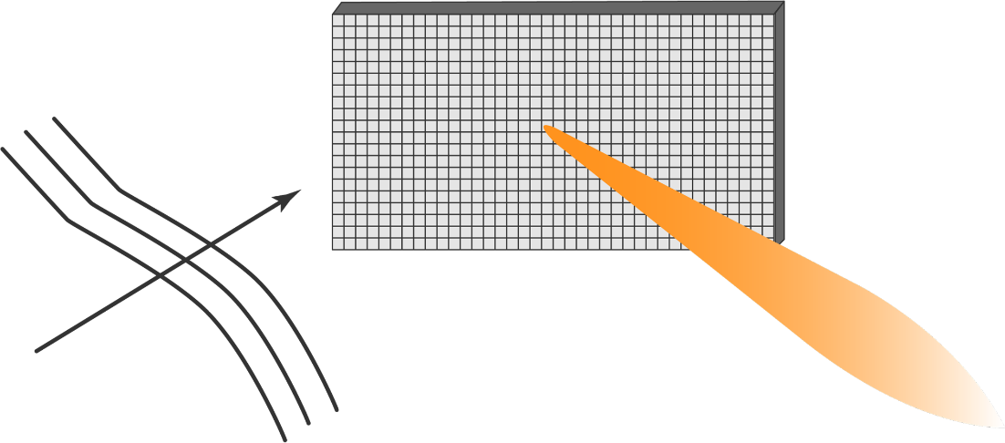
Passive Reflection Techniques for Wireless Communications
Ph.D. Dissertation Defense
December 8th, 2020
Mohamed Ali
Advisor: Prof. Zhu Han

Slide 2
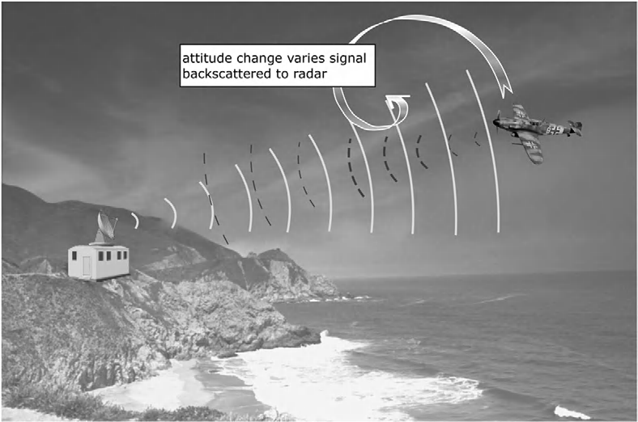



What is Passive Reflection Radio?
First use passive reflection for communication?$1$
Active radio transmission:
Signal source
Passive reflection transmission:
Reflect more
[$1$] D. M. Dobkin, The RF in RFID: UHF RFID in Practice, 2 edition. Amsterdam: Newnes, 2012.
Reflect less

Slide 3
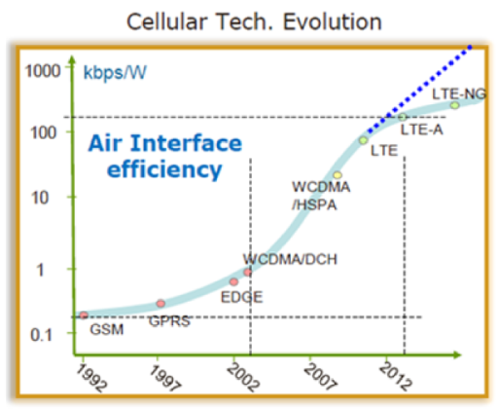
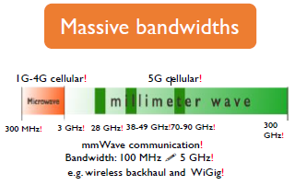
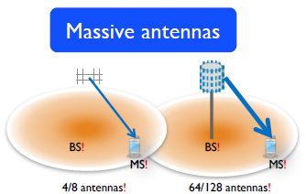
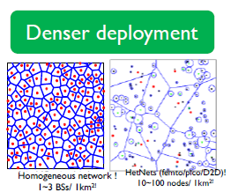

Motivation
Cisco estimates 500 billion devices connected by 2030$.^{1}$
Wireless networks consume as much energy as the airline industry$2$
Energy consumption is becoming a major concern
[1] https://www.cisco.com/c/dam/en/us/products/collateral/se/internet-of-things/at-a-glance-c45-731471.pdf
[2] A. Fehske, G. Fettweis, J. Malmodin and G. Biczok, "The global footprint of mobile communications: The ecological and economic perspective," in IEEE Communications Magazine, vol. 49, no. 8, pp. 55-62, August 2011.

Slide 4
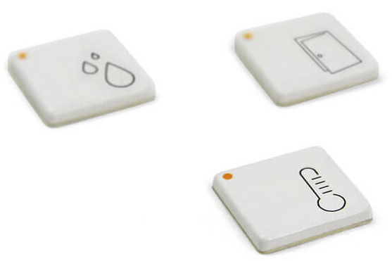


Motivation
How to keep supporting more devices/capacity while controlling power consumption?
Diverse requirements:
  High-rate broadband devices
  Low-rate massive connectivity devices

Slide 5


Motivation
Passive reflection radio techniques offer solutions for both use-cases
For low-rate short-range applications → Ambient Backscatter
  Uses passive reflection as a means of communicating information.
  Piggyback off ambient RF transmissions
High-rate applications → Reconfigurable Intelligent Surfaces
  Uses passive reflection as a means of improving signal propagation.
  Exercise control over signal propagation to increase capacity + simplify transceivers
Passive Tag

Slide 6
Outline
Motivation
Noncoherent Ambient Backscatter Techniques over OFDM:
  Introduction and System Model
  Pseudo-FSK with Energy Detection
  Noncoherent FSK
Reconfigurable Intelligent Surfaces:
  Introduction
  RIS for Orthogonal Spatial Multiplexing
  RIS for Interference Channels
Future work and Conclusion

Slide 7
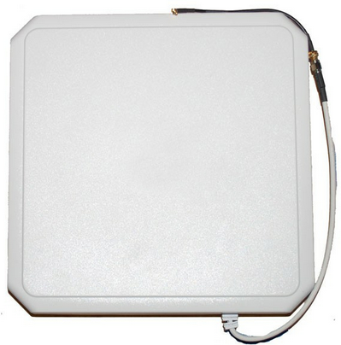
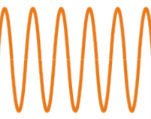
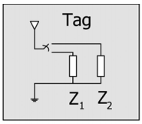
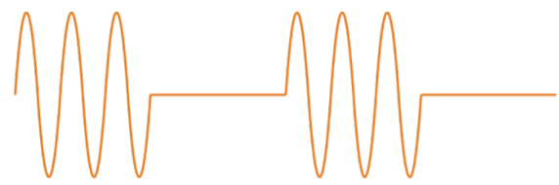
Traditional Backscatter Radio
Traditional backscatter is a mature technology.
Reader transmits dedicated constant wave
Tag intentionally changes antenna impedance to communicate
Easy to cancel self-interference.
Clean reader signal
[Figures] V. Liu, et al., “Ambient Backscatter: Wireless Communication out of Thin Air,” New York, NY, USA, 2013, pp. 39–50

Slide 8
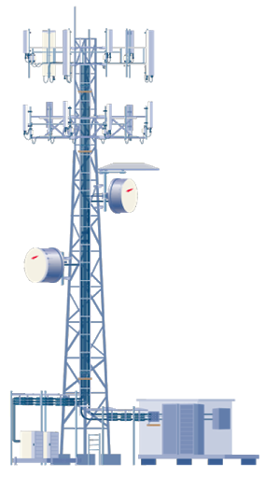

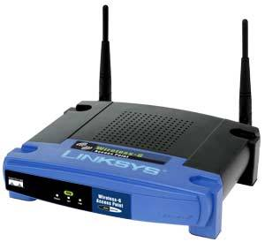
Ambient Backscatter Radio
Backscatter communication without requiring dedicated constant wave carriers?
We have ambient RF transmission everywhere!
Cellular
Wi-Fi
TV
[Figures] V. Liu, et al., “Ambient Backscatter: Wireless Communication out of Thin Air,” New York, NY, USA, 2013, pp. 39–50

Slide 9
Ambient Backscatter Radio
But, ambient signals are random and uncontrollable
Direct link interference is hard to cancel
Unknown channels → Noncoherent detection.
Cascaded fading → poor performance + hard to analyze
Traditional Backscatter
Ambient Backscatter
[Figures] V. Liu, et al., “Ambient Backscatter: Wireless Communication out of Thin Air,” New York, NY, USA, 2013, pp. 39–50

Slide 10
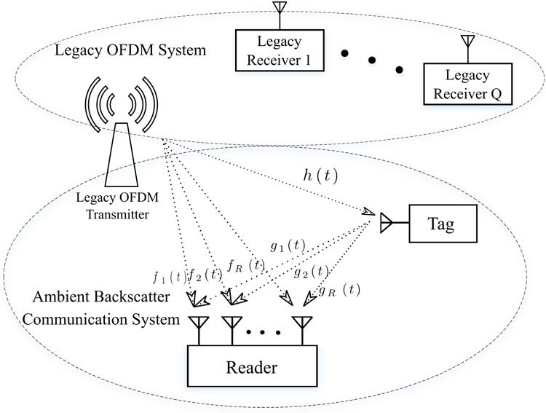
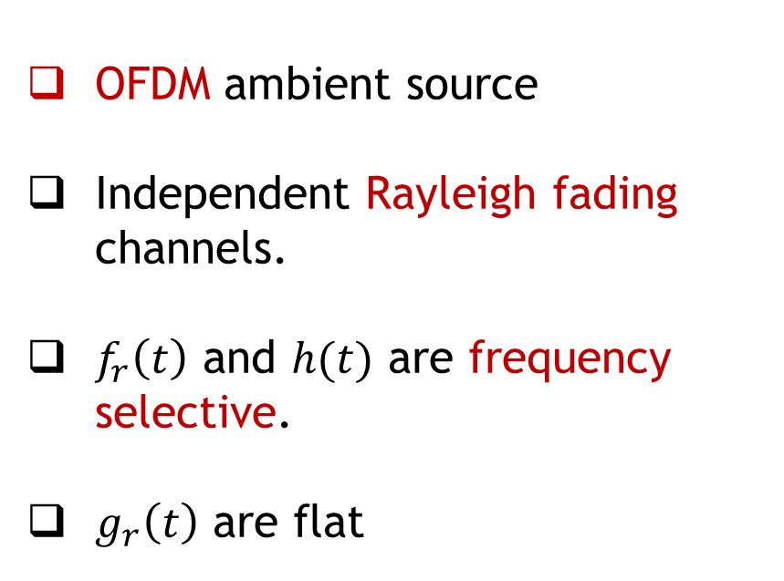
System Model
OFDM ambient source
Independent Rayleigh fading channels.
$f_{r}\left(t\right)$ and $h(t)$ are frequency selective.
$g_{r}\left(t\right)$ are flat

Slide 11


System Model
Ambient signal (OFDM → No approximations):
Received at the Tag:
Received at the Reader:
Tx Power
Baseband OFDM symbol
Our Goal:
What looks like?
How to detect?
Error Analysis
Tag Modulation
noise
useful
interference

Slide 12
Outline
Motivation
Noncoherent Ambient Backscatter Techniques over OFDM:
  Introduction and System Model
  Pseudo-FSK with Energy Detection
  Noncoherent FSK
Reconfigurable Intelligent Surfaces:
  Introduction
  RIS for Orthogonal Spatial Multiplexing
  RIS for Interference Channels
Future work and Conclusion

Slide 13

Tag Modulation Design
OFDM spectrum structure, :
Around 10% of channel bandwidth is left null (could be used for NB-IoT).
Use guard bands to avoid direct-link interference.
Basic idea:
  ‘1’: shift backscattered signal to guardbands
  ‘0’: do not shift backscattered signal
Lower Guard band
Upper Guard band

Slide 14


Tag Modulation Design
Deliberately mismatch the antenna at shift frequency.
Backscattered energy will be shifted to both sides of the guardband.
$$f_{shift}$$
14

Slide 15
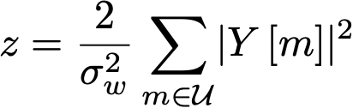
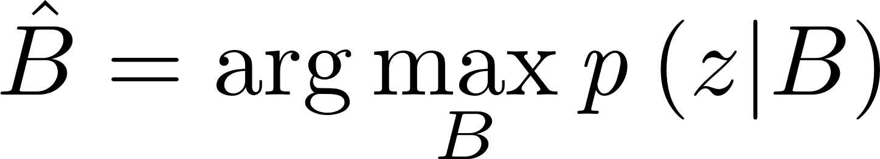


Detector
Noncoherent → energy detector over the null subcarriers:
Detector:
Test statistic distribution:
  Depends on the instantaneous SNR distribution
Test statistic
Noise variance
Baseband OFDM symbol after FFT
Set of inband null subcarriers
Transmitted bit
SNR
15

Slide 16
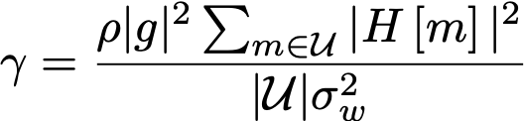
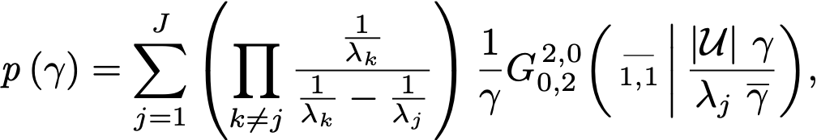
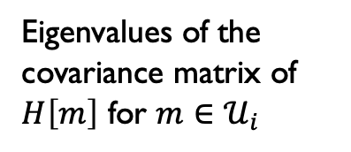
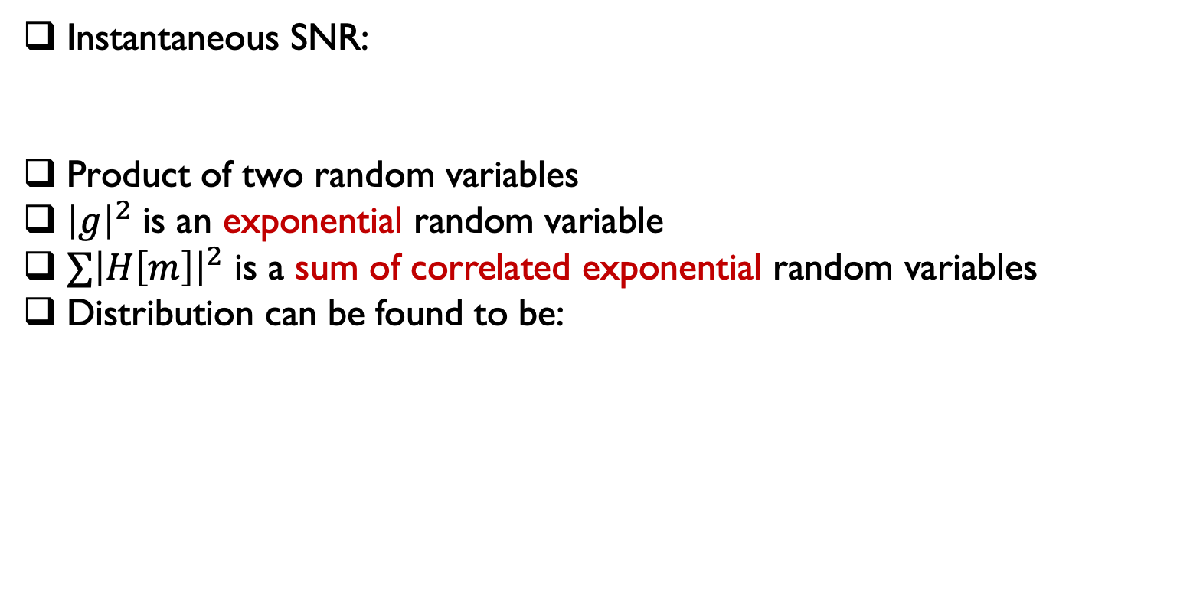
Detector
Instantaneous SNR:
Product of two random variables
${\left|g\right|}^{2}$ is an exponential random variable
$∑{\left|H\left[m\right]\right|}^{2}$ is a sum of correlated exponential random variables
Distribution can be found to be:
# of Eigenvalues
Eigenvalues of the covariance matrix of $H\left[m\right]$ for $m∈𝒰_{i}$
Meijer G-function
16

Slide 17
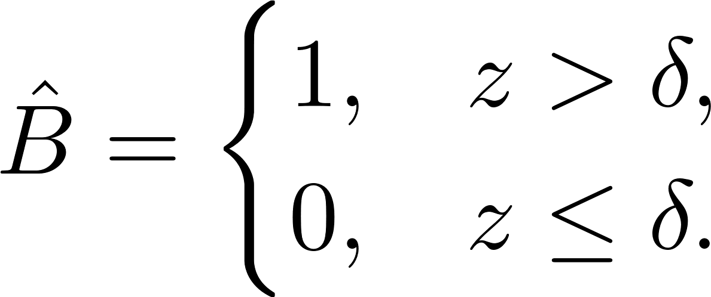
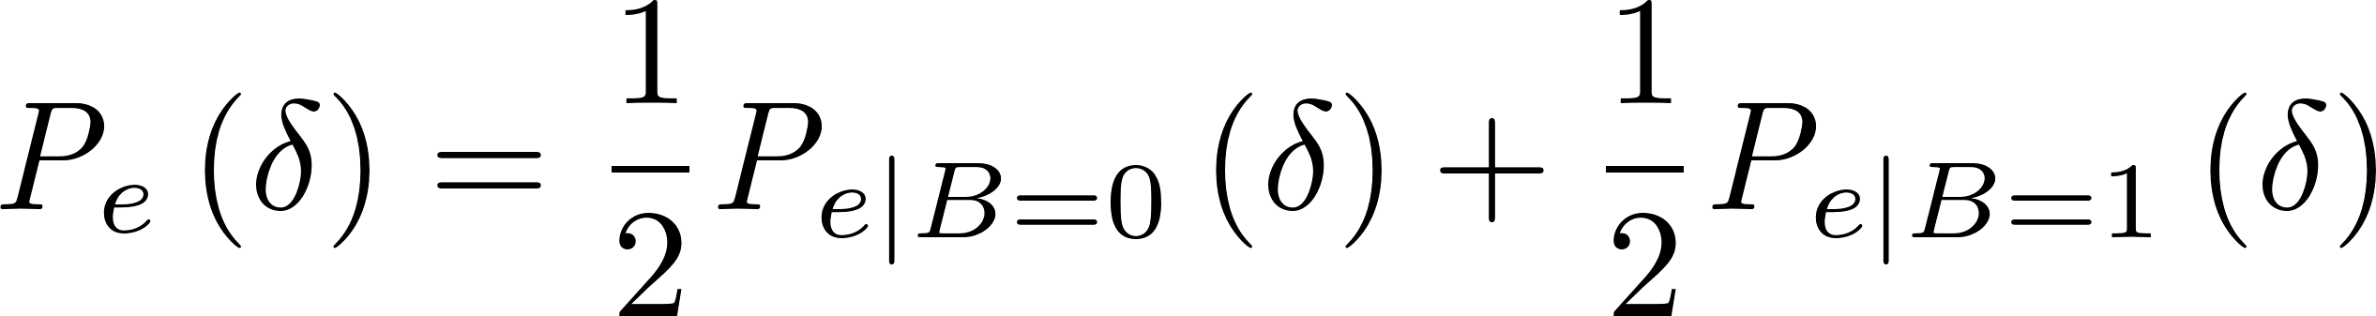

Error Analysis
Error rate function of the detection threshold, $δ$
Optimal $δ$ at the intersection of
Probability of error:
First term independent of SNR
Incomplete Gamma function
Gamma function
17

Slide 18

Error Analysis
2nd term complicated → condition on the SNR
Then average over the SNR distribution:
Integrate and finally get:
Marcum Q-function
Bi-variate Meijer G-function
18

Slide 19
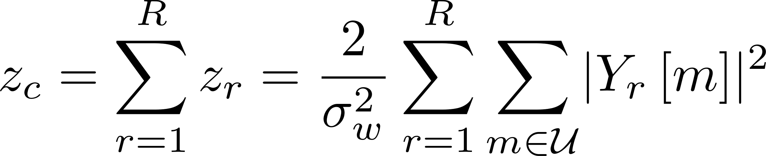
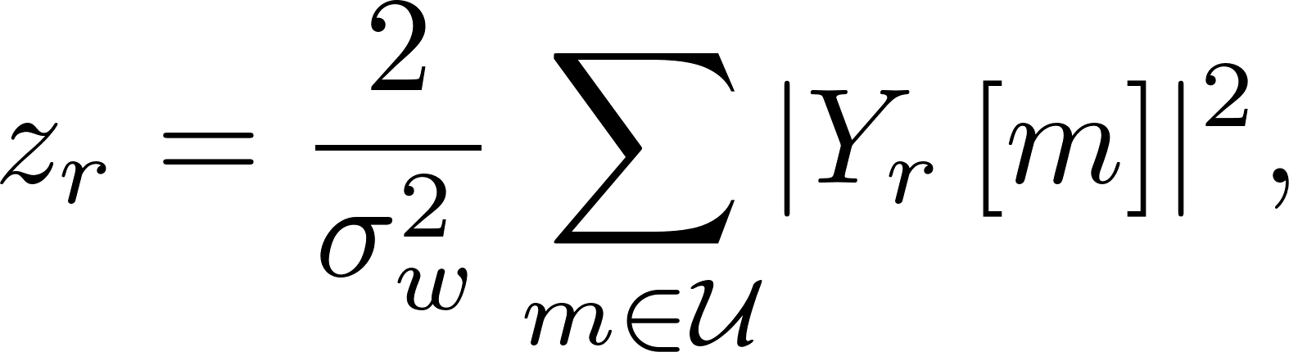
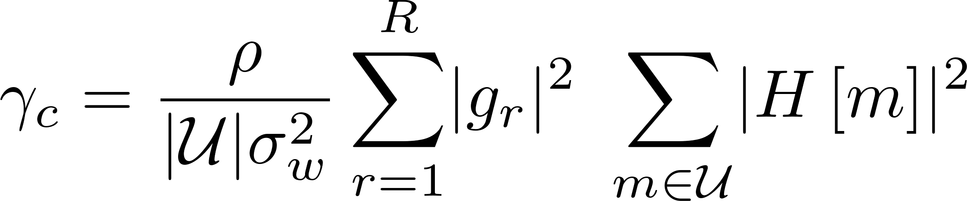
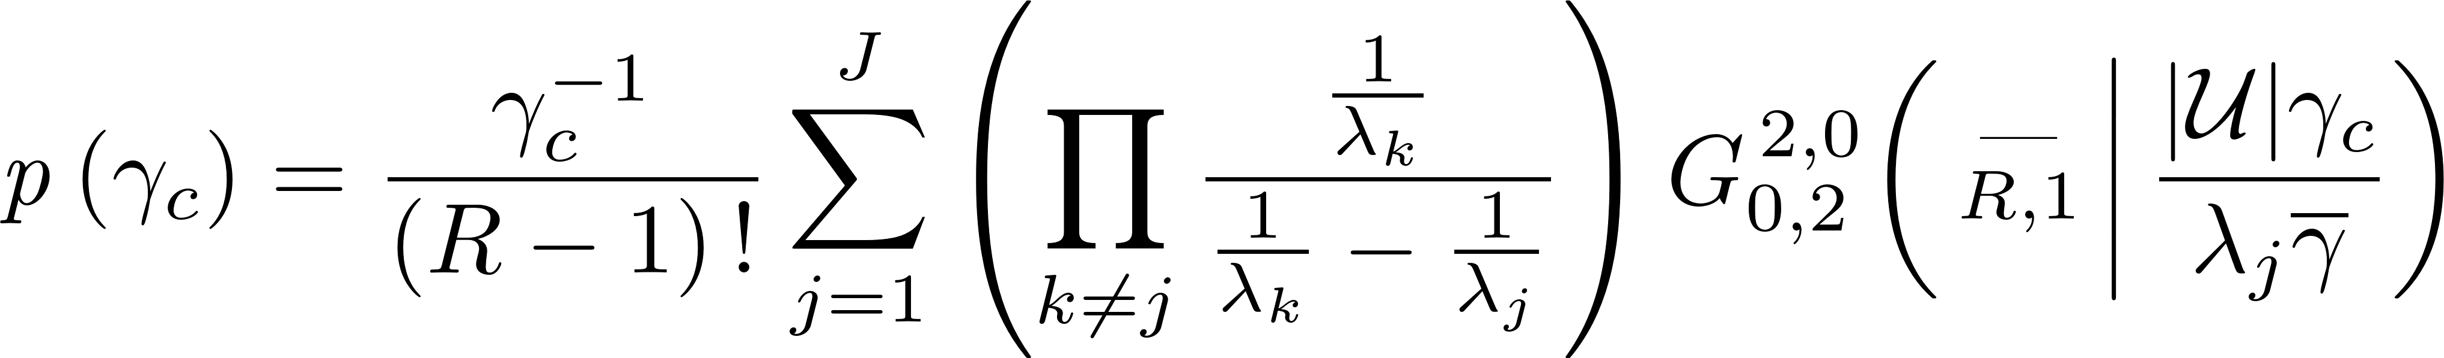
Multi-Antenna Rx
No channel info → Noncoherent combining, combined test statistic
Instantaneous SNR at combiner output:
Combiner SNR distribution
# of Rx Ant.
19

Slide 20



M-ary Modulation
Partial frequency shifts and multi-level energy detection?
Note the subsets are overlapping
No shift
20

Slide 21
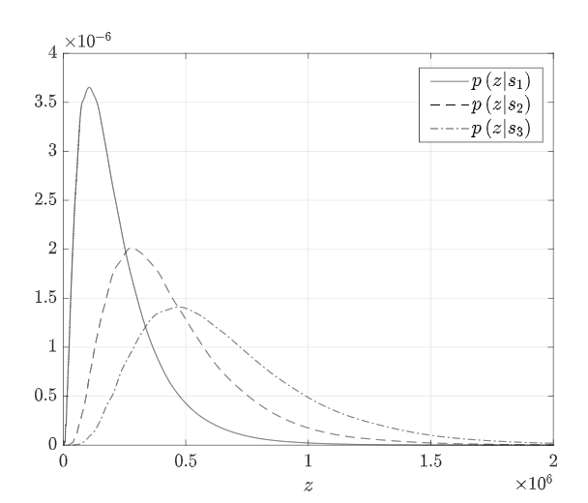
M-ary Modulation
Multi-level energy detection performs very poorly!
Even with 8 antennas @ 25 dB SNR.
Proposed a different technique: Do every subset independently, then combine using an ML rule.
21

Slide 22
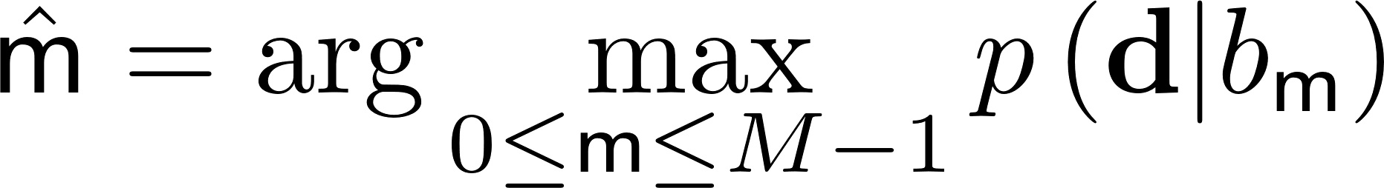
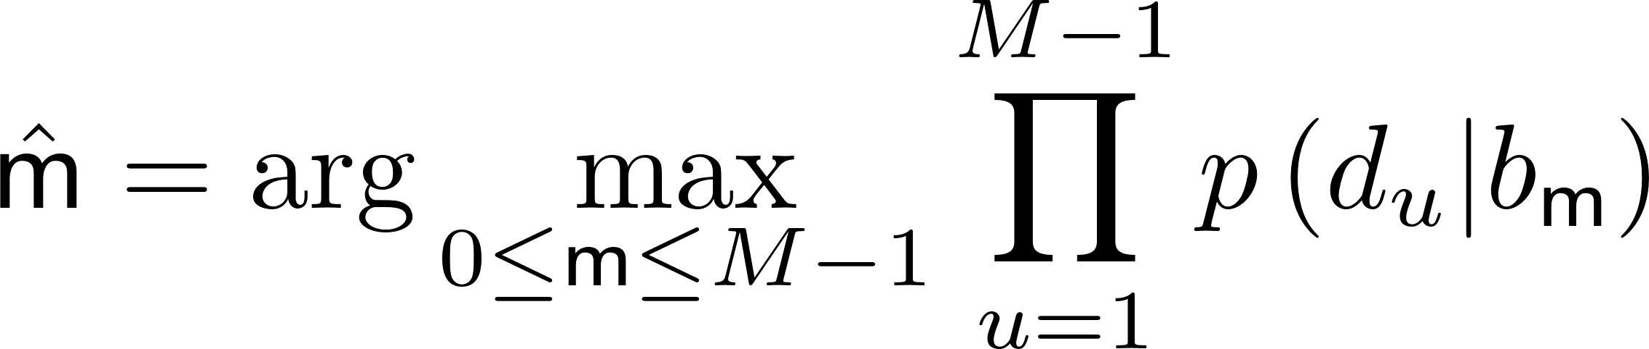
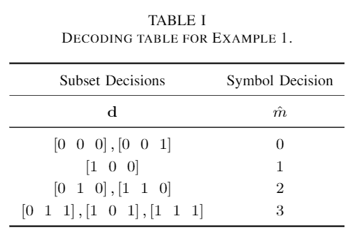
M-ary Modulation
Binary vector of decisions for all subsets
ML detection rule
Assume fading independent between subsets
Construct a decoding table

Slide 23
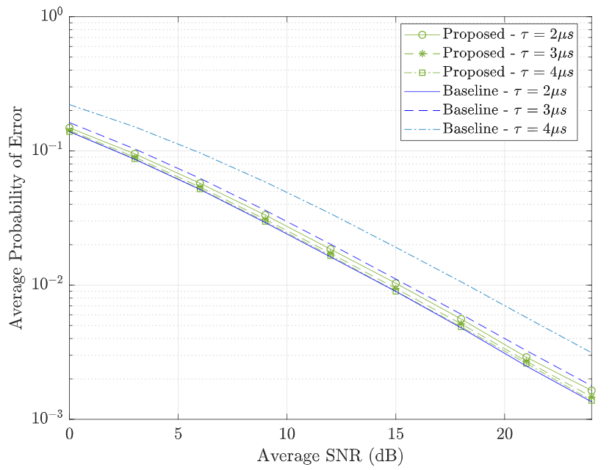
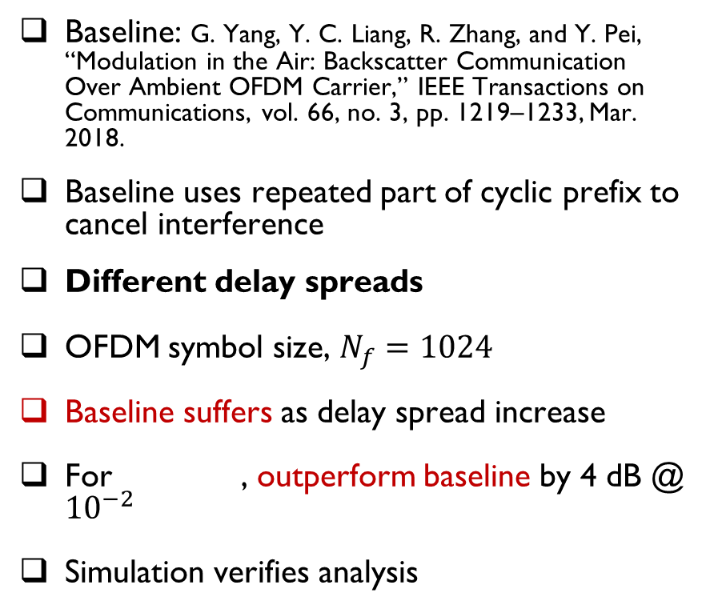
Simulation Results: Binary
Baseline: G. Yang, Y. C. Liang, R. Zhang, and Y. Pei, “Modulation in the Air: Backscatter Communication Over Ambient OFDM Carrier,” IEEE Transactions on Communications, vol. 66, no. 3, pp. 1219–1233, Mar. 2018.
Baseline uses repeated part of cyclic prefix to cancel interference
Different delay spreads
OFDM symbol size, $N_{f}=1024$
Baseline suffers as delay spread increase
For , outperform baseline by 4 dB @ ${10}^{−2}$
Simulation verifies analysis
23

Slide 24
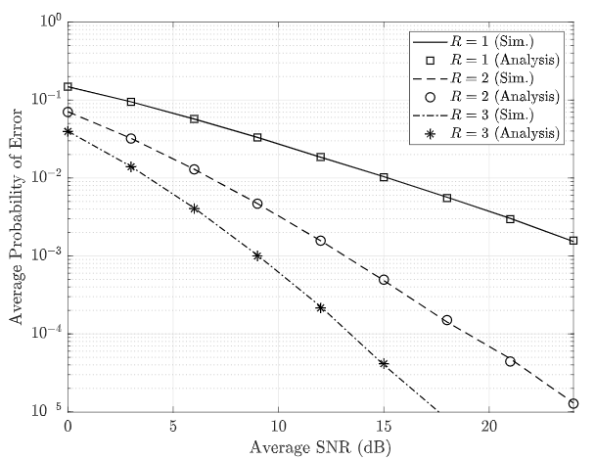
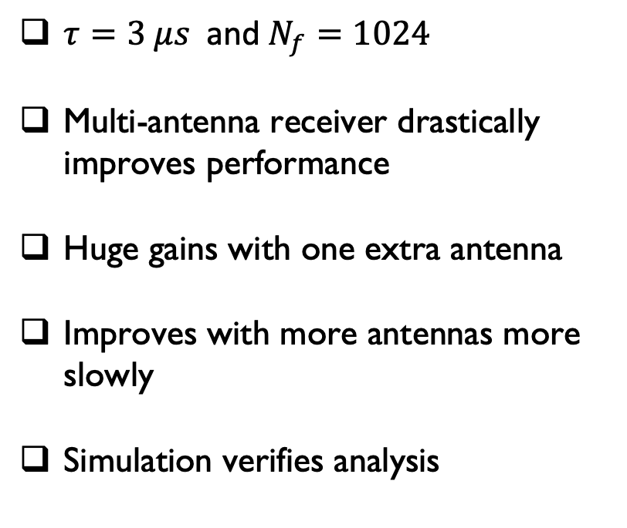
Simulation Results: Multi-Antenna Rx
$τ=3 μs$and$N_{f}=1024$
Multi-antenna receiver drastically improves performance
Huge gains with one extra antenna
Improves with more antennas more slowly
Simulation verifies analysis
24

Slide 25
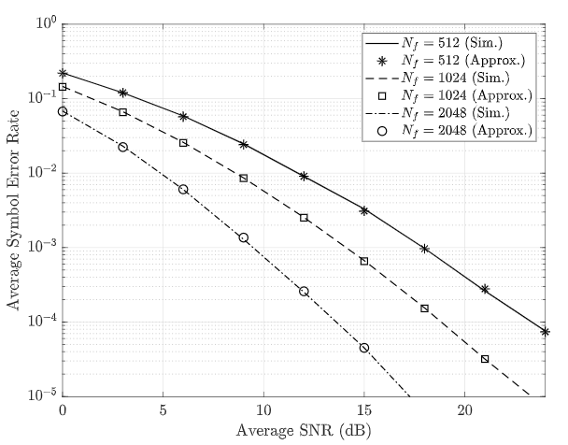
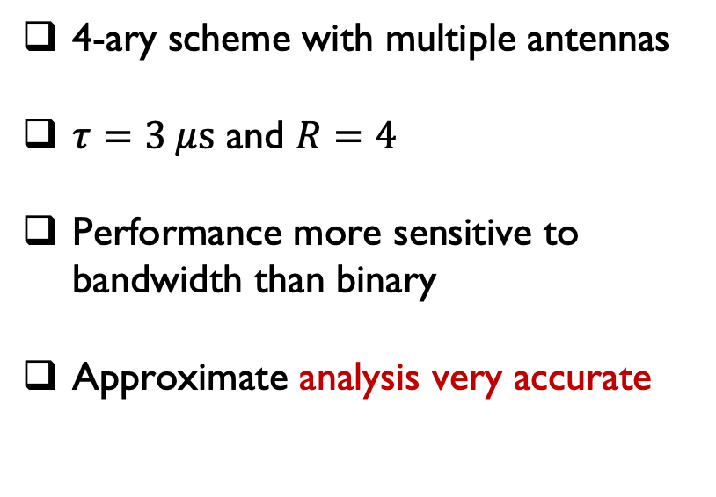
Simulation Results: 4-ary Scheme
4-ary scheme with multiple antennas
$τ=3 μs$ and $R=4$
Performance more sensitive to bandwidth than binary
Approximate analysis very accurate
25

Slide 26
Outline
Motivation
Noncoherent Ambient Backscatter Techniques over OFDM:
  Introduction and System Model
  Pseudo-FSK with Energy Detection
  Noncoherent FSK
Reconfigurable Intelligent Surfaces:
  Introduction
  RIS for Orthogonal Spatial Multiplexing
  RIS for Interference Channels
Future work and Conclusion

Slide 27
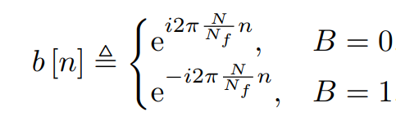


Can We Implement FSK?
Improvement over energy detection scheme?
  Asymmetric error probability
  Detection threshold function of SNR
Can we implement FSK?
$$B=0$$
$$B=1$$
27

Slide 28
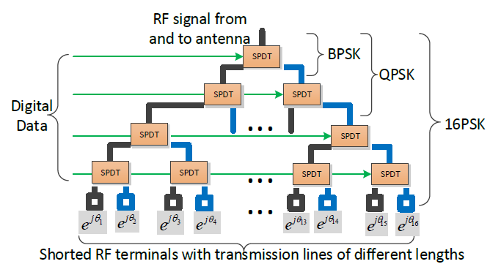

Can We Implement FSK?
Remember: tag can only change its antenna impedance
A complex sinusoid is just a sequence of phase shifts…
Phase shift keying has been done in backscatter radio$1$:
[1] D. Bharadia, K. R. Joshi, M. Kotaru, and S. Katti, “BackFi: High Throughput WiFi Backscatter,” in Proceedings of the 2015 ACM Conference on Special Interest Group on Data Communication, New York, NY, USA, 2015, pp. 283–296.
28

Slide 29











Can We Implement FSK?
Cycle through phase shifts at different order
29

Slide 30


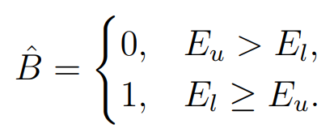
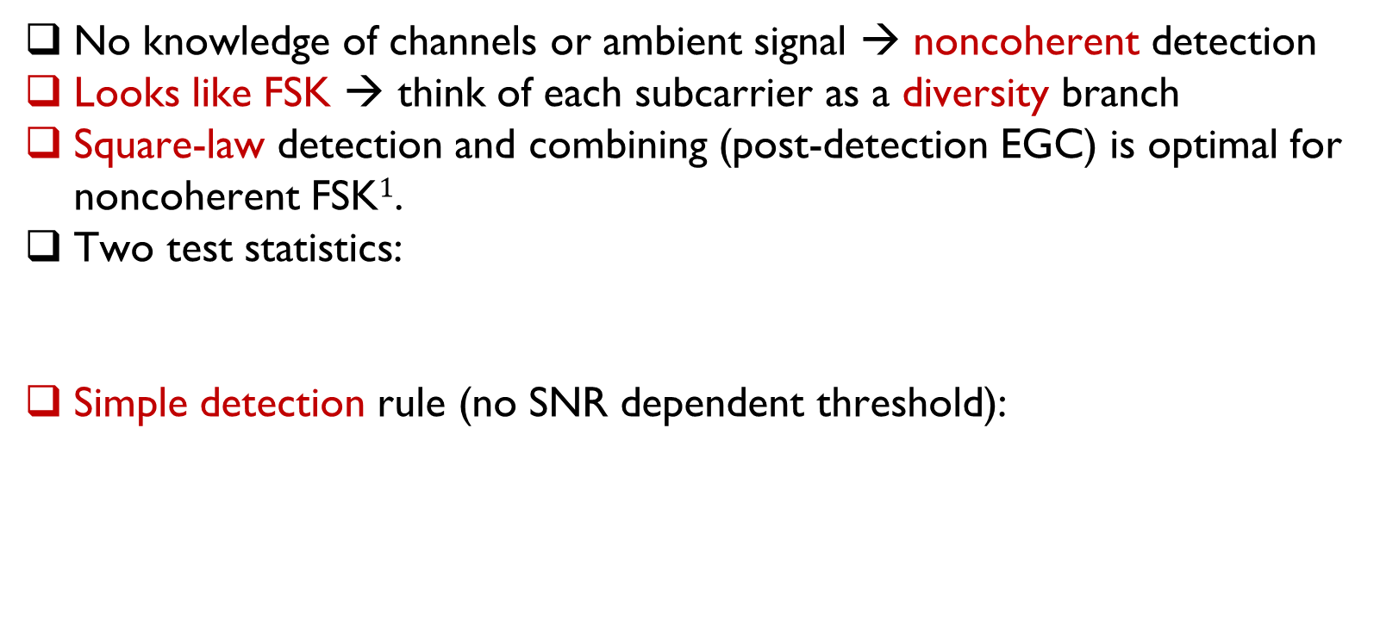
Detector
No knowledge of channels or ambient signal → noncoherent detection
Looks like FSK → think of each subcarrier as a diversity branch
Square-law detection and combining (post-detection EGC) is optimal for noncoherent FSK$1$.
Two test statistics:
Simple detection rule (no SNR dependent threshold):
[1] M. K. Simon and M.-S. Alouini, Digital Communication over Fading Channels, 2 edition. Hoboken, N.J: Wiley-IEEE Press, 2004.
30

Slide 31





Performance Analysis
Decision statistics distribution is complicated (cascaded correlated fading)
Find conditional distribution first…
Under
Under
# of subcarriers
31

Slide 32

Performance Analysis
Assuming equiprobable ‘1’s and ‘0’s
Remember the detection rule
Then:

Slide 33
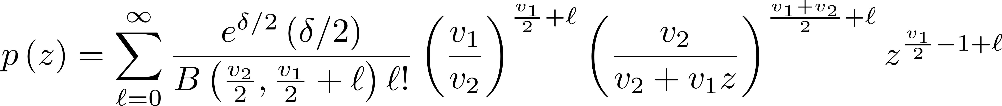
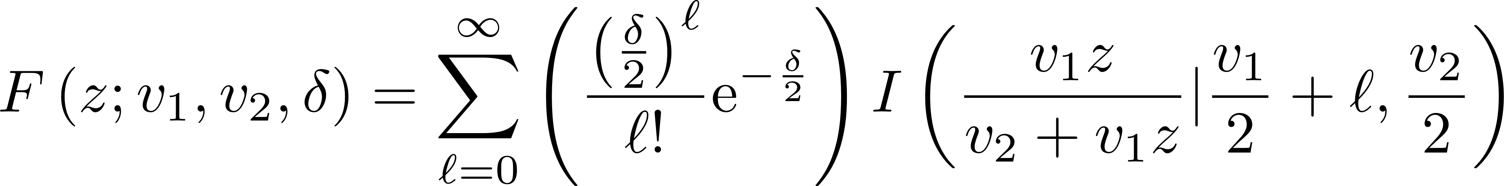

Performance Analysis
Need to find the distribution of and
Note they are actually equal in distribution
Conditional on SNR → ratio of a noncentral $χ^{2}$ to a central $χ^{2}$
Known as a singly noncentral F-distribution
PDF:
CDF:
Noncentrality parameter
of numerator
Beta function
DOF of denominator
DOF of numerator
Incomplete Beta function

Slide 34
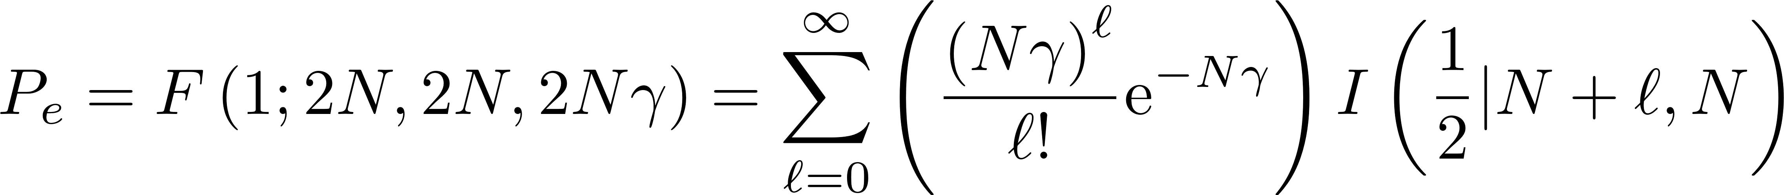
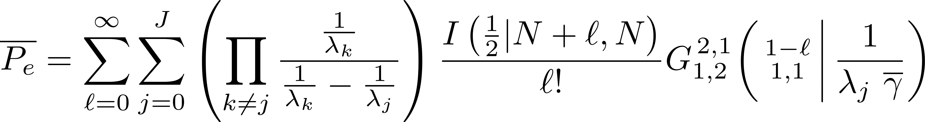
Performance Analysis
Substitute in CDF to get conditional probability of error
Average over the SNR distribution
Write the exponential in terms of Meijer’s G-function..
Finally:

Slide 35
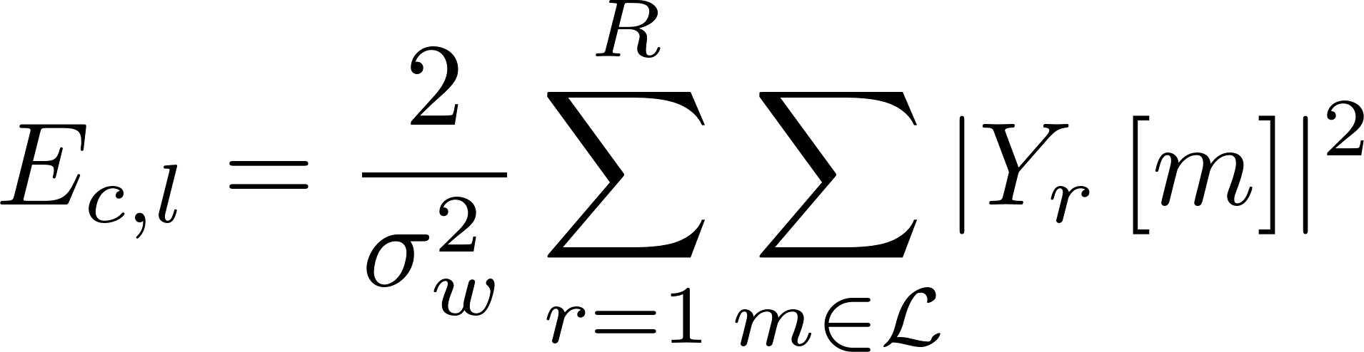
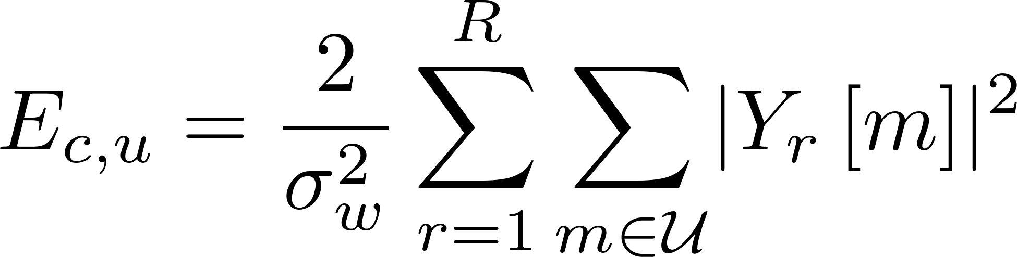

Multi-Antenna Rx
No channel info → Noncoherent combining, combined test statistic
Instantaneous SNR at combiner output: (the same for upper and lower)
Combined SNR distribution
35

Slide 36
4-ary Modulation
You can shift energy to disjoint subsets, causes negligible interference
Note no overlap between subsets
36

Slide 37



4-ary Modulation Error Analysis
Detector → Four test statistics:
Probability of error:
Exact expression intractable → Use a union bound
Pairwise probability of error:
Error probability bound:
37

Slide 38


Simulation Results
Baseline: M. A. ElMossallamy, M. Pan, R. Jäntti, K. G. Seddik, G. Y. Li, and Z. Han, “Noncoherent Backscatter Communications Over Ambient OFDM Signals,” IEEE Transactions on Communications, vol. 67, no. 5, pp. 3597–3611, May 2019.
Different OFDM symbol sizes (LTE)
Delay spread $τ$ = $3 μs$
Outperforms baseline for all sizes.
Gets better for increasing SNR: $N_{f}=2048$ → ~2 dB @ ${10}^{−2}$ and ~3 dB @ ${10}^{−3}$
Simulation verifies analysis

Slide 39


Simulation Results: Multi-Antenna Rx
Different number of antennas, R
Delay spread $τ$ $= 3 μs$
$N_{f}=1024$
Outperforms baseline for all cases.
Simulation verifies analysis

Slide 40




Simulation Results: 4-ary modulation
OFDM size = 2048
Delay spread $τ$ $= 3 μs$
Single-antenna Receivers
Outperforms baseline by 5 dB at ${10}^{−3}$ error rate
$N_{f}=1024$
Delay spread $τ$ $= 3 μs$
Two receive antennas
Bound is tight

Slide 41
Outline
Motivation
Noncoherent Ambient Backscatter Techniques over OFDM:
  Introduction and System Model
  Pseudo-FSK with Energy Detection
  Noncoherent FSK
Reconfigurable Intelligent Surfaces:
  Introduction
  RIS for Orthogonal Spatial Multiplexing
  RIS for Interference Channels
Future work and Conclusion

Slide 42

Reconfigurable Intelligent Surfaces
Large surfaces comprised of many tightly packed passive scatterers
Capable of backscattering/reflecting incident electromagnetic waves in a controllable manner.
Uses passive reflection to control propagation → enhance channel:
Candidate implementations: antenna reflect-arrays and metasurfaces

Slide 43
Outline
Motivation
Noncoherent Ambient Backscatter Techniques over OFDM:
  Introduction and System Model
  Pseudo-FSK with Energy Detection
  Noncoherent FSK
Reconfigurable Intelligent Surfaces:
  Introduction
  RIS for Orthogonal Spatial Multiplexing
  RIS for Interference Channels
Future work and Conclusion

Slide 44




System Model
Uplink: $M$-antenna basestation, and $K$ single-antenna users
Assisted by an $L$-element RIS
Received at base-station:
In matrix form:
No amplitude control →
RIS Effects
Fraction of power received through RIS

Slide 45



RIS for Orthogonal Spatial Multiplexing
You can control channel, what would you change?
Assuming linear practical receivers/precoders, SINRs:
An orthogonal channel matrix is desirable:
  Simple linear receiver can remove cross-user interference
  Power control is decoupled
Benefits of massive MIMO with much less RF chains!
$k$-th user channel
$k$-th precoder/receiver

Slide 46


RIS for Orthogonal Spatial Multiplexing
Equivalent to solving a system of multi-variate quadratics (NP-complete):
Solutions with higher gains desirable + more fairness
Maximize the minimum singular value of the effective channel:

Slide 47




RIS Optimization
The RIS amplitude constraint has a geometric interpretation.
Solution must lie of a surface of smooth Riemannian manifold.
The Complex Circle manifold:
Basic concepts:
  Tangent space : space of all tangent vectors at point.
  Riemannian gradient : direction of greatest increase restricted to tangent space.
  Vector transport : transport a vector from tangent space at one point to another point.
  Retraction : A mapping from tangent space to manifold.

Slide 48




RIS Optimization cont’d
The Riemannian Polak-Ribiere conjugate gradient algorithm converges superlinearly with little added complexity compared to steepest-descent$1$:
  Compute Euclidean gradient
  Project Euclidean gradient into tangent space:
  Find a descent direction:
  Find suitable step size (line search or Armijo backtracking)
  Retract updated point back to manifold surface.
Hadamard product
[1] P.-A. Absil, R. Mahony, and R. Sepulchre, Optimization algorithms on matrix manifolds. Princeton, N.J. ; Woodstock: Princeton University Press, 2008.
Hadamard division

Slide 49




RIS for Orthogonal Spatial Multiplexing
Cast as unconstrained problem on the complex circle manifold:
We use the Riemannian Polak-Ribiere conjugate gradient algorithm$1$
Euclidean gradient needed: differentiable when minimum singular value is not repeated (happens w.p. $1$)
[1] P.-A. Absil, R. Mahony, and R. Sepulchre, Optimization algorithms on matrix manifolds. Princeton, N.J. ; Woodstock: Princeton University Press, 2008.

Slide 50




Simulation Results
Baseline scheme (ER-C) uses the effective rank$1$:
$L = 100$, $α=0.5$
Outperform un-assisted by ~20 bps/Hz
Outperform baseline by ~8 bps/Hz
MF $=$ MMSE → channel is orthogonal
Nuclear norm
[1] P. d. Hougne, M. Fink, and G. Lerosey, “Optimally diverse communication channels in disordered environments with tuned randomness,” Nature Electronics, vol. 2, no. 1, pp. 36–41, Jan. 2019

Slide 51


Simulation Results
$α=0.5$
Multiple RIS sizes
Baseline does not take advantage of increased beamforming ability.
Outperforms baseline and non-assisted by large margins

Slide 52


Simulation Results
$L = 100$
Varying amount of power coming through the RIS
Outperforms non-assisted by $10$ bps/Hz, even when only $\frac{1}{32}$ of the power come through the RIS
RIS is beneficial even in when a strong line-of-sight path exists

Slide 53
Outline
Introduction
Noncoherent Ambient Backscatter Techniques over OFDM:
  Introduction and System Model
  Pseudo-FSK with Energy Detection
  Noncoherent FSK
Reconfigurable Intelligent Surfaces:
  Introduction
  RIS for Orthogonal Spatial Multiplexing
  RIS for Interference Channels
Future work and Conclusion

Slide 54


System Model
$K$-single antenna communicating pairs.
No ability to do any spatial processing at Tx/Rx.
Leverage the RIS to cancel unwanted interference.

Slide 55



Problem Formulation
Construct a quadratic expression including only interference terms:
and are linear functions of the channels $D$, $F$ and $G$.
Non-convex because of the constant modulus constraint.
Baseline: most prevalent technique in literature is to use Semidefinite Relaxation (SDR).
Proposed: cast as a non-constrained manifold optimization problem.

Slide 56








Problem Formulation
Baseline:
Note that is only rank $K$.
Minimizer will lie in the null space of which has dimensions $L+1−K≫1$.
Extract rank-1 solution using EVD.
Proposed:

Slide 57



Results
Performance metric:
$L=100$, $α=0.5$
Rates approaching no interference case for up to 6 user pairs
SDP baseline fails to obtain good solutions in all considered cases.

Slide 58

Results
Effect of no. of RIS elements
$K=3$, $α=0.5$
Interference effectively canceled until $L=25$.
Starts to deteriorate at $L=12$.
SDP baseline fails to obtain good solutions in all considered cases.

Slide 59

Results
Effect of power fraction $α$
$K=3$, $L=100$
Proposed MO-based effectively cancels interference for power fractions as low as $−9 dB$
Large gains in rates for power fractions as low as $−15 dB$

Slide 60
Outline
Introduction
Noncoherent Ambient Backscatter Techniques over OFDM:
  Introduction and System Model
  Pseudo-FSK with Energy Detection
  Noncoherent FSK
Reconfigurable Intelligent Surfaces:
  Introduction
  RIS for Orthogonal Spatial Multiplexing
  RIS for Interference Channels
Future work and Conclusion

Slide 61

Future work: Location-aided RIS Optimization
Exploits position info to aid RIS optimization without explicit channel info.
Datasets are available linking channel realizations/locations.
Potential for ML techniques.
A. Alkhateeb,"DeepMIMO: A Generic Deep Learning Dataset for Millimeter Wave and Massive MIMO Applications ," in Proc. of Information Theory and Applications Workshop (ITA), San Diego, CA, Feb. 2019.

Slide 62
Conclusion
Passive reflection techniques can be helpful in a variety of scenarios
  Ambient backscatter for low-rate IoT applications
  Reconfigurable Intelligent Surfaces for high-rate broadband applications
Proposed two noncoherent schemes for ambient backscatter over OFDM:
  Energy-detection based
  Frequency Shift Keying based
  Both outperform state-of-the-art
Proposed two RIS-assisted schemes:
  Allowing Orthogonal Spatial Multiplexing using RIS
  Allowing simultaneous by multiple transceivers pair in an Interference Channel using RIS

Slide 63
Publications
Journal Publications:
  M. A. ElMossallamy, M. Pan, R. Jantti, K. G. Seddik, G. Y. Li, and Z. Han, “Noncoherent Backscatter Communications Over Ambient OFDM Signals,” IEEE Transactions on Communications, vol. 67, no. 5, pp. 3597–3611, 2019.
  M. A. ElMossallamy, H. Zhang, L. Song, K. Seddik, Z. Han and G. Y. Li “Reconfigurable Intelligent Surfaces for Wireless Communications: Principles, Challenges, and Opportunities,” IEEE Trans. On Cognitive Commun. and Netw., vol. 6, no. 3, pp. 990–1002, Sep. 2020
  M. A. ElMossallamy, H. Zhang, R. Sultan, K. Seddik, L. Song, Z. Han and G. Y. Li “On Spatial Multiplexing Using Reconfigurable Intelligent Surfaces,” to appear in IEEE Wireless Commun. Letters
  M. A. ElMossallamy, R. Sultan, T. Liu, K. Seddik, G. Y. Li, and Z. Han, “Capacity Maximization of RIS-assisted Multi-User MIMO Broadcast Channels,” under review in IEEE Wireless Commun. Letters
  M. A. ElMossallamy, K. Seddik, W. Chen, L. Wang, Z. Han, and G. Y. Li, “RIS Optimization on the Complex Circle Manifold for Interference Mitigation in Interference Channels,” under review in IEEE Transactions On Vehicular Technology (Corres.)
  M. A. ElMossallamy, Z. Han, M. Pan, R. Jantti, K. Seddik, and G. Y. Li, “Noncoherent frequency shift keying for backscatter over ambient OFDM signals,” under preparation for submission to a journal
  X. Cao, Z. Song, B. Yang, M. A. Elmossallamy, L. Qian, and Z. Han, “A Distributed Ambient Backscatter MAC Protocol for Internet-of-Things Networks,” IEEE Internet of Things Journal, vol. 7, no. 2, pp. 1488–1501, Feb. 2020.
Conference Publications:
  M. A. ElMossallamy, Z. Han, M. Pan, R. Jantti, K. Seddik, and G. Y. Li “Backscatter communications over ambient OFDM signals using null subcarriers,” in Proc. IEEE Global Commun. Conf. (GLOBECOM), Abu Dhabi, UAE, Dec. 2018.
  M. ElMossallamy, Z. Han, M. Pan, R. Jantti, K. Seddik, and G. Y. Li, “Noncoherent frequency shift keying for ambient backscatter over OFDM signals,” in Proc. IEEE Int. Conf. on Commun. (ICC), Shanghai, China, May 2019. [IEEE ComSoc TCGCC Best Conference Paper Award]
  M. A. ElMossallamy, Z. Han, M. Pan, R. Jantti, K. Seddik, and G. Y. Li “Noncoherent MIMO Codes Construction using Autoencoders,” in Proc. IEEE Global Commun. Conf. (GLOBECOM), Waikoloa, HI, Dec. 2019.
  R. Duan, R. Jantti, M. A. ElMossallamy, Z. Han, and M. Pan, “Multi-Antenna Receiver for Ambient Backscatter Communication Systems,” in 2018 IEEE 19th International Workshop on Signal Processing Advances in Wireless Communications (SPAWC), Kalamata, Greece, Jun. 2018.
  X. Cao, Z. Song, B. Yang, M. A. ElMossallamy, L. Qian, and Z. Han, “A Distributed MAC Using Wi-Fi to Assist Sporadic Backscatter Communications,” in IEEE Conf. on Computer Commun. (INFOCOM), Apr. 2019, pp. 780–785.

Slide 64
Thank you!

