Slide 1
Femtocells: From the Perspective of Development
Past, Present, and Future
Paper is Authored by J. G. Andrews, H. Claussen, M. Dohler, S. Rangan, and M. C. Reed.
Slides are prepared by Wang Chen and Zhu Han

Slide 2
Contents
1. Overview of Femtocells
2. A Brief History of Femtocells
3. Femtocell Standardization
4. Femtocell Models
5. Overview of Key Challenges

Slide 3
1. Overview of Femtocells
2. A Brief History of Femtocells
3. Femtocell Standardization
4. Femtocell Models
5. Overview of Key Challenges

Slide 4
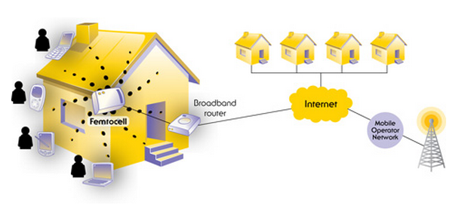
Overview of Femtocells
Femtocells are low-power wireless access points that operate in licensed spectrum to connect standard mobile devices to a mobile operator’s network using residential DSL or cable broadband connections.

Slide 5
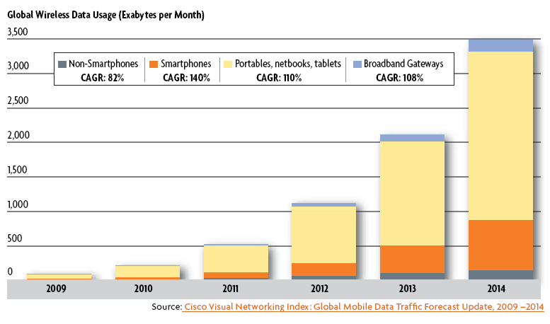
Overview of Femtocells
Why femtocells is needed?
Exponentially increasing wireless data traffic.

Slide 6
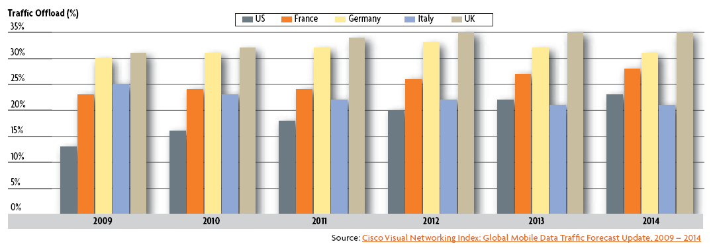
Overview of Femtocells
Why femtocells is needed?
Data offload is real and measurable.

Slide 7
Overview of Femtocells
The key attributes of femtocells:
Mature mobile technology
Operating in licensed spectrum
Generating coverage and capacity
Using internet-grade backhaul
At competitive prices
Fully managed by licensed operators
Question
What is the difference from WIFI: some control
What is different from microcell: backhaul

Slide 8
Overview of Femtocells
Vivek Dev, COO of Telefonica O2 Europe
“Our Apple iPhone and flat rate data tariffs place huge capacity demands on our networks. Because so much of that usage is at home, femtocells could play a crucial role in underpinning the explosive growth of mobile broadband usage.”
Frank Esser, CEO of SFR
“3G femtocells answer the needs of our mobile-centric strategy 100 per cent.”

Slide 9
1. Overview of Femtocells
2. A Brief History of Femtocells
3. Femtocell Standardization
4. Femtocell Models
5. Overview of Key Challenges

Slide 10
A Brief History of Femtocells
Early Origins
1980s:
“Small cells”
Cellular repeaters or “boosters”
1990s:
A precursor to cellular picocells
An indoor femtocell-like solution (Southwest Bell and Panasonic)
The birth of modern femtocells
March, 1999
Alcatel announced that they would bring to market a GSM home base station.
2002
Motorola engineers in Swindon claimed to have built the first complete 3G home base station.

Slide 11
A Brief History of Femtocells
Development of modern femtocells
2003
Chipset design company – picoChip – was demonstrating lower-cost 3G chipsets.
Mid-2004
Ubiquisys and 3Way networks were formed in the UK to develop their own 3G cellular home base stations.
2007
Products were demonstrated at the 3GSM conference.
The Femto Forum (www.femtoforum.org) was set up.
August, 2008
Commercial service was launched first by Sprint in the USA with their Airave CDMA offering.

Slide 12
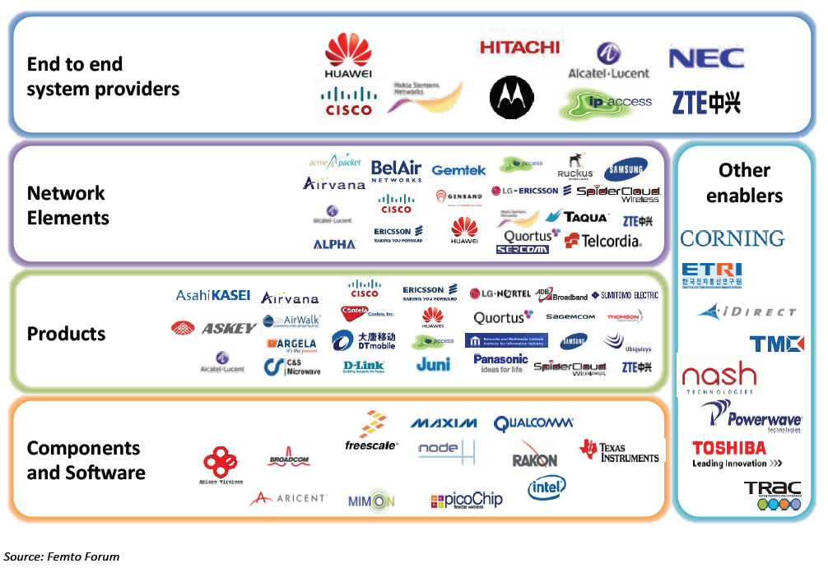
A Brief History of Femtocells
Femtocell ecosystem

Slide 13
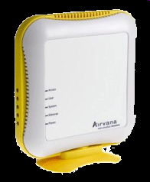
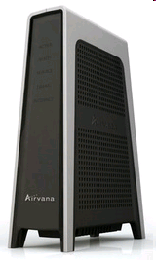
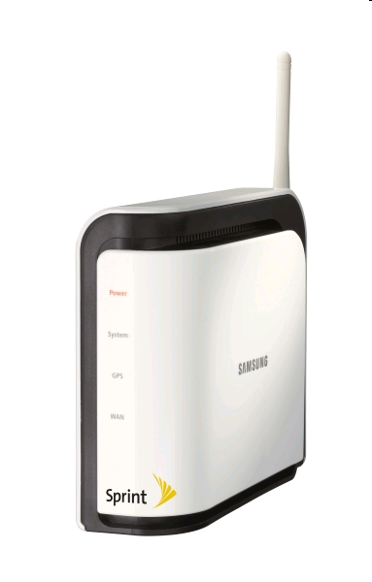
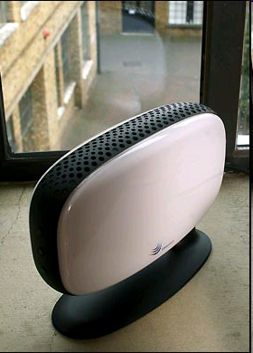
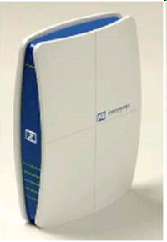
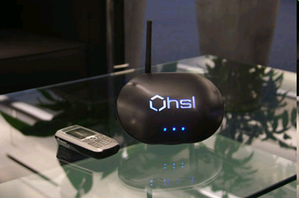
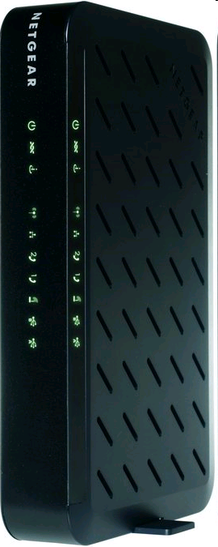
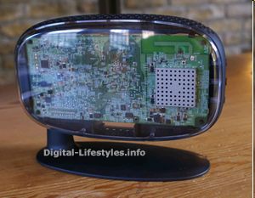
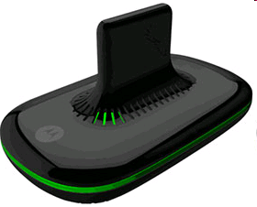
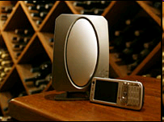
A Brief History of Femtocells
Femtocell products

Slide 14
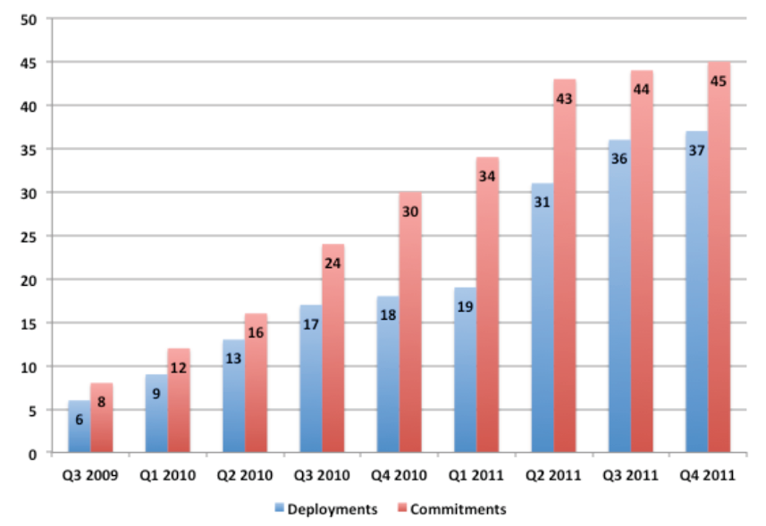
A Brief History of Femtocells
Femtocell service deployments and commitments

Slide 15
1. Overview of Femtocells
2. A Brief History of Femtocells
3. Femtocell Standardization
4. Femtocell Models
5. Overview of Key Challenges

Slide 16
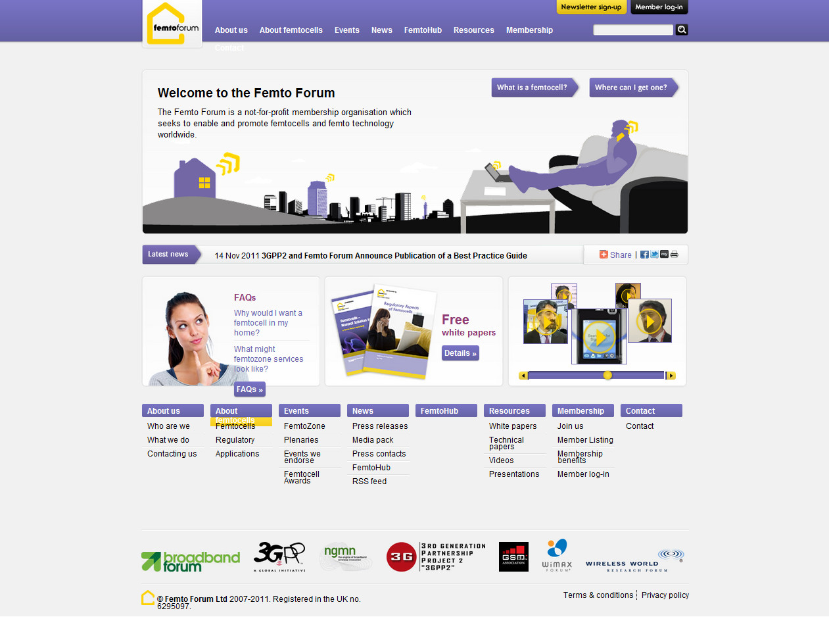
Femtocell Standardization
The governing body for standardization is the Femto Forum (www.femtoforum.org).

Slide 17
Femtocell Standardization
Mission:
The mission is to advance the development and adoption of small cells for the provision of high-quality 2G/3G/4G coverage and services within residential, enterprise, public and rural access markets.
3G or 4G
The Femto forum is active in two main areas:
Standardization, regulation & interoperability;
Marketing & promotion.

Slide 18
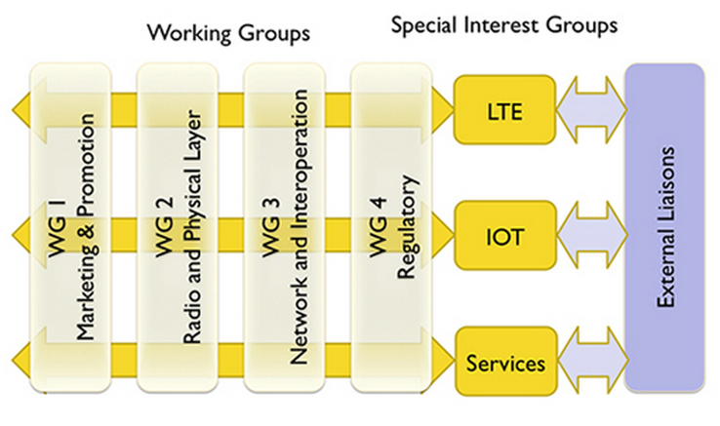
Femtocell Standardization
Working groups
The marketing & promotion group
The radio & physical layer group
The networks & interoperability group
The regulatory group

Slide 19
Femtocell Standardization
3GPP standards for UMTS femtocells
Interface between the femtocell (Home Node B - HNB) and the femto network gateway (HNB Gateway, HNB-GW)
Security protocols to authenticate femtocell (HNBs) and secure communications across the un-trusted Internet
Management protocols for “touch free” Operations, Administration, and Management (OA&M) of femtocells (HNB devices)

Slide 20
Femtocell Standardization
3GPP2 standards for CDMA femtocells
SIP/IMS-based 1x circuit services architecture
Packet data architecture
Security framework
Enhancements to mobile devices to make them more femto-aware
Foundations of femtozone services (Local IP Access and Remote IP Access)
Femtocell management architecture

Slide 21
Femtocell Standardization
The need for LTE femtocells
There is a limit to how many outdoor cell sites can be built;
The spectrum available to any particular operator is limited;
Cell site backhaul is expensive.
LTE is the first cellular technology which will be able to take full advantage of femtocell.
The large quantity of dynamically allocated time and frequency slots.

Slide 22
Femtocell Standardization
LTE architecture with deployed HeNB GW

Slide 23
1. Overview of Femtocells
2. A Brief History of Femtocells
3. Femtocell Standardization
4. Femtocell Models
5. Overview of Key Challenges

Slide 24
Femtocell Models
Traditional hexagonal grid model
Dozens of systems parameters can be modeled;
Other-cell interference can be modeled simply;
The results is sufficiently accurate to enable the evaluation of new proposed techniques.
Multi-tiered cellular model
Macrocells
Picocells
Femtocells
Possibly further radiating elements

Slide 25
Femtocell Models
Link level modeling
Channel status depend on a large number of factors
The propagation environment
Range & distance
Carrier frequency
Antenna placement
Antenna type
The channel behavior of femtocell channels is similar to WiFi channels.
Indoor, Winner II channel

Slide 26
Femtocell Models
System level model
Multi-tiered networks models begin with a spatial point process to statistically model the base station locations of each tier.
The simplest and best known such point process is the Poisson point process.
The base station positions are all independent which allows substantial tools to be brought to bear from stochastic geometry.

Slide 27
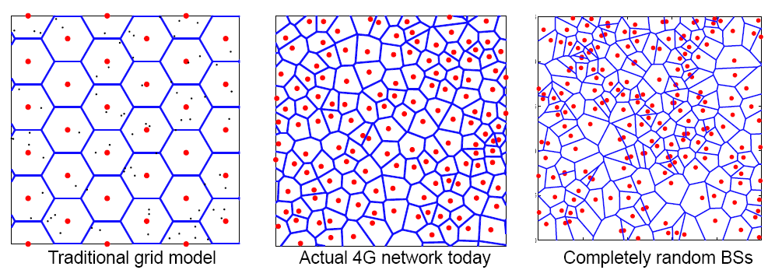
Femtocell Models
System level model

Slide 28
Femtocell Models
Femtocell access control model
Closed subscriber group (CSG)
Only pre-registered mobile users can use a certain femtocell.
Open subscriber group (OSG)
Any mobile can use any femtocell or at least one that is “open”.

Slide 29
Femtocell Models
Femtocell network model
Keep the grid model for macro base stations, drop femtocells “on top” of it, either randomly or in a deterministic fashion;
Focus on a single femtocell dropped in the cellular network;
Drop both the macrocells and femtocells randomly;
Keep all the channel gains and possibly even the various per-user capacities general, without specifying the precise spatial model for the various base stations.

Slide 30
1. Overview of Femtocells
2. A Brief History of Femtocells
3. Femtocell Standardization
4. Femtocell Models
5. Overview of Key Challenges

Slide 31
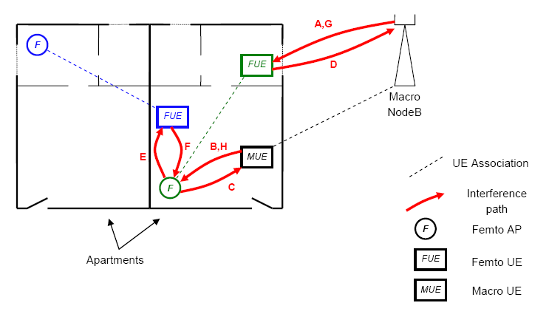
Overview of Key Challenges
Technical challenges
Interference scenario relationships

Slide 32
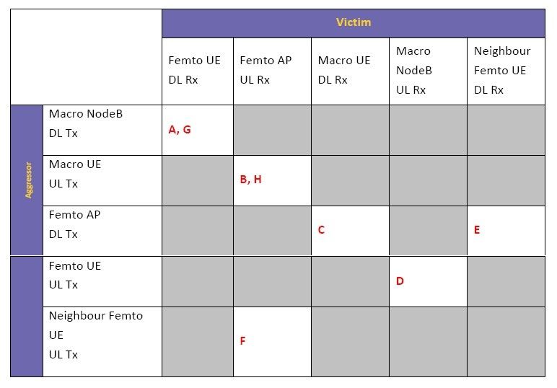
Overview of Key Challenges
Technical challenges
Interference scenario relationships

Slide 33
Overview of Key Challenges
Technical challenges
Interference level
With open-access and strongest cell selection, heterogeneous, multi-tiered deployments do not worsen the over all interference conditions or even change the SINR statistics.
Interference of femtocell networks in practice
Unregistered mobiles cause significant interference to the femtocell;
The signaling for coordinating cross-tier interference may be logistically difficult.

Slide 34
Overview of Key Challenges
Technical challenges
Interference coordination
3G CDMA femtos
power control strategies
Reserving a “femto-free” band
4G LTE femtos
Backhaul-based coordination
Dynamic orthogonalization
Subband scheduling
Adaptive fractional frequency reuse

Slide 35
Overview of Key Challenges
Technical challenges
Spectrum: Femtocells can use any and all of these standardized bands
Opening up spectrum bands
Re-using existing bands
Spectrum and economic efficiencies
Innovation and competition

Slide 36
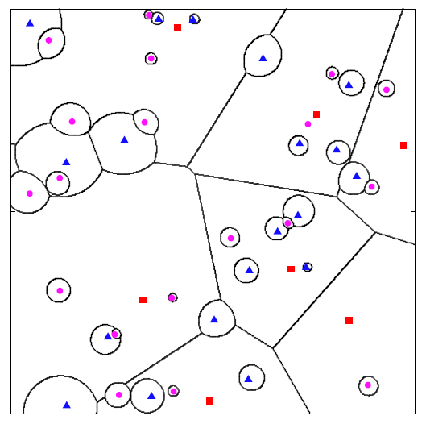
Overview of Key Challenges
Technical challenges
Cell association and biasing
assign each user to the strongest base station signal it receives

Slide 37
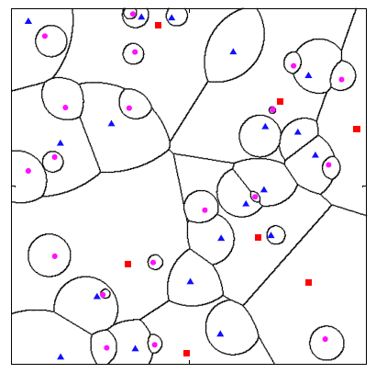
Overview of Key Challenges
Technical challenges
Cell association and biasing
Biasing: users are actively pushed onto small cells.

Slide 38
Overview of Key Challenges
Technical challenges
Cell association and biasing
How to inform a biased user its channel assignment?
How much biasing is “optimal”?
The throughput/QoS metric of interest
How users and the uarious base stations are distributed in space
Traffic patterns in space-time
The amount of adaptivity and side information the mobiles and small cell base stations are able to exploit

Slide 39
Overview of Key Challenges
Technical challenges
Mobility and soft handover
Femto-to-macro handover (outbound mobility)
Macro-to-femto handover (inbound mobility)
Possibly femto-to-femto handover
The most difficult aspect of femtocell mobility
Femtocells are not typically directly connected into the core network
Femtocells are typically unable to share a RNC with a macrocell or other femtocells.

Slide 40
Overview of Key Challenges
Technical challenges
Self-organizing networks (SON)
Femtocells must support an essentially plug-and-play operation
Considerable research attention
Automatic channel selection
Power adjustment
Frequency assignment for autonomous interference coordination
Coverage optimization
The autonomous shutting down and waking up of base stations for power savings

Slide 41
Overview of Key Challenges
Economic and Regulatory Issues
Operator Business Case
The cost of femtocells must be outweighed by the savings from offloading traffic from the macrocell networks;
Femtocells can be used to delay costly initial capital costs on macrocell network for operators deploying new 4G technology.
Subscriber and ISP incentives
Subscribers and enterprises become responsible for installing the femtocells while private ISPs provide the backhaul.

Slide 42
Overview of Key Challenges
Economic and Regulatory Issues
Femto vs. WiFi and Whitespace
WiFi: best-effort service;
Femto: managed service.
Regulatory benefits
Improved access
Spectrum efficiency
Innovation and opportunity

Slide 43
Overview of Key Challenges
Economic and Regulatory Issues
Regulatory aspects:
What is the impact of femtocells on spectrum licensing?
What about public health concerns?
What power levels do femtocells transmit?
How do operators stop users transmitting with femtocells on unauthorised frequencies or locations?
Could femtocells be “hacked”?
Do femtocells comply with existing standards?
How about the need to register base station locations?
What other regulatory issues should be considered?

Slide 44
Conclusion
Demand for cellular data services skyrockets
Femtocell
Organic plug-and-play deployment
Highly democratic cost
Possible chaos to the network
Forecast
Dense femtocell deployment
Economic and capacity benefit

Slide 45
Thank You !

