Slide 1
Location, Localization, and Localizability
Liu Y, Yang Z, Wang X et al.
JOURNAL OF COMPUTER SCIENCE AND
TECHNOLOGY, Mar. 2010
Slides prepared by Lanchao Liu and Zhu Han
ECE Department, University of Houston

Slide 2
Outline
Location
Localization
Physical Measurement and Single-Hop Positioning
Network-Wide Localization
Error Control for Network Localization
Localizability
Network Localizability
Node Localizability

Slide 3
Location information supports many fundamental network services
Routing
Topology Control
Coverage
Boundary Detection
Clustering
Medical care
Smart space
Logistics
Environment monitor
Mobile p2p

Slide 4
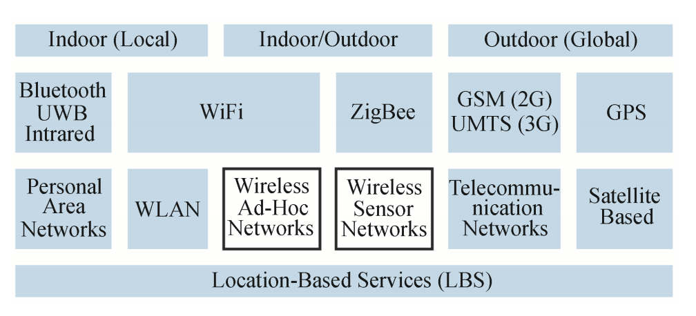
Location-based services for a wide range of wireless networks
Limitation of GPS and local positioning systems
Two stages
Measuring geographic information from the ground truth of network deployment;
Computing node locations according to the measured data.
Notes:
Narrow our scope a little bit, only focus on the wireless ad-hoc & wireless sensor networks.

Slide 5
Outline
Location
Localization
Physical Measurement and Single-Hop Positioning
Network-Wide Localization
Error Control for Network Localization
Localizability
Network Localizability
Node Localizability

Slide 6
Physical Measurement and Single-Hop Positioning Physical measurement classification
Notes:
Let’s go to the localization methods. It is difficult, to do localization without knowledge of the physical world. The Physical measurements can be classified as.......

Slide 7
Location | Distance | Angle | Area | Hop Count | Neighborhood
Directly obtain the position without any further computation
GPS
Deliberated deployed
Notes:
Too costly and impossible.

Slide 8
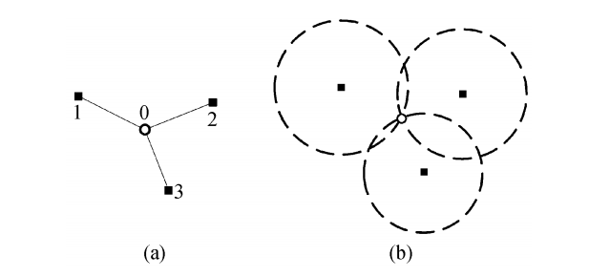
Location | Distance | Angle | Area | Hop Count | Neighborhood
Multilateration*: The distances from an unknown node to several references constrain the presence of this node
Notes:
An example of trilateration.

Slide 9
Location | Distance | Angle | Area | Hop Count | Neighborhood
Radio Signal Strength (RSS): noisy but cheap
path-loss exponent
fading effects
Received power at distance $d$
Received power at some reference distance $d_{0}$
Notes:
How to obtain distance information? Till to now, many ranging techniques are proposed and developed; among them, the radio signal strength based and time based ranging are two of the most widely used ones in existing designs.
More careful physical analysis of radio propagation may allow better use of RSS data

Slide 10
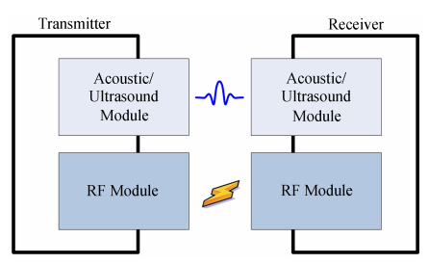
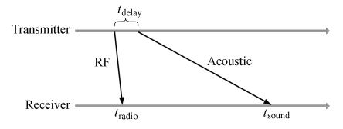
Location | Distance | Angle | Area | Hop Count | Neighborhood
TDoA: better resolution but costy
Need line-of-sight conditions
Notes:
Being accurate, TDoA systems suffer from high cost and are constrained by the line-of-sight condition.
Uncertainties: temperature, humility, synchronization & delay.

Slide 11
Location | Distance | Angle | Area | Hop Count | Neighborhood
Angle Of Arrival:
c
$$φ_{2}$$
$$φ_{1}$$
a
D
b
Notes:
The Angle of Arrival (AoA) data is typically gathered using radio or microphone arrays, which allow a receiver to determine the direction of a transmitter.
analyzing the phase or time difference between the signal arrivals at different microphones
Even more expensive than TDoA, need of spatial separation between microphone array.

Slide 12
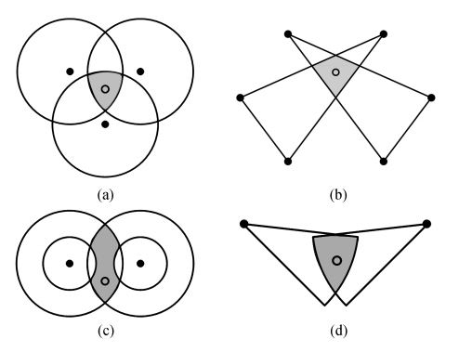
Location | Distance | Angle | Area | Hop Count | Neighborhood
Area measurement
Single Reference Area Estimation
distance and angle, etc.
Notes:
Compute the intersection of all overlapping coverage regions and choose the centroid as the location estimate
If an unknown node hears from several reference nodes, it can determine that it must lie in the geometric region described by the intersection of circles of radius
the shape of a single node's coverage is an annulus
when an angular sector and a maximum range Rmax can be determined for some radio antennas, the shape for a single node's coverage would be a cone with given angle and radius
Bound the error

Slide 13
Location | Distance | Angle | Area | Hop Count | Neighborhood
Multi-Reference Area Estimation
Approximate point in triangle (APIT)
The triangle formed by three arbitrary references
The node then decides whether it is inside or outside a given triangle.
Range measurement calibration and node density
The node simply finds the intersection of all overlapping coverage regions, and chooses the centroid as its position estimate
Notes:
PIT test. Moveable
The first one is that the range measurements are monotonic and calibrated to be comparable but are not required to produce distance estimates.
The second one assumes sufficient node density for approximating node movement.
Stable

Slide 14
Location | Distance | Angle | Area | Hop Count | Neighborhood
Hop Count Measurements
D = $h_{ij}∗R$
Number of hops
Communication range
The expected number of neighbors per node
D = $h_{ij}∗d_{hop}$
Notes:
approximation
If two nodes can communicate by radio, their distance from each other is less than R (the maximum range of their radios) with high
probability, many delicate approaches are designed for accurate localization.
N should be larger than 15

Slide 15
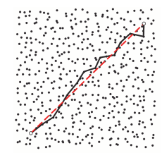
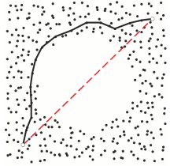
Location | Distance | Angle | Area | Hop Count | Neighborhood
Failed in anisotropic network ！
Notes:
Cost effective. Need high density of the nodes.
Failed in anisotropic network

Slide 16
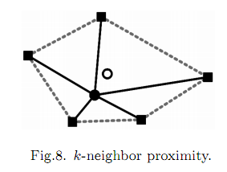
Location | Distance | Angle | Area | Hop Count | Neighborhood
Neighborhood Measurement
Reference nodes periodically emit beacons including their location IDs. Unknown nodes use the received locations as their own location, achieving a course-grained localization.
Very cheap
K-nearest neighbor
approximation
Centroid
Notes:
Reference nodes periodically emit beacons including their location IDs. Unknown nodes use the received locations as their own location, achieving a course-grained localization. The major advantage of such a neighbor proximity approach is the simplicity of computation.

Slide 17
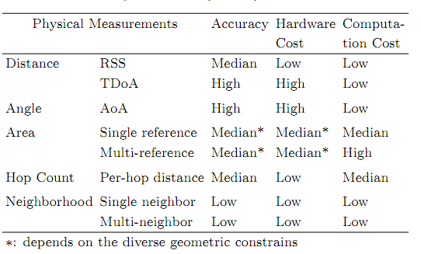
Comparative Study & Future work
Promising technique: UWB and Chirp Spread Spectrum

Slide 18
Outline
Location
Localization
Physical Measurement and Single-Hop Positioning
Network-Wide Localization
Error Control for Network Localization
Localizability
Network Localizability
Node Localizability

Slide 19
Network-Wide Localization
Computation Organization
Centralized: Network nodes collect environmental data and send back to a base station for analysis.
Multi-dimension scaling (MDS)
Semi-Definite programming (SDP)
Distributed:
Beacon-based, top-down manner
Local map based, bottom-up manner
Notes:
Centralized: powerful computational capabilities
high communication cost

Slide 20
Centralized | Distributed
Multi-Dimensional Scaling (MDS) $(O\left(n^{3}\right))$
Generate an n * n matrix M, whose (i; j) entry contains the estimated distance between nodes i and j
Apply classical metric-MDS on M to determine a map that gives the locations of all nodes in relative coordinates
Transform the solution into global coordinates based on some number of fixed anchor nodes

Slide 21
Centralized | Distributed
Semi-Definite Programming (SDP)
Geometric constraints between nodes are represented as linear matrix inequalities (LMIs). The LMIs can be combined to form a single semi-definite program, which is solved to produce a bounding region for each node.
Concise problem formulation, clear model representation, and elegant mathematic solution……but the constraints should be convex.

Slide 22
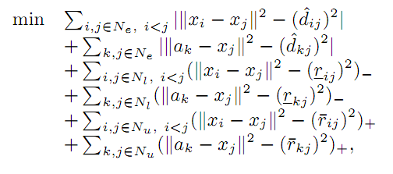
An example:
Biswas, P. and Yinyu Ye, “Semidefinite programming for ad hoc wireless sensor network localization”, IPSN,2004

Slide 23
Centralized | Distributed
Beacon Based Localization (top down manner)
Distance vector(DV)-hop: to the reference node
DV distance: if inter-node distance is known
Iterative localization: unknown to known, step by step
Notes:
These distances are propagated from reference nodes to unknown nodes using a basic distance-vector technique.
Cumulative error

Slide 24
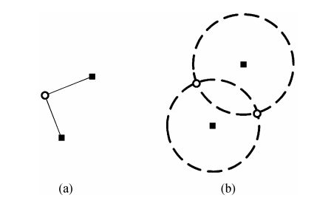
Centralized | Distributed
Multilateration-based algorithms require an average node degree beyond 10.
To make localization applicable for sparse networks, Sweeps partially relaxes the requirement of node dependence.
In this example,
two possible locations
Notes:
Sweeps adopts a new positioning scheme, called bilateration, to compute the candidate positions of a node by utilizing only two ranging measurements.
Similar to multilateration, the finitely localized node, called swept node, can act as a reference node to localize other nodes.
Sweeps checks the consistency among the candidate position sets and deletes those incompatible items.

Slide 25
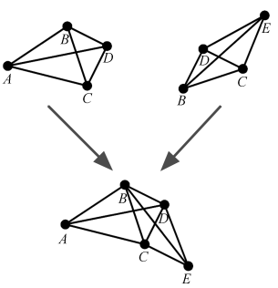
Centralized | Distributed
Coordinated System Stitching (jig-saw puzzle)
Notes:
Split the network into small overlapping sub-regions. Very often each sub-region is simply a single node and its one-hop neighbors.
For each sub-region, compute a “local map”, which is essentially an embedding of the nodes in the sub-region into a relative coordinate system.
Finally, merge sub-regions using a coordinate system registration procedure.

Slide 26
Centralized | Distributed
Coordinated System Stitching
Split the network into small overlapping subregions. Very often each sub-region is simply a single node and its one-hop neighbors.
For each sub-region, compute a “local map”, which is essentially an embedding of the nodes in the sub-region into a relative coordinate system.
Merge sub-regions using a coordinate system registration procedure.

Slide 27
Centralized | Distributed
How to produce robust local maps
Shortest side
Smallest angle
Threshold
Notes:
FLIP
Tendency to orphan nodes

Slide 28
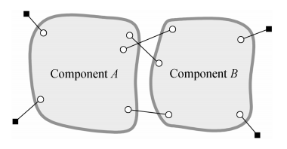
Centralized | Distributed
Component Based Localization
Rigid Structure
Notes:
A component is defined as a group of nodes that form a rigid structure.
The component-based localization algorithms are applicable for sparse networks.

Slide 29
Comparative Study & Future work
Beacon nodes
In a convex hull around the network
In the center of the network
Node Density
High density may not be always true
Accuracy
Location accuracy trades off with location precision
Cost
Hardware cost: node density, beacon density, and measurement equipment
Energy cost: communication

Slide 30
Obtaining a Pareto improvement is a major challenge
Device-Free Localization
Notes:
Application specific.
For some applications, however, the to-be-locate objects cannot participate in localization and it is also diffcult to attach networked nodes to them.

Slide 31
Outline
Location
Localization
Physical Measurement and Single-Hop Positioning
Network-Wide Localization
Error Control for Network Localization
Localizability
Network Localizability
Node Localizability

Slide 32
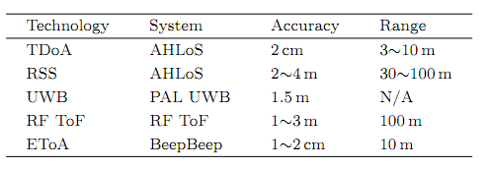
Error Control for Network Localization
Noisy Distance Measurement
Extrinsic: Physical effects on the measurement channel (multipath, shadowing…)
Intrinsic: Hardware limitation
Errors in Distance Measurements

Slide 33
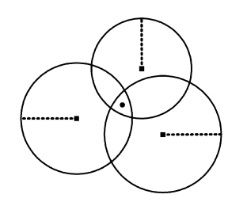
Error Control for Network Localization
Negative Impact of Noisy Ranging Results
Uncertainty
Non-Consistency
Error Propagation
Notes:
The computed result, however, is varying if different groups of references are chosen, resulting in non-consistency.
Iterative manner

Slide 34
Error Control for Network Localization
Error Characteristics of Localization
Creamer Rao Lower Bound (CRLB)
CRLB for Multihop Localization*
CRLB for One-Hop Localization
Notes:
Limited to unbiased estimators.

Slide 35
Error Control for Network Localization
Geographic Dilution of Precision
Variance of the estimate location
Angle between each pair of reference nodes
The ranging error
The geometric relationship of references and to be
localized nodes

Slide 36
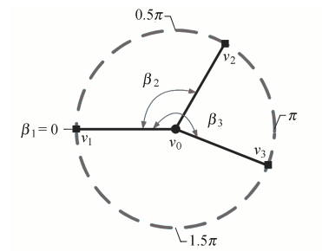
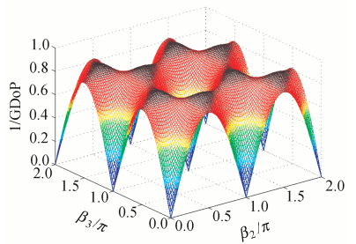
Geographic Dilution of Precision (GDoP): $\frac{σ_{0}}{σ}$
Highest location accuracy would be achieved if reference nodes are evenly separated

Slide 37
Error Control for Network Localization
Location Refinement
Framework of Location Refinement
Node Registry: Location + Confidence
Reference Selection: Selects the reference achieving the highest estimate confidence
Registry Update

Slide 38
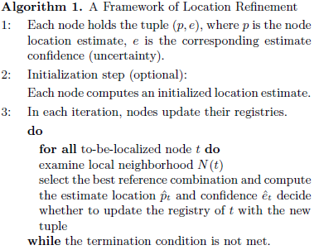
Framework of location refinement

Slide 39
Error Control for Network Localization
Location Refinement
Framework of Location Refinement
Metrics for Location Refinement
Analyze the performance both on noisy distance measurements and location uncertainly of reference.
Quality of Trilateration

Slide 40
Location Estimate
Estimated location error caused by noisy distance measurements
The error due to location uncertainty of references

Slide 41
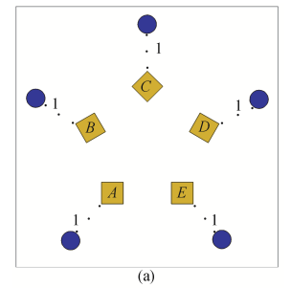
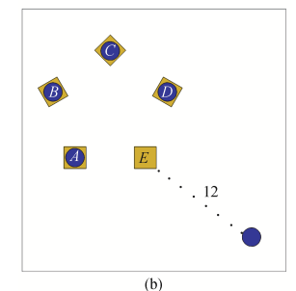
Error Control for Network Localization
Robust Localization
Severe errors can be seen as outliers of measurements that significantly deteriorate localization accuracy.
Amortize errors

Slide 42
Outline
Location
Localization
Physical Measurement and Single-Hop Positioning
Network-Wide Localization
Error Control for Network Localization
Localizability
Network Localizability
Node Localizability

Slide 43
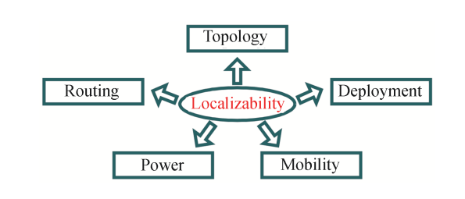
Localizability can assist network operation and management
Location-uniqueness
Notes:
Localizability assists localization fundamentally and importantly.
Being aware of localizability is of great benefit to many aspects of network operation and management, including topology control, network deployment, mobility control, power scheduling, and geographic routing

Slide 44
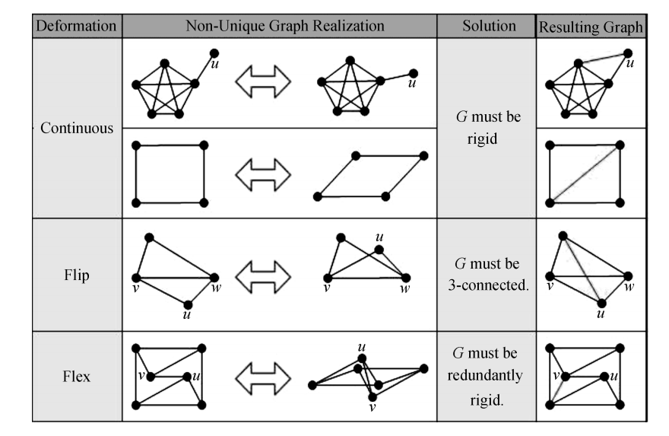
Network Localizability
Globally Rigid Graphs
Notes:
globally rigid graph: A graph is generically globally rigid if it is uniquely realizable under translations, rotations, and refections.

Slide 45
Network Localizability
Conditions for Network Localizability
Theorem 1: A graph with n >= 4 vertices is globally rigid in 2 dimensions if and only if it is 3-connected and redundantly rigid.
Theorem 2: A network is uniquely localizable if and only if its distance graph is globally rigid and it contains at least three anchors.

Slide 46
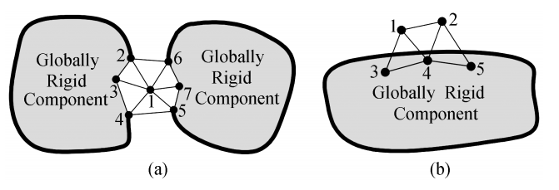
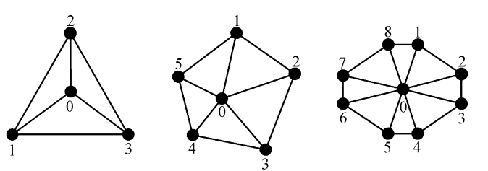
Inductive Construction of Globally Rigid Graphs
Network Localizability
Deficiency of trilateration
WHEEL!

Slide 47
Outline
Location
Localization
Physical Measurement and Single-Hop Positioning
Network-Wide Localization
Error Control for Network Localization
Localizability
Network Localizability
Node Localizability

Slide 48
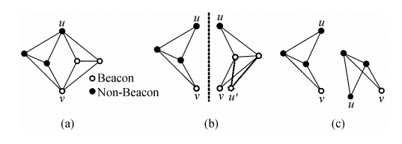
Node Localizability
The results derived for network localizability cannot be directly applied
Given a network configuration, whether or not a specific node is localizable?
How many nodes in a network can be located and which are them?
u is uniquely localizable, although the 3 connectivity property does not hold

Slide 49
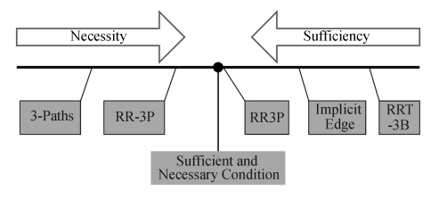
Node Localizability
Studies show that a vertex is localizable if it belongs to the redundantly rigid component of B in which there exists 3 vertex-disjoint paths connecting it to 3 beacon vertices.(RR3P)

Slide 50
Conclusion
Location
Localization
Localizability

Slide 51
Thank You!
Q & A

