Slide 1
An Introduction of Non-Orthogonal Multiple Access (NOMA) for 5G Wireless Networks
Huaqing Zhang
Wireless Networking, Signal Processing and Security Lab
Department of Electrical and Computer Engineering
University of Houston, TX, USA
Sep. 2016

Slide 2
Overview
Evolution of Multiple Access Technology
Non-Orthogonal Multiple Access (NOMA)
Research Challenges and Future Directions
Reference
Conclusion

Slide 3

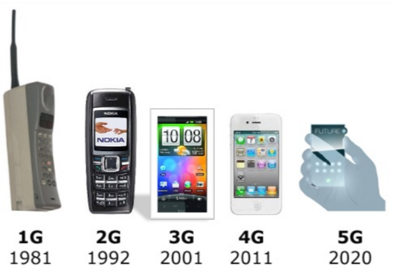
Evolution of Wireless
Evolution

Slide 4

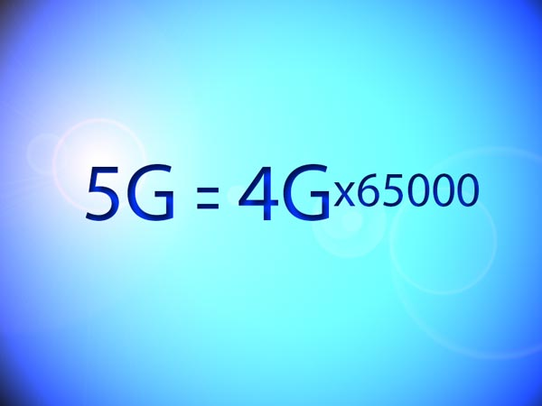
Data Transmission Speed
2014 Samsung tested a connection that reached speeds as high as 7.5 Gbps
LTE (100 Mbps)
HSPA+ (30 Mbps)
HSPA (5 Mbps)
bps
UMTS (348 kbps)
GPRS (48 kbps)
In Feb, 2015, researchers at the University of Surrey’s 5G Innovation Centre (5GIC) managed speeds of 1 Tbps
GSM（9.6 kbps)
Notes:
GSM(Global System for Mobile Communications)
GPRS(general packet radio service)
UMTS(Universal Mobile Telecommunications System)
HSPA(High Speed Packet Access)
EDGE (Enhanced Data rates for Global Evolution)

Slide 5
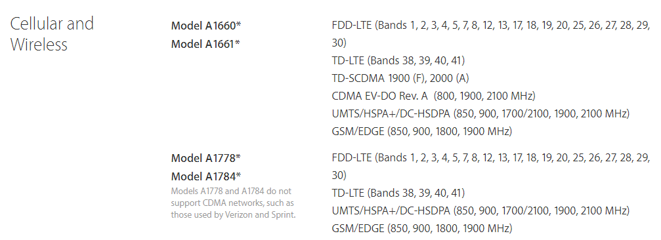
Start with IPHONE 7

Slide 6
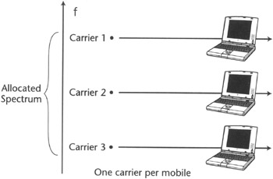


1G Technology
First introduced in 1980s and completed in early 1990s.
Analog signal
Typically 150 MHz and up
Voice only
Speed was upto 1.4 kbps.
FDMA
AMPS was first lauched in USA in 1G mobile systems
Notes:
Advanced mobile phone system (AMPS)
Dr. Martin Cooper of Motorola
$3995 30 mins
2 pounds
DynaTAC 8000X

Slide 7
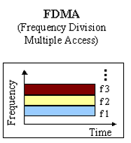
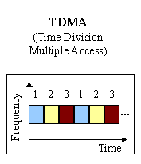
2G Technology
Launched in Finland in 1991.
Digital signals.
Services such as text messages, picture messages and MMS (Multi Media Message)
Originally designed on 900MHz range, now also available on 800MHz, 1800MHz and 1900 MHz ranges.
Carrier frequency 200 kHz
Allow multiple users in a single channel
Notes:
Global System for Mobile Communications (GSM)

Slide 8
3G Technology
2G
IS-95
GSM
IS-136 & PDC
GPRS
2.5G
IS-95B
HSCSD
EDGE
UMTS
CDMA2000-1xRTT
W-CDMA
3G
CDMA2000-1xEV,DV,DO
EDGE
CDMA2000-3xRTT
TD-SCDMA
CDMA2000
3GPP2
3GPP
Notes:
Global System for Mobile Communications (GSM)
GPRS(general packet radio service)
Circuit switch vs packet switch
EDGE (Enhanced Data rates for Global Evolution)
modulation technique from GMSK to 8PSK ;
Channel coding technology
UMTS(universal mobile telecommunications service)

Slide 9
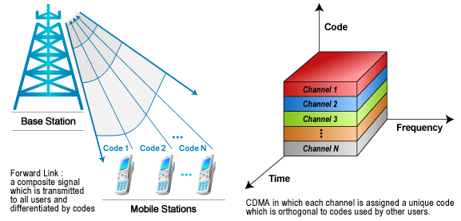
CDMA
Carrier frequency 5 MHz
Near-far problem
Notes:
Circuit switch vs packet switch

Slide 10
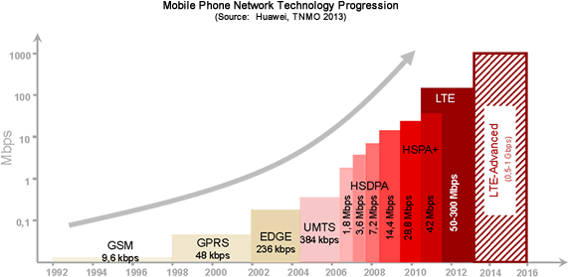
4G Technology
TDMA
CDMA
OFDMA
3GPP Release 8
Notes:
Release 5 to release 10

Slide 11
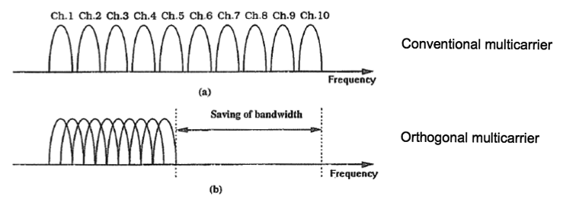
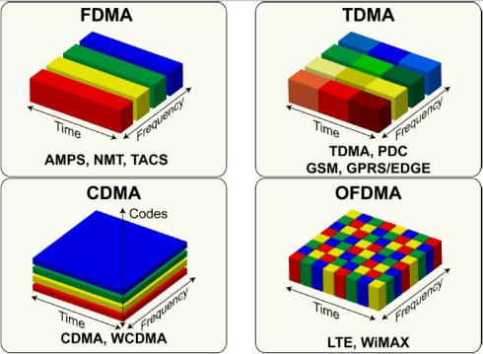
OFDMA

Slide 12
Why 5G
Internet of Things (IoT)
Wearable Devices
Vehicle-to-Vehicle Communications
Videos Conference
Smart Vehicles
4K Videos …

Slide 13
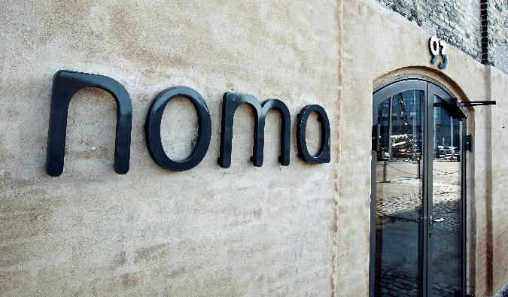
NOMA
Time + Code + Frequency
+
Power ?
NOMA
Notes:
Denmark

Slide 14
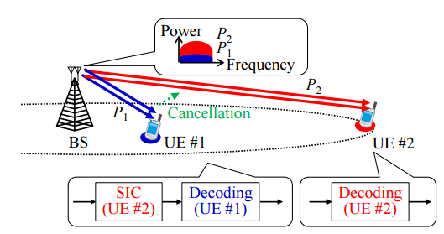
PD-NOMA
Notes:
successive interference canceller (SIC)

Slide 15
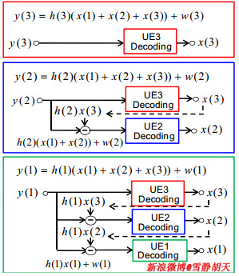
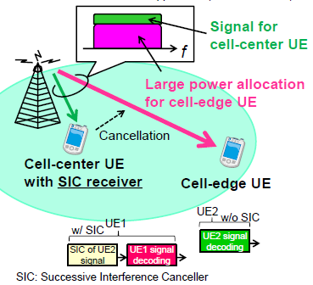
PD-NOMA
Far
Close

Slide 16
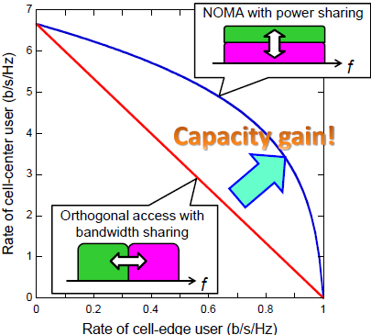
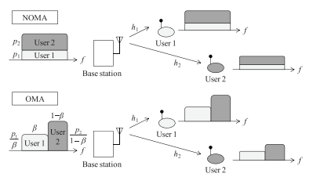


Reason of Improvement
Downlink
OMA
PD-NOMA
——Kenichi Higuchi, Anass Benjebbour, Non-orthogonal Multiple Access (NOMA) with Successive Interference Cancellation for Future Radio Access

Slide 17
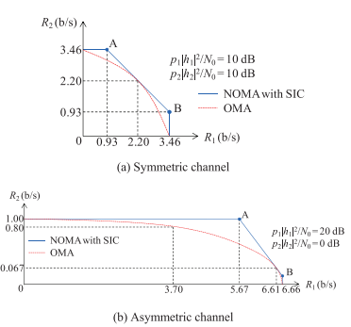

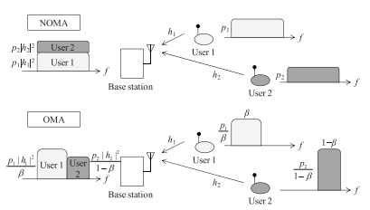


Reason of Improvement
Uplink
OMA
PD-NOMA
or
——Kenichi Higuchi, Anass Benjebbour, Non-orthogonal Multiple Access (NOMA) with Successive Interference Cancellation for Future Radio Access

Slide 18
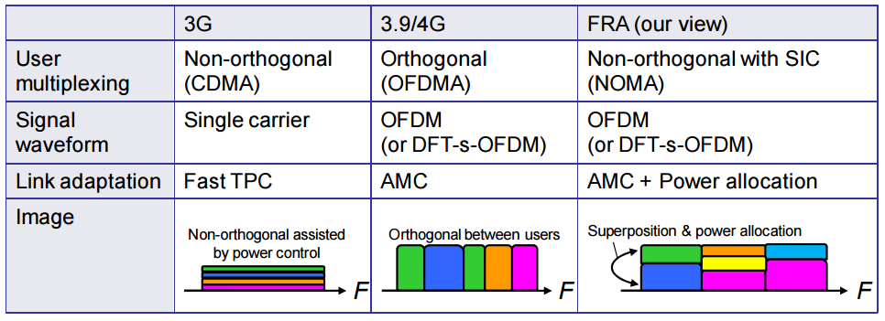
Comparison
Notes:
AMC (adaptive modulation coding)
TPC (transmit power control)

Slide 19
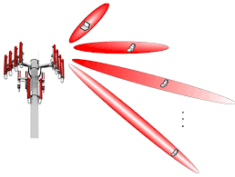
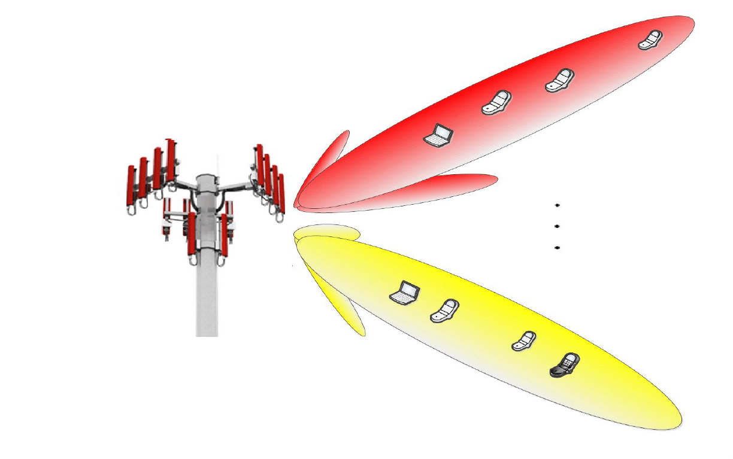
PD-NOMA+Beamforming

Slide 20
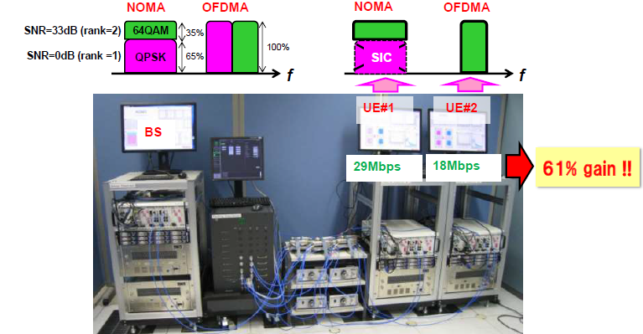
Testbed for Downlink PD-NOMA
Link-level performance
From NTT docomo

Slide 21
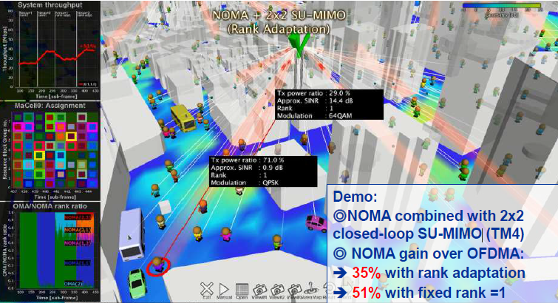
Testbed for Downlink PD-NOMA
System-level performance
@Dense urban area (Shinjuku, Tokyo)
From NTT docomo

Slide 22
Testbed for Downlink PD-NOMA

Slide 23
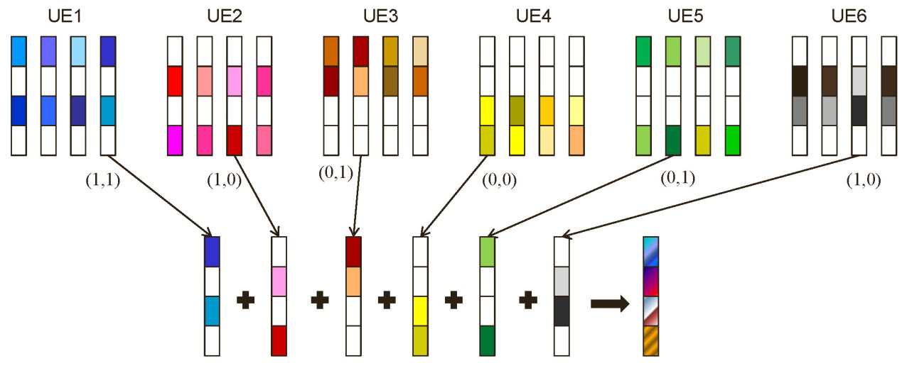
CD-NOMA
Sparse Code Multiple Access (SCMA)
Codebooks

Slide 24
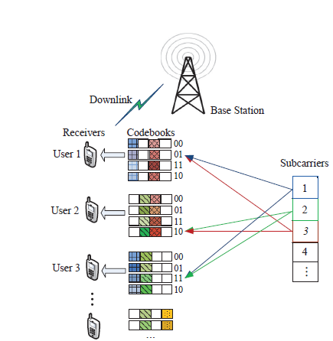
CD-NOMA

Slide 25
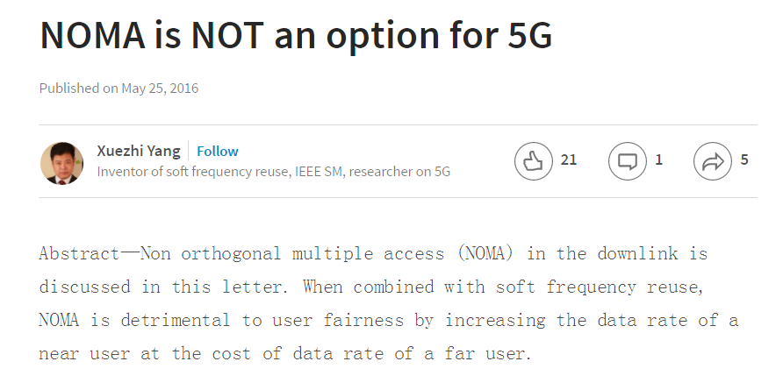
Challenges
Notes:
proposed for study at LTE Release 13, why still no result?

Slide 26

Challenges
Grouping and Fairness of users sharing the same sub-band
Resource allocation on spectrum, time, power, space
Multi-cell NOMA Transmissions
High equipment requirements on the end users.

Slide 27

Future Directions
PD-NOMA
Sub-band allocation
Power allocation (Fairness)
CD-NOMA
Research Directions
Sub-band allocation
Hybrid NOMA
MIMO NOMA
Cooperative NOMA
Cognitive NOMA

Slide 28
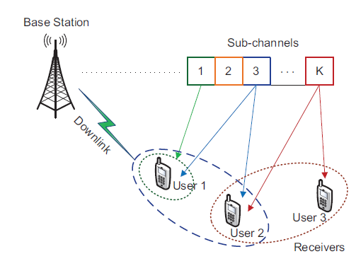
Sub-band Allocation (PD)
Coalition game
Difference of Channel gain
Service Demands

Slide 29

Power Allocation (PD)
Non-cooperative game
The Stronger, The Better
The Weaker, The Better
Notes:
Pricing; bargaining

Slide 30
Sub-band Allocation (CD)
Matching Theory
Sub-bands
……
Users
Codebooks
Preference list
Many-to-Many Two sided problem

Slide 31
Hybrid NOMA
Evolutionary Game
OMA/NOMA
PD-NOMA/CD-NOMA
……
Users
Graphical Game

Slide 32
MIMO NOMA
Multi-level Game
Sub-bands
Time
Space
Power
……
Users
Stackelberg game
Virtualization

Slide 33

Cooperative NOMA
Relaying
end user
relay
relay
end user
end user

Slide 34
Cognitive NOMA
Primary user: user 1
Secondary user: user 2
The performance of user 1 should be guaranteed when user 2 is joined.
user 2
user 1 (Strong Interference)

Slide 35
Reference
Lingyang Song, Yonghui Li, Zhiguo Ding and H. Vincent Poor, "Resource Management in Non-orthogonal Multiple Access Systems: State of the Art and Research Challenges"
Zhiguo Ding, Yuanwei Liu, Jinho Choi, Qi Sun, Maged Elkashlan, Chih-Lin I and H. Vincent Poor, "Application of Non-orthogonal Multiple Access in LTE and 5G Networks
NTT DOCOMO, inc., "DOCOMO 5G White Paper"
Anass Benjebbour, Anxin Li, Yuya Saito, Yoshihisa Kishiyama, Atsushi Harada and Takehiro Nakamura, "System-Level Performance of Downlink NOMA for Future LTE Enhancements"
Kenichi Higuchi, Anass Benjebbour, Non-orthogonal Multiple Access (NOMA) with Successive Interference Cancellation for Future Radio Access
Reference

Slide 36

Conclusions
Multiple Access Evolution from 1G to 4G
Introduction of NOMA
PD-NOMA
CD-NOMA
Challenges of NOMA and future works
Conclusions

Slide 37
Thank You!
Huaqing Zhang
markasjunior@gmail.com
Wireless Networking, Signal Processing and Security Lab
Department of Electrical and Computer Engineering
University of Houston, TX, USA

