Slide 1
A Framework of Belief Propagation for Cognitive Radio Security
Zhou Yuan
2012
Wireless Networking, Signal Processing and Security Lab
Electrical and Computer Engineering Department
University of Houston

Slide 2
Outline
Introduction
  Dynamic spectrum access and cognitive radio
  Security issues in cognitive radio systems
  Belief propagation
Works
  Defense primary user emulation (PUE) attack in cognitive radio networks
  Routing-toward-primary user (RPU) attack in cognitive radio networks and corresponding defense strategy

Slide 3
Outline
Introduction
  Dynamic spectrum access and cognitive radio
  Security issues in cognitive radio systems
  Belief propagation
Works
  Defense primary user emulation (PUE) attack in cognitive radio networks
  Routing-toward-primary user (RPU) attack in cognitive radio networks and corresponding defense strategy

Slide 4
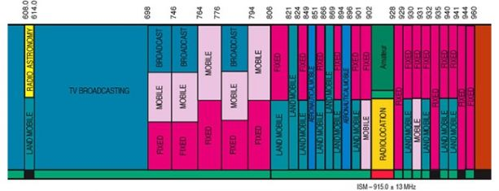
Spectrum Is A Natural Resource
Finite
Renewable
Administered
  Licensed/ primary
  Unlicensed/ secondary
Notes:
1.Today’s technology can only operate on certain frequencies; commercially usable frequencies are a scarce commodity.
2.Airwaves used to broadcast any transmission can be reused after the broadcast is completed.
4. To avoid interference from competing broadcast transmissions, frequency assignments are managed by recognized authorities.

Slide 5
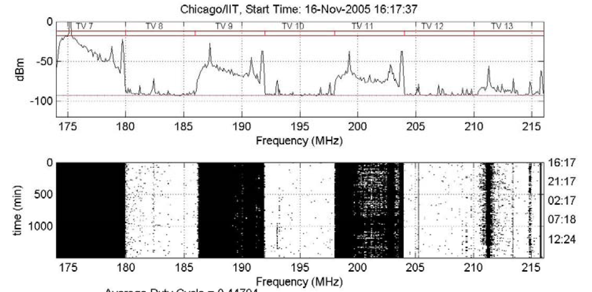
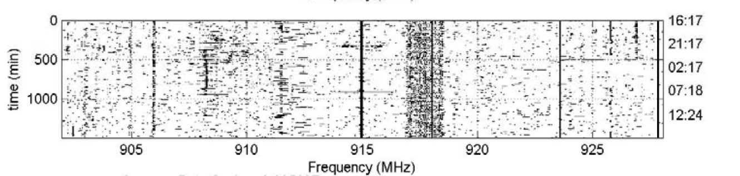
Dynamic Spectrum Access
Less than 5% of prime spectrum is used EVERYWHERE and ALL THE TIME → these “white spaces” change with time and location!
Need mechanisms that promote spectrum reuse and sharing
Policy makers need to work with technologists to enable better spectrum policies
  Dynamic spectrum access!
Notes:
Underlay, overlay

Slide 6
Cognitive Radio (CR)
Cognitive radio=software-defined radio + cognitive engine
Definition of cognitive radio:
  “A radio frequency transceiver designed to intelligently detect whether a particular segment of the radio spectrum is in use, and to jump into (and out of) the temporarily unused spectrum very rapidly, without interfering with the transmission of other authorized users.”
Notes:
Software-defined radio (SDR): A radio transmitter and/or receiver employing a technology that allows the RF operating parameters like frequency range, modulation type, or output power to be set or altered by software

Slide 7
Characteristics of Cognitive Radio
Three CR technical features
  Obtain the knowledge of radio operational and geographical environment;
  Dynamically adjust operational parameters and protocols according to the knowledge;
  Learn from the results of its actions to further improve its performance.

Slide 8
Outline
Introduction
  Dynamic spectrum access and cognitive radio
  Security issues in cognitive radio systems
  Belief propagation
Works
  Defense primary user emulation (PUE) attack in cognitive radio networks
  Routing-toward-primary user (RPU) attack in cognitive radio networks and corresponding defense strategy

Slide 9
Security Issues in Cognitive Radio Systems
CR systems face unique security challenges.
Existing attacks for CR networks
  Physical layer
  MAC layer
  Network layer
Security in CR systems is not fully studied yet.
Notes:
Physical layer: PUE/ Reporting false sensing data (RFSD) attack
MAC layer: Common Control Channel (CCC) Attack/ Reporting False Selection Frame/ False Evacuation
Network layer: Blackhole, wormhole. The goal of the various attacks is mainly to reduce the network throughput.
However, all of these attacks above are discovered in wireless mesh/sensor/ad hoc networks, without considering much about the cognitive radio system model and existence of the primary users.
Many of the security challenges are due to the fact that the networks inherently rely on cooperation among distributed entities. Cooperation can be fragile under malicious attacks.

Slide 10
Outline
Introduction
  Dynamic spectrum access and cognitive radio
  Security issues in cognitive radio systems
  Belief propagation
Works
  Defense primary user emulation (PUE) attack in cognitive radio networks
  Routing-toward-primary user (RPU) attack in cognitive radio networks and corresponding defense strategy

Slide 11
Belief Propagation (BP)
Efficient way to solve inference problems
  By propagating local messages around neighborhoods
Applied in various problems
  Computer vision
  AI
  Statistical physics
  Coding theory

Slide 12
Markov Random Field
y₁
y₂
y_{i}: observed nodes
x_{i}: hidden nodes
Local function,
Compatibility function,
Joint probability:
Marginal probability:
x₁
x₂
y_{i}
x_{i}
y_{n}
x_{n}
Notes:
Local function: Phi
Compatibility function: Psi (s ai)

Slide 13
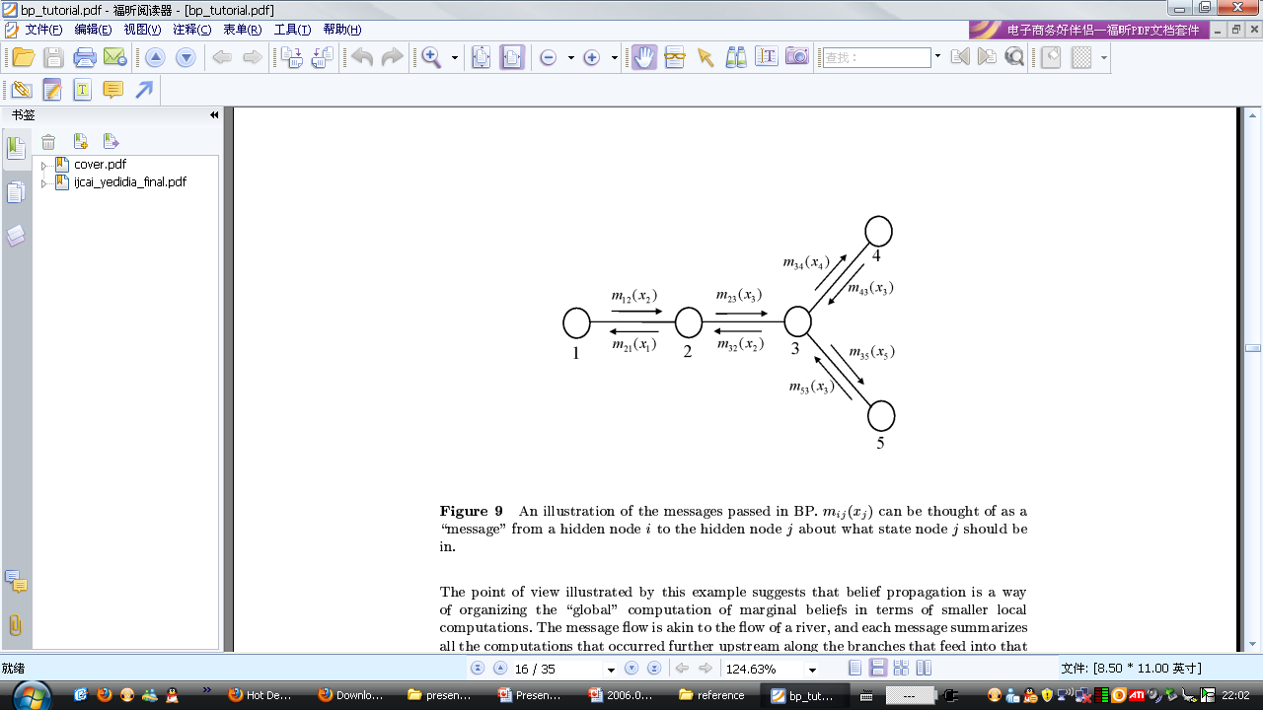
Message in Belief Propagation
Message m_{ij}(x_{j})
  From a hidden node i to the hidden node j
  About what state node j should be in.

Slide 14
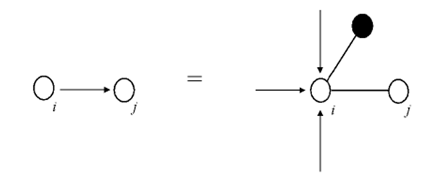

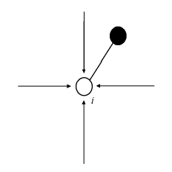
Update Message & Calculate Belief
Message update rule:
Message from i to j
Message from k to i
Local Function
Compatibility Function
Belief calculation:

Slide 15
Belief Propagation Example
4
1
3
Local Function
Compatibility Function
5
Belief

Slide 16
Outline
Introduction
  Dynamic spectrum access and cognitive radio
  Security issues in cognitive radio systems
  Belief propagation
Works
  Defense primary user emulation (PUE) attack in cognitive radio networks
  Routing-toward-primary user (RPU) attack in cognitive radio networks and corresponding defense strategy

Slide 17
Main Contributions
Belief propagation based defense against PUE attack
  Converges fast
  Effective and efficient to find the attacker
Flexible for modification and simplification
  Easily extended to detect various other kinds of attacks
No additional cost for new hardware
  Avoid deployment of an additional sensor network
  Avoid deployment of expensive hardware for TOA and FOA
Major publication
  Accepted to IEEE Journal on Selected Areas in Communications (JSAC): Cognitive Radio Series

Slide 18
Primary User Emulation (PUE) Attack
Attacker mimic PU TX signal characteristics.
Other SUs erroneously identify the attacker as a PU.
The attacker can access the spectrum,
while other SUs waiting for the idle licensed spectrum.
Simple simulation results show
  PUE attack can increase spectrum access failure probability from 10% to 60% when there are 5 channels.

Slide 19
Detect PUE Attacker By Interaction Between Neighboring Users
Assumptions:
  Each secondary user is equipped with a localization unit.
  Locations of PUs are fixed (TV towers), also known to SUs.
  A PUE attacker is a SU
    Able to change its modulation mode, frequency, location and transmission output power.
A transmitter verification scheme by calculating the location of PUE attacker is proposed
  Received signal strength (RSS) measurement
  Determine the location of the attacker by interactions between neighboring users.

Slide 20
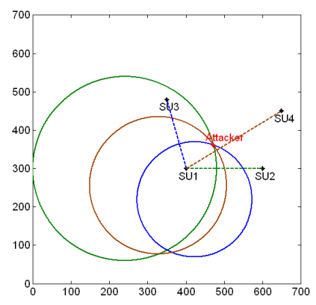
Detect PUE Attacker By Interaction Between Neighboring Users
Each SU can plot a circle based on the RSS from the attacker.
Three circles can determine the location of the attacker, which is different from the PUs’ locations.
In practical there is no common intersection point between three circles.
  Due to noise and shadowing fading
location detection strategies by interactions between neighboring users

Slide 21
Detect PUE Attacker Using BP
Single user detection can be inaccurate and noisy.
  To improve accuracy, joint detections from different users are required.
How to efficiently combine the joint detections?
  Belief propagation is a mathematical tool
    Fast calculation of marginal probabilities
    Computation complexity grows only linearly with the increasing number of users
Notes:
Local function, compatibility function
Phi, Psi
Honest, belief > threshold
Malicious, belief < threshold

Slide 22
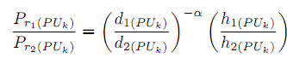
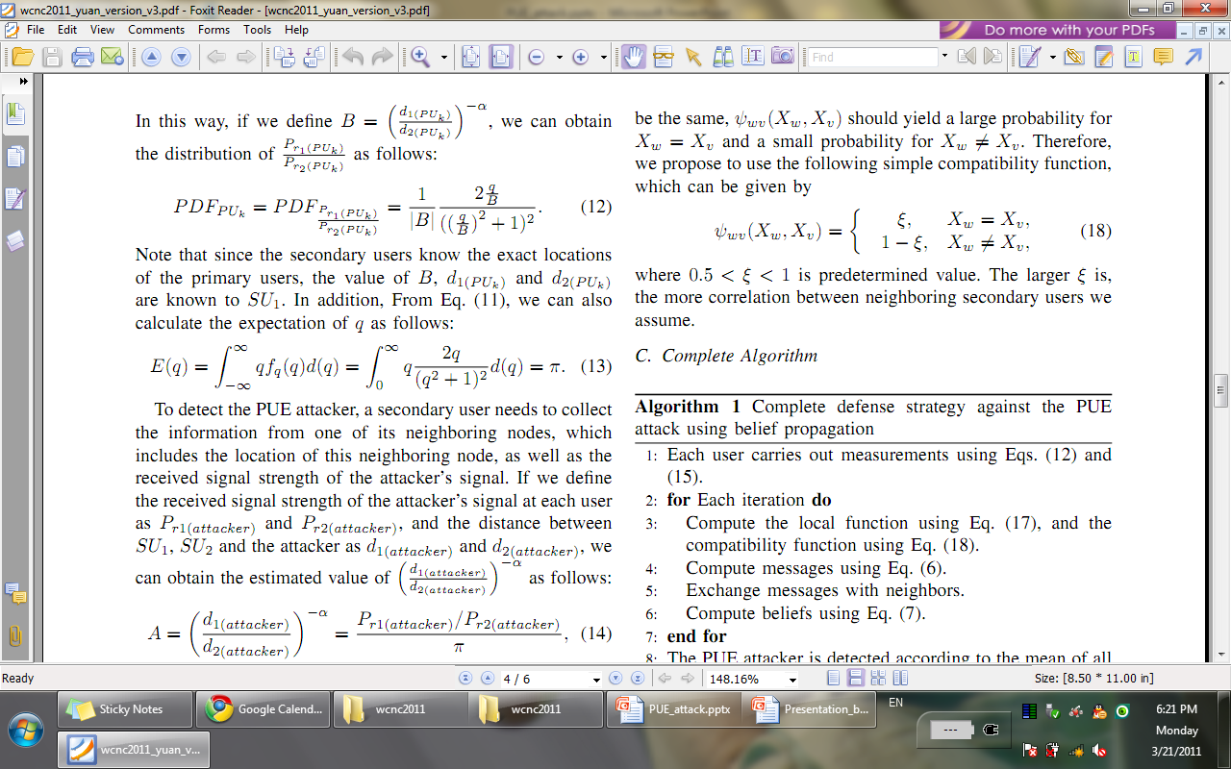
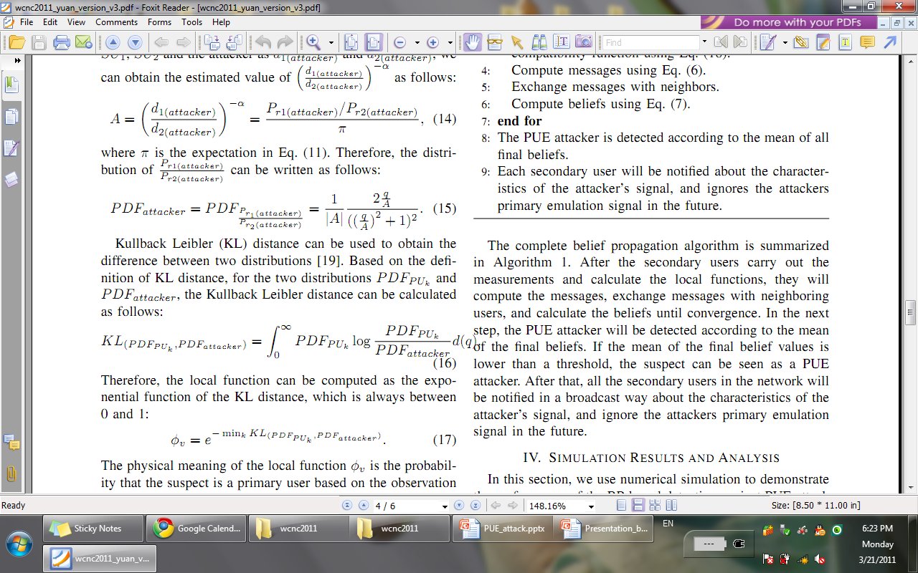
Local Function
If we define
Ratio of RSS from PU
We can get
where
We can also calculate
where
Ratio of RSS from attacker
The local function can be defined as the exponential function of
Kullback Leibler distance:
Notes:
Phi
When the value of KL distance is high, which means large difference between the two distributions, we can obtain a low value of ϕ
, which represents a high probability that the suspect is a PUE attacker.

Slide 23
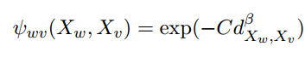
Compatibility Function
Difficult to find an explicit expression for the compatibility function.
The compatibility function is dependent on the correlation between the two neighboring nodes.
Proposed exponential compatibility function:
Notes:
C and β are two constants
When the distance is large, the value of compatibility function is low. The exponential function guarantees that the compatibility value is always between 0 and 1. Also the proposed compatibility function is symmetric for both random variables

Slide 24
Complete Algorithm
Each user carries out measurements about the RSSs from the suspect and the primary user.
for each iteration do
  Compute the local function and the compatibility function
  Compute messages
  Exchange messages with neighbors
  Compute beliefs
end for
PUE attacker is detected according to mean of all final beliefs
Notify other SUs to avoid PUE attack
  Based on characteristics of the attacker’s signal
Notes:
Honest, belief > threshold
Malicious, belief < threshold
Our advantage:
Do not need to deploy additional sensor networks
Do not need to calculate the exact location of the attacker
Avoid the deployment of expensive hardware for TOA and FOA

Slide 25
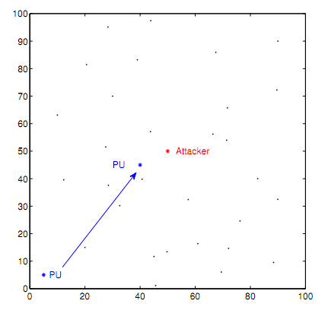
Simulation Setting
Case #2
Two cases for the different locations of PU.
Case #1

Slide 26
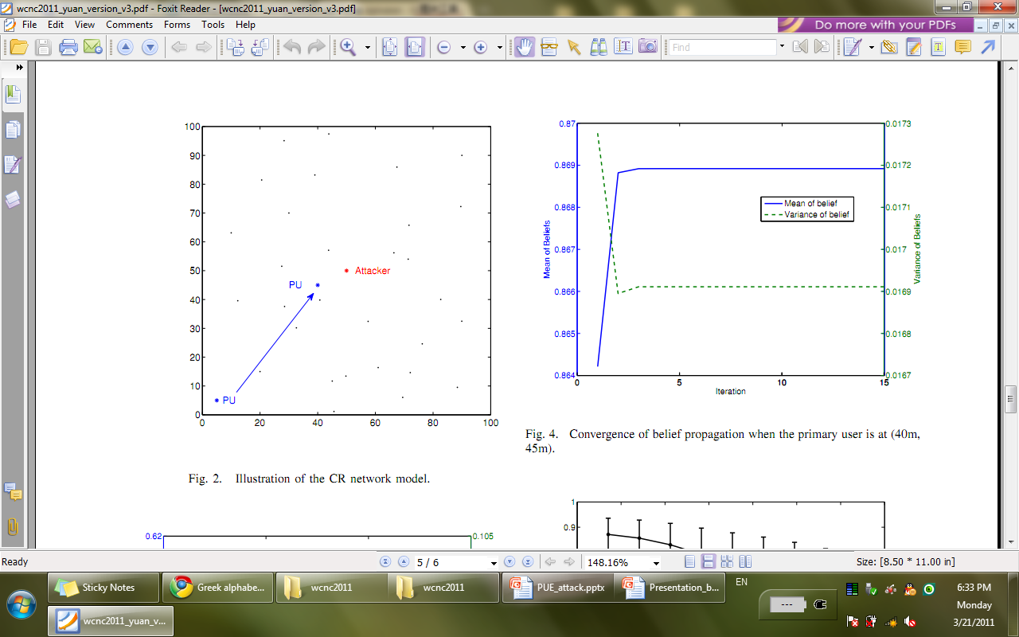
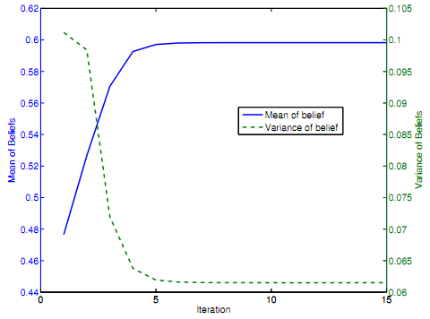
Simulation Results
Case #1
Case #2
Belief over iterations given two different locations.
In Case #1, belief is smaller than that in Case #2, since PU is farther away from the suspect.

Slide 27
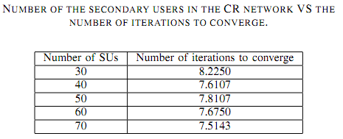
Simulation Results
Number of iterations does not change with the increasing number of SUs.

Slide 28
Outline
Introduction
  Dynamic spectrum access and cognitive radio
  Security issues in cognitive radio systems
  Belief propagation
Works
  Defense primary user emulation (PUE) attack in cognitive radio networks
  Routing-toward-primary user (RPU) attack in cognitive radio networks and corresponding defense strategy

Slide 29
Main Contributions
Routing-toward-primary-user (RPU) attack
  New
  Powerful
  Network layer
Belief propagation based defense strategy against RPU attack
  Converges very fast
  Effective and efficient to find the attacker
Major publication
  Accepted to IEEE Transactions on Mobile Computing.

Slide 30
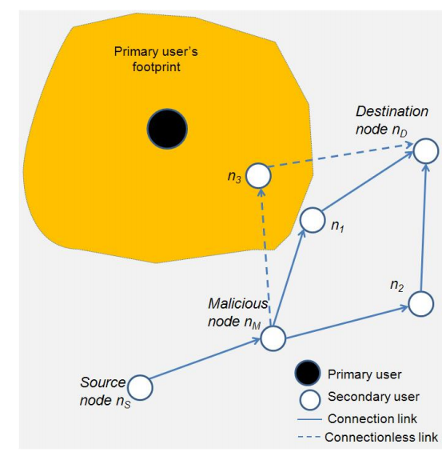
RPU Attack Model
Malicious node n_{M} sends fake information, claiming that it has optimum route with low costs to the destination.
Source node or other intermediate nodes will forward all the packets to n_{M}.
n_{M} will forward the data to those secondary users which are closer to primary users.
It is hard to detect which node is a malicious node.
RPU attack model
Notes:
Even if the interference from a single CR device is not severe, the aggregative effects can be significant.
Malicious nodes intentionally route a large amount of packets toward or around the PUs, aiming to cause interference to the primary users, and to increase delay.
the interference to the primary users is not directly generated by the malicious nodes. Instead, the interference is from the honest nodes that received the packets from the malicious nodes. Therefore, it is difficult to detect the malicious nodes.

Slide 31
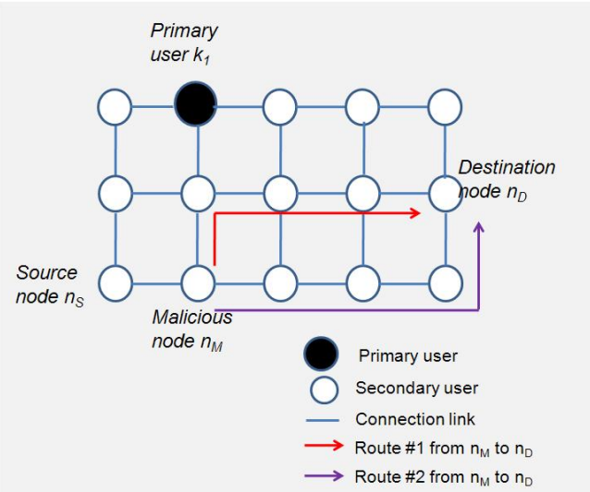
Strength of RPU Attack: A Toy Example

Slide 32
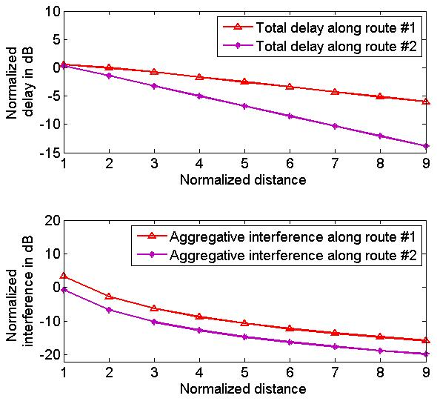

Strength of RPU Attack: A Toy Example
Red: route #1
Purple: route #2
Red route provides much higher delay than the purple route, as well as interference to the PU.

Slide 33
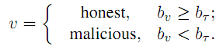
Defense Against RPU Attack
Find an initial route from source to destination
Each node collects the feedback information from the other nodes
Nodes use belief propagation to exchange messages
  Based on conditional probabilities, calculate marginal probability
Final detection criterion
Notes:
Each node on the initial route keeps a table recording feedbacks from other nodes.

Slide 34
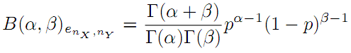
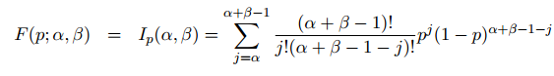
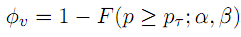
Local Function
α: Number of success
Beta distribution
  Describe link quality
  CDF of Beta distribution
β: Number of failure
Local function
Notes:
Link quality between two nodes can be described as a trust value, which can be represented in the form of Beta distribution.
Beta distribution is often used in the scenarios where the subject has collected binary observation.
Beta distribution is a family of continuous probability distributions defined on the interval (0, 1) parameterized by two positive shape parameters, typically denoted by α and β.
P is the interval between 0 and 1
The physical meaning of the local function is the probability that the node who sends back the feedback is an honest node or not.

Slide 35
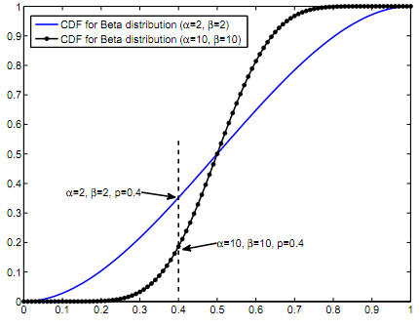
Local Function Example
CDF(α=2,β=2) > CDF(α=4,β=4), which means the value of the local function of (α=4,β=4) is bigger than the value of the local function of (α=2,β=2).

Slide 36
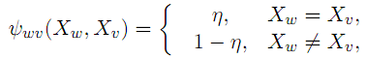
Compatibility Function
Dependent on the correlation between the states of two users
Difficult to find an explicit expression for the compatibility function
  A heuristic one is proposed
Notes:
eta

Slide 37
Complete Algorithm
Obtain an initial route from source to destination.
Each node on the initial route keeps a table recording feedbacks from other nodes.
for each iteration do
  Compute location function and compatibility function.
  Compute messages, and exchange messages.
  Compute belief values.
end for
The source node detects the malicious nodes according to final beliefs.

Slide 38
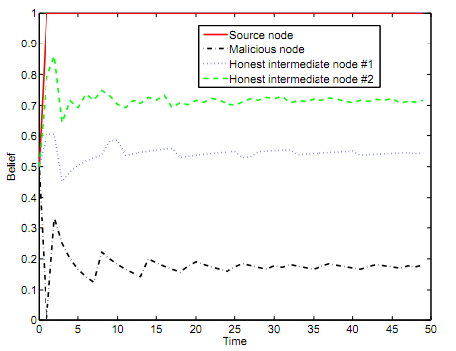
Simulation Results
Belief of the malicious node is clearly much smaller than that of the other nodes.

Slide 39
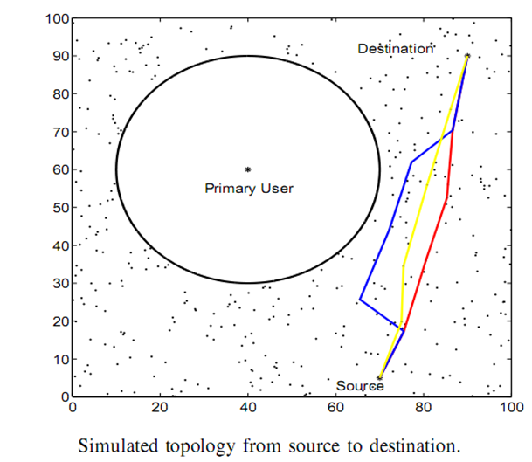
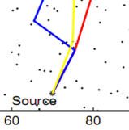
Simulation Results
Malicious node
Malicious node
The red line represents the route if the malicious behaves honestly.
The blue line is the route if the malicious node attacks.
The yellow line represents the new route after finding the attacker.

Slide 40

Thank you!

