Slide 1
Entering the World of GNU Software Radio
Thanh Le and Lanchao Liu

Slide 2
Outline
Introduction
Hardware
Software
GNU Companion
Communication Demos

Slide 3
PART I - Introduction

Slide 4
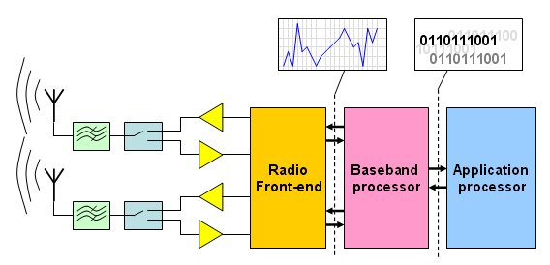

Software Defined Radio
RF/IF conversion circuit
FPGA
User App
http://www.da.isy.liu.se/research/bp/

Slide 5
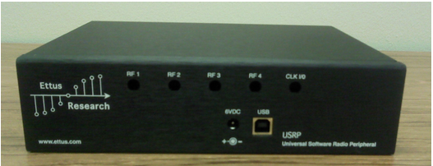
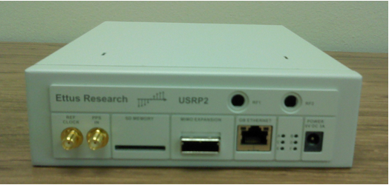
USRP: Universal Radio Peripheral
The hardware solution for GNU SDR
USRP
USRP2

Slide 6
PART II – Hardware

Slide 7
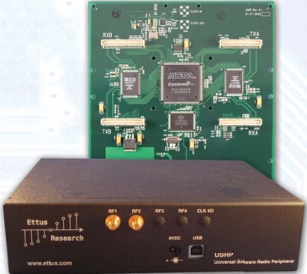
Universal Software Radio Peripheral (USRP)
4 ADC 64MS/s (12-bit)
4 DAC 128MS/s (14-bit)
USB 2.0 interface¹
Small FPGA²
MIMO capable
$700
Highest speed 480Mb/s
Capable of processing signals up to 16 MHz wide

Slide 8
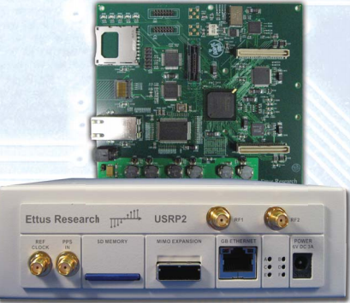

Universal Software Radio
Peripheral (USRP2) ¹
2 ADC 100MS/s (14-bit)
2 DAC 400MS/s (16-bit)
Gigabit Ethernet Interface
Larger FPGA²
On-board SRAM
MIMO capable
2 Gbps high-speed serial interface for expansion
Capable of processing signals up to 100 MHz wide
$1400

Slide 9
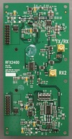






Available daughter-boards
Basic TX/RX: 1MHz – 250MHz
LFTX/LFRX: DC – 30MHz
TVRX: 50MHz-860Mhz
DBSRX: 800MHz – 2.4GHz
WBX0510: 50MHz – 1GHz(20dBm)
RFX400: 400MHz – 500MHz (20dBm)
RFX900: 750MHz – 1050MHz(23dBm)
RFX1200: 1150MHz – 1450MHz(23dBm)
RFX1800: 1.5GHz – 2.1GHz(20dBm)
RFX2400: 2.3GHz – 2.9GHz(17dBm)
XCVR2450: 2.4GHz – 2.5GHz & 4.9GHz -5.9GHz(20dBm)

Slide 10
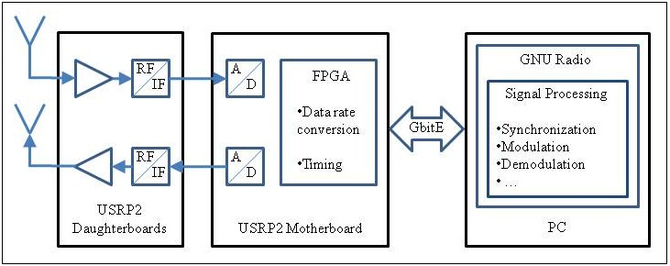
Software Defined Radio Block Diagram

Slide 11
RF Front End
Mixer
Low Noise Amplifier
Low Pass Filter
Low Pass Filter
ADC
Antenna
Local Oscillator

Slide 12
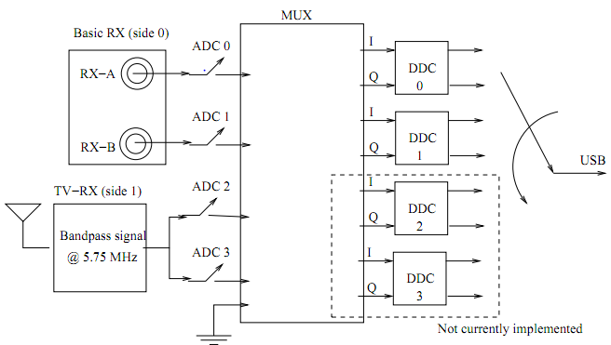
FPGA – MUX

Slide 13
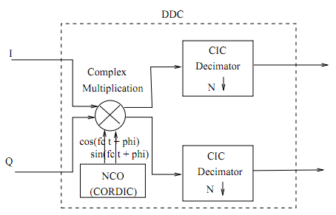
FPGA – DDC

Slide 14
Example 2-1: Simple transmission
A simple sinusoidal wave is transmitted. We can view it at the receiver in spectrum domain.

Slide 15
PART III – Software

Slide 16
GNU radio
  GNU radio is an open source, Python-based architecture for building SDR projects
  C++ written signal processing blocks and python written connectors
  Available on Linux, Mac OS and Windows
APP1
APP2
Python
Signal Generator
FFT
Filter
Modulation
C++

Slide 17
A thumb of rule
For any application, what you need to do at Python level is nothing but drawing a diagram to show the signal flow form the source to the sink using the Python, sometimes with the graphical user interface(GUI) support

Slide 18
GNU Radio Installation
Step-by-step instruction available on
http://gnuradio.org/redmine/projects/gnuradio/wiki/GettingStarted
  Install the pre-requisites
  Get the GNU Radio source code
  Configure, compile and install GNU Radio
All the following demos are built in: Ubuntu-10.10 + gnuradio-3.32

Slide 19
Example 3-1:
FFT
Src0
(440Hz)
Adder
Oscilloscope
Src1
(640Hz)

Slide 20
Data Type
Signal blocks communicate with each other via data stream
GNU Radio requires that input and output data types match exactly
Byte – 1 byte of data(8-bit) Short – 2 bytes integer
Int – 4 bytes integer Float – 4 bytes floating integer
Complex – 8 bytes(a pair of floats)

Slide 21
Tips: the name of the signal block indicates the input/output data type
  _f : input/output a float
  _fc: input a float and output a complex
  _vff: input and output a vector of floats
  _b: input/output a byte
  _i: input/output a integer
  _s: input/output for short

Slide 22
USRP Source/Sink
  Initialize variable represents the signal block
  u = usrp2.source_32fc(options.interface, options.mac_addr)
  u = usrp2.sink_32fc(options.interface, options.mac_addr)
  For the USRP source: self.connect(u, other_block)
  For the USRP sink: self.connect(other_block,u)

Slide 23
Receive: USRP Source Transmit: USRP Sink
Create the USRP source
Set the decimation /Interpolation rate
Set the gain
Set the center frequency
Connect to another block

Slide 24
Some useful blocks
FFT Vector
File Audio USRPn
Sinusoidal Noise
Null Vector
File Audio USRPn
Type Conversion
Sink
Source
Adding a constant Adder Subtracter
Multiplying a constant
Multiplier Divier Log
Low pass/High pass/Band pass/Hilbert/Raised Cosine
Simple operators
Filters

Slide 25
Example 3-2: Codes reading - FM Receiver
Explain the codes for FM receiver line by line.

Slide 26
Useful tools
‘Spectrum analyzer’: usrp2_fft.py
‘Signal generator’: usrp2_siggen_gui.py & usrp2_siggen.py
‘Recorder’: usrp2_rx_cfile.py
Offline analyzer: gr_plot_fft.py & gr_plot_psd.py

Slide 27
Example 3-3 : ‘Spectrum analyzer’
Example 3-4 : ‘Signal generator’
Example 3-5 : ‘Recorder’

Slide 28
PART IV GRC

Slide 29
GNU Radio Companion
A graphical tool that Create signal flow graphs & Generate flow-graph source code

Slide 30
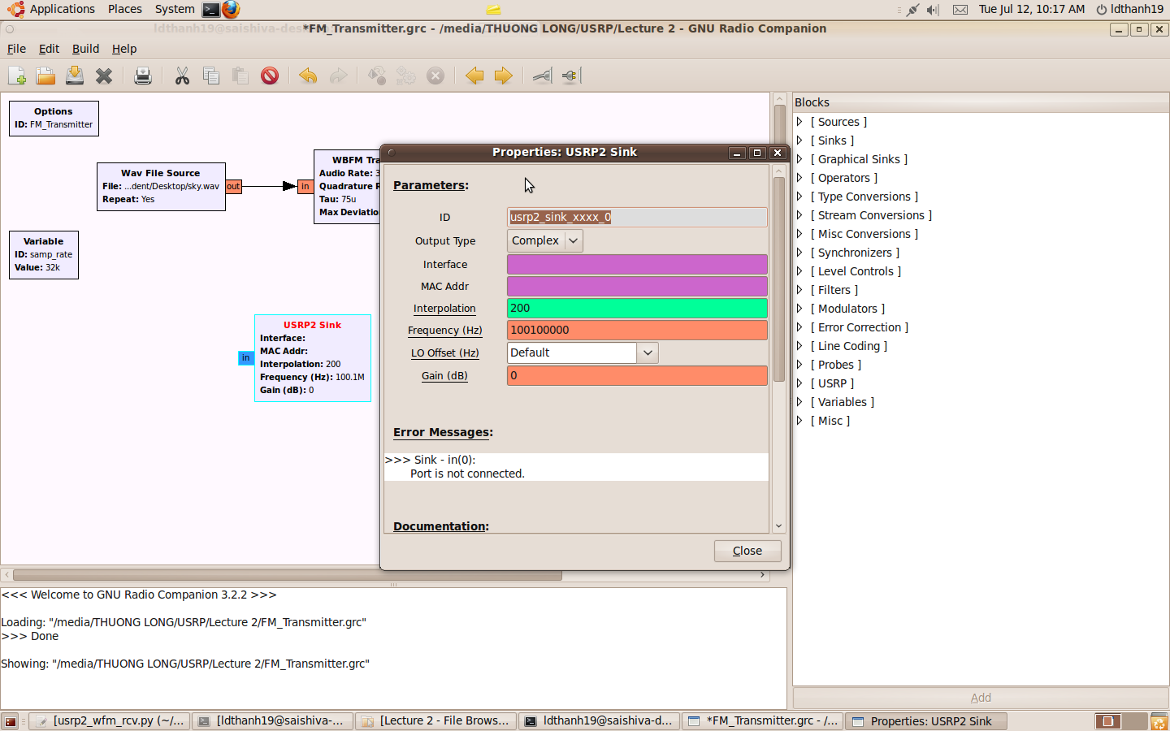
Adding proper blocks to the diagram and setting it parameters

Slide 31
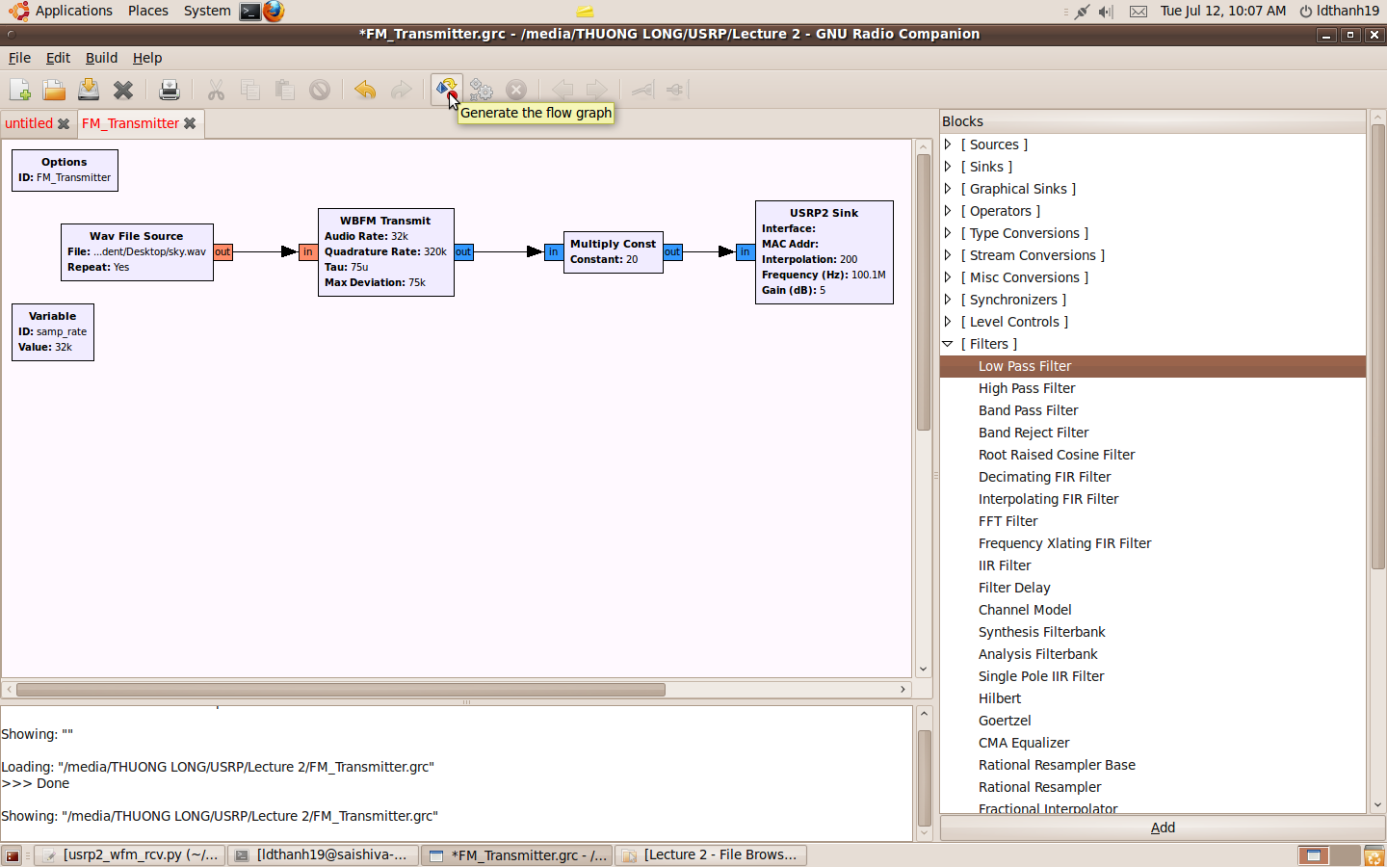
Connect proper blocks with each other, saving the file. Generating the flow graph, the system will save your design with a .grc file.

Slide 32

Executing the flow graph and receive the signal by using USRP2 receiver that we designed before.

Slide 33
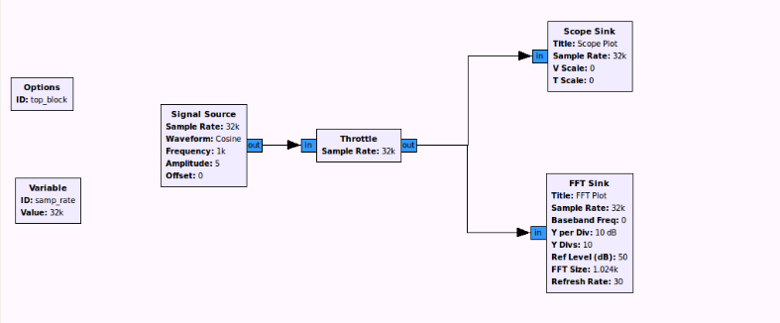
Example 4-1: View signal in time/spectrum domain

Slide 34
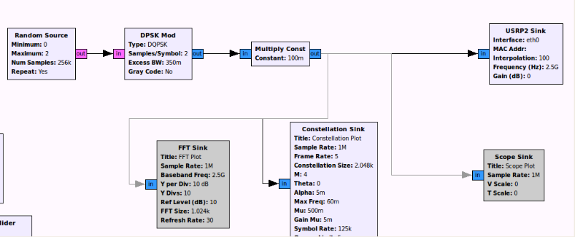
Example 4-2: View the constellation diagram of a signal

Slide 35
PART IV Communication Demos

Slide 36
FM Transmitter
gr.wavefile_source()
gr.multiply_const_cc()
Usrp2.sink_32fc()
gr.multiply_const_cc()

Slide 37
AM transmitter
Source
Gr.interp_fir_filter_fff()
gr.multiply_const_ff
Usrp2.sink_32fc
am_mod=gr.float_to_complex()

Slide 38
Benchmark_tx.py
source
usrp_transmit_path
USRP
self.packet_transmitter
Self.amp
Modulator

Slide 39
Benchmark_rx.py
source
usrp_receive_path
file
Low_pass_filter
Self.packet_reveiver
source

Slide 40
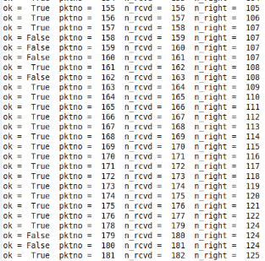
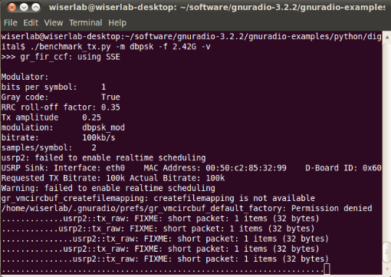
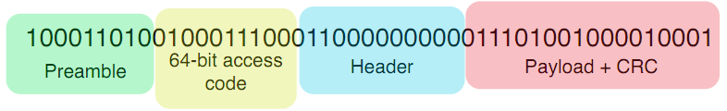
Connection

Slide 41
Spectrum sensing
source
window
fft
threshold
log10
c2mag

Slide 42
Reference
http://www.snowymtn.ca/gnuradio/gnuradiodoc-1.pdf
(Totally ten parts, just change the number to get it)
http://gnuradio.org/redmine/projects/gnuradio/wiki
Thanks to Ruolin Zhou @ Wright State University

Slide 43
Questions/Comments

