Slide 1
学术界职业发展的建模与优化
Modeling and Optimization for Academia Career
韩竹，1992-1997, 电子工程系学士
John and Rebecca Moores Professor
ECE/CS, 休斯敦大学
IEEE/AAAS Fellow

Slide 2
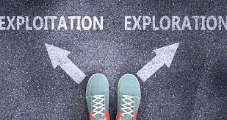
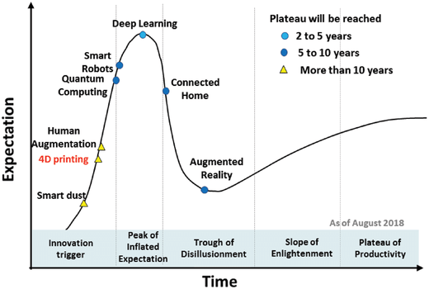
学术方向选择和identity建立
Exploration vs. Exploitation
Typical machine learning problem
Multi-Arm Bandit (MAB) Problem or Reinforcement Learning (RL)
40% of Exploitation to a SUSTAINABLE field that can shape your identity in 20 years
60% of Exploration to catch the current research waves (and funding)

Slide 3
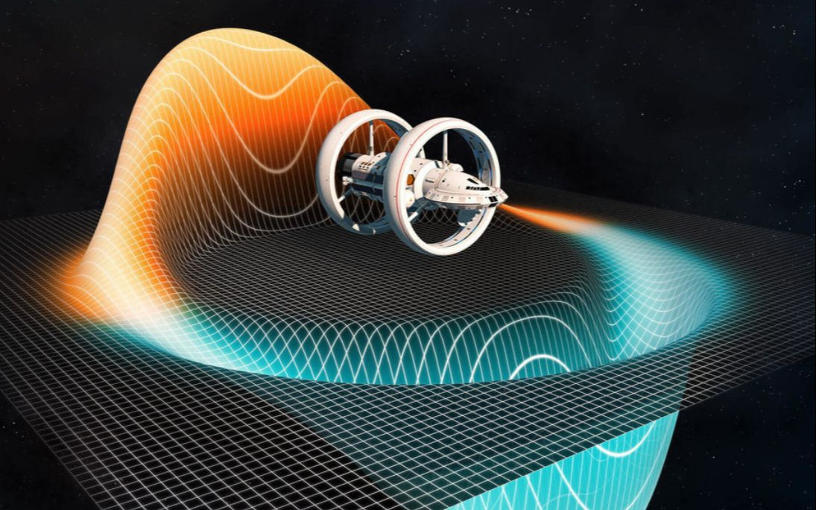
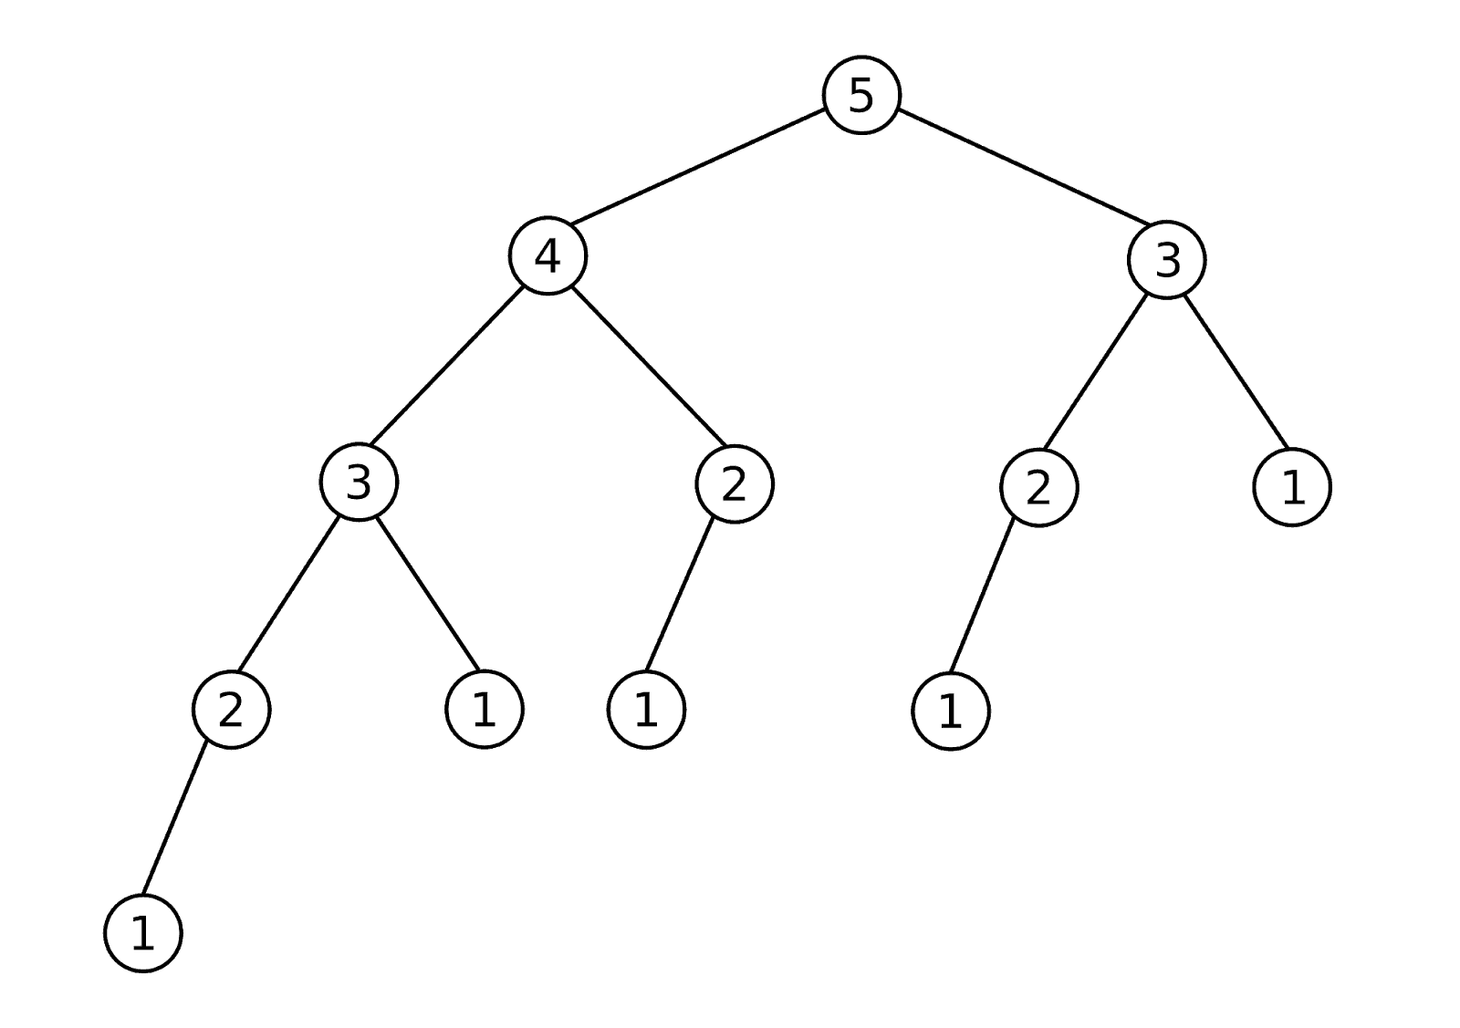
最后期限，匹配，和动态规划
Deadline is only productive force
Create ones for yourself
Example 1: 1 hour waiting for kid activity, finishing reading 1 paper in details
Example 2: Use student defense slides to present before student leaves
Assignment matching
Maintain two to do lists: one for all and one for today
To do list each day according calendar
Dynamic programming
Divide big tasks to small tasks so as to fit into small time slots
matching
Avoid adding to to-do-list: e.g. check email once and reply immediately (秒回)
03

Slide 4
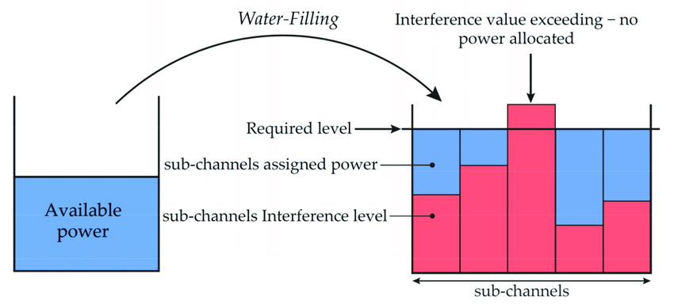
科学的时间分配
Everybody has limited energy
How to allocate efficiently
Water filling Algorithm
$max\sum_{i}{C(P_{i})}$, s.t. $\sum_{i}{P_{i}}≤P_{max}$
where C is efficiency, $P_{i}$ is energy allocated for time slot i, $P_{max}$ is total energy.
Example:
Morning: Proposal, research
Afternoon: Bureaucratic issues
Evening: Family time
02

Slide 5
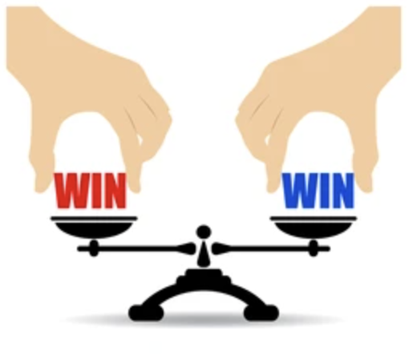
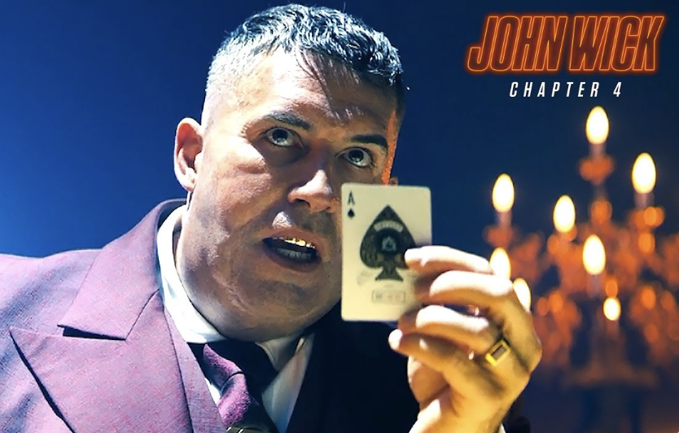
合作与共赢
Coalitional Game (my NSF career award)
Also study the common characters of successful people
Find mutual benefits
Gain a card by each cooperation
Merge and Split
04

Slide 6
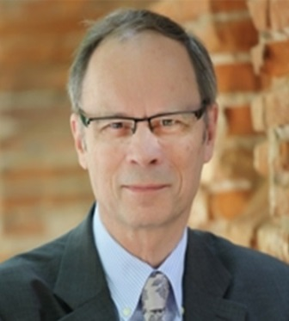
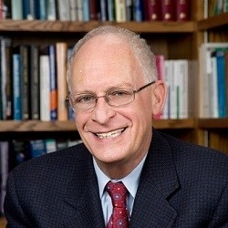
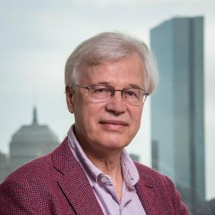
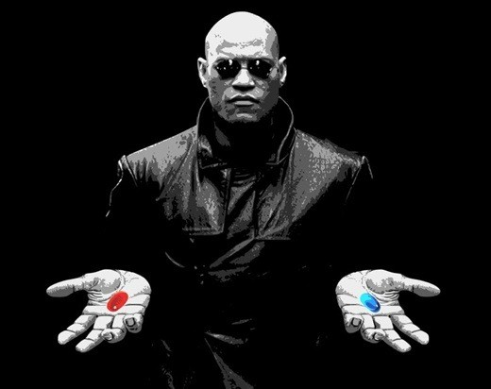
如何招学生
Contract Theory (Nobel 2014, 2016)
Asymmetric Information
Adversary Selection Contract of PhD Student
“I am going to be a professor at a major research university after I graduate.”
Look for career alternatives
Become a baker/rock star/writer
The plan you try to find the advisor with financial aid
The real plan
The secret plan
Solution: Two contracts
One for theory
One for practice
Truthfully revelation
05

Slide 7
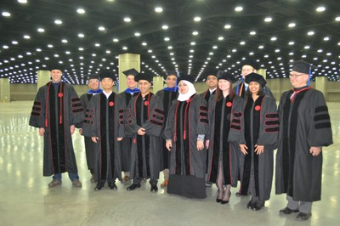
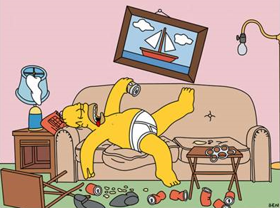
如何管学生
Moral Hazard Contract for Ph.D. Student
What my parents thinks I do
What my advisor thinks I do
What I actually do
When advisor presents
When advisor on travel
Solution:
Align student’s & professor’s interests
Example 1: 3 years playing and
1 year fighting with professor
Difference between 4 year
3 paper graduation policy
and 3 paper graduation policy
Example 2: Publish in rubbish places
Stronger than marriage
Advisor/student relationship
Future employer will check where
published to judge student’s Intellectures
06

Slide 8
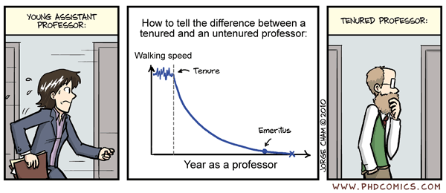
长聘之后的路
What to do next after tenure? A Routing Problem
Road of Pure Teaching:
Might need to teach a lot (the number teaching classes is inverse to research productivity
Difficulty to get promotion, and face possible early retirement and challenges from GPT
Enjoy life, family time, hobbies, etc.
Shaded areas are all classes that
needs to be covered per semester
Road of Management:
Need to know how to handle people, especially “difficult people”. Personality
Go to NSF or some government (funding) agency position, and then come back to academia (like Purdue President)
Might have to sacrifice a lot for research
4
Number of classes
1
6
Funding/Ph.D. students
07

Slide 9
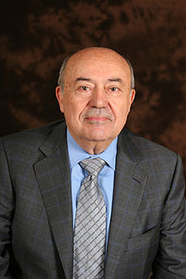
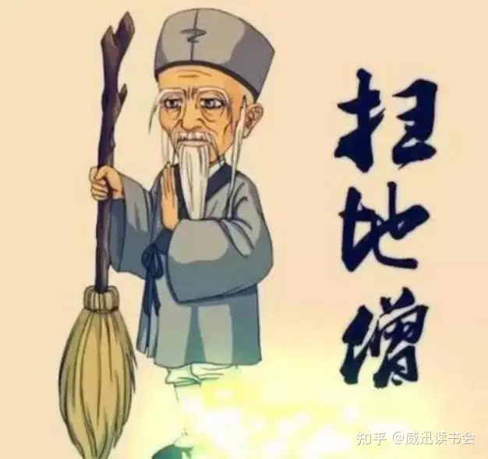
长聘之后的路
Road of start up:
Need timing of wave and environment.
Need to accumulate by years within academia
Some startup funding from government such as NSF STTR and SBIR
Legal issues
Andrew James Viterbi
UCLA professor
Qualcomm founder
Road of pure research:
Endless, hopeless and torturing
Have steps to achieve with age limit
Some society awards can be the middle steps for fellow or academy member (院士)
When the goal achieved, can easily adapt to other roads
07

Slide 10
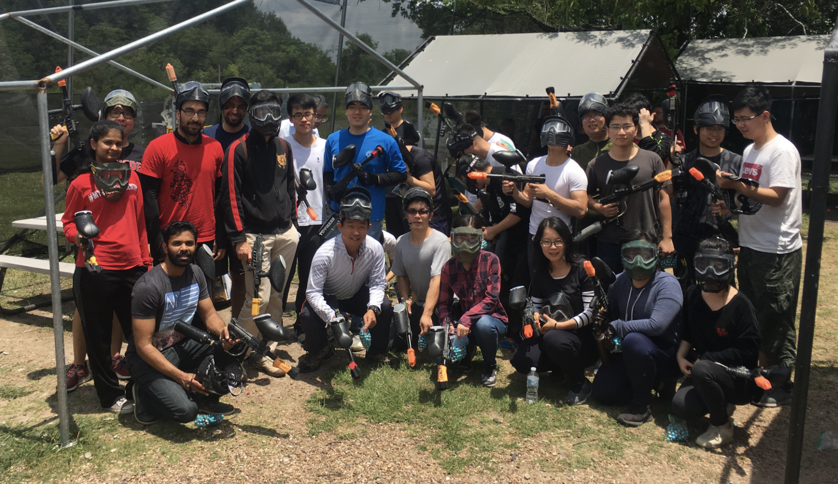
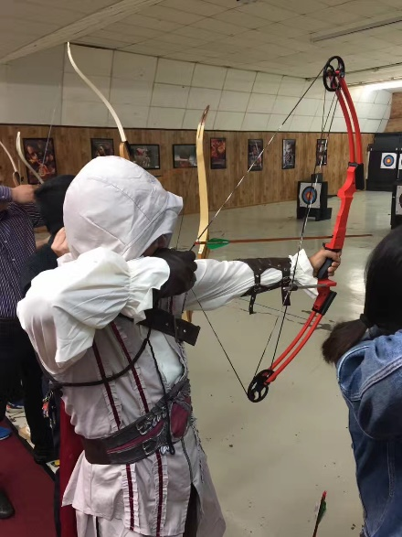
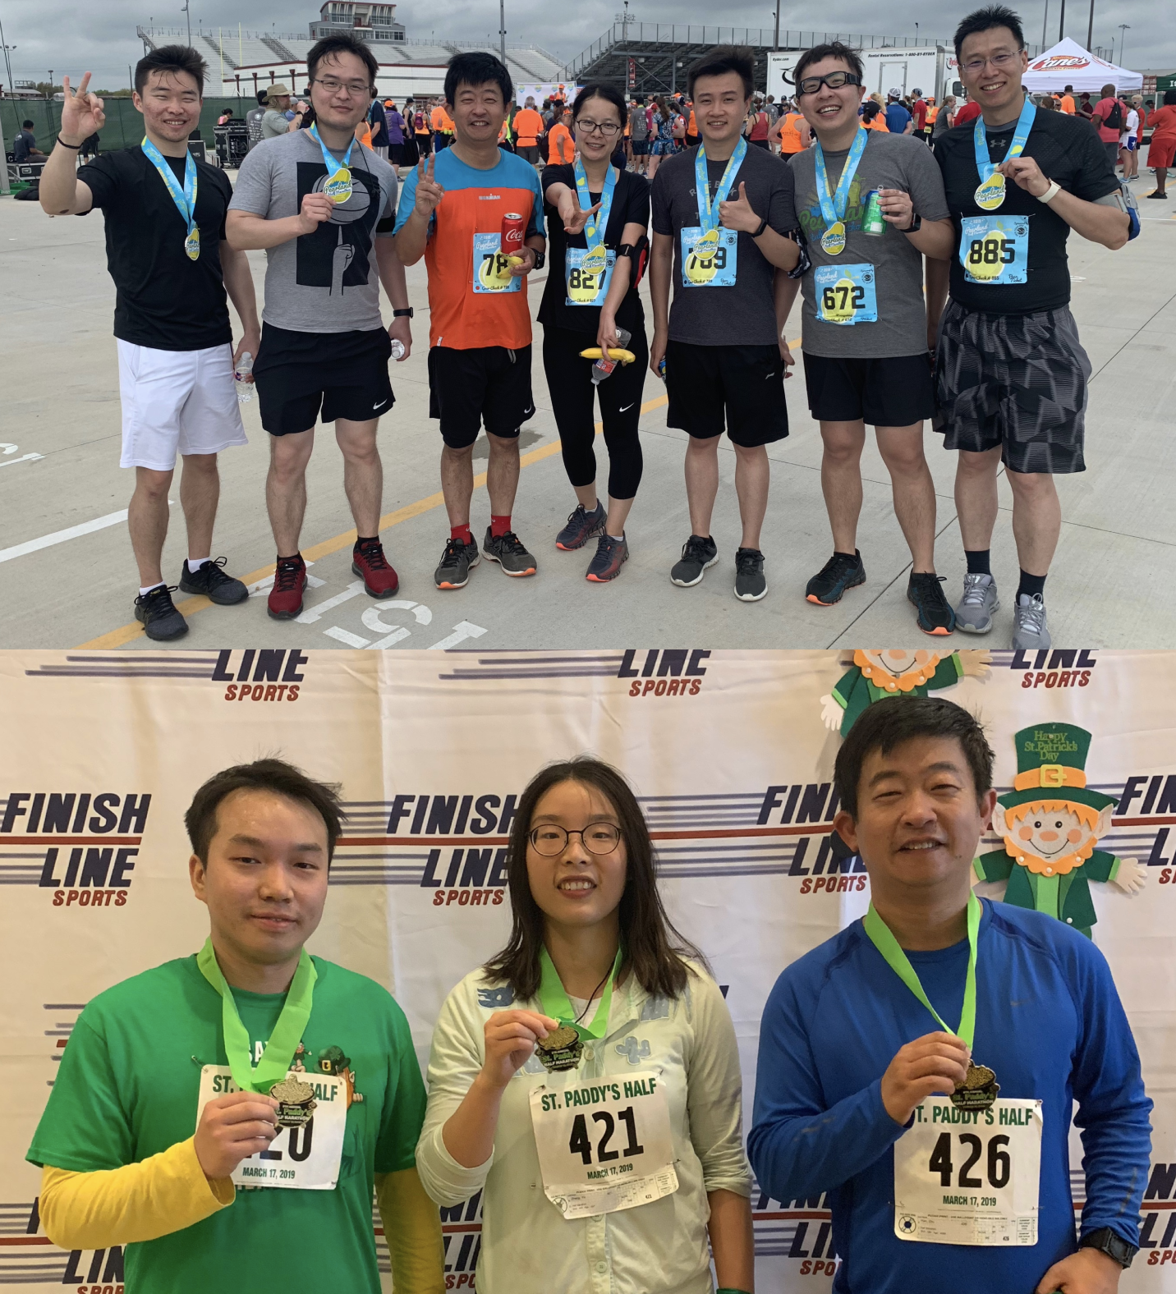
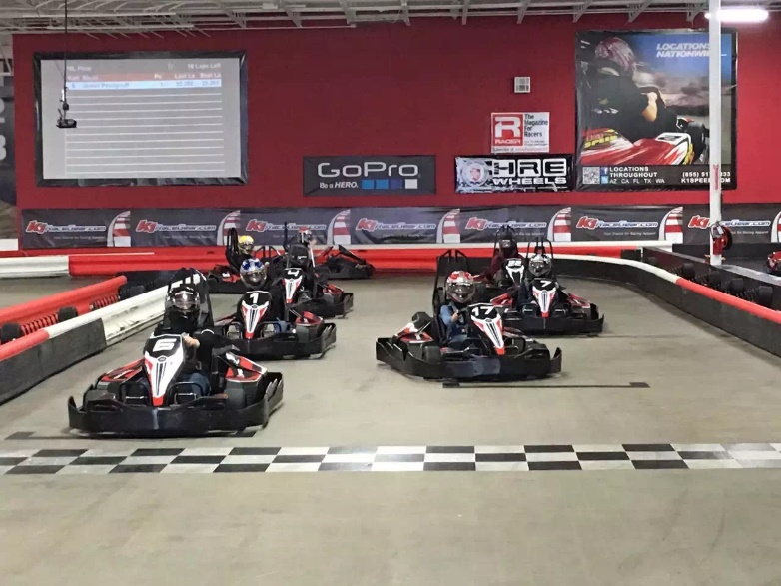
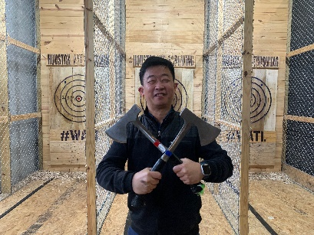
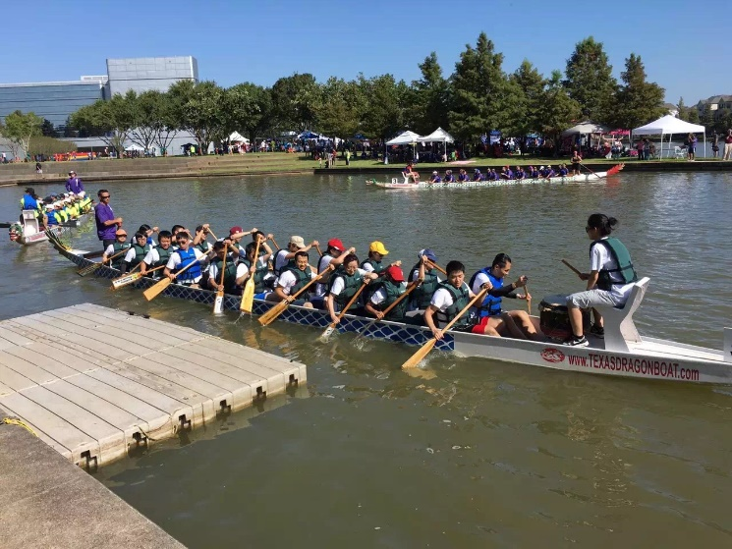
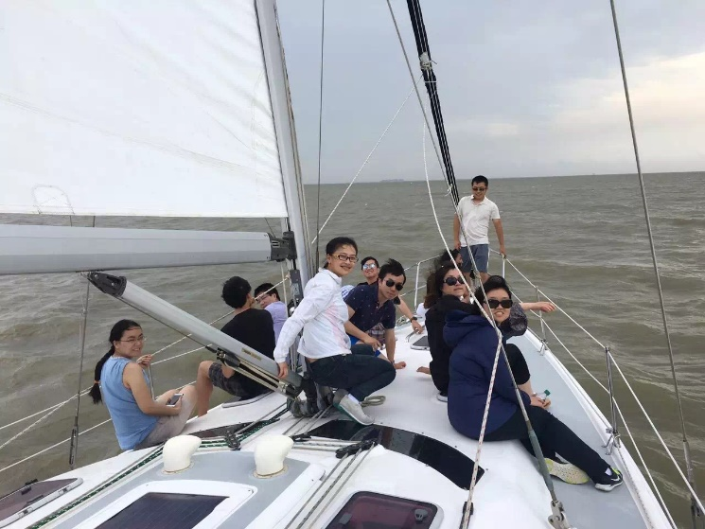
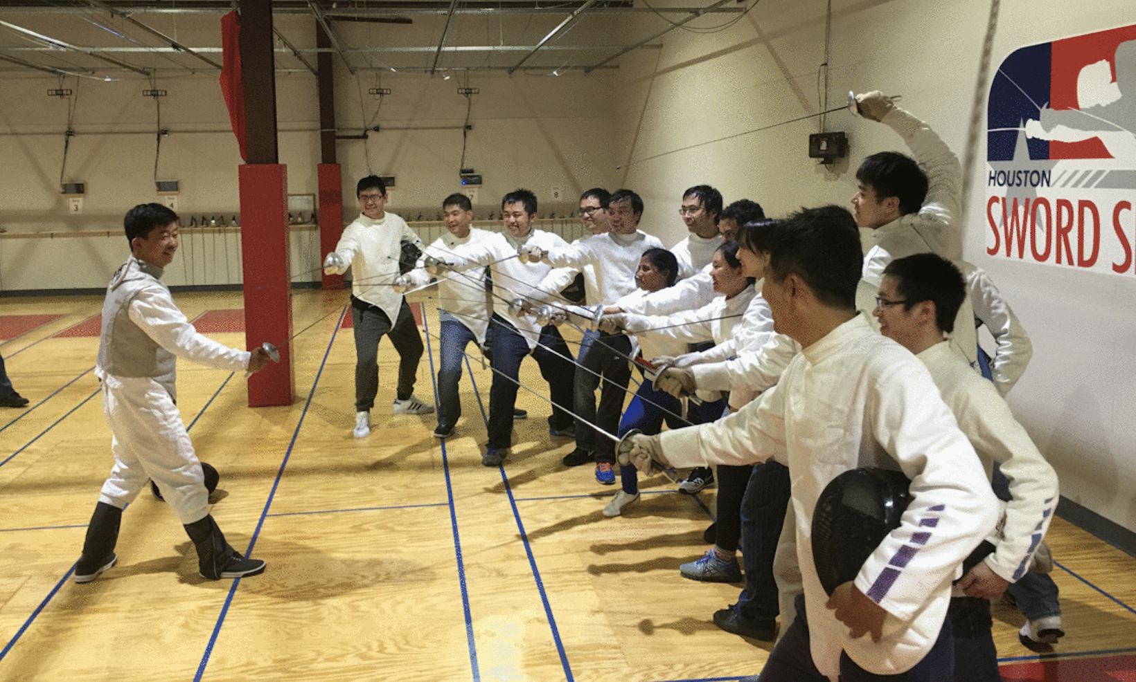
感谢母校，欢迎到休斯敦访问
Summary from my student’s facebook
Theory is something we know why, but it does not work.
Practice is something works, but we do not know why.
In our research lab, we have both: nothing works and we do not know why.
http://www2.egr.uh.edu/~zhan2/
https://wireless.egr.uh.edu/
http://wireless.egr.uh.edu/

