Slide 1
Intro to Python-Gurobi Modelling

Slide 2
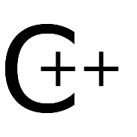
Why Python?
Different Gurobi customers use different interfaces
Python
Java
C++
.NET (C#, Visual Basic, …)
MATLAB,
R
...
Gurobi is committed to all of these interfaces
This presentation focuses on Python since
Python is simple to learn for new Gurobi users
Python has special features that make it easy to build and maintain optimization models

Slide 3
Installation
The Python API is a first-class citizen of Gurobi
To use Gurobi from Python you need to install the
gurobipy module (included in the Gurobi installation).
Automatic installation with Anaconda:
conda config --add channels http://conda.anaconda.org/gurobi conda install gurobi

Slide 4
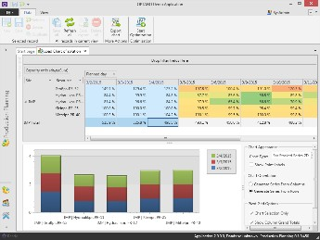
Optimization Workflow
Problem
Instance
The real-world problem instance is usually derived from a specific planning problem.
A configurable model generator is used to
build the model instance using data sources.
Model
Generator
Analysis
User Interface
Gurobi is used to find an optimal solution of
the model instance.
Solution
Retrieval
Model Instance
The solution is transferred back to the planning system for further analysis.
Gurobi Optimizer
The cycle repeats until a satisfying real-world solution has been found.

Slide 5
Concepts
Parameters control the operation of the Gurobi solvers. They must be modified before the optimization begins.
http://www.gurobi.com/documentation/current/parameters.html
Attributes are the primary mechanism for querying and modifying properties of a Gurobi model.
http://www.gurobi.com/documentation/current/refman/attributes.html
Model Attributes Parameters
Constraints
Attributes
Variables
Attributes
Special Ordered Sets
Attributes can be associated with
Attributes
the model as a whole (e.g. the objective function value)
variables (e.g. lower bounds)
constraints (e.g. the right-hand side)
SOSs (e.g. IIS membership)
Environment
Global Parameter Settings
Environments are the containers for models and global parameter settings. When a model is created inside an environment, it creates a local copy of all global parameter
Model 1
Local Parameter Settings
Model 2
settings.
Local Parameter Settings
The Python API automatically provides a default environment.

Slide 6
Concepts
Important global functions
setParam()
read()
set (global) parameters for new models in this session
create model object from a model file
Primary objects
Model
Var
Constr
the model a variable a constraint
Parameter/attribute examples:
setParam('TimeLimit', 60)
model.TimeLimit = 60
variable.VarName = 'TotalCosts'
constraint.RHS = 0
Set global parameter Set local parameter Set variable attribute Set constraint attribute
Other important methods:
Model.setObjective(expression)
Model.optimize()
Model.reset()
Set objective function Start optimization Reset model state

Slide 7
Concepts
Model summary information methods
Model.printAttr()
Model.printStats()
Model.printQuality()
display nonzero attribute values display sizes, coefficient statistics, etc. display info about solution quality
Model introspection methods
Model.getVars()
Model.getConstrs()
Model.getRow()
Model.getCol()
get variables as a list of Var objects
get constraints as a list of Constr objects get LHS expression for a given constraint get list of constraints for a given variable
Python control statements
for i in <some list>:
<do something for each i here>
if <condition>:
<do something if condition is true here>
Must indent body of each statement (at least one space or tab)

Slide 8
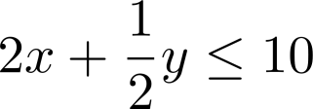
Concepts
For performance reasons we recommend the following structure when building a model instance
with the Gurobi Python API:
Create all variable objects
Set objective function(s)
Create
constraints
Run
optimization
addVar() addVars()
addConstr()
setObjective()
addConstrs()
optimize()
The Python API supports (linear and quadratic) expressions similar to the mathematical notation:
2*x + (1/2)*y <= 10

Slide 9
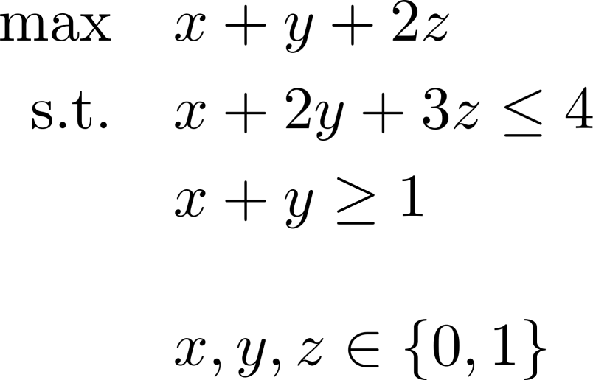
Examples
Simple example:
You want to decide about three activities (do or don‘t do) and aim for maximum value
You need to choose at least activity 1 or 2 (or both)
The total time limit is 4 hours
Activity 1 takes 1 hour
Activity 2 takes 2 hours
Activity 3 takes 3 hours
Activity 3 is worth twice as much as 1 and 2
This can be modelled as a linear mixed-integer problem
Binary variables x,y,z for activities 1,2,3
Linear constraint for time limit
Linear constraint for condition (1 or 2)

Slide 10
Examples
Open a new Jupyter Notebook
Follow the Best Practices
Create decision variables
Set objective function
Create linear expressions and use them to
create constraints
Call optimize()
Print out results
# Create a new model
m = Model()
# Add variables
x = m.addVar(vtype=GRB.BINARY, name="x")
y = m.addVar(vtype=GRB.BINARY, name="y")
z = m.addVar(vtype=GRB.BINARY, name="z")
# Set objective function m.setObjective(x + y + 2*z, GRB.MAXIMIZE)
# Add constraints
c1 = m.addConstr(x + 2*y + 3*z <= 4) c2 = m.addConstr(x + y >= 1)
# Solve model
m.optimize()
This model is the mip1 example that you can find for all APIs in the examples directory of the Gurobi installation.

Slide 11
Examples
Use the help() function with no arguments to get general help
You can get help on specific Gurobi objects
help(Model)
help(Var)
help(Constr)
Gurobi model object (or help(m) if m is a model) Gurobi variable object (or help(v) if v is a variable) Gurobi constraint object (or help(c) if c is a constraint)
help(GRB.attr) Gurobi attributes
You can get help on specific functions or methods
Ex: help(read)
Ex: help(Model.printAttr)
You can get help on any parameter
Ex: paramHelp('Method')

Slide 12
Examples
Use the help() function with no arguments to get general help
You can get help on specific Gurobi objects
help(Model)
help(Var)
help(Constr)
Gurobi model object (or help(m) if m is a model) Gurobi variable object (or help(v) if v is a variable) Gurobi constraint object (or help(c) if c is a constraint)
help(GRB.attr) Gurobi attributes
You can get help on specific functions or methods
Ex: help(read)
Ex: help(Model.printAttr)
You can get help on any parameter
Ex: paramHelp('Method')

Slide 13
Examples
A Gurobi class to store lists of tuples
Cities = ['A','B','C','D']
Routes = tuplelist([('A','B'),
('A','C'), ('B','C'), ('B','D'), ('C','D')])
What makes it special: select statement for efficient filtering
for c in Cities: print(Routes.select(c,'*'))
# | [('A','B'), | ('A','C')]
# | [('B','C'), | ('B','D')]
# | [('C','D')]
# | []
The tuplelist is indexed to make select() efficient

Slide 14
Examples
Using integers
x = m.addVars(2, 3, name="x") # x[0,0], x[0,1], x[0,2], x[1,0], x[1,1], | x[1,2]
Using lists of scalars
y = m.addVars(Cities, Cities, name="y") # y[A,A], y[A,B], y[A,C], y[A,D], y[B,A], | y[B,B], | y[B,C], | y[B,D]
# y[C,A], y[C,B], y[C,C], y[C,D], y[D,A], | y[D,B], | y[D,C], | y[D,D]
Using a tuplelist
z = m.addVars(Routes, name="z")
# z[A,B], z[A,C], z[B,C], z[B,D], z[C,D]
Using a generator expression (!)
w = m.addVars((i for i in range(5) if i != 2), name="w") # w[0], w[1], w[3], w[4]

Slide 15
Constraints
Uses a generator expression
x = m.addVars(Routes, name="x") y = m.addVars(Routes, name="y")
m.addConstrs((x[i,j]+y[i,j] <= 2 for i,j in Routes), name="capacity")
Use generator expression inside a quicksum function
obj = quicksum(cost[i,j]*x[i,j] for i,j in arcs)
quicksum works just like Python’s sum function, but it is more efficient for optimization models

Slide 16
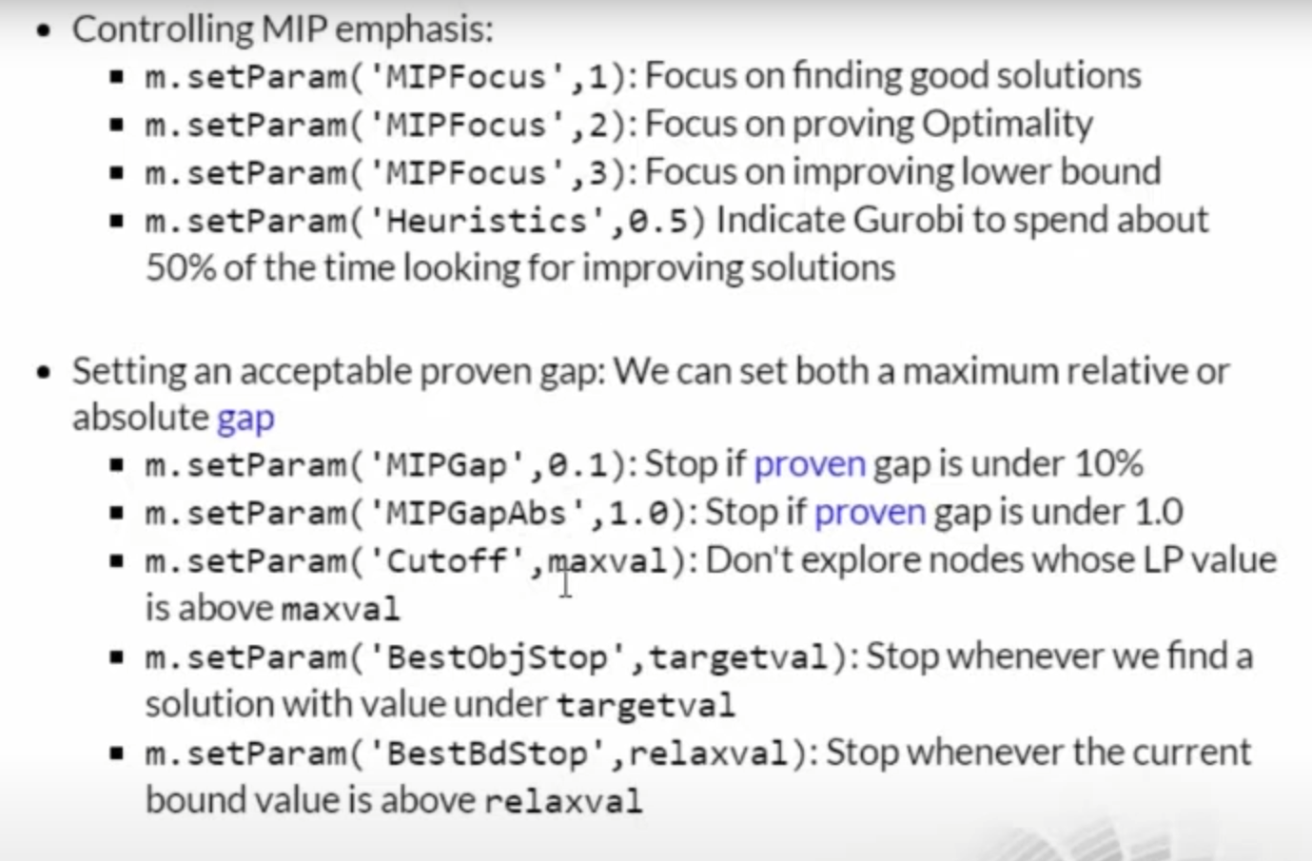
Parameters

Slide 17
Parameters

Slide 18
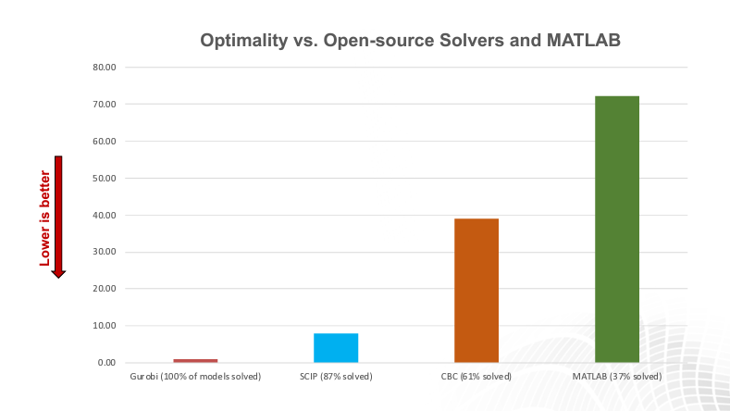
Gurobi VS Matlab
 | Gurobi | Matlab
Primary Purpose | Linear Programming (LP) Mixed-Integer Linear, Programming (MILP) Quadratic Programming (QP) Mixed-Integer Quadratic Programming (MIQP), Quadratically Constrained Programming (QCP), Mixed-Integer Quadratically Constrained Programming (MIQCP) | linear programming (LP), mixed-integer linear programming (MILP), quadratic programming (QP), second-order cone programming (SOCP), nonlinear programming (NLP)
Performance | One of the fastest solvers, especially for MILP problems | Efficient for linear and integer problems
Integration | Offers a dedicated MATLAB interface | Natively integrates with MATLAB
Cost | offer free academic license | requires a license
Scalability | large-scale optimization problem | Suitable for a wide range of problem sizes, but might not be as scalable as Gurobi for very large-scale problems

Slide 19
Mathematica VS Matlab
Mathematica | Matlab
Development is fast. | Development is not fast.
The program can be written in a simple manner using Mathematica. | Coding in Matlab is not going to be easy and simple.
Code compilation is slow. | Code compiles faster in Matlab.
Mathematica provides a notebook interface that literally looks like a notebook. | Matlab does not provide a notebook interface.
Mathematica has a central database along with Alpha to perform complex queries. | Matlab performs complex queries by itself.
Mathematica is developed to write mathematical functions in simple and convenient syntax. | Matlab is designed to do parallel computation to do operations in vectored form.
Mathematica uses a computer algebra system. | Matlab uses two-dimensional array systems.
Mathematica packages are built centrally and are not available to use freely. | Many Matlab packages are available free to use.

Slide 20
Mathematica VS Matlab
Mathematica | Matlab
Mathematica is not that great for simulations. | It is easy to work with Matlab for simulations.
We cannot share the code and the code is complex in Mathematica. | In Matlab, we are able to share the code and are more readable.
Data science, machine learning analysis can be done. | Data science cannot be done using Matlab.
Web applications can be written using Mathematica. | Web applications cannot be written using Matlab.
Debugging is not done in Mathematica. | The code does debugging in Matlab.
Code visualization cannot be done in mathematica. | Code visualization can be done in Matlab.
Hardware options are really good. | Hardware options are very limited.
User support is not good in Mathematica. | User support is really good in Matlab.
Mathematica is not easy to master but once mastered, you can solve any complex problems within seconds. | Matlab is easy to master due to the documentation and user support.

Slide 21
Mathematica VS Matlab
Mathematica | Matlab
Mathematica’s scope is more. | Matlab can be used only for a few applications.
Mathematica is not good at prototyping. | Matlab is good at prototyping programs or algorithms.
Mathematica is not used in big data analytics. | Matlab is used in AI and big data.
Data for setup is not readily available. | Matlab setup is easy.
No alternatives are available for Mathematica. | Many alternatives are available for Matlab.
We cannot call any languages or programs through Mathematica. | We can use other programs and languages through Matlab.
Mathematica is aimed for experienced users and scientists. | Matlab can be used by students, industrial workers, designers and so on.
Mathematica is written in C/C++ and Java. | Along with these languages. Matlab is written by itself.

