Slide 1
AI Transforming the Past and Future of Oil & Gas: Enhanced Sub-surface Imaging and Carbon Monitoring, with Data-Driven Optimization and Machine Learning
Zhu Han
John and Rebecca Moores Professor
Electrical and Computer Engineering Department
University of Houston
Notes:
Hello everyone today I will give my presentation about Distributionally Robust Optimization and Its Application in Wireless Communications

Slide 2
Outline
Introduction
Industry Challenges Overview
AI in Oil & Gas - A Transformative Force
Key AI Applications
Case 1: Supervised Learning-enhanced Subsurface Imaging
Case 2: Self-supervised Learning-enhanced Signal Processing
Case 3: Reinforcement Learning Subsurface Signal Processing
Case 4: Data-driven Optimization
Conclusion
Notes:
This presentation includes four parts. The first part is Distributionally Robust Optimization

Slide 3
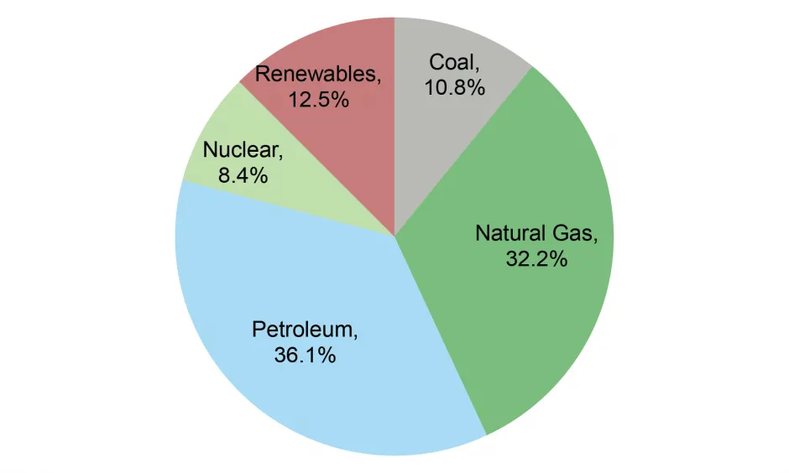
Introduction
Oil & Gas Industry's Importance
About 68% of energy consumption is from petroleum or natural gas,
while renewable and nuclear sources account for 20%.
[1]
Industry's Global Challenges
Oil and gas operations account for nearly 15% of energy-related greenhouse gas emissions today and the industry has the ability and resources to cut them quickly and cost-effectively. [2]
How innovation shape the industry in the history
Horizontal Drilling, Hydraulic fracturing, 4D monitoring,... [3]
[1] U.S. EIA (2022) Monthly Energy Review April 2022.
[2] IEA (2023), Emissions from Oil and Gas Operations in Net Zero Transitions, IEA, Paris
[3] History of Petroleum Technology

Slide 4
Introduction
The Role of AI in Transforming Industry: lower cost/risk and higher efficiency
Upstream
Midstream
Downstream
CCUS
Automation steps of
exploration and
production.
Streamlining supply chain
Reduce operational cost/risk
Resource Allocation Optimization
Defects inspection
Predictive maintenance
Catalyst discovery
Enhance exploration probability.
Anomaly monitoring/ Risk Assessment
Increase productivity and reduce risk.
Carbon Capture, Utilisation and Storage (CCUS)
Notes:
AI in Oil &amp; Gas - A Transformative Force
• The Power of Artificial Intelligence
• Exploring AI&#39;s transformative influence across industries
• AI&#39;s Potential Impact on Oil &amp; Gas
• Discussing how AI can revolutionize processes
• Benefits of AI Adoption
• Highlighting the advantages, including efficiency, safety, sustainability, and cost
savings

Slide 5
Introduction
Challenges in Industrial AI Adoption
Workforce/Budget Readiness
Data Quality
Lesson learned for Successful Implementation
ML/Optimization
Solvable Problem Formulation
Effective Communication between Domain Experts and Data Scientists
Effective Communication between Domain Experts and Data Scientists

Slide 6
Outline
Introduction
Industry Challenges Overview
AI in Oil & Gas - A Transformative Force
Key AI Applications
Case 1: Supervised Learning-enhanced Subsurface Imaging
Case 2: Self-supervised Learning-enhanced Signal Processing
Case 3: Reinforcement Learning Subsurface Signal Processing
Case 4: Data-driven Optimization
Conclusion
Notes:
This presentation includes four parts. The first part is Distributionally Robust Optimization

Slide 7
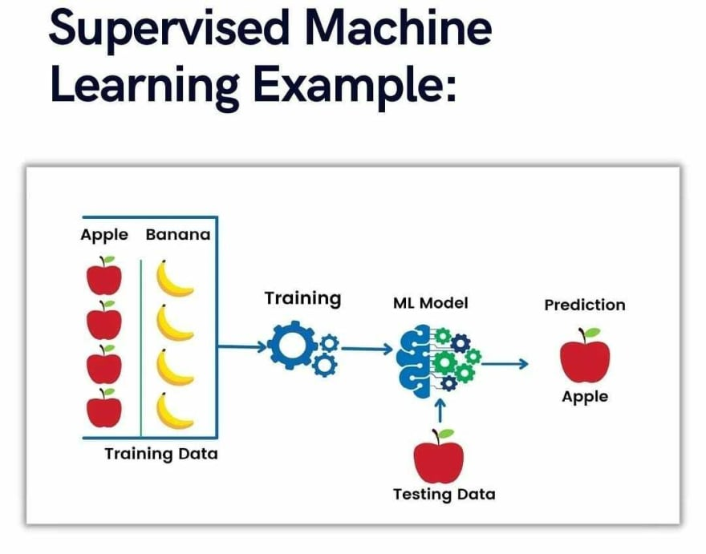
Supervised Learning
Problem: Classification/Regression
Model: MLP/CNN/Transformer
Data:
Real world Collection/Simulation

Slide 8
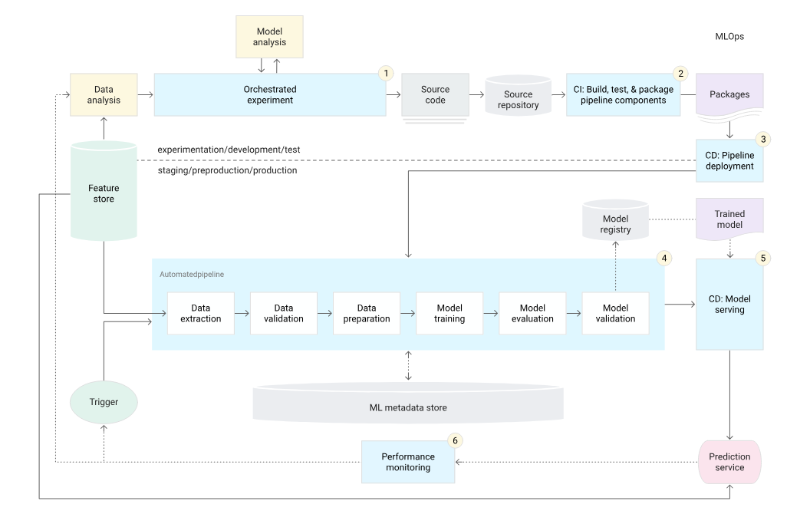
Supervised Learning- MLOps
ML operations (MLOps)
Automatic
CI: Continuous integration
CD: Continuous delivery
CT: Continuous testing
Pipeline [4]
[4] MLOps: Continuous delivery and automation pipelines in machine learning

Slide 9
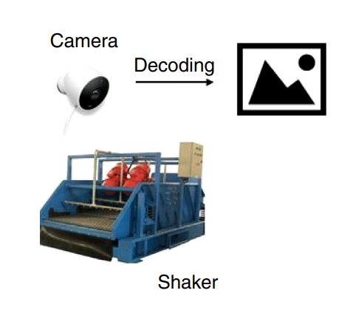
Industrial AI cases-real data
How AI help improving operational efficiency
Supervised learning for production level model training Mature MLOps (Machine Learning Operations Pipeline)
Automated Shale Shakers Monitoring
AI-enabled offshore drilling rigs by analyzing in real terms and saved labor working there or remotely. [4]
[4] Du, Xunsheng , Jin, Yuchen , Wu, Xuqing , Liu, Yu , Wu, Xianping (Sean), Awan, Omar , Roth, Joey , See, Kwee Choong, Tognini, Nicolas , Chen, Jiefu , and Zhu Han. "Classifying Cutting Volume at Shale Shakers in Real-Time Via Video Streaming Using Deep-Learning Techniques." SPE Drill & Compl 35 (2020): 317–328. doi: https://doi-org.ezproxy.lib.uh.edu/10.2118/194084-PA

Slide 10
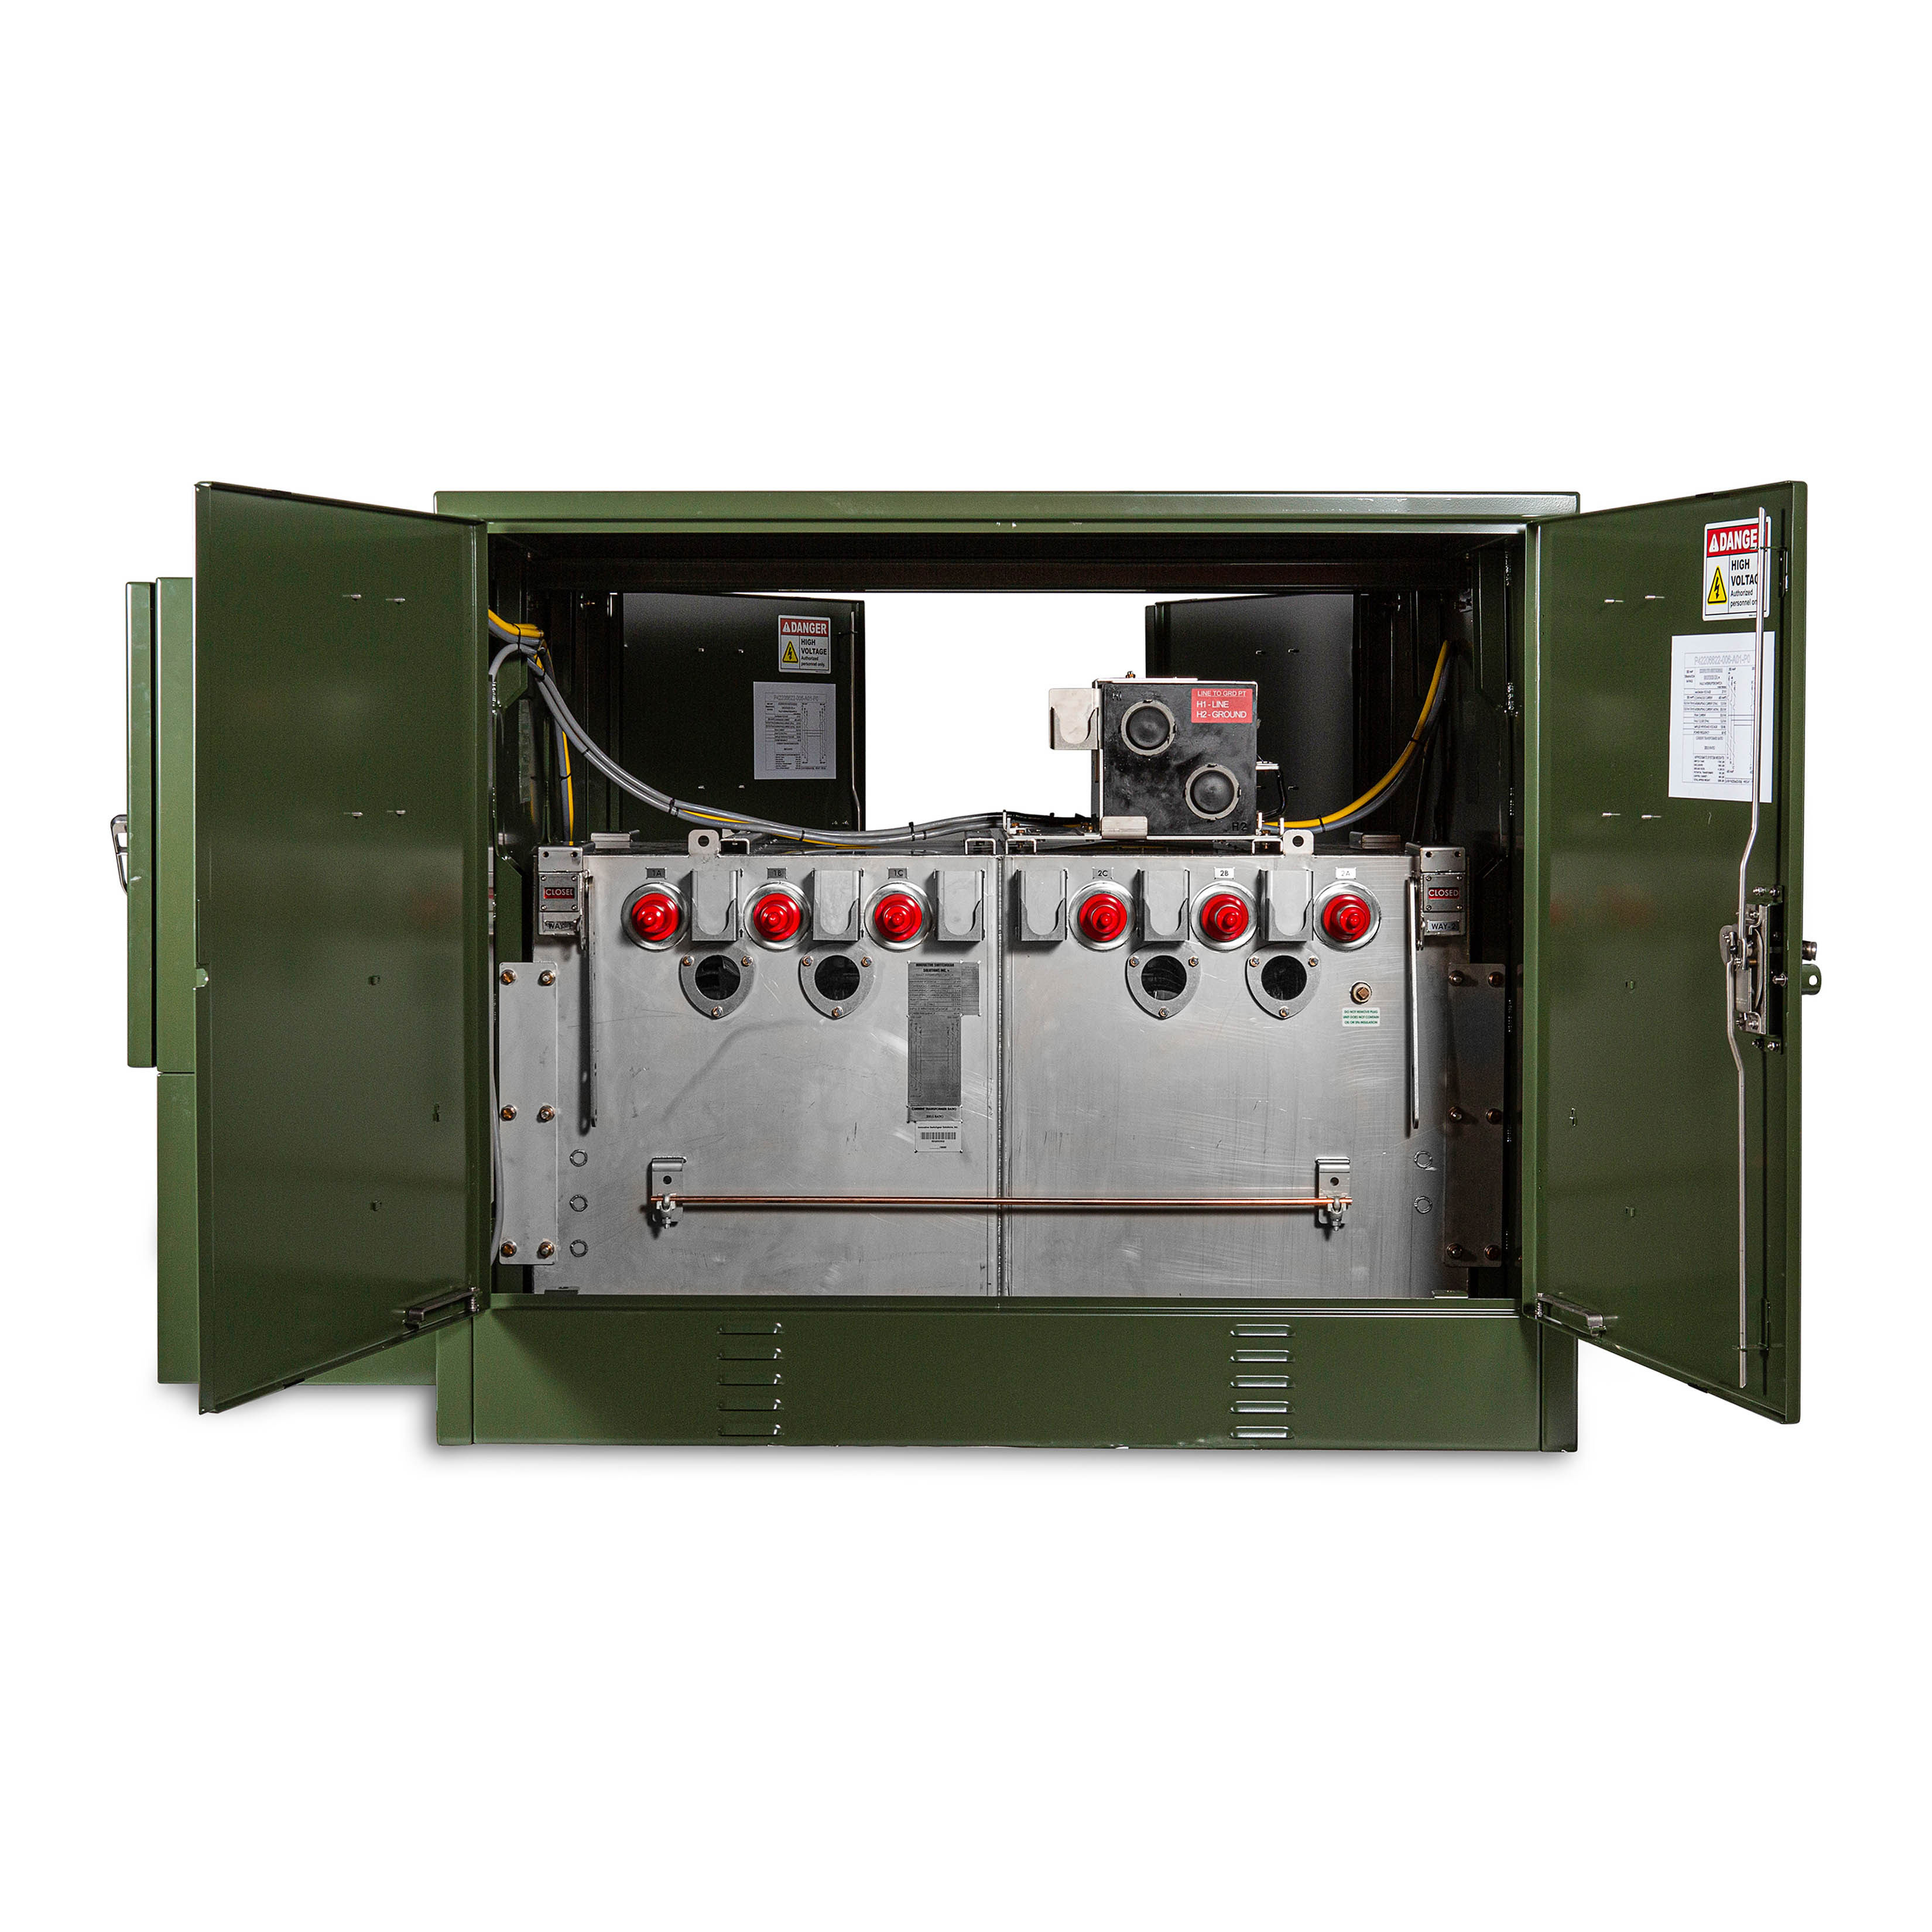
Industrial AI cases-real data
How AI helps improve Safety
Predictive maintenance
Drill Corrosion Detection and Maintenance
Pump/Vessel
/Tank
/Plant
/Pipeline Condition Monitoring
Based on the vibration sensor signal pattern recognition, AI can help prevent the risk of catastrophic caused by operation failure and reduce downtime.

Slide 11
Industrial AI cases-Simulated data
Idea: progressively shift training data distribution to production data
More accurate unmeasurable
environment parameters
Optimal decision
Approximated unmeasurable
environment parameters
Update
Inverse methods
AI generated Real-life measured sensor data
(full)
Digital twin/Simulator
Train
ML model
Simulated sensor data
(full)
Prediction
RPL: Robust Progressive Learning
Real-life measured sensor data
(partial)
BWE: Bandwidth extension
High-low frequency wave data (EM wave and Seismic wave) has
Non-linear relationship.
Using machine learning learn this mapping and help better imaging quality. [5] [6]
[5] Y. Jin, W. Hu, S. Wang, Y. Zi, X. Wu and J. Chen, "Efficient Progressive Transfer Learning for Full-Waveform Inversion With Extrapolated Low-Frequency Reflection Seismic Data," in IEEE Transactions on Geoscience and Remote Sensing, vol. 60, pp. 1-10, 2022, Art no. 5908810, doi: 10.1109/TGRS.2021.3129810.
[6] Y. Jin, Y. Zi, W. Hu, Y. Hu, X. Wu and J. Chen, "A Robust Learning Method for Low-Frequency Extrapolation in GPR Full Waveform Inversion," in IEEE Geoscience and Remote Sensing Letters, vol. 19, pp. 1-5, 2022, Art no. 8029305, doi: 10.1109/LGRS.2022.3205590.

Slide 12
Industrial AI cases-Simulated data
Ground truth
AI enhanced result
RPL: Robust Progressive Learning
BWE: Bandwidth extension
High-low frequency wave data (EM wave and Seismic wave) has
Non-linear relationship.
Using machine learning learn this mapping and help better imaging quality. [5] [6]
Low frequency information is missing and
AI can help enhance the result
[5] Y. Jin, W. Hu, S. Wang, Y. Zi, X. Wu and J. Chen, "Efficient Progressive Transfer Learning for Full-Waveform Inversion With Extrapolated Low-Frequency Reflection Seismic Data," in IEEE Transactions on Geoscience and Remote Sensing, vol. 60, pp. 1-10, 2022, Art no. 5908810, doi: 10.1109/TGRS.2021.3129810.
[6] Y. Jin, Y. Zi, W. Hu, Y. Hu, X. Wu and J. Chen, "A Robust Learning Method for Low-Frequency Extrapolation in GPR Full Waveform Inversion," in IEEE Geoscience and Remote Sensing Letters, vol. 19, pp. 1-5, 2022, Art no. 8029305, doi: 10.1109/LGRS.2022.3205590.

Slide 13
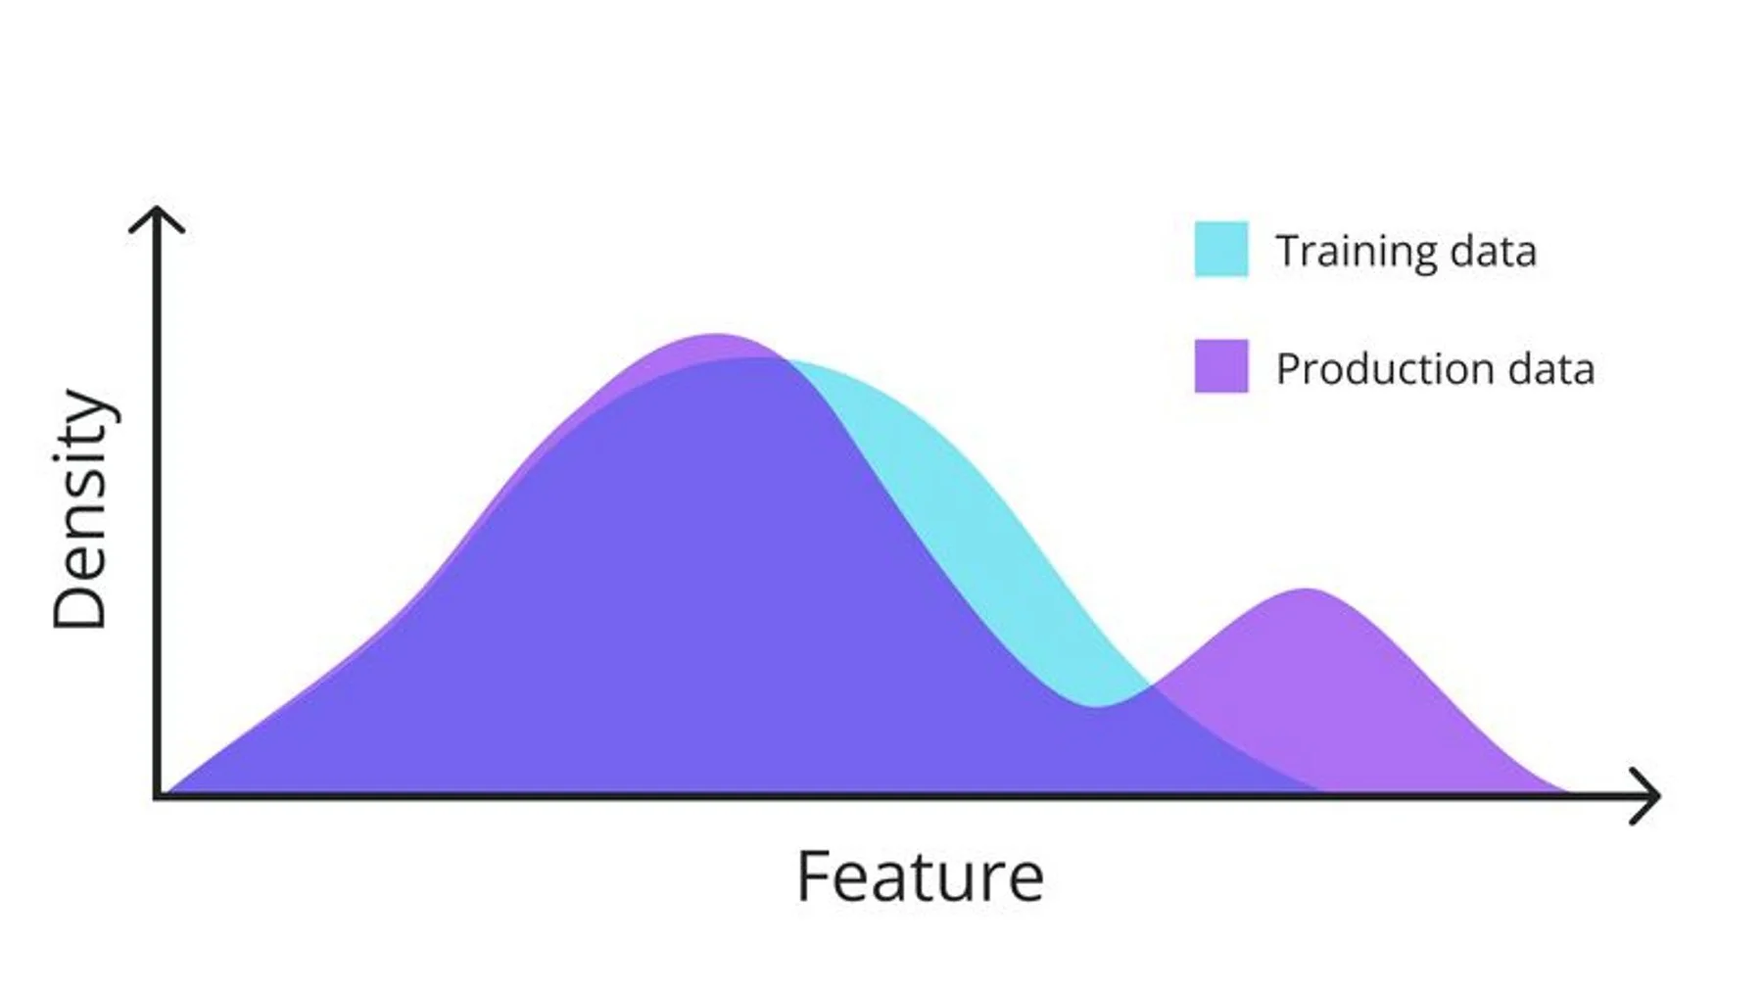
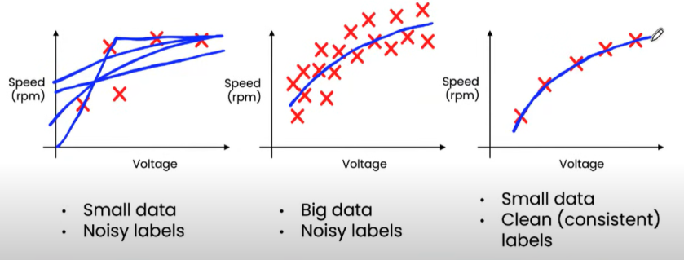
Supervised Learning-Lessons learned
Generalization problem: production data distribution shift
Real-world Collection:
Collect high-quality training data as closely as testing production scenarios. (lighting, rotation, environment)
Simulation:
Accurate real world sensing data
Simulator as similar as the production scenarios. (velocity model, Digital Twins)
Progressive designed Machine learning scheme

Slide 14
Outline
Introduction
Industry Challenges Overview
AI in Oil & Gas - A Transformative Force
Key AI Applications
Case 1: Supervised Learning-enhanced Subsurface Imaging
Case 2: Self-supervised Learning-enhanced Signal Processing
Case 3: Reinforcement Learning Subsurface Signal Processing
Case 4: Data-driven Optimization
Conclusion
Notes:
This presentation includes four parts. The first part is Distributionally Robust Optimization

Slide 15
Self-Supervised Learning
Problem: Denoising/
Reconstruction
Model: MLP/CNN/Transformer
[7]
Data:
Real world Collection/Simulation
[7] Yann LeCun @EPFL - "Self-supervised learning: could machines learn like humans?"

Slide 16
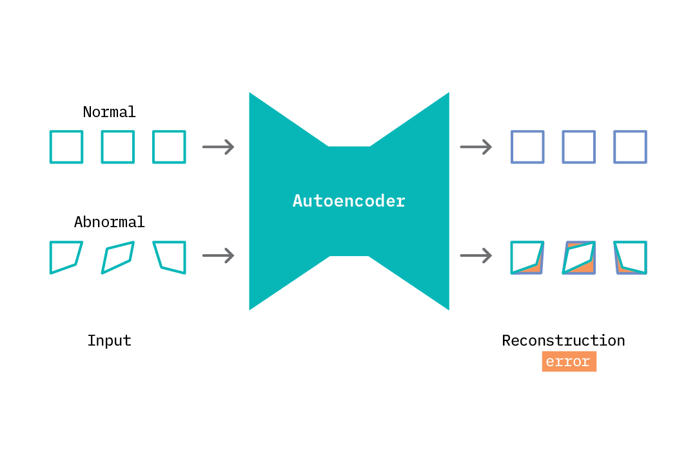
Self-Supervised Learning
Credit: https://ff12.fastforwardlabs.com/
Applications
Anomaly detection: Only train on normal data, ML cannot reconstruct abnormal data.
Denoising: Only train on signal, cannot reconstruct noise.

Slide 17
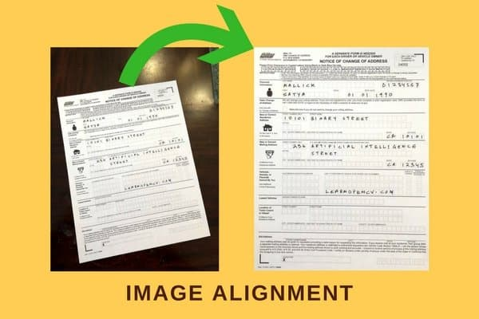
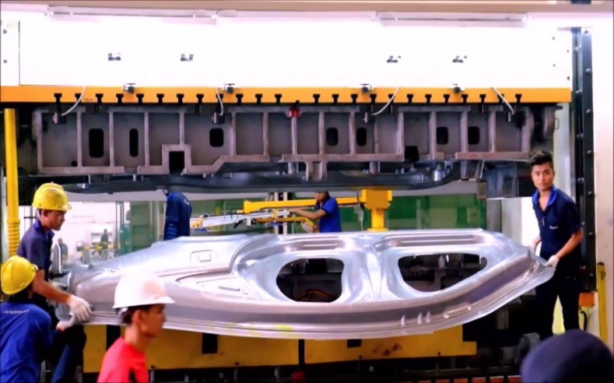
Self-Supervised Learning-cold start
How AI help improving operational efficiency
Automated Anomaly detection
Leason learned:
Making ML learn rotation is more complex and less cost-efficient than simplifying problems by image alignment or synchronization for time series data. Data preprocessing
Automated inspection system saves manufacturing workers from lifting heavy samples for vision inspection.

Slide 18
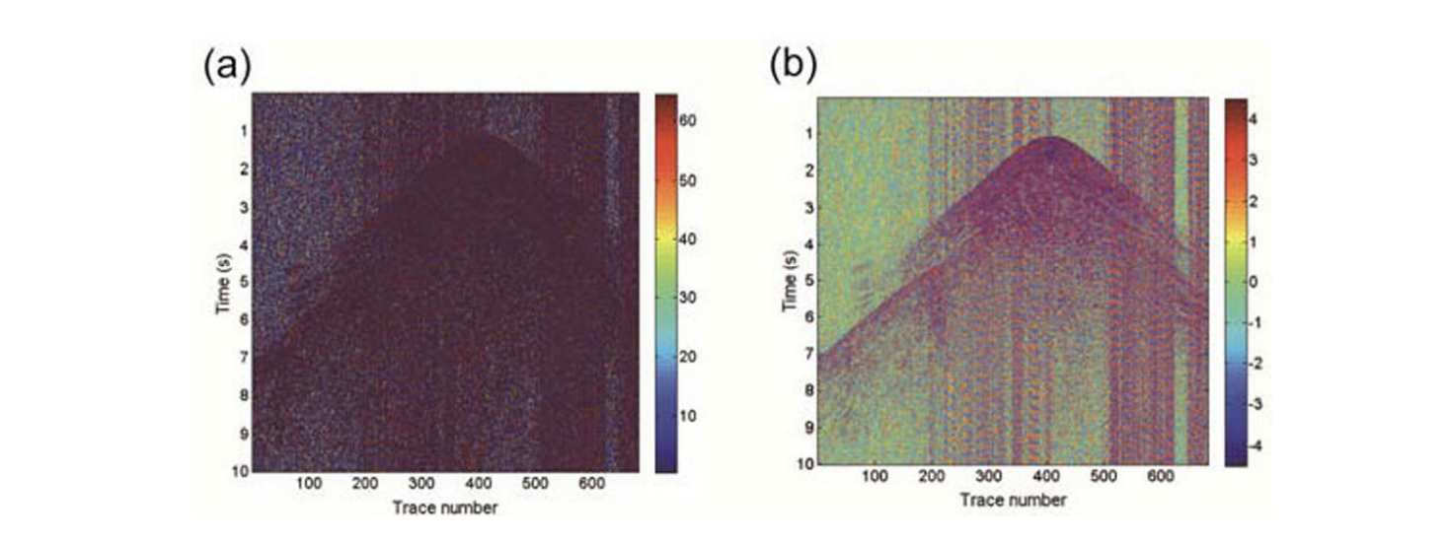
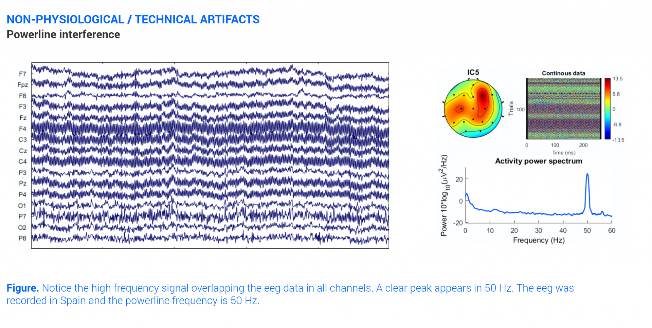
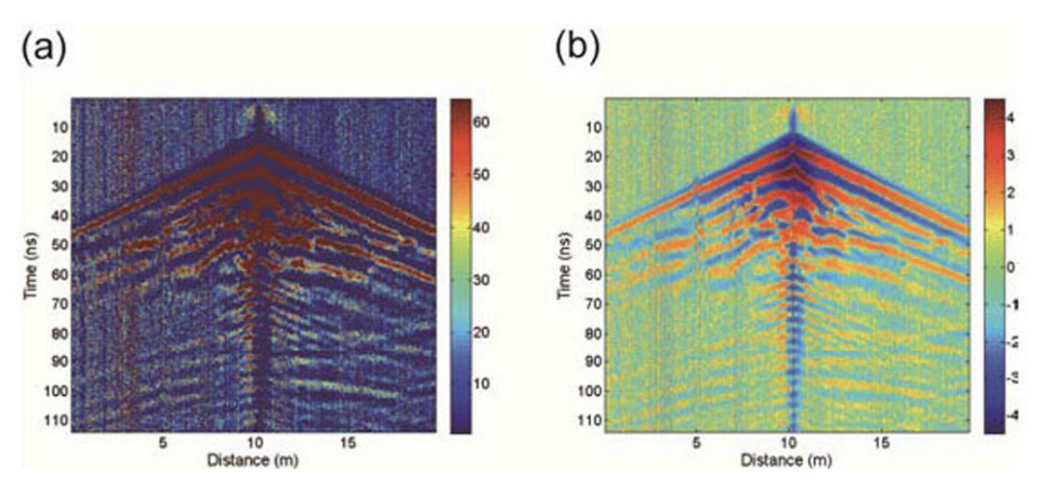
Self-Supervised Learning – denoise
Seismic data [8]
EEG data
(electroencephalogram)
[9]
GPR (Ground penetrating radar) data
[8]
Seismic
Swell Noise
[10]
Time
Receiver
[8] Jeng, Yih, and C-S. Chen. "A nonlinear method of removing harmonic noise in geophysical data." Nonlinear Processes in Geophysics 18.3 (2011): 367-379.
[9] Islam, Md Kafiul, Amir Rastegarnia, and Zhi Yang. "Methods for artifact detection and removal from scalp EEG: A review." Neurophysiologie Clinique/Clinical Neurophysiology 46.4-5 (2016): 287-305.
[10] Zi, Yuan, Shirui Wang, Pengyu Yuan, Xuqing Wu, Jiefu Chen, and Zhu Han. "Self-supervised learning for seismic swell noise removal." In Second International Meeting for Applied Geoscience & Energy, pp. 1910-1914. Society of Exploration Geophysicists and American Association of Petroleum Geologists, 2022.
18

Slide 19
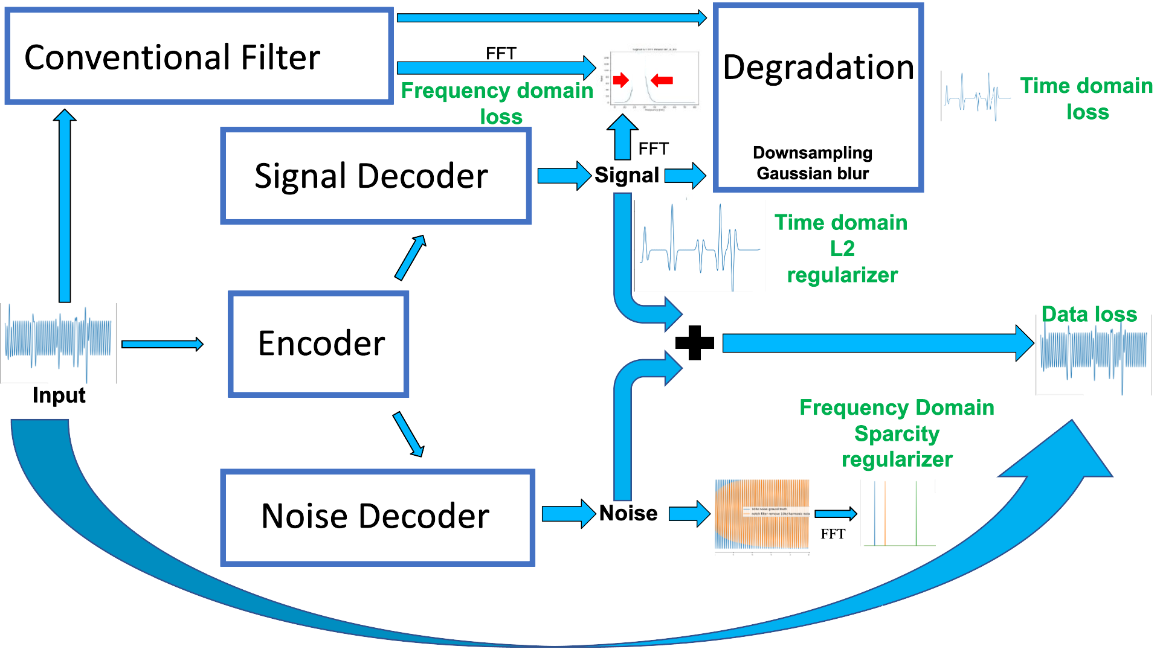
Self-Supervised Learning
Prior four
Prior four
Prior three
Prior three
Signal Decoder
Prior two
Prior two
Encoder
MSE Data
MSE Data
Noise Decoder
Prior one
Prior one
[11] Zi, Yuan, Wenyi Hu, Jiefu Chen, Xuqing Wu, and Zhu Han. "Physics-guided self-supervised learning for monochromatic noise removal." In SEG International Exposition and Annual Meeting, p. D011S058R002. SEG, 2021.

Slide 20
Self-Supervised Learning
Trust-band misfit loss
Entry-wise multiplication
Construct trust frequency spectrum mask
1D FFT
Each Trace
[10] Zi, Yuan, Shirui Wang, Pengyu Yuan, Xuqing Wu, Jiefu Chen, and Zhu Han. "Self-supervised learning for seismic swell noise removal." In Second International Meeting for Applied Geoscience & Energy, pp. 1910-1914. Society of Exploration Geophysicists and American Association of Petroleum Geologists, 2022.

Slide 21
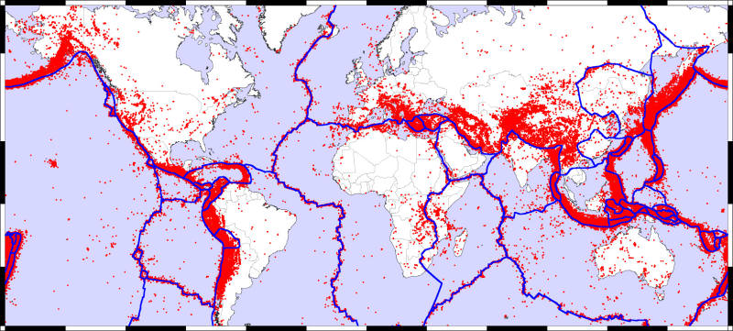
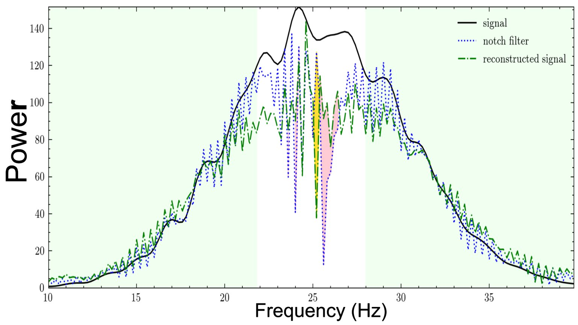
Self-Supervised Learning-Lessons learned
[12]
Map of the Earth showing fault lines (blue) and zones of volcanic activity (red). Credit: zmescience.com
Lessons learned
Simplifying the problem might save more time and cost compared to arm-racing ML models, hardware, and cost.
Physical priors and domain knowledge are keys to formulating self-supervised learning. (Focus on the high-risk area)
[11] Zi, Yuan, Wenyi Hu, Jiefu Chen, Xuqing Wu, and Zhu Han. "Physics-guided self-supervised learning for monochromatic noise removal." In SEG International Exposition and Annual Meeting, p. D011S058R002. SEG, 2021.

Slide 22
Outline
Introduction
Industry Challenges Overview
AI in Oil & Gas - A Transformative Force
Key AI Applications
Case 1: Supervised Learning-enhanced Subsurface Imaging
Case 2: Self-supervised Learning-enhanced Signal Processing
Case 3: Reinforcement Learning Subsurface Signal Processing
Case 4: Data-driven Optimization
Conclusion
Notes:
This presentation includes four parts. The first part is Distributionally Robust Optimization

Slide 23
Reinforcement Learning
The mathematic tool used to formulate the reinforcement learning is the Markov Decision Process (MDP)
Characteristics of the MDP
State $S=\left\{s_{n}\right\}$: a set of N states
Action $A=\left\{a_{m}\right\}$: a set of M actions
Reward $R: S×A→R$: reward function
$R=R(s_{n},a_{m})$
Transition probability P: 𝑆×𝐴→𝜋(𝑆)
Element in set P: $Pr\{s_{k}|s_{n},a_{m}\}$
Discount factor $γ∈\left[0,1\right)$
$γ$ → 1 : future reward
$γ$ → 0 : immediate reward
Agent
Environment
From state $s$, take action $a$
Get Reward $R$, new state $s′$

Slide 24
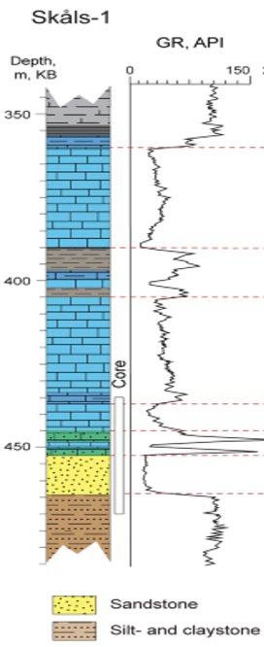
Reinforcement Learning: Signal Localization
Well 1
Well 2
Gamma-Ray Signal Localization Task
Many 1D signals containing the same signal pattern are collected by the well-logging process and sent to human-expert to do hand-picking for oil&gas localization.
Traditional methods
The human experts pick the patterns associated with interested rock based on one reference signal:
Recognize the pattern with domain prior knowledges.
Roughly matching with correlation matching methods.
[12] Zi, Yuan, Fan, Lei, Wu, Xuqing, Chen, Jiefu, Wang, Shirui, and Zhu Han. "Active gamma-ray well logging pattern localization with reinforcement learning." Paper presented at the SEG/AAPG International Meeting for Applied Geoscience & Energy, Houston, Texas, USA, August 2022. doi: https://doi.org/10.1190/image2022-3745281.1
[13] Y. Zi, L. Fan, X. Wu, J. Chen, S. Wang and Z. Han, "Active Gamma-Ray Log Pattern Localization With Distributionally Robust Reinforcement Learning," in IEEE Transactions on Geoscience and Remote Sensing, vol. 61, pp. 1-11, 2023, Art no. 5911011, doi: 10.1109/TGRS.2023.3278491.
Notes:
Now I will introduce Wasserstein DRO Application 1: A Transactive Energy Framework for Coordinated Energy Management of Networked Microgrids With Distributionally Robust Optimization
Transactive Energy Management Framework
A transactive market is organized by the Distribution Network Operator to coordinate the energy management of the DS and MGs in the operation
DS is connected with the HV system and the DNO needs to manage the power exchange between the DS and the HV system.

Slide 25
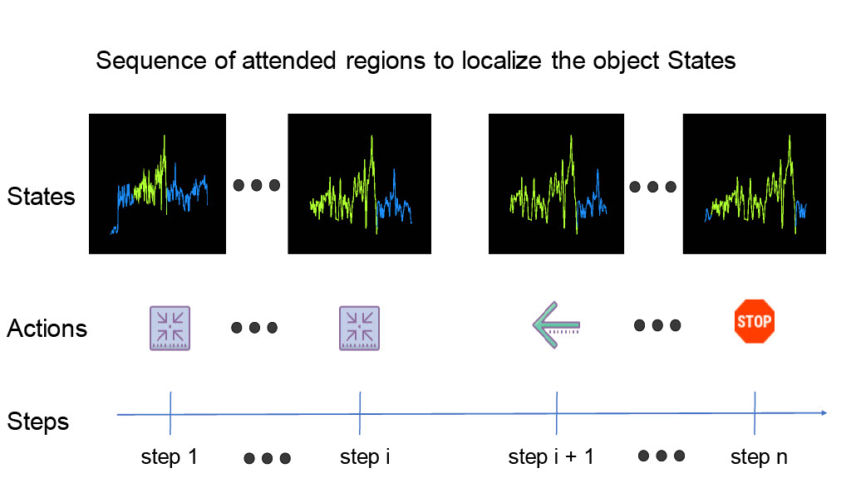
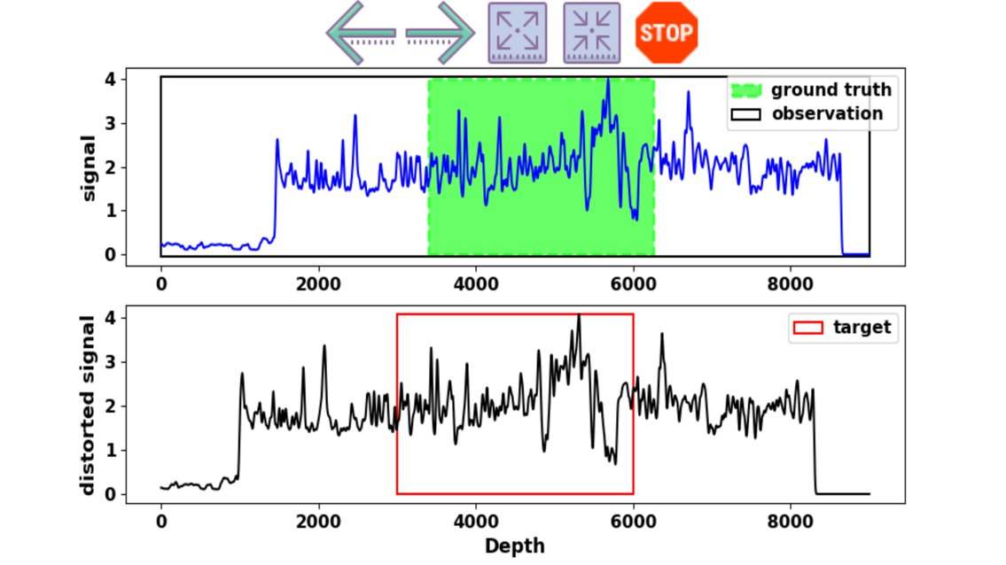
Reinforcement Learning: Signal Localization
Reinforcement Learning Signal Localization Scheme
Thoroughly studied log with interested signal fragment as reference/target.
In the new log, there is a signal fragment that has the same pattern as the reference
Initial the whole new log trace as the agent's observation.
Let the agent move (left, right, expand, shrink) to search the reference pattern.
Notes:
Optimization Model of Distribution Network Operator
cost for the scheduled power exchange between the DS and HV system
generation cost of the MTs in the DS.
the cost for the deviant power exchange between the DS and HV system
settlement between the DS and MGs
the power exchange between the DS and MG m by the solutions of the MGs' energy scheduling optimization

Slide 26
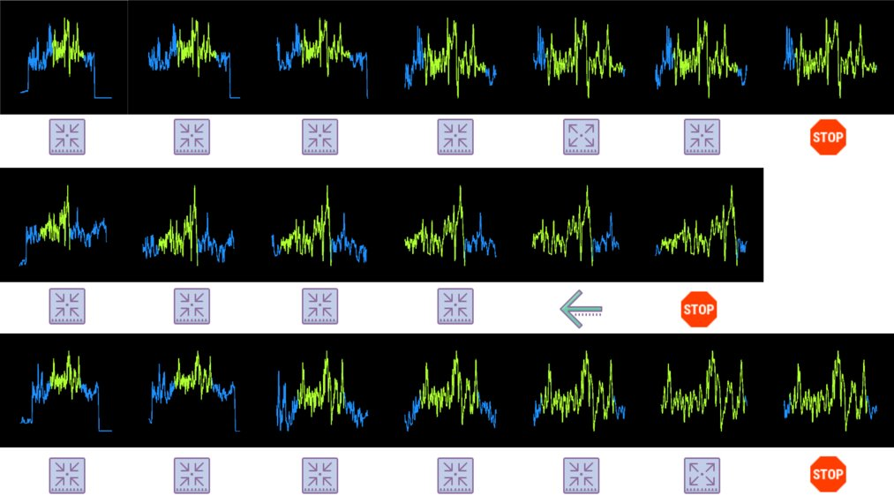
Reinforcement Learning: Signal Localization
The Top-down attention reinforcement learning searching model can successfully and efficiently localize the target.
Notes:
The Wasserstein distance can be defined in the following expression
An iterative algorithm based on the relaxation approach for the minimax optimization

Slide 27
Reinforcement Learning-Lessons learned
Agent
Environment
From state $s$, take action $a$
Lessons learned
Robust and safe constrains are crucial for the RL production applications.
Simpler action space design higher successful ratio for RL training.
Get Reward $R$, new state $s′$
Problem: Control/sequential decision-making
Model: Model based/Model Free
Data:
Real world Collection/Simulation

Slide 28
Outline
Introduction
Industry Challenges Overview
AI in Oil & Gas - A Transformative Force
Key AI Applications
Case 1: Supervised Learning-enhanced Subsurface Imaging
Case 2: Self-supervised Learning-enhanced Signal Processing
Case 3: Reinforcement Learning Subsurface Signal Processing
Case 4: Data-driven Optimization
Conclusion
Notes:
This presentation includes four parts. The first part is Distributionally Robust Optimization

Slide 29
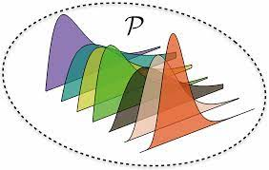
Data-driven Optimization
Robust Optimization (RO)
$\min_{x∈χ }{\max_{ξ∈U} h}\left(x,ξ\right)$ (2)
$x$ -- Decision variables
$ξ$ -- Uncertain Parameter
$χ$ -- Convex set of feasible solutions
$U$ -- Uncertain set
$h\left(x,ξ\right)$ -- Objective function in $x$ that depends on parameters $ξ$
Choose an intermediate approach to obtain a robust form of distributed optimization problem (DRO):
$\min_{x∈χ }{E_{P}[h\left(x,ξ\right)]}$ $\min_{x∈χ}{\max_{P∈𝒫}{E_{P}[h\left(x,ξ\right)]}}$
$𝒫$is an uncertain set of probability distributions constructed from the samples.
Stochastic Optimization (SO)
Distributionally Robust Optimization (DRO)
Notes:
We first consider Stochastic Programming which represents uncertain parameters by a random vector - a classical stochastic optimization: the probability distribution of random parameters is known (inferred from the historical data). Objective is to find a decision $x$that minimizes a functional of the expected cost.
The probability distribution of the random parameter vector is independent of decisions - exogenously given relaxing it requires addressing endogenous uncertainty. The "true" probability distribution of the random parameter vector is known relaxing it requires addressing distributional uncertainty.

Slide 30
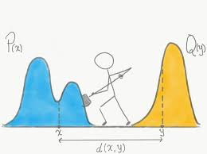
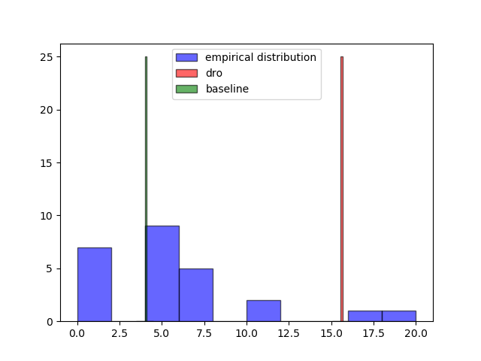
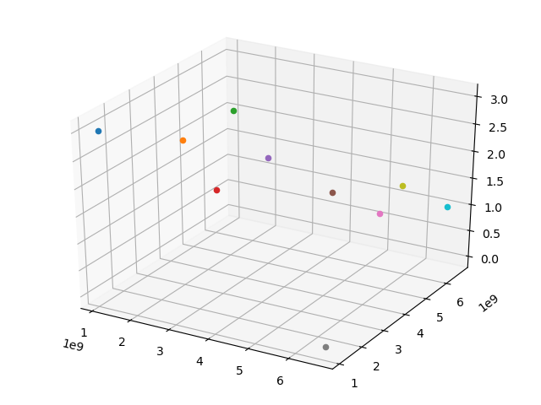
Data-driven Optimization: Methane sensor
Historical data
Wind Speed
Wind direction
Leakage rates
Potential leak positions (wells, pipelines and plants)
Numerical Simulation Software
Physical based
Methane Dispersion Simulation
Uncertainty Estimation
Distributionally Robust
Theory
Worst-case Scenarios under uncertainty
Sensor Placement Optimization
Using the distributionally robust expectation of worst detection time under uncertainty for sensor placement optimization.
Sensor locations
Notes:
We first consider Stochastic Programming which represents uncertain parameters by a random vector - a classical stochastic optimization: the probability distribution of random parameters is known (inferred from the historical data). Objective is to find a decision $x$that minimizes a functional of the expected cost.
The probability distribution of the random parameter vector is independent of decisions - exogenously given relaxing it requires addressing endogenous uncertainty. The "true" probability distribution of the random parameter vector is known relaxing it requires addressing distributional uncertainty.

Slide 31
Data-driven Optimization: Microseismic sensor
DRO placement is different from traditional
Lessons learned
Need to wisely choose methods for different Robust level requirements and data availability.
Data and fast simulation tool availabilities usually are bottlenecks for using these methods.
Right ambiguity set construction can easier the solving of problem.
Notes:
We first consider Stochastic Programming which represents uncertain parameters by a random vector - a classical stochastic optimization: the probability distribution of random parameters is known (inferred from the historical data). Objective is to find a decision $x$that minimizes a functional of the expected cost.
The probability distribution of the random parameter vector is independent of decisions - exogenously given relaxing it requires addressing endogenous uncertainty. The "true" probability distribution of the random parameter vector is known relaxing it requires addressing distributional uncertainty.

Slide 32
Conclusion
Introduction of challenges, opportunities and case studies of AI and data driven optimization. in Oil&Gas industry
Supervised Learning
Supervised learning are mature and powerful when high-quality labeled data are available.
Progressive training data updates can improve distribution shifting between training and production
Self-supervised Learning
Simplify problem might save more time and cost comparing arm racing ML models, hardware and cost.
Physical priors and domain knowledge are keys to formulating self-supervised learning.
Reinforce Learning
Some sequential decision making with small actions space in industry has potential to use RL.
Data-driven Optimization
Need to wisely choose methods for different Robust level requirements and data availability.
Data and fast simulation tool availabilities usually are bottlenecks for using these methods
Data and fast simulation tool availabilities usually are bottlenecks for using these methods.
Right ambiguity set construction can easier the solving of problem.
Notes:
And finally I will give some conclusions.
DRO accounts for the fact that one is never able to exactly specify a probability distribution in practice.
Distributionally robust chance constraints can be conservatively approximated by worst-case CVaR constraints.
The Wasserstein distributionally robust problems can often be reformulated as (or tightly approximated by) finite convex programs within a certain Wasserstein distance from the empirical distribution constructed from training samples.

Slide 33
Thank You Very Much
for
Your Attention !

