Slide 1


IEEE GC’ 23 Tutorial
Holographic Radio: A New Paradigm for Ultra-Massive MIMO
Lingyang Song*, Zhu Han#,
Boya Di*, and Hongliang Zhang*
*School of Electronics, Peking University, China
#Department of ECE, University of Houston, USA
ACK: Ruoqi Deng, Yutong Zhang, Haobo Zhang, Xiaoyu Zhang, and Xinyuan Hu
Notes:
全息多址接入

Slide 2
Objectives
To introduce a new paradigm to achieve ultra-massive MIMO using reconfigurable holographic surfaces (RHSs)
  Wireless Communications
  RF Sensing
To understand how to optimize and analyze RHS-aided networks
  Communication: higher data rate
  Sensing: higher detection accuracy
Notes:
随着5G通信的蓬勃发展，目前世界各国比如中国，美国，欧洲等地都已经开始了6G通信项目的相关研究工作，

Slide 3
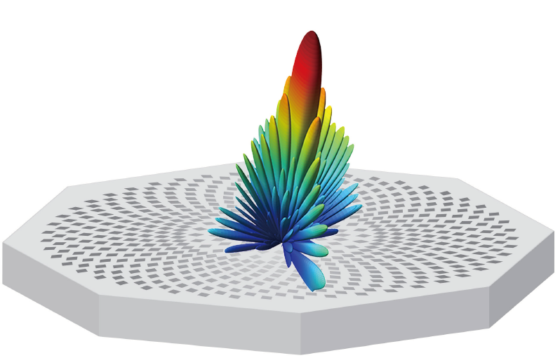
Outline
Background
  6G Communications and Requirements
  Holographic Radio Basics
Mathematical Tools
  Optimization Theory
RHS-aided Wireless Communications
  RHS-aided Holographic Beamforming
  A Limited Number of Radiation Amplitudes
  HDMA: Holographic-Pattern Division Multiple Access
  RHS-aided Satellite Communications
RHS-aided Sensing
  RHS Radar
  Holographic Integrated Sensing and Communication
Physical Implementations and Prototypes
  RHS-aided Communication and Sensing Platform

Slide 4
Sixth Generation--6G
A number of 6G projects have been started around the world.
2019, Finland
The Oulu university published the first white paper for 6G
2018.7, ITU-T
Established a focus group called Technologies for Network 2030
2019.9, Huawei (Canada)
Started research on future 6G mobile technology
2020.5, US
The president announced the start of several 6G research programs
2019.11, China
The country's Ministry of Science and Technology officially announced the start of work to create a 6G network
[1] L. U. Khan, I. Yaqoob, M. Imran, Z. Han and C. S. Hong, "6G Wireless Systems: A Vision, Architectural Elements, and Future Directions," IEEE Access, vol. 8, pp. 147029-147044, Aug. 2020.
Notes:
随着5G通信的蓬勃发展，目前世界各国比如中国，美国，欧洲等地都已经开始了6G通信项目的相关研究工作，

Slide 5
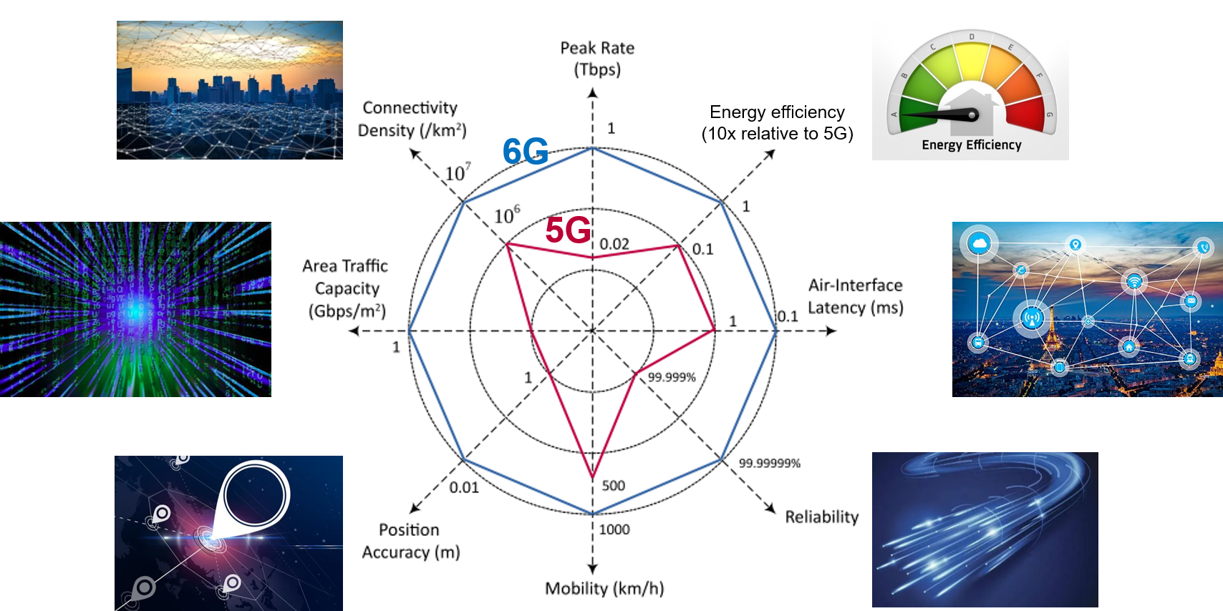
General 6G KPI Targets
Peak data rate 50x
[1] W. Jiang, B. Han, M. A. Habibi and H. D. Schotten, "The Road Towards 6G: A Comprehensive Survey," IEEE Open J. Commun. Society, vol. 2, pp. 334-366, Feb. 2021
Notes:
相比于5G，6G对通信的各项指标如通信速率，能量速率，通信可靠性，可支持用户数量等都提出了更高标准的要求，比如，6G要求通信速率达到Tbps量级，同时是要求能量效率，可支持用户数目都达到5G的10倍等等，这些要求对现有通信技术提出了极大的挑战

Slide 6
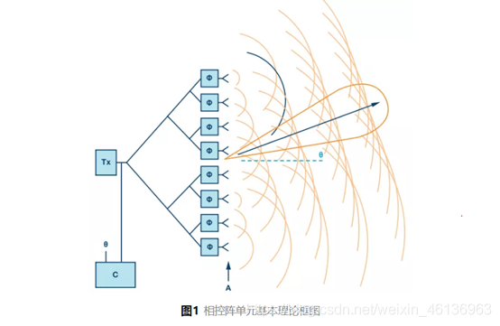
6G Ultra-massive MIMO
Massive multiple input multiple output (MIMO)
  Principle: Exploit spatial diversity through highly directional beamforming
  Development: MIMO → Massive MIMO →Ultra-massive MIMO
    Phase-controlled beamforming achieved by phased array
    Scaling up MIMO and size of phased array for significant
    data rate enhancement
MIMO
From single-antenna system to multi-antenna system
Massive MIMO
Scaling up MIMO by orders of magnitude
Ultra-massive MIMO
To meet the explosively increasing mobile data demands in 6G era
Notes:
为了实现6G高速率，海量连接的通信要求，目前所广泛采用的技术是空分多址技术，也就是SDMA，它通过高方向性的波束成形技术来实现空间分集，为了实现发射机可以在空间中发射出多个定向波束，具体的实现方法是采用MIMO多天线技术，利用相控阵对电磁波的相位进行控制从而产生定向波束，为了进一步提升通信系统的系统容量，可进一步扩大MIMO天线阵列的规模形成大规模MIMO乃至超大规模MIMO

Slide 7
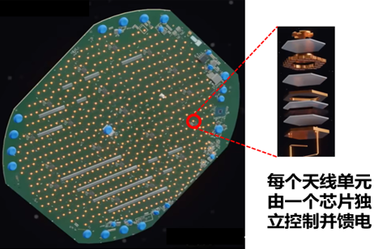

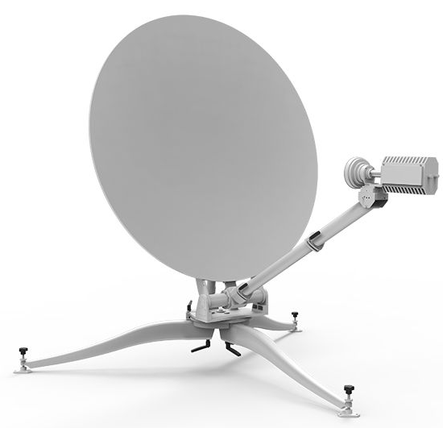
Dilemma in Conventional Massive MIMO
Phase Arrays in 5G
Costly hardware components: numerous phase shifters
High power consumption: complicated feeding network
Limiting the scale of the phased array
Reflecting Arrays for Satellites
Hard to integrate：the feed and antenna surface are separated, leading to bulky deployment
Limited resolution：relying on the mechanical manner for beam steering
Notes:
但是，利用传统的相控阵天线来实现超大规模MIMO在实际工程中是难以实现的，原因主要有两点，一是考虑工艺制造难度和天线性能，相控阵的单元间距一般为半波长，这样的间距便会限制在给定天线尺寸下相控阵的方向性增益，二是，相控阵依赖于昂贵的移相器和复杂的移相电路来实现波束成形，因此随着MIMO规模的不断增大，相控阵的硬件成本和功率损耗都会变得非常高，因此，需要新的天线技术来满足6G时代的通信要求

Slide 8
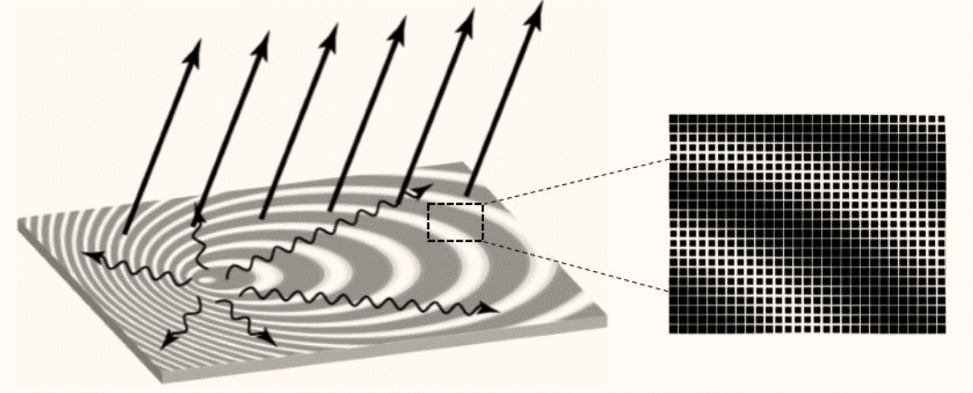
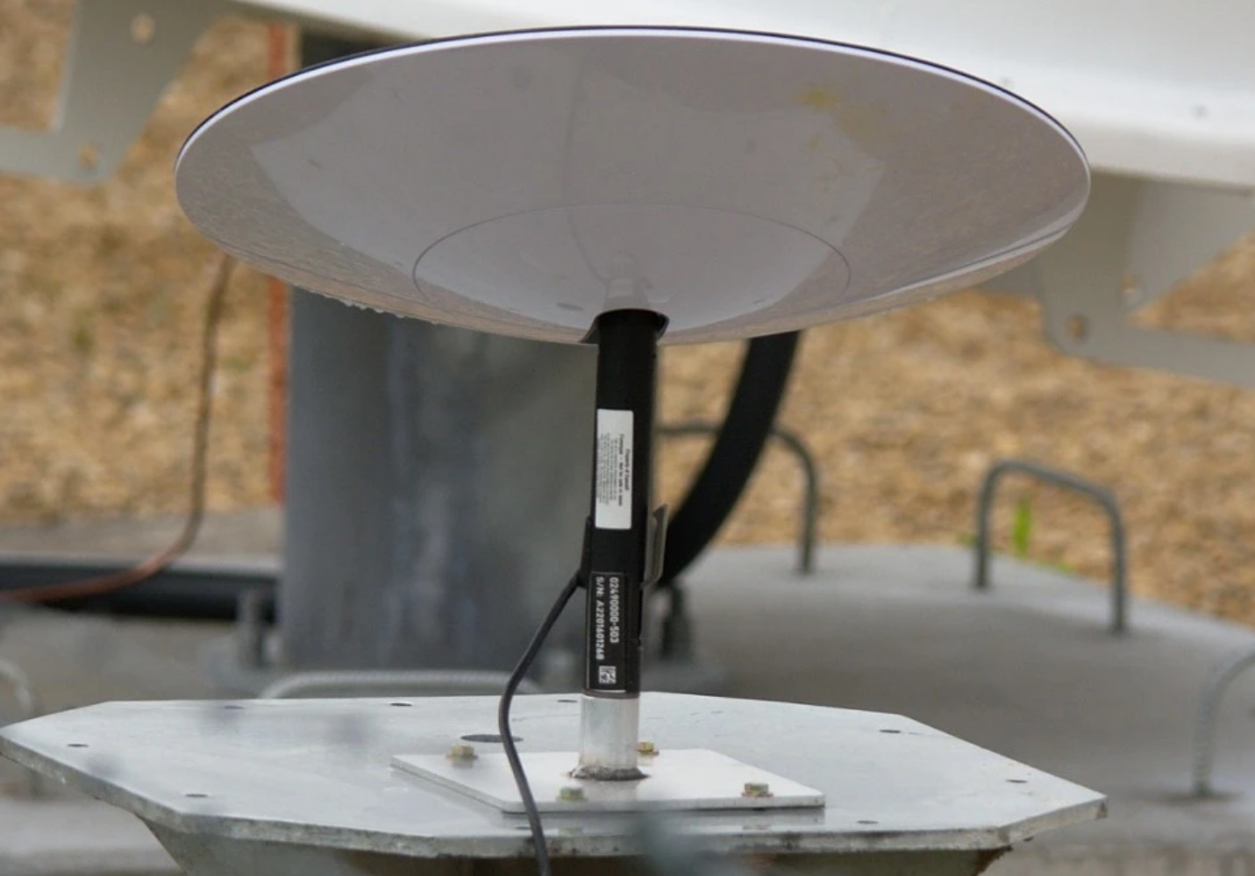
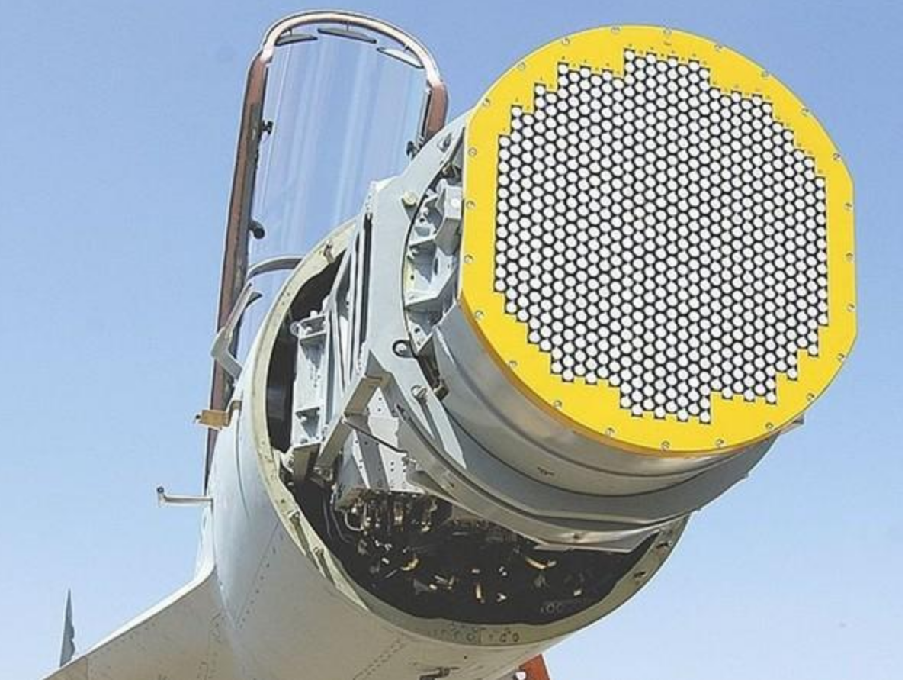
Solution: Holographic Antenna
Applying Hologram to Antenna Design
  Large Scale：numerous metallic patches
  Low Cost：PCB-level manufacturing
  Low Power Consumption: No complex phase-shifting circuits
Metallic patch
Holographic pattern
Military Applications
  Satellites & terrestrial communications
  Radar detection for aircrafts
Emergency Communications
Notes:
随着近年来超材料的不断发展，可重构超材料天线成为了一个很有前景的解决方案，首先，超材料天线的超材料单元排布更加紧密，单元间距通常小于四分之一波长，其次，超材料天线可以通过软件而不是昂贵的硬件器材来调控电磁波，因此它的硬件成本是很低的，最后，超材料天线内部没有功率放大器或者复杂的移相电路，功耗是很低， 因此可重构超材料天线可以有效克服相控阵的三大不足之处，是实现超大规模MIMO的有效手段

Slide 9
Basics of Holographic Antenna
Hardware Structure: A Type of Leaky Wave Antenna
  The surface composes of numerous metallic patches
  The feed (which inputs the transmit signal) is embedded in the surface
  EM wave propagates along the surface and then emitted to the free space
  Ultra-thin
Feed
Metallic patch
Holographic pattern
  Easy to be integrated
Key Concepts
  Holographic pattern: a specific geometric configuration of metallic patches according to the holographic principle
  One holographic pattern refers to a specific EM radiation pattern in the free space, which can be utilized to generate directional beams
Notes:
随着近年来超材料的不断发展，可重构超材料天线成为了一个很有前景的解决方案，首先，超材料天线的超材料单元排布更加紧密，单元间距通常小于四分之一波长，其次，超材料天线可以通过软件而不是昂贵的硬件器材来调控电磁波，因此它的硬件成本是很低的，最后，超材料天线内部没有功率放大器或者复杂的移相电路，功耗是很低， 因此可重构超材料天线可以有效克服相控阵的三大不足之处，是实现超大规模MIMO的有效手段

Slide 10
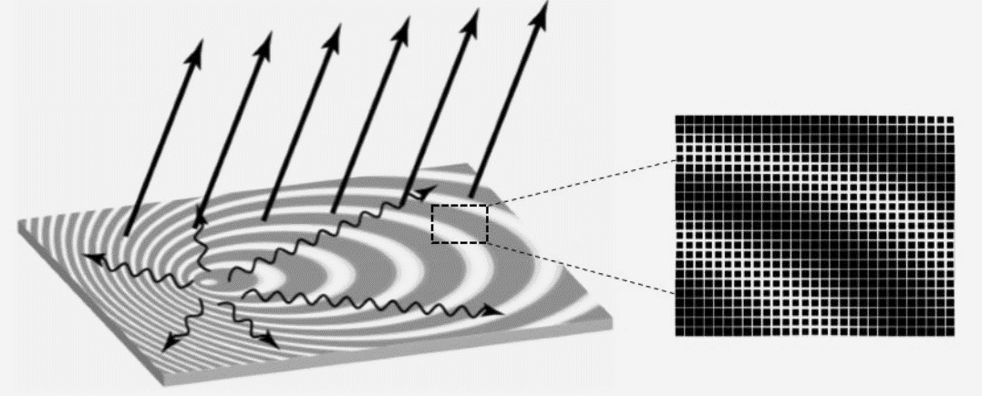

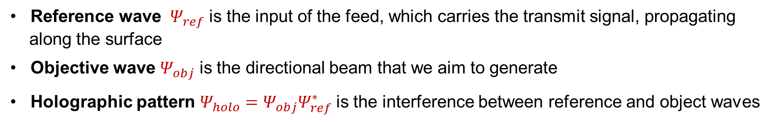




Working Principle of Holographic Antenna
Definitions
    Reference wave ${ Ψ}_{ref}$ is the input of the feed, which carries the transmit signal, propagating
    along the surface
    Objective wave $Ψ_{obj}$ is the directional beam that we aim to generate
    Holographic pattern $Ψ_{holo}=$ $Ψ_{obj}Ψ_{ref}^{∗}$ is the interference between reference and object waves
Step 1: Holographic Pattern Construction
$$Ψ_{obj}$$
$Ψ_{holo}=$ $Ψ_{obj}Ψ_{ref}^{∗}$
Record a holographic pattern $Ψ_{holo}$ by placing the metallic patches on the surface in a specific manner such that adjacent patches can interfere with each other
$Ψ_{holo}=$ $Ψ_{obj}Ψ_{ref}^{∗}$
$${ Ψ}_{ref}$$
Notes:
随着近年来超材料的不断发展，可重构超材料天线成为了一个很有前景的解决方案，首先，超材料天线的超材料单元排布更加紧密，单元间距通常小于四分之一波长，其次，超材料天线可以通过软件而不是昂贵的硬件器材来调控电磁波，因此它的硬件成本是很低的，最后，超材料天线内部没有功率放大器或者复杂的移相电路，功耗是很低， 因此可重构超材料天线可以有效克服相控阵的三大不足之处，是实现超大规模MIMO的有效手段

Slide 11


Working Principle of Holographic Antenna
Definitions
    Reference wave ${ Ψ}_{ref}$ is the input of the feed, which carries the transmit signal, propagating
    along the surface
    Objective wave $Ψ_{obj}$ is the directional beam that we aim to generate
    Holographic pattern $Ψ_{holo}=$ $Ψ_{obj}Ψ_{ref}^{∗}$ is the interference between reference and object waves
Step 2: Holographic Beamforming
$$Ψ_{obj}$$
$Ψ_{holo}=$ $Ψ_{obj}Ψ_{ref}^{∗}$
When the reference wave ${ Ψ}_{ref}$ is fed to the surface, it interferes with the holographic pattern $Ψ_{holo}$
$Ψ_{holo}{ Ψ}_{ref}∝$ $Ψ_{obj}{ |Ψ}_{ref}|2$
object wave is recovered
real-value
$${ Ψ}_{ref}$$
Notes:
随着近年来超材料的不断发展，可重构超材料天线成为了一个很有前景的解决方案，首先，超材料天线的超材料单元排布更加紧密，单元间距通常小于四分之一波长，其次，超材料天线可以通过软件而不是昂贵的硬件器材来调控电磁波，因此它的硬件成本是很低的，最后，超材料天线内部没有功率放大器或者复杂的移相电路，功耗是很低， 因此可重构超材料天线可以有效克服相控阵的三大不足之处，是实现超大规模MIMO的有效手段

Slide 12


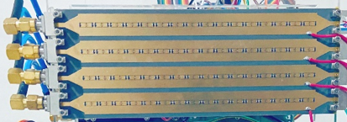
Evolution: Reconfigurable Holographic Surface
Limitation of the Holographic Antenna
  The configuration of metallic patches is fixed
  One holographic antenna corresponds to a fixed beam pattern
  Unable to support the mobile scenarios
Reconfigurable Holographic Surface (RHS)
By applying the reconfigurable metasurface technique to holographic antenna design, the holographic pattern can be reconfigured via metasurface elements
4 data streams
Notes:
随着近年来超材料的不断发展，可重构超材料天线成为了一个很有前景的解决方案，首先，超材料天线的超材料单元排布更加紧密，单元间距通常小于四分之一波长，其次，超材料天线可以通过软件而不是昂贵的硬件器材来调控电磁波，因此它的硬件成本是很低的，最后，超材料天线内部没有功率放大器或者复杂的移相电路，功耗是很低， 因此可重构超材料天线可以有效克服相控阵的三大不足之处，是实现超大规模MIMO的有效手段

Slide 13
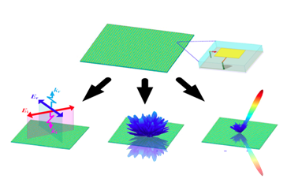

Reconfigurable Metasurface Technique
Metasurface
A thin surface composed of an array of elements
Reconfigurable Metasurface Element
Subwavelength, often in the range of $\frac{λ}{5}\sim \frac{λ}{2}$
Contain PIN diodes as active components
Electromagnetic responses of the element can be controlled by the biased voltages on the PIN diodes
Benefits
Capable of dynamically controlling the EM response of the antenna element
Low cost and low energy consumption owing to cheap PIN diodes and the PCB technique
Notes:
随着近年来超材料的不断发展，可重构超材料天线成为了一个很有前景的解决方案，首先，超材料天线的超材料单元排布更加紧密，单元间距通常小于四分之一波长，其次，超材料天线可以通过软件而不是昂贵的硬件器材来调控电磁波，因此它的硬件成本是很低的，最后，超材料天线内部没有功率放大器或者复杂的移相电路，功耗是很低， 因此可重构超材料天线可以有效克服相控阵的三大不足之处，是实现超大规模MIMO的有效手段

Slide 14
RHS Working Principle
Metasurface: a 2D planar structure consisting of numerous sub-wavelength elements
Reconfiguration: by controlling each element, the EM amplitude response can be controlled
  ① The feed (RF chain) inputs the reference wave to the surface, carrying the transmit signal
② When the reference wave arrives at each RHS element, it interplays with the holographic pattern and radiates part of energy into the space
Holographic pattern is recorded via amplitude responses
The amplitude response at each RHS element can be dynamically controlled by the diode
Reference wave on the surface
③ Reference wave turns into the radiated signals from multiple RHS elements, which superpose in the free space and form a directional beam (objective wave)
Notes:
随着近年来超材料的不断发展，可重构超材料天线成为了一个很有前景的解决方案，首先，超材料天线的超材料单元排布更加紧密，单元间距通常小于四分之一波长，其次，超材料天线可以通过软件而不是昂贵的硬件器材来调控电磁波，因此它的硬件成本是很低的，最后，超材料天线内部没有功率放大器或者复杂的移相电路，功耗是很低， 因此可重构超材料天线可以有效克服相控阵的三大不足之处，是实现超大规模MIMO的有效手段

Slide 15






Mathematical Details of RHS Working Principle
  1. Holographic pattern construction
$$Ψ_{ref}\left(r_{n_{y},n_{z}}^{k}\right)=exp\left(−jk_{s}⋅r_{n_{y},n_{z}}^{k}\right)$$
Reference wave
Desired object wave $Ψ_{obj}$
Holographic pattern $Ψ_{holo}=$ $Ψ_{obj}Ψ_{ref}^{∗}$
Propagation vector of the reference wave
The distance vector from feed $k$ to the element
$$Ψ_{obj}\left(r_{n_{y},n_{z}},θ_{0},φ_{0}\right)=exp\left(−jk_{f}⋅r_{n_{y},n_{z}}\right)$$
Objective wave
Propagation vector in free space
Position of the element
Holographic pattern
$$Ψ_{\text{holo} }\left(r_{n_{y},n_{z}}^{k},θ_{0},φ_{0}\right)=Ψ_{obj}Ψ_{ref}^{∗}$$
Reference wave ${ Ψ}_{ref}$
Feed
Notes:
在微波波段的全息原理和光学全息原理是一样的，RHS 会在超表面上创建全息图案来记录馈源产生的参考波和目标波束的干涉，当馈源发出的参考波激励全息图案时，RHS就能产生目标波束

Slide 16

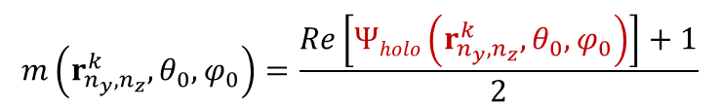


Mathematical Details of RHS Working Principle
  1. Holographic pattern construction
To construct the holographic pattern, we record its real-part information using the amplitude response of the element, which can adjusted by the embedded diode:
$$m\left(r_{n_{y},n_{z}}^{k},θ_{0},φ_{0}\right)=\frac{Re\left[Ψholo\left(r_{n_{y},n_{z}}^{k},θ_{0},φ_{0}\right)\right]+1}{2}$$
$$Re[Ψholo(r_{n_{y},n_{z}}^{k} ,θ_{0}, φ_{0})]=\cos{(k_{s}∙r_{n_{y},n_{z}}^{k}−k_{f}{∙r}_{n_{y},n_{z}})}$$
Desired object wave $Ψ_{obj}$
  Key idea: when the phase shift of the reference wave at an element is different from that of the objective wave, the element is detuned and radiates little energy into free space (small amplitude). Otherwise, the element is tuned to radiate much energy (large amplitude).
Holographic pattern $Ψ_{holo}=$ $Ψ_{obj}Ψ_{ref}^{∗}$
16
Reference wave ${ Ψ}_{ref}$
Feed
Notes:
在微波波段的全息原理和光学全息原理是一样的，RHS 会在超表面上创建全息图案来记录馈源产生的参考波和目标波束的干涉，当馈源发出的参考波激励全息图案时，RHS就能产生目标波束

Slide 17
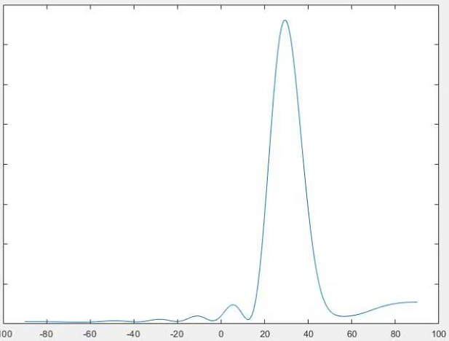
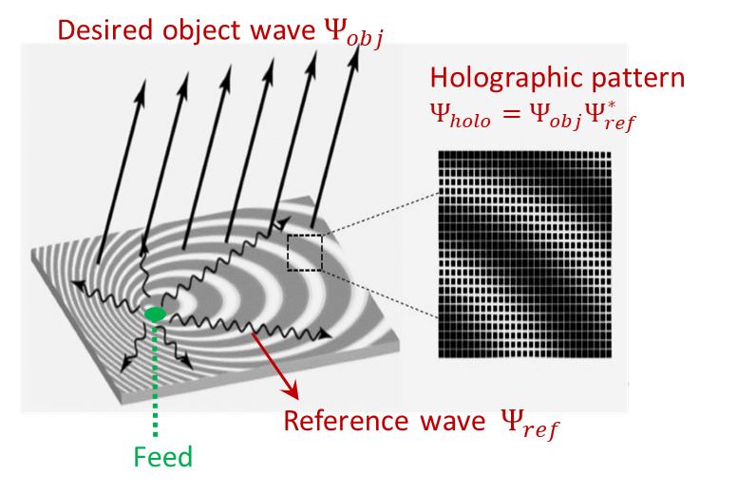

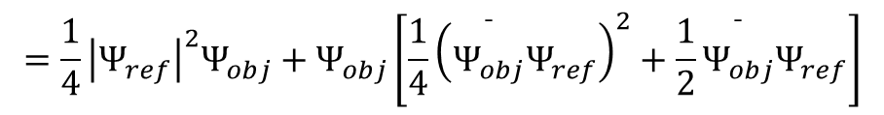
Mathematical Details of RHS Working Principle
  2. Holographic beamforming: generate the objective wave towards the target direction
The reference wave $Ψ_{ref}$ interferes with the holographic pattern ($r_{n_{y},n_{z}}^{k}$ is omitted for convenience)
$$\begin{aligned}m\left(θ_{0},φ_{0}\right)⋅Ψ_{ref}&=\frac{Re\left[Ψ_{holo}\left(θ_{0},φ_{0}\right)\right]+1}{2}⋅Ψ_{ref} \\ &=\frac{1}{4}Ψ_{obj}\left(θ_{0},φ_{0}\right){\left|Ψ_{ref}\right|}^{2}+\frac{1}{4}Ψ_{obj}^{∗}\left(θ_{0},φ_{0}\right)Ψ_{ref}^{2}+\frac{1}{2}Ψ_{ref} \\ & \\ \\ \\ a \\ =\frac{1}{4}\left(Ψ_{obj}\left(θ_{0},φ_{0}\right)\right)\left[{\left|Ψ_{ref}\right|}^{2}+C\right]\end{aligned}$$
Example: desired signal towards 30⁰
$$=\frac{1}{4}{\left|Ψ_{ref}\right|}^{2}Ψ_{obj}+Ψ_{obj}\left[\frac{1}{4}{\left(\overset{¯}{Ψ_{obj}}Ψ_{ref}\right)}^{2}+\frac{1}{2}\overset{¯}{Ψ_{obj}}Ψ_{ref}\right]$$
Neglectable sidelobe item
The desired signal is projected towards the target direction
Neglectable item
Notes:
在微波波段的全息原理和光学全息原理是一样的，RHS 会在超表面上创建全息图案来记录馈源产生的参考波和目标波束的干涉，当馈源发出的参考波激励全息图案时，RHS就能产生目标波束

Slide 18
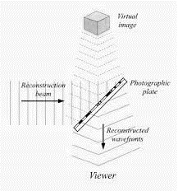
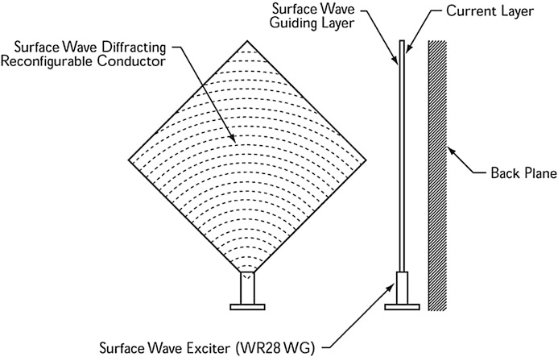
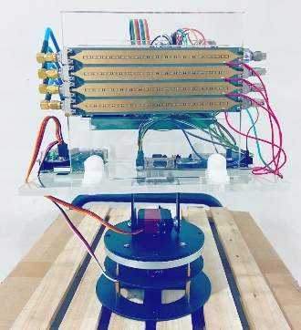
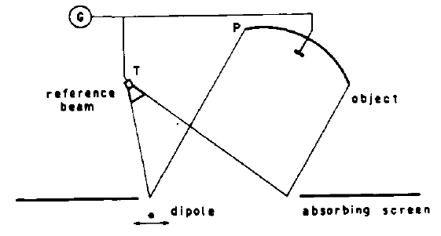
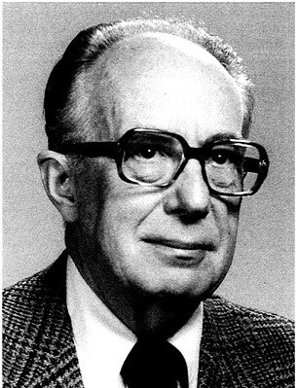
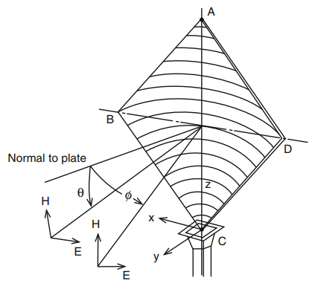
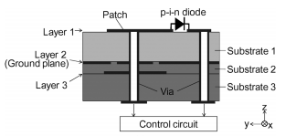
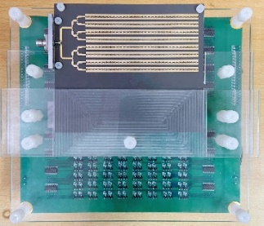
Historical Development
First proposal of holographic technology (D. Gabor)
First proposal and design of holographic antennas (P. F. Checcacci)
Introduction of surface wave theory (M. Elsherbiny)
Ku-band RHS enabled point-to-point communication （Peking Univ.）
1948
1970
2004
2021
1967
1975
2010~2011
2023
Holographic technology is first proposed in microwave band theoretically
(G. A. Deschamps)
Volume-type holographic antenna
(K. Lizuka)
Generalized Snell‘s law and PIN diode based modulation（N. Yu, H. Kamoda etc.）
5G mmWave RHS prototype
(Peking Univ.)
Notes:
随着近年来超材料的不断发展，可重构超材料天线成为了一个很有前景的解决方案，首先，超材料天线的超材料单元排布更加紧密，单元间距通常小于四分之一波长，其次，超材料天线可以通过软件而不是昂贵的硬件器材来调控电磁波，因此它的硬件成本是很低的，最后，超材料天线内部没有功率放大器或者复杂的移相电路，功耗是很低， 因此可重构超材料天线可以有效克服相控阵的三大不足之处，是实现超大规模MIMO的有效手段

Slide 19
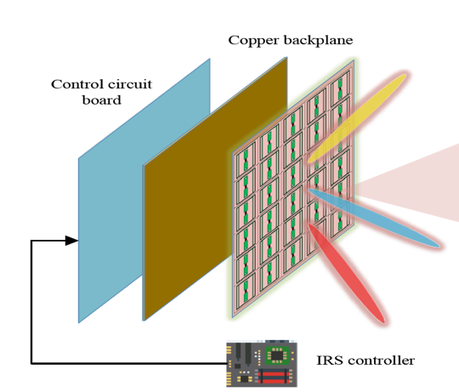
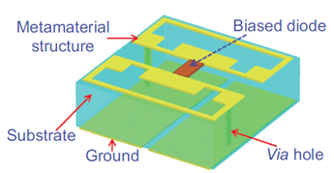
Another Solution: Reconfigurable Intelligent Surface
  Reconfigurable intelligent surface (RIS)
Middle layer
—— An ultra-thin metasurface composed of multiple layers
Inner layer
Outer layer: A 2D-array of RIS elements which directly interacts with incident signals
Middle layer: A copper plate which prevents the signal energy leakage
Inner layer: A printed circuit which connects the RIS elements to the RIS controller
Outer layer
RIS controller
PIN diode
RIS element
Low-cost sub-wavelength programmable metamaterial particle
Reflect incident RF signals and impose a controllable phase shift
RIS element

Slide 20
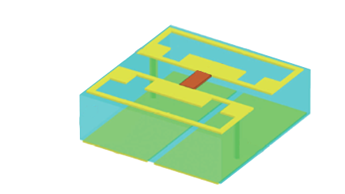
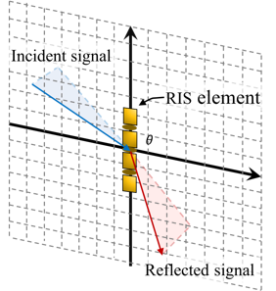

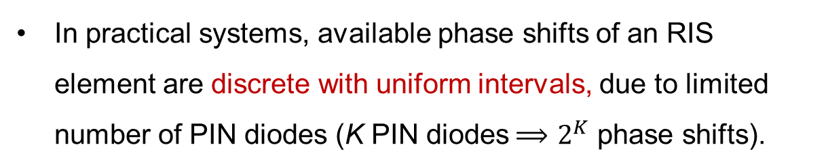





Working Principle of the RIS
  RIS works as a reflecter
Reflect: $e^{j2πft+θ}$
Incident: $e^{j2πft}$
Incident EM wave generates induced current
Signals can be reflected or transmitted (emitted from the induced current)
Phase shift of the radiation is controlled by PIN diodes’ bias voltages (ON/OFF of the diode)
Programming the ON/OFF of all diodes
collectively realize different beamforming modes
Refract: $e^{j2πft+θ}$
RIS element
Mechanism
Incident EM wave
$$x$$
Phase shifts
$$Γ,θ$$
In practical systems, available phase shifts of an RIS element are discrete with uniform intervals, due to limited number of PIN diodes (K PIN diodes$⟹$ $2^{K}$ phase shifts).
$$y$$
Emitted EM radiation
from induced
current

Slide 21
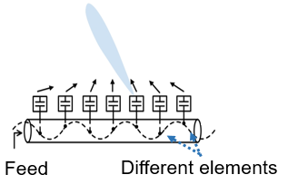
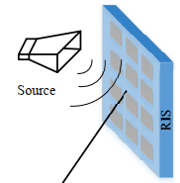
Differences Between RHS and RIS
Technology | Physical Structure | Operating Mechanism | Typical Applications
RHS | RF front end is integrated into a PCB | Leaky-wave antenna Series feeding | Transmit/Receive antennas Mounted on mobile platforms Sensing, microwave imaging
RIS | RF front end is on the outside of the meta-surface | Reflection antenna Parallel feeding | Passive relays Deployed in the cell edge for cell-edge users’ performance improvement
Simultaneous reflection

Slide 22
Typical Antennas
Item | Features | Active component | Cost | Power | Gain | Thickness | Weakness
Phased Array | Each element independently fed Parallel feeding | Phase shifters | High | High | Very High | Medium | The size is constrained by the hardware and manufacturing
RIS | RF front end is on the outside of the surface Parallel feeding | Diodes | Low | Low | Low | Thick | Limitations in deployment
RHS | Integrated feed and surface Series feeding | Diodes | Low | Low | High | Ultra-thin | Requires integrated design of the whole surface

Slide 23
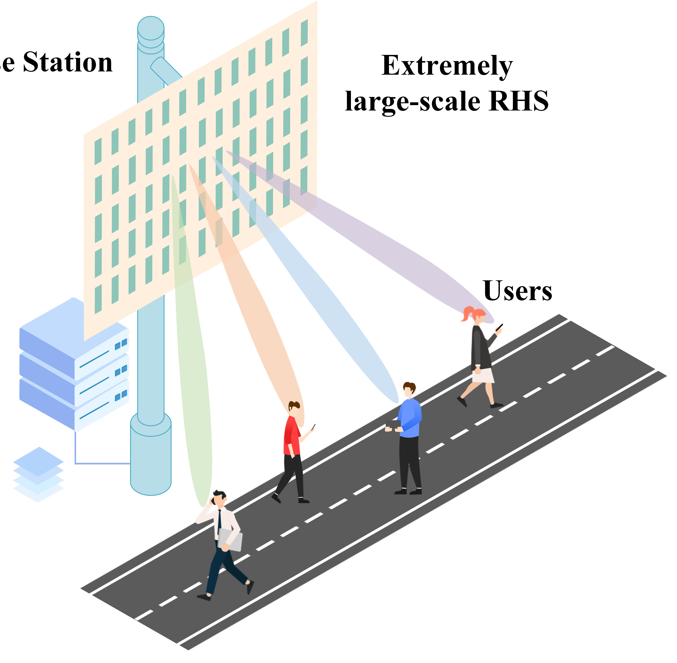

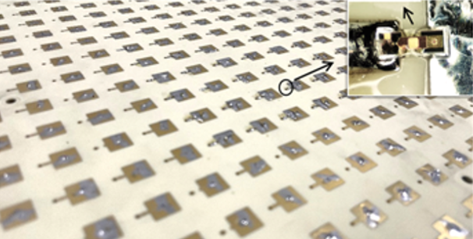

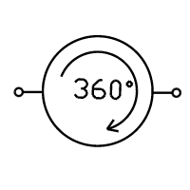

Applications: Wireless Communications
Spectrum efficiency enhancement
Large-scale deployment of RHS provides higher spatial diversity gain
Energy efficiency improvement
RHS has no active amplification internally and complex phase-shifting circuits
  Spectrum efficiency
BS
RHS
  Energy efficiency

Slide 24
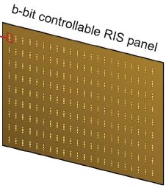

Applications: Sensing
RHS radar
Enhance the detection accuracy by leveraging the superior beam-steering capability of the RHS
Reduce the complexity and cost of the radar system
RHS-aided integrated sensing and communication
Increase the integration density of the ISAC system due to the low profile of the RHS
RHS
TX RHS
Transmitter
Target
Receiver
RX RHS
Beam-steering capabilities

Slide 25
Outline
Background
  6G Communications and Requirements
  Holographic Radio Basics
Mathematical Tools
  Optimization Theory
RHS-aided Wireless Communications
  RHS-aided Holographic Beamforming
  A Limited Number of Radiation Amplitudes
  HDMA: Holographic-Pattern Division Multiple Access
  RHS-aided Satellite Communications
RHS-aided Sensing
  RHS Radar
  Holographic Integrated Sensing and Communication
Physical Implementations and Prototypes
  RHS-aided Communication and Sensing Platform

Slide 26
Optimization Theory
Convex Set and Convex Functions
Gradient Descent and Newton’s Method
Duality and KKT Condition

Slide 27
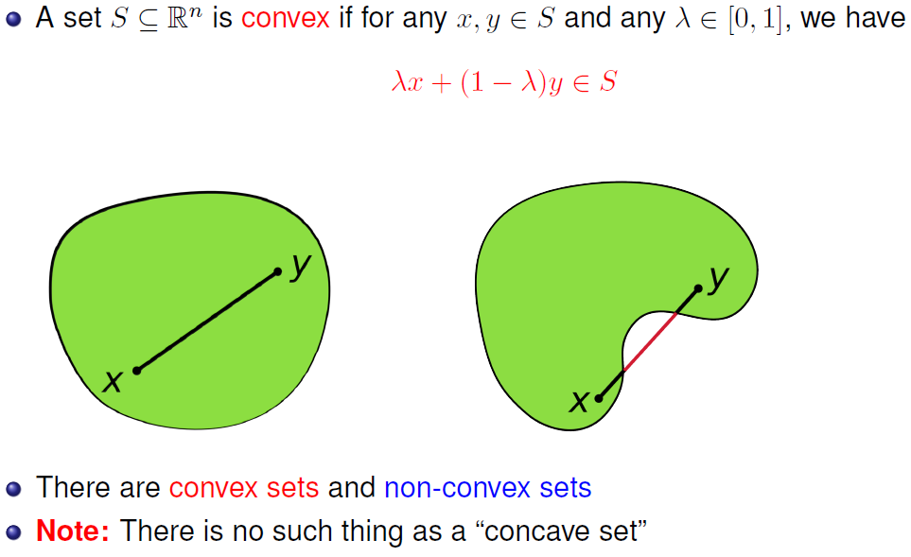
Convex Set

Slide 28
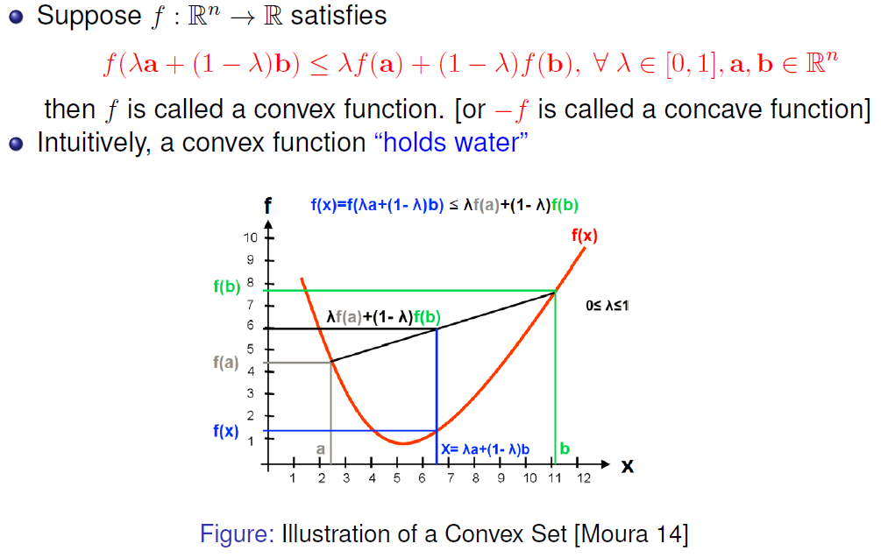
Convex Function

Slide 29
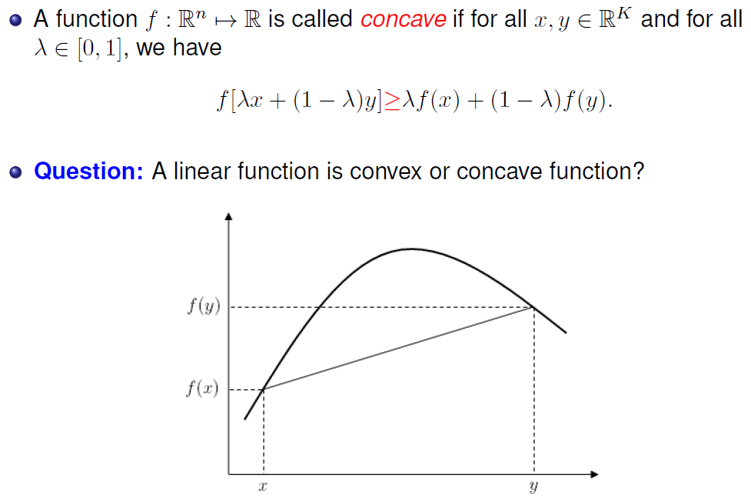
Concave Function

Slide 30
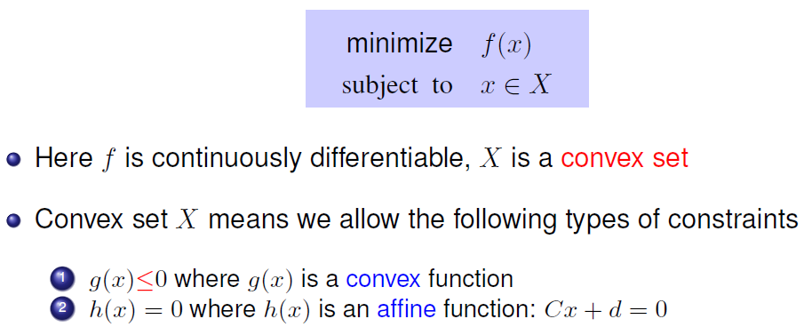
Convex Optimization
Convex means local minimum = global minimum

Slide 31
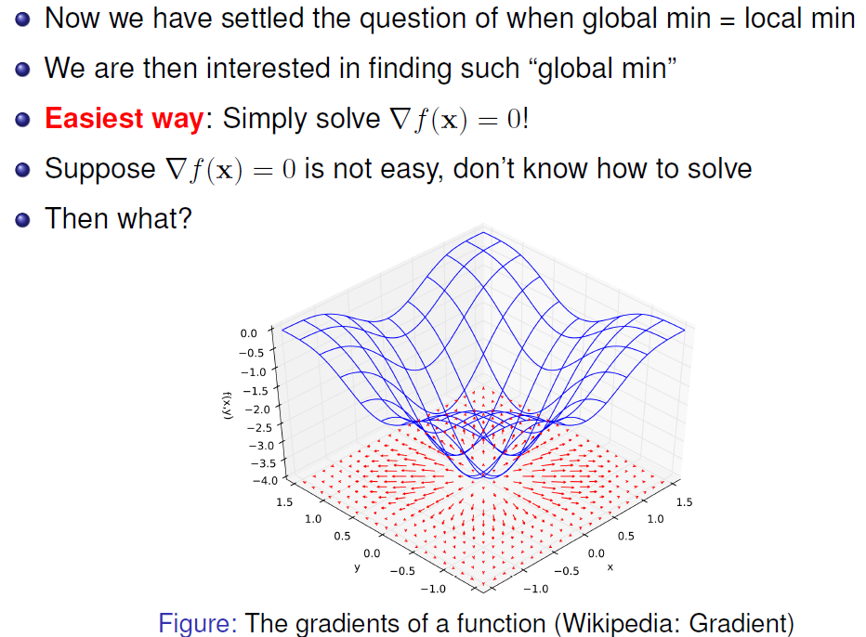
Algorithms to Find Optimum

Slide 32
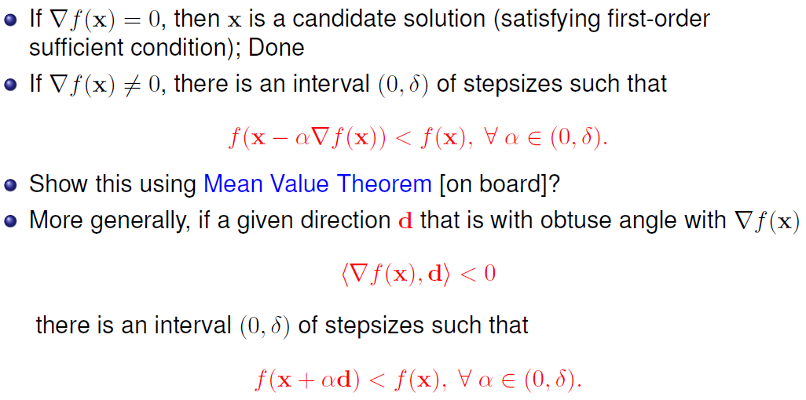
Gradient Descent Method

Slide 33
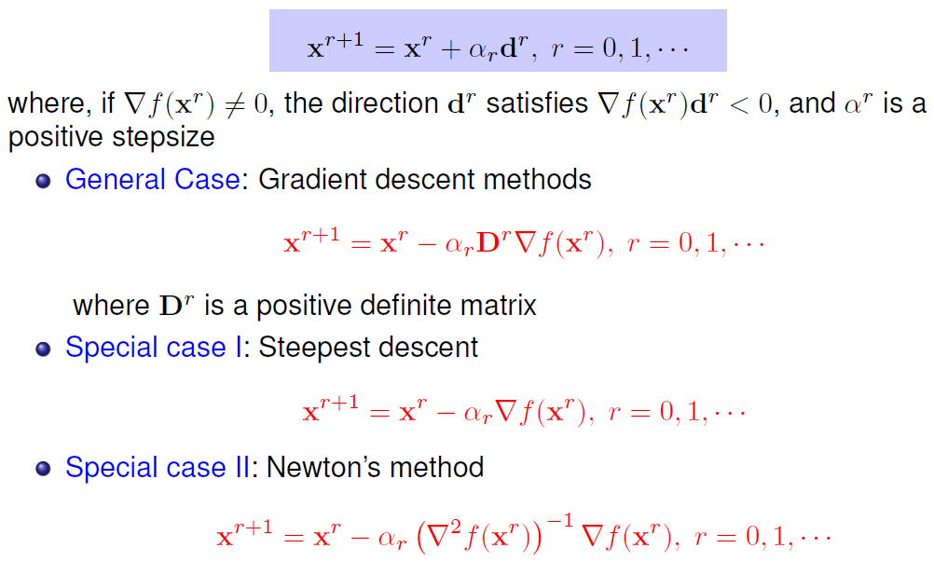
Iterative Descent Method

Slide 34
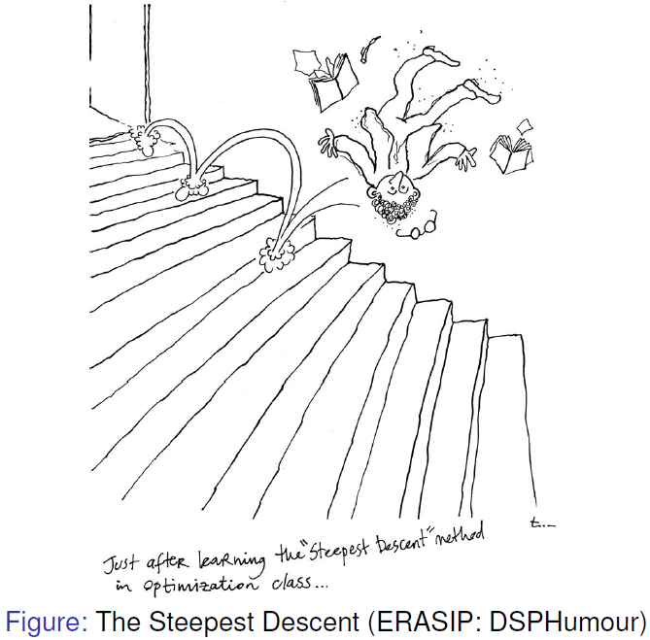
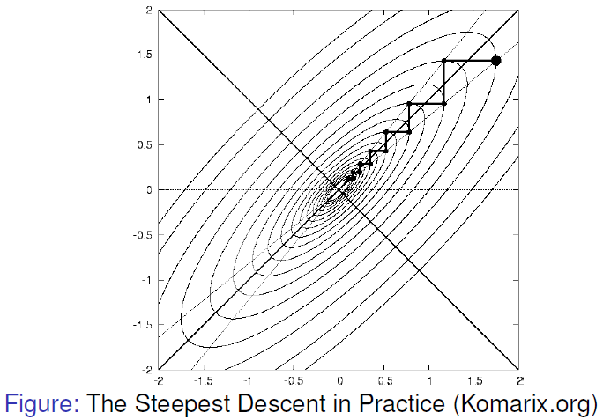
Shortcoming of Gradient Method
However, in practice steepest descent may have slow convergence

Slide 35
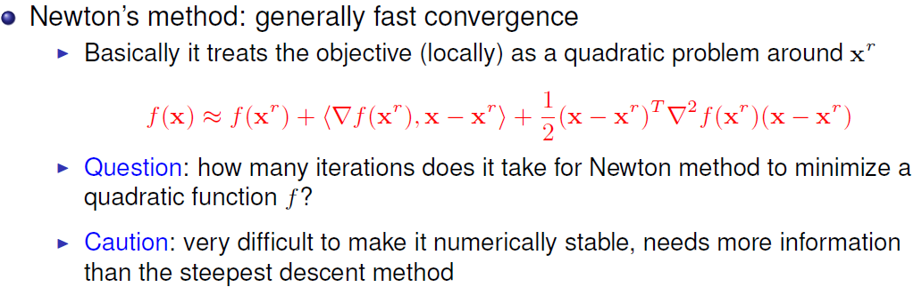
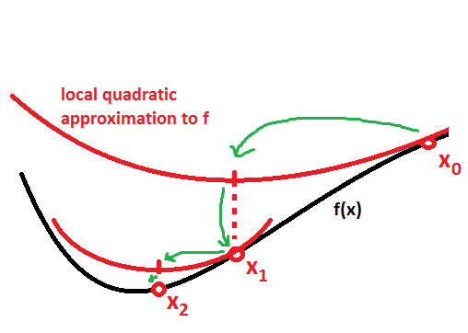
Newton’s Method

Slide 36
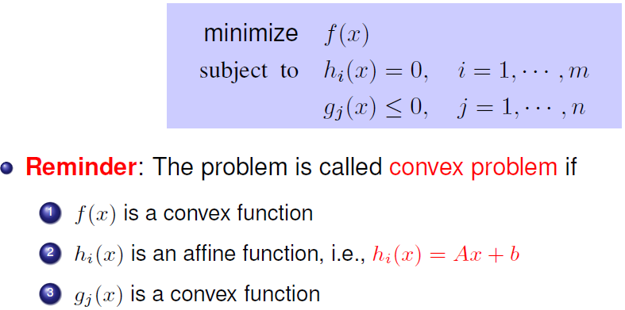
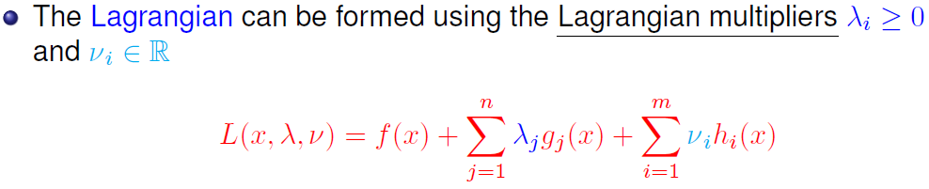
Lagrangian Multiplier

Slide 37


Duality

Slide 38

Duality

Slide 39

KKT Condition: When to Stop?

Slide 40

Barrier Function

Slide 41


Interior Point Method

Slide 42
Outline
Background
  6G Communications and Requirements
  Holographic Radio Basics
RHS-aided Wireless Communications
  RHS-aided Holographic Beamforming
  A Limited Number of Radiation Amplitudes
  HDMA: Holographic-Pattern Division Multiple Access
  RHS-aided Satellite Communications
RHS-aided Sensing
  RHS Radar
  Holographic Integrated Sensing and Communication
Physical Implementations and Prototypes
  RHS-aided Communication and Sensing Platform

Slide 43

New Challenges
Parallel transmission → Serial transmission
Power Divider
Phase control
→ Amplitude control
Feed
Traditional phase arrays
RHS
  Transmission model：
  signal propagates along the surface, urging new models
  2. Amplitude control：
  traditional phase-controlled beamforming does not apply
Beamforming technique
Holographic beamforming for multiple beams
Low-complexity space-domain multiplexing based on holographic pattern superposition
Multiple Access
Notes:
在微波波段的全息原理和光学全息原理是一样的，RHS 会在超表面上创建全息图案来记录馈源产生的参考波和目标波束的干涉，当馈源发出的参考波激励全息图案时，RHS就能产生目标波束

Slide 44
Case Study I: RHS-aided Holographic Beamforming
RHS Enabled Multi-User Wireless Communications:
Amplitude-Controlled Holographic Beamforming
Ruoqi Deng, Boya Di, Hongliang Zhang, Yunhua Tan, and Lingyang Song, “Reconfigurable holographic surface-enabled multi-user wireless communications: amplitude-controlled holographic beamforming”, IEEE Trans. Wireless Commun., vol. 21, no. 8, Aug. 2022.
Notes:
每个单元的谐振频率可以被独立调控。这样，在给定频段，我们就可以通过调整谐振频率来改变这个频率的辐射幅度。

Slide 45


System Model
Scenario
  Downlink RHS-aided multi-user communication system
    A BS equipped with an RHS transmits to $K$ users
    Each user equipped with a single antenna
    RHS: 𝐾 feeds, $N_{y}×N_{z}$radiation elements
Key Questions
How to model the signal propagation on the surface?
How to generate multiple beams via the RHS-enabled holographic beamforming?

Slide 46



System Model
Scenario
  Downlink RHS-aided multi-user communication system
    A BS equipped with an RHS transmits to $K$ users
    Each user equipped with a single antenna
    RHS: 𝐾 feeds, $N_{y}×N_{z}$radiation elements
RHS-aided hybrid beamforming framework
  BS: Digital beamforming $V$
  RHS: Holographic beamforming $M$
Enabling the function of traditional analog beamforming
$K$ data streams

Slide 47







Holographic Beamforming Model
Holographic beamformer:
$$M∈ℂ^{N_{y}N_{z}×K}$$
reference wave
$$M_{n_{y},n_{z}}^{k}=\sqrt{η}⋅m_{n_{y},n_{z}}⋅e^{−α\left|r_{n_{y},n_{z}}^{k}\right|}⋅e^{−jk_{s}⋅r_{n_{y},n_{z}}^{k}}$$
Element-wise $Ψ_{holo}{ Ψ}_{ref}$
$m_{n_{y},n_{z}}∈\left[0,1\right]$: the radiation amplitude response of the $\left(n_{y},n_{z}\right)$-th RHS element, controlled via the diode
Holographic pattern of the RHS is recorded via the amplitudes of all elements, i.e., $\left\{m_{n_{y},n_{z}}\right\}$
$η<1$: the ratio of the power accepted by the RHS element $P_{a}$ to the total transmit power $P_{t}$: $η=P_{a}/P_{t}$
$\left(n_{y},n_{z}\right)$-th RHS element
$r_{n_{y},n_{z}}^{k}$: distance vector from the $k$-th feed to the $\left(n_{y},n_{z}\right)$-th RHS element
$k$-th feed
$e^{−α\left|r_{n_{y},n_{z}}^{k}\right|}$: propagation loss of the reference wave on the surface
$e^{−jk_{s}⋅r_{n_{y},n_{z}}^{k}}$: phase of the reference wave, which naturally varies along
its propagation on the surface

Slide 48

Holographic Beamforming Model
Holographic beamformer:
$$M∈ℂ^{N_{y}N_{z}×K}$$
reference wave
$$M_{n_{y},n_{z}}^{k}=\sqrt{η}⋅m_{n_{y},n_{z}}⋅e^{−α\left|r_{n_{y},n_{z}}^{k}\right|}⋅e^{−jk_{s}⋅r_{n_{y},n_{z}}^{k}}$$
Element-wise $Ψ_{holo}{ Ψ}_{ref}$
$m_{n_{y},n_{z}}∈\left[0,1\right]$: the radiation amplitude response of the $\left(n_{y},n_{z}\right)$-th RHS element, controlled via the diode
Holographic pattern of the RHS is recorded via the amplitudes of all elements, i.e., $\left\{m_{n_{y},n_{z}}\right\}$
$η<1$: the ratio of the power accepted by the RHS element $P_{a}$ to the total transmit power $P_{t}$: $η=P_{a}/P_{t}$
$\left(n_{y},n_{z}\right)$-th RHS element
$k$-th feed
Unique power constraint brought by series feeding
Sum of radiated power from all RHS elements is limited by transmit power
$$\sum_{n_{z}}{\sum_{n_{y}}{ηP_{t}⋅m_{n_{y},n_{z}}^{2}≤P_{t}}}$$

Slide 49












Problem Formulation
Achievable rate of each user
Sum rate maximization problem
Channel matrix between RHS and user $k$
$$R_{k}=\log_{2}\left(1+\frac{{\left|H_{k}MV_{k}\right|}^{2}}{σ^{2}+\sum_{l^{′}≠k}{ }{\left|H_{k}MV_{l^{′}}\right|}^{2}}\right)$$
$$K$$
$$K$$
$$k$$
Digital beamforming
$$k$$
$$k$$
$$k=1$$
  Problem
  Decomposition
$$K$$
Power constraint
$$k$$
Holographic beamforming
$$k$$
Amplitude constraint

Slide 50







Sum Rate Maximization Algorithm
Overall iterative algorithm
  Two subproblems will be solved alternatively
  Until the difference of the sum rate 𝑅 between two adjacent iterations (𝑖 and 𝑖+1) is less than a predefined threshold 𝜖
Solutions to sub-problems
  Digital beamforming: Zero-forcing+ Power allocation
  Holographic beamforming: Fractional programming technique
    Eliminate the non-convex ratio
    in 𝑅_{𝑙} and recast 𝑅_{𝑙} into the maxima of a concave function
Begin
Optimize the digital beamformer $V$
Optimize the RF combiner $W$
No
Optimize the holographic beamformer $Mm,n$
|R(i+1)-R(i)|<$ε$?
$$\max_{x}{\frac{A(x)}{B(x)}},$$
$$s.t. x∈X$$
$$\max_{x,y}{2y\sqrt{A(x)}−y^{2}B(x)},$$
$$s.t. x∈X$$
Yes
End

Slide 51


Simulation Results
c is the cost ratio of the phased array’s T/R module to the metamaterial radiation element
The sum rate grows rapidly with a small size of RHS and gradually flattens as the size of RHS continues to increase.
The RHS can achieve a higher cost efficiency than a phased array

Slide 52
Case Study II: Limited Radiation Amplitudes
RHS Aided Wireless Communications With Limited Radiation Amplitudes:
How Many Quantized Bits Do We Need?
X. Hu, R. Deng, B. Di, H. Zhang, and L. Song, “Holographic beamforming for ultra massive MIMO with limited radiation amplitudes: How many quantized bits do we need?” IEEE Commun. Lett., vol. 26, no. 6, pp. 1403-1407, Jun. 2022.
Notes:
每个单元的谐振频率可以被独立调控。这样，在给定频段，我们就可以通过调整谐振频率来改变这个频率的辐射幅度。

Slide 53
Motivations and Contributions
Motivations
  Most works assume that the RHS elements can control the radiation amplitude of the electromagnetic wave continuously, which is hard to be implemented in practice
  It is worthwhile to reveal the relation between the radiation amplitude quantized bits and the sum rate
Contributions
  We discuss the relation between the sum rate with continuous amplitude values and that with discrete amplitude values to evaluate the performance degradation limited by radiation amplitude quantification
  We derive the closed-form expressions of the minimum quantized bits to reach the sum rate threshold. The relations among the size of the RHS, the number of users, data rates, and quantized bits are also revealed

Slide 54




System Model
Scenario
  Downlink RHS-aided multi-user communication system
    A BS equipped with an RHS transmits to $L$ single-antenna users
    RHS: 𝐾 feeds, $U×V$radiation elements
    Radiation amplitude of RHS element: $Q$-bit quantized, i.e., $2^{Q}$ uniformly-spaced
RHS-aided hybrid beamforming
  BS: Digital beamforming$W$
  RHS: Holographic beamforming $M$
  Achievable rate of each user:
Channel matrix between RHS and user $l$

Slide 55






Analysis on Radiation Amplitude Quantization
Q-bit Quantization
(with continuous amplitude) (with discrete amplitude)
Sum rate degradation
Quantized bits minimization problem
Threshold
The closed-form solution of the minimum quantized bit Q is hard to derive since is not an explicit function of Q: use lower bound of instead
The lower bound of :
Increase as the quantized bit Q grows
The closed-form expression of the minimum quantized bits:
In the single user scenario, 1 bit is enough when the RHS size (UV) is sufficiently large.

Slide 56



Simulation Results
The system performance level increases as quantized bit $Q$ grows.
The derived minimum quantized bit $Q$ perfectly match the practical minimum quantized bits.
2 bits are sufficient to approximate the sum rate with continuous amplitude values in the multi-user case, and 1 bit is already enough in the single-user case.

Slide 57
Case Study III: Multiple Access Technology Based on RHS
HDMA:
Holographic-Pattern Division Multiple Access
R. Deng, B. Di, H. Zhang, and L. Song, “HDMA: Holographic-pattern division multiple access,” IEEE J. Sel. Areas Commun., vol. 40, no. 4, pp. 1317-1332, Apr. 2022.
Notes:
每个单元的谐振频率可以被独立调控。这样，在给定频段，我们就可以通过调整谐振频率来改变这个频率的辐射幅度。

Slide 58

HDMA Wireless Communication
Scenario
  A BS equipped with an RHS transmits to $L$ users via multiple access
    RHS: $K$feeds, $N_{y}×N_{z}$ elements
    Each user requires a single data stream
RHS-aided transmission scheme
  Power allocation and digital beamforming performed at the BS
  Holographic beamforming performed at the RHS
BS
RHS

Slide 59


Motivations and Contributions
Motivations
Recall the holographic beamforming for multi-beam generation
Number of variables for the holographic beamformer optimization $\left\{m_{n_{y},n_{z}}\right\}$ equals the number of RHS elements
$$K$$
$$k$$
Holographic beamforming
For ultra-massive MIMO, the complexity scales up with the growing number of RHS elements!
$$k$$
Contributions
Leverage the feature of amplitude control: holographic patterns can be superposed
Propose a low-complexity holographic beamforming scheme based on a weighted sum of different single-beam holographic patterns
Multiplexing over different users in the space domain

Slide 60





Holographic Pattern Design for a Single Beam
Proposition 1: To generate a single beam towards the direction $\left(θ_{0},φ_{0}\right)$ via a 2D RHS, the radiation amplitude of each $\left(n_{y},n_{z}\right)$-th RHS element, denoted as $m\left(r_{n_{y},n_{z}}^{},θ_{0},φ_{0}\right)$, can be set as
$$m\left(r_{n_{y},n_{z}}^{},θ_{0},φ_{0}\right)=\frac{Re\left[Ψholo\left(r_{n_{y},n_{z}}^{},θ_{0},φ_{0}\right)\right]+1}{2}$$
$$Re[Ψholo(r_{n_{y},n_{z}}^{} ,θ_{0}, φ_{0})]=\cos{(k_{s}∙r_{n_{y},n_{z}}^{}−k_{f}{∙r}_{n_{y},n_{z}})}$$
Holographic pattern is recorded via these amplitude information at each element, i.e., $\left\{m_{n_{y},n_{z}}\right\}$
$\left(n_{y},n_{z}\right)$-th RHS element
  Intuitive interpretation: when the phase shift of the reference wave at an element is different from that of the objective wave, the element is detuned and radiates little energy into free space (small amplitude). Otherwise, the element is tuned to radiate much energy (large amplitude).
$$x$$
$$y$$

Slide 61





Holographic Pattern Superposition for Multi-beams
Given $K$ single-beam holographic patterns, can we obtain a $K$-beam holographic pattern directly?
Yes!
Observation: The amplitude of an RHS element is a real number, reflecting the radiated energy.
Each holographic pattern is recorded via the amplitude distribution of the RHS.
Additivity holds for holographic patterns
Proposition 2: A $K$-beam holographic pattern can be obtained by a weighted sum of multiple single-beam holographic patterns
$$m_{n_{y},n_{z}}=\sum_{k=1}^{K}{ }a_{k}m\left(r_{n_{y},n_{z}}^{},θ_{k},φ_{k}\right)$$
Weighting factor for $k$-th beam
Pre-defined single-beam holographic pattern towards direction $\left(θ_{k},φ_{k}\right)$

Slide 62

HDMA Principle
  Map the transmitted data onto a single holographic pattern utilizing the superposition
  of the holographic patterns corresponding a single beam
  Based on the superposed holographic pattern, the RHS can control the radiation amplitude of the leaky wave at each element to generate multiple desired beams
Users
Superposition
Holographic patterns
(Single beam)
Superposed holographic pattern
(Multiple beams)

Slide 63



HDMA Principle
  Map the transmitted data onto a single holographic pattern utilizing the superposition
  of the holographic patterns corresponding a single beam
  Based on the superposed holographic pattern, the RHS can control the radiation amplitude of the leaky wave at each element to generate multiple desired beams
$$m_{n_{y},n_{z}}=\sum_{k=1}^{K}{ }a_{k}m\left(r_{n_{y},n_{z}}^{},θ_{k},φ_{k}\right)$$
Weighting factor for $k$-th beam
Pre-defined single-beam holographic pattern towards direction $\left(θ_{k},φ_{k}\right)$
Multi-beam holographic pattern optimization can be achieved via optimizing the weighting factors $\left\{a_{k}\right\}$. Complexity is only proportional to the number of users $K$!

Slide 64



Holographic Pattern Optimization
Received signals at users:
HDMA optimization problem
  Optimize weight factor $a_{k}$ of each holographic pattern for sum rate maximization:
The superposition of holographic patterns brings a low complexity
$$\max_{\left\{a_{k}\right\}} \sum_{k=1}^{K}{ }\log_{2}\left(1+\frac{{\left|H_{k}MV_{k}P_{k}\right|}^{2}}{σ^{2}+\sum_{l^{′}≠k}{ }{\left|H_{k}MV_{l^{′}}P_{l^{′}}\right|}^{2}}\right), \text{s}\text{.}\text{t}\text{. }\sum_{k=1}^{K}{ }a_{k}=1.$$
Utilize the Lagrangian dual form to relax the constraint

Slide 65



Comparison Between HDMA and SDMA
Cost efficiency: The ratio of the sum rate to the hardware cost
  Cost ratio of phased array to RHS of the same number of elements is about 2-10
    Cost ratio:$β=\frac{Hardware cost of a phased array with N elements}{Hardware cost of an RHS with N elements}$
  The physical dimension as well as the element spacing of the phased array and those of the RHS is set as the same
The superiority of the HDMA scheme in cost savings becomes clearer with the number of elements N and the cost ratio $β$.

Slide 66
Case Study IV: RHS-aided Satellite Communications
Holographic Satellite Communications
R. Deng, B. Di, H. Zhang, H. V. Poor, and L. Song, “Holographic MIMO for LEO Satellite Communications Aided by Reconfigurable Holographic Surfaces,” IEEE J. Sel. Areas Commun., vol. 40, no.10, Oct. 2022.
Notes:
每个单元的谐振频率可以被独立调控。这样，在给定频段，我们就可以通过调整谐振频率来改变这个频率的辐射幅度。

Slide 67
Motivations and Contributions
Motivations
  Traditional antennas for satellite communications such as dish antennas and phased arrays either require heavy mechanical components or costly phase shifters
  LEO satellite communications call for novel cost-efficient antenna technologies with lightweight structures to overcome the limitations of traditional antennas
Contributions
  We propose an RHS-aided multi-satellite communication scheme jointly considering the mobility of LEO satellites and the HDMA scheme optimization
  We develop a sum rate maximization algorithm and derive a closed-form optimal HDMA scheme
  The robustness of the proposed algorithm can be guaranteed in that the tracking errors of the satellites’ positions can hardly influence the maximum sum rate

Slide 68



System Model
RHS-aided multi-satellite communication system
  One user terminal (UT) equipped with an RHS uploads terrestrial users' data streams to $Q$ LEO satellites via HDMA
  RHS: $L$feeds, $N_{x}×N_{y}$radiation elements
  Satellite: $K$receive antennas, altitude $H$, position of satellite $q$ ($θ_{q},φ_{q}$),
  Distance vector between UT and satellite $q$ $d_{q}$
Radius of the Earth

Slide 69
RHS-aided Multi-Satellite Communication Scheme
Overview of multi-satellite communication scheme
  LEO satellite tracking scheme + HDMA scheme
    Divide the time of communication into T time slots , during each of which the position of each satellite is considered as unchanged
    In the first two time slots, the UT transmits the signals to the satellites via HDMA based on the initial satellite positioning
    In each of the following time slots, the UT tracks the positions of the LEO satellites based on the temporal variation law of the satellites’ positions, and updates the HDMA scheme accordingly
Begin
Initial satellite positioning
Data transmission via HDMA
Satellite tracking
No
Are the satellites outside the communication range of the UT?
Yes
End

Slide 70


LEO Satellite Tracking Scheme
Track the satellites based on the temporal variation law of the satellites’ positions
  The satellite moves in a uniform circular motion, given the position of the satellite in two adjacent time slots → Obtain the angular velocity of the satellite → Derive the position of the satellite in the next time slot
  Frequent satellite positioning can then be avoided
Temporal variation law

Slide 71






HDMA Scheme
Sum rate maximization problem
  Holographic beamformer:
Amplitude ratio for the beam pointing to satellite $q$ from feed $l$
Receive combiner
Channel matrix
Superposed holographic pattern
Amplitude attenuation of the reference wave
Phase of the reference wave

Slide 72






Sum Rate Maximization Algorithm
The sum rate can be upper bounded by
  The equality holds when for each satellite $q$, there exists a unique $l_{q}$satisfying $\left\{\begin{aligned}a_{q,l}≠0, l=l_{q} \\ a_{q,l}=0, l≠l_{q}\end{aligned}\right.$
Define $a_{q,l_{q}}=a_{q}$, the sum rate maximization problem can be reformulated as
  Utilize the Lagrangian dual form to relax the constraint:
  The optimal {$a_{q}$} can be obtained by solving
  the following system of equations:
A constant related with the position of satellite $q$
Lagrangian multiplier

Slide 73


Simulation Results
The robustness of the proposed sum rate maximization algorithm against the satellite tracking errors
  Tracking errors of the satellites’ angles are set as large as ${10}^{°}$
  Tracking errors of the satellites’ altitudes are set as large as $10 Km$
The proposed sum rate maximization algorithm is robust against the tracking errors of the satellites’ positions

Slide 74
Outline
Background
  6G Communications and Requirements
  Holographic Radio Basics
RHS-aided Wireless Communications
  RHS-aided Holographic Beamforming
  A Limited Number of Radiation Amplitudes
  HDMA: Holographic-Pattern Division Multiple Access
  RHS-aided Satellite Communications
RHS-aided Sensing
  RHS Radar
  Holographic Integrated Sensing and Communication
Physical Implementations and Prototypes
  RHS-aided Communication and Sensing Platform

Slide 75


Background
RF Sensing
  Living environment is covered seamlessly by wireless signals
  Ubiquitous signals provide the foundation for RF sensing
Visualization of cellular signals
Principles
  Sensing targets between a pair of RF Tx and Rx impact the RF channel
  Rx can recognize different sensing targets by getting different received signals
Received signals change due to change of target

Slide 76






Applications
Security
Smart Space
Safety
Theft Detection
Interaction
Fall Detection
Theft detection
Emergency Alarm
Elderly Care
Advantage
  No needs for the contact or line-of-sight view of the sensing targets

Slide 77

Technique Review
Millimeter-wave Radar
  Utilize the directional beams in mmWave communications generated by phased array
  Receivers can detect reflected signals from targets
Limitations of Phased Array
  Complicated circuit (phased shifters)
  High energy costs
Alternative Method: RHS radar

Slide 78
Goals and Challenges
Goals
  Practical RHS-aided RF sensing systems
  High sensing accuracy
  Compatible with current system
Challenges
  How to control the RHS configuration (amplitude) for better detection performance?
  How to integrate sensing functions with current communication systems?

Slide 79
Case Study V: RHS Radar
RHS Radar: Target Detection and Estimation Enabled by Reconfigurable Holographic Surfaces
X. Zhang, H. Zhang, H. Zhang, and B. Di, "Holographic Radar: Target Detection Enabled by Reconfigurable Holographic Surfaces," IEEE Commun. Lett., vol. 27, no. 1, pp. 332-336, Jan. 2023.
X. Zhang, H. Zhang, H. Zhang, L. Liu, and B. Di, “Parameter Estimation for Reconfigurable Holographic Surfaces enabled Radars,” IEEE ISWCS, Hangzhou, China, Oct. 2022.
H. Zhang, H. Zhang, B. Di, Z. Han, and L. Song, “Holographic Radar: Optimal Beamformer Design for Detection Accuracy Maximization”, Proc. IEEE Radarconf., San Antonio, Texas, May 2023.

Slide 80




System Model
Scenario
  A transmitter (Tx) and a receiver (Rx)
  Tx RHS and Rx RHS with amplitude vectors $ψ^{t},ψ^{r}$
  A target located at $\left(R,θ,φ\right)$ with reflection coefficient
  $β=β_{re}+jβ_{im}$
  Detection: to detect the existence of the target in $\left(θ,φ\right)$
  Estimation: to estimate the parameters $α={\left[R,β_{re},β_{im}\right]}^{T}$
Received model
  The received signal when a target exists in direction $\left(θ,φ\right)$
steering vectors
time delay
reflected signal noise

Slide 81


System Model
Target Detection Model
  Binary hypothesis test
  $\left\{\begin{aligned}Hypothesis ℋ_{0}:y(t)=\tilde{n}(t), \\ Hypothesis ℋ_{1}:y\left(t\right)= r\left(t\right) + \tilde{n}\left(t\right), \end{aligned}\right.$
  Decision rule
  $\int_{T}{{\left|y(t)−r\left(t\right)\right|}^{2}dt}\begin{matrix}ℋ_{0} \\ ≶ \\ ℋ_{1}\end{matrix}δ$
Parameter Estimation Model
  Maximum likelihood (ML) estimator
    The estimated parameters given by the ML estimator
  $${\hat{α}}_{ML}=\arg{\max_{α}{L\left(y|α\right)}}$$
    where $L\left(y|α\right)=−\frac{1}{2σ_{R}^{2}}\int_{T}{{\left|y(t)−r\left(t\right)\right|}^{2}dt}$ denotes the log-likelihood function
$→$No target exists in $\left(θ,φ\right)$
$→$A target exists in $\left(θ,φ\right)$
Detection threshold

Slide 82


Problem Formulation
Optimization Objective of Target Detection
  Neyman-Pearson criterion: the optimization objective is to maximize $p_{d}$ given $p_{f}$, where
    $p_{d}=P(accept ℋ_{1}|ℋ_{1})$: probability of detection
    $p_{f}=P(accept ℋ_{1}|ℋ_{0})$: probability of false alarm
  The objective is equivalent to maximizing SNR since
    $p_{d}$ is positively related to the SNR given $p_{f}$
Optimization Objective of Parameter Estimation
  The CRBs of the unknown parameters $R,β_{re},β_{im}$ in $α$ are all inversely proportional to the SNR
The performance of target detection can be optimized by maximizing the SNR
The performance of parameter estimation can be optimized by maximizing the SNR

Slide 83





Problem Formulation
SNR maximization problem
  Maximize SNR given the constraints of power and radiation amplitudes
$$\begin{aligned}P1: \max_{ψ^{t},ψ^{r}} &SNR, \\ s.t. &{\left|Ψ^{t}q^{t}x^{t} \right|}^{2}=P^{t}, \\ &0≤ψ_{n}^{t}≤1,∀n∈\{1,⋯,N_{t}\}, \\ &0≤ψ_{n}^{r}≤1,∀n∈\{1,⋯,N_{r}\}.\end{aligned}$$
Problem Decomposition
  Variables $ψ^{t}$ and $ψ^{r}$ can be optimized separately since they are decoupled in both the objective function ($SNR=γ_{t}γ_{r}$) and constraints
Amplitude of Tx RHS
radiation power constraint
RHS radiation amplitudes
Amplitude of Rx RHS
Transmit subproblem
Receive subproblem
Similar
form

Slide 84







RHS Amplitude Optimization
Optimization of the sub-problem
Transmit and receive subproblems can be optimized using the same procedure
  Relaxation: constraint of radiation amplitudes
  Normalization:
Optimal solution
With closed-form expression
Optimal solution of the subproblem

Slide 85


Simulation Results
The proposed RHS scheme exhibits lower power consumption compared to the phased array for the same SNR.
The probability of detection increases with higher transmit power given false alarm probability

Slide 86
Case Study VI: Integrated Sensing and Communication
Holographic Integrated Sensing and Communication
H. Zhang, H. Zhang, B. Di, M. Di Renzo, Z. Han, H. V. Poor, and L. Song, “Holographic integrated sensing and communication,” IEEE J. Sel. Areas Commun., vol. 40, no. 7, pp. 2114-2130, Jul. 2022.
Notes:
每个单元的谐振频率可以被独立调控。这样，在给定频段，我们就可以通过调整谐振频率来改变这个频率的辐射幅度。

Slide 87



System Model
Scenario
  A base station equipped with an RHS and a MIMO antenna array
  RHS: 𝐾 feeds, 𝑀 radiation elements
  𝐿 mobile users
  Several targets to be sensed
Holographic beamforming scheme
  Digital beamforming at the BS
    $L$ data streams and $K$ radar waveforms are mixed
  Analog beamforming at the RHS

Slide 88




Problem Formulation
Performance metrics
  Radar utility: $δ=P_{d}−ρRMSC$
    Average beampattern gain: $P_{d}=\frac{1}{D}\sum_{d=1}^{D}{P(θ_{d},φ_{d})}$
      Larger beampattern gain, higher SINR of the received radar echo signals
    Root mean square cross-correlation:
      Lower RMSC, easier to separate the echo signals reflected by different targets
    Weighting factor: $ρ$
  SINR of the communication users: $γ_{l}, l=1, ⋯, L$
Holographic ISAC problem
  Maximize the radar utility $δ$ given SINR and power constraints by optimizing digital beamformer $B$ and analog beamformer $Ψ$
Number of angular grids in the region of interest
Beampattern gain in $(θ, φ)$
Cross-correlation between transmit signals in $(θ_{d}, φ_{d})$ and $(θ_{d′}, φ_{d′})$

Slide 89




Holographic Beamforming Optimization Algorithm
Overall iterative algorithm
  Two beamformers are optimized sequentially in each iteration
  Algorithm ends when the difference of the radar utilities between two consecutive iterations is less than a predefined threshold 𝜖
Optimization of beamformers
  Digital beamformer: semidefinite relaxation (SDR) technique
  Analog beamformer: SDR + alternating optimization (AO)
    Relax the discrete constraint (discrete amplitude of the RHS element), and solve the relaxed problem by using SDR technique
    Quantize the beamformer obtained by solving the relaxed problem and further optimize this beamformer by using AO technique
Start
Optimize the digital beamformer $B$
Optimize the analog beamformer $Ψ$
No
$$δ_{t}−δ_{t−1}>ε?$$
Yes
Amplitude of RHS element:
End

Slide 90







Performance Analysis
Beampattern gain
  RHS (lower bound): $P_{L}≈MP_{M}/4$
  Hybrid MIMO array (upper bound): $P_{A}=M_{A}P_{M}$
  Ratio of RHS to MIMO array (same transmit power)
$$ι≥{P_{L}}/{P_{A}}≈M/{4M_{A}}$$
    Hybrid MIMO array: 64 or 128 elements
    RHS: 1024 elements or larger (16 or 8 times)
Cost-effectiveness analysis
  Cost saving of using an RHS instead of using a MIMO array
$$η≥1−\frac{4ν_{R}δ+χ_{C}}{ν_{A}δ+χ_{C}}=1−\frac{4ν_{R}δ+χ_{C}}{βν_{R}δ+χ_{C}}$$
    Typically $β$ can be at most $10$ because the structure of an RHS element is much simpler than that of a phase shifter.
$$M_{x}$$
Number of RHS elements
Number of MIMO antennas
Transmit power
$$M_{y}$$
RHS: $M=M_{x}×M_{y}$
$$M_{A, x}$$
Cost of an RHS element
Cost related to RF chains
$$M_{A,y}$$
Cost of a phase-shifting
element
Cost ratio
MIMO array:
$M_{A}=M_{A,x}×M_{A,y}$

Slide 91



Simulation Results
By setting a large value of $ρ$, the signals in different target directions can be uncorrelated to accurately discriminate among targets
Cost-effectiveness greater than 0 $→$ cost saving of holographic beamforming is positive
Cost-effectiveness increases with radar utility $→$ larger cost saving when requiring higher performance

Slide 92
Outline
Background
  6G Communications and Requirements
  Holographic Radio Basics
RHS-aided Wireless Communications
  RHS-aided Holographic Beamforming
  A Limited Number of Radiation Amplitudes
  HDMA: Holographic-Pattern Division Multiple Access
  RHS-aided Satellite Communications
RHS-aided Sensing
  RHS Radar
  Holographic Integrated Sensing and Communication
Physical Implementations and Prototypes
  RHS-aided Communication and Sensing Platform

Slide 93

Physical Implementation
RHS element design
Design the space between two adjacent elements
Impedance matching
RHS antenna array design
RHS element structure
Adjust biased voltage applied to the diodes
Radiation amplitude of the element changes
Amplitude control based holographic beamforming

Slide 94


RHS Element Design
    RHS element resonance structure
RHS element resonance structure
We adopt the complementary electric-LC (cELC) geometric structure, which has multiple geometric parameters for flexible design
The PIN diode is embedded in the resonance structure, controlled by the DC feed on the fifth layer
PIN diode
cELC geometric structure
Top view
Top view
    Each RHS element consists of five layers
Front view
    From top to bottom are copper, medium, ground (copper), medium, and DC feed (copper) which provides biased voltage for PIN diodes
Top layer
copper
2nd layer
3rd layer
medium
4th layer
5th layer
Front view

Slide 95

1D RHS Antenna Array
    The RHS antenna array consists of multiple elements, two SMA connectors, and two symmetric evolutionary structures
SMA connector: connects to the feed which sends the transmit signals
Evolutionary structure: designed for impedance matching
Transmit signal from the feed
Matched impedance
Evolutionary
structure
Evolutionary
structure
One RHS element
SMA
connector
SMA
connector

Slide 96

Fabrication Methodologies
Fabrication methodologies of the RHS element
  RHS element with controllable radiation amplitude can be fabricated by loading RF switches or tunable materials
    Typical methodologies: PIN diodes, varactor diodes, liquid crystal

Slide 97
Fabrication Methodologies
Fabrication methodologies of the RHS element
  Key idea
    Analyze the influence of different fabrication methodology on the cost-efficiency
    Select suitable fabrication methodology of the RHS element for different applications
 | Tuning Range | Precision | Integration | Circuit | Energy loss
PIN Diodes | Wide | Binary control | Easy | Easy | High
Varactor Diodes | Wide | Continuous | Easy | Complicated | High
Liquid Crystal | Limited | Continuous | Need to be packed | Complicated | Low

Slide 98





Holographic Beamforming
Binary amplitude control
  PIN diodes OFF at each RHS element: Radiate much energy into free space → State “1”
  PIN diodes ON at each RHS element: Radiate little energy into free space → State “0”
Holographic beamforming: control the ON/OFF state of each RHS element
The radiation amplitude of an RHS element at position $\left(n_{y},n_{z}\right)$ is
The radiation efficiency varies at different states, verifying the effectiveness of amplitude control
$$m\left(r_{n_{y},n_{z}}^{k},θ_{0},φ_{0}\right)=\frac{Re\left[Ψholo\left(r_{n_{y},n_{z}}^{k},θ_{0},φ_{0}\right)\right]+1}{2}$$
Discretization

Slide 99

Full-Wave Analyses
Full-wave analyses of RHSs with different sizes
  One-dimensional RHS with 16 elements: Target angle 0°, 30°
  Two-dimensional RHSs with 32 and 64 elements: Target angle (330°, 50°), (80°, 20°)
Simulated results
  The direction of main-lobe matches the
  theoretical target angle
  RHS with more elements can generate
  a main-lobe with narrower beam-width
  When the number of RHS elements
  doubles, the antenna gain increases
  about 3 dB
elevation angle
azimuth angle

Slide 100



1D Prototype of the RHS @ Ku Band
RHS beam pattern measurement
  Control circuit (FPGA) for PIN diodes state control
  Vector network analyzer (VNA) for measurement
  Standard horn antenna
Experimental results of one-dimensional RHS
  Good agreement between the experiment and the full-wave analysis
  Transmit and receive beam patterns are almost the same → Transceiver reciprocity
Theoretical angle: 0°
Theoretical angle: 30°
Notes:
\

Slide 101




2D Prototype of the RHS @ Ku Band
Experimental results of two-dimensional RHS
  We show the beam pattern obtained by the three-dimensional holographic beamforming
E-plane pattern
H-plane pattern

Slide 102


2D RHS-Aided Communication Platform (Ku Band)
Tx USRP conducts baseband signal processing and realize RF modulation
The frequency converter connected to the Tx USRP upconverts the signal frequency and then sends the up-converted signal to the RHS
RHS transmits signal to two receivers via holographic beamforming
Signal received by horn antennas are demodulated and recovered by Rx USRPs
Rx USRP
Tx USRP
* Photo shows the actual metasurface prototype used as the testbed in PKU lab.
Notes:
每个单元的谐振频率可以被独立调控。这样，在给定频段，我们就可以通过调整谐振频率来改变这个频率的辐射幅度。

Slide 103

Experimental Results @ Ku Band
The signal-noise ratio (SNR) of each Rx is above 20 dB under the experimental environment
RHS-aided communication platform supports real-time transmission of high-definition video

Slide 104


2D RHS Antenna Array Design @ Ka Band
256 RHS elements
水平面波束方向图
The antenna gain increases by 3dB when the size of RHS doubles
Feed: send the transmit signal (carried by the reference wave) to the surface
Micro strip power divider: deliver the reference wave to the whole surface
28/39

Slide 105






38/45
RHS Control Circuit and Integration @ Ka Band
Control：1 bit PIN diode amplitude control
Range: horizontal $±{60}^{°}$，vertical $±{15}^{°}$
Switching speed：
1 us（beam switching only）
RHS
Feed
3 us (including control signaling）
Control Circuit
${30}^{°}$ beam pattern
$0^{°}$ beam pattern

Slide 106


RHS Prototype @ Ka-band (Peking Univ. and CICT)
One RHS-enabled transmitter sends to two mmWave user terminals
RHS
4 pieces of RHS
Supporting cross polarization
mmWave User Terminal

Slide 107

RHS Prototype @ Ka-band (Peking Univ. and CICT)
One RHS-enabled transmitter sends to two mmWave user terminals
64 QAM：achieving EVM at 6.87%
(lower than the threshold 8%)
Total throughput of two users: exceeding 4 Gbps
mmWave User Terminal

Slide 108

RHS-aided ISAC Platform
ISAC transceiver module
  Transmits ISAC signals and receives echo signals for radar detection
  Components:
    Intel NUC as the host computer
    FPGA-based controller for RHS
    USRP and frequency converter
    Tx antenna: RHS
    Rx antenna: horn antenna
User module
  Receives and decodes the ISAC signals to retrieve the communication stream.
Target module
  Simulates radar targets by generating controllable radar echo signals.

Slide 109


Experimental Results
Radar sensing: one of the main lobes of the radiation pattern is steered towards the direction of the target ($−50°, 0°,$ or $20°$), and the estimated range is close to the real range.
Communication: the other main lobe of the radiation pattern points towards the direction of the user and is able to support real-time data transmission.

Slide 110


Future Direction
Key Techniques
  RHS size design
  Element spacing design
  Channel estimation
  Resource management
Applications
  Broadband communications: beam squint
  Indoor communications: RHS placement
  Vehicle networks: mobility and doppler effect
  Localization: coupled with position estimation
leaky-wave effect
beam squint issue

Slide 111


Potential Applications
Satellite Communications
  User terminal：dynamic control compared to traditional reflecting arrays
  On-board：replacing the bulky and expensive phase arrays
RHS enabled Radar Sensing
  Improving the spatial resolution via large-scale antennas
Emergency Communications
  Deployed at narrow spaces such as tunnels and mines
  Ultra-thin and lightweight
High-frequency band backhaul
  Improving the backhaul capacity via ultra-massive MIMO
28/39

Slide 112
Publications
“Reconfigurable Holographic Surfaces for Ultra-Massive MIMO in 6G: Practical Design, Optimization and Implementation”, IEEE J. Sel. Areas Commun., vol. 41, no. 8, Aug. 2023.
“HDMA: Holographic-pattern division multiple access,” IEEE J. Sel. Areas Commun., vol. 40, no. 4, pp. 1317-1332, Apr. 2022.
“Holographic integrated sensing and communication,” IEEE J. Sel. Areas Commun., vol. 40, no. 7, pp. 2114-2130, Jul. 2022.
“Holographic MIMO for LEO Satellite Communications Aided by Reconfigurable Holographic Surfaces,” IEEE J. Sel. Areas Commun., vol. 40, no. 10., pp. 3071-3085, Aug. 2022.
“Reconfigurable holographic surface: Holographic beamforming for metasurface-aided wireless communications,” IEEE Trans. Veh. Tech., vol. 70, no. 6, pp. 6255-6259, June 2021.
“Reconfigurable holographic surfaces for future wireless communications,” IEEE Wireless Commun., vol. 28, no. 6, pp. 126-131, Dec. 2021.
“Reconfigurable holographic surface enabled multi-user wireless communications: Amplitude-controlled holographic beamforming,” IEEE Trans. Wireless Commun., vol. 26, no. 6, pp. 1403-1407, June 2022.
“Reconfigurable Holographic Surface: A New Paradigm to Implement Holographic Radio” IEEE Veh. Tech. Mag. vol. 18, no. 1., pp. 20-28, Mar. 2023.
“Holographic Radar: Target Detection Enabled by Reconfigurable Holographic Surfaces”, IEEE Commun. Lett., vol. 27, no. 1, Jan. 2023.

Slide 113
Conclusion
  RHS provides a promising alternative to traditional large-scale antennas
    An ultra-thin, lightweight metamaterial antenna
    A more cost-effective solution for pursing high data rates
    Great potential in capacity improvement and enhancing massive connectivity
  We explore different aspects related to holographic communications and sensing
    Limited radiation amplitudes effect
    Amplitude-controlled holographic beamforming design
    A novel multiple access technique: HDMA
    RHS radar for target detection and estimation
    Holographic integrated sensing and communication
    RHS-aided communication and sensing platform verification
    Another method: IOS-aided communication platform verification

Slide 114
Thanks for your attention

Slide 115
RHS Publication
B. Di, “Reconfigurable holographic metasurface aided wideband OFDM communications against beam squint,” IEEE Trans. Veh. Tech., vol. 70, no. 5, pp. 5099-5103, May 2021.
R. Deng, B. Di, H. Zhang, Y. Tan, and L. Song, “Reconfigurable holographic surface: Holographic beamforming for metasurface-aided wireless communications,” IEEE Trans. Veh. Tech., vol. 70, no. 6, pp. 6255-6259, Jun. 2021.
R. Deng, B. Di, H. Zhang, D. Niyato, Z. Han, H. V. Poor, and L. Song, “Reconfigurable holographic surfaces for future wireless communications,” IEEE Wireless Commun., vol. 28, no. 6, pp. 126-131, Dec. 2021.
R. Deng, B. Di, H. Zhang, and L. Song, “HDMA: Holographic-pattern division multiple access,” IEEE J. Sel. Areas Commun., vol. 40, no. 4, pp. 1317-1332, Apr. 2022.
R. Deng, B. Di, H. Zhang, Y. Tan, and L. Song, “Reconfigurable holographic surface enabled multi-user wireless communications: Amplitude-controlled holographic beamforming,” IEEE Trans. Wireless Commun., vol. 21, no. 8, Aug. 2022.
H. Zhang, H. Zhang, B. Di, M. Di Renzo, Z. Han, H. V. Poor, and L. Song, “Holographic integrated sensing and communication,” IEEE J. Sel. Areas Commun., vol. 40, no. 7, pp. 2114-2130, Jul. 2022.
X. Hu, R. Deng, B. Di, H. Zhang, and L. Song, “Holographic beamforming for ultra massive MIMO with limited radiation amplitudes: How many quantized bits do we need?” IEEE Commun. Lett., vol. 26, no. 6, pp. 1403-1407, Jun. 2022.
R. Deng, B. Di, H. Zhang, H. V. Poor, and L. Song, “Holographic MIMO for LEO Satellite Communications Aided by Reconfigurable Holographic Surfaces,” IEEE J. Sel. Areas Commun., vol. 40, no. 10, pp. 3071-3085, Oct. 2022.
X. Zhang, H. Zhang, H. Zhang, L. Liu, and B. Di, “Parameter Estimation for Reconfigurable Holographic Surfaces enabled Radars,” IEEE ISWCS, Hangzhou, China, Oct. 2022.
X. Zhang, H. Zhang, H. Zhang, and B. Di, "Holographic Radar: Target Detection Enabled by Reconfigurable Holographic Surfaces," IEEE Commun. Lett., vol. 27, no. 1, pp. 332-336, Jan. 2023.
H. Zhang, H. Zhang, B. Di, Z. Han, and L. Song, “Holographic Radar: Optimal Beamformer Design for Detection Accuracy Maximization”, Proc. IEEE Radarconf., San Antonio, Texas, May 2023.
H. Zhang, H. Zhang, B. Di, and L. Song, “Holographic Integrated Sensing and Communications: Principles, Technology, and Implementation”, IEEE Commun. Mag., accepted.
R. Deng, Y. Zhang, H. Zhang, B. Di, H. Zhang, and L. Song, “Reconfigurable Holographic Surface: A New Paradigm to Implement Holographic Radio,” IEEE Veh. Technol. Mag., vol. 18, no. 1, pp. 20-28, Mar. 2023.

Slide 116
IOS Publication
H. Zhang and B. Di, “Intelligent Omni-Surfaces: Simultaneous Refraction and Reflection for Full-dimensional Wireless Communications”, IEEE Commun. Tut. Survey, vol. 24, no. 4, pp. 1997-2028, 4th Quart. 2022.
H. Zhang, B. Di, L. Song, Z. Han, “Reconfigurable Intelligent Surface-Empowered 6G”, Springer, 2021.
Y. Zhang, B. Di, H. Zhang, Z. Han, H. V. Poor, and L. Song, “MetaWall: Intelligent Omni-Surfaces Aided Multi-cell MIMO Communications,” IEEE Trans. Wireless. Commun., vol. 21, no. 9, pp. 7026-7039, Sep. 2022.
H. Zhang, S. Zeng, B. Di, Y. Tan, M. Di Renzo, M. Debbah, L. Song, Z. Han, and H. V. Poor, “Intelligent Omni-Surfaces for Full-Dimensional Wireless Communications: Principle, Technology, and Implementation,” IEEE Commun. Mag., vol. 60, no.2, Feb. 2022.
S. Zhang, H. Zhang, B. Di, Y. Tan, M. D. Renzo, Z. Han, H. V. Poor, and L. Song, “Intelligent Omni-Surfaces: Ubiquitous Wireless Transmission by Reflective-Refractive Metasurfaces,” IEEE Trans. Wireless Commun., vol. 21, no. 1, Jan. 2022.
S. Zeng, H. Zhang, B. Di, Y. Tan, Z. Han, H. V. Poor, and L. Song, “Reconfigurable Intelligent Surfaces in 6G: Reflective, Transmissive, or Both?”, IEEE Commun. Lett., vol. 25, no. 6, pp. 2063-2067, Jun. 2021.
S. Zhang, H. Zhang, B. Di, Y. Tan, Z. Han, and L. Song, “Reflective-Transmissive Metasurface Aided Communications for Full-dimensional Coverage Extension,” IEEE Trans. Veh. Technol., vol. 69, no. 11, pp. 13905-13909, Nov. 2020.
S. Zeng, H. Zhang, B. Di, Yuanwei Liu, Marco Di Renzo, Zhu Han, Vincent Poor, and Lingyang Song, “Intelligent Omni-Surfaces: Reflection-Refraction Circuit Model, Full-Dimensional Beamforming, and System Implementation”, IEEE Trans. Commun., vol. 70, no. 11, pp. 7711-7727, Nov. 2022.
Y. Zhang, B. Di, H. Zhang, M. Dong, L. Yang, and L. Song, “Dual Codebook Design for Intelligent Omni-Surface Aided Communications,” IEEE Trans. Wireless Commun., vol. 21, no. 11, pp. 9232 - 9245, Nov. 2022.
Y. Zhang, B. Di, H. Zhang, M. Dong, L. Yang, and L. Song, “Codebook Design and Beam Training for Intelligent Omni-Surface Aided Communications”, IEEE WCNC, Austin, TX, Apr. 2022.
S. Yue, S. Zeng, H. Zhang, F. Lin, L. Liu, and B. Di, “Intelligent Omni-Surfaces Aided Wireless Communications: Does the Reciprocity Hold?”, IEEE Trans. Veh. Technol., to be published.
S. Zhang, Y. Zhang, H. Zhang, N. Ye, and B. Di, “Rate-Overhead Tradeoff for IOS-aided Beam Training: How Large Codebook for the IOS is Enough?”, IEEE Wireless Commun. Lett., to be published.

