Slide 1
Mean Field Games Guided Machine Learning
in Distributed Systems
Zhu Han, John and Rebecca Moores Professor
Electrical and Computer Engineering Department
The University of Houston
Thanks to Drs. Hao Gao and Yuhan Kang, MURI and NSF

Slide 2
Outline
Introduction
Game Theory vs Mean Field Game
Mathematical Foundations
Application I: Evolutionary Neural Architecture Search with Mean Field Game Selection Mechanism
Application II: Joint Server Selection and Handover Design for Satellite-Based Federated Learning Using Mean-field Evolutionary Approach
Application III: Mean Field Game Guided Deep Reinforcement Learning for Task Placement in Cooperative Multi-access Edge Computing
Conclusion

Slide 3
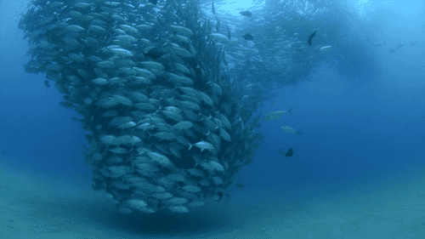
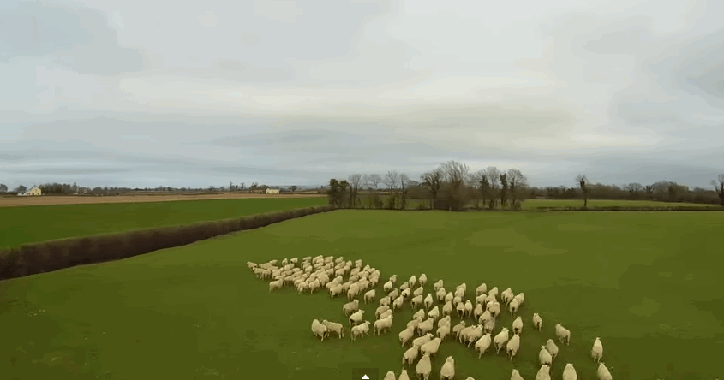
Introduction - MFG
Mean Field Game (MFG) in Real World
A population of fish or sheep moving based on some shared rules. From the perspective of MFG, each fish or sheep is a player and the entire group of players is called “mean field”.
Reef fish swimming like hurricane
Sheep running in fear of a drone

Slide 4
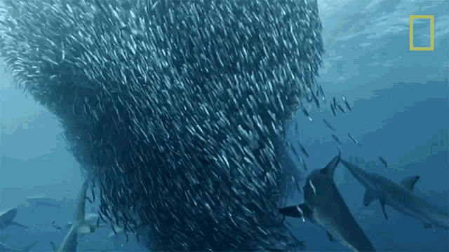
Introduction - MFG
Mean Field Game VS Traditional Game
A model to study the group behavior for a large-population system by utilizing the group states distribution. By modeling the group behavior, the system model will be simplified significantly.
Traditional solution
MFG solution
I react to every other fish and the man.
I react to the fish group and the man.
I react to every single fish.
I react to the fish group.

Slide 5
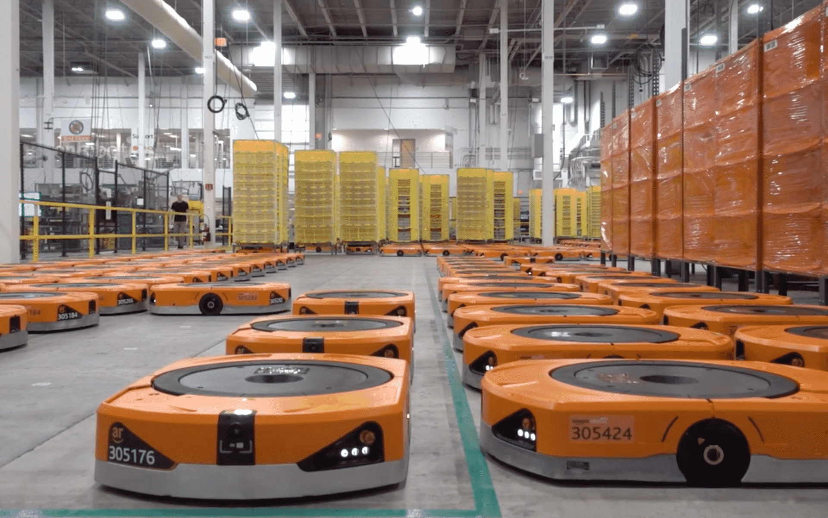
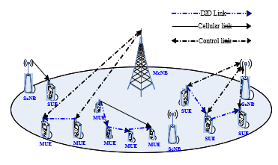
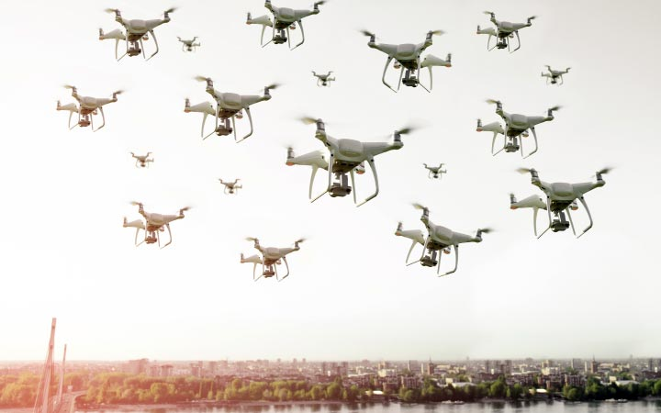
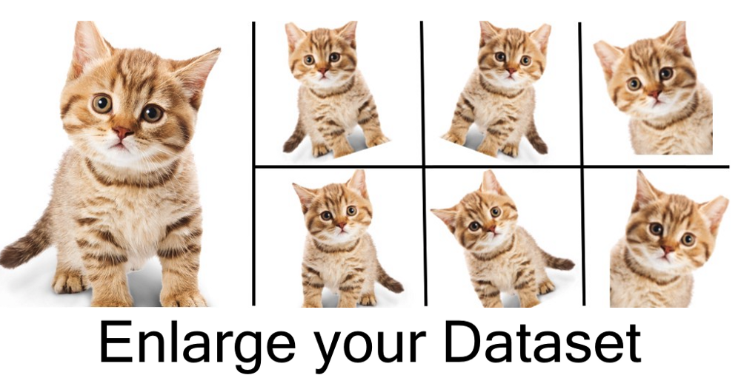
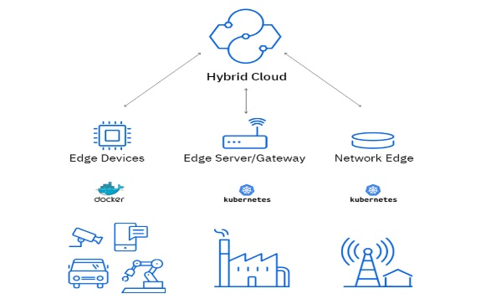
Introduction - MFG
MFG Applications
Robots Path Planning
Power Control in Ultra-Dense D2D Networks
UAVs control
Data Augmentation
Edge Computing
Epidemic Model

Slide 6
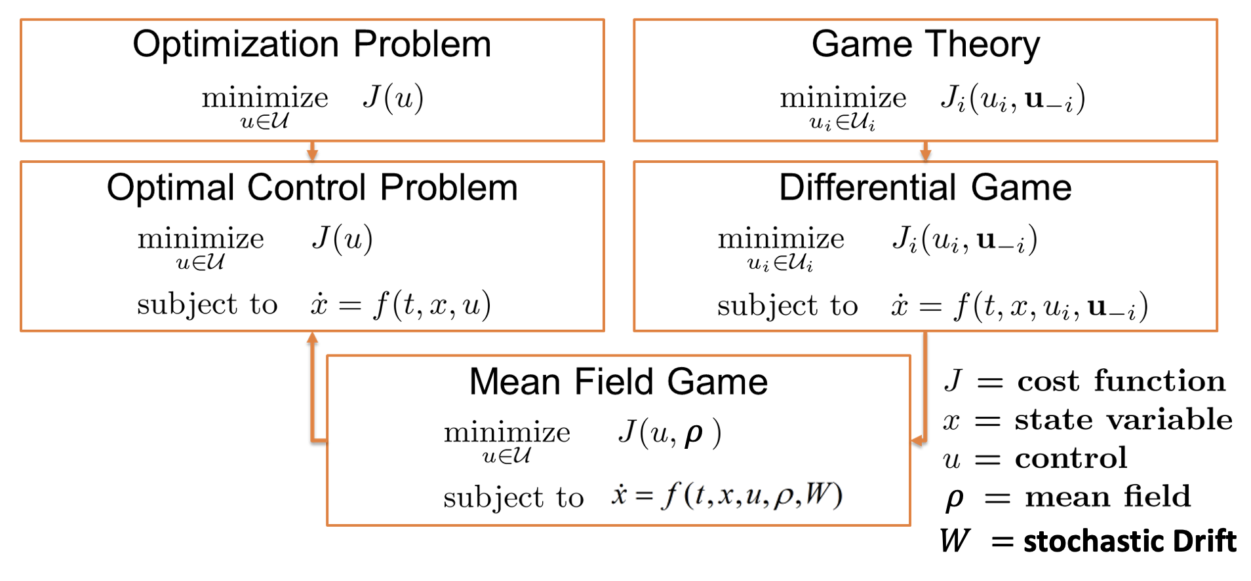
Introduction - MFG
MFG – An Optimal Control Perspective

Slide 7
Introduction - MFG
MFG – A System of Two Partial Differential Equations
The proposed MFG is usually transformed to a system of two partial differential equations, named Hamilton-Jacobi-Bellman (HJB) equation and Fokker-Planck-Kolmogorov (FPK) equation.
HJB find the best control 𝑢 to optimize the utility function 𝐹 given current distribution 𝜌, while FPK evolves the state distribution of agents given the control 𝑢.
Phase1: HJB equation
Best control
New distribution
Phase2: FPK equation

Slide 8
Outline
Introduction
Game Theory vs Mean Field Game
Mathematical Foundations
Application I: Evolutionary Neural Architecture Search with Mean Field Game Selection Mechanism
Application II: Joint Server Selection and Handover Design for Satellite-Based Federated Learning Using Mean-field Evolutionary Approach
Application III: Mean Field Game Guided Deep Reinforcement Learning for Task Placement in Cooperative Multi-access Edge Computing
Conclusion

Slide 9
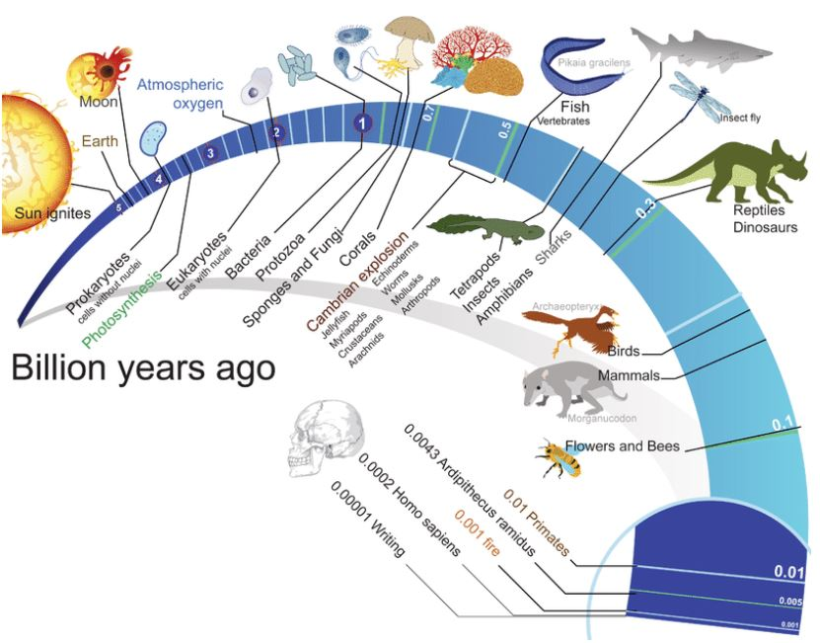
Evolutionary Algorithm
Biologically inspired, population-based EA make no assumptions on the optimization landscape.
They are gradient-free and well suited for some non-linear, non-convex, or non-smooth optimization landscape.
Notes:
5G networks are the next generation of mobile internet connectivity, offering faster speeds and more reliable connections on smartphones and other devices than ever before. Smart city as a benefit of 5G.
IoT has shown a great potential in our life and work, which is enabling to a smart world. e.g., smart home, smart shopping and smart library. However, the smart world requires a continuous reduction of the energy consumption.

Slide 10
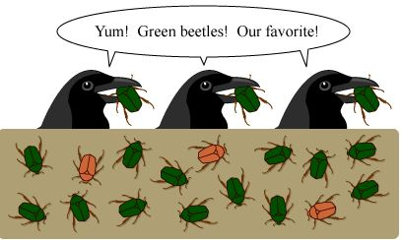
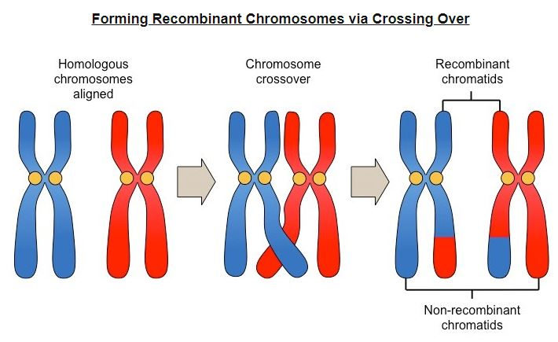
Evolutionary Algorithm
General steps of EA
Evaluation: evaluate the fitness of individual based
on the task or environment
Selection: select the individuals to generate the offspring (Fitness and Diversity)
Crossover: two parents generate the offsprings based on certain mechanisms.
Mutation: randomly mutate the genes of the individual to bring some new features.
Notes:
5G networks are the next generation of mobile internet connectivity, offering faster speeds and more reliable connections on smartphones and other devices than ever before. Smart city as a benefit of 5G.
IoT has shown a great potential in our life and work, which is enabling to a smart world. e.g., smart home, smart shopping and smart library. However, the smart world requires a continuous reduction of the energy consumption.

Slide 11
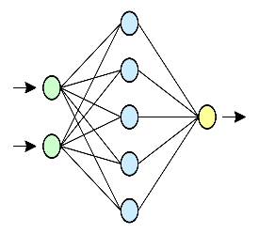
Evolutionary Neural Architecture Search
Neural Architecture Search is an computational methods to generate neural network architectures tailored to specific problems, without prior knowledge, intuition, and expertise in the given task.
Evolutionary Neural Architecture Search (NAS) using evolutionary algorithm to search the better neural architectures.
Selection
Crossover
Control diversity
& fitness
Mutation
selected parents
candidates in
generation K
candidates in
generation K+1

Slide 12
Search Space
Search space contains all possible neural architectures
search space is encoded in a supernet
supernet contains $m$ choice blocks and each choice blocks have $n$ different network architecture choices
the size of the search space is $n^{m}$
every single path in the supernet represents one neural architecture candidate
Only trained the supernet once and no need to train the sampled network
supernet
Choice 1
Choice 1
Choice 1
Choice 2
Choice 2
Choice 2
IN
Choice 3
Choice 3
Choice 3
OUT
Choice 4
Choice 4
Choice 4
Choice Block 1
Choice Block 2
Choice Block 3

Slide 13
Weight Sharing
Researchers [1] achieve competitive performance on the CIFAR-10 with
800 GPUs and spend three to four weeks on training
the computational cost is majorly caused by the training of every sampled architecture from scratch
weight sharing technique reduce the cost of evaluating the fitness of sampled network
supernet
Sampled
Architecture
Choice 1
Choice 1
Choice 1
Block 1
Choice 1
Choice 2
Choice 2
Choice 2
sample
training
check the fitness of the candidate
IN
OUT
Block 2
Choice 2
Choice 3
Choice 3
Choice 3
Choice 4
Choice 4
Choice 4
Block 3
Choice 3
unaffordable computation cost !
Choice Block 1
Choice Block 2
Choice Block 3
[1] Zoph B, Le Q V. Neural architecture search with reinforcement learning[J]. arXiv preprint arXiv:1611.01578, 2016.

Slide 14
Weight Sharing
Weight sharing is a technique to reduce the computational cost
supernet weights of all architectures in the search space are optimized simultaneously
sampled architecture directly inherited weights from the supernet without training
the validation accuracy of any sampled architecture $a$ using inherited weight $W_{s}\left(a\right)$is a highly predictive accuracy of the fine-tuned architecture $a$
prior distribution of sampling architecture
weight of sampled architecture

Slide 15
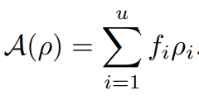
MFG Selection
After sampling the architecture candidates, we need to select the parents from them to generate offsprings
need to select the candidates with higher fitness
also need to keep good population diversity to avoid premature convergence
fitness of candidate i
selection probability of candidate i
strength constant
Shannon entropy

Slide 16
MFG Selection
The solution space for the selection probability is a simplex
The selection problem can be summarized as
the set of $u$candidates
probability requirement
average fitness of population
population diversity

Slide 17
MFG Selection
Update the selection probability with the discrete FPK can help us find the optimal solution to the proposed optimization problem
$F_{i}= \frac{∂J}{∂ρ_{i}}$ refers to the potential of candidate i to increase the reward
$\left[⋅\right]=\max\left(⋅, 0\right)$is a function mark
A comparison-wise evolutionary dynamic. It will help us assign more probability to the candidates, which can increase the total reward
$$dρ_{i}=\sum_{j=1}^{n}{ρ_{j}{\left[F_{i} −F_{j}\right]}^{+} −ρ_{i}{\left[F_{j} −F_{i}\right]}^{+}}$$

Slide 18
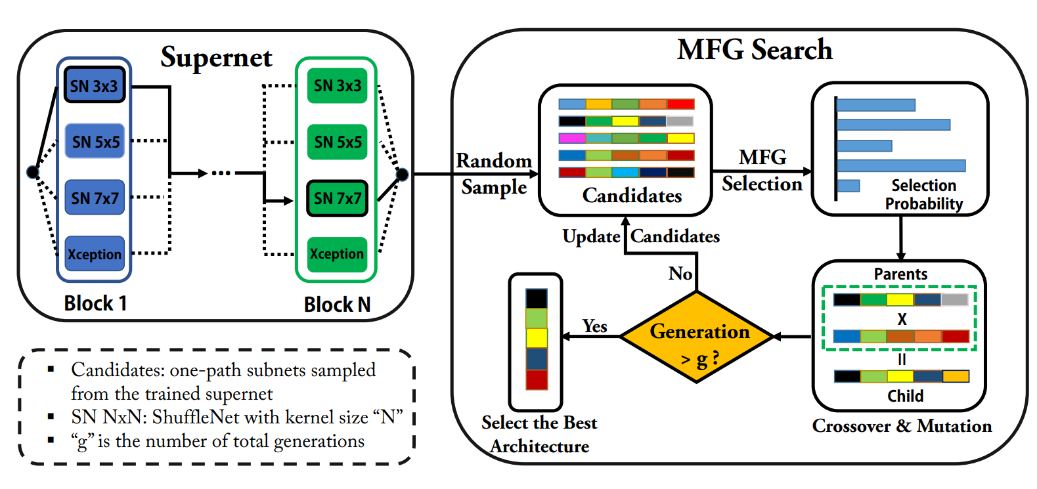
Overall Architecture of NAS
The overall framework of evolutionary NAS with MFG selection mechanism
two stages: supernet training and MFG evolutionary search
weight sharing technique reduce the cost of evaluating the fitness of sampled network
MFG help find the best selection probability

Slide 19
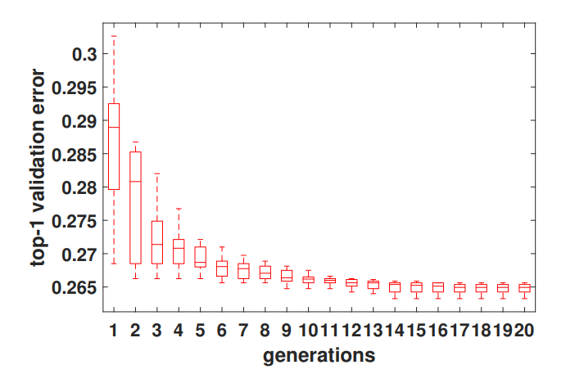
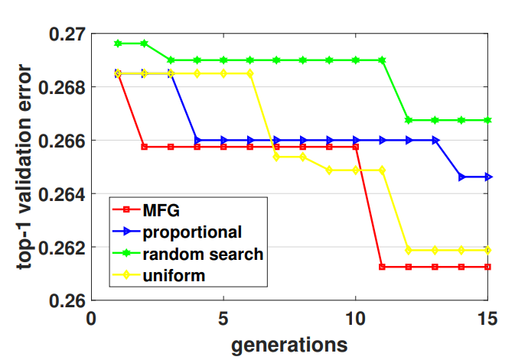
Simulation Results
Simulation results
performance of the top 10 best neural network
congested distribution and steadiness of the best architecture shows the convergence
comparison between MFG selection and other selection methods

Slide 20
Outline
Introduction
Game Theory vs Mean Field Game
Mathematical Foundations
Application I: Evolutionary Neural Architecture Search with Mean Field Game Selection Mechanism
Application II: Joint Server Selection and Handover Design for Satellite-Based Federated Learning Using Mean-field Evolutionary Approach
Application III: Mean Field Game Guided Deep Reinforcement Learning for Task Placement in Cooperative Multi-access Edge Computing
Conclusion

Slide 21
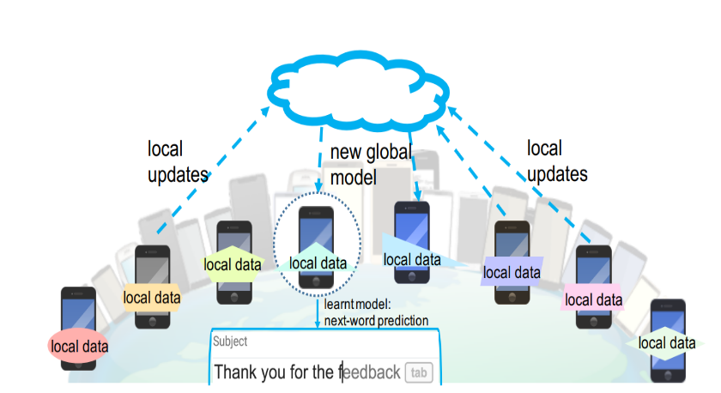
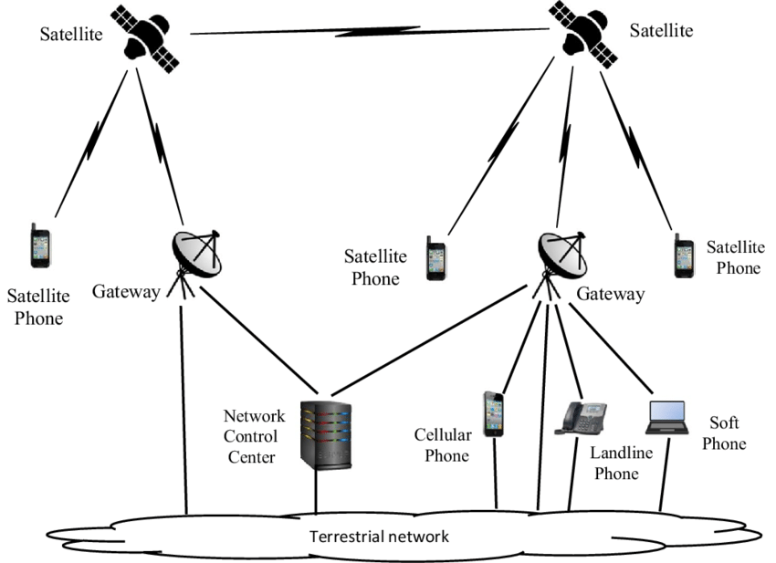
Introduction to Federated Learning
Federated Learning:
Federated learning (also known as collaborative learning) is a machine learning technique that trains an algorithm via multiple independent sessions, each using its own dataset.
Next word prediction by Google in 2016 [1]
Satellite Communication System:
Large Coverage: Huge coverage area of satellite
Flexibility: In some cases such as NBA or WorldCup which requires lots of communication source or computation source, the Satellite and HAP can provide flexible sources.
[1] McMahan B, Moore E, Ramage D, et al. Communication-efficient learning of deep networks from decentralized data[C]//Artificial intelligence and statistics. PMLR, 2017: 1273-1282.
[2] A Biometric-Based Authenticated Key Agreement Protocol for User-to-User Communications in Mobile Satellite Networks
Notes:
5G networks are the next generation of mobile internet connectivity, offering faster speeds and more reliable connections on smartphones and other devices than ever before. Smart city as a benefit of 5G.
IoT has shown a great potential in our life and work, which is enabling to a smart world. e.g., smart home, smart shopping and smart library. However, the smart world requires a continuous reduction of the energy consumption.

Slide 22
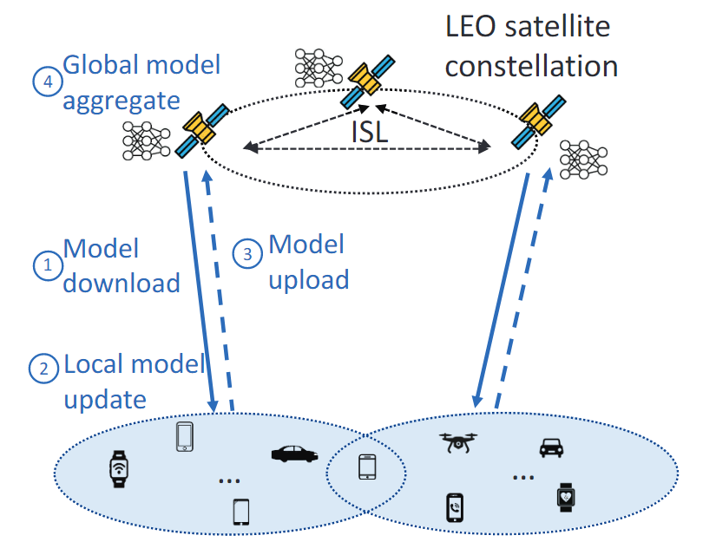
System Model & Challenges
Satellite Communication based Federated Learning:
Step 1: Devices download the model from satellites
Step 2: Devices train the model using local data
Step 3: Devices upload updated model to the satellites
Step 4: Satellites aggregate the received model parameters
Challenges:
Scalability: The number of devices is large. Complex system architecture.
Heterogeneity: The devices’ communication resource, owned data, CPU, etc. are heterogeneous.
Mobility: Satellites may move out of devices reachable area. Handover mechanism

Slide 23
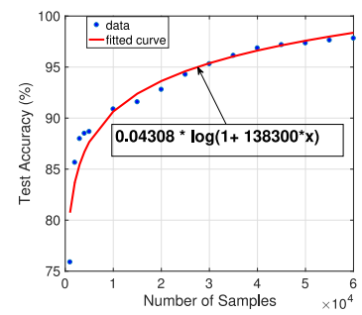
Joint Server-Selection and Hand-over Design Mechansim
Problem formulation: An evolutionary game for workers to select clusters
The $m$-th device owns $D_{m}$ data quantity.
The $m$-th device decides the probability to select the $n$-th satellite and the satellite decide the handover action.
The m-th devices action profile : , satellites action profile:
Cost for device $m$ to select satellite $n$:
Communication Cost of device $m$:
Handover cost:
The remaining model hasn’t been transmitted
Model size
$$C_{m,n,t}^{ho}={δ_{n,t}λ}_{m,n}^{4}p_{m,n}^{t}E_{n}\frac{{\overline{S}}_{n}^{t^{′}}}{{H_{nn^{′}}^{t}c}_{n,n^{′}}^{t}}$$
Capacity of intersatellite link of $n$ with next round satellites $n^{′}$
Channel Gain between device $m$ and satellite $n$
The constant transmission power of S2S communication.
Whether the model need to be handover on satellite $n$, i.e., [0,1]
Payoff for attending the FL process:
The payoff depend of the global model accuracy and is proportion to device’s contribution.
Example of $f$:
$+a_{m,n}$
Data quantity that model owner k has
A compensate term
The profit is shared by all devices
Notes:
5G networks are the next generation of mobile internet connectivity, offering faster speeds and more reliable connections on smartphones and other devices than ever before. Smart city as a benefit of 5G.
IoT has shown a great potential in our life and work, which is enabling to a smart world. e.g., smart home, smart shopping and smart library. However, the smart world requires a continuous reduction of the energy consumption.

Slide 24
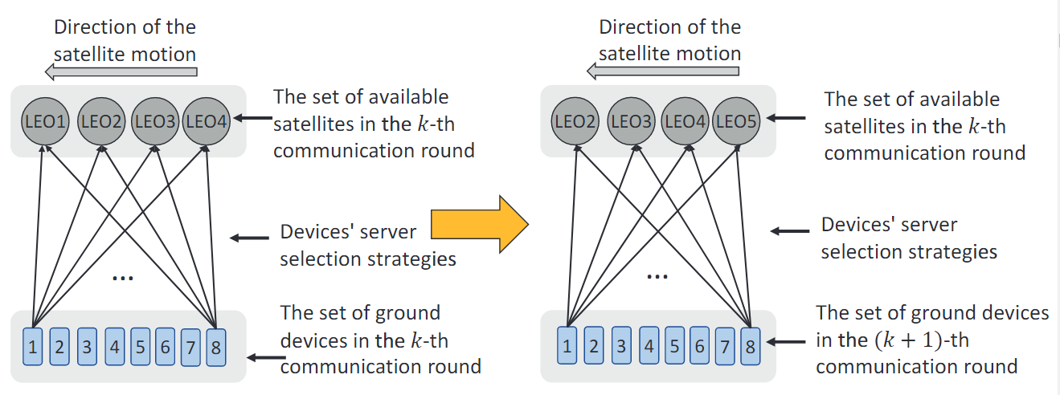
Joint Server-Selection and Hand-over Design Mechansim
Problem formulation: An evolutionary game for workers to select clusters
The $m$-th device owns $D_{m}$ data quantity.
The $m$-th device decides the probability to select the $n$-th satellite and the satellite decide the handover action.
The m-th devices action profile : , satellites action profile:
Dynamics of the satellites:
We consider a time interval [0,T], where the $n$-th communication round period is ${[t}_{n},t_{n+1}].$
At time $t∈{[t}_{n},t_{n+1}],$ the set of satellites that can cover device $m$ is denoted by $ℬ_{m}(t)⊆ℳ. ℳ$is the set of all satellites.
We use a bipartite graph to represent satellite selection strategy.
$$G=<N,ℬ_{m}^{t},E>$$
Device set
Satellite selection strategy
Available satellite set
Notes:
5G networks are the next generation of mobile internet connectivity, offering faster speeds and more reliable connections on smartphones and other devices than ever before. Smart city as a benefit of 5G.
IoT has shown a great potential in our life and work, which is enabling to a smart world. e.g., smart home, smart shopping and smart library. However, the smart world requires a continuous reduction of the energy consumption.

Slide 25
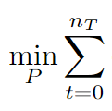
Joint Server-Selection and Hand-over Design Mechansim
Reduce the communication cost and handover cost, and maximize devices payoff for attending the FL process
$$H,$$
$$=$$
$$+{δ_{n,t}λ}_{m,n}^{4}p_{m,n}^{t}E_{n}\frac{{\overline{S}}_{n}^{t^{′}}}{{H_{nn^{′}}^{t}c}_{n,n^{′}}^{t}}$$
$$+$$
$+a_{m,n}$
FL global accuracy as the payoff from the server 𝑛
Handover cost
Communication cost
Edge Constraint: Probability $p > 0$
Edge constraint: Sum of Probability $p$ is 1.
$$G=<N,ℬ_{m}^{t},E>$$
Satellites’ mobility.
Notes:
5G networks are the next generation of mobile internet connectivity, offering faster speeds and more reliable connections on smartphones and other devices than ever before. Smart city as a benefit of 5G.
IoT has shown a great potential in our life and work, which is enabling to a smart world. e.g., smart home, smart shopping and smart library. However, the smart world requires a continuous reduction of the energy consumption.

Slide 26
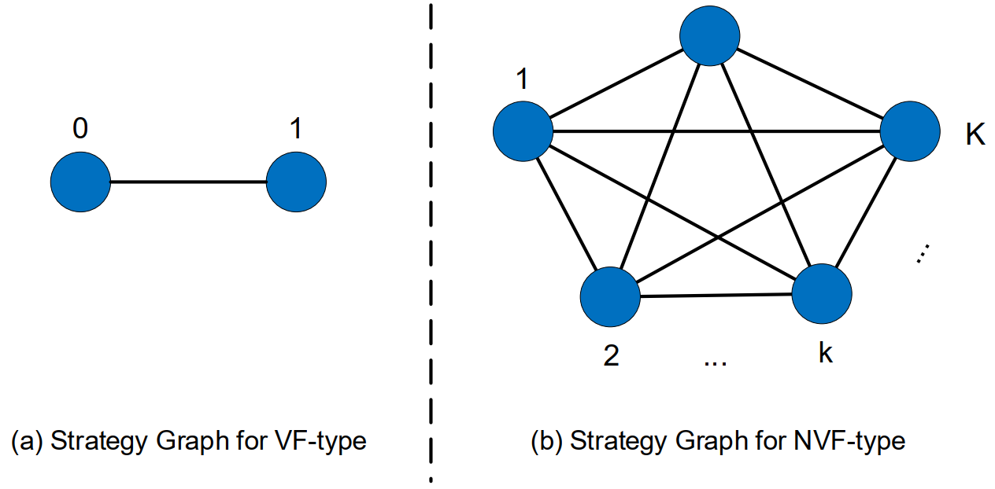
Mean-field Evolutionary Approach:
Devices Server-Selection Strategy graph
Vertices: Devices’ server-selection strategies in the strategy set
Edges: form an edge if one device can switch from one strategy to the other
Strategy Space: state space is all available mixed strategies of the players
1-d Graph
Fully Connected Graph
The probability to select strategy i
Fokker-Plank Equation:
degree
Cost of selecting $i$-th satellite
Fokker-Plank Equation provides a gradient flow starting from any initial point $ρ_{0}$ to the optimal solution.
Notes:
5G networks are the next generation of mobile internet connectivity, offering faster speeds and more reliable connections on smartphones and other devices than ever before. Smart city as a benefit of 5G.
IoT has shown a great potential in our life and work, which is enabling to a smart world. e.g., smart home, smart shopping and smart library. However, the smart world requires a continuous reduction of the energy consumption.

Slide 27
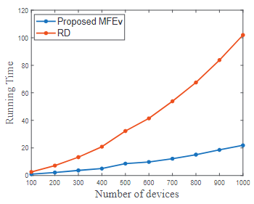
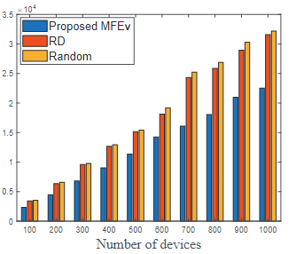
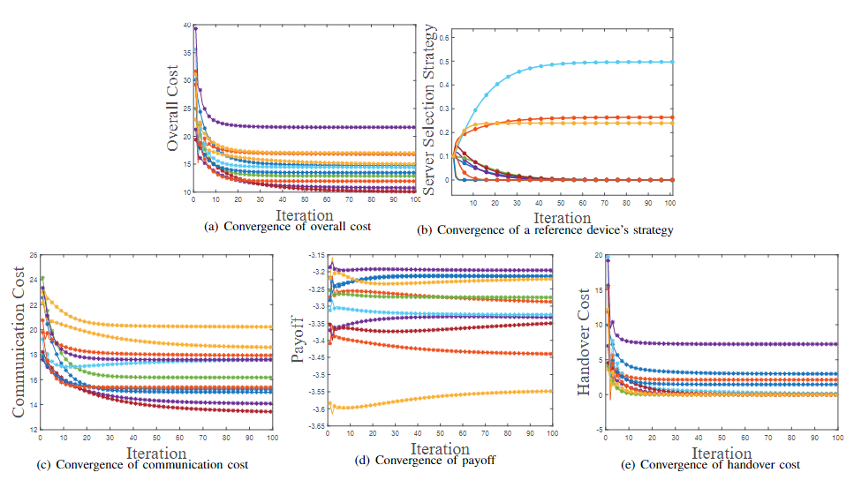
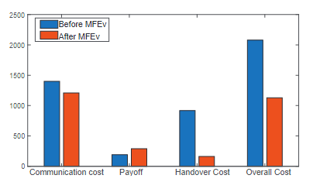
Simulation Results
Convergence Analysis:
Scalability Analysis:
100 mobile devices and 10 satellites
Code running time comparison
Optimized costs comparison
StarLink Simulator:
Performance Analysis:

Slide 28
Outline
Introduction
Game Theory vs Mean Field Game
Mathematical Foundations
Application I: Evolutionary Neural Architecture Search with Mean Field Game Selection Mechanism
Application II: Joint Server Selection and Handover Design for Satellite-Based Federated Learning Using Mean-field Evolutionary Approach
Application III: Mean Field Game Guided Deep Reinforcement Learning for Task Placement in Cooperative Multi-access Edge Computing
Conclusion

Slide 29
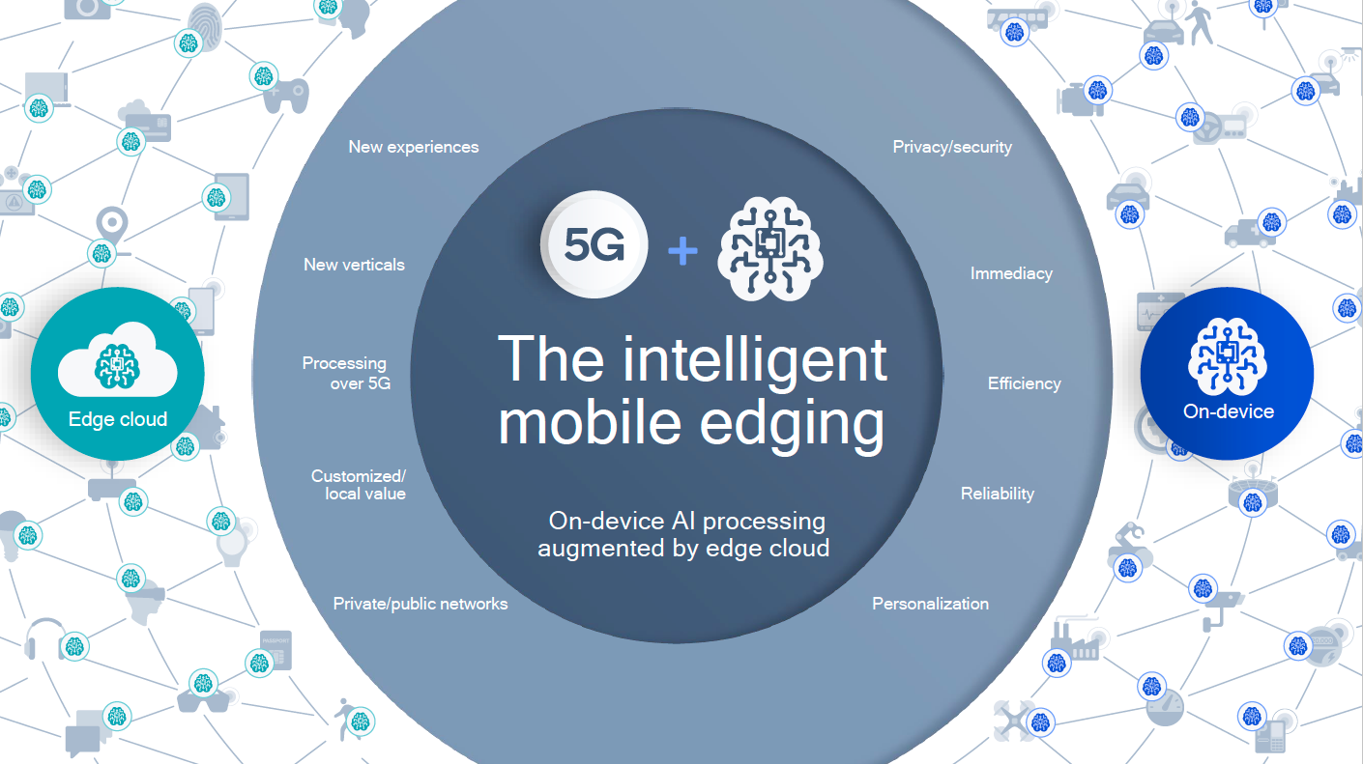
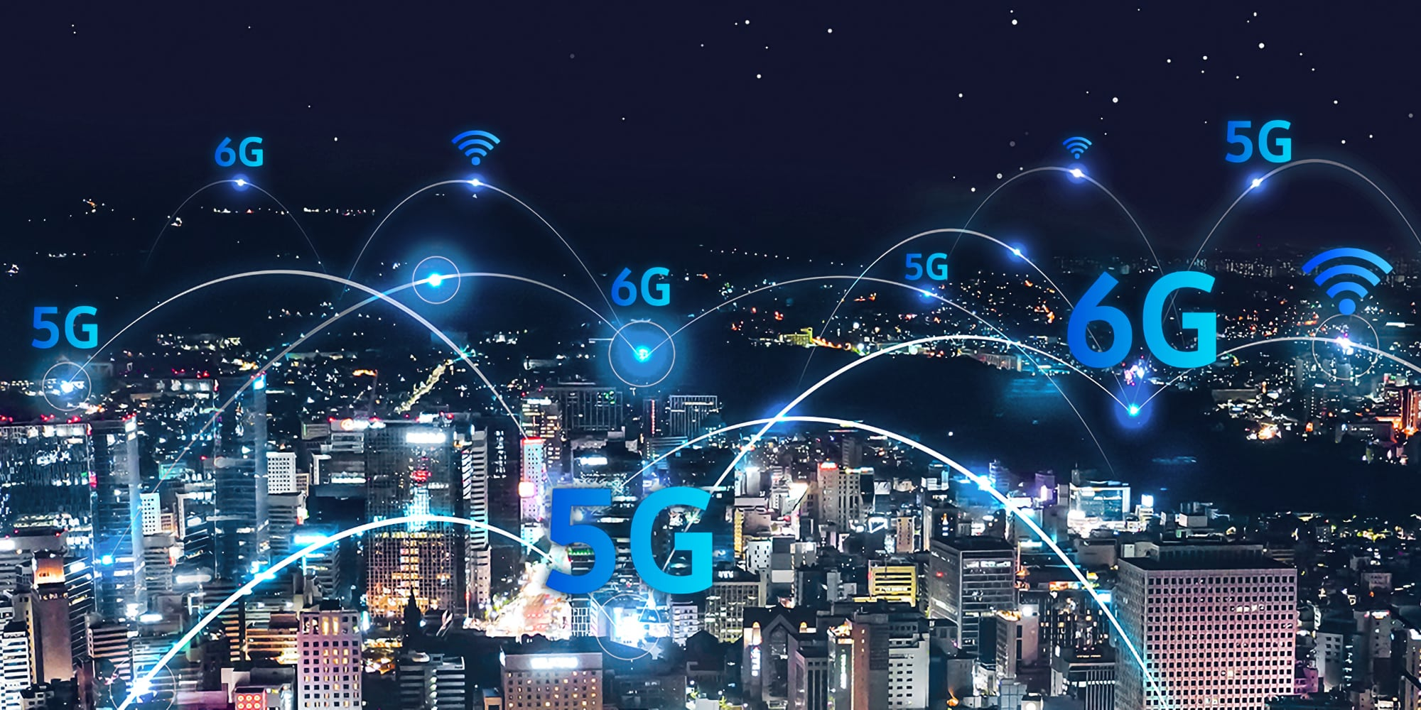
Intelligent Mobile Edging
Mobile Networks
(5G, 6G, Wi-Fi…)
Artificial Intelligence (Machine Learning)
Notes:
5G networks are the next generation of mobile internet connectivity, offering faster speeds and more reliable connections on smartphones and other devices than ever before. Smart city as a benefit of 5G.
IoT has shown a great potential in our life and work, which is enabling to a smart world. e.g., smart home, smart shopping and smart library. However, the smart world requires a continuous reduction of the energy consumption.

Slide 30
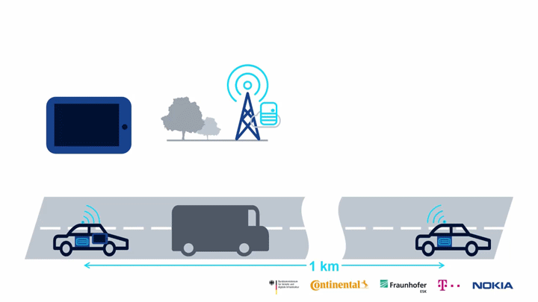
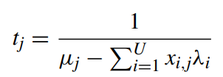
Resource Allocation in MEC
System Overview
The multi-access edge computing system consists of edge servers and mobile users (e.g. cars)
Edge servers (discrete strategy set)
b) Mobile users (players)
c) Response time of server j
service rate
total load
d) Energy consumption of server j
MEC for autonomous-driving vehicles
Notes:
5G networks are the next generation of mobile internet connectivity, offering faster speeds and more reliable connections on smartphones and other devices than ever before. Smart city as a benefit of 5G.
IoT has shown a great potential in our life and work, which is enabling to a smart world. e.g., smart home, smart shopping and smart library. However, the smart world requires a continuous reduction of the energy consumption.

Slide 31
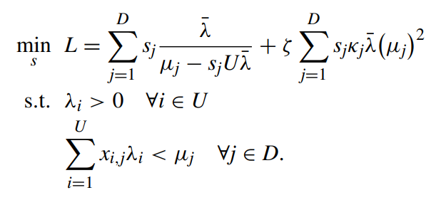
Resource Allocation in MEC
System Overview
Resource allocation optimization in MEC system
Target: Minimize the total expected response time and energy consumption by adjusting the distribution of jobs on servers.
Stability requirement: the serving capacity of each server should be
larger than the total load
Notes:
5G networks are the next generation of mobile internet connectivity, offering faster speeds and more reliable connections on smartphones and other devices than ever before. Smart city as a benefit of 5G.
IoT has shown a great potential in our life and work, which is enabling to a smart world. e.g., smart home, smart shopping and smart library. However, the smart world requires a continuous reduction of the energy consumption.

Slide 32
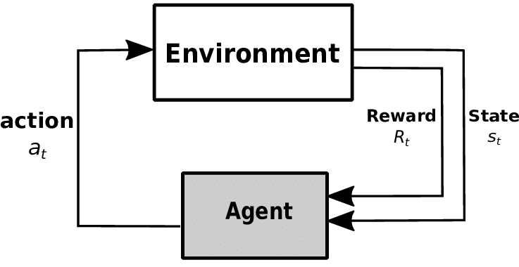
Reinforcement Learning Framework
RL is a general-purpose framework for decision-making
RL is for an agent with the capacity to act
Each action influences the agent's future state
Success is measured by a scalar reward signal
Goal: select actions to maximize long term reward
Notes:
5G networks are the next generation of mobile internet connectivity, offering faster speeds and more reliable connections on smartphones and other devices than ever before. Smart city as a benefit of 5G.
IoT has shown a great potential in our life and work, which is enabling to a smart world. e.g., smart home, smart shopping and smart library. However, the smart world requires a continuous reduction of the energy consumption.

Slide 33
Reinforcement Learning Framework
Formulate the problem as a Markov Decision Process
state $s^{t}$: the distribution of all users at time t
where D is the number of MEC servers
action $a^{t}$: the proportion of the users whose tasks in the current server switching to other servers
reward $r(s^{t}, a^{t})$
the reward is the negative of the cost given current state and action
Notes:
5G networks are the next generation of mobile internet connectivity, offering faster speeds and more reliable connections on smartphones and other devices than ever before. Smart city as a benefit of 5G.
IoT has shown a great potential in our life and work, which is enabling to a smart world. e.g., smart home, smart shopping and smart library. However, the smart world requires a continuous reduction of the energy consumption.

Slide 34
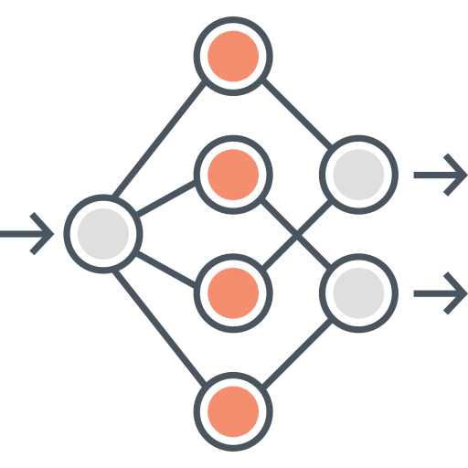
Deep Deterministic Policy Gradient
Model-free policy-based method for continuous action
Actor network (Policy Network): a neural network approximate policy $π\left(s\right)=a$
Critic network (Q Network): a neural network approximate $Q\left(s, a\right)$, where the action is computed by the actor network
State-Action Value
$$Q(s,a)$$
State $S$
Action $a$
Critic Network: trained with
standard Q-learning
Actor Network: trained to maximize Q
Notes:
5G networks are the next generation of mobile internet connectivity, offering faster speeds and more reliable connections on smartphones and other devices than ever before. Smart city as a benefit of 5G.
IoT has shown a great potential in our life and work, which is enabling to a smart world. e.g., smart home, smart shopping and smart library. However, the smart world requires a continuous reduction of the energy consumption.

Slide 35
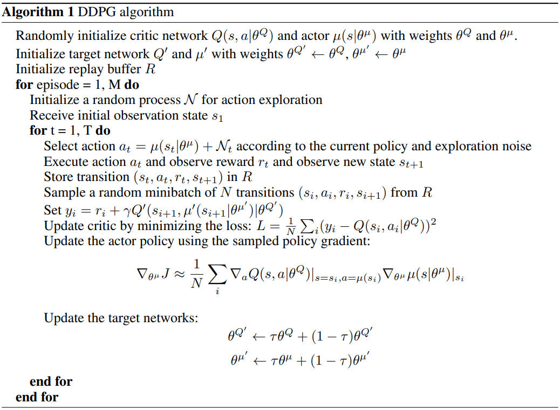
Deep Deterministic Policy Gradient
Experience replay and batch methods
Update critic by minimizing the loss
the label $y_{i}$ is computed by
$Q^{′}$and $u^{′}$ are target networks
Update actor by the policy gradient
Notes:
5G networks are the next generation of mobile internet connectivity, offering faster speeds and more reliable connections on smartphones and other devices than ever before. Smart city as a benefit of 5G.
IoT has shown a great potential in our life and work, which is enabling to a smart world. e.g., smart home, smart shopping and smart library. However, the smart world requires a continuous reduction of the energy consumption.

Slide 36
MFG-guided Deep Deterministic Policy Gradient
The label of DDPG is estimated by target critic network $Q^{′}$and target actor network $u^{′}$
this is an highly biased estimator of the Q-value
need to maintain two extra networks
$$y_{i}=r_{i}+γQ′(s_{i+1}, u′(s_{i+1}|θ^{u^{′}})|θ^{Q^{′}})$$
In the MFG-guided DDPG, we use MFG to compute the target action $u_{MF}^{′}$
the MFG-based estimation of $u^{′}$ is unbiased
no need of the actor network
$$y_{i}=r_{i}+γQ′(s_{i+1}, u_{MF}^{′}|θ^{Q^{′}})$$
Notes:
5G networks are the next generation of mobile internet connectivity, offering faster speeds and more reliable connections on smartphones and other devices than ever before. Smart city as a benefit of 5G.
IoT has shown a great potential in our life and work, which is enabling to a smart world. e.g., smart home, smart shopping and smart library. However, the smart world requires a continuous reduction of the energy consumption.

Slide 37
MFG-guided Deep Deterministic Policy Gradient
Original DDPG
MFG-guided DDPG
Policy
Policy
MFG value
Target value
state
Value
Function
state
Value
Function
MFG
action
action
reward
reward
MEC Environment
MEC Environment
Notes:
5G networks are the next generation of mobile internet connectivity, offering faster speeds and more reliable connections on smartphones and other devices than ever before. Smart city as a benefit of 5G.
IoT has shown a great potential in our life and work, which is enabling to a smart world. e.g., smart home, smart shopping and smart library. However, the smart world requires a continuous reduction of the energy consumption.

Slide 38
MFG-guided Deep Deterministic Policy Gradient
Compute the accurate target action with MFG
the action is the change of the population distribution on a given server
the discrete Fokker-Planck equation can compute the action
where F(j) is the potential of sever j to reduce the response time
Notes:
5G networks are the next generation of mobile internet connectivity, offering faster speeds and more reliable connections on smartphones and other devices than ever before. Smart city as a benefit of 5G.
IoT has shown a great potential in our life and work, which is enabling to a smart world. e.g., smart home, smart shopping and smart library. However, the smart world requires a continuous reduction of the energy consumption.

Slide 39
MFG-guided Deep Deterministic Policy Gradient
Compute the accurate target action with MFG
the discrete Fokker-Planck equation can compute the action
state $s^{t}={{(s}_{i}^{t})}_{i=1}^{D}$
coefficient matrix $Λ^{t}$
target action!
Notes:
5G networks are the next generation of mobile internet connectivity, offering faster speeds and more reliable connections on smartphones and other devices than ever before. Smart city as a benefit of 5G.
IoT has shown a great potential in our life and work, which is enabling to a smart world. e.g., smart home, smart shopping and smart library. However, the smart world requires a continuous reduction of the energy consumption.

Slide 40
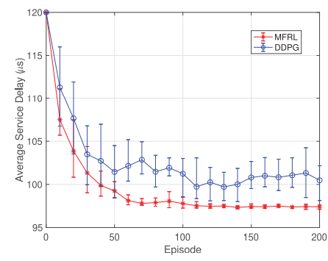
MFG-guided Deep Deterministic Policy Gradient
The advantages of the proposed MFG-guided DDPG
real-time resource allocation
faster and stable convergence than traditional DDPG
less computation and storage cost than traditional DDPG
Notes:
5G networks are the next generation of mobile internet connectivity, offering faster speeds and more reliable connections on smartphones and other devices than ever before. Smart city as a benefit of 5G.
IoT has shown a great potential in our life and work, which is enabling to a smart world. e.g., smart home, smart shopping and smart library. However, the smart world requires a continuous reduction of the energy consumption.

Slide 41
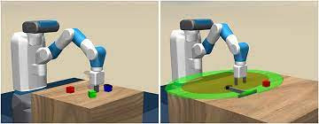
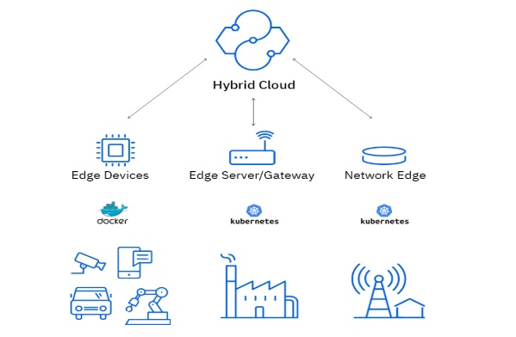
Conclusion
Mean-field Game is a powerful tool to study the behavior of a large populations distributed system. In today’s topic, we discussed Mean-field Games with Artificial Intelligence field applications in distributed systems, and introduce three applications.
Based on the applications, we summarized MFG advantages:
Evolutionary Neural Architecture Search with Mean Field Game Selection Mechanism
Joint Server Selection and Handover Design for Satellite-Based Federated Learning Using Mean-field Evolutionary Approach
Mean Field Game Guided Deep Reinforcement Learning for Task Placement in Cooperative Multi-access Edge Computing
Address scalability issue for large-scale population systems by mean-field approximation.
Address agents’ heterogeneity by evolutionary approach.
Reinforcement Learning
Federated Learning
Machine Learning
Notes:
5G networks are the next generation of mobile internet connectivity, offering faster speeds and more reliable connections on smartphones and other devices than ever before. Smart city as a benefit of 5G.
IoT has shown a great potential in our life and work, which is enabling to a smart world. e.g., smart home, smart shopping and smart library. However, the smart world requires a continuous reduction of the energy consumption.

Slide 42
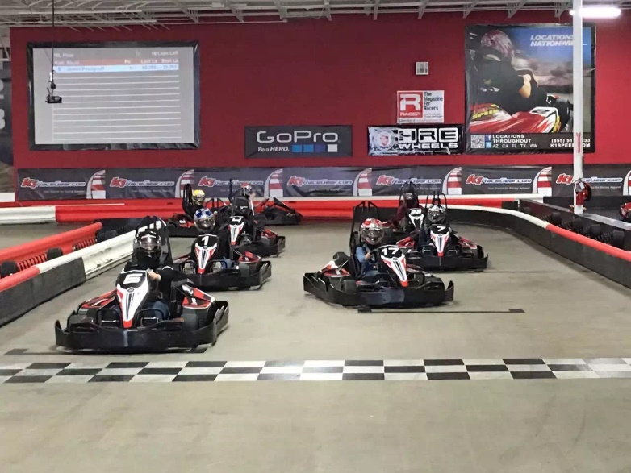
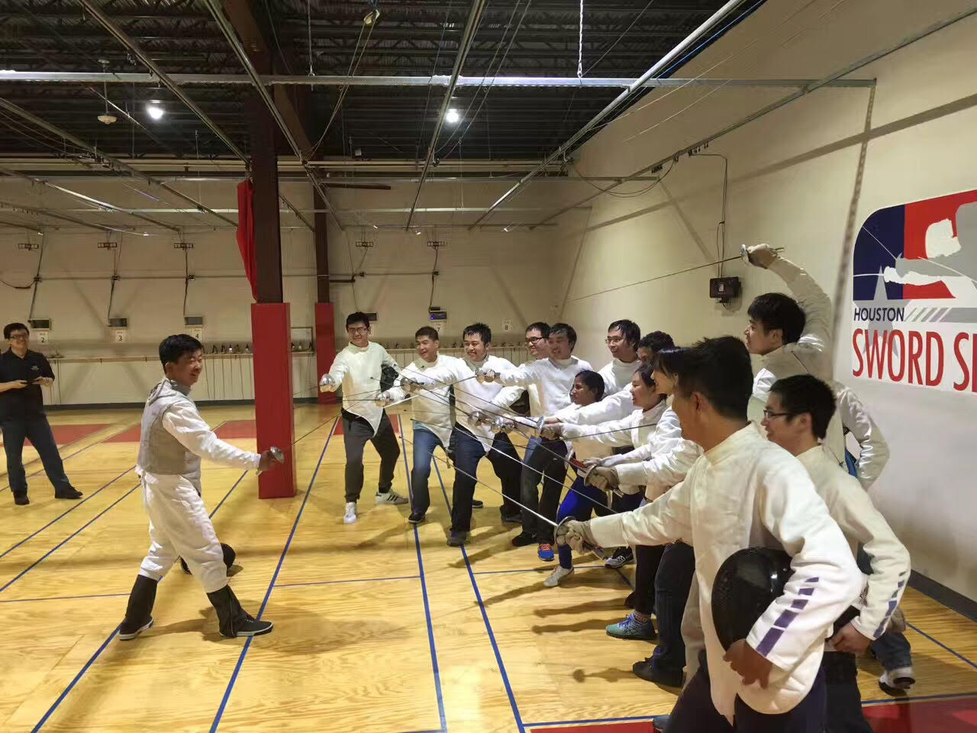
Thanks for students and visitors
Lab Website: http://wireless.egr.uh.edu/
Personal Website: http://www2.egr.uh.edu/~zhan2/

