Slide 1
Xinran Zhang University of Houston University of Electronic Science and Technology of China 1/11/2024 (Thanks Kai-Chu Tsai and Yuhan Kang)
A Brief Introduction to
the LEO Satellite Constellations

Slide 2
Overview
Background
Satellites Constellations Network
Satellite orbital elements
Inter-satellite link
How to formulate?
Conclusion

Slide 3
Overview
Background
Satellites Constellations Network
Satellite orbital elements
Inter-satellite link
How to formulate?
Conclusion

Slide 4
Background
What can satellites do?
Earth observation satellites can monitor weather, disaster, agriculture...
Figrues are obtained from https://www.youtube.com/watch?v=n70zjMvm8L0

Slide 5
Background
What can satellites do?
Navigation satellite can determine the ground position
Figrues are obtained from https://www.youtube.com/watch?v=n70zjMvm8L0

Slide 6
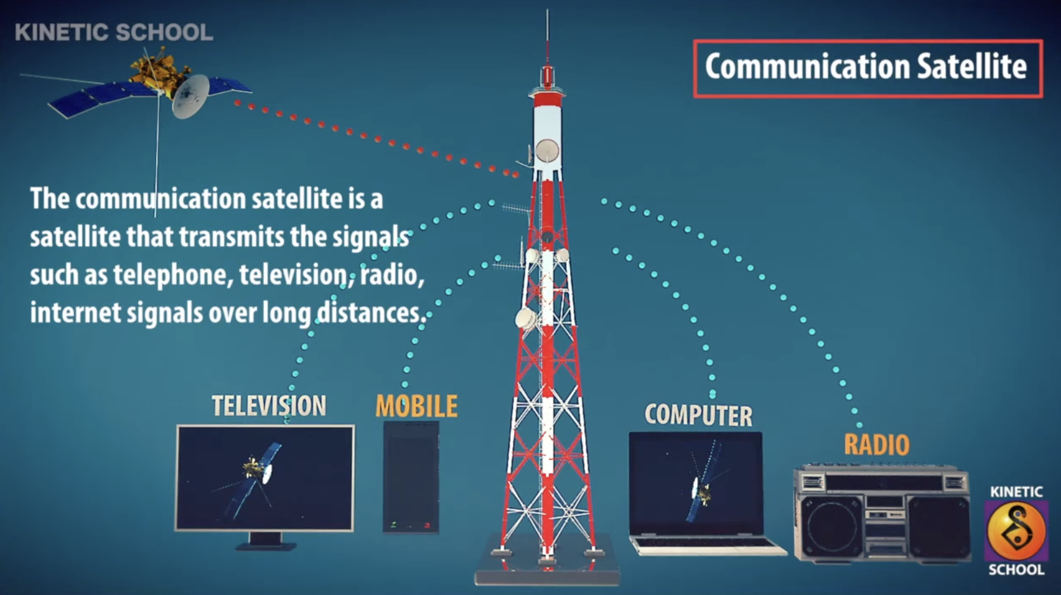
Background
What can satellites do?
Communication satellites can provide communication services with a global coverage
Figrues are obtained from https://www.youtube.com/watch?v=n70zjMvm8L0

Slide 7
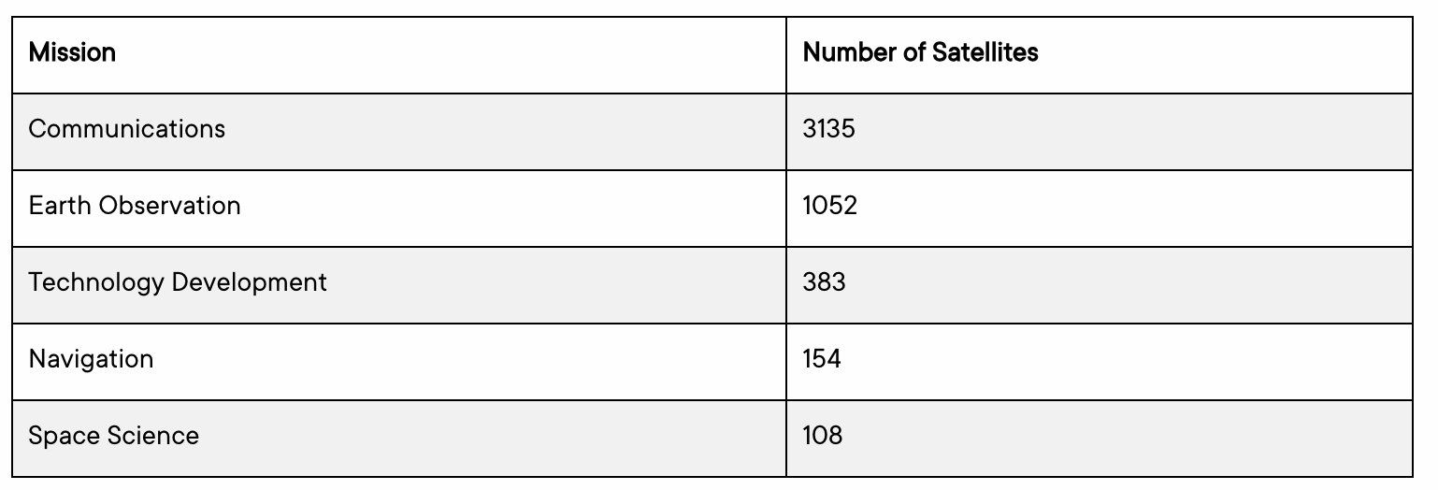
Background
What can satellites do?
The five most common primary missions and according numbers
Figrues are obtained from https://nanoavionics.com/blog/how-many-satellites-are-in-space/

Slide 8
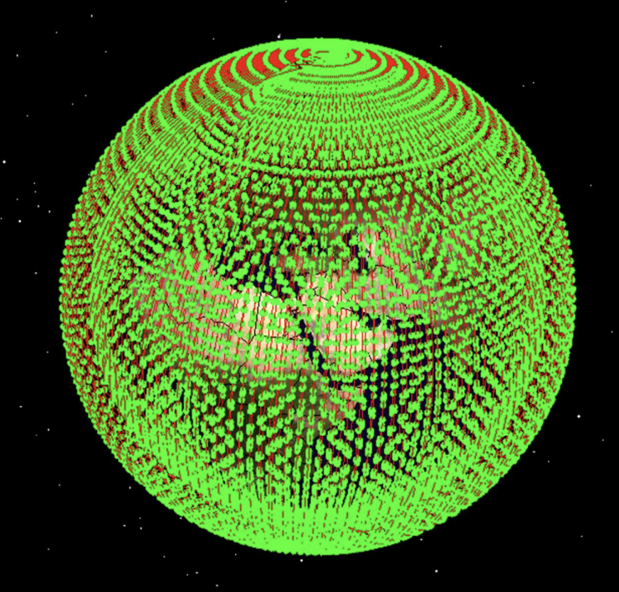
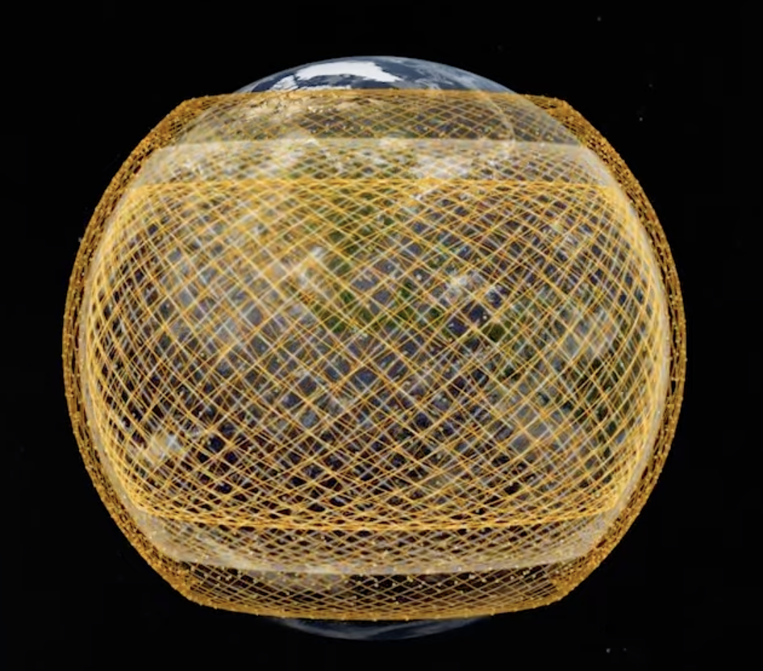
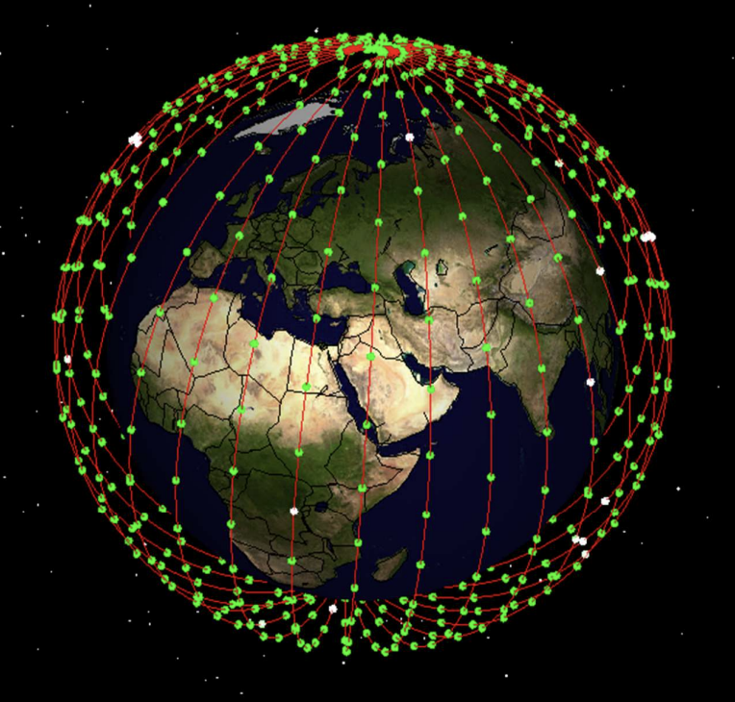
Background
Commercial Satellite Constellations
11,943 satellites
3,236 satellites
648 satellites
Figures are obtained from https://www.google.com/, https://www.aboutamazon.com/what-we-do/devices-services/project-kuiper
X. Yang, “Low Earth Orbit (LEO) Mega Constellations – Satellite and Terrestrial Integrated Communication Networks”.

Slide 9
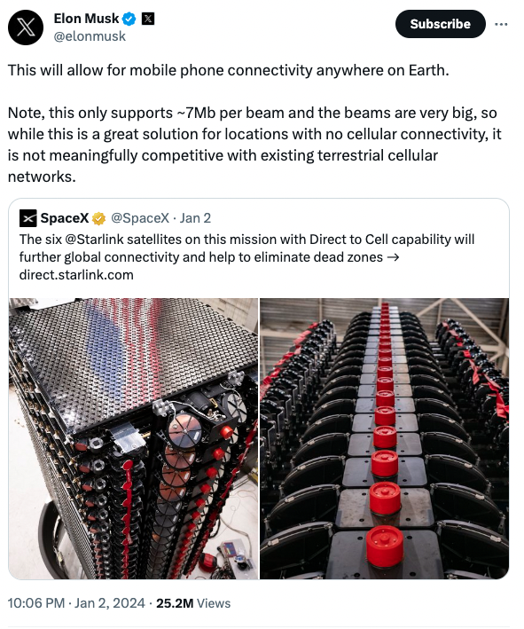
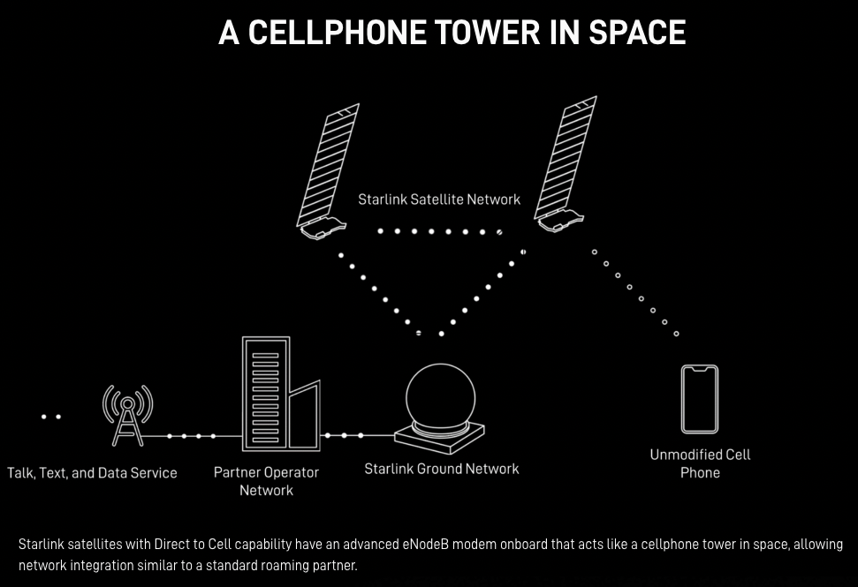
Background
Starlink - Direct to Cell
SpaceX launched its first batch of Starlink Direct-to-Cell satellites on 1/2/2024.
Seamless access to text, voice, and data for LTE phones;
Further global connectivity and help to eliminate dead zones.
Source from https://direct.starlink.com/

Slide 10
Overview
Background
Satellites Constellations Network
Satellites orbit elements
Inter-satellite link
How to formulate?
Conclusion

Slide 11
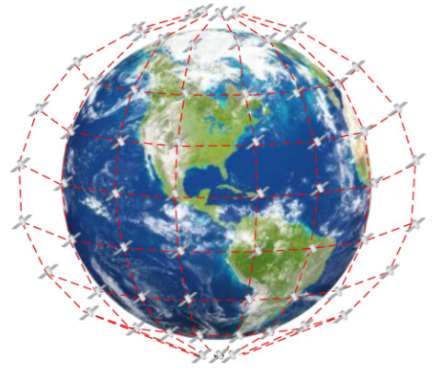
SC Network
What are Satellite Constellations (SC)?
Groups of artificial satellites working together
Provide nearly continuous global coverage
With similar altitude, orbital eccentricity and inclination
Medium Earth orbit (MEO) and low Earth orbit (LEO) SCs
The advantages of SC:
Low latency
Broadband communications
Lower path losses and power requirement
F. Zheng, C. Wang, Z. Zhou, Z. Pi, and D. Huang, “LEO laser microwave hybrid inter-satellite routing strategy based on modified Q-routing algorithm,” J Wireless Com Network, vol. 2022, no. 1, p. 36, Dec. 2022, doi: 10.1186/s13638-022-02119-1.
B. Matthiesen, N. Razmi, I. Leyva-Mayorga, A. Dekorsy, and P. Popovski, “Federated Learning in Satellite Constellations,” IEEE Network, pp. 1–16, 2023, doi: 10.1109/MNET.132.2200504.
Q. Chen, G. Giambene, L. Yang, C. Fan, and X. Chen, “Analysis of Inter-Satellite Link Paths for LEO Mega-Constellation Networks,” IEEE Trans. Veh. Technol., vol. 70, no. 3, pp. 2743–2755, Mar. 2021, doi: 10.1109/TVT.2021.3058126.

Slide 12
SC Network
The SC can be described as $i:PQ/P/F$
$$i$$ | Inclination with respect to the equator $∈[0,π]$
Q | # satellites per plane
P | # orbits planes
F | Phasing factor: to determine the relative spacing between satellites in adjacent planes $=\frac{2πF}{PQ}$
Walker star: $\text{80°: 40}\text{/}\text{5/1}$
Walker delta: $\text{6}\text{0°: 40}\text{/}\text{5/1}$
B. Matthiesen, N. Razmi, I. Leyva-Mayorga, A. Dekorsy, and P. Popovski, “Federated Learning in Satellite Constellations,” IEEE Network, pp. 1–16, 2023, doi: 10.1109/MNET.132.2200504.
(two locally separate overlapping meshes, an ascending and a descending one)

Slide 13
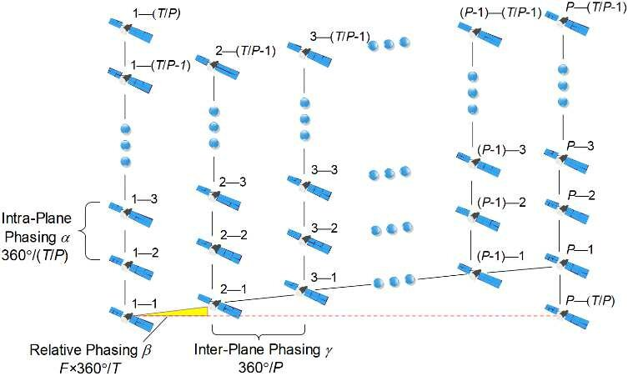
SC Network
The intra-plane satellites: adjacent satellites within the same orbital plane
The inter-planes satellites: satellites across orbital planes
Phasing
Inter-plane phasing: $\frac{2 π}{P}$
Intra-plane phasing: $\frac{2 π}{Q}$
The relative phasing between satellites in adjacent planes: $∆f= \frac{2 π F}{P Q}$
F is a phasing factor:
$$PQ$$
Liang, Jintao, Aizaz U. Chaudhry, and Halim Yanikomeroglu. "Phasing parameter analysis for satellite collision avoidance in starlink and kuiper constellations." In 2021 IEEE 4th 5G world forum (5GWF), pp. 493-498. IEEE, 2021.

Slide 14
Overview
Background
Satellites Constellations Network
Satellite orbital elements
Inter-satellite link
How to formulate?
Conclusion

Slide 15
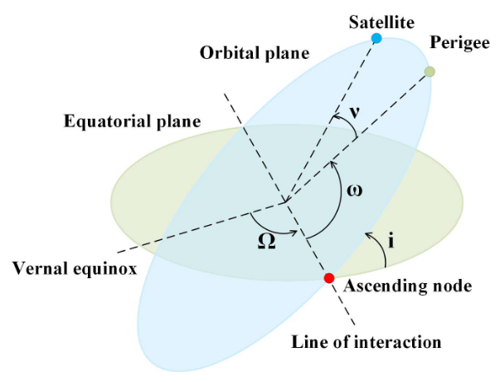
Satellite orbital elements
The 6 traditional orbital elements
$$i$$ | Inclination angle to the equator $∈\left[0,π\right]$
$$\text{e}$$ | Eccentricity $∈\left[0,1\right]$
𝑎 | Semi-major axis
Ω | The right ascension of ascending node (RAAN)
ν | True anomaly (the geocentric angle between perigee direction and satellite direction)
$$\text{ω}$$ | Argument of the perigee
Other global constants of the orbit:
ℎ | Altitude
G. Stock, J. A. Fraire, and H. Hermanns, “Distributed On-Demand Routing for LEO Mega-Constellations: A Starlink Case Study,” in 2022 11th Advanced Satellite Multimedia Systems Conference and the 17th Signal Processing for Space Communications Workshop (ASMS/SPSC), Sep. 2022, pp. 1–8. doi: 10.1109/ASMS/SPSC55670.2022.9914716.
Q. Chen, G. Giambene, L. Yang, C. Fan, and X. Chen, “Analysis of Inter-Satellite Link Paths for LEO Mega-Constellation Networks,” IEEE Trans. Veh. Technol., vol. 70, no. 3, pp. 2743–2755, Mar. 2021, doi: 10.1109/TVT.2021.3058126.
R. Deng, B. Di, H. Zhang, L. Kuang, and L. Song, “Ultra-Dense LEO Satellite Constellations: How Many LEO Satellites Do We Need?,” IEEE Trans. Wireless Commun., vol. 20, no. 8, pp. 4843–4857, Aug. 2021, doi: 10.1109/TWC.2021.3062658.

Slide 16
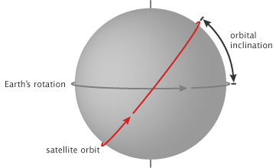
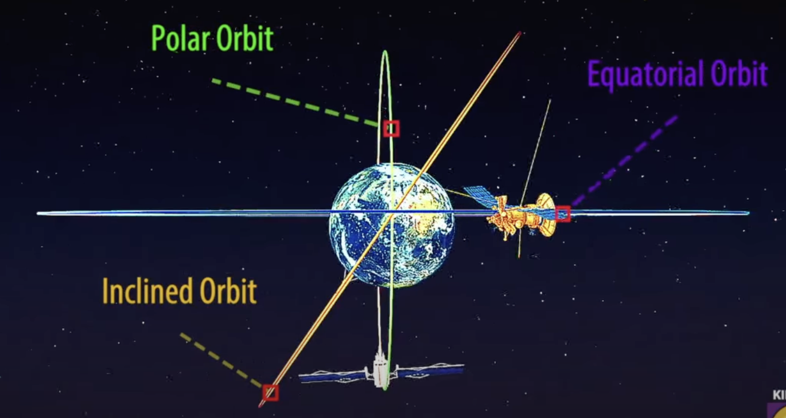
Satellite orbital elements
$$i$$
$$i$$ | Orbit Inclination to the equator $$∈\left[0,π\right]$$ | Equtorial orbit: 0 Polar orbit: $\frac{π}{2}$ The direction of the satellite’s motion is opposite to that of the Earth’s rotation: $\left[\frac{π}{2},π\right]$
Figrues are obtained from https://www.youtube.com/watch?v=n70zjMvm8L0

Slide 17
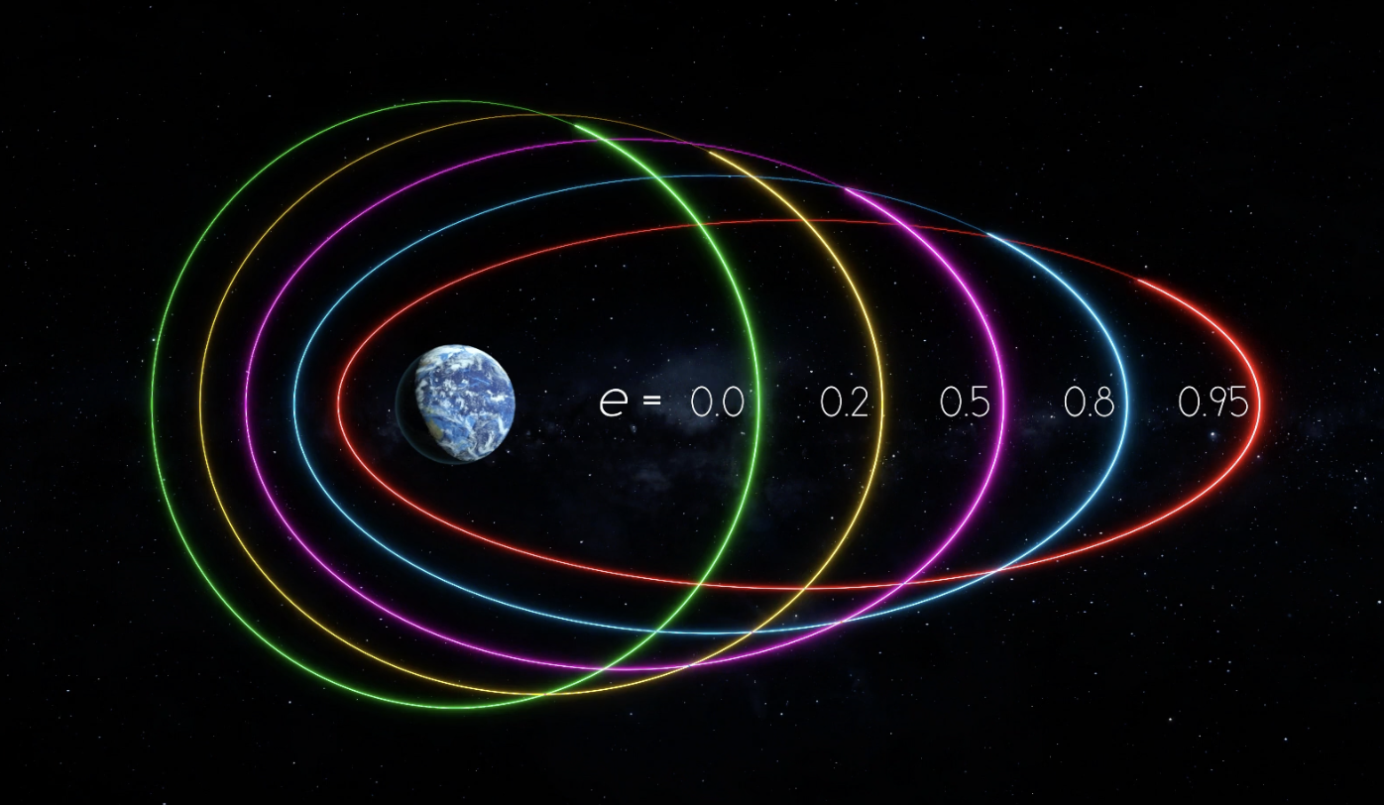
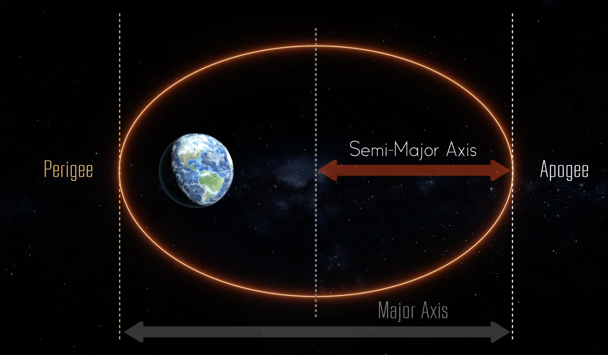
Satellite orbital elements
r1
r2
$$\text{e}$$ | Eccentricity | [0,1] when the orbit is circular: 0 (the LEO satellite orbit is assumed) | $$\frac{r2−r1}{r2+r1}$$
𝑎 | semi-major axis | circular: a = radius | $$\frac{r1+r2}{2}$$
Figrues are obtained from https://www.youtube.com/watch?v=2gAYqtmNJx8, https://www.youtube.com/watch?v=BvjlBpP4zU8

Slide 18
Satellite orbital elements
$$\text{ω}$$ | Argument of the perigee
Ω | The right ascension of ascending node (RAAN) = The longitude of the ascending node | The angle between the vernal equinox and the interactions of the orbital and the equatorial planes
ν | The true anomaly | The degrees from orbit perigee to the satellite’s location
If the orbit is circular, ν is undfines, and we have instead:
u | Argument of latitude = phase angle $$∈\left[−π,π\right]$$ | The angle between the ascending node and the satellite
G. Stock, J. A. Fraire, and H. Hermanns, “Distributed On-Demand Routing for LEO Mega-Constellations: A Starlink Case Study,” in 2022 11th Advanced Satellite Multimedia Systems Conference and the 17th Signal Processing for Space Communications Workshop (ASMS/SPSC), Sep. 2022, pp. 1–8. doi: 10.1109/ASMS/SPSC55670.2022.9914716.
Figrues are obtained from https://www.youtube.com/watch?v=2gAYqtmNJx8.

Slide 19
Satellite orbital elements
All the satellites can be categorized: ascending satellites and descending satellites
Ascending satellites
Fly towards the latitude-increasing direction
the direction is northeast, when the orbit inclination $i∈\left[0, \frac{π}{2}\right]$
Descending satellites
Fly towards the latitude-decreasing direction
The direction is southeast
Q. Chen, G. Giambene, L. Yang, C. Fan, and X. Chen, “Analysis of Inter-Satellite Link Paths for LEO Mega-Constellation Networks,” IEEE Trans. Veh. Technol., vol. 70, no. 3, pp. 2743–2755, Mar. 2021, doi: 10.1109/TVT.2021.3058126.

Slide 20
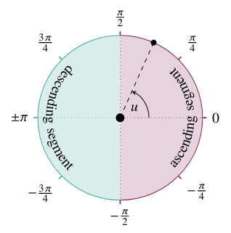
Satellite orbital elements
Argument of latitude (phase angle) u to classify ascending satellites and descending satellites
Descending
Ascending
G. Stock, J. A. Fraire, and H. Hermanns, “Distributed On-Demand Routing for LEO Mega-Constellations: A Starlink Case Study,” in 2022 11th Advanced Satellite Multimedia Systems Conference and the 17th Signal Processing for Space Communications Workshop (ASMS/SPSC), Sep. 2022, pp. 1–8. doi: 10.1109/ASMS/SPSC55670.2022.9914716.

Slide 21
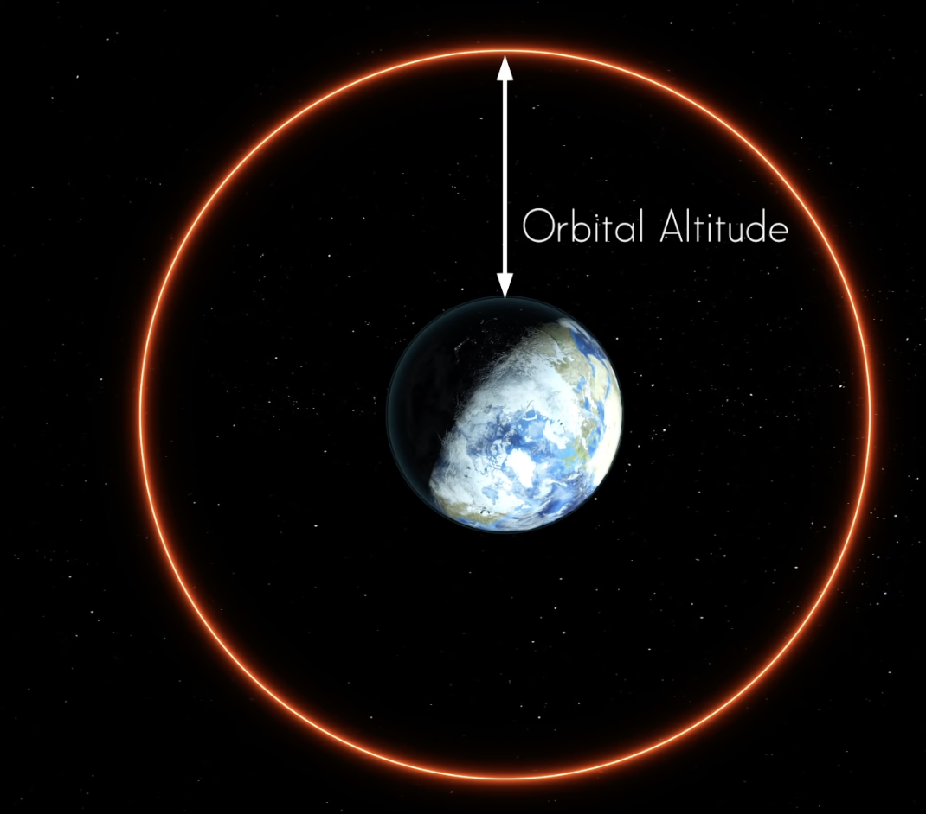
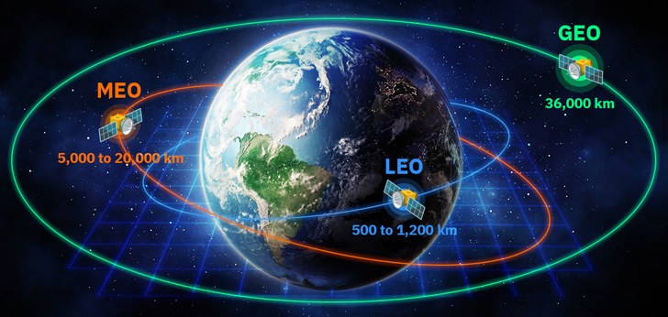
Satellite orbital elements
ℎ | altitude | Orbit radius = h + Re, where Re is the radius of the Earth = 6378 km
Low earth orbit (LEO) satellites
Medium Earth orbit (MEO) satellites
Geostationary equatorial orbit (GEO) satellites
Figrues are obtained from https://www.youtube.com/watch?v=BvjlBpP4zU8, https://www.google.com/, https://www.youtube.com/watch?v=bA-V2DixZBk and https://www.youtube.com/watch?v=n70zjMvm8L0

Slide 22
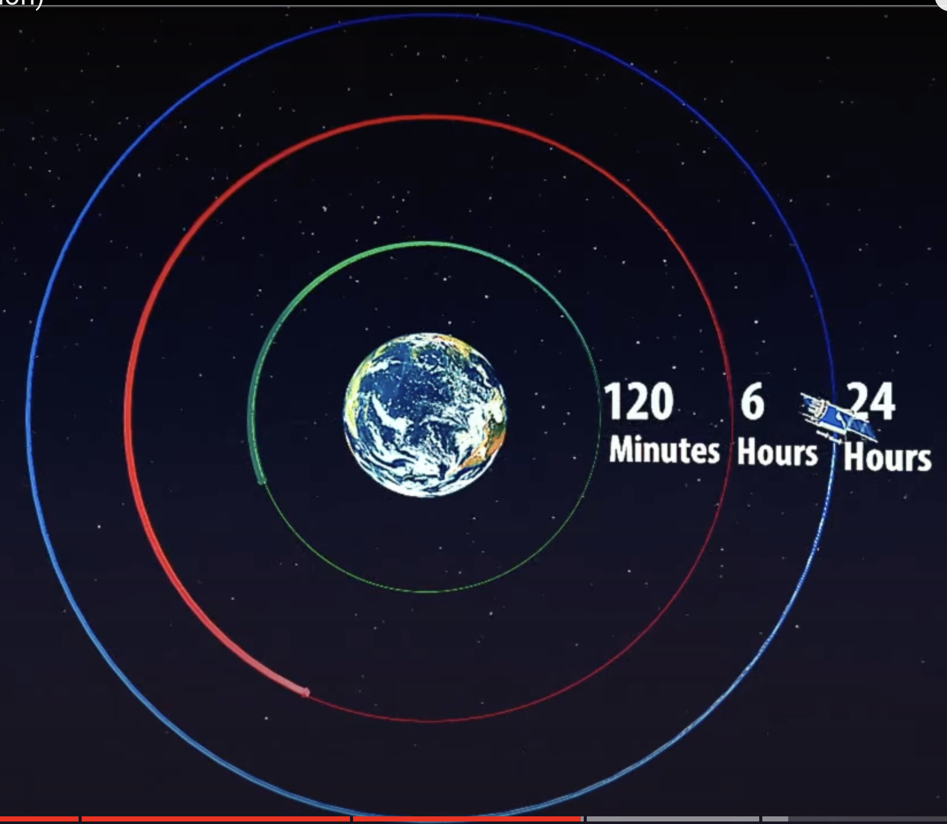
Satellite orbital elements
LEO satellites are better than GEO satellites for communication:
Time efficient
Smaller signal loss due to shorter propagation distance
Connectable even if an obstacle is in the line of sight (LOS) from terminal to satellite
Figrues are obtained from https://www.youtube.com/watch?v=BvjlBpP4zU8, https://www.google.com/, https://www.youtube.com/watch?v=bA-V2DixZBk and https://www.youtube.com/watch?v=n70zjMvm8L0
Z. Qu, G. Zhang, H. Cao, and J. Xie, “LEO Satellite Constellation for Internet of Things,” IEEE Access, vol. 5, pp. 18391–18401, 2017, doi: 10.1109/ACCESS.2017.2735988.

Slide 23
Overview
Background
Satellites Constellations Network
Satellite orbital elements
Inter-satellite link
How to formulate?
Conclusion

Slide 24
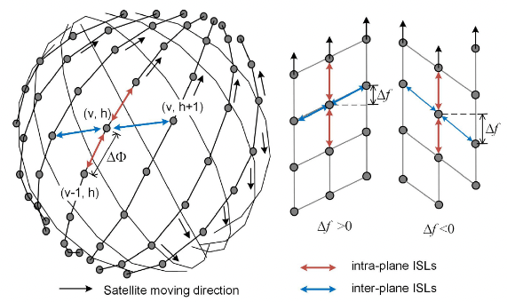
Inter-satellite link
The Inter-satellite links (ISLs)
To enable inter-satellite communications including data transmissions and relays
ISL can be classified into the intra-plane ISLs and inter-planes ISLs
B. Matthiesen, N. Razmi, I. Leyva-Mayorga, A. Dekorsy, and P. Popovski, “Federated Learning in Satellite Constellations,” IEEE Network, pp. 1–16, 2023, doi: 10.1109/MNET.132.2200504.
Q. Chen, G. Giambene, L. Yang, C. Fan, and X. Chen, “Analysis of Inter-Satellite Link Paths for LEO Mega-Constellation Networks,” IEEE Trans. Veh. Technol., vol. 70, no. 3, pp. 2743–2755, Mar. 2021, doi: 10.1109/TVT.2021.3058126.

Slide 25
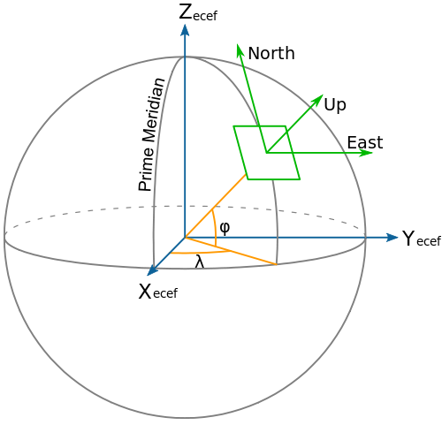
Inter-satellite link
Geodetic coordinates $(φ,λ)$:
To calculate the sub-satellite point (SSP) of a satellite on the ground at time t
$$φ$$ | latitude | $$arcsin⁡(sin i sin u)$$ | $$[−i,i]$$
$$λ$$ | longitude | $$(ζ(u)+\text{Ω}\text{) }\text{mod}\text{ 2}\text{π}$$ | $$[−π,π]$$
where the longitude difference is:
$$ζ\left(u\right)=\text{arctan}\text{(}\text{cos} i \text{tan} \text{u}\text{)}\text{+}\left\{\begin{aligned}0, ascending segment \\ π, desencing segment\end{aligned}\right.$$
G. Stock, J. A. Fraire, and H. Hermanns, “Distributed On-Demand Routing for LEO Mega-Constellations: A Starlink Case Study,” in 2022 11th Advanced Satellite Multimedia Systems Conference and the 17th Signal Processing for Space Communications Workshop (ASMS/SPSC), Sep. 2022, pp. 1–8. doi: 10.1109/ASMS/SPSC55670.2022.9914716.
Q. Chen, G. Giambene, L. Yang, C. Fan, and X. Chen, “Analysis of Inter-Satellite Link Paths for LEO Mega-Constellation Networks,” IEEE Trans. Veh. Technol., vol. 70, no. 3, pp. 2743–2755, Mar. 2021, doi: 10.1109/TVT.2021.3058126.
Figures are obtained from https://dirsig.cis.rit.edu/docs/new/coordinates.html.

Slide 26
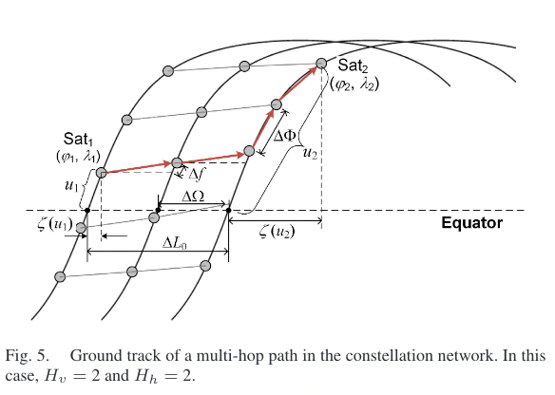
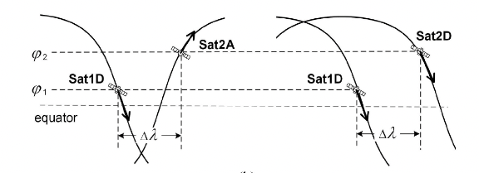
Inter-satellite link
The distance between two access inter-plane satellites $\left(φ_{1},λ_{1}\right)$ and $(φ_{2},λ_{2})$:
The RAAN difference: $Δ\text{L}0 ={\text{Ω}}_{2}−{\text{Ω}}_{1}$
The longitude difference: $Δλ={\text{Ω}}_{2}+ζ\left(u2\right)−{\text{Ω}}_{1}−ζ(u1)$
The inter-plane hop-count: $Hh =Round \left[ \frac{ΔL0}{ΔΩ}\right]=Round [ \frac{Δλ + ζ\left(u1\right)− ζ\left(u2\right) }{ΔΩ}]$
Intra-plane satellites distance:
The phase angle difference: $Δu =HhΔf+HvΔΦ$
The intra-plane hop-count: $Hv = Round [ \frac{Δu −HhΔf}{ΔΦ} ]$
The total hop-count: $H = |Hh| + |Hv|$
26
Q. Chen, G. Giambene, L. Yang, C. Fan, and X. Chen, “Analysis of Inter-Satellite Link Paths for LEO Mega-Constellation Networks,” IEEE Trans. Veh. Technol., vol. 70, no. 3, pp. 2743–2755, Mar. 2021.

Slide 27
Overview
Background
Satellites Constellations Network
Satellite orbital elements
Inter-satellite link
How to formulate?
Conclusion

Slide 28
How to formulate?
LEO constellation without ISLs
Orbit period
The coverage area of a satellite
LEO constellation with ISLs
Communication model
ISL
Satellite-terrestrial channel

Slide 29
How to formulate?
LEO constellation without ISLs - orbital period
The radius of the circular orbit:
$r=h+R_{e}$.
The satellite’s velocity in the circular orbit:
$v=\sqrt{\frac{μ}{r}}$,
where $μ=M∗G=3.986 ∗{10}^{14}m^{3}/s^{2}$, as a product of Earth’s mass and gravitational Earth’s constant.
The orbital period:
$$T=2π\sqrt{\frac{r^{3}}{μ}}$$
The number of the daily passes:
$n=\frac{T_{e}}{T}$,
where the sideral day satisfies $T_{e}=$ 23ℎ 56𝑚𝑖𝑛 4.1𝑠=86164.1s.
S. Cakaj, “The Parameters Comparison of the ‘Starlink’ LEO Satellites Constellation for Different Orbital Shells,” Front. Comms. Net., vol. 2, p. 643095, May 2021, doi: 10.3389/frcmn.2021.643095.

Slide 30
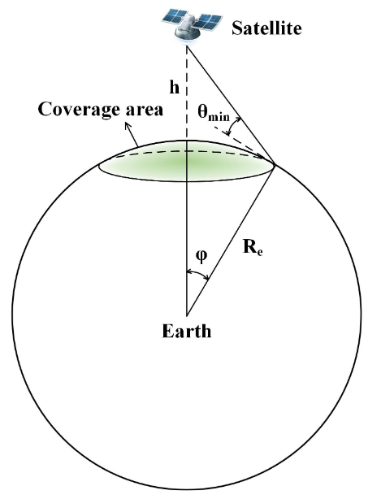
How to formulate?
LEO constellation without ISLs – the coverage
The coverage area served by a satellite is dependent on the line-of-sight (LoS) propagation and the minimum elevation angle θmin at the user terminal.
The angular radius of the coverage circle:
The coverage area:
A higher altitude h / a lower θmin -> larger coverage
R. Deng, B. Di, H. Zhang, L. Kuang, and L. Song, “Ultra-Dense LEO Satellite Constellations: How Many LEO Satellites Do We Need?,” IEEE Trans. Wireless Commun., vol. 20, no. 8, pp. 4843–4857, Aug. 2021, doi: 10.1109/TWC.2021.3062658.

Slide 31
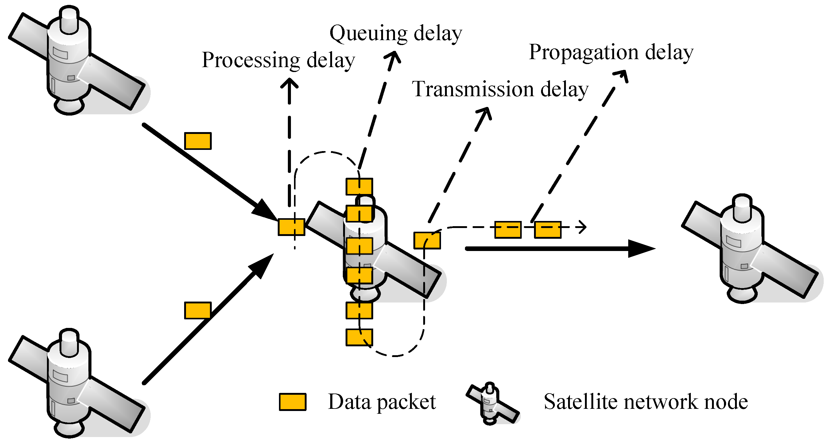
How to formulate?
LEO constellation with ISLs
Delay = processing delay + queuing delay + transmission delay + propagation delay
Qu, Hua, Meng Wang, Jihong Zhao, Shuyuan Zhao, Taihao Li, and Pengcheng Yue. "Generalized Asymmetric Correntropy for Robust Adaptive Filtering: A Theoretical and Simulation Study." Remote Sensing 14, no. 15 (2022): 3677.

Slide 32
How to formulate?
LEO constellation with ISLs - ISL transmission channel model
The signal-to-noise ratio (SNR) of ISLs $\text{in} \text{the} \text{free} \text{space}$:
$$SNR= \frac{P_{T}G_{T}G_{R}L_{F}}{kTEM}$$
The free space loss is: $L_{F}= \frac{c^{2}}{{(4πdf)}^{2}}$ ,
where $c$ is the light speed, $f$ is the communications frequency of ISL, and $d$ is the distance between two satellites.
$$P_{T}$$ | transmission power | $$k$$ | Boltzmann’s constant
$$G_{T}$$ | transmitting antenna gain | $$T$$ | resultant noise temperature
$$G_{R}$$ | receiving antenna gain | $$E$$ | the required ratio of received energy-per-bit to noise-density
$$L_{F}$$ | free space loss | $$M$$ | link margin
K.-C. Tsai, L. Fan, R. Lent, L.-C. Wang, and Z. Han, “Integrated Satellite-Terrestrial Routing Using Distributionally Robust Optimization,” in ICC 2023 - IEEE International Conference on Communications, May 2023, pp. 277–282. doi: 10.1109/ICC45041.2023.10279579.
Y. Lu et al., “Enhancing Transmission Efficiency of Mega-Constellation LEO Satellite Networks,” IEEE Transactions on Vehicular Technology, vol. 71, no. 12, pp. 13210–13225, Dec. 2022, doi: 10.1109/TVT.2022.3197321.

Slide 33
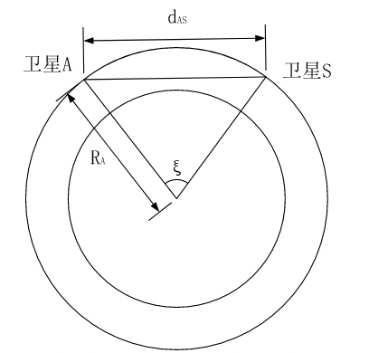
How to formulate?
LEO constellation with ISLs - Propagation delay between two ISL satellites:
The angle for satellites $A \left(λ_{A},φ_{A}\right)$ and B$(λ_{B},φ_{B})$ is ξ:
The distance between the two satellites is:
where $R_{A}$ represents the orbital altitude of the two satellites.
The propagation latency
Satellite A
Satellite S
Earth center O
F. Zheng, C. Wang, Z. Zhou, Z. Pi, and D. Huang, “LEO laser microwave hybrid inter-satellite routing strategy based on modified Q-routing algorithm,” J Wireless Com Network, vol. 2022, no. 1, p. 36, Dec. 2022, doi: 10.1186/s13638-022-02119-1.

Slide 34
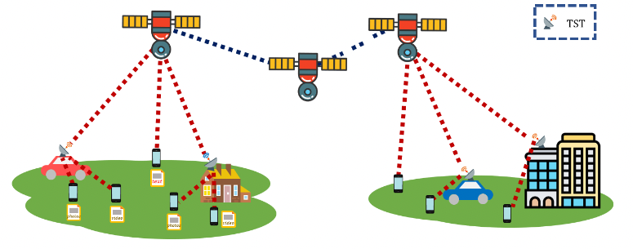
How to formulate?
LEO constellation with ISLs - Satellite-terrestrial transmission channel model
The SNR of the uplink at time slot t:
$SNR= \frac{P_{T}G_{T}G_{R}{L_{F}L}_{P}^{t}}{N}$,
where $N$ is the noise, and the propagation loss (mostly rain attenuation) $L_{P}^{t}$at time slot $t$:
$L_{P}^{t}=L_{S}∗ρ_{R}^{t}$,
where $L_{s}$ measures the slant-path length between the satellite and devices (it is a constant), and $ρ_{R}^{t}$is the attenuation per kilometer.
The uplink data rate: $r=B\log_{2}(1+SNR)$, where B is the allocated bandwidth.
source
destination
K.-C. Tsai, L. Fan, R. Lent, L.-C. Wang, and Z. Han, “Integrated Satellite-Terrestrial Routing Using Distributionally Robust Optimization,” in ICC 2023 - IEEE International Conference on Communications, May 2023, pp. 277–282. doi: 10.1109/ICC45041.2023.10279579.
S. Tani, K. Motoyoshi, H. Sano, A. Okamura, H. Nishiyama, and N. Kato, “An adaptive beam control technique for diversity gain maximization in LEO satellite to ground transmissions,” in 2016 IEEE International Conference on Communications (ICC), Kuala Lumpur, Malaysia: IEEE, May 2016, pp. 1–5. doi: 10.1109/ICC.2016.7510942.

Slide 35
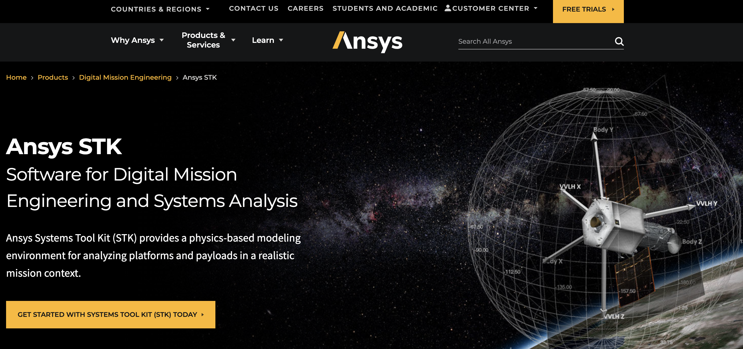
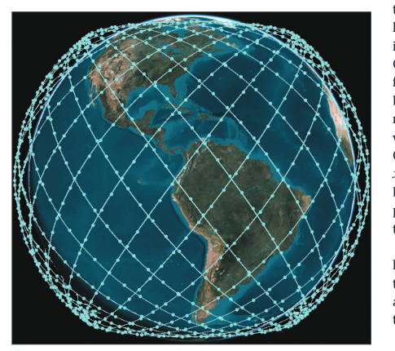
How to formulate?
The simulation can be conducted by
Analytical Graphics, Inc.’s (AGI’s) Systems Tool Kit (STK) simulator
A. U. Chaudhry and H. Yanikomeroglu, “Laser Intersatellite Links in a Starlink Constellation: A Classification and Analysis,” IEEE Veh. Technol. Mag., vol. 16, no. 2, pp. 48–56, Jun. 2021, doi: 10.1109/MVT.2021.3063706

Slide 36
Overview
Background
Satellites Constellations Network
Satellite orbital elements
Inter-satellite link
How to formulate?
Conclusion

Slide 37
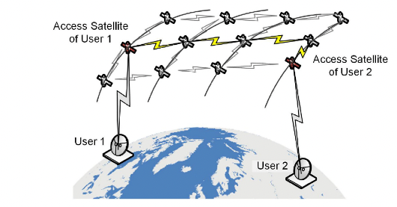
Conclusion
Challenges:
No network infrastructure
Constrained on-board resources
Satellite movement and the switches of user-satellite connection
Directions:
Routing design
Distributed computation to share resources
......
F. Zheng, C. Wang, Z. Zhou, Z. Pi, and D. Huang, “LEO laser microwave hybrid inter-satellite routing strategy based on modified Q-routing algorithm,” J Wireless Com Network, vol. 2022, no. 1, p. 36, Dec. 2022, doi: 10.1186/s13638-022-02119-1.
“What challenges do space networks face as they venture into deep space?”https://baijiahao.baidu.com/s?id=1787296551071165312&wfr=spider&for=pc

Slide 38
Conclusion
Satellites model is composed with 6 Keplerian elements: i, e, 𝑎, Ω, ν, ω
The Satellites Constellations can be described as $i:PQ/P/F$
The Inter satellite links (ISL) can be classified into the intra-plane ISL and inter-planes ISL
The formulated equations can be utilized

Slide 39
Reference
F. Zheng, C. Wang, Z. Zhou, Z. Pi, and D. Huang, “LEO laser microwave hybrid inter-satellite routing strategy based on modified Q-routing algorithm,” J Wireless Com Network, vol. 2022, no. 1, p. 36, Dec. 2022, doi: 10.1186/s13638-022-02119-1.
G. Stock, J. A. Fraire, and H. Hermanns, “Distributed On-Demand Routing for LEO Mega-Constellations: A Starlink Case Study,” in 2022 11th Advanced Satellite Multimedia Systems Conference and the 17th Signal Processing for Space Communications Workshop (ASMS/SPSC), Sep. 2022, pp. 1–8. doi: 10.1109/ASMS/SPSC55670.2022.9914716.
Q. Chen, G. Giambene, L. Yang, C. Fan, and X. Chen, “Analysis of Inter-Satellite Link Paths for LEO Mega-Constellation Networks,” IEEE Trans. Veh. Technol., vol. 70, no. 3, pp. 2743–2755, Mar. 2021, doi: 10.1109/TVT.2021.3058126.
B. Matthiesen, N. Razmi, I. Leyva-Mayorga, A. Dekorsy, and P. Popovski, “Federated Learning in Satellite Constellations,” IEEE Network, pp. 1–16, 2023, doi: 10.1109/MNET.132.2200504.
A. U. Chaudhry and H. Yanikomeroglu, “Laser Intersatellite Links in a Starlink Constellation: A Classification and Analysis,” IEEE Veh. Technol. Mag., vol. 16, no. 2, pp. 48–56, Jun. 2021, doi: 10.1109/MVT.2021.3063706.
K.-C. Tsai, L. Fan, R. Lent, L.-C. Wang, and Z. Han, “Integrated Satellite-Terrestrial Routing Using Distributionally Robust Optimization,” in ICC 2023 - IEEE International Conference on Communications, May 2023, pp. 277–282. doi: 10.1109/ICC45041.2023.10279579.
Z. Qu, G. Zhang, H. Cao, and J. Xie, “LEO Satellite Constellation for Internet of Things,” IEEE Access, vol. 5, pp. 18391–18401, 2017, doi: 10.1109/ACCESS.2017.2735988.

Slide 40
Reference
Qu, Hua, Meng Wang, Jihong Zhao, Shuyuan Zhao, Taihao Li, and Pengcheng Yue. "Generalized Asymmetric Correntropy for Robust Adaptive Filtering: A Theoretical and Simulation Study." Remote Sensing 14, no. 15 (2022): 3677.
R. Deng, B. Di, H. Zhang, L. Kuang, and L. Song, “Ultra-Dense LEO Satellite Constellations: How Many LEO Satellites Do We Need?,” IEEE Trans. Wireless Commun., vol. 20, no. 8, pp. 4843–4857, Aug. 2021, doi: 10.1109/TWC.2021.3062658.
S. Cakaj, “The Parameters Comparison of the ‘Starlink’ LEO Satellites Constellation for Different Orbital Shells,” Front. Comms. Net., vol. 2, p. 643095, May 2021, doi: 10.3389/frcmn.2021.643095.
Y. Lu et al., “Enhancing Transmission Efficiency of Mega-Constellation LEO Satellite Networks,” IEEE Transactions on Vehicular Technology, vol. 71, no. 12, pp. 13210–13225, Dec. 2022, doi: 10.1109/TVT.2022.3197321.
S. Tani, K. Motoyoshi, H. Sano, A. Okamura, H. Nishiyama, and N. Kato, “An adaptive beam control technique for diversity gain maximization in LEO satellite to ground transmissions,” in 2016 IEEE International Conference on Communications (ICC), Kuala Lumpur, Malaysia: IEEE, May 2016, pp. 1–5. doi: 10.1109/ICC.2016.7510942.
“What challenges do space networks face as they venture into deep space?”https://baijiahao.baidu.com/s?id=1787296551071165312&wfr=spider&for=pc
Liang, Jintao, Aizaz U. Chaudhry, and Halim Yanikomeroglu. "Phasing parameter analysis for satellite collision avoidance in starlink and kuiper constellations." In 2021 IEEE 4th 5G world forum (5GWF), pp. 493-498. IEEE, 2021.

Slide 41
Q & A

