Slide 1
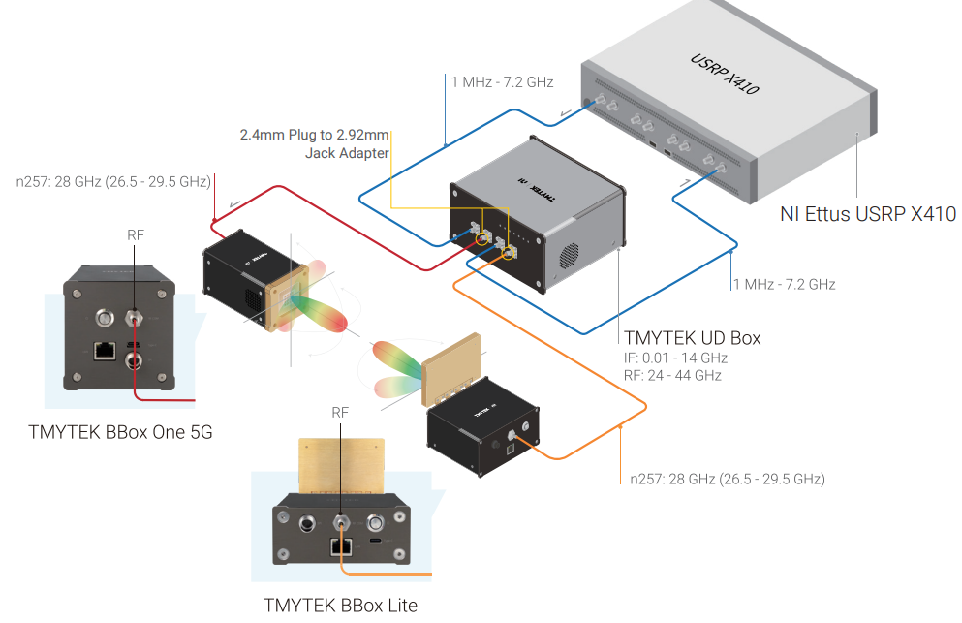
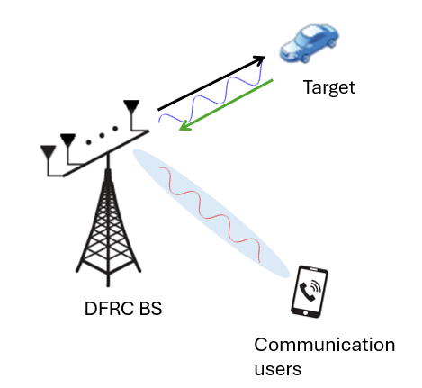
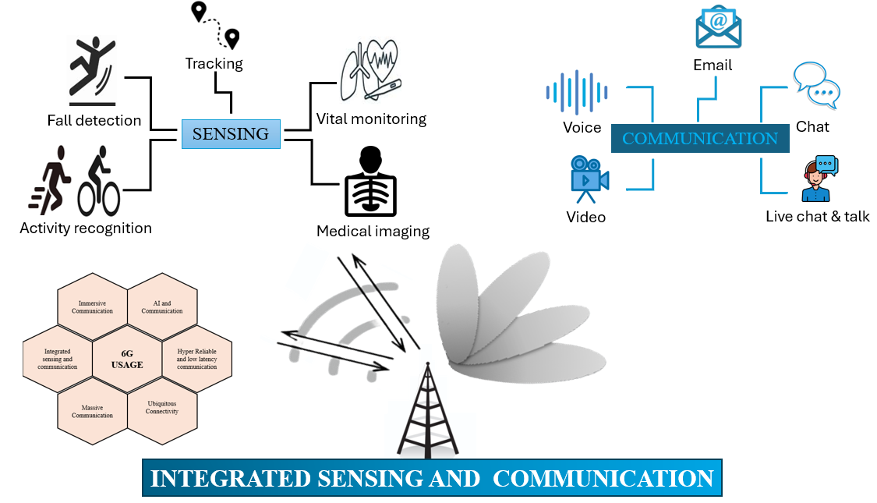
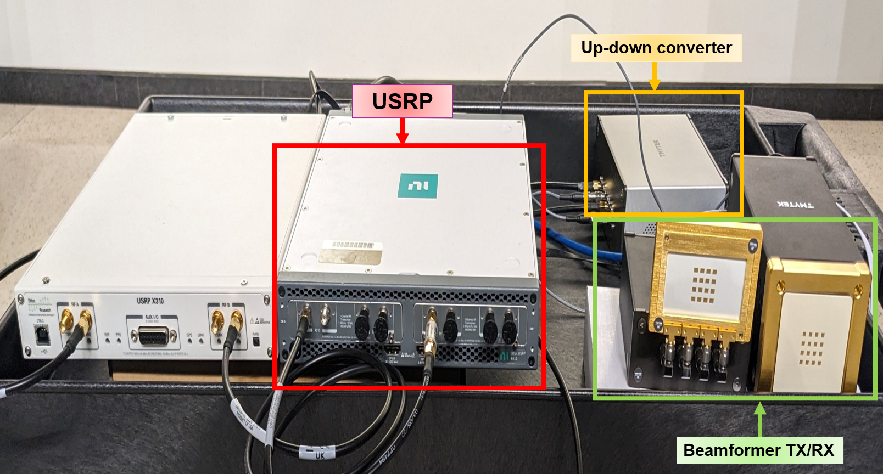
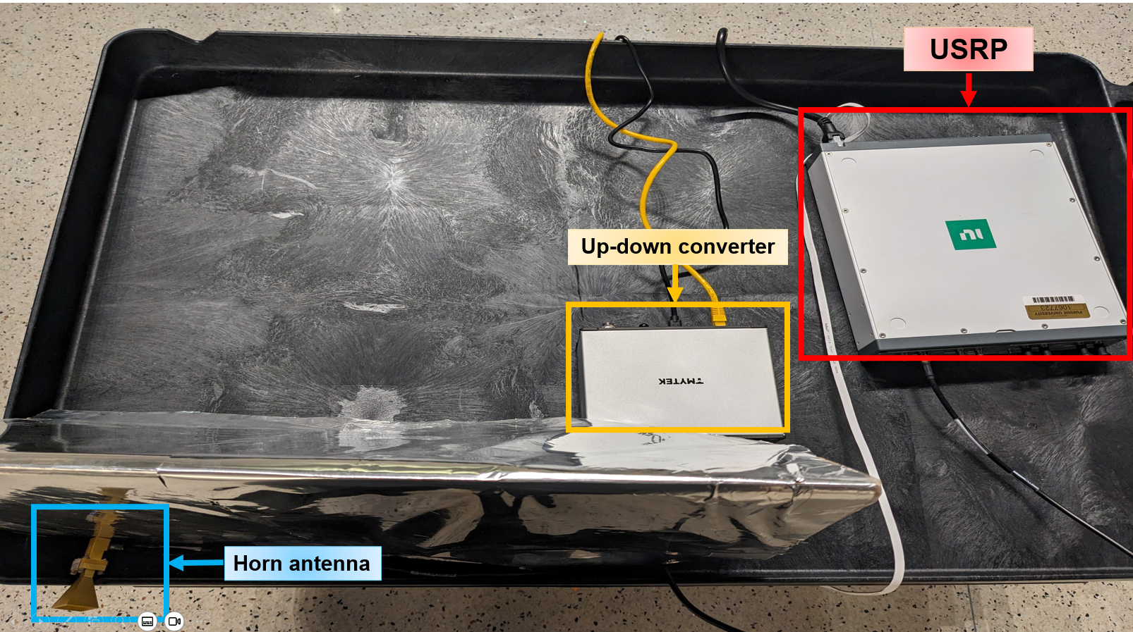
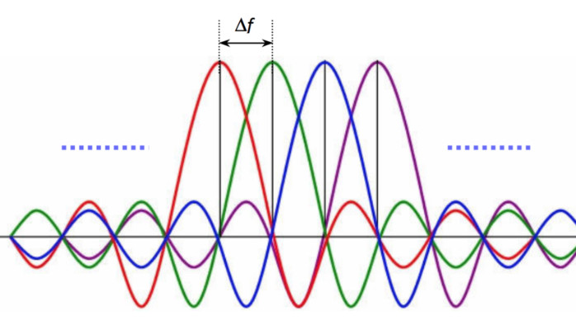
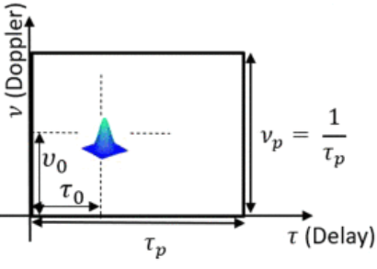
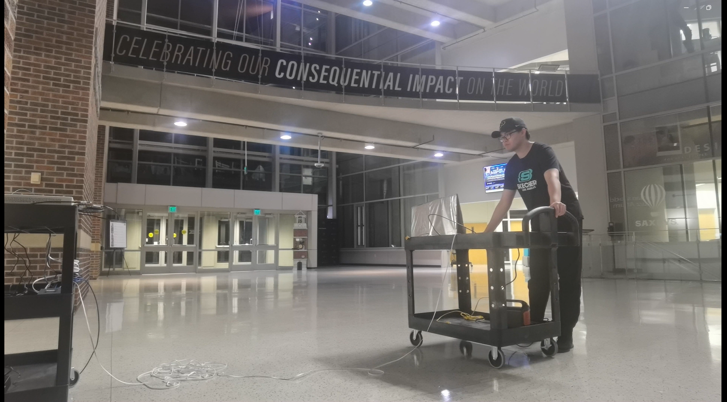
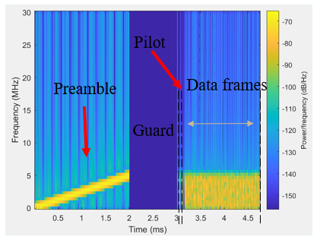
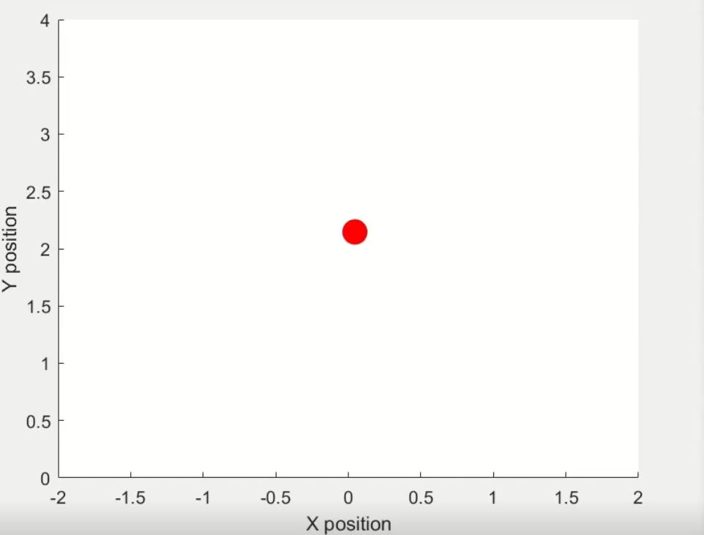
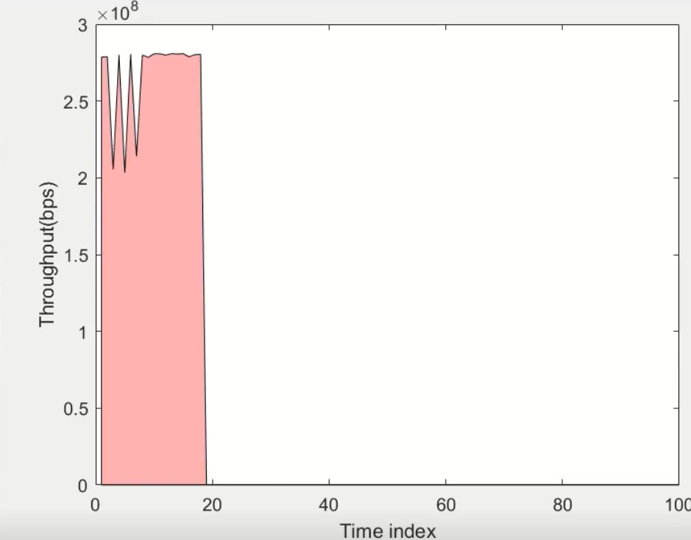
Waveform Shaping in Integrated Sensing and Communications
Henglin Pu*, Salma Sultana#, Husheng Li*, Zhu Han#, and H. Vincent Poor$
*Elmore Family School of Electrical and Computer Engineering, Purdue University, West Lafayette, IN, USA
#Electrical and Computer Engineering Department, University of Houston, Houston, TX, USA
$Electrical Engineering Department, Princeton University, Princeton, NJ, USA
Motivation
Prototype
Findings & Summary
Enhance flexibility and adaptability in ISAC systems by optimizing waveform selection for different sensing and communication scenarios.
Promote a unified framework that integrates radar and communication functions, improving spectrum efficiency and reducing hardware complexity.
Facilitate advanced research and real-world applications, such as autonomous systems, by supporting waveform optimization.
High Mobility Performance
Enhanced Spectral Efficiency
Improved Multipath Handling
Dual functionality in Multiuser Scenarios
Prototype results validate user tracking and high data throughput.
ISAC improves efficiency by merging communication and sensing.
The system ensures sustainable spectrum use and better connectivity.
ISAC enables advanced applications for 6G, like autonomous vehicles and smart cities.
Introduction
Integrated Sensing and Communication (ISAC) is a key technology and one of six ITU usage scenarios in 6G networks.
USRP X410: Software-defined radio (SDR) to design, prototype and deploy wireless systems.
Up-down converter: Convert baseband signal to high frequency band, and vice versa.
Beamformer TX/RX: RF:26.5~29.5GHz
Horn antenna: 17dBi gain and frequency range of 26.5-40GHz to receive the signal.
Hardware Description
 | OFDM | MC-OTFS | Zak-OTFS
Spectral Efficiency | High | Superior, improved due to the absence of cyclic prefix | Same as MC-OTFS
Mobility Support | Poor in high mobility; suffers from Doppler effects. | Superior; highly resilient to Doppler and suitable for dynamic environments. | Best, due to predictability and non-fading attributes
Multipath Handling | Effective with cyclic prefix but reduces efficiency. | Superior; utilizes full channel response for better multipath resolution. | Best, due to predictability and non-fading attributes
Complexity | Low complexity | Higher complexity | Higher complexity
Standardization | Widely adopted in Wi-Fi, LTE, and 5G. | Less standardized; still in early stages of adoption but can reuse the OFDM structure. | Least standardized; needs a brand-new structure.
Application Scenarios | Best for low to moderate mobility like fixed wireless. | Ideal for high-speed applications like V2X and high-speed trains. | Same as MC-OTFS
Demonstration Results
Technique that merges sensing and communication function into an integrated framework.
Motivation: ISAC – OTFS model allows high reliability and data rate for high mobility and multiuser scenarios.
Integration Gain
Efficiency Improvement
Cost Reduction
Coordination Gain
Communication assisted sensing
Sensing assisted Communication
ISAC Transceiver Platform
Receiver
Transceiver
OFDM
OTFS
Industrial & Social Impacts
Orthogonal Frequency-Division Multiplexing (OFDM) divides the spectrum into multiple orthogonal subcarriers.
Joint Spectrum Utilization
Low Computational Complexity
Robustness to Multipath and Delay
Orthogonal Time Frequency Space (OTFS) modulates in delay doppler domain.
High Mobility and Doppler Resilience
Full Diversity in Delay-Doppler Domain
Unified Framework for Communication and Sensing
Single user tracking and data rate estimate:
Advanced real-time sensing for autonomous vehicles and emergency response.
Contribution
In this demo we demonstrate the ISAC model to empower 6G networks.
The system illustrate dual-functionality in providing reliable communication services while accurately localizing users.
This dual-purpose approach is particularly beneficial in multi-user environments, where resource efficiency is critical.
Spectrogram of transmission package
User Position Tracking
Data Transmission:
Sustainable spectrum utilization, reducing congestion and improving connectivity.
System Parameters | Settings
Bandwidth | 200MHz
Sampling rate | 250MHz
No. of subcarriers | 64
No. of symbols | 32
Central frequency | 28GHz
Modulation scheme | QPSK
User Throughput
Boosts economic productivity and social connectivity in smart cities and remote areas through better networks.
This framework demonstrates better performance and tracking abilities of the ISAC OTFS model.

