Slide 1
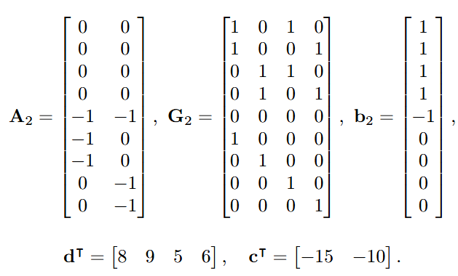
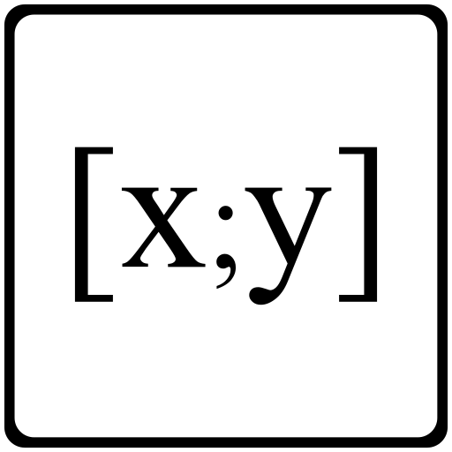
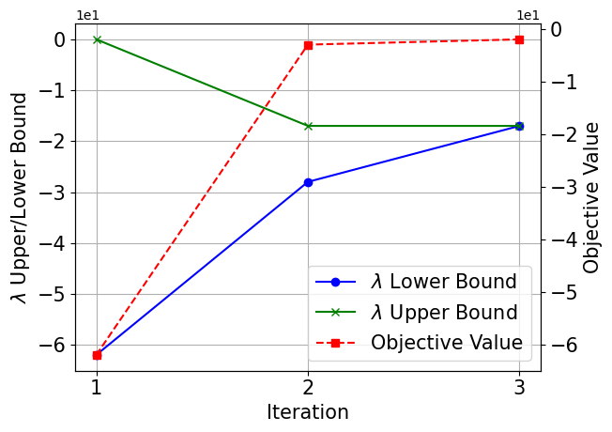
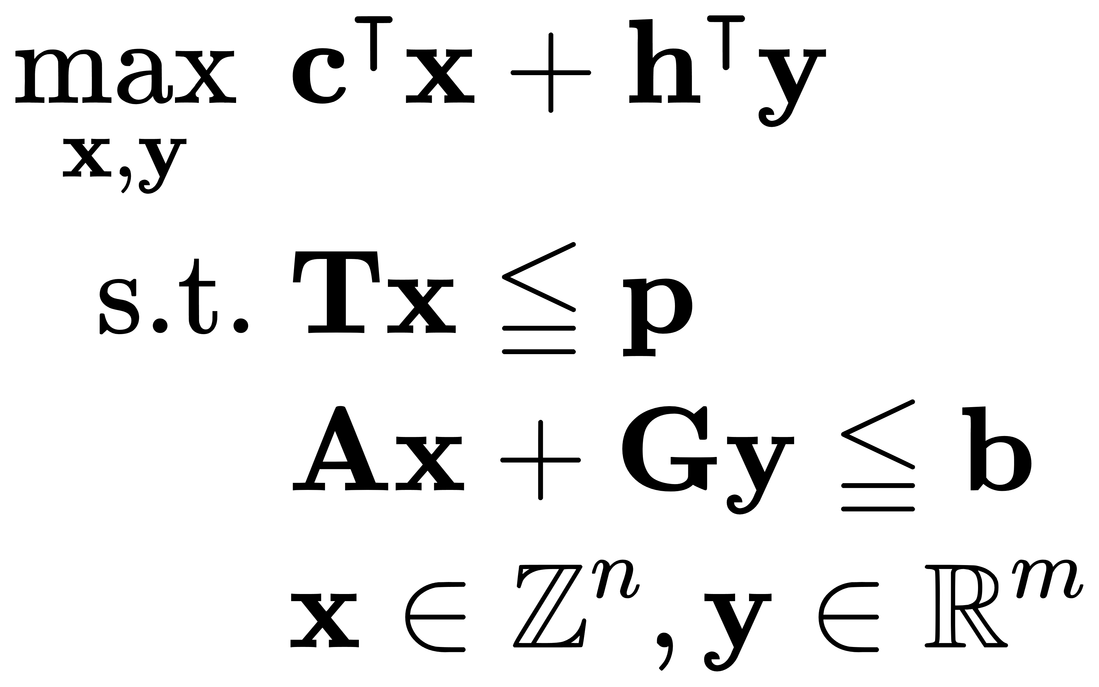
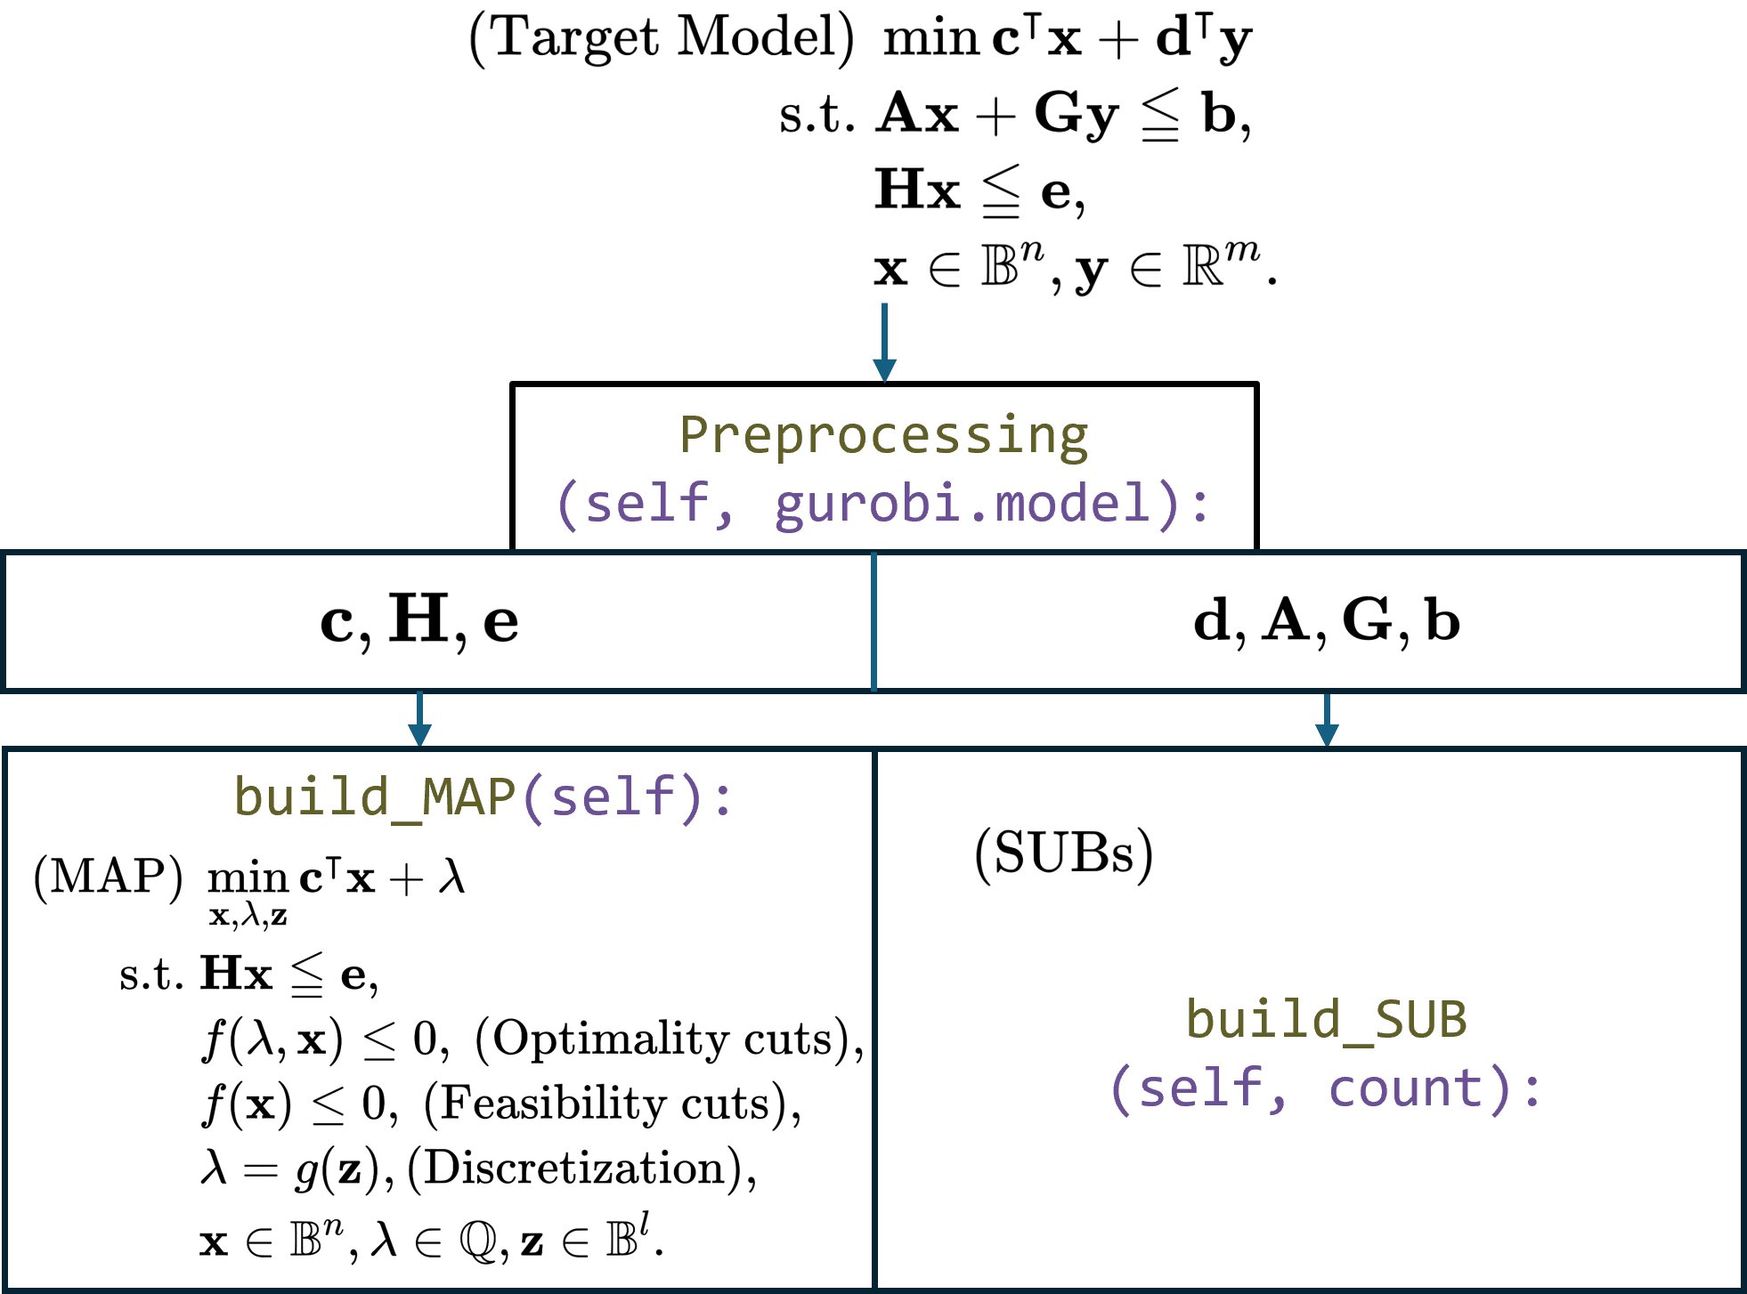
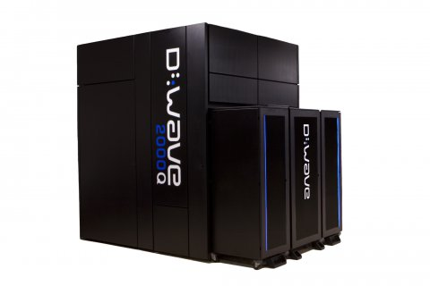
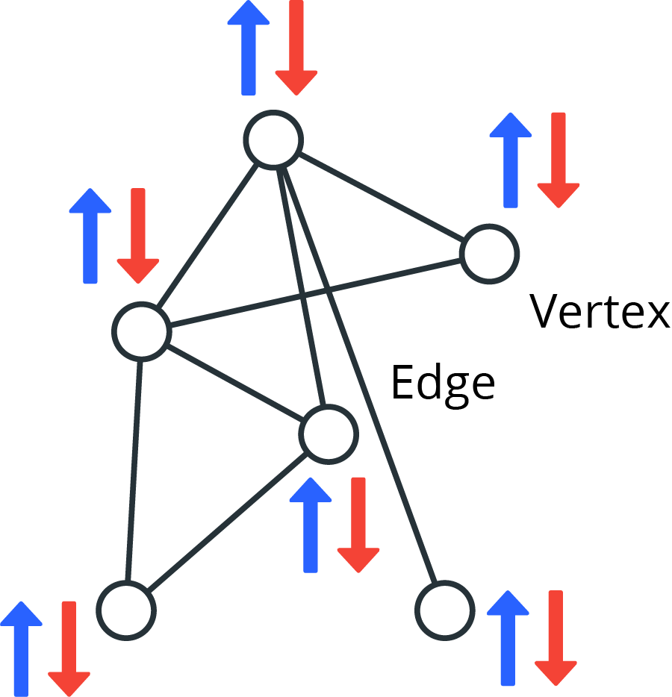
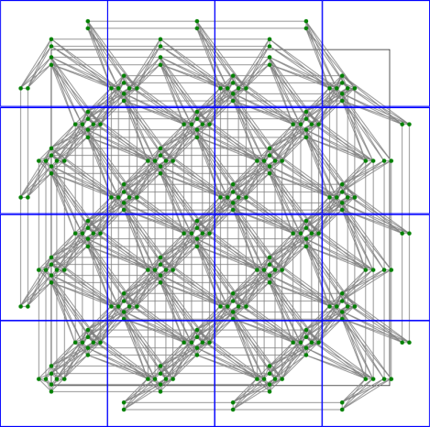
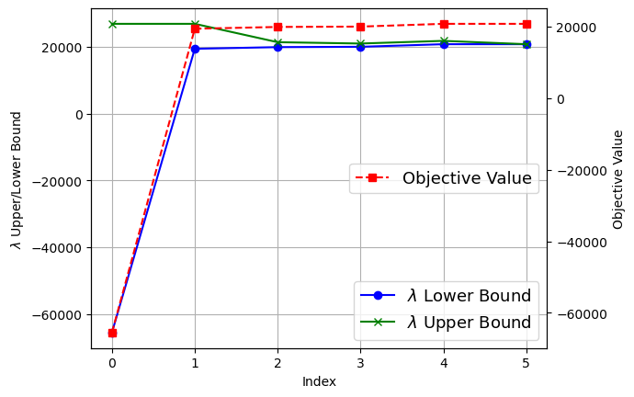
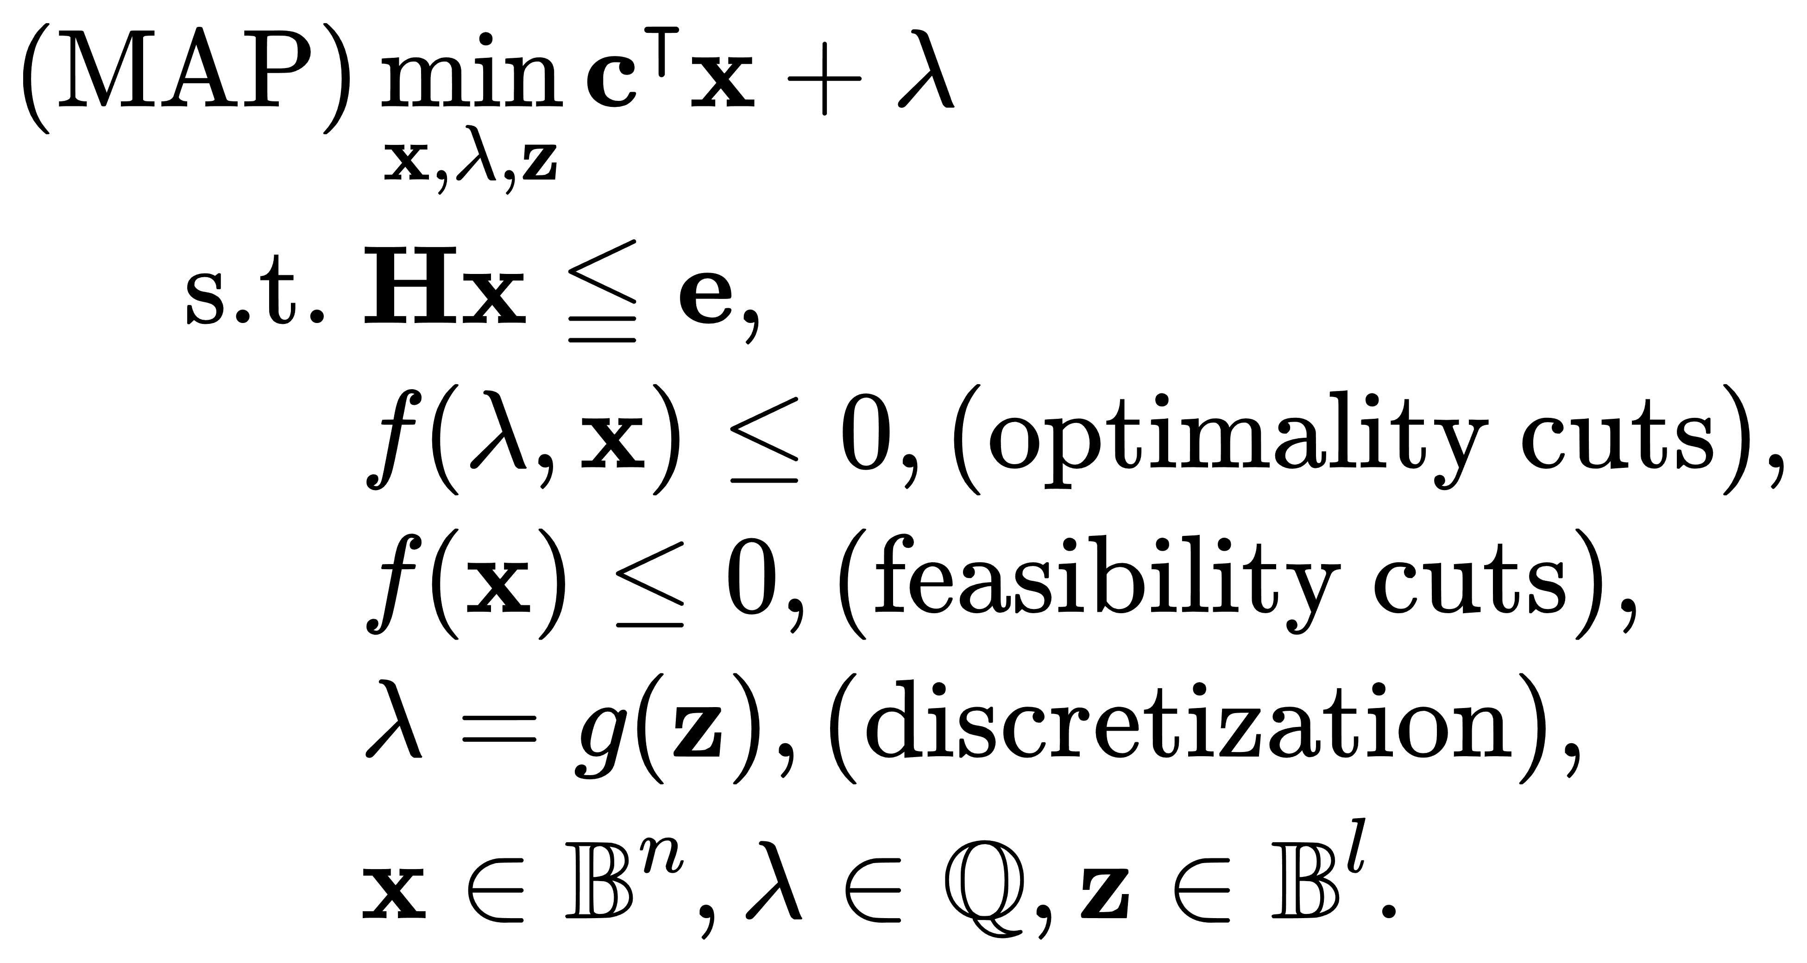
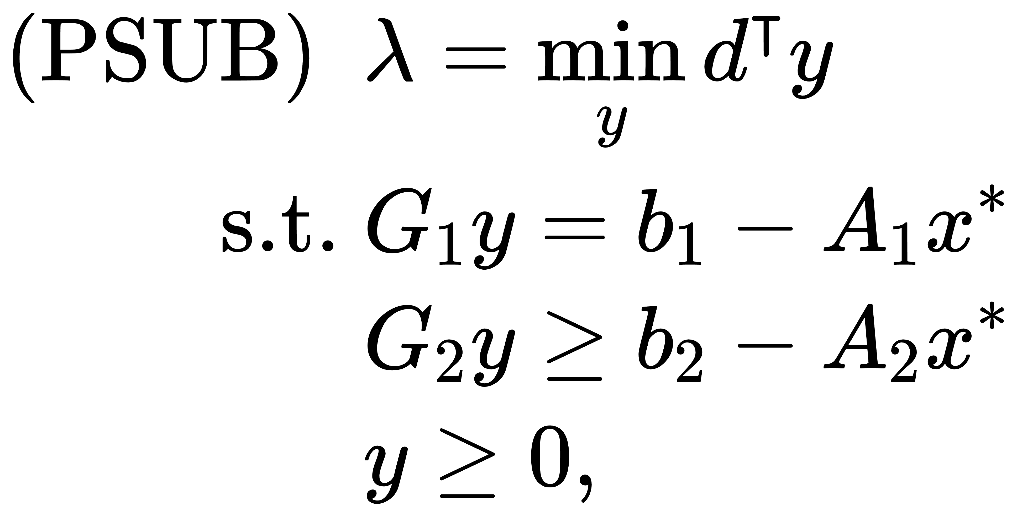
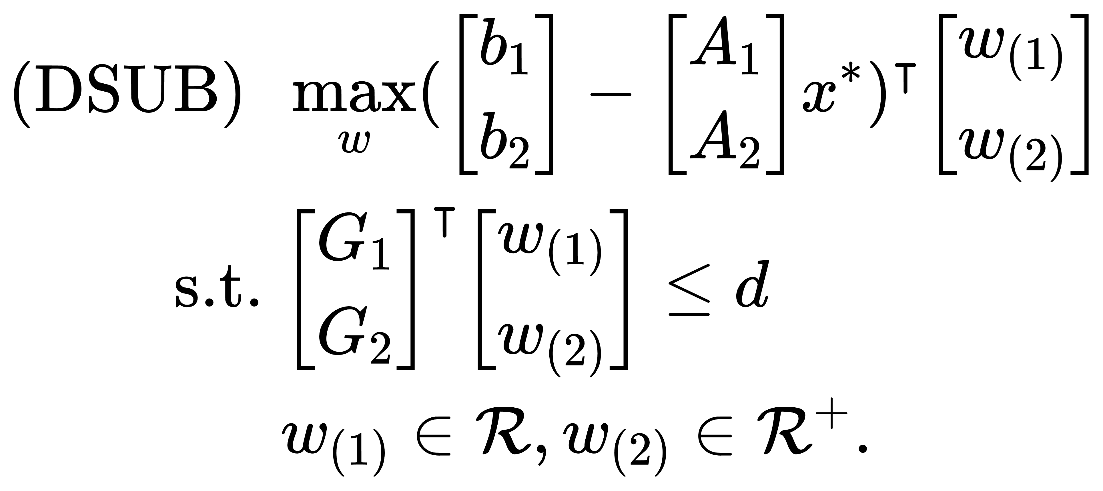
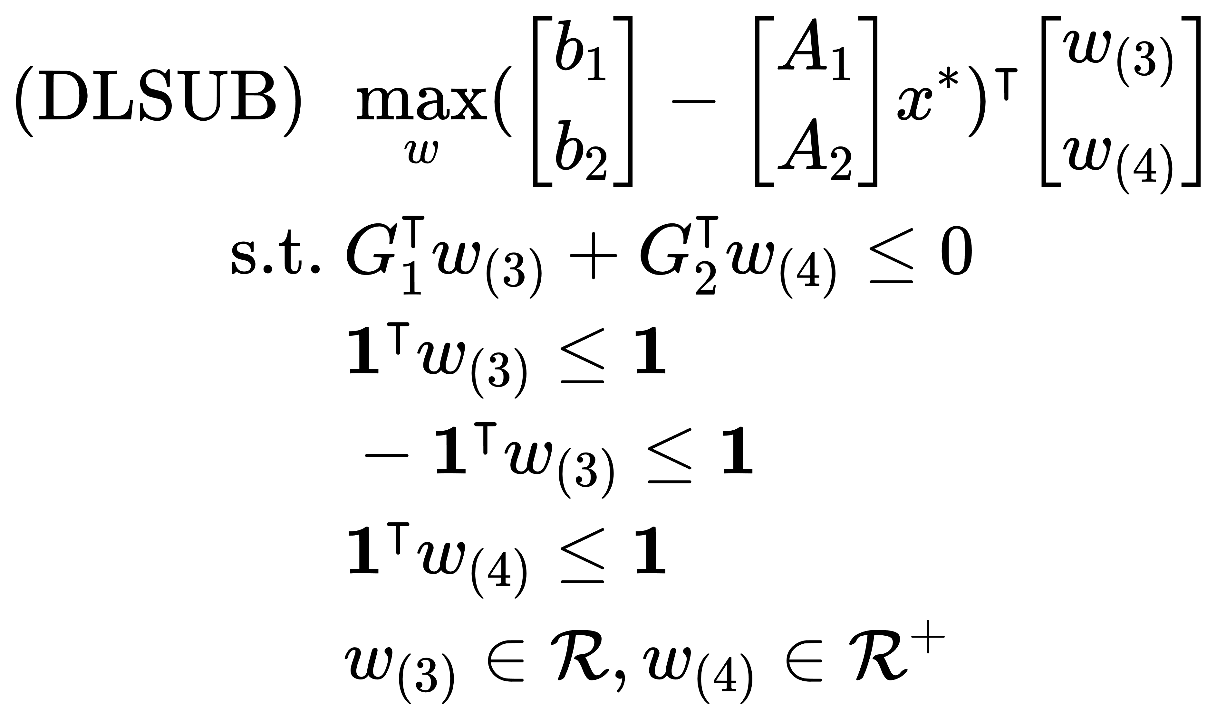
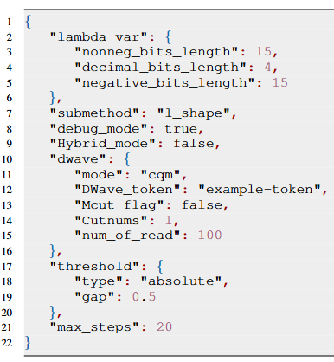
HQC-Bend: A Python Package of Hybrid Quantum-Classical Benders’ Decomposition
Zhongqi Zhao*#, Mingze Li*#, Lei Fan*#, and Zhu Han#
*Department of Engineering Technology, University of Houston, Houston, TX, USA
#Electrical and Computer Engineering Department, University of Houston, Houston, TX, USA
Motivation
Software Overview
Example Usage & Result
Employ the quantum computer to modified classical Benders’ decomposition algorithm to find the solution for the mixed-integer linear programming (MILP) problem Faster.
Employ multiple platforms to tackle the MILP problem with flexibility, such as quantum annealing computer, classical solvers in CPU, and simulated bifurcation assisted by GPU.
Master Problem
class HQC-Bend_algorithm
In Jupyter Notebook # Suppress warnings in Jupyter Notebook
import warnings
warnings.filterwarnings("ignore")
%run HQCMCBD_notebook.ipynb
Import Necessary Libraries import gurobipy as gp
from gurobipy import GRB, Model, quicksum
import numpy as np import math
import sys
Example Problem
A = np.array([[0, 0], …]); b = np.array([1,1,1,1,-1,0,0,0,0]);
G = np.array([[1,0,1,0], …]); c = np.hstack(np.array([-15.0,-10.0]))
h = np.hstack(np.array([8,9,5,6]))
__main__(self)
Master Problem (MAP)
build_MAP(self):
BD Cuts
$$x^{∗}$$
Target problem
CPU
QA models
1. Hybrid BQM
2. Direct BQM
3. CQM
4. Bifurcation
2
Sub-problems
Preprocessing (self, gurobi.model):
GPU
hbqm_solve(self):
In Pure Python Script from HQCMCBD import *
qbqm_solve(self):
MAP_Add_constr (self, count, index):
Example Problem Solving Script
# Create a new Gurobi model
model = gp.Model("MILP") # Add variables
x = model.addMVar(shape=len(c), vtype=GRB.BINARY, name="x")
y = model.addMVar(shape=len(h),
vtype=GRB.CONTINUOUS, lb=0, name="y")
z = model.addVar(vtype=GRB.CONTINUOUS, lb=0, name="z")
p = model.addVar(vtype=GRB.BINARY, name="p") # Set the objective function
model.setObjective(c @ x + h @ y, GRB.MAXIMIZE) # Add the constraints
model.addConstr(A @ x + G @ y <= b, name="constraints") model.addConstr(z == 1, name="constraints_eq")
model.addConstr(p == 1, name="constraints_eq2") # Optimize the model
model.optimize()
1
QPU
cqm_solve(self):
QPU
Binary Solution(s)
bifurcation(self):
solve_MAP(self, count):
Cut-adding method
1. Normal
2. L-shaped
Optimal Solution
pass
threshold_check(self, count):
fail
Introduction
CPU $1$
Optimality/Feasibility cuts
Example Problem
Platform
CPU $2$
…
SUB_normal(self, count, index):
(Mixed)-integer linear programming structure:
Complex
CPU $N$
SUB_lshape(self, count, index):
NP-Hard
Subproblems (SUB)
build_SUB(self, count):
3
# User Defined methods and modes
Solver = HQCMCBD_algorithm(model, mode = "manual") Solver.run()
NP-Complete
1️⃣
Preprocessing of the Target Model
the target optimization model is decomposed into multiple subproblems.
1️⃣ Decompose Target Model:
2️⃣ Preprocessing:
Using Gurobi to extract key components:
3️⃣ Problems Construction:
MAP (Master Problem):
SUB (Subproblems):
# Default methods and modes (hybrid + Lshape)
Solv2 = HQCMCBD_algorithm(model, mode = "default") Solv2.run()
NP
P
Simple
1
M-cuts Example
Example Configuration Files
Common methods for MILP:
2️⃣
Example Text Output
The n-th Config file of quantum sampling is created successfully at f:\...\HQCMCBD-API\data_output\Dwave_info-round-n.json.
create optimality cut
create optimality cut Round n: Current Objective value is 9.0; lambda_upper is 17.0; lambda_lower is 11.0;
Relative gap is 54.545%. Absolute gap is 6.0
Enumerative Methods
Branch and Bounds
Cutting Planes Methods
3️⃣
3️⃣
3
Quantum Processing Unit
Introduced a Python package implementing the HQC-Bend algorithm, capable of solving complex (M)ILP problems.
Leverage the strength of QC for certain optimization tasks while utilizing classical solvers for others, thus providing an efficient, robust solution for handling (M)ILP problems.
Energy
Classical path
Qubits
Tunnel effect
2
CPU Classical solver: Gurobi solver (1-cut)
GPU simulated QA solver: Bifurcation
Quantum Annealing Models
1. Hybrid BQM 2. Direct BQM
3. CQM
hbqm_solve(self):
qbqm_solve(self):
Solution
Bifurcation_solver(self):
cqm_solve(self):
CPU / QPU? | Advantage | Disadvantage
CPU (Central Processing Unit) | Versatility Efficient for Classical Algorithms | Limited Parallelism Slower for Certain Tasks
QPU (Quantum Processing Unit) | Quantum Parallelism Quantum Tunneling Exponential Speedup* | Limited & Specialized Cases
qbqm
CH
QM
Industrial & Social Impacts
BQM
hbqm
CH
QM
Solution(s)
Wide Application: Potential in many industrial fields: wireless communication, networks, power energies, etc.
CQM
cqm
CH
QM
3
D-Wave’s Hybrid Solver Service schemes. CH = Classical Heuristic Module. QM = Quantum Module.
Contribution
Cut-adding Method Scheme: 1️⃣Normal; 2️⃣L-shaped.
build_SUB (self, count):
(1)
Propose a python-based hybrid quantum-classical Benders’ decomposition algorithm to find the solution for MILP problems.
Offers a range of classical and quantum solvers for the MAP, as well as various cut-adding methods for subproblems, such as quantum annealing computer, classical solvers (Gurobi) in CPU, and simulated bifurcation by GPU.
(2)
Normal
Easy to Use: Users do not need to know too much about the quantum and math. Once configuration is set, algorithm will run and solve automatically and fast.
SUB_normal:
$$Objective =0$$
L-shape
(3)
$$Objective>0$$
Future work: Focus on extending the compatibility of the package with other model programming languages (e.g. Pyomo, Gekko, JuMP), and will further improve the solution quality & speed.
SUB_lshape:
(4)
Configuration file in JSON format

