Slide 1




Qubit Allocation, Entanglement Routing, and Topology Optimization for Quantum Networks and Computing
Zhu Han, John and Rebecca Moores Professor IEEE Fellow, AAAS Fellow, ACM Fellow Electrical and Computer Engineering Department University of Houston, TX USA
Thanks to Groups of Profs. Lei Fan, Yu Wang, Yuanxiong Guo and NSF

Slide 2
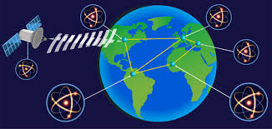
Outline
Background
Quantum Communication and Networking
Limitations of ground-based quantum entanglement distribution
Ariel Access Networks
Quantum Computing
Joint Optimization of Qubit Allocation, Entanglement Routing, and Quantum Computing
Optimizing Satellite-based Entanglement Distribution in Quantum Networks via Quantum-Assisted Approaches
Efficient Entanglement Routing for Satellite-Aerial-Terrestrial Quantum Networks
Co-Design of Network Topology and Qubit Allocation for Distributed Quantum Computing
Conclusions
2

Slide 3
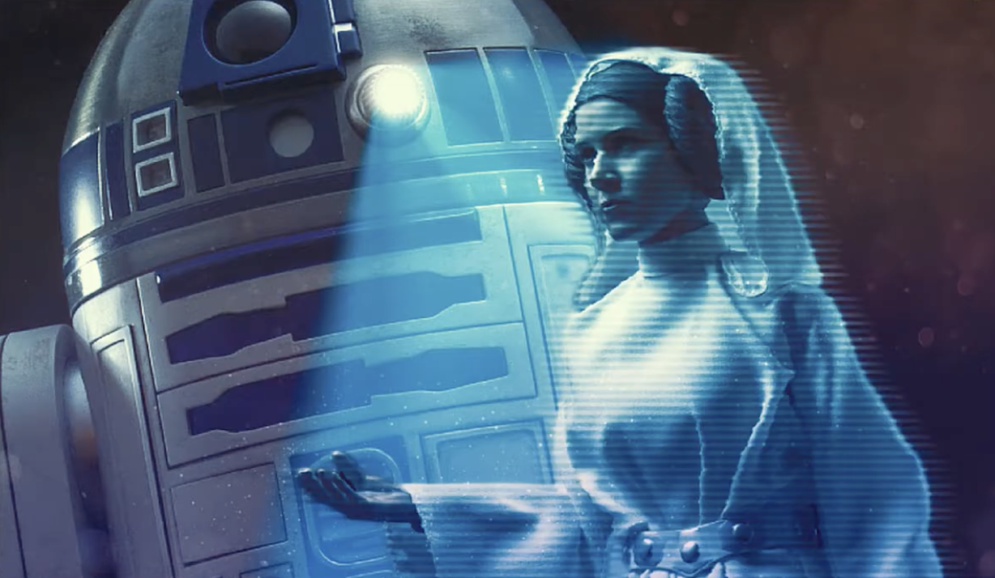
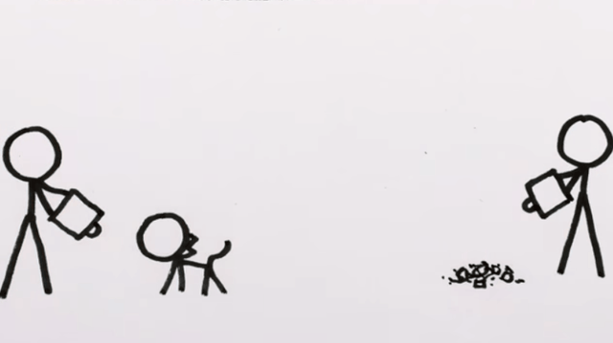
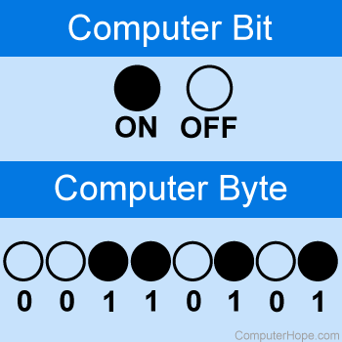
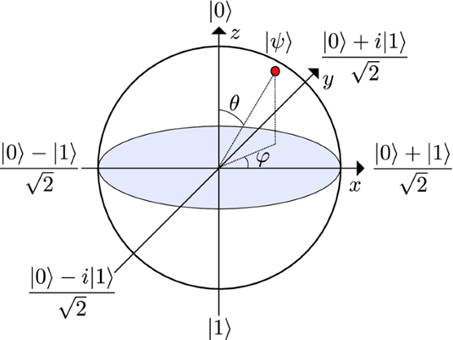
Quantum Communication and Networking
Transmit quantum information between nodes,
using quantum phenomena superposition and entanglement
No bits, but qubits
Quantum teleportation
Bits
Qubits
Bit. [Online]. Available: https://www.computerhope.com/jargon/b/bit.htm
What is a qubit. [Online]. Available: https://www.quantum-inspire.com/kbase/what-is-a-qubit/
Teleportation is real, thanks to quantum entanglement. [Online]. Available: https://www.popularmechanics.com/science/a25699/how-quantum-teleportation-works/
3

Slide 4
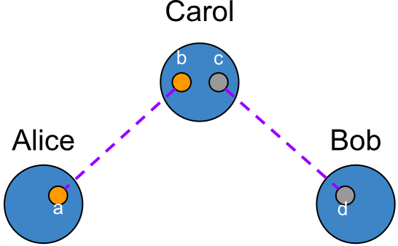
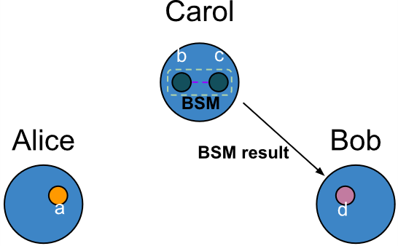
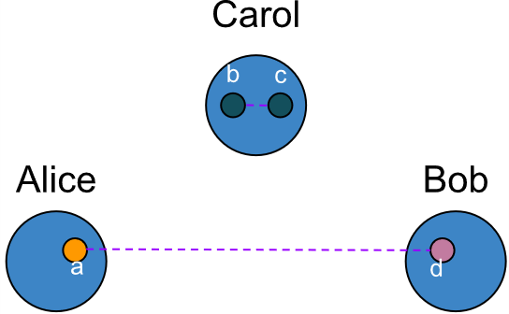
Quantum Communication and Networking
Entanglement Generation and Swapping
Stage 1: Alice and Bob generate an Einstein-Podolsky-Rosen (EPR) pair and send one qubit from their respective pairs to Carol
Stage 2: Carol performs a Bell-state measurement (BSM) and transmits the result to Bob, i.e., entanglement swapping
Stage 3: Alice and Bob are entangled
(a) Entanglement generation
(b) Entanglement swapping
(c) Entanglement established
4

Slide 5
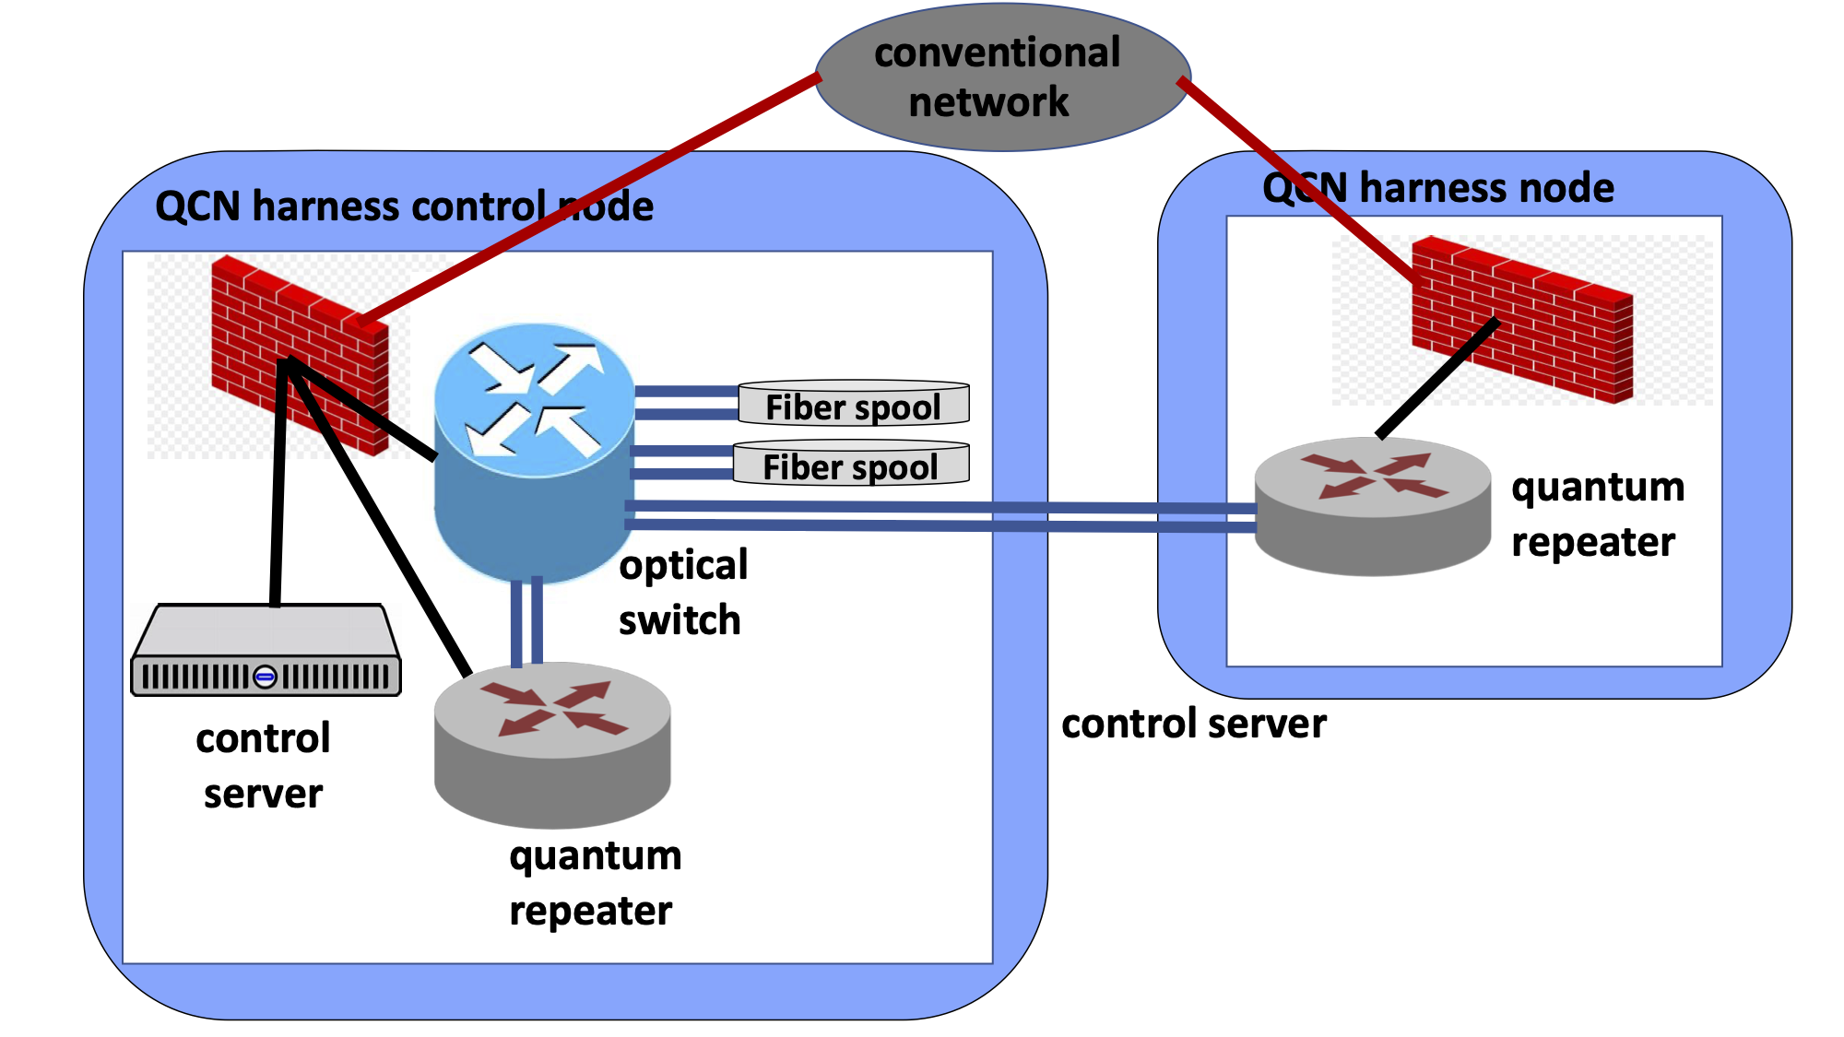

Quantum Communication and Networking
Terrestrial Quantum Network (TQN)
Utilize optical fiber links
Exponential increase in photon loss with distance
Terrestrial repeaters perform entanglement swapping and purification to ensuring high fidelity
Limited Coverage
Inefficient communication
Constrained scalability
5

Slide 6
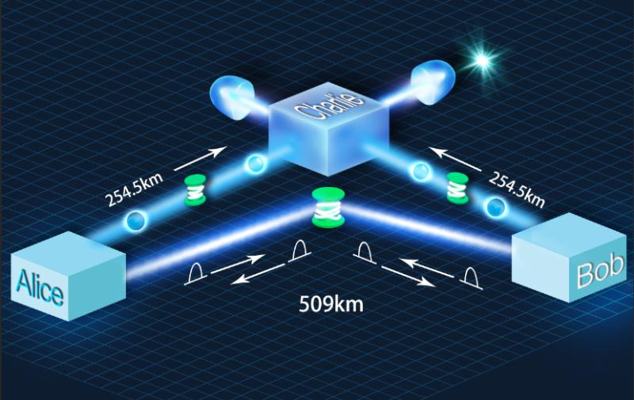
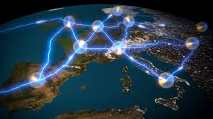
Limitation and Challenges
Limitations of ground-based quantum entanglement distribution
Signal attenuation and decoherence: Entanglement is fragile and easily disrupted by loss and noise during transmission.
Distance constraints: Reliable entanglement maintenance is limited over long ground-based distances.
Environmental interference: Electromagnetic noise, temperature shifts, and vibrations degrade quantum stability.
Device imperfections: Hardware errors and component flaws reduce entanglement fidelity.
Security risks: Protecting entanglement channels from eavesdropping and attacks remains difficult.
Cost and scalability: High implementation costs and complex maintenance hinder large-scale deployment.
6

Slide 7
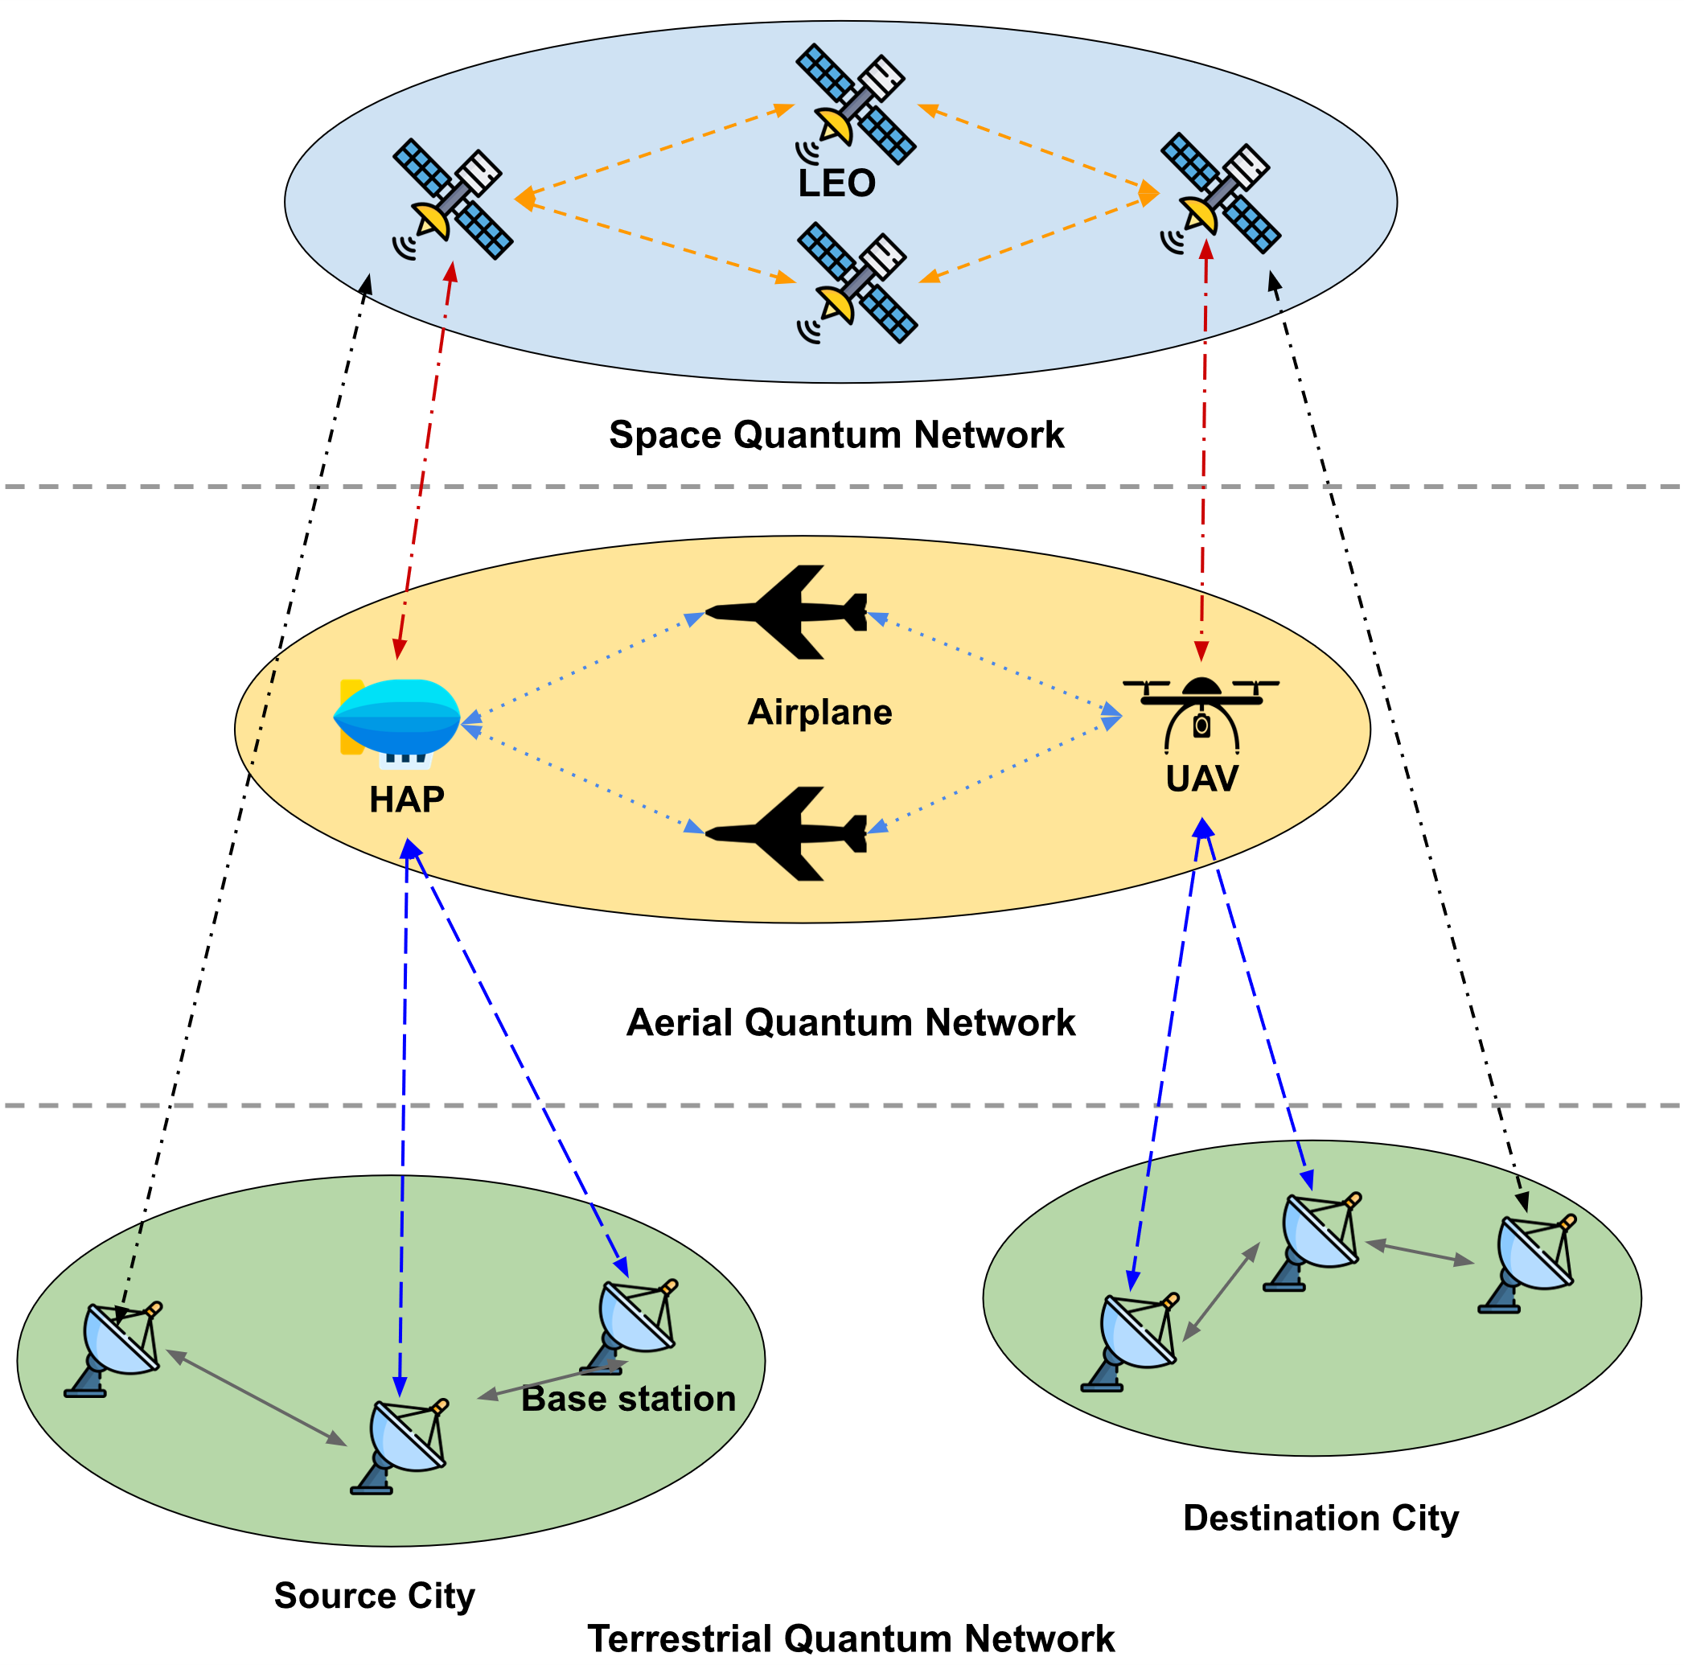
Ariel Access Networks
Space-Aerial-Terrestrial Quantum Networks (SATQNs)
SATQN has three layers
Space quantum network enables long-distance entanglement distribution via free space optical links
Aerial quantum network supports flexible and rapid deployment using free space optical links
Terrestrial quantum network offers stable quantum connections via optical fiber links
7

Slide 8
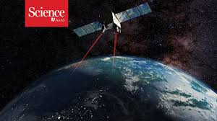
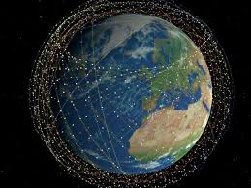
Aeriel Access Networks
An alternative way: satellite-based entanglement distribution
Overcoming distance limits: Satellites enable global-scale entanglement distribution beyond ground-based range.
Reduced signal loss: Space offers minimal attenuation and interference for more reliable quantum transmission.
Broad coverage: Satellites connect remote and inaccessible regions lacking ground infrastructure.
Freedom from obstacles: Signals are unaffected by terrain, buildings, or other terrestrial barriers.
Global quantum networking: Satellite links are essential for secure, worldwide quantum communication.
Complementary integration: Satellite systems enhance and extend ground-based quantum networks
8

Slide 9
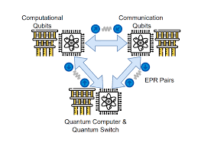
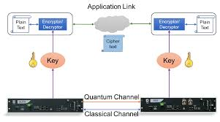
Ariel Access Networks
SATQN Applications
Time-sensitive applications
Complete tasks as quickly as possible
Avoid information decoherence due to noise or delay
E.g., Distributed quantum computing (DQC)
Time-insensitive applications
Support long-term stream of entanglements
Require secure communications
Steady stream of entanglement over time
E.g., Quantum key distribution (QKD)
Distributed quantum phase estimation with entangled photons. [Online]. Available: https://www.nature.com/articles/s41566-020-00718-2
Quantum Key Distribution Technology. [Online]. Available: https://www.drishtiias.com/daily-updates/daily-news-analysis/quantum-key-distribution-technology/print_manually
9

Slide 10
Ariel Access Networks
Challenges in SATQNs
Complex Integration
free space optical links and optical fiber links
Decoherence and Errors
noise in quantum channels and imperfections in quantum operations
10

Slide 11
Outline
Background
Quantum Communication and Networking
Limitations of ground-based quantum entanglement distribution
Ariel Access Networks
Quantum Computing
Joint Optimization of Qubit Allocation, Entanglement Routing, and Quantum Computing
Optimizing Satellite-based Entanglement Distribution in Quantum Networks via Quantum-Assisted Approaches
Efficient Entanglement Routing for Satellite-Aerial-Terrestrial Quantum Networks
Co-Design of Network Topology and Qubit Allocation for Distributed Quantum Computing
Conclusions
11

Slide 12


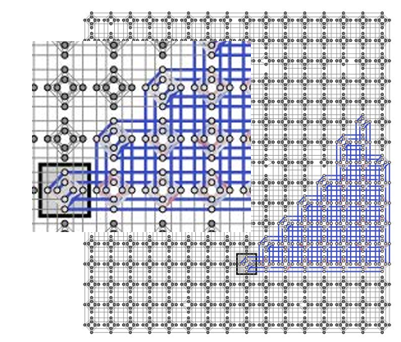
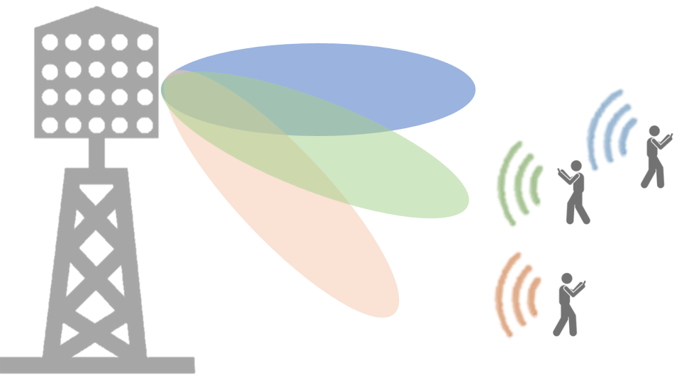
Quantum Computing
Quantum Computing: use quantum mechanics to solve problems too complex for classical computers.
?
MIMO Detection
Network Slicing
NP-hard Optimization Problems
Resource Allocation
. . .
e. g. Maximum Likelihood MIMO Detection Using Quantum Computing
Quantum Computing:
Network
Function Virtualization
Network Slicing
. . .
[2]
[2] M. Kim, D. Venturelli, and K. Jamieson, “Leveraging quantum annealing for large MIMO processing in centralized radio access networks,” in Proceedings of the ACM Special Interest Group on Data Communication, Beijing, China, Aug. 2019.
12

Slide 13
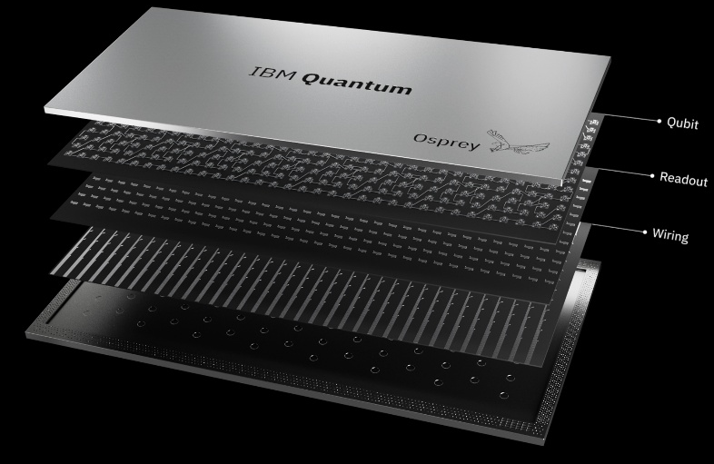
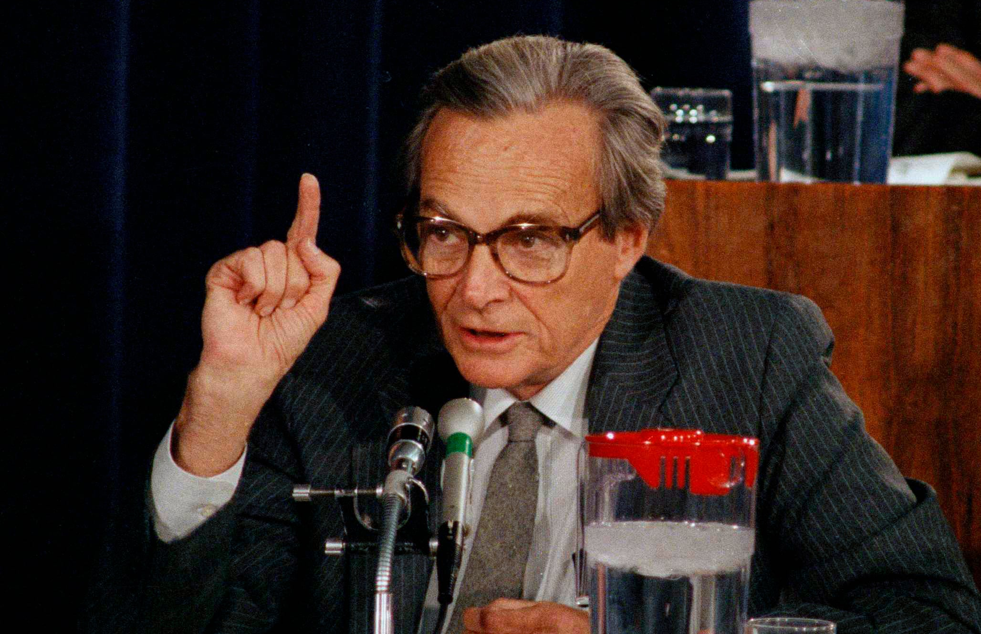
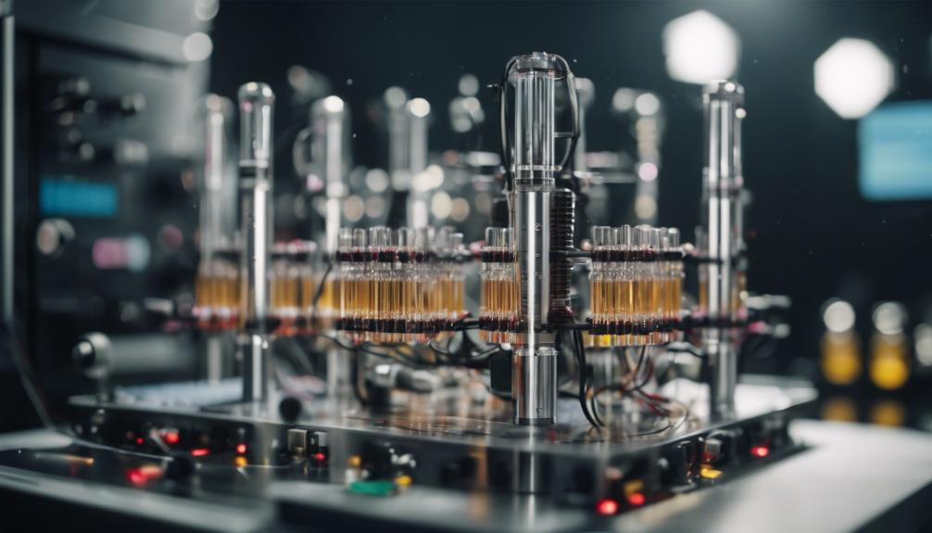
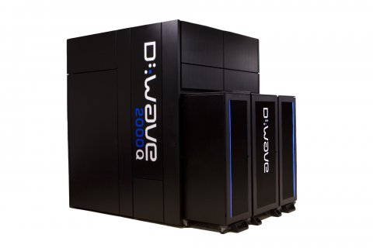
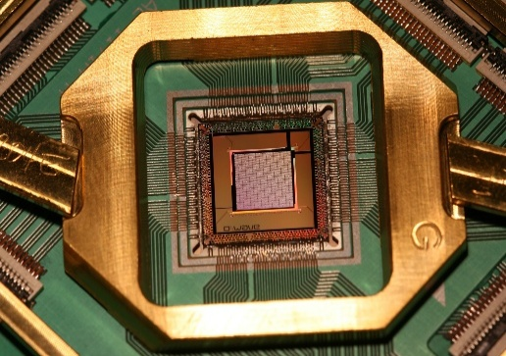
Quantum Computing
Quantum Computer
Maybe we need to use quantum mechanics in our computers.
Gate Model
Analog Quantum Model
Quantum Annealing
More Qubits
Faster than classical solvers
Fit some optimization problems
13

Slide 14
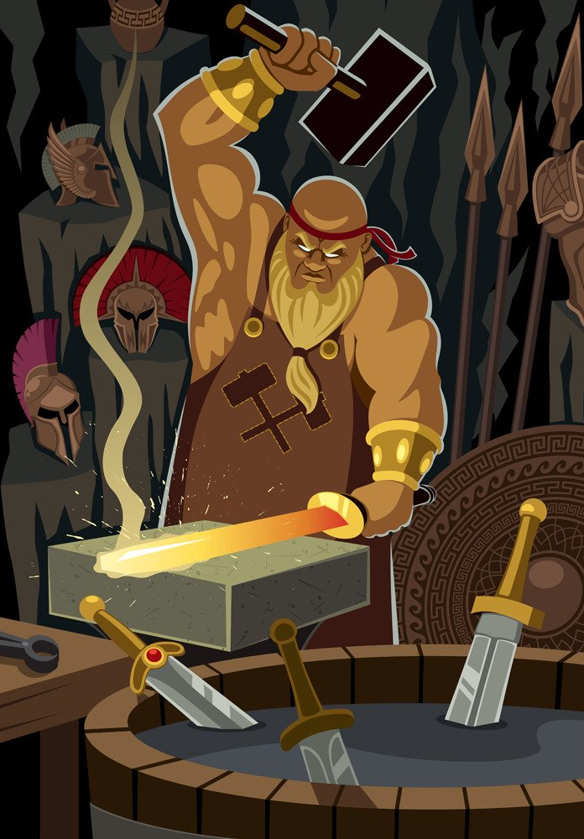
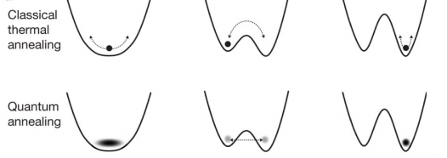
Different Annealing
Annealing a Metal
Heat the metal to a temperature;
Lower the temperature;
Simulated Annealing
Heuristic algorithm;
Random search method;
The temperature variable;
Quantum Annealing
Enables jumping from one classical state to another
– Decreases likelihood of getting stuck in a local minimum
Width of energy barrier is important, but height is not
Quantum tunneling
14

Slide 15
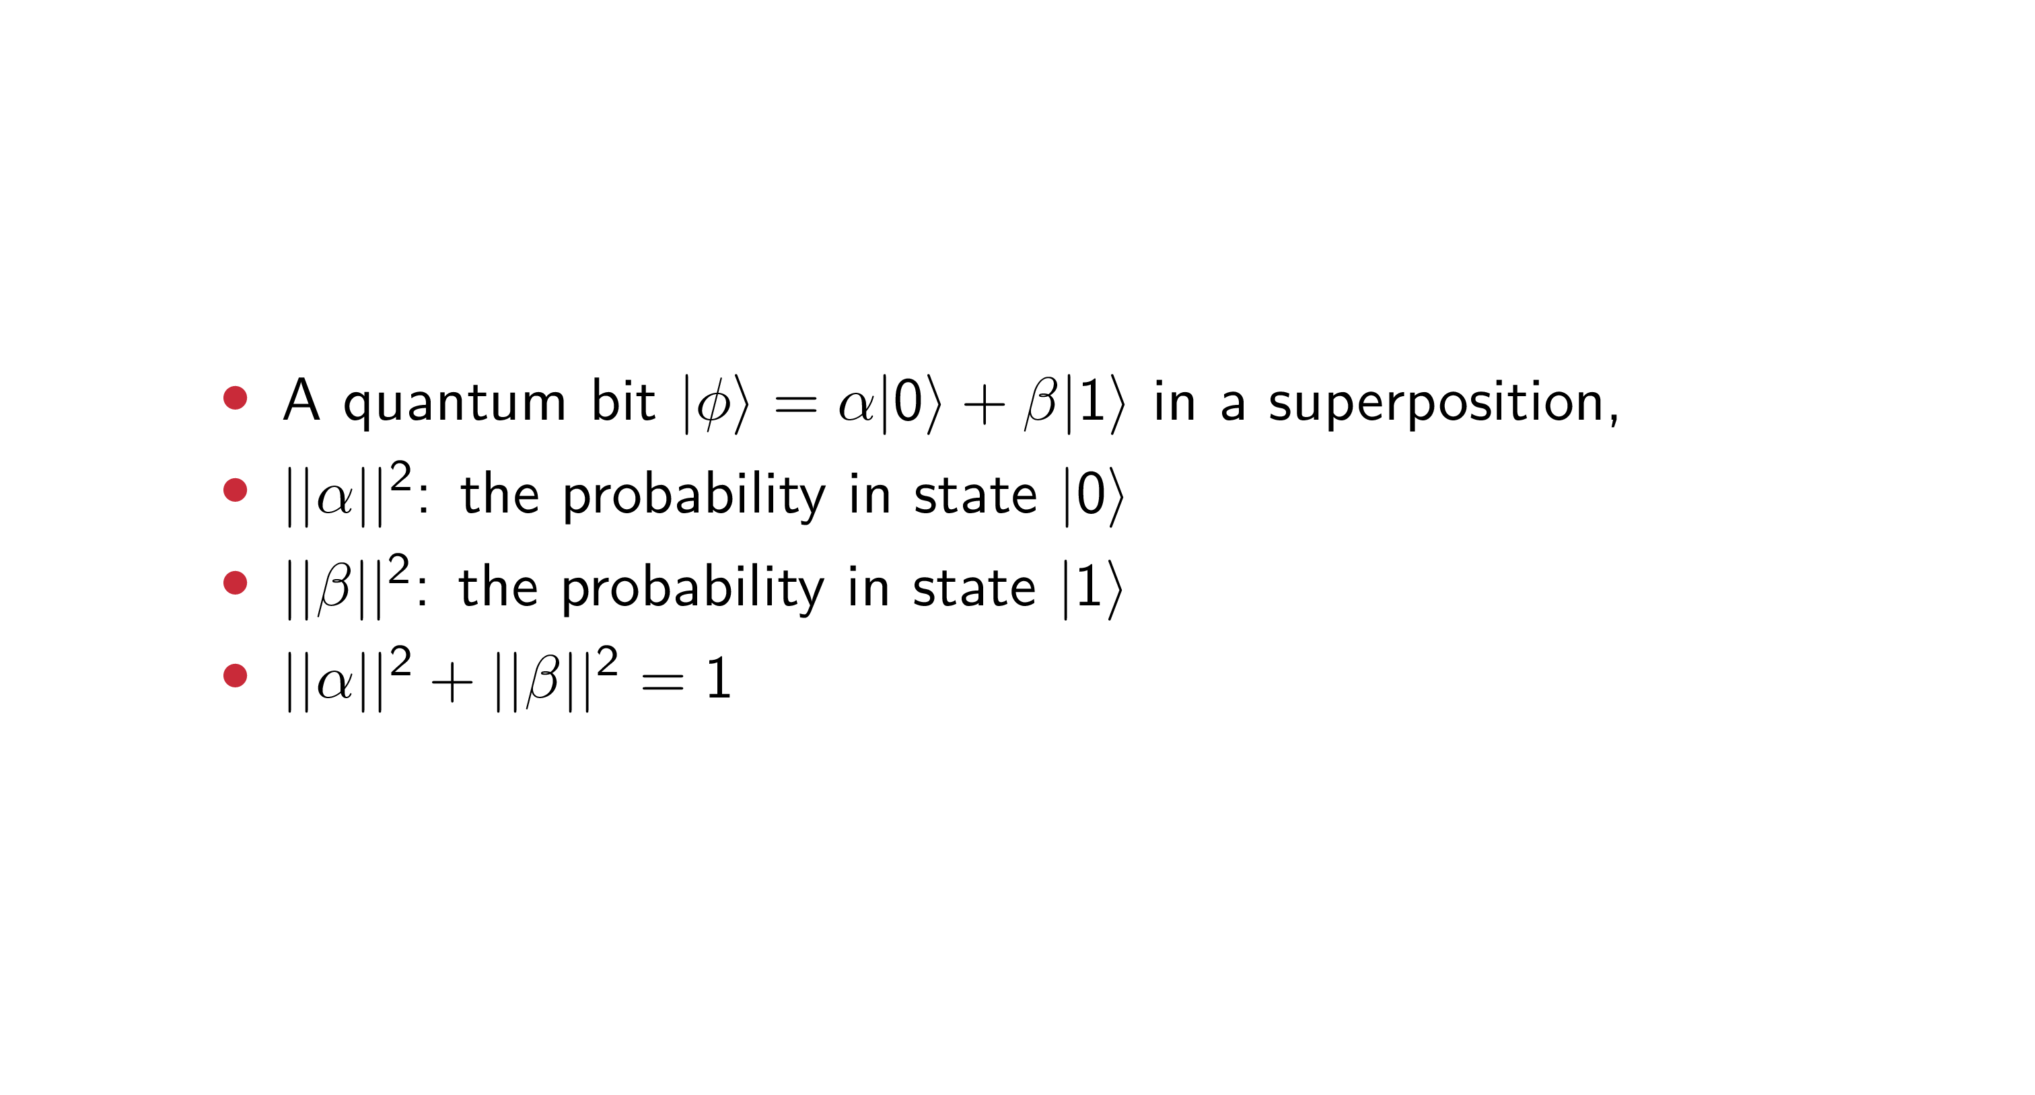
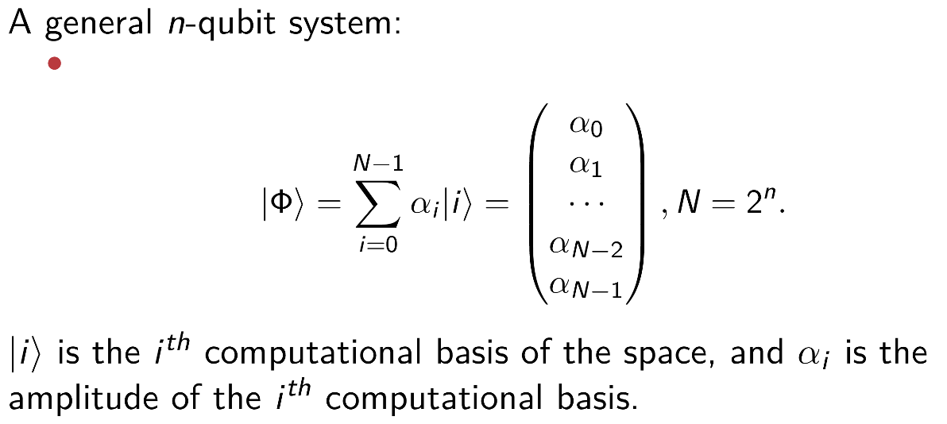
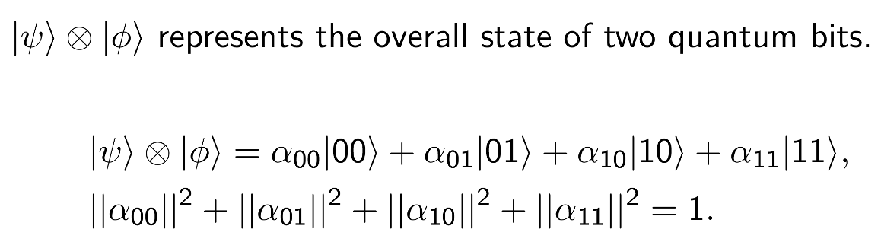
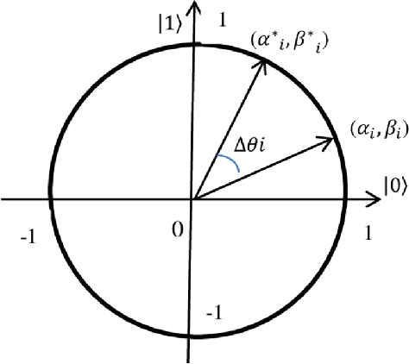
Qubits and Quantum Operation
Superposition
Tensor Product
15

Slide 16
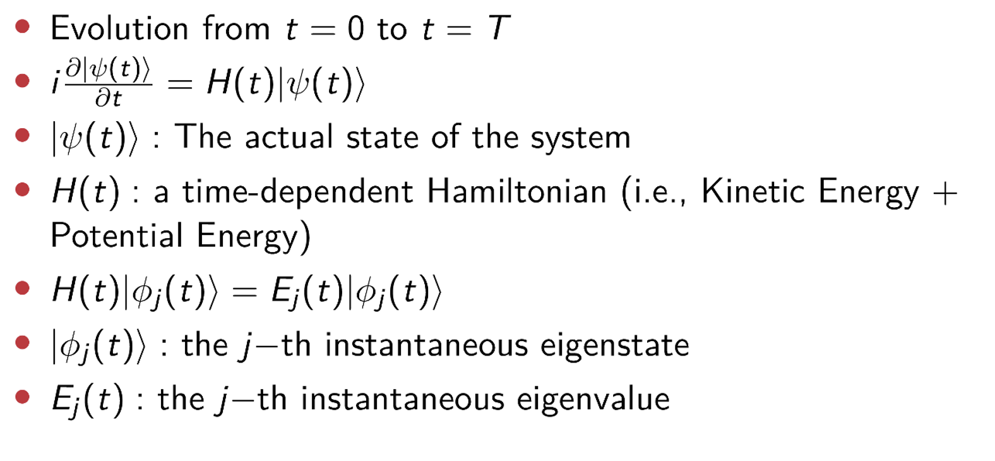
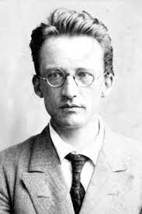
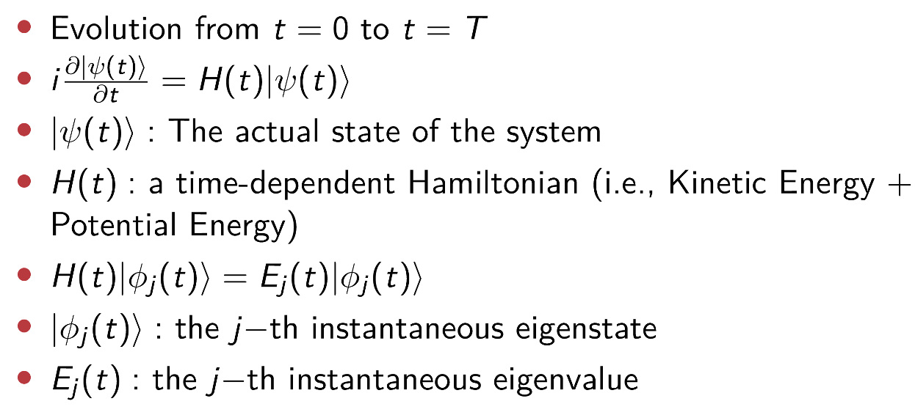
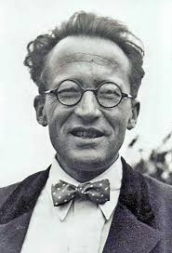
Schrödinger Equation
Before studying quantum
after studying quantum
16

Slide 17
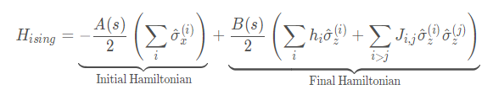
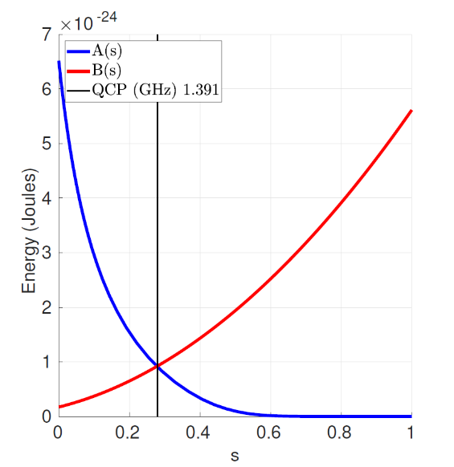
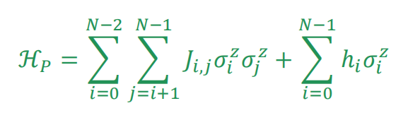
Dwave Hamiltonian
Problem of Hamiltonian:
Goal (what the hardware does)
Minimize σ_{i} ∈ {-1, +1} subject to provided J_{i,j} ∈ R and h_{i} ∈ R coefficients
In other words, a quantum optimization program is merely a list of J_{i,j} and h_{i}
Classical
Much easier to reason than a quantum Hamiltonian
Quantum effects are used internally to work towards the goal
Sparsely connected
Possible to map fully connected problems onto the D-Wave’s Chimera graph
17
Notes:
dwave 所实现的coupling 中的configuration是右上角奇美拉或者天马座circuit(Notably, D-Wave Systems' nearest-neighbor coupling achieves a highly connected unit cell of 8 qubits in the Chimera graph configuration. Generally, quantum algorithms require coupling between arbitrary qubits, therefore the connectivity limitation is likely to require multiple swap operations, limiting the length of the possible quantum computation before the processor decoherence.)

Slide 18
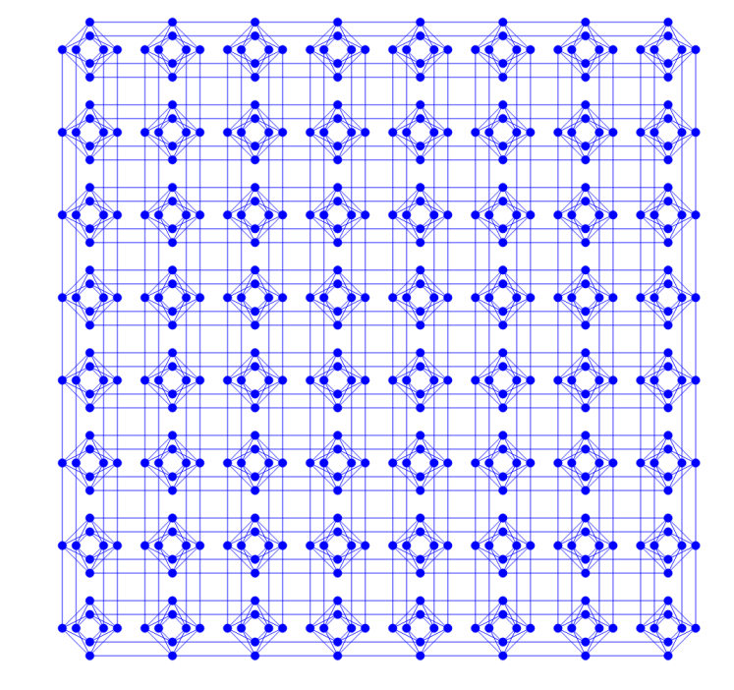
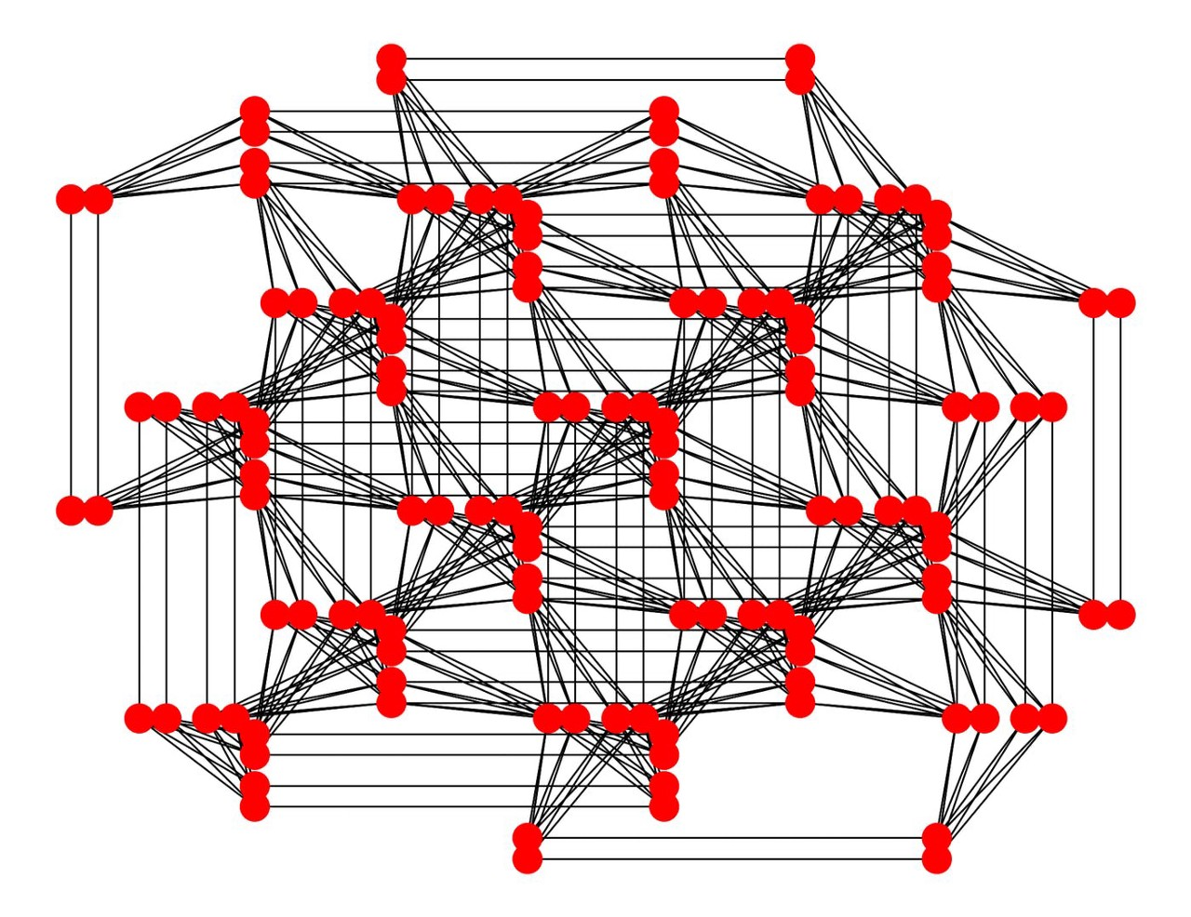
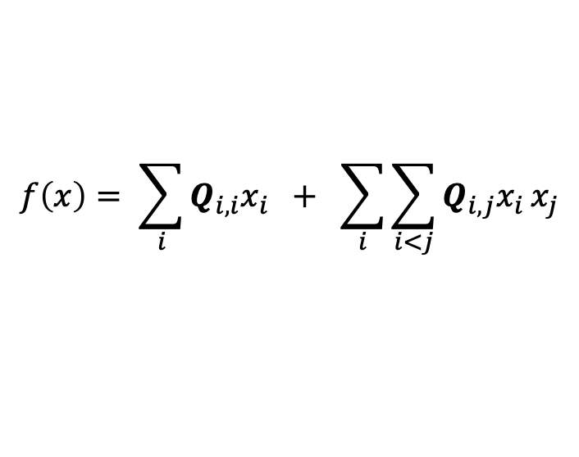

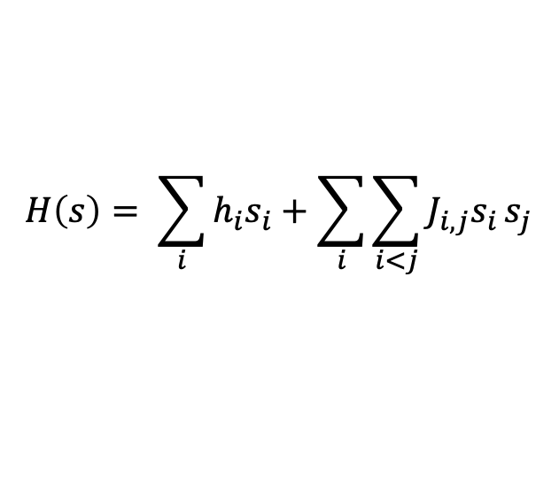
Link Schrodinger with QUBO Model
Core idea: Encoding the objective function as the eigenvalue of the final ground state of
Schrodinger equation, based on Adiabatic Quantum Computing Model
Ising Model
$$H\left(s\right)= \sum_{i}{h_{i}s_{i}}+\sum_{i}{\sum_{i<j}{J_{i,j}s_{i}}s_{j}}$$
Spins interact with applied field
Neighboring spins interact with each other
QUBO (Quadratic Unconstrained Binary Optimization)
Pegasus
Chimera
$$f\left(x\right)= \sum_{i}{Q_{i,i}x_{i}} + \sum_{i}{\sum_{i<j}{Q_{i,j}x_{i}}x_{j}}$$
$Q$ : upper-diagonal matrix
These important optimization problems can be transformed into QUBO model:
Knapsack Problems
Assignment Problems
Task Allocation Problems
Capital Budgeting Problems
… (NP-hard problem)
Quantum Computing:
provide an alternative method to solve some NP-hard problems
18

Slide 19
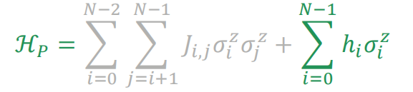
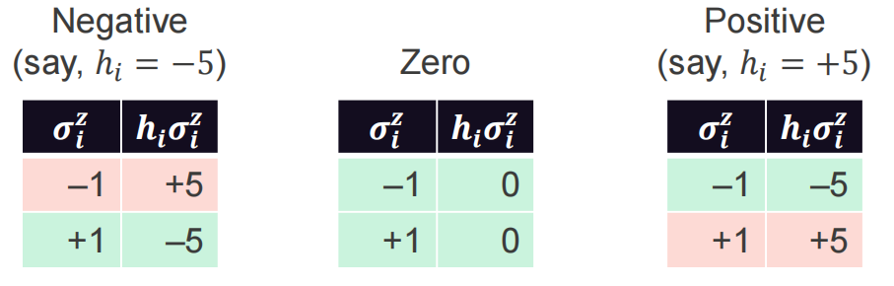
QUBO Equation
Considering only the external field:
We arbitrarily call σ^{z} = +1 “TRUE” and σ^{z} = —1 “FALSE”
Here are the optimal values of σ^{z} for different values of h
Observations
– A negative h_{i} means, “I want σ^{z} to be TRUE”
– A zero h_{i} means, “I don’t care if σ^{z} is TRUE or FALSE”
– A positive h_{i} means, “I want σ^{z} to be FALSE”
19

Slide 20
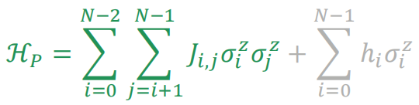
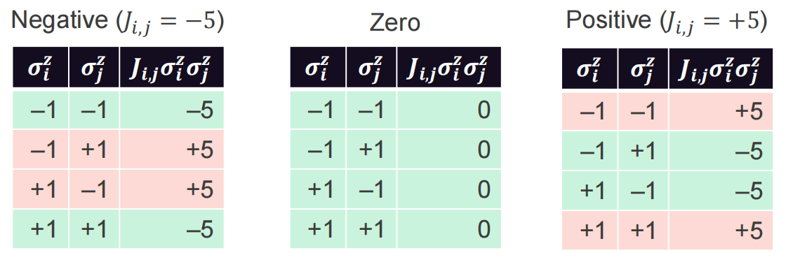
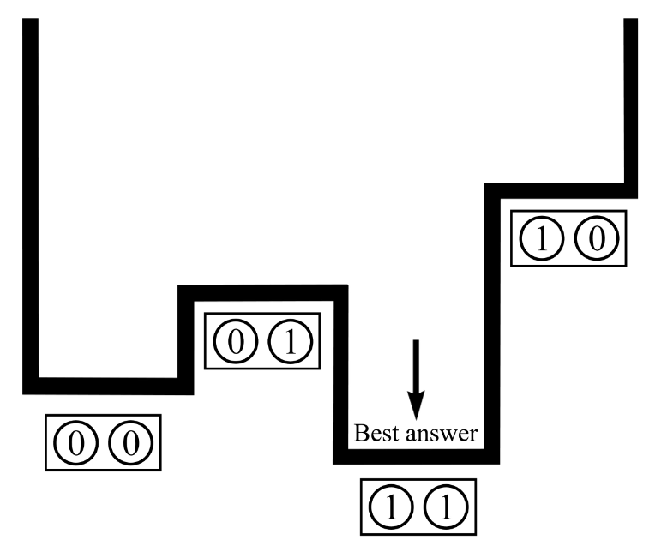
QUBO Equation
Consider only the coupler strengths:
Here are the optimal values of σ^{z} and σ^{z} for different values of J_{i,j}:
Observations
A negative J_{i,j} means, “I want σ^{z} and σ^{z} to be equal”
i j
A zero J_{i,j} means, “I don’t care how σ^{z} and σ^{z} are related”
i j
A positive J_{i,j} means, “I want σ^{z} and σ^{z} to be different”
i j
Best answer appear with high probability
but not 100%, which is Achilles’ heel for
many quantum algorithms but not ours
20
Notes:
animation
margin word

Slide 21
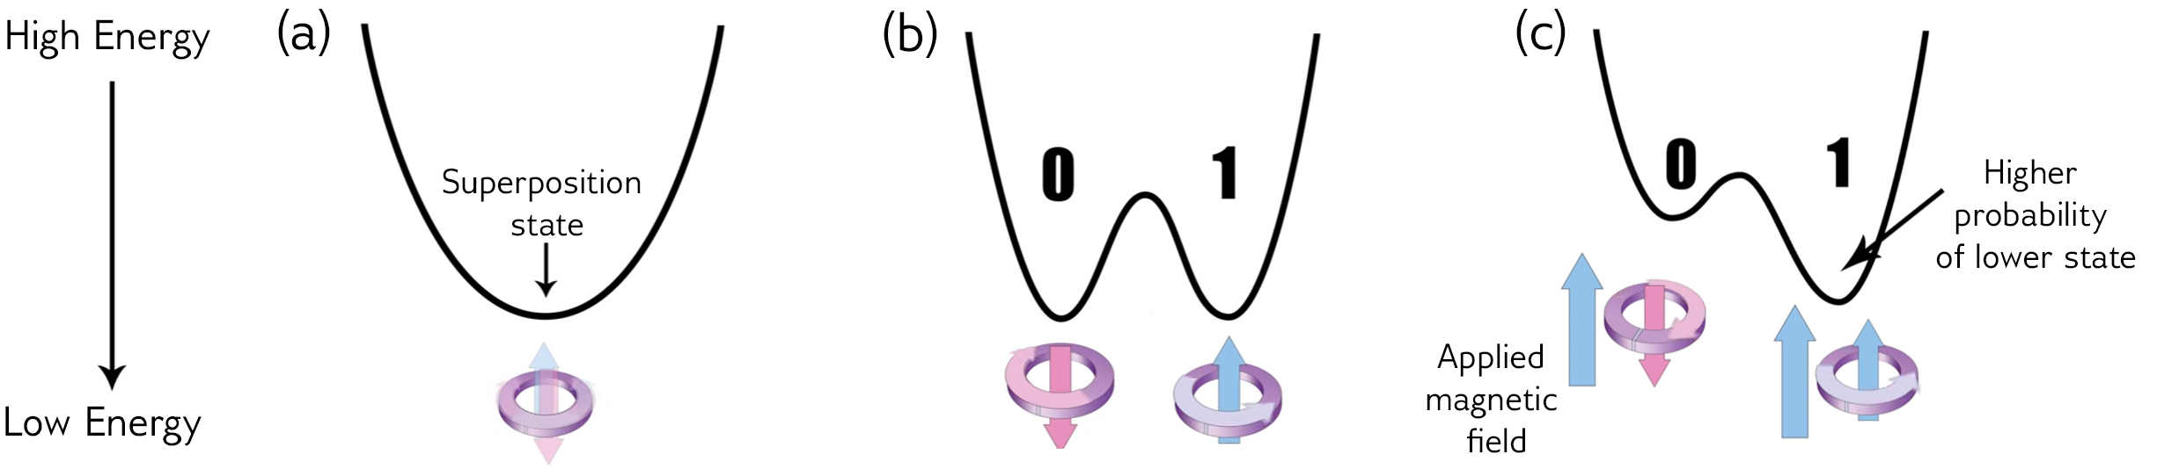

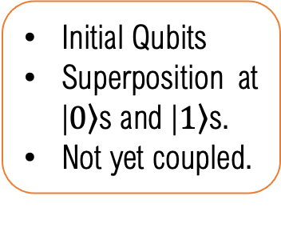
QUBO Quantum Annealing
Energy diagram in Quantum Annealing
A matter of microseconds.
Initial Qubits
Superposition at |$\left.0\right\rangle$s and |$\left.1\right\rangle$s.
Not yet coupled.
Qubits are entangled.
At state of many possible answers.
Couplers & biases applied
Inputs’ energy are set.
Lowest energy is at or closes to the optima.
Energy → possibility
21
Notes:
The signal processing’s final goal is to inverse the data acquisition process:
Figure out the physical properties of the undersurface model based on the signal acquired.
Unfortunately, many problems block our way from observed signals to our interested velocity model.
这张图是定性地在说dwave如何进行退火的，
第一个状态是先初始化qubit(s)并使其处于叠加态，量子之间并未被circuit或者gate耦合.(如何具体耦合见于这个link https://en.m.wikipedia.org/wiki/Superconducting_quantum_computing的coupling qubit第一段)
第二个是通过增添耦合couple和偏置bias模拟问题(类似于构造山峰地形图，但是还没有让小球滚落)，此时qubits已经开始纠缠了，所以此时读取是state of many possible answers。
最后一步是冷却(让所有在不同位置的小球滚落)并读数，state的能量越低越容易被读到(energy变possibility)

Slide 22

Distributed Quantum Computing
What is Distributed Quantum Computing (DQC)?
Multiple interconnected quantum processors (QPUs) work together to solve large-scale computational problems
Why DQC?
single QPUs have limited qubits
monolithic large QPU is very hard to build
a promising pathway to large-scale quantum computing
Challenges in DQC
Qubit allocation/Circuit partition: distribution and management of qubits across multiple QPUs to optimize communication and execution time
Quantum network function: serve high-quality & low-latency connections among quantum nodes to for remote operations
22
Notes:
The signal processing’s final goal is to inverse the data acquisition process:
Figure out the physical properties of the undersurface model based on the signal acquired.
Unfortunately, many problems block our way from observed signals to our interested velocity model.
这张图是定性地在说dwave如何进行退火的，
第一个状态是先初始化qubit(s)并使其处于叠加态，量子之间并未被circuit或者gate耦合.(如何具体耦合见于这个link https://en.m.wikipedia.org/wiki/Superconducting_quantum_computing的coupling qubit第一段)
第二个是通过增添耦合couple和偏置bias模拟问题(类似于构造山峰地形图，但是还没有让小球滚落)，此时qubits已经开始纠缠了，所以此时读取是state of many possible answers。
最后一步是冷却(让所有在不同位置的小球滚落)并读数，state的能量越低越容易被读到(energy变possibility)

Slide 23
Outline
Background
Quantum Communication and Networking
Limitations of ground-based quantum entanglement distribution
Ariel Access Networks
Quantum Computing
Joint Optimization of Qubit Allocation, Entanglement Routing, and Quantum Computing
Optimizing Satellite-based Entanglement Distribution in Quantum Networks via Quantum-Assisted Approaches
Wei, X., Fan, L., Guo, Y., Han, Z. and Wang, Y., 2024, July. Optimizing satellite-based entanglement distribution in quantum networks via quantum-assisted approaches. In 2024 International Conference on Quantum Communications, Networking, and Computing (QCNC) (pp. 280-287). IEEE.
Efficient Entanglement Routing for Satellite-Aerial-Terrestrial Quantum Networks
Co-Design of Network Topology and Qubit Allocation for Distributed Quantum Computing
Conclusions
23

Slide 24
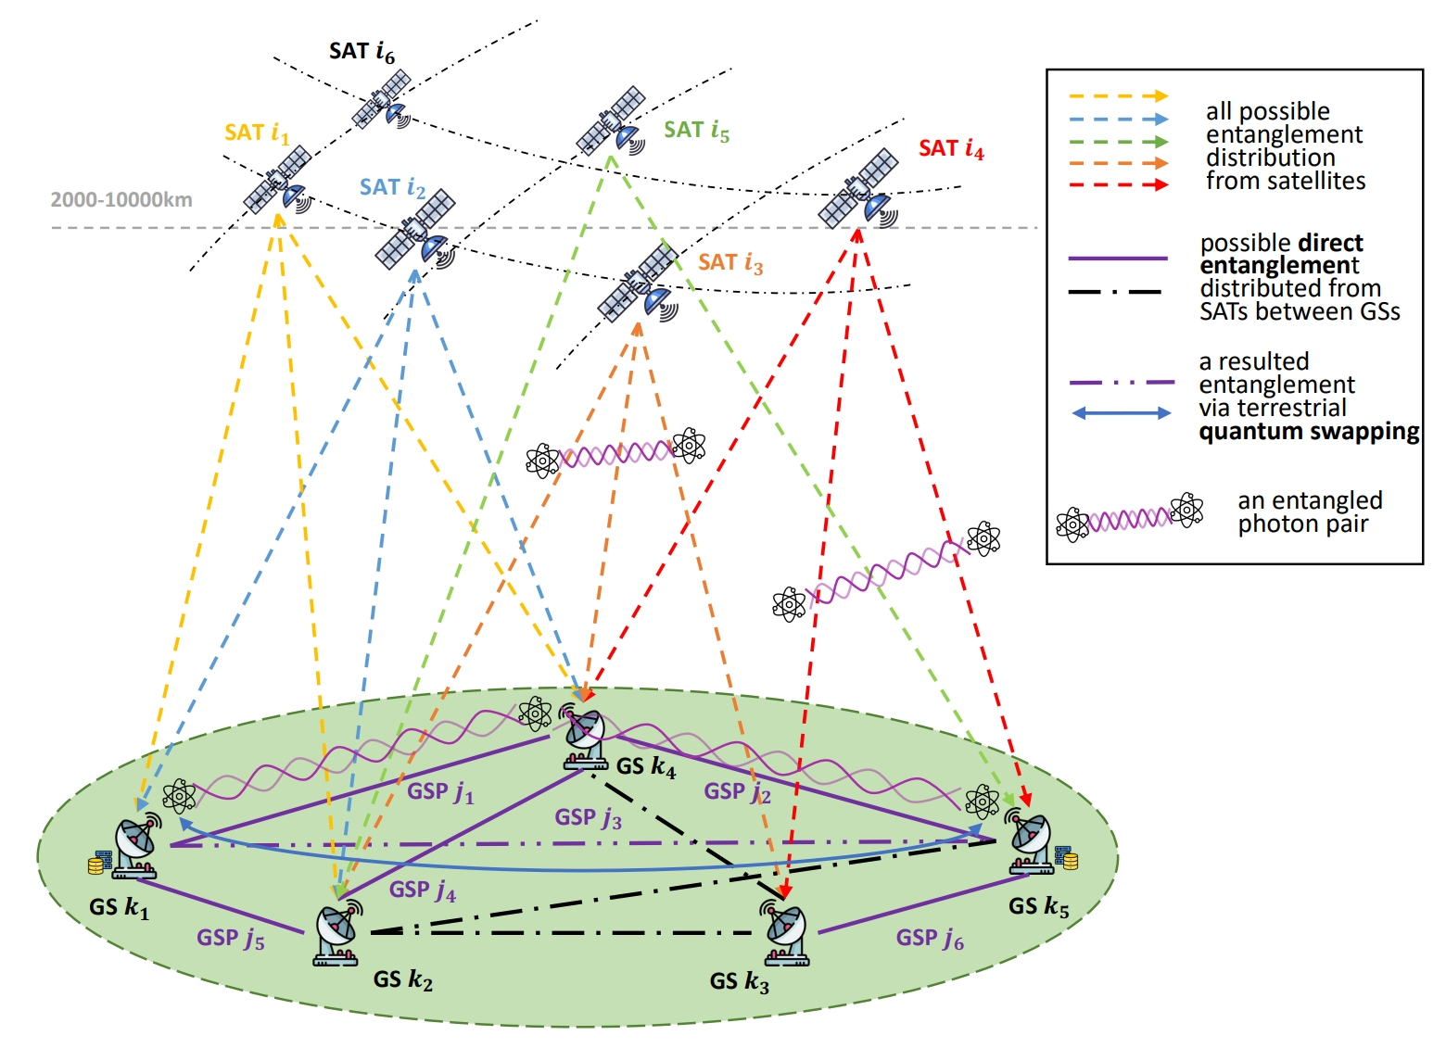
Motivation
Limitations and challenges of previous works
a heuristic greedy algorithm and ignores some resource constraints
only consider some specific settings by converting the problem into either a maximum weight independent set problem or a maximum weight bipartite matching problem.
This paper investigates a joint satellite assignment, resource allocation, and path selection scenario to build quantum entanglements for ground stations by leveraging satellite-based entanglement distribution and terrestrial quantum swapping.
Fig. 1. The satellite-based entanglement distribution and terrestrial quantum swapping architecture.
24

Slide 25
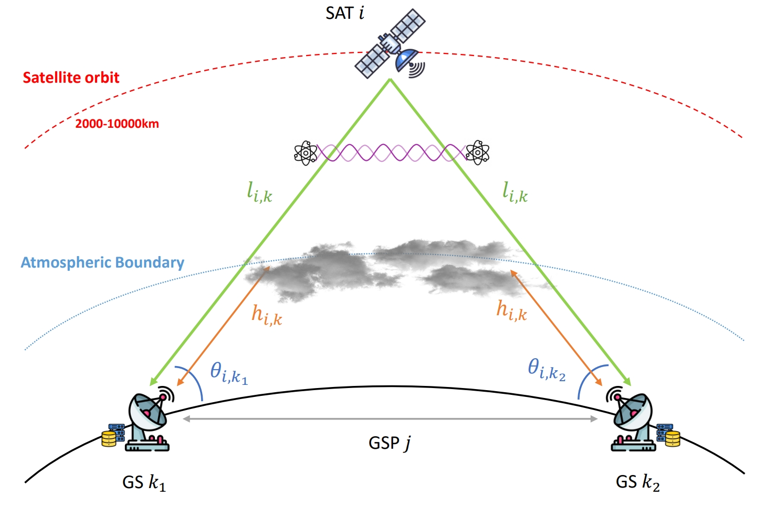
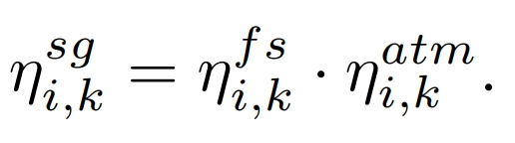




System Model
1. Network Model
satellites (SAT): $M = \{1, · · · , |M|\}$, $sm_{i}$: quantum memory of SAT $i$, ${tr}_{i}$: number of transmitters of SAT $i$.
ground stations (GS): $N = \left\{1, · · · , \left|N\right|\right\}$, g$m_{k}$: quantum memory of GS $k$, ${rr}_{k}$: number of receivers of GS $k$.
ground station pairs (GSP): $O = \{1, · · · , |O|\}$
2. Channel Model
Fig. 2. An example of the space-to-ground transmittance between one SAT and two GSs for the entanglement distribution to this GSP.
spontaneous parametric down-conversion (SPDC)
space-to-ground transmittance:
free-space transmittance:
atmospheric transmittance:
$d_{i}^{T}, d_{k}^{R}$: the circular apertures of diameter of the transmitter and receiver telescopes
$λ$: the specific wavelength
$\hat{α}$: the atmospheric extinction coefficient
25

Slide 26


System Model
2. Channel Model
The fidelity of entangled photon pair after transmission can be approximated by
$F_{0}$ is the initial fidelity of the entangled photon pair.
${\overline{n}}_{k}$ is the number of background photons received by GS $k$.
Assumptions[1]: $η_{i,k_{1}}^{sg}=η_{i,k_{2}}^{sg}{=η}_{i,j}^{sg}$, ${\overline{n}}_{k_{1}}={\overline{n}}_{k_{2}}={\overline{n}}_{j}$
Fig. 2. An example of the space-to-ground transmittance between one SAT and two GSs for the entanglement distribution to this GSP.
3. Terrestrial Quantum Swapping
The fidelities of the new states after swapping are defined below [2]
$F_{1}$ and $F_{2}$ are the fidelities of two entanglement links, respectively.
[1] N. K. Panigrahy, P. Dhara, D. Towsley, S. Guha, and L. Tassiulas, “Optimal Entanglement Distribution using Satellite Based Quantum Networks,” in IEEE Conference on Computer Communications (INFOCOM) Workshops, Virtual, May 2022.
[2] A. Zang, X. Chen, A. Kolar, and J. Chung, “Entanglement Distribution in Quantum Repeater with Purification and Optimized Buffer Time,” in IEEE Conference on Computer Communications Workshops, New York, NY, May 2023.
26

Slide 27


Problem Formulation
The joint satellite assignment, resource allocation, and path selection problem.
NP-hard
Satellite assignment or
Terrestrial quantum swapping
Objective: maximize the overall utility of all traffic GSPs
each GSP $j$ only connects to one satellite or only selects one swapping path if the satellite assignment is not available.
a GS $k$ can be part of multiple GSPs and thus is not allowed to be allocated to more than ${rr}_{k}$satellites.
SAT $i$ does not get allocated to more than ${tr}_{i}$ GSPs.
the total entangled photon received from different satellites cannot exceed g$m_{k}$.
the total entangled photon pair allocation fraction of SAT $i$ cannot exceed $sm_{i}$ .
if a swapping path is selected, then two entanglement links along this path must be established based on the satellite assignment.
the fidelity of entanglement links after transmitting or swapping is larger than the fidelity threshold.
$x_{i,j}$: if satellite $i$ is assigned to GSP $j$; $y_{i,j}$: the entangled photon pair allocation;
$z_{p,j}$: if path $p$ is selected to GSP $j$; ${\hat{y}}_{p,j}$: the entangled photon pair allocation.
27

Slide 28


















Hybrid Quantum-Classic Dantzig-Wolfe Decomposition (HQCDW)
⑤ DW decomposition
④ linear combination of extreme points
① Linearization
③ reformulation
$$B_{1}$$
$$b_{1}$$
② general form
Block
structure
$$0$$
$$B_{2}$$
$$b_{2}$$
$$0$$
$$C$$
$$b_{3}$$
$$A$$
$$G$$
$$b_{4}$$
28

Slide 29





HQCDW Algorithm
Proposed HQCDW framework for joint satellite-based quantum entanglement distribution and terrestrial quantum swapping.
Integer
optimization
Continuous
optimization
29

Slide 30

Evaluation
Network architecture
Comparison methods
Parameters | Value
Number of SATs $|M|$ | $$100$$
Satellites altitude | $$2,000\sim 10,000 km$$
Quantum memory of SATs $sm_{i}$ | $$20\sim 100$$
Number of transmitters ${tr}_{i}$ | $$6\sim 10$$
Number of GSs $\left|N\right|$ | $$36$$
Quantum memory of GSs $gm_{k}$ | $$10\sim 20$$
Number of transmitters ${rr}_{k}$ | $$2\sim 6$$
Steepest Descent (SD) [3]: SD is a solver for binary quadratic models by D-Wave Systems with the best move determined through a local minimization.
Random Steepest Descent (RASD) [3]: RASD combines random sampling and steepest descent, with the algorithm using random sampling to generate initial states for SD.
Classical Optimizer (COPT): COPT solves the original problem (5) by using a classical optimizer (e.g., Gurobi, Scipy) in a classical CPU computer.
Classical DW Decomposition (CDWD): CDWD decouples the original problem using DW decomposition and solves all problems with a classical optimizer.
[3] D-Wave Systems Inc., “Ocean software documentation: dwave-samplers, steepestdescentsolver, randomsampler,” Oct. 2023. [Online]. Available: https://docs.ocean.dwavesys.com/en/stable/docs samplers/reference.html
30

Slide 31



Evaluation
1. This highlights the effectiveness and robustness of using DW decomposition to tackle larger network scales.
3. This result highlights the benefits of DW decomposition for larger-scale problems.
2. This analysis highlights the advantage of using the DW decomposition to overcome constraints imposed by the maximum number of qubits in the quantum machine.
31

Slide 32
Outline
Background
Quantum Communication and Networking
Quantum Computing
Limitations of ground-based quantum entanglement distribution
Ariel Access Networks
Joint Optimization of Qubit Allocation, Entanglement Routing, and Quantum Computing
Optimizing Satellite-based Entanglement Distribution in Quantum Networks via Quantum-Assisted Approaches
Efficient Entanglement Routing for Satellite-Aerial-Terrestrial Quantum Networks
Zhang, Y., Gong, Y., Fan, L., Wang, Y., Han, Z. and Guo, Y., 2025, August. Efficient entanglement routing for satellite-aerial-terrestrial quantum networks. In 2025 34th International Conference on Computer Communications and Networks (ICCCN) (pp. 1-9). IEEE.
Co-Design of Network Topology and Qubit Allocation for Distributed Quantum Computing
Conclusions
32

Slide 33




System Model
We have $K$ source-destination pairs of terrestrial base stations. Each pair is denoted by a tuple $k=\left(Q_{s(k)}, Q_{d(k)}\right)$
Each pair requests quantum entanglement
Quantum key distribution
Distributed quantum computing
Goal: Maximize SATQN throughput, i.e., end-to-end entanglement generation rate (EGR)
Present it by a graph$𝒢=\left(𝒱,ℰ\right)$
$𝒱=𝒱_{s}∪𝒱_{a}∪𝒱_{b}:$ nodes
sets of satellites $𝒱_{s}$, aerial platforms $𝒱_{a}$, and terrestrial base station $𝒱_{b}$
$ℰ=\{{(v}_{i}^{t}, v_{j}^{t}{) | v}_{i}, v_{j}∈𝒱,v_{i}≠v_{j}, t∈𝒯\}:$ links between nodes
Storage node set $ℳ∈𝒱.$ Each $m∈ℳ$ has storage capacity $C_{m}$
33

Slide 34





Model Details
Loss and noise model between node $i$ and$j$
Fiber optical transmittance
ideal density matrix
distance
Free Space Optical Transmittance
Fidelity
receiver’s efficiency
ideal entangled state
turbulence-induced transmittance
atmospheric loss
34

Slide 35





Model Details
Imperfect entanglement swapping
the end-to-end fidelity of pair $k$ along path $p$, which consists of links ${\{e}_{1}, e_{2}, …, e_{X}\}$ $⊆$ℰ and nodes $\left\{k_{1}, k_{2}, …, k_{\left\{X+1\right\}}\right\}⊆$ $𝒱$
fidelity parameters related with $F_{i,j}^{t}$
required purification steps
source-destination pair $k$ target fidelity
success probability of $u$ step
35

Slide 36


Problem Formulation
the aggregate weighted EGR across all user pairs, all path, and all time intervals
path selection constraints
$x$– path selection
$y$ – EGR
$z$ – average number of EPR pairs storage
storage and channel capacity constraints
fidelity and balance constraints
36

Slide 37


Problem Reformulation
Quantum network throughput
$x$– path selection
$q=\left(y, z\right)$: $y$ – EGR; $z$ – average number of EPR pairs storage
Path selection, channel, storage, fidelity, and flow constraints
It is a mix-integer linear problem (MILP)!
37

Slide 38



Benders’ Decomposition
Problem P₁
Fix the binary variables and construct the linear subproblem
Fix the continuous variables and construct the mix-integer linear master problem
Binary variables
Upper Bound
Lower Bound
Optimality and feasibility cuts
38

Slide 39



Experiments
We consider an SATQN consisting of 2 satellites, 2 HAPs, and 12 terrestrial base stations
Baselines
Satellite-Only Scheme (SOS): All entanglement requests are managed by satellites
Random Routing Scheme (RRS): EGR is optimized, while the routing path is randomly selected
No-Storage Scheme (NSS): None of the nodes has storage capacity
Proposed scheme can better utilize the storage capacity
Proposed scheme has larger network throughput
39

Slide 40
Outline
Background
Quantum Communication and Networking
Quantum Computing
Limitations of ground-based quantum entanglement distribution
Ariel Access Networks
Joint Optimization of Qubit Allocation, Entanglement Routing, and Quantum Computing
Optimizing Satellite-based Entanglement Distribution in Quantum Networks via Quantum-Assisted Approaches
Efficient Entanglement Routing for Satellite-Aerial-Terrestrial Quantum Networks
Co-Design of Network Topology and Qubit Allocation for Distributed Quantum Computing
Liu, J., Fan, L., Guo, Y., Han, Z. and Wang, Y., 2025, March. Co-Design of Network Topology and Qubit Allocation for Distributed Quantum Computing. In 2025 International Conference on Quantum Communications, Networking, and Computing (QCNC) (pp. 355-362). IEEE.
Conclusions
40

Slide 41
Overview
Quantum Network G(V,E)
Quantum Circuit
Qubit Interaction Graph G’(Q,C)
v₄
q₁
H
qubit allocation
q₃
q₂
Y
q₂
q₃
1
2
v₁
H
1
q₁
q₄
X
q₄
1
final topology
2
q₅
q₅
number of CNOT gate operation between two logical qubits
v₂
v₃
logical qubit
Quantum circuits describe quantum algorithms
Single qubit gates + CNOT are universal
Qubit Interaction Graph (QIG) captures all inter-qubit communications
Exactly a graph partition problem, which is NP-hard
Entangled qubits enables remote quantum gates and teleportation-based communication
Qubit allocation requires balancing local processing and remote operations.
Network topology affects entanglement fidelity and cost of served entangled qubits.
41

Slide 42

Objective
Objective: minimizing the total communication costs among all QPUs (after assignment)
whether edge (u, z) is included in the path between QPUs (i, j)
edge cost (e.g., distance)
CNOT gate demand between qubits (a, b)
qubits (a, b) are assigned to QPUs (i, j)
$$\min{\sum_{i<j}{\sum_{u,z}{b_{u,z}p_{i,j,u,z}\sum_{a,b}{c_{a,b}x_{a,i}x_{b,j}}}}}$$
communication between single QPU pair
QPU pairs
single path cost
42

Slide 43




Constraints
Qubit Allocation
Topology Sparsity
3. Each QPU connects to a limited number of edges
1. Each qubit should be assigned to
exactly one QPU
Edge (u, z) is not used by the path between (i, j)
$$\sum_{i}{x_{a,i}}=1, ∀q_{a}∈Q$$
$$\sum_{z}{\left[1−\prod_{i<j}{\left(1−p_{i,j,u,z}\right)\left(1−p_{i,j,z,u}\right)}\right]}≤n_{u}, ∀v_{u}∈V$$
2. Each QPU holds a limited number of qubits
Edge (u, z) is not used by any path
$$\sum_{a}{x_{a,i}}≤m_{i}, ∀v_{i}∈V$$
4. The total number of edges cannot exceed
$$\sum_{u<z}{\left[1−\prod_{i<j}{\left(1−p_{i,j,u,z}\right)\left(1−p_{i,j,z,u}\right)}\right]}≤W$$
43
43

Slide 44




Shortest Paths
$$\left[\sum_{u}{p_{i,j,i,u}}−\sum_{z}{p_{i,j,z,i}}\right]\sum_{a,b}{x_{a,i}x_{b,j}}=\sum_{a,b}{x_{a,i}x_{b,j}}, ∀i<j$$
Entanglement Path
In degree - out degree for the source node
$$\sum_{z}{p_{i,j,u,z}}−\sum_{z}{p_{i,j,z,u}}=0,∀i<j, u∉\{i,j\}$$
5-7. Modified from the typical flow/path constraints
In degree - out degree for middle nodes
$$\left[\sum_{u}{p_{i,j,j,u}}−\sum_{z}{p_{i,j,z,j}}\right]\sum_{a,b}{x_{a,i}x_{b,j}}=−\sum_{a,b}{x_{a,i}x_{b,j}}, ∀i<j$$
In degree - out degree for the destination node
8. The length of each path should not exceed $\left(\left|V\right|−1\right)$
$$\sum_{u,z}{p_{i,j,u,z}}≤\left(\left|V\right|−1\right)\sum_{a,b}{x_{a,i}x_{b,j}}, ∀i<j$$
44

Slide 45










Reformulations
$$\sum_{u<z}{\left[1−\prod_{i<j}{\left(1−p_{i,j,u,z}\right)\left(1−p_{i,j,z,u}\right)}\right]}≤W$$
$$\sum_{u<z}{w_{u,z}}≤W$$
$w_{u,z}$: whether edge (u,z) is used
Edge Existence
$$w_{u,z}≤\sum_{i,j}{\left(p_{i,j,u,z}+p_{i,j,z,u}\right)}≤w_{u,z}\left(2\left|V\right|\left(\left|V\right|−1\right)\right),$$
$$∀u<z$$
Reduce from ${O(|V|}^{2})$ to linear
$$\left[\sum_{u}{p_{i,j,i,u}}−\sum_{z}{p_{i,j,z,i}}\right]\sum_{a,b}{x_{a,i}x_{b,j}}=\sum_{a,b}{x_{a,i}x_{b,j}}, ∀i<j$$
$$\sum_{u}{p_{i,j,i,u}}−\sum_{z}{p_{i,j,z,i}} =y_{i,j}, ∀i<j$$
$$y_{i,j}≤\sum_{a,b}{x_{a,i}x_{b,j}}≤y_{i,j}\frac{1}{2}\left|Q\right|, ∀i<j$$
Demand Existence
$y_{i,j}$: there are communications between QPUs (i, j)
Reduce from cubic to quadratic
All constraints reduced to at most quadratic (as it is unlikely to reduce $\sum_{a,b}{x_{a,i}x_{b,j}}$ to linear)
Objective is still cubic
45

Slide 46

Evaluations
TACO: original formulation
TACO-NL: original formulation with high order expression by Guoibi
TACO-L: proposed simplified formulation
In all cases, TACO-L is the most efficient and finds the best objective
TACO-NL performs worse than TACO, which means the latest automatic linearization feature of Gurobi should be used carefully
Larger circuit and quantum network lead to higher communication cost
46

Slide 47


Conclusion
Quantum Communication Resource Allocation helped by Quantum Computing
Quantum Computing helped by Quantum Communication
47

Slide 48










Thank you and visit our lab
http://wireless.egr.uh.edu/
48
Videos, slides and codes can be found
48
http://www2.egr.uh.edu/~zhan2
48

