Slide 1
AI for Research and Marketing: An Overview
Reporter: Shuhao Zeng
Date: 04/03/2026
ACK: Weimin Yuan, Ziyu Xiong, and Yiming Zuo

Slide 2
Outline
An introduction for LLM and AI agent (openclaw)
AI for research
AI for marketing
2

Slide 3
Outline
An introduction for LLM and AI agent (openclaw)
AI for research
AI for marketing
3

Slide 4












Current LLMs
ChatGPT
Gemini
Claude
DeepSeek
OPENAI
GOOGLE
ANTHROPIC
DEEPSEEK
The versatile market leader. Known for GPT-4o's native multimodal capabilities and the o1 series' advanced reasoning. It excels in creative writing, general knowledge, and user adaptability.
The ecosystem integrator. Features a massive 1M+ token context window and native understanding of video and audio. Deeply integrated with Google Workspace for seamless enterprise productivity.
The nuanced thinker. Renowned for high safety standards, distinctively natural prose, and the coding prowess of Sonnet 3.5. The "Artifacts" UI has redefined how users interact with generated code.
The open challenger. A powerhouse in efficiency, DeepSeek-V3 and the reasoning-focused R1 deliver state-of-the-art coding and math performance, rivaling proprietary giants.
4

Slide 5
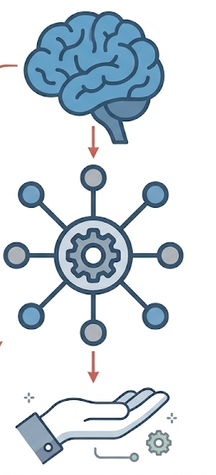
Openclaw (AI agent)
Agent Architecture & The Role of Openclaw
The "Brain": Large Language Model (LLM)
Acts as the decision-maker.
Responsible for translating high-level user goals into a sequence of actionable steps and determining exactly which tool to call next.
The "Hands": External Tools & APIs
Responsible for executing the actual work in the real world.
Examples: Sending messages, reading local files, triggering GitHub/Slack, browsing the web, running scripts, or accessing external services.
The "Nervous System": The Openclaw Framework
Acts as the central orchestrator that connects the LLM and the tools.
It handles all the heavy lifting behind the scenes: managing the conversation state, assembling context, and routing executions.
5

Slide 6
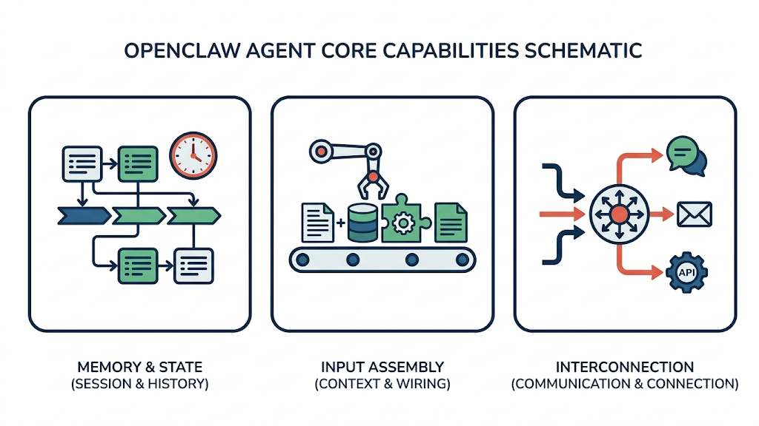
Openclaw (AI agent)
Openclaw's Core Capabilities
Session & History Management
Session Management: Tracks the "who" and "where." It distinguishes between users, saves current session states, and monitors the progress of ongoing tasks.
History Tracking: Logs past dialogues, tool invocations, and their results so the agent doesn't start from scratch every turn.
Context Assembly & Wiring
Context Assembly: Packages everything the LLM needs to see before a call (user input + history + system prompt + tools + external data).
Prompt Wiring: Structures how this information is formatted and ordered into the final prompt sent to the model.
Tool Wiring: Acts as the bridge for tools, formally defining them for the LLM (function names, parameters, and expected returns).
Communication & Connection
Channel/Message Adaptation: Standardizes inputs and outputs. It ensures the agent can communicate seamlessly across different platforms (e.g., Slack, Web UI, Email, API) by parsing various formats into a unified system.
6

Slide 7
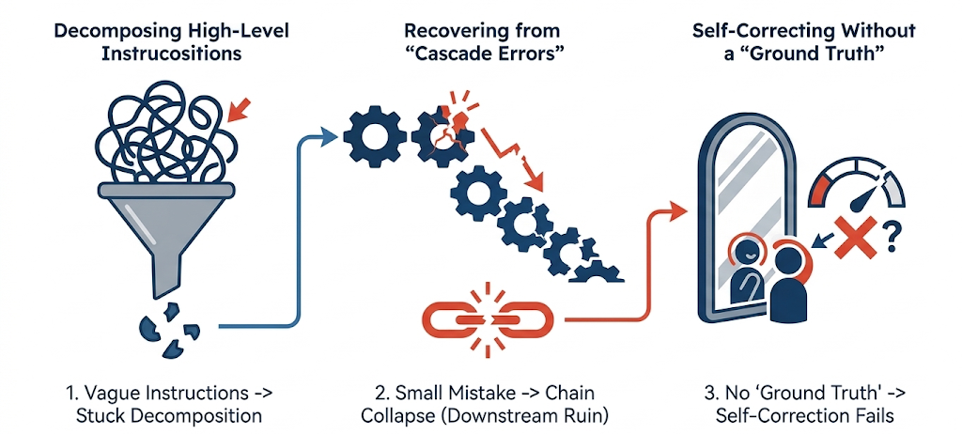
Openclaw (AI agent)
Key bottlenecks in the current workflow
Decomposing High-Level Instructions
LLM struggles to break down complex or vague user directives into executable steps.
Recovering from "Cascade Errors"
Because Openclaw operates autonomously without human intervention in the loop, a single mistake in an early step will ruin the entire downstream workflow. It struggles with unpredictable, open-ended steps that lack certainty.
Self-Correcting Without a "Ground Truth"
While the agent possesses a "reflection" feature to auto-correct mistakes, this mechanism fails if there is no standard answer. Openclaw cannot effectively evaluate or fix its own errors in complex, subjective tasks without a definitive benchmark.
7

Slide 8
Openclaw (AI agent)
Current ideal task types for Openclaw
Highly Structured & Deterministic Tasks
Tasks with simple, repeatable steps where the chance of error is low.
Example: Automating daily pushes of the latest relevant papers from arXiv [R1], market research, and competitor analysis.
Exploratory Tasks (High Error Tolerance)
Open-ended generation where partial or subjective results are highly valuable, even if imperfect.
Examples: Literature reviews and visual analytics [R2][R3], drafting proposals, ideation.
Complex Tasks with Verifiable Results
Multi-step tasks that have a clear "standard answer" or measurable success state, allowing the agent's reflection/auto-correction mechanism to function effectively.
Example: Reproducing code from academic papers [R4].
Ps. Some useful skills, which may support other applications [R5][R6]
[R1] https://clawhub.ai/
[R2] https://www.xiaohongshu.com/explore/69ac21ff000000000e03c3a4?app_platform=ios&app_version=9.20&share_from_user_hidden=true&xsec_source=app_share&type=normal&xsec_token=CBmizHLNCG-WwEmRHoY22_67fvVJE7LKT6P7MELUFeTp8=&author_share=1&xhsshare=WeixinSession&shareRedId=N0w3RDlLRkI2NzUyOTgwNjY0OTc2RjY_&apptime=1775146891&share_id=5d0e2c12e6414ff286d93d57a6870a05
[R3]https://www.xiaohongshu.com/explore/69c2a99f00000000230223bc?app_platform=ios&app_version=9.20&share_from_user_hidden=true&xsec_source=app_share&type=video&xsec_token=CBFASpXESxgJAyoyGZz-Y7CPBdHtHey6DRIzivnsmABB0=&author_share=1&xhsshare=WeixinSession&shareRedId=N0w3RDlLRkI2NzUyOTgwNjY0OTc2RjY_&apptime=1775082387&share_id=8b63e846d00048dd9689de20ae8450e3
[R4]https://www.xiaohongshu.com/explore/69c6826e00000000230102ba?app_platform=ios&app_version=9.20&share_from_user_hidden=true&xsec_source=app_share&type=video&xsec_token=CB6EK4ePjPKnxQsyEOmn-nTFUhrA1efNe8JSYR2tUMNso=&author_share=1&xhsshare=WeixinSession&shareRedId=N0w3RDlLRkI2NzUyOTgwNjY0OTc2RjY_&apptime=1775147461&share_id=ddfc1383e45e45beb0fd955be88b4bf1
[R5] https://github.com/VoltAgent/awesome-openclaw-skills
[R6] https://github.com/hesamsheikh/awesome-openclaw-usecases?tab=readme-ov-file
8

Slide 9
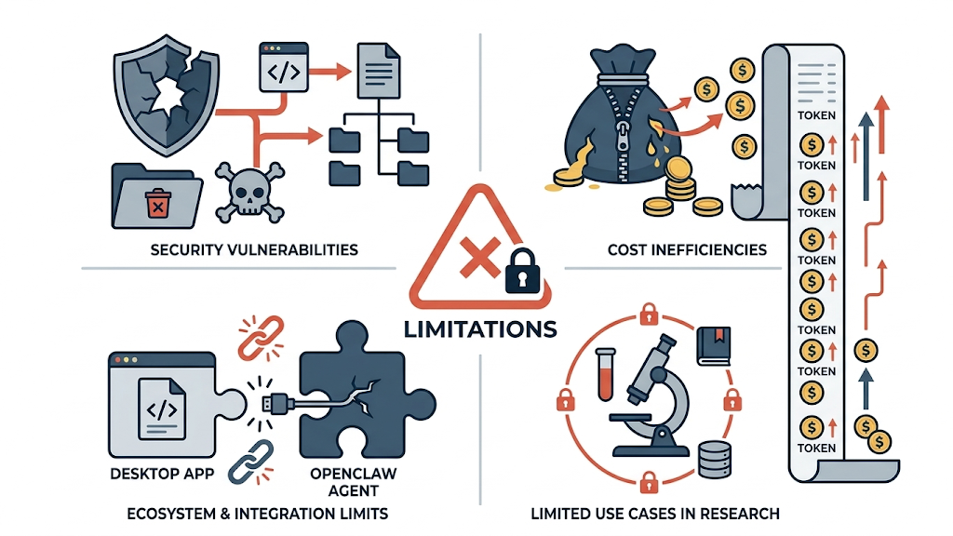
Openclaw (AI agent)
Limitations
Security Vulnerabilities
High risk of unintended system impacts, such as accidentally deleting or modifying important local files.
Susceptibility to executing malicious code or viruses.
Cost Inefficiencies
Strict token-based billing can become prohibitively expensive for complex, multi-step agent tasks.
Lack of flat-rate/monthly subscription models for top-tier API access (e.g., Claude).
Ecosystem & Integration Limits
Many desktop applications lack open APIs, severely limiting the agent's ability to interact with them (e.g., poor UI/API integration with software like MATLAB).
Limited use cases in research
9

Slide 10
Outline
An introduction for LLM and AI agent (openclaw)
AI for research
AI for marketing
10

Slide 11
Research Paradigm
Traditional
Now——with AI
10%
Search
Prompt & Search
15%
20%
Read
Read
40%
25%
Think
1 year
half year
Think
40%
25%
Code
Code
~0%
20%
Write
Write
5%
11

Slide 12
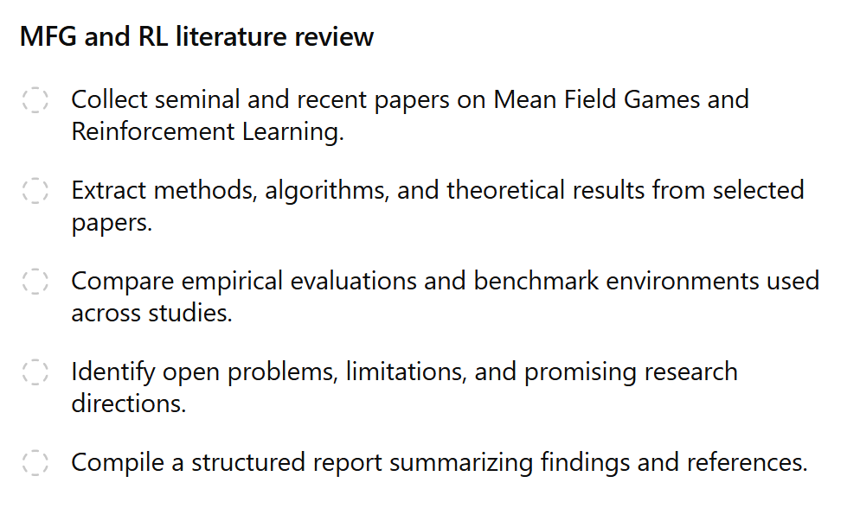
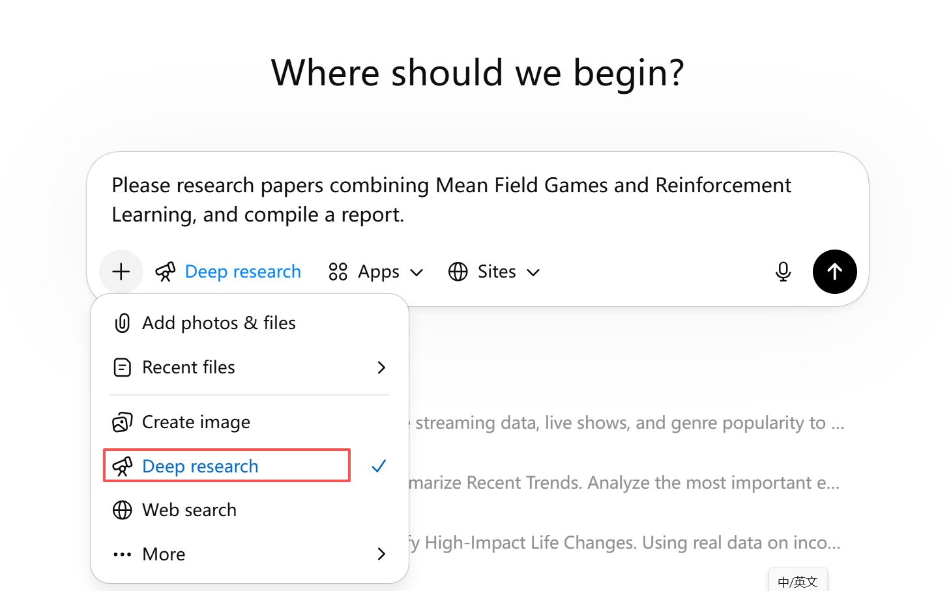
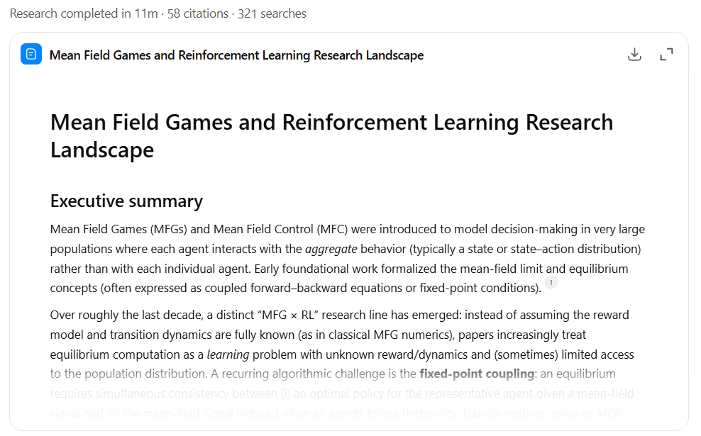
LLM for literature retrieval
12
Notes:
这一页讲基本流程

Slide 13
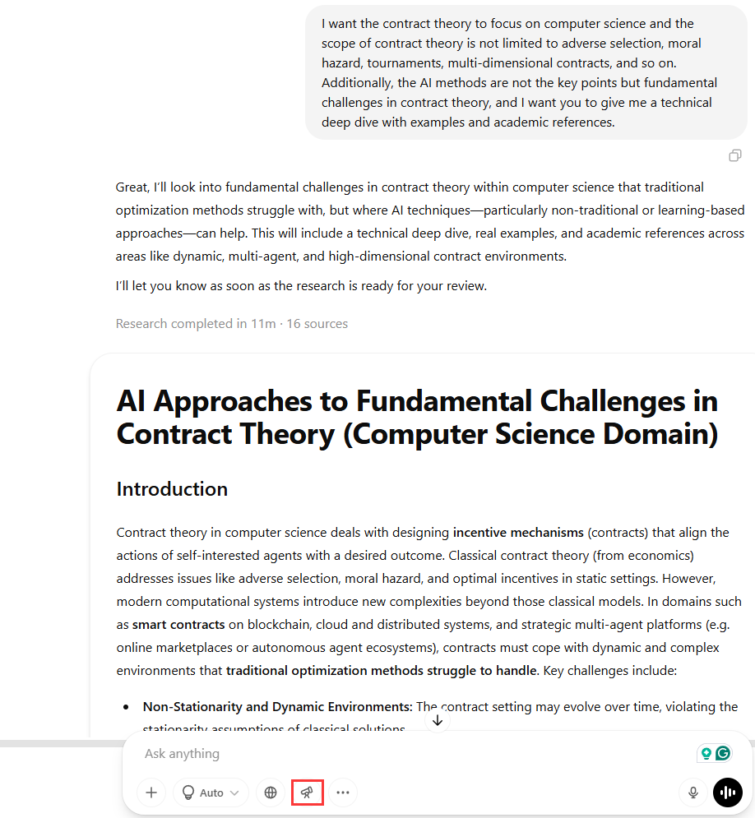
LLM for literature retrieval
Generate up-to-date literature review
Explore research direction
Obtain literature searching key words
Fresh our mind
Deep Research of ChatGPT
Prompt Instance
I want the contract theory to focus on computer science and the scope of contract theory is not limited to adverse selection, moral hazard, tournaments, multi-dimensional contracts, and so on. Additionally, the AI methods are not the key points but fundamental challenges in contract theory, and I want you to give me a technical deep dive with examples and academic references.
13
Notes:
这一页讲好处和实例

Slide 14
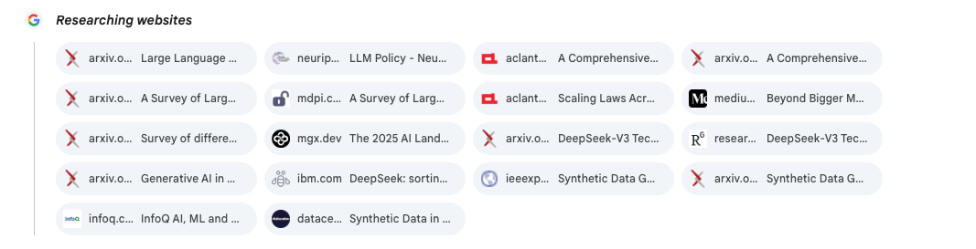

LLM for literature retrieval
Attention
Do not rely entirely on LLMs.
LLM has no access to IEEE database, which is a main drawback
LLMs are highly sensitive to prompts; even semantically similar keywords may lead to significantly different sets of retrieved papers.
Do not directly copy and cite the output in academic manuscripts.
A single search typically retrieves only a subset of the relevant literature and is not exhaustive.
14
Notes:
这一页review一下缺点

Slide 15
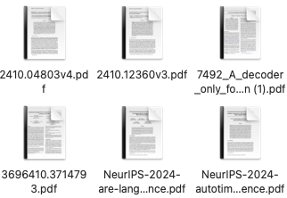
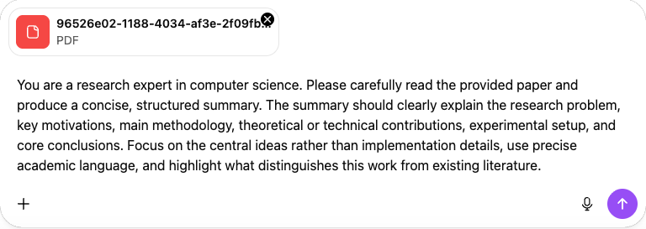
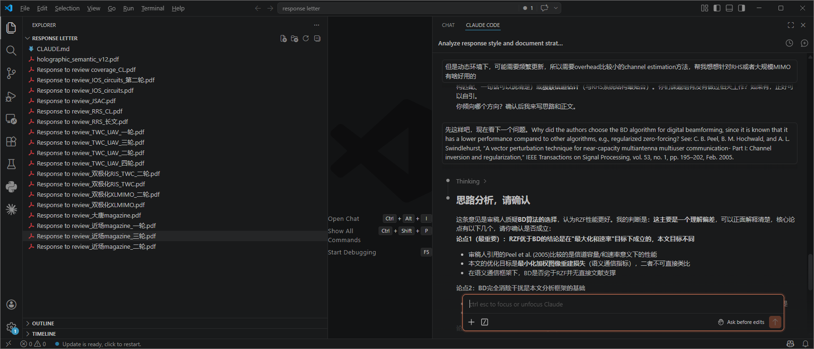
Reading the literature
Coarse-grained reading
Fine-grained reading
Long time: how to avoid uploading files repeatedly?
Long context: how to remind the AI of previous context?
Gemini is a good option
Vscode+Claude code is a good option
15

Slide 16
Code Generation
Task Analysis
Prompts are crucial and should clearly specify the full background and requirements.
Programming language / framework / runtime environment
Constraints (performance, memory usage, parallelism, reproducibility, logging, and files that must not be modified)
Task Decomposition
Ask the model to first produce a module- or function-level design sketch.
The AI may not be able to generate very long code in a single response; therefore, the implementation should be decomposed into modules and generated incrementally across multiple outputs.
Specify which modules should be implemented first and which can follow later.
For each module, clearly define its responsibilities, inputs and outputs, and failure modes (e.g., exceptions or error returns).
Module Definition
Define the purpose of each module, along with its parameter types and return types.
Include explicit input–output specifications (i.e., input → expected output).
Module Testing
Design test cases based on your own understanding.
Ask another AI model to generate additional test cases.
Tests should cover normal cases, boundary conditions, invalid inputs, and randomness (with a fixed random seed).
Systemwide Testing
Integrate the code into a complete system. Conduct systematic testing.
Plan in advance what information needs to be logged for experiments (e.g., training logs, runtime, etc.), and reserve appropriate interfaces for subsequent validation and analysis.
AI Cross-Validation
Have multiple LLMs review the code according to the task requirements.
16

Slide 17
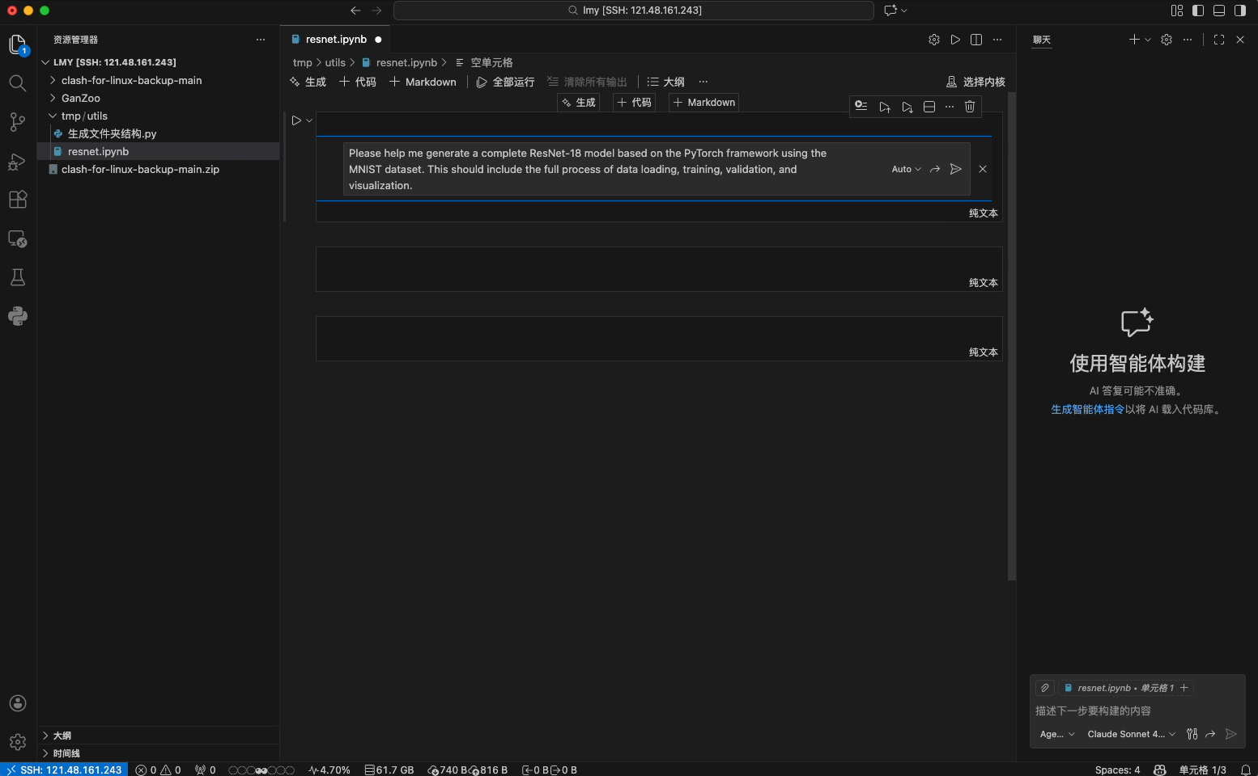
Code Generation
Copilot
Integrates the latest LLMs.
Can be used directly within Vscode via a plugin.
Offers a generous free quota after GitHub Student verification.
Configuration can be somewhat cumbersome.
Claude code
Possibly the strongest code tool right now
Requires a Pro subscription.
Need detailed prompt: can be done by Gemini
Have agent mode, can debug by iteself
17

Slide 18
Paper Writing
Prompt Instance
You are the one who knows your work best.
AI can be prone to hallucinations.
But AI is a powerful assistant.
You are a researcher with extensive experience in writing papers for top-tier computer science conferences (such as NeurIPS / ICML / ICLR), possessing a strong theoretical background as well as substantial academic writing expertise.
I am currently writing the Introduction of a high-level computer science research paper and only need to compose a single paragraph at this stage.
The role of this paragraph within the Introduction and its core message have already been clearly defined.
Please write only this single paragraph according to the following requirements:
[Function of this paragraph]
[Core points that this paragraph needs to convey]
Writing requirements:
Use a formal, objective, and impersonal academic writing style; avoid first-person expressions (e.g., we, our) and obvious AI-generated phrasing.
Ensure logical coherence and focused argumentation; do not expand into content intended for subsequent paragraphs.
Do not prematurely hint at the paper’s contributions or methodological details (unless explicitly required in this paragraph).
Avoid templated or formulaic AI-style expressions.
Keep the length appropriate for a single paragraph in an Introduction section.
Please output only the paragraph text itself, providing both the English version and the corresponding Chinese translation, without any paragraph titles or outline explanations.
Title
Research gap
Analysis
Story Line
Contributions
Experiment results
An outline generated by AI
My own outline
Combine the strengths of both
Ask the AI to evaluate the outline
Ask AI to write the text
Review and refine the writing by myself
18

Slide 19
Paper Writing
Prompt Instance
Prompt Instance
You are a researcher with extensive experience in writing papers for top-tier computer science conferences and journals (such as NeurIPS / ICML / ICLR / T-PAMI), and you are familiar with the linguistic style and terminological conventions of computer science academic writing.
Please translate the following Chinese academic text into publication-ready academic English suitable for submission to top-tier conferences or journals, with the following requirements:
Strictly preserve the original technical content, logical structure, and causal relationships.
While remaining faithful to the original meaning, allow necessary syntactic restructuring to conform to English academic writing conventions.
Use concise, formal language with no colloquial expressions.
Avoid first-person expressions and subjective evaluations.
Do not use templated AI-style phrases (e.g., in recent years, it is worth noting).
Maintain consistency in terminology and notation.
Use standard computer science technical terminology.
Do not use em dashes.
Output only the translated English text. Do not add explanations or commentary.
[Chinese original text]
You are now acting as a strict, critical, but fair reviewer for top-tier computer science conferences and journals (Reviewer #2 style). The goal of the review is to maximize the identification of issues and minimize misjudgment. Do not be lenient; base your assessment solely on textual quality and academic standards, and provide actionable suggestions.
I will send you the paper content paragraph by paragraph (which may include the Introduction, Related Work, Method, Experiments, Discussion, Appendix, etc.). You should treat each paragraph as original text from a submitted paper and review it accordingly.
Your output must include the following structure every time:
Restatement of the paragraph’s core claim (1–3 sentences): Accurately restate, in your own words, what the authors intend to convey. If the intent is unclear, explicitly point this out. If it is exceptionally clear, this section may be omitted.
Major Concerns: List at least [3–8] items. Each item must include:
What the issue is (specific to sentences, terminology, or logical chains).
Why this affects publishability (e.g., novelty, correctness, rigor, reproducibility, experimental sufficiency, fairness of comparison, writing clarity).
How to fix it (specific revisions, required experiments or proofs, or concrete rewriting suggestions).
Minor Issues: List at least [5–15] items (e.g., terminology, notation, grammar, ambiguity in phrasing, missing citations, insufficient figure or table explanations).
Verifiability and Reproducibility Check: Assess whether this paragraph alone enables reproduction. Identify missing details (e.g., hyperparameters, data processing, training details, metric definitions, statistical significance, code or pseudocode).
Scores Against Top-Conference Standards (0–10): Provide and justify scores for:
Novelty, Technical Correctness, Clarity, Experimental Rigor (if this paragraph is not experimental, assess whether it sets up potential pitfalls for later experiments), Impact
Concluding Recommendation for This Paragraph: In one sentence, state whether you would lean toward accept, reject, or borderline if only this paragraph were considered, and explain the most critical one or two reasons.
19

Slide 20
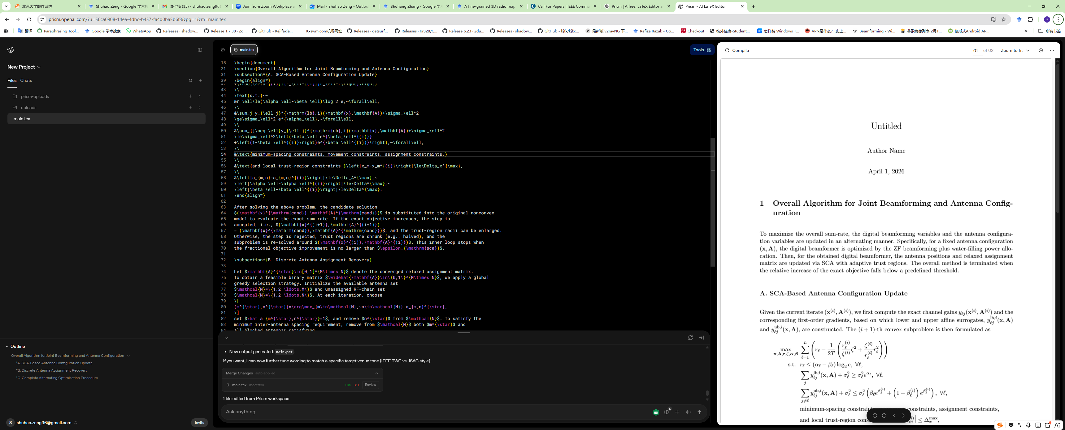
Tools：Prism
A combination of GPT and overleaf, which is free
Advantage: do not have to shift between two apps so as to improve efficiency
Use case: since currently, GPT is good at organizing languages, can be used when writing papers, and checking/revising typos

Slide 21
Handle AI Writing Detector
Maintain a "Chain of Custody" (Version Control):
Draft exclusively on platforms with automated history tracking (e.g., Google Docs, Microsoft 365, Overleaf).
Retain raw research notes, initial outlines, and early drafts as irrefutable proof of the human thought process.
Beware of "Over-Rewriting" by Grammar Tools:
Restrict tools like Grammarly to basic spelling and punctuation checks.
Strictly avoid "Rewrite," "Rephrase," or "Make it professional" features, which erase human voice and trigger AI detector red flags.
Manually Disrupt Statistical Consistency:
Increase Burstiness: Intentionally alternate between short, punchy statements and complex, multi-clause academic sentences.
Natural Vocabulary: Avoid overusing AI synonym replacements, which flatten the text's natural diversity and lower its "perplexity.“
Neutralize "Hidden Prompt" Injections (A possible solution):
Strip document formatting by using <span style="color:red">Plain Text extraction</span> before utilizing AI for reading or peer review.
Manually copy and paste content into a basic text editor to expose <span style="color:red">invisible instructions</span> (e.g., white text) designed to force specific AI outputs.
21

Slide 22
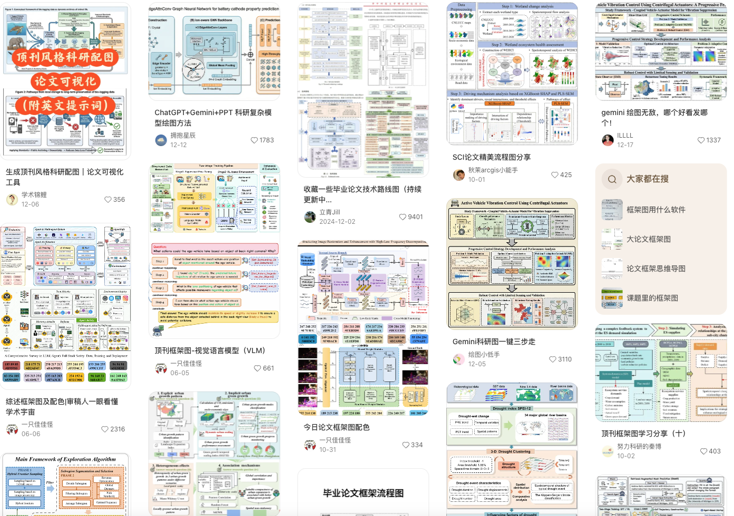
Research Figures
Ensure that LLMs fully understand the entire workflow of your project (including data flow and functional modules); ideally, provide the code to the LLMs as input.
Feed well-designed framework diagrams to the LLMs as references.
Ask the LLMs to describe the complete diagram in natural language, including every arrow, data flow, icon, and color scheme.
Use the Nano Banana mode in Gemini for diagram generation.
Reproduce and fine-tune the generated diagrams locally.
Avoid leaving empty space.
Ensure harmonious color coordination.
Use figures to replace text whenever possible.
Keep data flows clear and well organized.
22

Slide 23
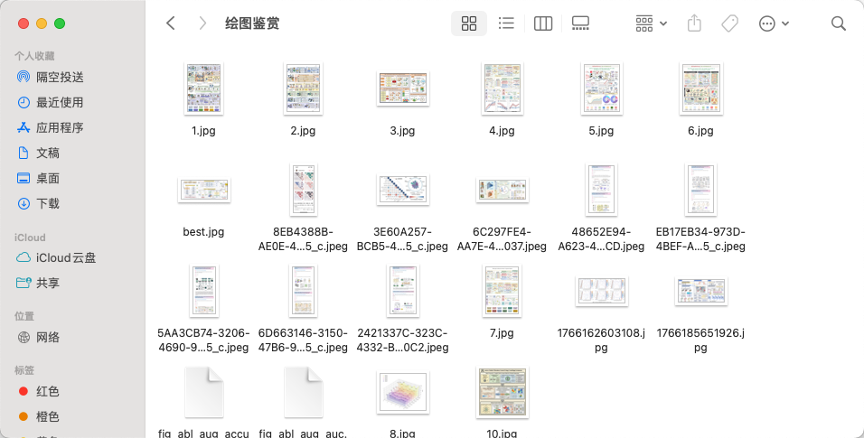
Research Figures
Step 1: Provide the paper abstract or key points to Gemini and ask it to output a simplified textual sketch consisting of an element list, spatial layout, and arrow relationships.
Step 2: Feed the textual sketch to NanoBanana, specifying a journal-style mechanism diagram / review-cover style, with consistent color scheme and clear annotations.
Step 3: Fine-tuning:
Ask the model to adjust only colors and fonts, without redrawing the main structure.
Perform manual checks on arrow directions, capitalization of abbreviations, scale bars, and units.
If watermarks are present, crop by enlarging and trimming the edges, or mask them with a background overlay in Photoshop.
23

Slide 24

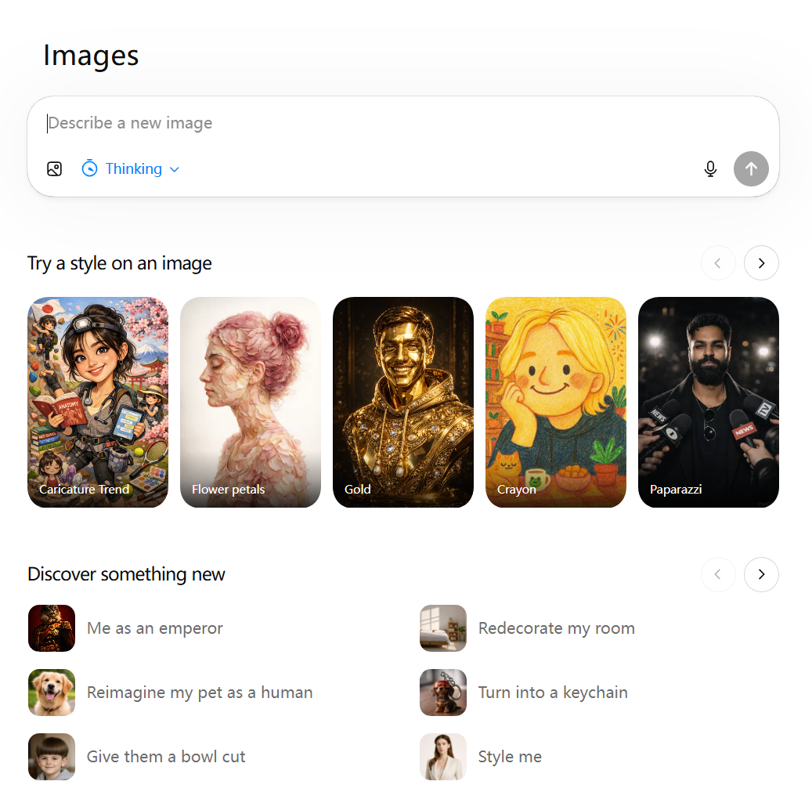

Research Figures
Remove background
https://www.remove.bg/zh/upload
https://magicstudio.com/zh/magiceraser/
Icon elements
https://bioicons.com/
https://www.flaticon.com/
https://www.freepik.com/
https://icon-icons.com/
Please draw an exact replica of this diagram without the dashed lines. High resolution is required.
Color
https://coolors.co/palettes/trending
Guide
https://antigravityide.org/blog/the-complete-guide-to-nano-banana-pro-10-tips-for-professional-asset-production/
Google AI Studio
https://aistudio.google.com/prompts/new_chat
24

Slide 25
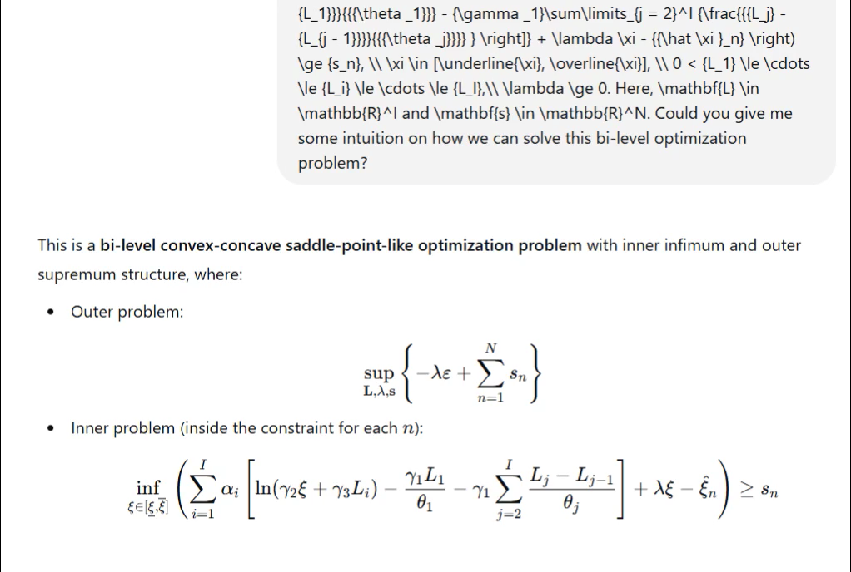
Mathematical
LLM ≠ a theorem prover: it is good at filling in logical gaps but not at guaranteeing correctness.
Every step must be verifiable: each step should be traceable back to a definition, theorem, or established result.
Derivations should be modular: do not ask an LLM to derive a long formula in a single shot.
You must ensure notation consistency: this is one of the most common failure modes of LLM-generated derivations.
The final version must be a derivation you can reproduce by hand.
Specify the known conditions (assumptions, distributions, constraints) and the target result (what to prove or which equation to reach).
Have the LLM first restate the problem and check whether the derivation is feasible under the stated conditions.
Perform notation and dimensional-consistency checks.
Do a reverse validation from a reviewer’s perspective (i.e., identify likely failure points or hidden assumptions).
Gemini is a good helper!
25

Slide 26
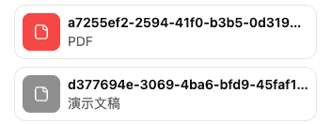
Slide Creation
Prompt Instance
Prompt Instance
Please generate a real Google Slides file titled “XXXX”, consisting of XX slides.
Please strictly adhere to all of the following visual, technical, and rendering consistency rules:
[Hard Constraints on File Generation]
All images must be generated by the model and embedded into the slides as PNG/JPG files. External links, BASE64, SVG, or CSS styles are strictly prohibited.
The background of each slide and all icons must be a single high-resolution PNG image, inserted into the slide as an image, rather than as font icons, SVGs, or external resources.
All glow effects, gradient text, shadows, and 3D effects must be generated by the model as PNG images, and must not rely on built-in slide styling features.
All text must use system fonts (SAN FRANCISCO / HELVETICA / ARIAL). Fonts that cannot be loaded by the presentation software are not allowed.
Do not generate HTML, CSS, SVG, or Markdown-based image syntax.
[Visual Style Requirement]
Follow the Anthropic-style visual design.
[Content Requirements]
XXXX
You are now the “AI-focused PhD student group meeting PPT writing and visualization specialist.” I have provided several AI-related papers. Based on these, please complete an academic PPT file suitable for group meetings. It should feature professional terminology, aesthetic design, charts, data tables, and summaries of key findings. The PPT style must replicate that of the last PPT file I sent you—clean, visually appealing, and academic. Deliver a 10-page PPT file to me.
GPT Extended thinking mode
Paper
Reference PPT
Gemini Canvas mode
26

Slide 27
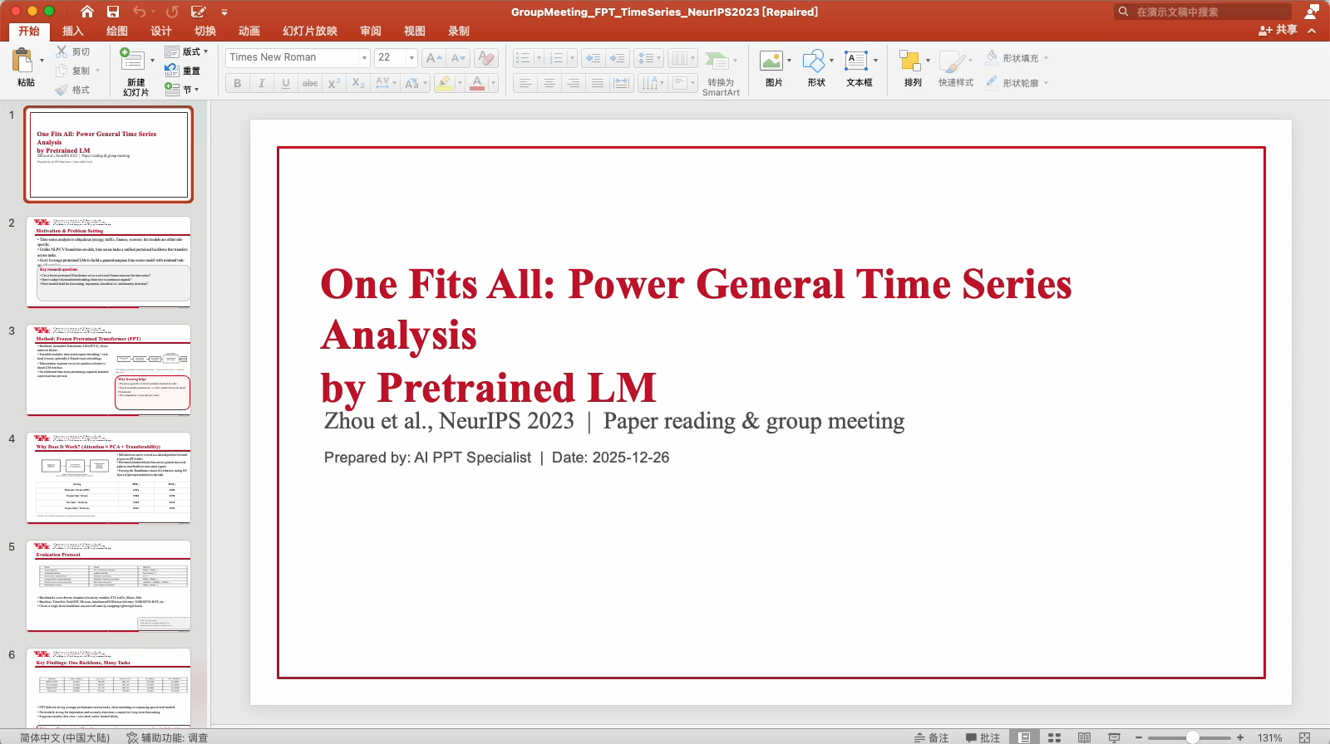
Slide Creation
27

Slide 28
Outline
An introduction for LLM and AI agent (openclaw)
AI for research
AI for marketing
28

Slide 29
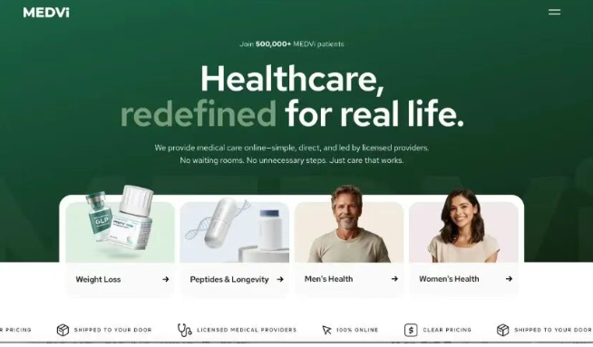
One Example: Medvi Corp.
Company Overview
Sector: Telehealth (initially GLP-1 weight-loss drugs).
Team: Only 2 full-time employees (Founder + Brother).
Financials: * 2025 Revenue: $401 million (16.2% profit margin).
2026 Target: $1.8 billion (Currently >$3M/day).
Business Model & AI Contribution
The Strategy: Hyper-efficient middleman. Focuses 100% on customer acquisition via AI, while entirely outsourcing doctor consultations and pharmacy fulfillment.
AI as the Workforce ($20k initial cost):
Dev & Copy: ChatGPT, Claude, Grok.
Ads & Visuals: Midjourney, Runway.
Customer Service: ElevenLabs (Voice bots).
Operations: Custom AI Agents automate and connect all software workflows.

Slide 30
Market Research & Demand Validation
Pain Point Mining
Replaced Role: UX Researcher / Market Research Specialist
Details: Monitor platforms like X/Twitter and Reddit 24/7 to scrape user complaints and unmet needs.
Use Case: OpenClaw - Market Research & Product Factory [1]
Competitor Analysis
Replaced Role: Business Analyst / Strategy Planner
Details: Auto-aggregate competitor updates, pricing strategies, and user reviews into market reports.
Use Case: Agent Framework - CrewAI Market Research Example [2]
Idea Validation
Replaced Role: Product Manager (PM) / Commercialization Director
Details: Scan GitHub and Product Hunt to assess market crowding and feasibility before building.
Use Case: OpenClaw - Pre-Build Idea Validator [3]
[1] https://github.com/hesamsheikh/awesome-openclaw-usecases/blob/main/usecases/market-research-product-factory.md
[2] https://github.com/crewAIInc/crewAI-examples/tree/main?tab=readme-ov-file
[3] https://github.com/hesamsheikh/awesome-openclaw-usecases/blob/main/usecases/pre-build-idea-validator.md

Slide 31
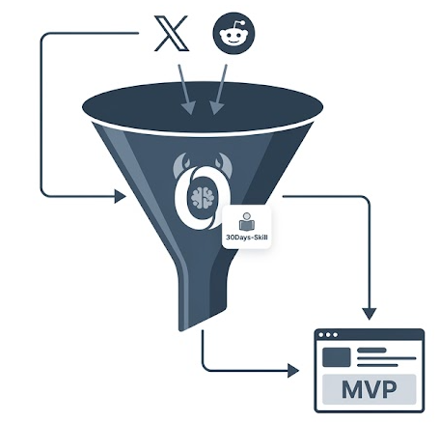
Case Study
The "Last 30 Days" Market Research Pipeline
Core Strategy: Mine platforms like X/Twitter and Reddit 24/7 to scrape user complaints and unmet needs.
The AI Tech Stack: OpenClaw (Market Research & Product Factory) + Last 30 Days Skill + Telegram API.
Executable Workflow:
Install the `last30days-skill` via OpenClaw's plugin manager to bypass sanitized survey data.
Schedule a weekly cron job via CLI: "Every Monday, research technical challenges people have with [Your Niche] on Reddit."
Instruct the agent to format findings into: Top pain points, specific complaints, and gaps in existing solutions.
Trigger the execution protocol: Feed the generated report back into OpenClaw with the prompt, "Build me an MVP web app that solves [Top Pain Point]."-
Real-world Solopreneur Use Case: Discovering continuous user complaints about API rate limits on a forum, and immediately dispatching the agent to build a reverse-proxy solution MVP.

Slide 32
Product R&D & Technical Build
Prototype & MVP Development
Replaced Role: Front-end & Back-end Engineer / UI/UX Designer
Details: Write code from natural language prompts, enabling autonomous "overnight builds" of mini-apps.
Use Case: OpenClaw - Goal-Driven Autonomous Tasks [1]
Algorithm & Model Deployment
Replaced Role: Algorithm Engineer / Machine Learning (ML) Engineer
Details: Handle environment setup, scripting, and testing for complex models, freeing you for core architecture.
Use Case: Agent Framework - MetaGPT [2]
Code Review & Self-Healing
Replaced Role: QA Engineer / DevOps / Tech Lead
Details: Auto-review code pre-commit and autonomously search logs to fix errors (Bugs First policy).
Use Case: OpenClaw - Autonomous Game Dev Pipeline [3]
[1] https://github.com/hesamsheikh/awesome-openclaw-usecases/blob/main/usecases/overnight-mini-app-builder.md
[2] https://github.com/FoundationAgents/MetaGPT
[3] https://github.com/hesamsheikh/awesome-openclaw-usecases/blob/main/usecases/autonomous-game-dev-pipeline.md

Slide 33
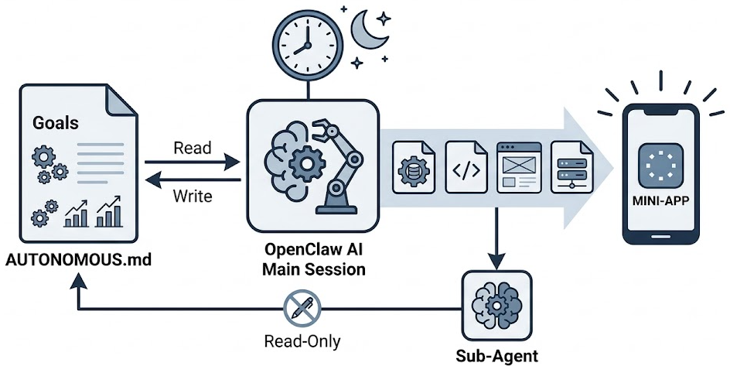
Case Study
Setting Up the "Overnight Mini-App" Builder
Core Strategy: Write code from natural language prompts, enabling autonomous "overnight builds" of mini-apps aligned with long-term business goals.
The AI Tech Stack: OpenClaw (Goal-Driven Autonomous Tasks) + `AUTONOMOUS.md` + Next.js.
Executable Workflow:
Create an `AUTONOMOUS.md` core file in your root directory containing a brain dump of all quantitative business and technical goals.
Configure a daily 8:00 AM trigger instructing the agent to parse this file and generate 4-5 executable background tasks (e.g., algorithm deployment scripts, UI generation).
Explicitly prompt the agent to build a "surprise mini-app" overnight using lightweight frameworks like Next.js or Python/Streamlit.
Prevent fatal race conditions: Strictly isolate the `AUTONOMOUS.md` file so that only the main session possesses write permissions, while sub-agents have read-only access.

Slide 34
Marketing & Content Distribution
Content Factory
Replaced Role: Copywriter / Content Operator
Details: Multi-agent collaboration to track trends, write technical blogs, and generate media scripts.
Use Case: OpenClaw - Multi-Agent Content Factory [1]
Automated Social Media Operations
Replaced Role: Social Media Manager
Details: Auto-post, reply, like, and proactively DM potential early adopters.
Use Case: OpenClaw - X/Twitter Automation [2]
[1] https://github.com/hesamsheikh/awesome-openclaw-usecases/blob/main/usecases/multi-agent-team.md
[2] https://github.com/hesamsheikh/awesome-openclaw-usecases/blob/main/usecases/x-twitter-automation.md

Slide 35
Customer Service & Sales Conversion
24/7 Omnichannel Support
Replaced Role: Customer Support / After-Sales Support
Details: Unify WhatsApp, Instagram, and Email into one AI inbox to answer FAQs using your knowledge base.
Use Case: OpenClaw - Multi-Channel AI Customer Service [1]
Lead Follow-up (CRM)
Replaced Role: Sales Development Rep (SDR) / Account Manager
Details: Extract client info from emails/calendars into a database and auto-send follow-up emails.
Use Case: OpenClaw - Local CRM Framework [2]
[1] https://github.com/hesamsheikh/awesome-openclaw-usecases/blob/main/usecases/multi-channel-customer-service.md
[2] https://github.com/hesamsheikh/awesome-openclaw-usecases/blob/main/usecases/local-crm-framework.md

Slide 36
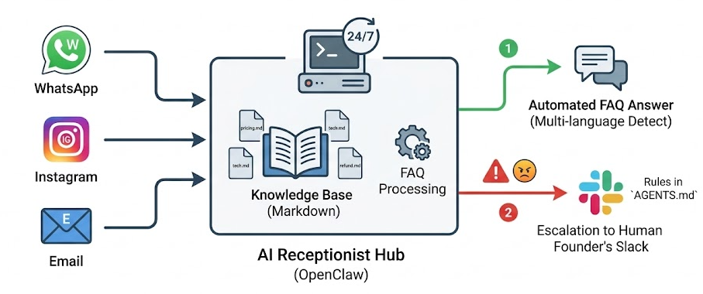
Case Study
The 24/7 AI Receptionist: Unified Communications API
Core Strategy: Unify WhatsApp, Instagram, and Email into one AI inbox to answer FAQs using your localized knowledge base.
The AI Tech Stack: OpenClaw (Multi-Channel AI Customer Service) + WhatsApp API + Instagram Graph API + `gog` CLI.
Executable Workflow:
Authenticate multiple endpoints inside OpenClaw: Connect WhatsApp Business via 360dialog, IG via Meta Business Suite, and Gmail via `gog` OAuth.
Mount a business context directory: Feed markdown files containing your pricing architecture, technical specs, and refund policies.
Code hardline escalation protocols in `AGENTS.md`: If sentiment analysis detects high frustration, or the user requests complex technical support, instantly route the thread to the human founder's personal Slack.
Enable native auto-language detection to parse and respond to international queries without third-party translation latency.

Slide 37
Question?

