Slide 1




IEEE QCE 2026 Tutorial
Hybrid Satellite-Ground Quantum Networks and Computing
TUT::QNET::QDC::57: Hybrid Satellite-Ground Quantum Networks and Computing
Yu Wang · Temple University
Lei Fan, Zhu Han · University of Houston
Yuanxiong Guo · University of Texas at San Antonio
Sept 14, 2026 · Toronto, Canada

Slide 2
Schedule of This Tutorial
1
Introduction to Hybrid Satellite-Ground Quantum Networks (10-10:30am)
Motivation, background, and overall system of satellite-ground QN
2
Hybrid Quantum-Classical Computing Framework (10:30-11am)
Key concepts and techniques used by hybrid QC computing to solve optimization problems
3
Entanglement Distribution in Hybrid Satellite-Ground Quantum Networks (11-11:30am)
How to use satellite to provide entanglement for ground quantum networks
4
Entanglement Routing in Hybrid Satellite-Ground Quantum Networks (1-1:40pm)
How to routing entanglement in satellite-ground quantum networks
5
Distributed Quantum Computing via Hybrid Satellite-Ground Quantum Networks (1:50-2:30pm)
How to support distributed quantum computing in hybrid quantum networks
Hybrid Satellite-Ground Quantum Networks and Computing | QCE ’26
2

Slide 3
SECTION 1
Introduction
Motivation, background, and overall system of satellite-ground QN
Hybrid Satellite-Ground Quantum Networks and Computing | QCE ’26
3

Slide 4
Outline
1
Quantum Network
2
Quantum Computing and Distributed Quantum Computing
3
Satellite-Ground Communication
4
Satellite-Assisted Quantum Networks
5
Satellite-Ground Quantum Computing
UNIQ · Communication-Efficient Distributed Quantum Computing via Unified NIP
2

Slide 5


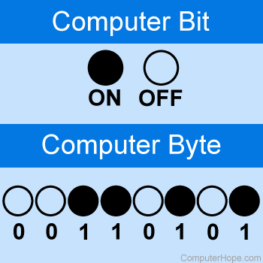
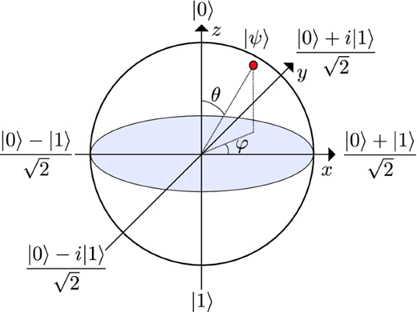
INTRODUCTION
Quantum Network and Computing
Quantum Network
Transmit quantum information between nodes,
using quantum phenomena superposition and entanglement
Quantum Computing
No bits, but qubits
Distributed Quantum Computing
Satellite-Ground Communications
Satellite Assisted Quantum Networks
Quantum teleportation
Bits
Qubits
Satellite-Ground Quantum Computing
Bit. [Online]. Available: https://www.computerhope.com/jargon/b/bit.htm
What is a qubit. [Online]. Available: https://www.quantum-inspire.com/kbase/what-is-a-qubit/
Teleportation is real, thanks to quantum entanglement. [Online]. Available: https://www.popularmechanics.com/science/a25699/how-quantum-teleportation-works/
3

Slide 6
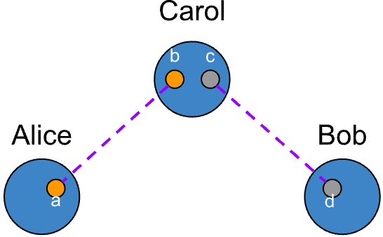
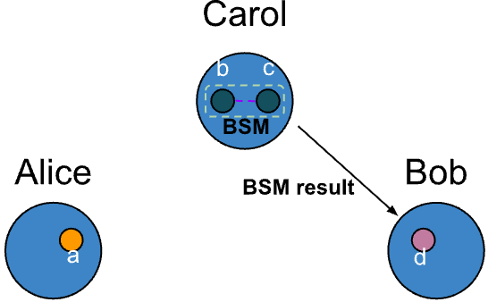
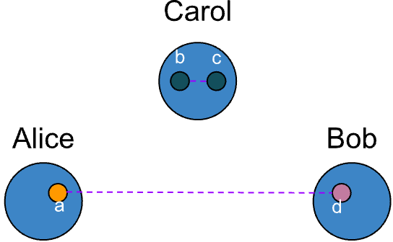
INTRODUCTION
Quantum Network
Quantum Network
Entanglement Generation and Swapping
Stage 1: Alice and Bob generate an Einstein-Podolsky-Rosen (EPR) pair and send one qubit from their respective pairs to Carol
Quantum Computing
Stage 2: Carol performs a Bell-state measurement (BSM) and transmits the result to Bob, i.e., entanglement swapping
Distributed Quantum Computing
Stage 3: Alice and Bob are entangled
Satellite-Ground Communications
Satellite Assisted Quantum Networks
Satellite-Ground Quantum Computing
(a) Entanglement generation
(b) Entanglement swapping
(c) Entanglement established
3

Slide 7
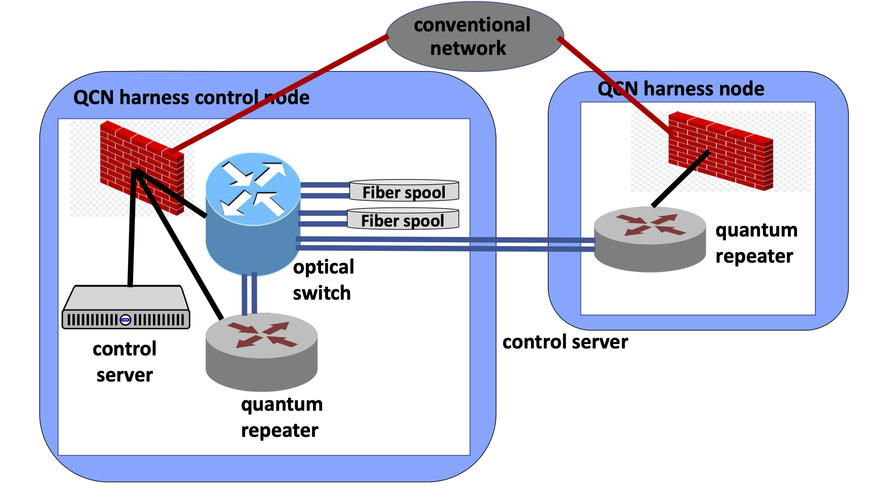

INTRODUCTION
Terrestrial Quantum Network (TQN)
  Utilize optical fiber links
  Exponential increase in photon loss with distance
  Terrestrial repeaters perform entanglement swapping and purification to ensuring high fidelity
Quantum Network
Quantum Computing
Distributed Quantum Computing
Limited Coverage
Satellite-Ground Communications
Inefficient communication
Satellite Assisted Quantum Networks
Constrained scalability
Satellite-Ground Quantum Computing
3

Slide 8
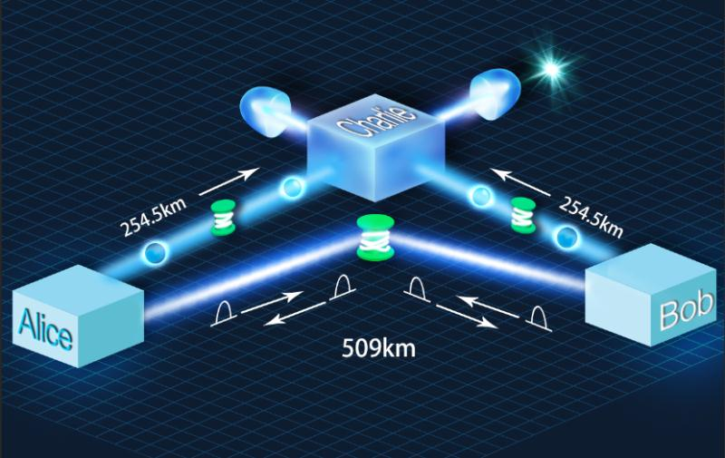
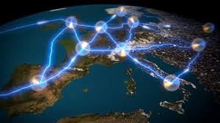
INTRODUCTION
Limitations of ground-based quantum entanglement distribution
Quantum Network
Signal attenuation and decoherence: Entanglement is fragile and easily disrupted by loss and noise during transmission.
Distance constraints: Reliable entanglement maintenance is limited over long ground-based distances.
Environmental interference: Electromagnetic noise, temperature shifts, and vibrations degrade quantum stability.
Device imperfections: Hardware errors and component flaws reduce entanglement fidelity.
Security risks: Protecting entanglement channels from eavesdropping and attacks remains difficult.
Cost and scalability: High implementation costs and complex maintenance hinder large-scale deployment.
Quantum Computing
Distributed Quantum Computing
Satellite-Ground Communications
Satellite Assisted Quantum Networks
Satellite-Ground Quantum Computing
3

Slide 9
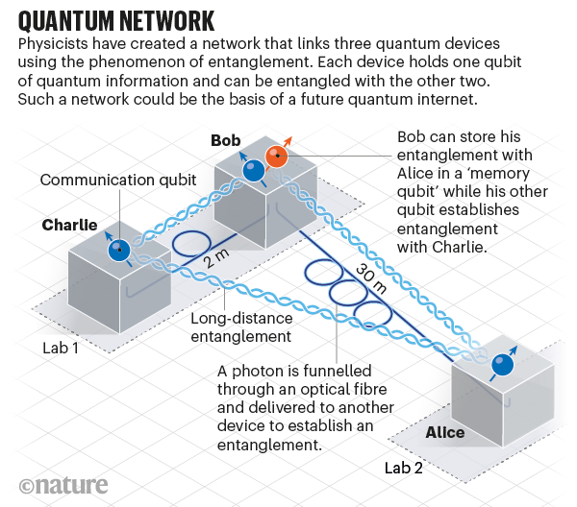
INTRODUCTION
Quantum Network
Quantum Computing
Distributed Quantum Computing
Satellite-Ground Communications
Satellite Assisted Quantum Networks
Satellite-Ground Quantum Computing
3

Slide 10


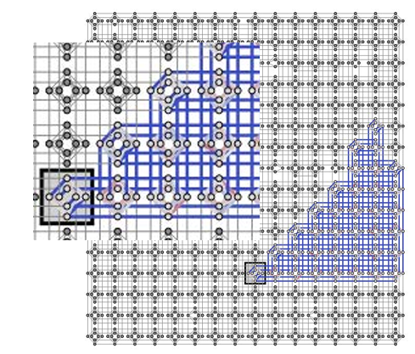
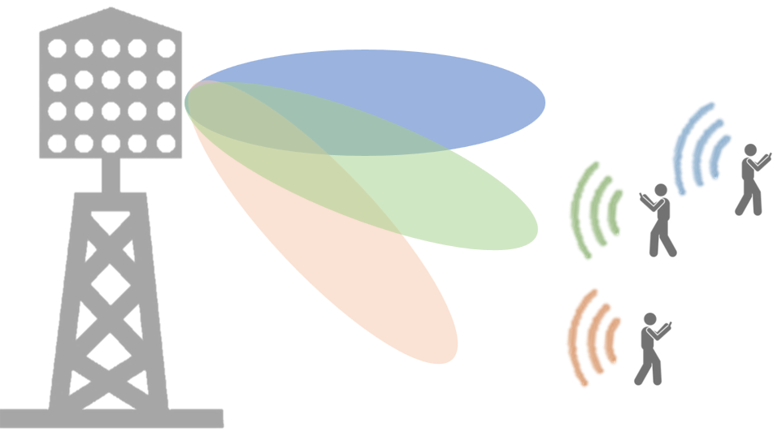
INTRODUCTION
Quantum Computing: use quantum mechanics to solve problems too complex for classical computers.
Quantum Network
MIMO Detection
Quantum Computing
Network Slicing
NP-hard Optimization Problems
Resource Allocation
. . .
Distributed Quantum Computing
e. g. Maximum Likelihood MIMO Detection Using Quantum Computing
Quantum Computing:
Satellite-Ground Communications
Network
Function Virtualization
Satellite Assisted Quantum Networks
Network Slicing
. . .
[2]
Satellite-Ground Quantum Computing
[2] M. Kim, D. Venturelli, and K. Jamieson, “Leveraging quantum annealing for large MIMO processing in centralized radio access networks,” in Proceedings of the ACM Special Interest Group on Data Communication, Beijing, China, Aug. 2019.
3

Slide 11
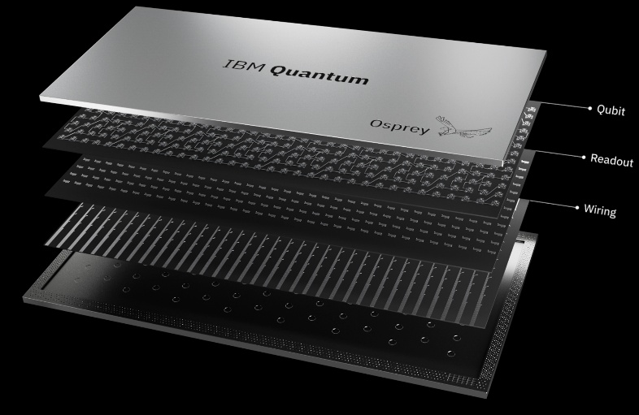
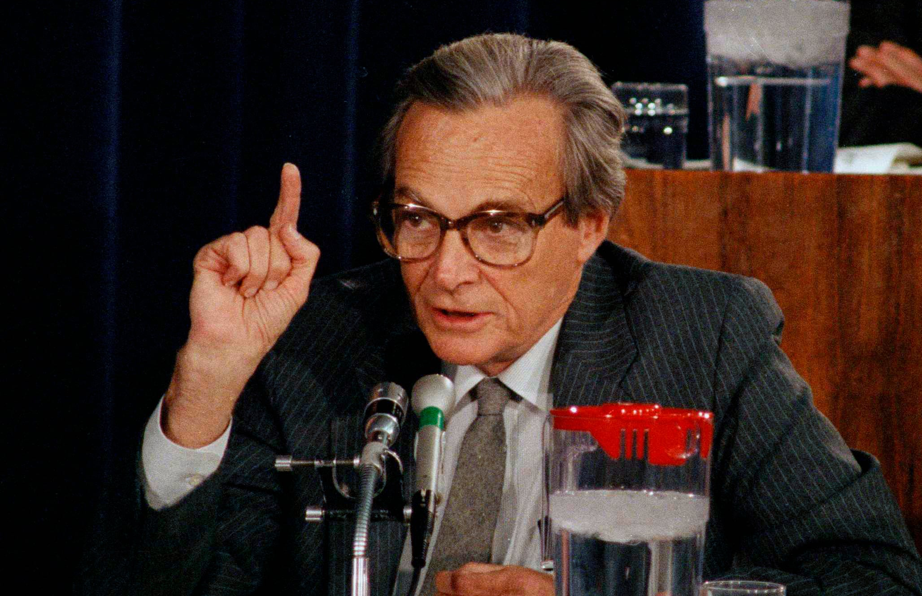

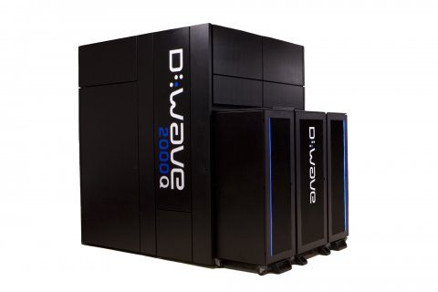
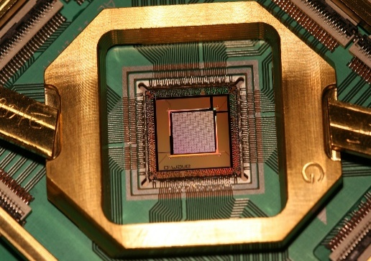
INTRODUCTION
Quantum Computer
Maybe we need to use quantum mechanics in our computers.
Quantum Network
Gate Model
Analog Quantum Model
Quantum Annealing
Quantum Computing
Distributed Quantum Computing
Satellite-Ground Communications
More Qubits
Faster than classical solvers
Fit some optimization problems
Satellite Assisted Quantum Networks
Satellite-Ground Quantum Computing
3

Slide 12
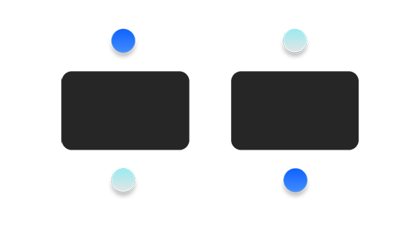
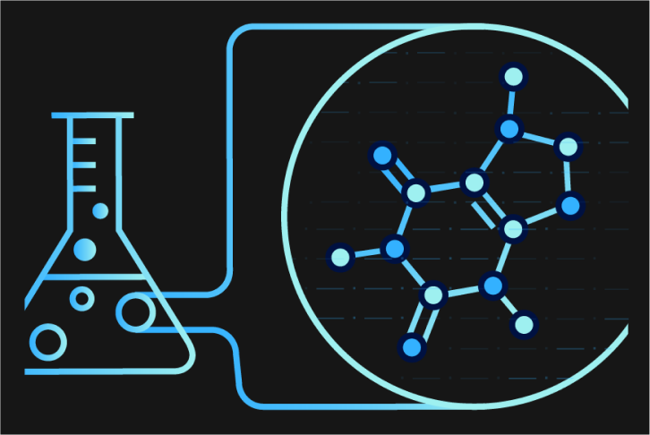
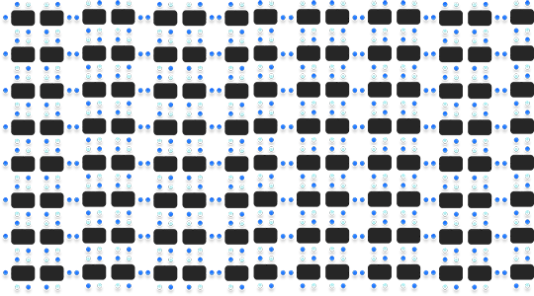

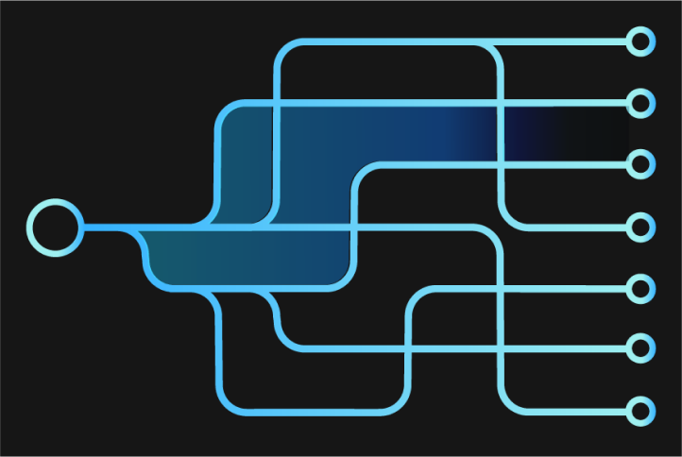
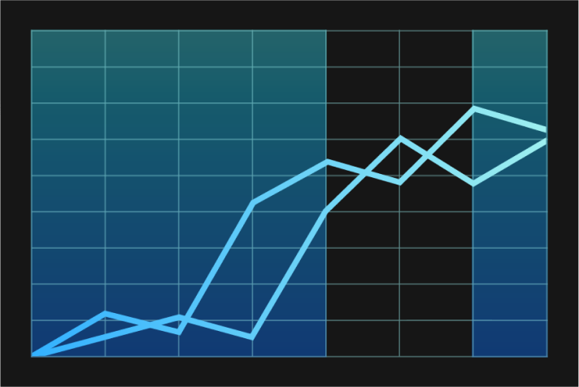
INTRODUCTION
What is wrong in classic computing?
Many Practical NP hard Problems
Quantum Network
Quantum Computing
Distributed Quantum Computing
Life science
Satellite-Ground Communications
Satellite Assisted Quantum Networks
Total number of combinations exponentially grows
Manufacturing & Logistics
Financial Services
Satellite-Ground Quantum Computing
3

Slide 13
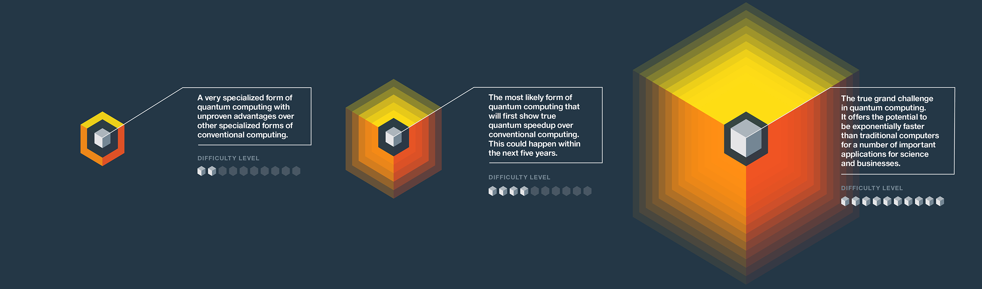
INTRODUCTION
Known Types of Quantum Computing and Their Applications and Generality.
Quantum Network
Quantum Computing
Distributed Quantum Computing
Satellite-Ground Communications
Satellite Assisted Quantum Networks
Application: | Optimization
Generality : | Restrictive
Application: | Chemistry Sampling Quantum Dynamics
Generality : | Partial
Application: | Cryptography Searching Secure Computing
Generality : | High
Satellite-Ground Quantum Computing
3

Slide 14
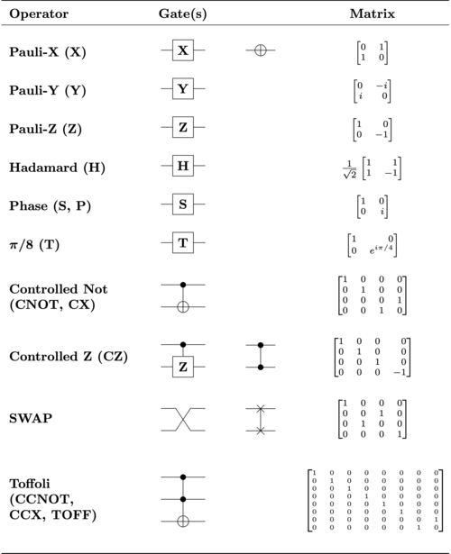
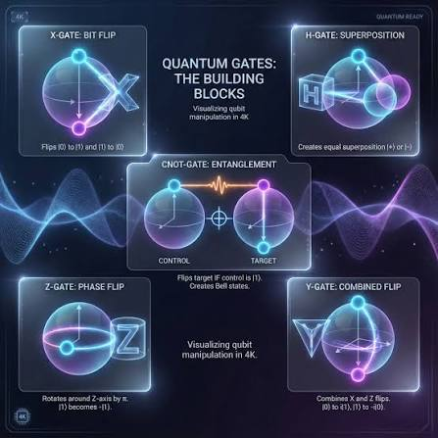
Gate Level Quantum Computing
INTRODUCTION
Quantum Network
Quantum Computing
Distributed Quantum Computing
Satellite-Ground Communications
Satellite Assisted Quantum Networks
Satellite-Ground Quantum Computing
3

Slide 15
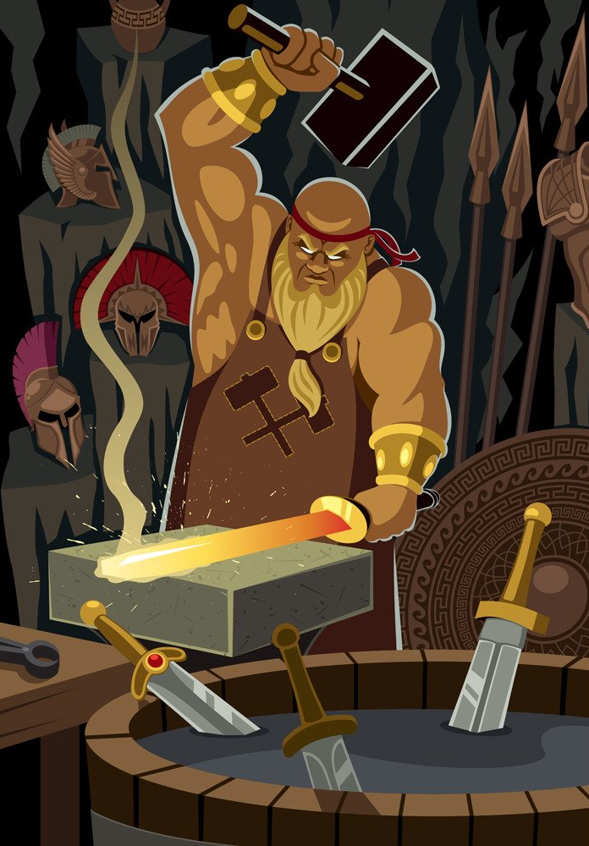
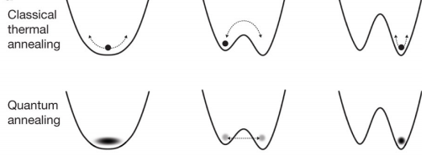
Quantum Annealing
INTRODUCTION
Annealing a Metal
Heat the metal to a temperature;
Lower the temperature;
Quantum Network
Quantum Computing
Simulated Annealing
Heuristic algorithm;
Random search method;
The temperature variable;
Distributed Quantum Computing
Satellite-Ground Communications
Quantum Annealing
Enables jumping from one classical state to another
– Decreases likelihood of getting stuck in a local minimum
Width of energy barrier is important, but height is not
Satellite Assisted Quantum Networks
Satellite-Ground Quantum Computing
Quantum tunneling
3

Slide 16
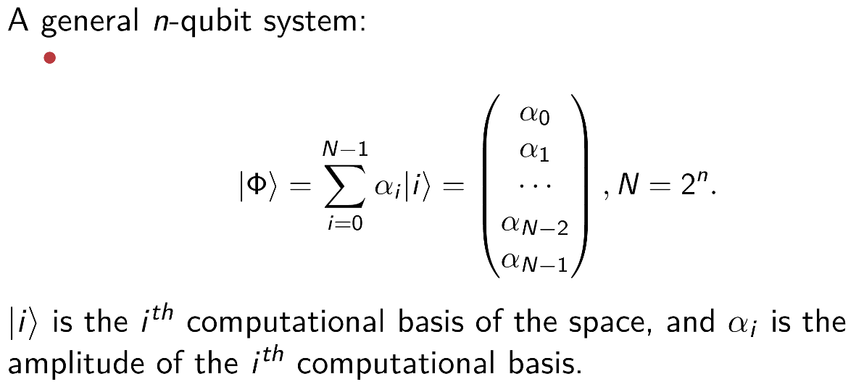
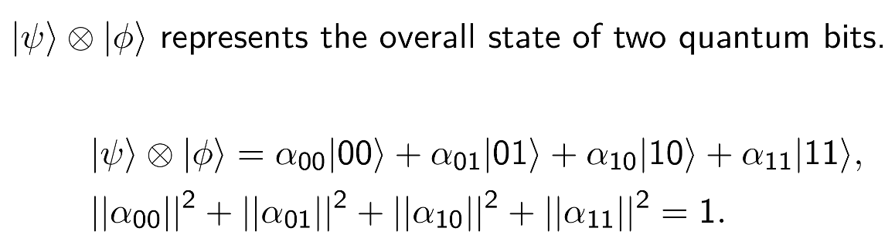
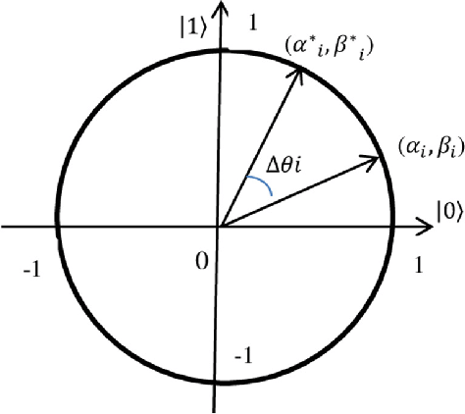
INTRODUCTION
Qubits and Quantum Operation
Superposition
Tensor Product
Quantum Network
Quantum Computing
Distributed Quantum Computing
Satellite-Ground Communications
Satellite Assisted Quantum Networks
Satellite-Ground Quantum Computing
3

Slide 17
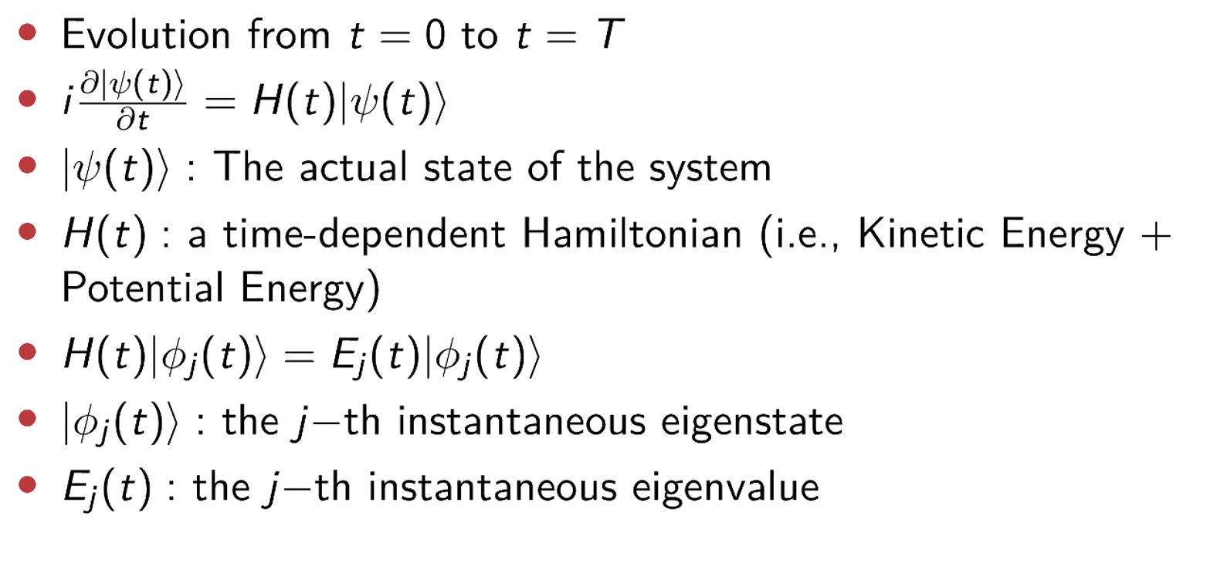
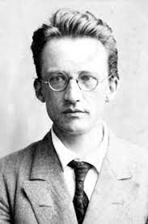
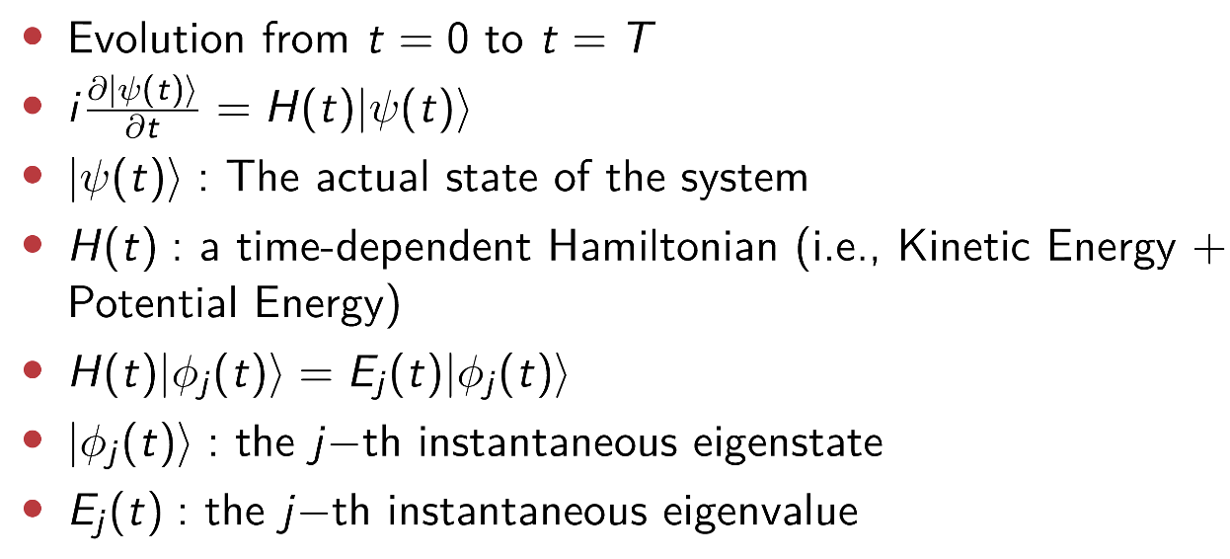
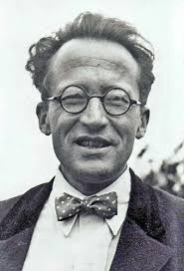
INTRODUCTION
Schrödinger Equation
Quantum Network
Before studying quantum
Quantum Computing
Distributed Quantum Computing
Satellite-Ground Communications
after studying quantum
Satellite Assisted Quantum Networks
Satellite-Ground Quantum Computing
3

Slide 18
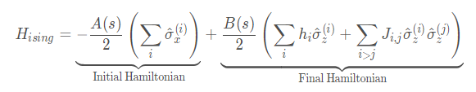
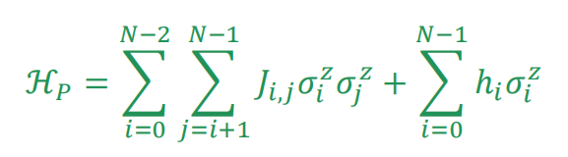
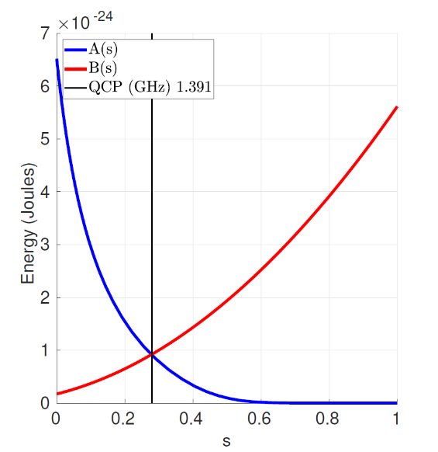
INTRODUCTION
Dwave Hamiltonian
Problem of Hamiltonian:
Goal (what the hardware does)
  Minimize σ_{i} ∈ {-1, +1} subject to provided J_{i,j} ∈ R and h_{i} ∈ R coefficients
  In other words, a quantum optimization program is merely a list of J_{i,j} and h_{i}
Classical
  Much easier to reason than a quantum Hamiltonian
  Quantum effects are used internally to work towards the goal
Sparsely connected
  Possible to map fully connected problems onto the D-Wave’s Chimera graph
Quantum Network
Quantum Computing
Distributed Quantum Computing
Satellite-Ground Communications
Satellite Assisted Quantum Networks
Satellite-Ground Quantum Computing
3

Slide 19
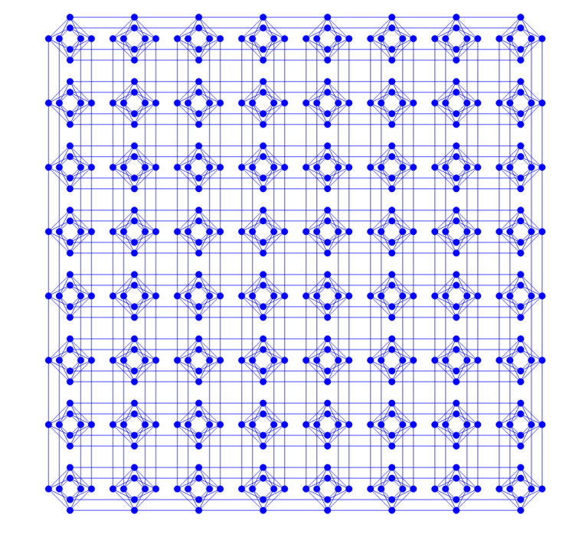
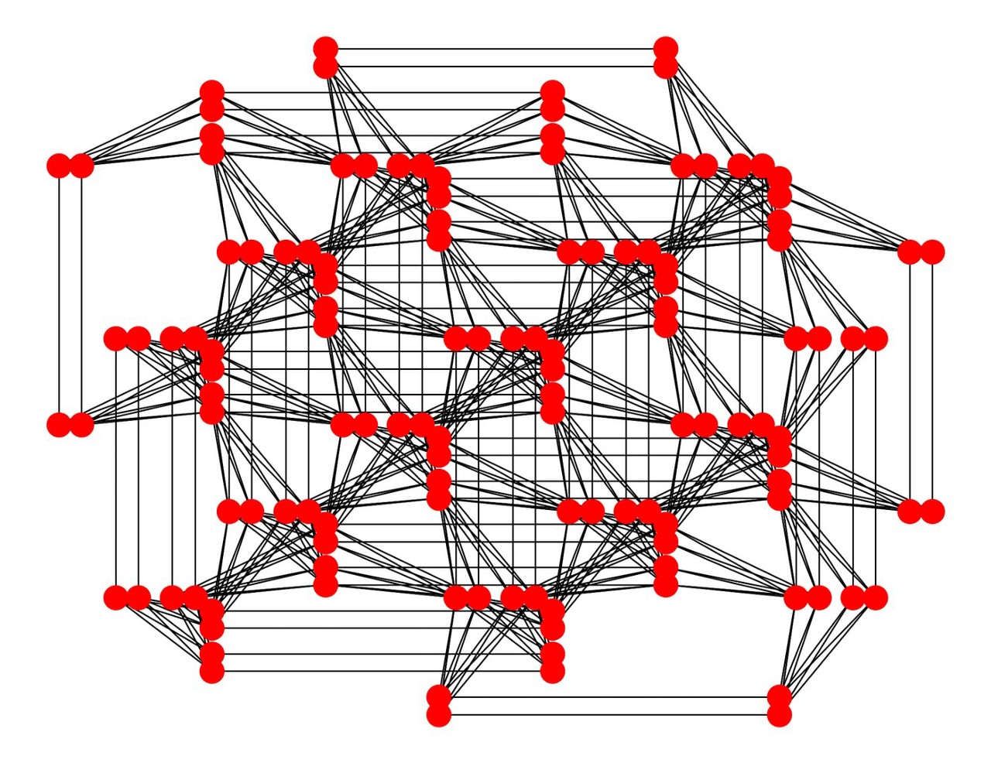
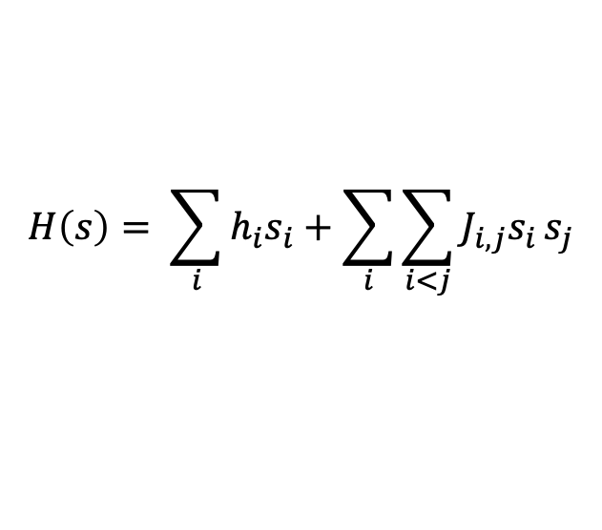
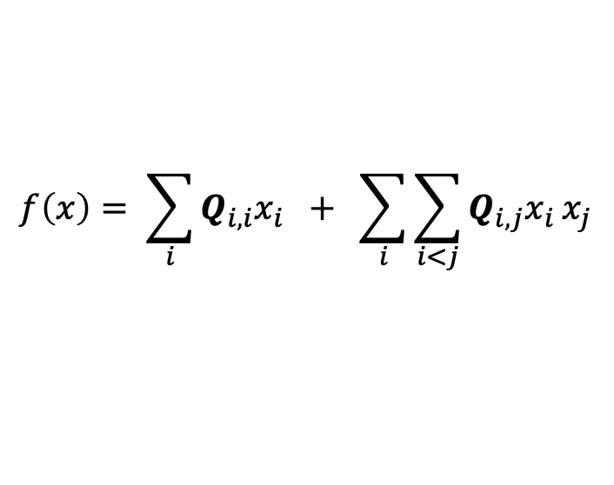

Link Schrodinger with QUBO Model
INTRODUCTION
Core idea: Encoding the objective function as the eigenvalue of the final ground state of Schrodinger equation, based on Adiabatic Quantum Computing Model
Quantum Network
Ising Model
$$H\left(s\right)= \sum_{i}{h_{i}s_{i}}+\sum_{i}{\sum_{i<j}{J_{i,j}s_{i}}s_{j}}$$
Quantum Computing
Spins interact with applied field
Neighboring spins interact with each other
Distributed Quantum Computing
QUBO (Quadratic Unconstrained Binary Optimization)
Chimera
Pegasus
$$f\left(x\right)= \sum_{i}{Q_{i,i}x_{i}} + \sum_{i}{\sum_{i<j}{Q_{i,j}x_{i}}x_{j}}$$
$Q$ : upper-diagonal matrix
Satellite-Ground Communications
These important optimization problems can be transformed into QUBO model:
Satellite Assisted Quantum Networks
Knapsack Problems
Assignment Problems
Task Allocation Problems
Capital Budgeting Problems
… (NP-hard problem)
Quantum Computing:
provide an alternative method to solve some NP-hard problems
Satellite-Ground Quantum Computing
3

Slide 20
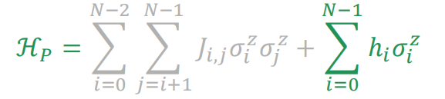
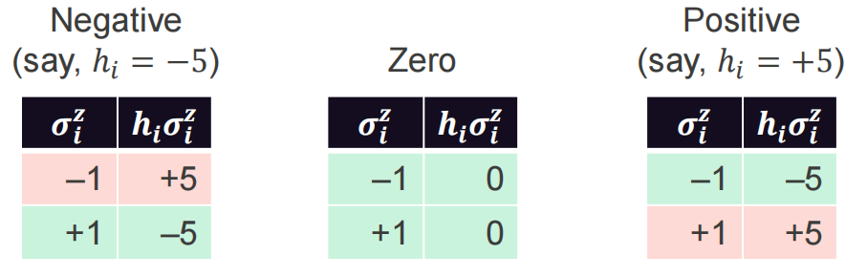
INTRODUCTION
QUBO Equation
Quantum Network
Considering only the external field:
We arbitrarily call σ^{z} = +1 “TRUE” and σ^{z} = —1 “FALSE”
Here are the optimal values of σ^{z} for different values of h
Quantum Computing
Distributed Quantum Computing
Satellite-Ground Communications
Satellite Assisted Quantum Networks
Observations
– A negative h_{i} means, “I want σ^{z} to be TRUE”
– A zero h_{i} means, “I don’t care if σ^{z} is TRUE or FALSE”
Satellite-Ground Quantum Computing
– A positive h_{i} means, “I want σ^{z} to be FALSE”
3

Slide 21
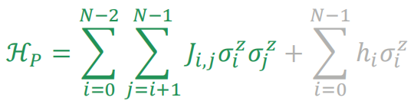
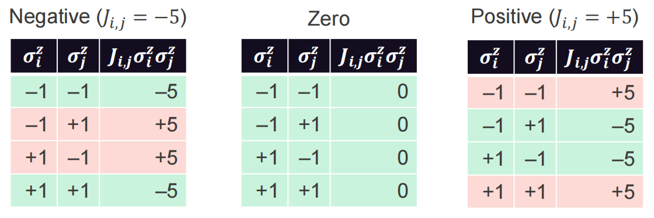
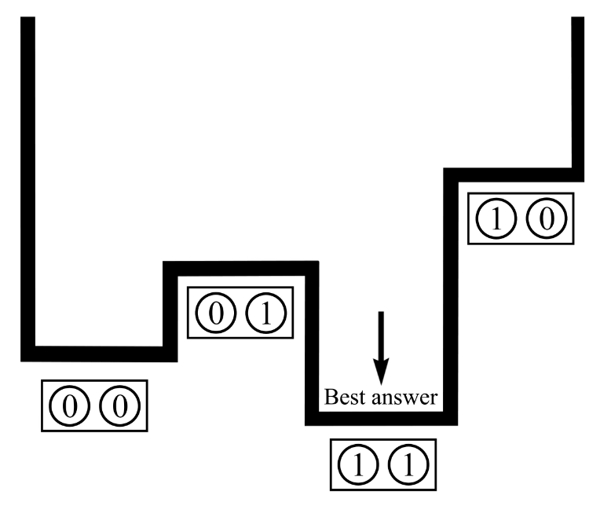
INTRODUCTION
QUBO Equation
Consider only the coupler strengths:
Here are the optimal values of σ^{z} and σ^{z} for different values of J_{i,j}:
Quantum Network
Quantum Computing
Distributed Quantum Computing
Satellite-Ground Communications
Observations
  A negative J_{i,j} means, “I want σ^{z} and σ^{z} to be equal”
i j
  A zero J_{i,j} means, “I don’t care how σ^{z} and σ^{z} are related”
i j
  A positive J_{i,j} means, “I want σ^{z} and σ^{z} to be different”
i j
Satellite Assisted Quantum Networks
Best answer appear with high probability
but not 100%, which is Achilles’ heel for
many quantum algorithms but not ours
Satellite-Ground Quantum Computing
3

Slide 22
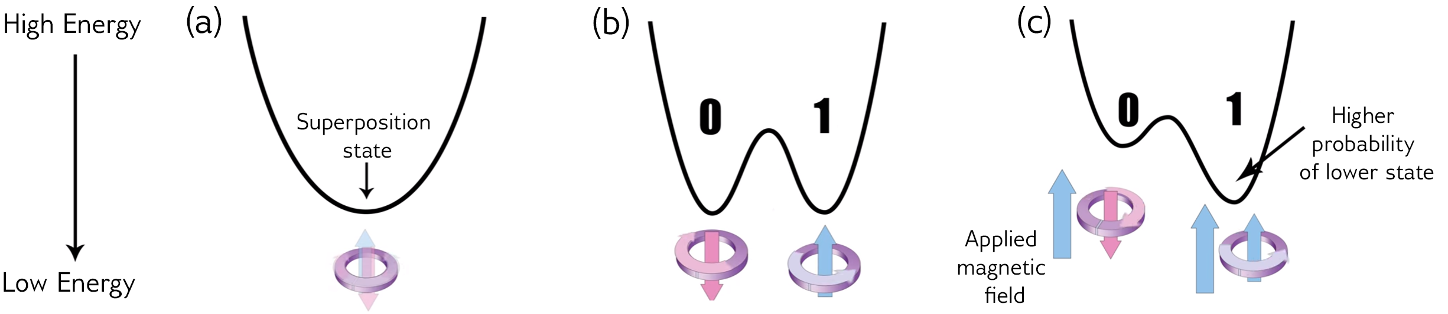

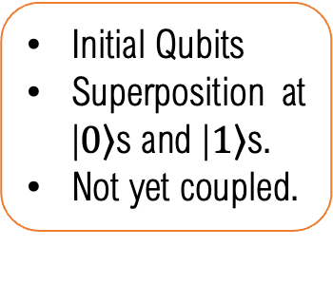
INTRODUCTION
QUBO Quantum Annealing
Energy diagram in Quantum Annealing
Quantum Network
Quantum Computing
Distributed Quantum Computing
A matter of microseconds.
Satellite-Ground Communications
Initial Qubits
Superposition at
|$\left.0\right\rangle$s and |$\left.1\right\rangle$s.
Not yet coupled.
Qubits are entangled.
At state of many possible answers.
Couplers & biases applied
Inputs’ energy are set.
Lowest energy is at or closes to the optima.
Energy → possibility
Satellite Assisted Quantum Networks
Satellite-Ground Quantum Computing
3

Slide 23
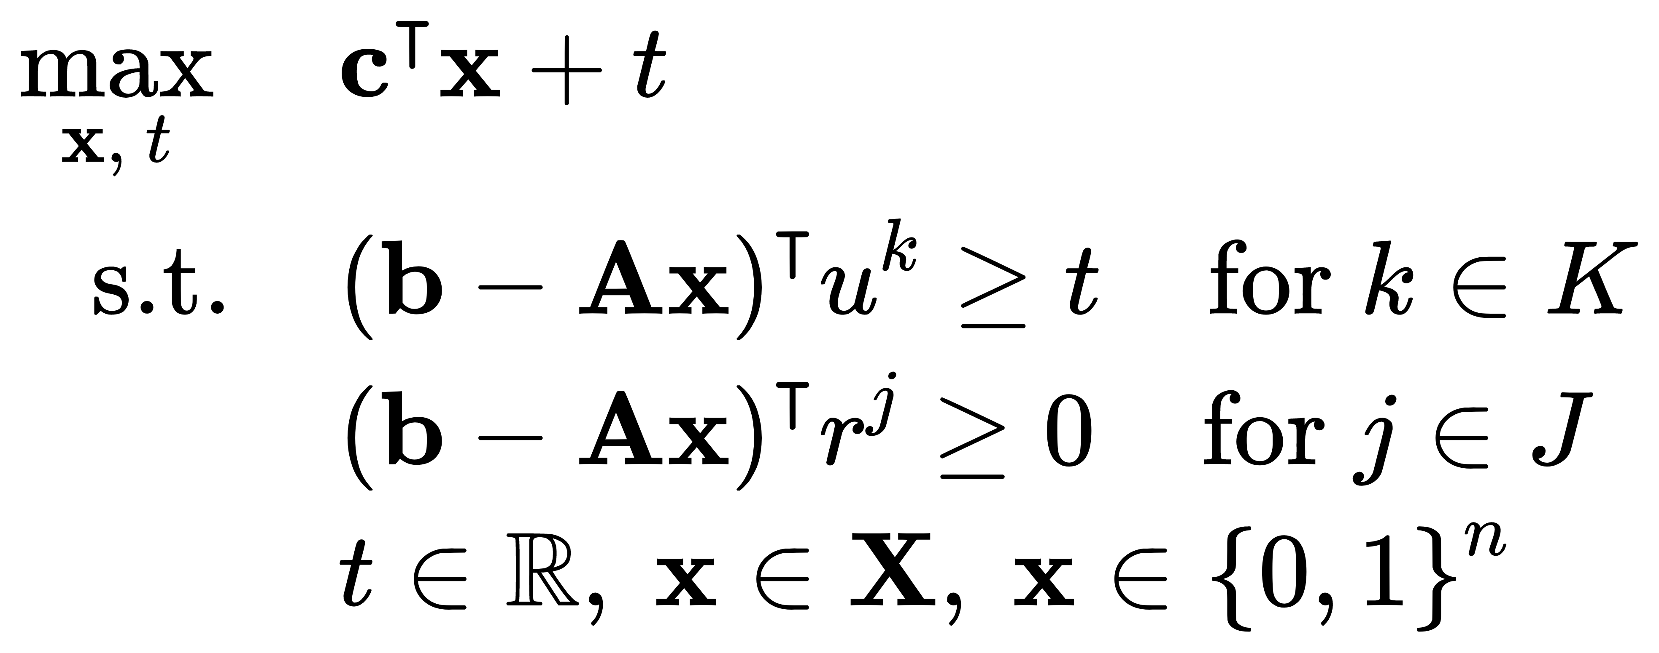
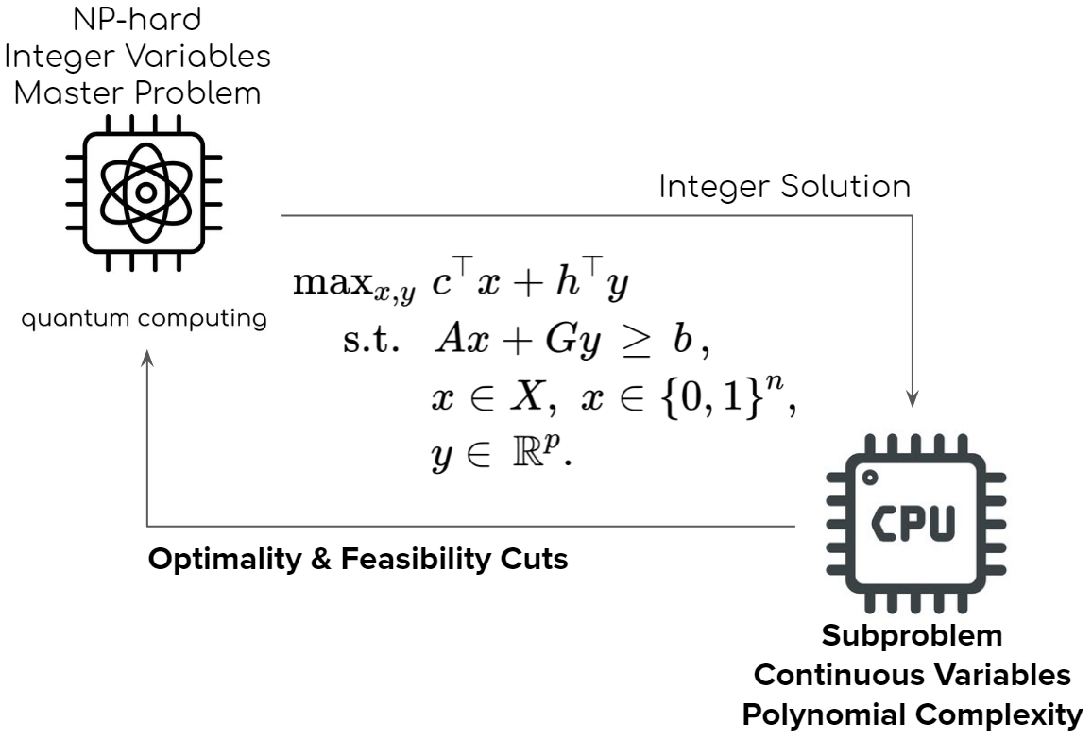
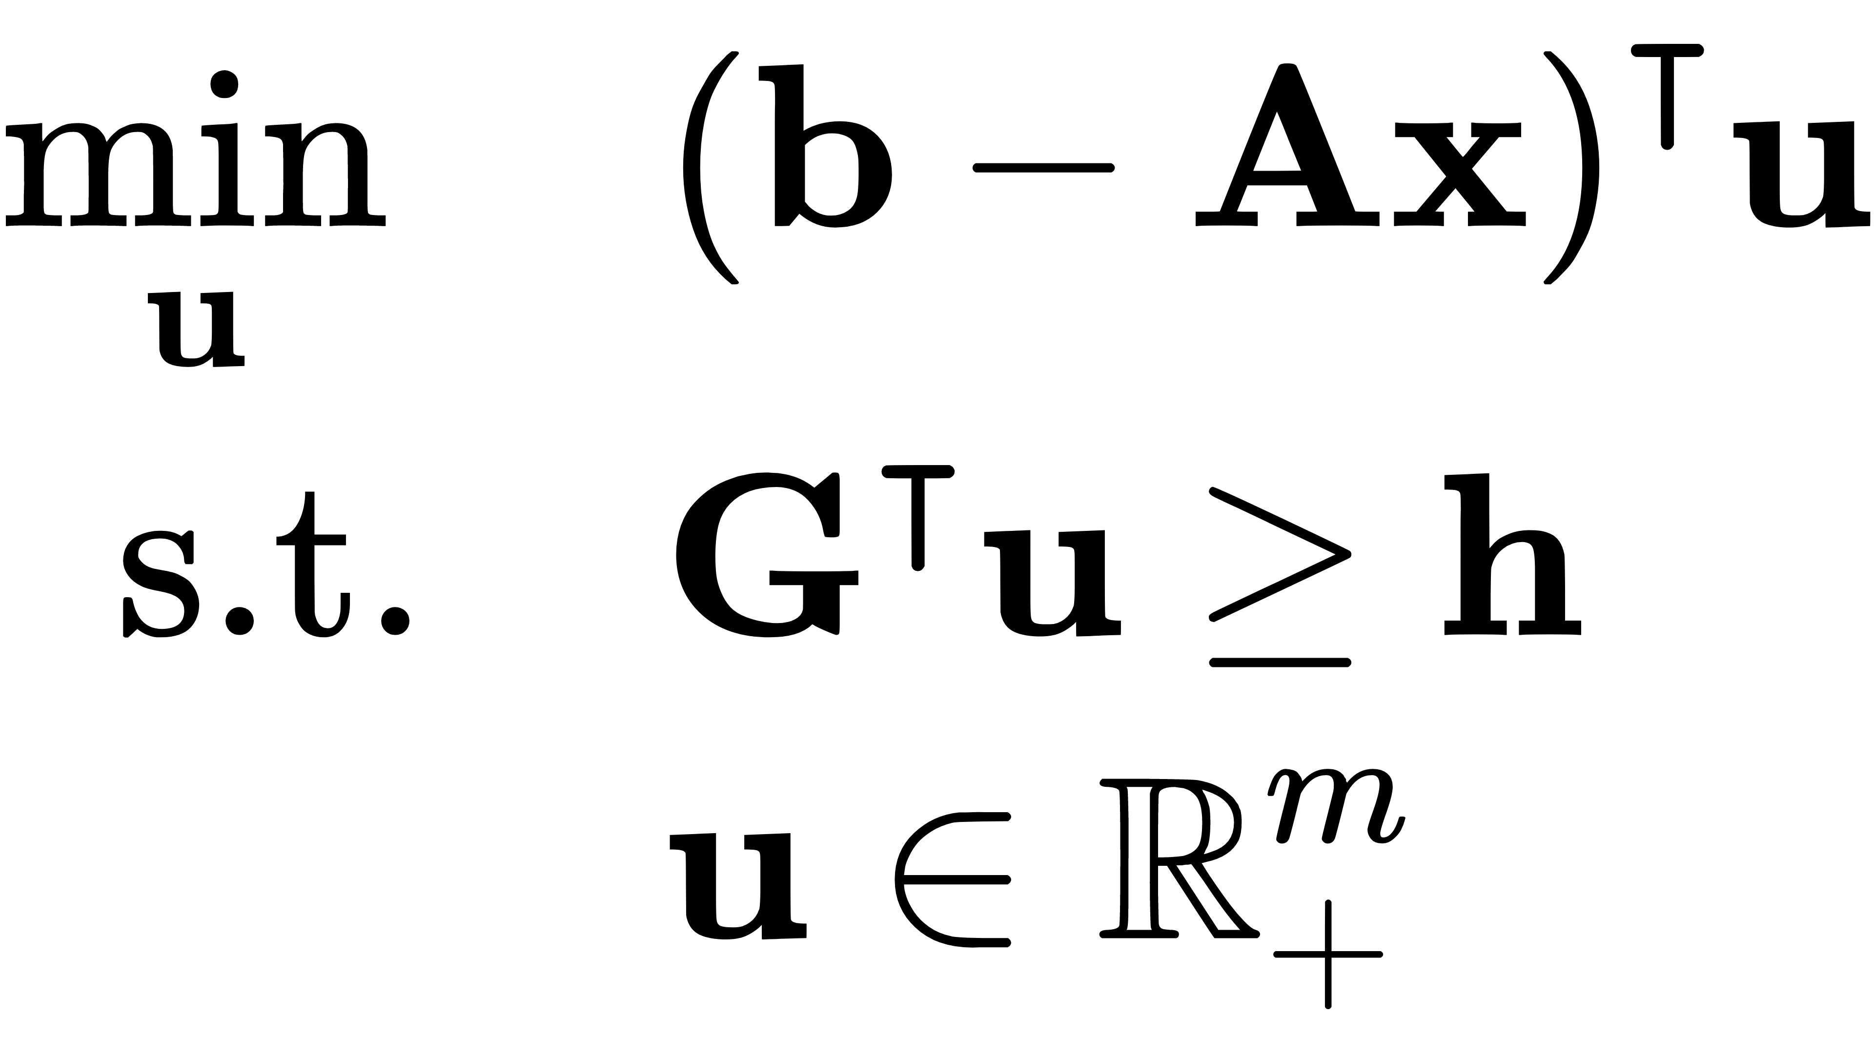




INTRODUCTION
Hybrid GPU and Quantum Computing
using Benders' Decomposition for Mixed Integer Programming
$$x$$
Quantum Network
Master Problem
Quantum Computing
$\underline{t}=\overline{t}$ ?
Distributed Quantum Computing
solution $x$
Satellite-Ground Communications
Satellite Assisted Quantum Networks
$$\underline{t}={(b−Ax)}^{\text{T}}u$$
$u^{k}$ or $r^{k}$
Satellite-Ground Quantum Computing
Subproblem
3

Slide 24
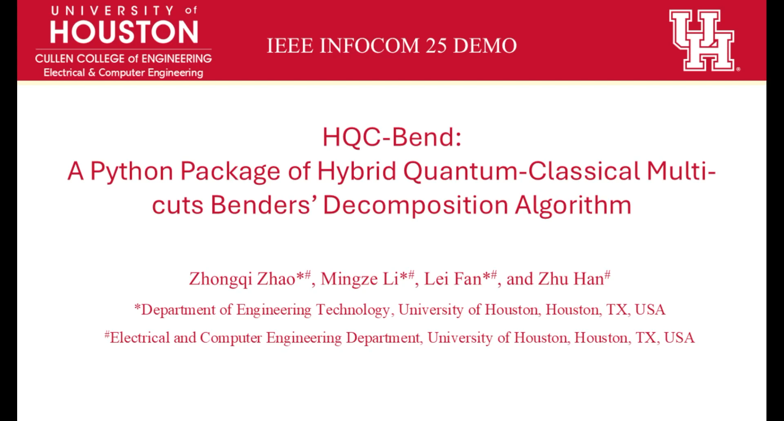
INTRODUCTION
Quantum Network
Quantum Computing
Distributed Quantum Computing
Satellite-Ground Communications
Satellite Assisted Quantum Networks
Satellite-Ground Quantum Computing
3

Slide 25

INTRODUCTION
Distributed Quantum Computing
Quantum Network
What is Distributed Quantum Computing (DQC)?
  Multiple interconnected quantum processors (QPUs) work together to solve large-scale computational problems
Why DQC?
  single QPUs have limited qubits
  monolithic large QPU is very hard to build
  a pathway to large-scale quantum computing
Challenges in DQC
  Qubit allocation/Circuit partition: distribution and management of qubits across multiple QPUs to optimize communication and execution time
  Quantum network function: serve high-quality & low-latency connections among quantum nodes to for remote operations
Quantum Computing
Distributed Quantum Computing
Satellite-Ground Communications
Satellite Assisted Quantum Networks
Satellite-Ground Quantum Computing
3

Slide 26
Distributed Quantum Computing
INTRODUCTION
Quantum Network
G(V,E)
Quantum Circuit
Qubit Interaction Graph
G’(Q,C)
v₄
Quantum Network
q₁
H
q₃
qubit allocation
q₂
Y
q₂
q₃
1
2
v₁
Quantum Computing
H
1
q₁
q₄
X
q₄
1
final topology
2
q₅
q₅
Distributed Quantum Computing
number of CNOT gate operation between
two logical qubits
v₂
v₃
logical qubit
Satellite-Ground Communications
Quantum circuits describe quantum algorithms
Single qubit gates + CNOT are universal
Qubit Interaction Graph (QIG) captures all inter-qubit communications
Exactly a graph partition problem, which is NP-hard
Satellite Assisted Quantum Networks
  Entangled qubits enables remote quantum gates and teleportation-based communication
  Qubit allocation requires balancing local processing and remote operations.
  Network topology affects entanglement fidelity and cost of served entangled qubits.
Satellite-Ground Quantum Computing
3

Slide 27

INTRODUCTION
Quantum Network
Quantum Computing
Distributed Quantum Computing
Satellite-Ground Communications
Satellite Assisted Quantum Networks
Satellite-Ground Quantum Computing
3

Slide 28

INTRODUCTION
Quantum Network
Quantum Computing
Distributed Quantum Computing
Satellite-Ground Communications
Satellite Assisted Quantum Networks
Satellite-Ground Quantum Computing
3

Slide 29

INTRODUCTION
Quantum Network
Quantum Computing
Distributed Quantum Computing
Satellite-Ground Communications
Satellite Assisted Quantum Networks
Satellite-Ground Quantum Computing
3

Slide 30

INTRODUCTION
Satellite-Ground Quantum Networking and Computing
Quantum Network
Space-Aerial-Terrestrial Quantum Networks (SATQNs)
Quantum Computing
SATQN has three layers
  Space quantum network enables long-distance entanglement distribution via free space optical links
  Aerial quantum network supports flexible and rapid deployment using free space optical links
  Terrestrial quantum network offers stable quantum connections via optical fiber links
Distributed Quantum Computing
Satellite-Ground Communications
Satellite Assisted Quantum Networks
Satellite-Ground Quantum Computing
3

Slide 31

INTRODUCTION
AI in Space
Quantum Network
Quantum Computing
Distributed Quantum Computing
Satellite-Ground Communications
Satellite Assisted Quantum Networks
Satellite-Ground Quantum Computing
3

Slide 32

INTRODUCTION
AAN Standardization in 3GPP
Quantum Network
Adapting New Radio to support AAN
Necessary features including architecture, higher-layer protocols, and physical layer aspects
Integration with 5G Enhanced
AAN Native Integration for 6G
Three Use Cases of AAN
Concept of satellite network access
Quantum Computing
Coverage enhancement; mobility and service continuity enhancement; deployment in higher bands
GNSS-resilient AAN operation; IoT AAN Phase 4; 6G AAN architecture study initiated
2019
Release 15
2021
Release 17
2025
Release 19
Distributed Quantum Computing
3GPP TR 38.811
3GPP TR 38.863
3GPP TR 21.919
Satellite-Ground Communications
2017
Release 14
3GPP TR 22.822
2020
Release 16
2022
Release 18
2026 Ongoing
Release 20
3GPP TR 38.821
3GPP TR 38.882
Satellite Assisted Quantum Networks
5G enabled AAN
Study on deployment scenarios, key parameters, and channel models
New Radio specifications for AAN
AAN Deep Integration Enhancement
Satellite-Ground Quantum Computing
Time, synchronization, and HARQ enhancement; mobility management; switch-over; signaling
Regenerative payload for AAN; GNSS-independent access; store-and-forward; RedCap UE support
3

Slide 33


INTRODUCTION
Satellite-assisted Quantum Networks (SATQN)
Quantum Network
Overcoming distance limits: Satellites enable global-scale entanglement distribution beyond ground-based range.
Reduced signal loss: Space offers minimal attenuation and interference for more reliable quantum transmission.
Broad coverage: Satellites connect remote and inaccessible regions lacking ground infrastructure.
Freedom from obstacles: Signals are unaffected by terrain, buildings, or other terrestrial barriers.
Global quantum networking: Satellite links are essential for secure, worldwide quantum communication.
Complementary integration: Satellite systems enhance and extend ground-based quantum networks
Quantum Computing
Distributed Quantum Computing
Satellite-Ground Communications
Satellite Assisted Quantum Networks
Satellite-Ground Quantum Computing
3

Slide 34


INTRODUCTION
SATQN Applications
Quantum Network
Time-sensitive applications
  Complete tasks as quickly as possible
  Avoid information decoherence due to noise or delay
  E.g., Distributed quantum computing (DQC)
Quantum Computing
Distributed Quantum Computing
Time-insensitive applications
  Support long-term stream of entanglements
  Require secure communications
  Steady stream of entanglement over time
  E.g., Quantum key distribution (QKD)
Satellite-Ground Communications
Satellite Assisted Quantum Networks
Satellite-Ground Quantum Computing
Distributed quantum phase estimation with entangled photons. [Online]. Available: https://www.nature.com/articles/s41566-020-00718-2
Quantum Key Distribution Technology. [Online]. Available: https://www.drishtiias.com/daily-updates/daily-news-analysis/quantum-key-distribution-technology/print_manually
3

Slide 35
INTRODUCTION
Challenges in SATQNs
Quantum Network
Complex Integration
free space optical links and optical fiber links
Quantum Computing
Distributed Quantum Computing
Decoherence and Errors
noise in quantum channels and imperfections in quantum operations
Satellite-Ground Communications
Satellite Assisted Quantum Networks
Satellite-Ground Quantum Computing
3

Slide 36

INTRODUCTION
Satellite-Assisted Quantum Networks
Quantum Network
The quantum repeaters are depicted as nodes, connected via fiber links.
Dedicated ground stations (satellite dishes) have both fiber and satellite connections.
Link colors represent entanglement generation probability, with blue indicating higher probability (shorter links) transitioning to red for lower probability (longer links).
Quantum Computing
Distributed Quantum Computing
Satellite-Ground Communications
Satellite Assisted Quantum Networks
Satellite-Ground Quantum Computing
Simplified example of a satellite-assisted quantum network.
Arxiv: SatQNet: Satellite-assisted Quantum Network Entanglement Routing Using Directed Line Graph Neural Networks
3

Slide 37

INTRODUCTION
Satellite-Ground Quantum Computing
Quantum Network
Quantum Computing
https://www.linkedin.com/pulse/how-quantum-computing-could-transform-satellite-ground-kiran-kolipaka-oqpgc
Distributed Quantum Computing
Satellite-Ground Communications
Satellite Assisted Quantum Networks
Quantum Key Distribution (QKD): Satellites send fragile light particles (photons) to ground stations to create unbreakable encryption keys.
Space-Based Advantage: Photons travel through empty space with very little loss or interference, unlike ground fiber-optic cables that degrade over long distances.
Entanglement: Low-Earth-orbit satellites generate and split pairs of linked photons, sending one half to the ground and keeping or sending the other elsewhere to connect remote networks.
Satellite-Ground Quantum Computing
3

Slide 38





INTRODUCTION
Satellite-Ground Quantum Computing
Quantum Network
Quantum Computing
SPOQC Mission (UK)
Distributed Quantum Computing
Satellite-Ground Communications
Boeing’s Q4S Mission
EAGLE-1 & SAGA (European Space Agency)
Satellite Assisted Quantum Networks
IonQ & Skyloom
Infrastructure
Micius (Mozi) Satellite (China)
Satellite-Ground Quantum Computing
Global Security: Creating hack-proof communication networks across continents.
Distributed Computing: Linking separate quantum computers together via space relays.
Quantum Sensing: Improving environmental monitoring and timing precision from space
3

Slide 39
SECTION 2
Hybrid Quantum-Classical Computing Framework
Key concepts and techniques used by hybrid QC computing to solve optimization problems
Hybrid Satellite-Ground Quantum Networks and Computing | QCE ’26
3

Slide 40
Outline
1
Quantum Optimization Algorithms
Key math foundations and principles
2
Hybrid Quantum Classical Computing
Key concepts and workflow
3
Hybrid Quantum-Classical Application
Simulation Results
4
Conclusion
Hybrid Satellite-Ground Quantum Networks and Computing | QCE ’26

Slide 41







Quantum Quantum Optimization Algorithms
Hamiltonian Simulation on Quantum Computer
Q Algorithm
Evolution from $t = 0$ to $t = T$.
$$i\frac{∂\left.|ψ(t)\right\rangle }{∂t}=H(t)\left.|ψ(t)\right\rangle$$
$\left.|ψ(t)\right\rangle$: the actual state of the system
$H(t)$: a time-dependent Hamiltonian (i.e., Kinetic energy + Potential Energy)
$$H\left(t\right)\left.|φ_{j}(t)\right\rangle =E_{j}\left(t\right)\left.|φ_{j}(t)\right\rangle$$
$\left.|φ_{j}(t)\right\rangle$: the $jth$ instantaneous eigenstate
$E_{j}\left(t\right)$: the $jth$ instantaneous eigenvalue
HyQC
Application
Energy
Conclusion
Classical path
Tunnel effect
$$H(t)$$
Solution
Evolution (Path)
Hybrid Satellite-Ground Quantum Networks and Computing | QCE ’26

Slide 42




Quantum Optimization Algorithms
*Encode the objective function in the final Hamiltonian of the Quantum System
Q Algorithm
QUBO (Quadratic Unconstrained Binary Optimization)
HyQC
Application
Q: Upper triangular matrix $x_{\text{i} }$ : Binary variable
Final Hamiltonian
Conclusion
${\hat{σ}}_{z}^{(i)}$ | : Pauli matrices operating on qubit $q_{i}$.
$h_{i}$ | : qubit biases
$${\text{J}}_{\text{i}\text{, }\text{j}}$$ | : coupling strengths.
Hybrid Satellite-Ground Quantum Networks and Computing | QCE ’26

Slide 43


Quantum Optimization Algorithms
*Encode the objective function in the final Hamiltonian of the Quantum System
Q Algorithm
HyQC
Application
Conclusion
Time Dependent Hamiltonian
Hybrid Satellite-Ground Quantum Networks and Computing | QCE ’26

Slide 44

INTRODUCTION
Quantum Adiabatic Algorithm
Q Algorithm
HyQC
Application
Conclusion
Hybrid Satellite-Ground Quantum Networks and Computing | QCE ’26

Slide 45


Hybrid Quantum Classical Optimization Algorithms
Hybrid QPU-CPU Algorithm Design
Q Algorithm
Leverage Classical Optimization Frameworks
  Build on proven decomposition and convex optimization methods to ensure scalability, stability, and interpretability
Identify Quantum-Ready Problem Structures
  Extract discrete, combinatorial, or non-convex components that can be efficiently mapped to quantum processors (QPU) while keeping continuous parts classical.
Accelerate While Preserving Guarantees
  Integrate quantum modules to speed up computation without compromising theoretical properties such as convergence, feasibility, and optimality.
On QPU:
Quantum Adiabatic Algorithm
Quantum Hamiltonian Descent
On CPU:
Linear Programming
Convex optimization
Dual Updates
HyQC
QPU
Application
QPU
Conclusion
QPU
Hybrid Satellite-Ground Quantum Networks and Computing | QCE ’26

Slide 46





Hybrid Quantum Classical Optimization Algorithms
Hybrid Quantum Classical Benders’ Decomposition
Q Algorithm
Master Problem
Quadratic Penalty
HyQC
Application
Optimality/Feasibility Cuts
Hamiltonian
Formulation
Conclusion
Sub Problem
Ising Model
$$x^{∗}$$
Integer Solutions
Zhao, Zhongqi, Lei Fan, and Zhu Han. "Hybrid quantum benders’ decomposition for mixed-integer linear programming." 2022 IEEE Wireless Communications and Networking Conference (WCNC). IEEE, 2022.

Slide 47

Hybrid Quantum Classical Optimization Algorithms
Hybrid Quantum Multi-Cut Benders’ Decomposition
Q Algorithm
Quantum algorithm returns multiple solutions after solving the master problem
Each integer solution produce a subproblem, which further returns an optimality/feasibility cut
Reduce the number of iterations and speed up the convergence
HyQC
Application
Conclusion
Zhao, Zhongqi, Mingze Li, Lei Fan, and Zhu Han. "HQC-Bend: A Python Package of Hybrid Quantum-Classical Multi-cuts Benders’ Decomposition Algorithm." In 2025 International Conference on Quantum Communications, Networking, and Computing (QCNC), pp. 591-597. IEEE, 2025.

Slide 48




Hybrid Quantum Classical Optimization Algorithms
Dantzig-Wolfe (DW) Decomposition
Q Algorithm
A. Integer Linear Programming
B. Dantzig-Wolfe (DW) Decomposition
Let
HyQC
if $P_{i}$ is bounded, $x_{i}$ can be expressed as a convex combination of the vertices of $P_{i}$.
Application
Conclusion
Block structure
if $P_{i}$ is bounded or unbounded, $x_{i}$ can also be represented by a linear combination of vertices and polar rays of $P_{i}$.
$$A_{0,i}$$
$$b_{0}$$
$$A_{1,1}$$
$$0$$
$$b_{1}$$
$$0$$
$$A_{2,2}$$
$$0$$
$$b_{2}$$
…
…
$$0$$
$$A_{i,i}$$
$$b_{i}$$
Wei, Xinliang, Jiyao Liu, Lei Fan, Yuanxiong Guo, Zhu Han, and Yu Wang. "Hybrid quantum-classical computing via Dantzig-Wolfe decomposition for integer linear programming." In 2024 33rd international conference on computer communications and networks (ICCCN), pp. 1-9. IEEE, 2024.

Slide 49



Hybrid Quantum Classical Optimization Algorithms
Dantzig-Wolfe (DW) Decomposition
Master Problem
Q Algorithm
$i$-th Subproblem
if $P_{i}$ is bounded or unbounded:
HyQC
Three cases:
Application
The optimal target value is $−∞$. In this case, $α_{i,j}, β_{i,k}<0$and the solution of the subproblem is the extreme ray $w_{i}^{(k)}$, and then we add $A_{0,i}w_{i}^{(k)}$to the master problem for next round calculation.
The optimal target value is bounded and $f_{i}<z_{i}$. In this case, $α_{i,j}< 0$and the solution of the subproblem is the extreme point $v_{i}^{(j)}$, and then we add $A_{0,i}v_{i}^{(j)}$to the master problem for next round calculation.
The optimal target value is bounded and $f_{i}≥z_{i}$. In this case, $0≤α_{i,j}≤β_{i,k}$, and $z_{i}≥0$, and therefore we find the optimal solution.
Conclusion
if $P_{i}$ is bounded:
Wei, Xinliang, Jiyao Liu, Lei Fan, Yuanxiong Guo, Zhu Han, and Yu Wang. "Hybrid quantum-classical computing via Dantzig-Wolfe decomposition for integer linear programming." In 2024 33rd international conference on computer communications and networks (ICCCN), pp. 1-9. IEEE, 2024.

Slide 50


Hybrid Quantum Classical Optimization Algorithms
Dantzig-Wolfe (DW) Decomposition
Q Algorithm
HyQC
Application
Conclusion
Wei, Xinliang, Jiyao Liu, Lei Fan, Yuanxiong Guo, Zhu Han, and Yu Wang. "Hybrid quantum-classical computing via Dantzig-Wolfe decomposition for integer linear programming." In 2024 33rd international conference on computer communications and networks (ICCCN), pp. 1-9. IEEE, 2024.

Slide 51

APPLICATION · CASE STUDY
One SAGIN snapshot couples four resource decisions
Q Algorithm
JOINT DECISION VECTOR
x
User association x, y, z
Connect each Mobile User to at most one terrestrial Base Station (TBS), HAP, or LEO. Binary
HyQC
η
High-altitude Platform(HAP) cache placement η
Store requested items subject to each HAP's capacity. Binary
ξ
HAP location ξ
Application
Choose one of two feasible locations; both links change. Binary
b
Bandwidth allocation b
Allocate continuous TBS-to-MU and LEO-to-MU bandwidth.
Conclusion
MODELING SCOPE
Centralized, snapshot-based, quasi-static channels
Fixed MU / LEO / TBS positions; perfect CSI
Each HAP selects one of two candidate locations
Direct TBS/LEO service competes with HAP service; an HAP cache miss also consumes LEO-HAP relay capacity.
Key coupling: HAP location changes access and backhaul; caching changes relay demand and user cost.
Wei, Xinliang, Jiyao Liu, Lei Fan, Yuanxiong Guo, Yanmin Gong, Zhu Han, and Yu Wang. "Quantum-Assisted Resource Management for Data Access in Space-Air-Ground Integrated Networks." IEEE Transactions on Wireless Communications (2025).
Hybrid Satellite-Ground Quantum Networks and Computing | QCE '26
Notes:
Open with the optimization snapshot. The controller jointly chooses association, HAP cache placement, one of two HAP locations, and TBS/LEO bandwidth. Emphasize that a location decision changes two paths at once, while an HAP cache miss creates both a relay-flow requirement and an extra utility cost.
[Sources]
- [Claim and asset] Wei et al., Fig. 1 and Sec. II, pp. 2-4, user-provided paper PDF.
- [Style] Session 1 Lei.pdf, user-provided visual reference.

Slide 52



APPLICATION · MATHEMATICAL MODEL I
Rates, location, and caching define the utility
Q Algorithm
BANDWIDTH-CONTROLLED ACCESS RATES
RATE MINUS ACCESS AND CACHE-MISS COSTS
HyQC
With channel and power fixed during the snapshot, these rates are linear in the optimized bandwidth b.
h: channel efficiency
HAP LOCATION CONTROLS TWO LINKS
utility = delivered rate - association cost - HAP cache-miss cost
Application
NETWORK OBJECTIVE
Conclusion
The same ξ_k selects the MU-HAP access rate and the LEO-HAP backhaul rate.
r: achievable rate
WHY P1 IS A MINLP
Products x·b and z·b gate bandwidth by association; y·η, y·ξ, and y·η·ξ couple HAP association, caching, and location.
Wei et al., Eqs. (2)-(16), pp. 3-5; m(i) denotes the item requested by MU i.
Hybrid Satellite-Ground Quantum Networks and Computing | QCE '26
Notes:
Show why this is not four independent decisions. TBS and satellite rates are bandwidth-linear in the quasi-static snapshot. HAP location changes both access and backhaul rates. User utility subtracts an extra HAP relay cost when the requested item is not cached. The paper leaves the data index implicit in Eq. (14); m(i) is used here to denote the item requested by user i.
[Sources]
- [Claims] Wei et al., Secs. II-B, II-C, and III-A, Eqs. (2)-(16), pp. 3-5.
- [Notation clarification] The slide writes eta_{m(i),k} to make the paper's implicit requested-item index explicit.

Slide 53




APPLICATION · MATHEMATICAL MODEL II
Linearization exposes a Benders-ready MILP
Q Algorithm
PHYSICAL FEASIBILITY IN P1
EXACT BINARY-PRODUCT LINEARIZATION
ASSOCIATION + SATELLITE CAPACITY
Representative exact hull for u = yη
HyQC
CACHE + BANDWIDTH BUDGETS
The same 3-constraint pattern enforces v = uξ and w = yξ.
Application
CACHE-MISS BACKHAUL FLOW
AUXILIARY BINARY GROWTH
Increase Binary Varaibles
Conclusion
Reformulated MILP Model
QPU master: X binary
CPU LP: Y = bandwidth
Wei et al., Eqs. (16a)-(20)
Hybrid Satellite-Ground Quantum Networks and Computing | QCE '26
Notes:
Group the constraints by physical role instead of reading all ten lines of P1. The nonlinearity is removed with exact auxiliary binaries. This adds 2MQO + MO binary variables, which is also why the QUBO grows quickly. Eq. (20) makes the decomposition boundary explicit: all binary choices are X, while continuous TBS/LEO bandwidth is Y.
[Sources]
- [Claims] Wei et al., Sec. III, Eqs. (16a)-(20), pp. 5-6.
- [Derived count] Auxiliary binary count 2MQO + MO follows directly from u, v, and w index ranges.

Slide 54

APPLICATION · ALGORITHM
HyBD sends only the discrete master to the QPU
The classical Benders loop stays intact; quantum annealing acts as the binary master oracle and sample generator.
Q Algorithm
1 Build QUBO master
2 Sample on QPU
3 Solve σ LPs on CPUs
4 Add σ cuts
binary X + encoded ω + accumulated cuts
retain top σ feasible candidate solutions X'
recover bandwidth Y and dual point or ray
update upper/lower bounds and repeat
HyQC
Application
Conclusion
Hybrid Satellite-Ground Quantum Networks and Computing | QCE '26
Notes:
Be precise about the quantum role. The QPU does not solve continuous bandwidth allocation and does not replace Benders decomposition. It solves the current penalized binary master. CPUs validate each candidate by solving an LP or dual and generate optimality or feasibility cuts. HyBDM uses the top sigma feasible samples to solve sigma LPs in parallel and add sigma cuts per master iteration. The paper establishes no worst-case complexity reduction.
[Sources]
- [Claims] Wei et al., Sec. IV, Eqs. (22)-(28), Algorithms 1-2, pp. 6-8.
- [Penalty notation] The slide shows penalties with explicit subtraction for positive lambda; the paper's printed sign convention in Eqs. (26)/(28) is ambiguous.

Slide 55



APPLICATION · SIMULATION AND HARDWARE RESULTS
Hardware tests match CBD with fewer Benders rounds
Q Algorithm
Benders rounds to convergence
Case 3​
HyQC
Application
Conclusion
TEST CASES tuple = {MU, TBS, HAP, LEO, data}
Case 1
{25, 5, 1, 1, 8}
Case 2
{25, 5, 2, 1, 5}
Case 3
{25, 3, 2, 2, 5}
621 reported logical binaries
774 reported logical binaries
749 reported logical binaries
D-Wave Leap + classical LP solver | Same optimal objective as CBD in the tested cases | RAND is lower
Hybrid Satellite-Ground Quantum Networks and Computing | QCE '26
Notes:
Use the exact table values. HyBD reaches the same tested objective as classical Benders with modest single-cut iteration reductions. The largest round reduction comes from HyBDM with five cuts: 14 to 5 in Case 1. The 82.8% timing figure is Case 3's average solver-access time, 167.3 to 28.81 ms. It is not end-to-end wall-clock time because setup, transfer, embedding, queue, and other overhead are excluded.
[Sources]
- [Results] Wei et al., Tables II-IV and Figs. 4-7, pp. 9-10.
- [Caveat] Solver-access-time definition and excluded overhead are stated on p. 10.
- [Consistency choice] The slide uses the reproducible 82.8% from Table III rather than the unexplained 93.0% sentence on p. 12.

Slide 56
CONCLUSION
Hybrid Quantum Classical Computing
Select the right role for each processor
  QPU: hard tasks; CPU: convex optimization;
Decomposition provides the bridge
  Benders and Dantzig–Wolfe decomposition create a structured interface between quantum and classical computing
  Multiple QPU samples can generate multiple cuts in one iteration and reduce the number of decomposition rounds
The SAGIN case study demonstrates the workflow
  hybrid method reached the same optimal objective as classical Benders decomposition while requiring fewer Benders rounds
Q Algorithm
HyQC
Application
Conclusion
Hybrid Satellite-Ground Quantum Networks and Computing | QCE '26
Notes:
Use the exact table values. HyBD reaches the same tested objective as classical Benders with modest single-cut iteration reductions. The largest round reduction comes from HyBDM with five cuts: 14 to 5 in Case 1. The 82.8% timing figure is Case 3's average solver-access time, 167.3 to 28.81 ms. It is not end-to-end wall-clock time because setup, transfer, embedding, queue, and other overhead are excluded.
[Sources]
- [Results] Wei et al., Tables II-IV and Figs. 4-7, pp. 9-10.
- [Caveat] Solver-access-time definition and excluded overhead are stated on p. 10.
- [Consistency choice] The slide uses the reproducible 82.8% from Table III rather than the unexplained 93.0% sentence on p. 12.

Slide 57
SECTION 3
Entanglement Distribution in Hybrid Satellite-Ground Quantum Networks
How to use satellite to provide entanglement for ground quantum networks
Hybrid Satellite-Ground Quantum Networks and Computing | QCE ’26
3

Slide 58
Outline
1
Introduction
Motivation, background, and problem setup
2
System Model and Problem Formulation
Key concepts and definitions used throughout
3
Proposed HQCDW Algorithm
Main techniques covered in this tutorial
4
Evaluation
Applying the methods, evaluation highlights
5
Conclusion
Takeaways, open problems, and resources
Hybrid Satellite-Ground Quantum Networks and Computing | QCE ’26
2

Slide 59

INTRODUCTION
Satellite-based Entanglement Distribution
Introduction
Limitations of ground-based quantum entanglement distribution
  Exponential photon loss in fiber (roughly 0.2 dB/km)
  Decoherence accumulates with distance (more swapping, more noise))
  Geographic and infrastructure constraints
An alternative way: satellite-based entanglement distribution
  Bypass many environmental factors, enable the creation of long-distance entangled links with higher fidelity
  Single “hop” replaces many repeater nodes
  Overcome the geographical constraints of ground-based systems
  Downward atmospheric path is shorter and more favorable
Model and Problem
HQCDW Algorithm
Evaluation
Conclusion
Hybrid Satellite-Ground Quantum Networks and Computing | QCE ’26
4

Slide 60



INTRODUCTION
Satellite-based Entanglement Distribution
Introduction
Model and Problem
QUARC (UK) [4]
HQCDW Algorithm
Evaluation
EAGLE-1 & SAGA (European Space Agency) [2&3]
Micius (Mozi) Satellite (China) [1]
QUBE II (Germany) [5]
Conclusion
  [1] Yin et al., “Satellite-based entanglement distribution over 1200 kilometers,” Science, vol. 356, no. 6343, Jun. 2017
  [2] Hiemstra et al. "The European satellite-based QKD system EAGLE-1." Free-space laser communications XXXVII. Vol. 13355. SPIE, 2025.
  [3] Merolla et al. "High-performance 1560 nm entangled photon source for high secure key rates QKD satellite-based communications." International Conf. on Space Optics—ICSO 2022. Vol. 12777. SPIE, 2023.
  [4] Mazzarella et al., “QUARC: Quantum research CubeSat—A constellation for quantum communication,” Cryptography, vol. 4, no. 1, p. 7, 2020
  [5] Hutterer, et al. "QUBE-II - Quantum Key Distribution with a CubeSat". 73rd International Astronautical Congress, IAC 2022
Hybrid Satellite-Ground Quantum Networks and Computing | QCE ’26
4

Slide 61


INTRODUCTION
Optimization of Entanglement Distribution from Sky
Introduction
Selecting an optimal satellite configuration for satellite-based entanglement distribution
  [1] Khatri et al., npj Quantum Inf., 2021
  [2] Panigraphy et al. INFOCOM workshop, 2022
  [3] Wei et al. IEEE Network, 2025
Satellite assignment x_{i,j} to maximize the weighted utility
  Constraints on GS receivers (R_{k}), satellite transmitters (T_{i}), fidelity threshold (F_{j}^{th})
Solutions: Greedy^{[1]}, MIS-based^{[2]} (only for special cases), MaxFlow-based^{[3]} (for more general special cases), LP-based (opt but large time-complexity)
Model and Problem
HQCDW Algorithm
Evaluation
Conclusion
Hybrid Satellite-Ground Quantum Networks and Computing | QCE ’26
4

Slide 62

INTRODUCTION
Motivation & Contribution
Introduction
Limitations and challenges of previous works
  a heuristic greedy algorithm and ignores some resource constraints
  only consider some specific settings by converting the problem into either a maximum weight independent set problem or a maximum weight bipartite matching problem
  without possible terrestrial swapping (which can improve feasibility of the problem)
Our work investigates a joint satellite assignment, resource allocation, and path selection scenario to build quantum entanglements for ground stations by leveraging satellite-based entanglement distribution and terrestrial quantum swapping.
  X. Wei, L. Fan, Y. Guo, Z. Han, Y. Wang, Entanglement from Sky: Optimizing Satellite-based Entanglement Distribution for Quantum Networks, IEEE/ACM Trans. on Networking (TON), Volume: 32, Issue: 6, Pages: 5295-5309, Dec. 2024.
Model and Problem
HQCDW Algorithm
Evaluation
Conclusion
Fig. 1. The satellite-based entanglement distribution and terrestrial quantum swapping architecture.
Hybrid Satellite-Ground Quantum Networks and Computing | QCE ’26
4

Slide 63




MODEL AND PROBLEM
System Model
Introduction
Network Model
  satellites (SAT): 𝑀 = {1, · · · , |𝑀|}, 𝑠𝑚_{𝑖}: quantum memory of SAT 𝑖, 𝑡𝑟_{𝑖}: number of transmitters of SAT 𝑖.
  ground stations (GS): 𝑁 = {1, · · · , |𝑁|}, g𝑚_{𝑘}: quantum memory of GS 𝑘, 𝑟𝑟_{𝑘}: number of receivers of GS 𝑘.
  ground station pairs (GSP): 𝑂 = {1, · · · , |𝑂|}
Channel Model
spontaneous parametric down-conversion (SPDC)
  space-to-ground transmittance:
  free-space transmittance:
  atmospheric transmittance:
Model and Problem
HQCDW Algorithm
Fig. 2. An example of the space-to-ground transmittance between one SAT and two GSs for the entanglement distribution to this GSP.
Evaluation
$d_{i}^{T}, d_{k}^{R}$: the circular apertures of diameter of the transmitter and receiver telescopes
$λ$: the specific wavelength
$\hat{α}$: the atmospheric extinction coefficient
Conclusion
Hybrid Satellite-Ground Quantum Networks and Computing | QCE ’26
4

Slide 64


MODEL AND PROBLEM
System Model
Introduction
Entanglement Model
  Either via satellite-based entanglement
  Or via GS swapping (limited to two-hop)
Model and Problem
HQCDW Algorithm
Evaluation
Conclusion
Fig. 1. The satellite-based entanglement distribution and terrestrial quantum swapping architecture.
Hybrid Satellite-Ground Quantum Networks and Computing | QCE ’26
4

Slide 65


MODEL AND PROBLEM
System Model
Introduction
Satellite-to-Ground Entanglement
  The fidelity of entangled photon pair after transmission can be approximated by
Terrestrial Quantum Swapping
  The fidelities of the new states after swapping are defined below ^{[2]}
Model and Problem
HQCDW Algorithm
$F_{0}$ is the initial fidelity of the entangled photon pair.
${\overline{n}}_{k}$ is the number of background photons received by GS $k$.
Fig. 2. An example of the space-to-ground transmittance between one SAT and two GSs for the entanglement distribution to this GSP.
Evaluation
Assumptions^{[1]}: $η_{i,k_{1}}^{sg}=η_{i,k_{2}}^{sg}{=η}_{i,j}^{sg}$, ${\overline{n}}_{k_{1}}={\overline{n}}_{k_{2}}={\overline{n}}_{j}$
Conclusion
[1] N. K. Panigrahy, P. Dhara, D. Towsley, S. Guha, and L. Tassiulas, “Optimal Entanglement Distribution using Satellite Based Quantum Networks,” in IEEE Conference on Computer Communications (INFOCOM) Workshops, Virtual, May 2022.
[2] A. Zang, X. Chen, A. Kolar, and J. Chung, “Entanglement Distribution in Quantum Repeater with Purification and Optimized Buffer Time,” in IEEE Conference on Computer Communications Workshops, New York, NY, May 2023.
$F_{1}$ and $F_{2}$ are the fidelities of two entanglement links, respectively.
Hybrid Satellite-Ground Quantum Networks and Computing | QCE ’26
4

Slide 66

MODEL AND PROBLEM
Problem Formulation
hard problem to solve
Introduction
The joint satellite assignment, resource allocation, and path selection problem.
Satellite assignment or
Terrestrial quantum swapping
Objective: maximize the overall utility of all traffic GSPs
Model and Problem
each GSP $j$ only connects to one satellite or only selects one swapping path if the satellite assignment is not available.
a GS $k$ can be part of multiple GSPs and thus is not allowed to be allocated to more than ${rr}_{k}$satellites.
HQCDW Algorithm
SAT $i$ does not get allocated to more than ${tr}_{i}$ GSPs.
the total entangled photon received from different satellites cannot exceed g$m_{k}$.
Evaluation
the total entangled photon pair allocation fraction of SAT $i$ cannot exceed $sm_{i}$ .
if a swapping path is selected, then two entanglement links along this path must be established based on the satellite assignment.
Conclusion
the fidelity of entanglement links after transmitting or swapping is larger than the fidelity threshold.
$x_{i,j}$: if satellite $i$ is assigned to GSP $j$; $y_{i,j}$: the entangled photon pair allocation;
$z_{p,j}$: if path $p$ is selected to GSP $j$; ${\hat{y}}_{p,j}$: the entangled photon pair allocation.
Hybrid Satellite-Ground Quantum Networks and Computing | QCE ’26
4

Slide 67


HQCDW ALGORITHM
HQCDW Algorithm
Introduction
Model and Problem
HQCDW Algorithm
Evaluation
Fig. 3. Proposed HQCDW framework for joint satellite-based quantum entanglement distribution and terrestrial quantum swapping.
Conclusion
Hybrid Satellite-Ground Quantum Networks and Computing | QCE ’26
4

Slide 68








HQCDW ALGORITHM
HQCDW Algorithm
Introduction
⑤ DW decomposition
Model and Problem
④ linear combination of extreme points
HQCDW Algorithm
Evaluation
① Linearization
③ reformulation
Conclusion
$$B_{1}$$
$$b_{1}$$
② general form
Block
structure
$$0$$
$$B_{2}$$
$$b_{2}$$
$$0$$
$$C$$
$$b_{3}$$
$$A$$
$$G$$
$$b_{4}$$
Hybrid Satellite-Ground Quantum Networks and Computing | QCE ’26
4

Slide 69



HQCDW ALGORITHM
Partial Linearization & Three DW Subprobelms
Introduction
Model and Problem
HQCDW Algorithm
Evaluation
Conclusion
Hybrid Satellite-Ground Quantum Networks and Computing | QCE ’26
4

Slide 70
EVALIATION
Evaluation Setting and Baselines
Introduction
Network architecture
Comparison methods
Model and Problem
Parameters | Value
Number of SATs $|M|$ | $$100$$
Satellites altitude | $$2,000\sim 10,000 km$$
Quantum memory of SATs $sm_{i}$ | $$20\sim 100$$
Number of transmitters ${tr}_{i}$ | $$6\sim 10$$
Number of GSs $\left|N\right|$ | $$36$$
Quantum memory of GSs $gm_{k}$ | $$10\sim 20$$
Number of transmitters ${rr}_{k}$ | $$2\sim 6$$
Steepest Descent (SD) [3]: SD is a solver for binary quadratic models by D-Wave Systems with the best move determined through a local minimization.
Random Steepest Descent (RASD) [3]: RASD combines random sampling and steepest descent, with the algorithm using random sampling to generate initial states for SD.
Classical Optimizer (COPT): COPT solves the original problem (5) by using a classical optimizer (e.g., Gurobi, Scipy) in a classical CPU computer.
Classical DW Decomposition (CDWD): CDWD decouples the original problem using DW decomposition and solves all problems with a classical optimizer.
HQCDW Algorithm
Evaluation
Conclusion
Hybrid Satellite-Ground Quantum Networks and Computing | QCE ’26
4

Slide 71

EVALIATION
Evaluation – Objective Value
Introduction
Model and Problem
HQCDW Algorithm
Evaluation
Conclusion
This highlights the effectiveness and robustness of using DW decomposition to tackle larger network scales.
Hybrid Satellite-Ground Quantum Networks and Computing | QCE ’26
4

Slide 72


EVALIATION
Evaluation – Solver Accessing Time: QUBO-DW2
Introduction
Model and Problem
HQCDW Algorithm
Evaluation
This analysis highlights the advantage of using the DW decomposition to overcome constraints imposed by the maximum number of qubits in the quantum machine.
Conclusion
Hybrid Satellite-Ground Quantum Networks and Computing | QCE ’26
4

Slide 73


EVALIATION
Evaluation – Solver Accessing Time: DW3 & PL
Introduction
Model and Problem
HQCDW Algorithm
Evaluation
Conclusion
This analysis highlights the advantage of using the DW3 and PL to overcome constraints imposed by the maximum number of qubits in the quantum machine.
Hybrid Satellite-Ground Quantum Networks and Computing | QCE ’26
4

Slide 74

EVALIATION
Evaluation – Qubit Usage
Introduction
Model and Problem
HQCDW Algorithm
Evaluation
Conclusion
This result highlights the benefits of DW decomposition (also partial linear) for larger-scale problems.
Hybrid Satellite-Ground Quantum Networks and Computing | QCE ’26
4

Slide 75

EVALIATION
Evaluation – Qubit Usage
Introduction
Model and Problem
HQCDW Algorithm
Evaluation
Conclusion
The benefits of DW with three subproblems are further
Hybrid Satellite-Ground Quantum Networks and Computing | QCE ’26
4

Slide 76
CONCLUSION
Conclusion
Introduction
Satellite-based entanglement distribution provides a great
alternative way to support ground-based quantum networks
However, finding optimal satellite assignment is a challenging
optimization problem in hybrid satellite-ground networks!
We studied a joint satellite assignment, resource allocation, and path selection for entanglement distribution within a satellite-ground network
We proposed a hybrid quantum-classical Dantzig-Wolfe decomposition technique by leveraging both quantum and classical computing to effectively solve large-scale network optimization challenges and balance qubit usage
Experiments provided compelling evidence of the efficiency and robustness of the proposed methods, with a stable solver accessing time and consistent results compared to classical optimizers
Model and Problem
HQCDW Algorithm
Evaluation
Conclusion
Hybrid Satellite-Ground Quantum Networks and Computing | QCE ’26
4

Slide 77
Schedule of This Tutorial
1
Introduction to Hybrid Satellite-Ground Quantum Networks (10-10:30am)
Motivation, background, and overall system of satellite-ground QN
2
Hybrid Quantum-Classical Computing Framework (10:30-11am)
Key concepts and techniques used by hybrid QC computing to solve optimization problems
3
Entanglement Distribution in Hybrid Satellite-Ground Quantum Networks (11-11:30am)
How to use satellite to provide entanglement for ground quantum networks
4
Entanglement Routing in Hybrid Satellite-Ground Quantum Networks (1-1:40pm)
How to routing entanglement in satellite-ground quantum networks
5
Distributed Quantum Computing via Hybrid Satellite-Ground Quantum Networks (1:50-2:30pm)
How to support distributed quantum computing in hybrid quantum networks
Hybrid Satellite-Ground Quantum Networks and Computing | QCE ’26

Slide 78
SECTION 4
Entanglement Routing/Service in Hybrid Satellite-Ground Quantum Networks
How to routing entanglement in satellite-ground quantum networks
Hybrid Satellite-Ground Quantum Networks and Computing | QCE ’26
3

Slide 79
Outline
1
Introduction
Motivation and background
2
Reliable Bell-Pair Routing
How can Bell entanglement be routed reliably across a heterogeneous satellite-ground QN?
3
Mixed Bell/GHZ Routing
How can one integrated network serve Bell and GHZ demands together?
4
Stochastic Infrastructure Planning
What should be deployed before uncertain Bell/GHZ demand arrives?
5
Conclusion
Summary and takeaways
Hybrid Satellite-Ground Quantum Networks and Computing | QCE ’26

Slide 80
INTRODUCTION
Entanglement distribution is the core service
Introduction
Transmit quantum information between nodes using quantum phenomena superposition and entanglement
Bell Routing
No bits, but qubits
Quantum entanglement of two qubits
  Reveal both by revealing either
  Even separated by a large distance
Bell + GHZ
Planning
Bits
Qubits
Quantum teleportation
Conclusion
The core networking primitive is entanglement distribution—not classical packet forwarding.
Hybrid Satellite-Ground Quantum Networks and Computing | QCE ’26
80

Slide 81
INTRODUCTION
Swapping extends entanglement across distance
Introduction
Step 1: Alice and Bob generate an Einstein-Podolsky-Rosen (EPR) pair and send one qubit from their respective pairs to Carol
Step 2: Carol performs a Bell-state measurement (BSM) and transmits the result to Bob
Step 3: Alice and Bob are entangled
Bell Routing
Bell + GHZ
Planning
(a) Entanglement generation
(b) Entanglement swapping
(c) Entanglement established
Conclusion
Generation and swapping are probabilistic and consume quantum resources.
Hybrid Satellite-Ground Quantum Networks and Computing | QCE ’26
81

Slide 82

INTRODUCTION
Fiber-only networks do not scale
Introduction
Bell Routing
Bell + GHZ
Limited Coverage
Inefficient communication
Planning
Utilize optical fiber links
Exponential increase in photon loss with distance
Terrestrial repeaters perform entanglement swapping and purification to ensuring high fidelity
Constrained scalability
Conclusion
This motivates free-space satellite and aerial assistance.
Hybrid Satellite-Ground Quantum Networks and Computing | QCE ’26
82

Slide 83
INTRODUCTION
SATQNs add aerial and space relays
Introduction
Satellite-Aerial-Terrestrial Quantum Networks (SATQN) has three layers
  Space quantum network enables long-distance entanglement distribution via free space optical links
  Aerial quantum network supports flexible and rapid deployment using free space optical links
  Terrestrial quantum network offers stable quantum connections via optical fiber links
Bell Routing
Bell + GHZ
Planning
Conclusion
Hybrid Satellite-Ground Quantum Networks and Computing | QCE ’26
83

Slide 84



INTRODUCTION
Ground and satellite paths use distinct resources
Introduction
Ground-only candidate path
  Fiber links between ground stations (GS)
  Bell-state swapping at intermediate GSs
  Consumes GS qubits and fiber-channel capacity
  Good for nearby stations
Satellite-assisted candidate path
  GS–SAT uplink, SAT forwarding, SAT–GS downlink
  Consumes satellite lenses and endpoint GS qubits
  Limited by visibility and the number of optical lenses in satellite
  Useful for long-range connectivity
Bell Routing
Bell + GHZ
Planning
Conclusion
A path choice determines both its success probability and its hardware consumption.
Hybrid Satellite-Ground Quantum Networks and Computing | QCE ’26
84

Slide 85
INTRODUCTION
Bell and GHZ services require different structures
Introduction
Bell-state service: Bipartite entanglement between two nodes
  Two terminals
  One bipartite entangled state
  Source–destination service
  Natural for pairwise communication
GHZ-state service: Multipartite entanglement among a group of nodes
  Three or more terminals
  One shared multipartite entangled state
  Group service
  Natural for group-oriented applications
Bell Routing
Bell + GHZ
Planning
C
A
B
Conclusion
one pairwise link
A
B
one shared multipartite state
The requested entanglement state determines the structure of the networking problem.
Hybrid Satellite-Ground Quantum Networks and Computing | QCE ’26
85

Slide 86
INTRODUCTION
Three studies connect routing to planning
Introduction
The program progresses from physical-aware Bell routing to mixed Bell/GHZ orchestration and finally to scenario-robust capacity deployment.
Bell Routing
Bell + GHZ
1
2
3
BELL ROUTING ^{[1]}
Route and store reliable EPR pairs.
BELL + GHZ ^{[2]}
Coordinate admission, fusion, and shared capacity.
PLANNING ^{[3]}
Deploy qubits and fiber before uncertain demand.
Planning
Conclusion
[1] Zhang, et al. "Efficient Entanglement Routing for Satellite-Aerial-Terrestrial Quantum Networks." IEEE ICCCN, 2025.
[2] Guo, et al. "Multipartite Entanglement Routing in Integrated Ground–Satellite Quantum Networks." IEEE ICCCN, 2026.
[3] Guo, et al. "Stochastic Infrastructure Planning for Entanglement Distribution in Integrated Terrestrial–Satellite Quantum Networks." under review.
Hybrid Satellite-Ground Quantum Networks and Computing | QCE ’26
86

Slide 87
IEEE ICCCN 25
Efficient Entanglement Routing for Satellite-Aerial-Terrestrial Quantum Networks
How can Bell entanglement be routed reliably across a heterogeneous SATQN?
Yu Zhang, Yanmin Gong, Lei Fan, Yu Wang, Zhu Han, Yuanxiong Guo
Department of Information Systems and Cybersecurity · University of Texas at San Antonio
Department of Electrical and Computer Engineering · University of Houston
Department of Computer and Information Science · Temple University
Hybrid Satellite-Ground Quantum Networks and Computing | QCE ’26

Slide 88
BELL ROUTING
Routing decisions are coupled across time
Introduction
We have 𝐾 source-destination pairs of terrestrial base stations. Each pair is denoted by a tuple $k=\left(Q_{\left(s\left(k\right)\right)},Q_{\left(d\left(k\right)\right)}\right)$
Each pair requests quantum entanglement
Goal: Maximize SATQN throughput (i.e., end-to-end entanglement generation rate, EGR)
Bell Routing
Bell + GHZ
Planning
Conclusion
Hybrid Satellite-Ground Quantum Networks and Computing | QCE ’26
88

Slide 89



BELL ROUTING
Heterogeneity and time shape routing decisions
Introduction
Heterogeneous network nodes
  Satellites.
  Aerial platforms such as HAPs or UAVs.
  Terrestrial base stations.
Time-indexed links
  The set and quality of feasible links can change over time.
Bell-pair demands
  There are $K$ source–destination pairs of terrestrial base stations.
Quantum storage
  A subset of network nodes can store EPR pairs, and each storage node has a finite capacity.
Bell Routing
Bell + GHZ
Planning
Conclusion
The problem couples route selection across heterogeneous layers with limited storage across time.
Hybrid Satellite-Ground Quantum Networks and Computing | QCE ’26
89

Slide 90




BELL ROUTING
Link loss and noise determine path fidelity
Introduction
Usable fidelity is determined by time-varying link transmittance, receiver efficiency, channel noise, and how those effects compose along a path.
Bell Routing
Bell + GHZ
1
2
3
LINK LOSS
Distance and atmosphere set link transmittance.
RECEIVER
Receiver efficiency scales the usable signal.
FIDELITY
Noise is compared with the ideal Bell state.
Planning
Conclusion
Hybrid Satellite-Ground Quantum Networks and Computing | QCE ’26
90

Slide 91


BELL ROUTING
Swapping and purification set usable throughput
Introduction
Imperfect entanglement swapping
  the end-to-end fidelity of pair 𝑘 along path 𝑝, which consists of links $\left\{e_{1},e_{2},…,e_{X}\right\}∈ℰ$ and nodes $\left\{k_{1},k_{2},…,k_{X+1}\right\}∈𝒱$
  We utilize purification to increase the fidelity
Bell Routing
m=1
Bell + GHZ
fidelity parameters related with $F_{i,j}^{t}$
Planning
required purification steps
Conclusion
source-destination pair $k$ target fidelity
success probability of $u$ step
Usable throughput depends on both how many Bell pairs are generated and whether they meet the target fidelity.
Hybrid Satellite-Ground Quantum Networks and Computing | QCE ’26
91

Slide 92
BELL ROUTING
Route, rate, and storage decisions are coupled
Introduction
Decisions
  Decision 1 — Path selection $x$: which path is selected for each demand and time interval
  Decision 2 — EGR allocation $y$: how much entanglement generation rate is allocated
  Decision 3 — Stored EPR pairs $z$: how many EPR pairs are retained at storage-capable nodes
Constrains groups
  Path selection: A valid path must be selected for each served demand.
  Channel capacity: Total EGR on a link cannot exceed its available capacity.
  Storage capacity: Stored EPR pairs cannot exceed node memory.
  Fidelity and purification: Delivered pairs must satisfy the target fidelity after accounting for purification.
  Flow and balance: Entanglement generation, storage, and consumption must remain consistent through the network and over time.
Problem statement
  Choose $x$, $y$, and $z$ together so that high-rate paths are also physically usable and supported by available channel and memory resources.
Bell Routing
Bell + GHZ
Planning
Conclusion
Hybrid Satellite-Ground Quantum Networks and Computing | QCE ’26
92

Slide 93

BELL ROUTING
Bell routing is a constrained mixed-integer model
Introduction
the aggregate weighted EGR across all user pairs, all path, and all time intervals
Bell Routing
path selection constraints
$x$– path selection
$y$ – EGR
$z$ – average number of EPR pairs storage
Bell + GHZ
storage and channel capacity constraints
Planning
Conclusion
fidelity and balance constraints
Hybrid Satellite-Ground Quantum Networks and Computing | QCE ’26
93

Slide 94



BELL ROUTING
Benders decomposes routing and allocation
Introduction
A binary master chooses paths; a continuous subproblem allocates EGR and storage; cuts coordinate both layers until upper and lower bounds converge.
Bell Routing
Problem P₁
Bell + GHZ
Fix the binary variables and construct the linear subproblem
Fix the continuous variables and construct the mix-integer linear master problem
Binary variables
Planning
Conclusion
Upper Bound
Lower Bound
Optimality and feasibility cuts
Hybrid Satellite-Ground Quantum Networks and Computing | QCE ’26
94

Slide 95

BELL ROUTING
Experiment design and benchmark policies
Introduction
We consider an SATQN consisting of 2 satellites, 2 HAPs, and 12 terrestrial base stations
Baselines
  Satellite-Only Scheme (SOS): All entanglement requests are managed by satellites
  Random Routing Scheme (RRS): EGR is optimized, while the routing path is randomly selected
  No-Storage Scheme (NSS): None of the nodes has storage capacity
Bell Routing
Bell + GHZ
Planning
Conclusion
Hybrid Satellite-Ground Quantum Networks and Computing | QCE ’26
95

Slide 96


BELL ROUTING
Joint routing improves storage and throughput
Introduction
Bell Routing
Bell + GHZ
Planning
Conclusion
Proposed scheme can better utilize the storage capacity
Proposed scheme has larger network throughput
Hybrid Satellite-Ground Quantum Networks and Computing | QCE ’26
96

Slide 97
BELL ROUTING
Bell routing coordinates the service chain
Introduction
Reliable Bell-pair routing requires joint control of path selection, generation rate, fidelity, purification, and quantum memory.
Bell Routing
This study serves pairwise Bell demands. Group applications require a shared multipartite state, which introduces coordinated fusion and multi-arm routing.
Bell + GHZ
Planning
Conclusion
Hybrid Satellite-Ground Quantum Networks and Computing | QCE ’26
97

Slide 98
IEEE ICCCN 26
Multipartite Entanglement Routing in Integrated Ground–Satellite Quantum Networks
How can one integrated network serve Bell and GHZ demands together?
Xiangxing Guo, Yu Zhang, Yanmin Gong, Lei Fan, Yu Wang, Zhu Han, Yuanxiong Guo
Department of Information Systems and Cybersecurity · University of Texas at San Antonio
Department of Electrical and Computer Engineering · University of Houston
Department of Computer and Information Science · Temple University
Hybrid Satellite-Ground Quantum Networks and Computing | QCE ’26

Slide 99
BELL + GHZ
Bell and GHZ demands have different structures
Introduction
Notations
  Demand sets
$𝒟={\{𝒟}^{B},𝒟^{g}$}
  Bell demand sets
$$𝒟^{B}=\{d_{ij}=(v_{i}^{g},v_{j}^{g})\}$$
  GHZ demand sets
$$𝒟^{G}=\left\{r_{ijk}=\left(v_{i}^{g},v_{j}^{g},v_{k}^{g}\right)\right\}$$
Demand examples
  Bell demand $d$: two terminals $i$ and $j$
  GHZ demand $r$: terminal set$T\left(r\right)=\{v_{i}^{g},v_{j}^{g},v_{k}^{g}\}$
Bell Routing
i
j
one Bell-pair service
Bell + GHZ
Planning
i
Conclusion
j
k
one shared multipartite service
The challenge is no longer only finding reliable paths; it is coordinating two entanglement services with different structures over one shared resource pool.
Hybrid Satellite-Ground Quantum Networks and Computing | QCE ’26
99

Slide 100

BELL + GHZ
One ground–satellite graph supports both services
Introduction
Model
  Graph model $𝒢=\left(𝒱,ℰ\right)$ with $𝒱=𝒱^{g}∪𝒱^{s}$ and $ℰ=ℰ^{g}∪ℰ^{s}{∪ℰ}^{gs}∪ℰ^{sg}$
    $𝒱^{g}$: ground stations
    $𝒱^{s}$: satellite
    $ℰ^{g}$: fiber links
    $ℰ^{s}$: inter-satellite links
    $ℰ^{gs}$ and $ℰ^{sg}$: uplink/downlink visibility links
Bell Routing
Bell + GHZ
Planning
Conclusion
We focus on a ground–satellite snapshot to isolate mixed-service routing and infrastructure-planning questions.
Hybrid Satellite-Ground Quantum Networks and Computing | QCE ’26
100

Slide 101
BELL + GHZ
Path choice trades reliability against resource use
Introduction
Ground-only path $A_{ij}={(v}_{i},v_{1},…,v_{\left|A_{ij}\right|},v_{j})$
  Simple routing
  Bell swapping at intermediate GSs
  Consumes GS qubits and fiber channel
  $$P\left(A_{ij}\right)=\prod_{\left(m,n∈A_{ij}\right)}{q_{m,n}^{g}}⋅{\left(p_{B}\right)}^{\left|A_{ij}\right|−1}$$
Satellite-assisted path $A_{ij}={(v}_{i},v_{1},…,v_{\left|A_{ij}\right|},v_{j})$
  Uses uplink, satellite hops, and downlink
  Visibility-dependent
  Consumes satellite lenses
  $$P\left(A_{ij}\right)=q_{v_{i},v_{1}}q_{v\left|A_{ij}\right|−1}{\left(q^{s2s}\right)}^{\left|A_{ij}\right|−2}$$
Bell Routing
Bell + GHZ
Planning
Conclusion
Each path choice changes both success probability and resource consumption.
Hybrid Satellite-Ground Quantum Networks and Computing | QCE ’26
101

Slide 102
BELL + GHZ
GHZ fusion couples multiple Bell-routing problems
Introduction
GHZ construction example
GHZ model
  Step 1: select a candidate fusion node
  $$f∈ℱ_{r}$$
  Step 2: route induced Bell links to every terminal
  $$d_{f,v},∀v∈T\left(r\right)$$
  Step 3: perform GHZ fusion at the selected node
  $$P\left(r;f_{r}\right)=p_{G}⋅\prod_{v∈T\left(r\right)}{P}\left(A_{(f_{r},v)}\right)$$
Bell Routing
Bell + GHZ
Planning
Conclusion
GHZ routing = fusion-node selection + multiple induced Bell-routing subproblems
Hybrid Satellite-Ground Quantum Networks and Computing | QCE ’26
102

Slide 103

BELL + GHZ
The weakest branch limits GHZ throughput
Introduction
one λ must be feasible for every terminal branch
weakest induced Bell arms limits GHZ rate
fusion-node selection changes which branches are used
Bell Routing
v₂
Bell + GHZ
v₁
v₃
branch 0.5
branch 0.8
branch 0.7
Planning
f
Conclusion
fusion node
This is the main reason GHZ routing is harder than independent Bell routing.
Hybrid Satellite-Ground Quantum Networks and Computing | QCE ’26
103

Slide 104
BELL + GHZ
One model jointly serves Bell and GHZ demands
Introduction
Given an integrated quantum network $𝒢=\left(𝒱,ℰ\right)$ comprising a ground station network $𝒢^{g}=\left(𝒱^{g},ℰ^{g}\right)$ and a satellite network $𝒢^{s}=\left(𝒱^{s},ℰ^{s}\right)$, with Bell demands $𝒟^{B}$, GHZ demands $𝒟^{G}$, candidate paths $𝒜$, and GS/SAT/fiber capacity limits, find a feasible routing plan to maximize the expected entanglement delivery and enforce GHZ service control.
Decision variables
  $x_{d}∈\left\{0,1\right\}$: whether to serve Bell demand $d$
  $y_{r}∈\left\{0,1\right\}$: whether to serve GHZ demand $r$
  $z_{r,f}∈\left\{0,1\right\}$: whether to select fusion node f for GHZ demand $r$
  $n_{A}∈ℤ_{≥0}$: how many attempts allocated to path $A$
Bell Routing
Bell + GHZ
Planning
Conclusion
Hybrid Satellite-Ground Quantum Networks and Computing | QCE ’26
104

Slide 105
BELL + GHZ
Attempts, success, and bottlenecks set throughput
Introduction
The expected throughput $h_{d}$ of $d∈𝒟^{B}$ is
$$h_{d}=\sum_{A}{n_{A}}P\left(A\right)$$
  $n_{A}$: the number of parallel path attempts on path $A$
  $P\left(A\right)$: success probability of candidate path $A$
The expected throughput $h_{r}$ of $r∈𝒟^{G}$ is
$$h_{r}=p_{G}\sum_{f}{λ_{r,f}}$$
  $p_{G}$: probability of GHZ-state fusion success
  $λ_{r,f}$: pre-fusion throughput at fusion node $f$, which is bottlenecked by weakest arm
  $$λ_{r,f}≤\sum_{A∈𝒜_{(f,v)}}{n_{A}}P\left(A\right),∀v$$
Bell Routing
Bell + GHZ
Planning
Conclusion
Hybrid Satellite-Ground Quantum Networks and Computing | QCE ’26
105

Slide 106
BELL + GHZ
Mixed Bell/GHZ routing problem
Objective: Maximize weighted expected entanglement throughput
$$\max{\sum_{d∈𝒟^{B}}{h_{d}}}+w\sum_{r∈𝒟^{G}}{h_{r}}$$
Constraints
Introduction
Bell Routing
  Bell activation
  $$\sum_{A_{d}∈𝒜_{d}}{n_{A_{d}}}≤Mx_{d}, ∀d∈𝒟^{B}$$
  $$\sum_{A_{d}∈𝒜_{d}}{n_{A_{d}}}≥x_{d}, ∀d∈𝒟^{B}$$
  GHZ bottleneck
  $$λ_{f_{r}}≤\sum_{A_{\left(f_{r},v\right)}∈𝒜_{\left(f_{r},v\right)}}{n_{A_{\left(f_{r},v\right)}}}P\left(A_{\left(f_{r},v\right)}\right),∀v∈T\left(r\right)$$
  GHZ activation
  $$\sum_{A_{\left(f_{r},v\right)}∈𝒜_{\left(f_{r},v\right)}}{n_{A_{\left(f_{r},v\right)}}}≤Mz_{r,f_{r}}$$
  $$\sum_{A_{\left(f_{r},v\right)}∈𝒜_{\left(f_{r},v\right)}}{n_{A_{\left(f_{r},v\right)}}}≥z_{r,f_{r}}$$
  GHZ serving guarantee
  $$\sum_{r∈𝒟^{G}}{y_{r}}≥ε$$
Bell + GHZ
Planning
Conclusion
Hybrid Satellite-Ground Quantum Networks and Computing | QCE ’26
106

Slide 107
BELL + GHZ
Mixed Bell/GHZ routing problem
Introduction
Resource Constraints
  GS qubits
  $$\sum_{r∈𝒟^{G}}{\sum_{f_{r}∈ℱ_{r}}{\sum_{v∈T\left(r\right)}{\sum_{A_{\left(f_{r},v\right)}∈𝒜_{\left(f_{r},v\right)}}{α_{g,A}}}}}⋅n_{A_{\left(f_{r},v\right)}}+\sum_{d∈𝒟^{B}}{\sum_{A_{d}∈𝒜_{d}}{α_{g,A}}}⋅n_{A_{d}}≤C_{g}^{\text{qb}}, ∀g∈𝒱^{g}$$
  SAT lenses
  $$\sum_{r∈𝒟^{G}}{\sum_{f_{r}∈ℱ_{r}}{\sum_{v∈T\left(r\right)}{\sum_{A_{\left(f_{r},v\right)}∈𝒜_{\left(f_{r},v\right)}}{β_{s,A}}}}}⋅n_{A_{\left(f_{r},v\right)}}+\sum_{d∈𝒟^{B}}{\sum_{A_{d}∈𝒜_{d}}{β_{s,A}}}⋅n_{A_{d}}≤C_{s}^{\text{len}}, ∀s∈𝒱^{s}$$
  Fiber channels
  $$\sum_{r∈𝒟^{G}}{\sum_{f_{r}∈ℱ_{r}}{\sum_{v∈T\left(r\right)}{\sum_{A_{\left(f_{r},v\right)}∈𝒜_{\left(f_{r},v\right)}}{γ_{e,A}}}}}⋅n_{A_{\left(f_{r},v\right)}}+\sum_{d∈𝒟^{B}}{\sum_{A_{d}∈𝒜_{d}}{γ_{e,A}}}⋅n_{A_{d}}≤C_{e}^{\text{fib}}, ∀e∈ℰ^{g}.$$
Bell Routing
Bell + GHZ
Planning
Conclusion
Each includes all GHZ-induced Bell branches and Bell paths, so the two demand types compete for the same resources.
Hybrid Satellite-Ground Quantum Networks and Computing | QCE ’26
107

Slide 108
BELL + GHZ
The joint routing model is a solvable MILP
Introduction
The final model is a Mixed-Integer Linear Programming (MILP) problem
  Binary variables: demand activation and fusion node selection
  Integer variables: number of path attempts
  Continuous variables: auxiliary variables $λ_{r,f}$ to bound the throughputs
The routing problem can be solved by off-the-shelf optimizer
Bell Routing
Bell + GHZ
Planning
Conclusion
Hybrid Satellite-Ground Quantum Networks and Computing | QCE ’26
108

Slide 109
BELL + GHZ
Evaluation setup and baselines
Introduction
Network
  17 ground stations, 10 orbital planes × 15 satellites=150 LEO satellites
Demands
  Random chosen from ground stations
  20 Bell demands + 20 GHZ demands
Resources
  4 qubits per GS, 4 fiber channel among GSs, 4 lenses per satellite
Baselines^{[1]}
  Two-Step: coverage-first, then throughput
  FER: Greedy admission by expected throughput
  Q-PASS: FER with reliability-aware routing
  B1: Q-PASS with shortest-hop routing
Metric:
  Total expected throughputs
Bell Routing
Bell + GHZ
Planning
Conclusion
[1] Zeng, Yiming, et al. "Multi-entanglement routing design over quantum networks." Proc. of IEEE INFOCOM, 2022.
Hybrid Satellite-Ground Quantum Networks and Computing | QCE ’26
109

Slide 110


BELL + GHZ
ε controls the service-throughput tradeoff
Introduction
Throughput–GHZ frontier
  Higher ε → more GHZ, lower throughput.
Admission behavior
  Bell service decreases as GHZ target rises.
Bell Routing
Bell + GHZ
Planning
Conclusion
Higher ε admits more GHZ service but consumes more shared resources.
Hybrid Satellite-Ground Quantum Networks and Computing | QCE ’26
110

Slide 111

BELL + GHZ
Satellites improve throughput across demand mixes
Introduction
Different demand combinations
  The throughput–GHZ admission tradeoff persists under different Bell/GHZ demand combinations.
Satellite benefit
  Satellite-assisted paths increase throughput from 4.67 to 6.21.
Bell Routing
Setting | Served Bell | Served GHZ | Throughput
Ours with satellite | 6.33 | 5.00 | 6.21
Ours without satellite | 5.67 | 5.00 | 4.67
Bell + GHZ
Planning
Conclusion
The tradeoff is stable across different combinations, and satellites improve throughput.
Hybrid Satellite-Ground Quantum Networks and Computing | QCE ’26
111

Slide 112
BELL + GHZ
Mixed Bell/GHZ service needs fusion-aware control
Introduction
Mixed Bell/GHZ networking requires fusion-aware routing, balanced three-arm allocation, shared-resource coordination, and explicit GHZ service control.
Bell Routing
Next question: what should be installed before that demand is known?
Bell + GHZ
Planning
Conclusion
Hybrid Satellite-Ground Quantum Networks and Computing | QCE ’26
112

Slide 113
Under Review
Stochastic Infrastructure Planning for Entanglement Distribution in Integrated Terrestrial–Satellite Quantum Networks
What should be deployed before uncertain Bell/GHZ demand arrives?
Xiangxing Guo, Yu Zhang, Yanmin Gong, Lei Fan, Yu Wang, Zhu Han, Yuanxiong Guo
Department of Information Systems and Cybersecurity · University of Texas at San Antonio
Department of Electrical and Computer Engineering · University of Houston
Department of Computer and Information Science · Temple University
Hybrid Satellite-Ground Quantum Networks and Computing | QCE ’26

Slide 114
PLANNING
Routing reacts; planning positions capacity
Introduction
Routing uses capacity after demand is known; planning decides where that capacity exists before demand arrives.
Bell Routing
1
2
3
Bell + GHZ
ROUTING
Choose paths and fusion nodes for current demand.
PLANNING
Deploy qubits and fiber for uncertain future demand.
IMPLICATION
Bad placement cannot be repaired by clever routing.
Planning
Conclusion
Hybrid Satellite-Ground Quantum Networks and Computing | QCE ’26
114

Slide 115
PLANNING
Two stages separate deployment and recourse
Introduction
Deploy terrestrial qubits and fiber now; route Bell and GHZ demand after each scenario is revealed.
Bell Routing
1
2
3
Bell + GHZ
BEFORE DEMAND
Choose one implementable capacity plan.
DEMAND REVEALED
Observe the realized Bell/GHZ scenario.
ROUTING RECOURSE
Adapt paths, fusion nodes, and allocations.
Planning
Conclusion
Hybrid Satellite-Ground Quantum Networks and Computing | QCE ’26
115

Slide 116
PLANNING
One deployment must serve every demand scenario
Introduction
Stage 1: before demand
  Here-and-now infrastructure decisions
    Select fiber-edge capacity $x$
    Select GS qubit capacity $y$
    Subject to budget $C^{\text{tol}}$
Stage 2
  Demand uncertainty $Ω$
  Each scenario$ω$with probability $π_{ω}$
    $$\sum_{ω∈Ω}{π_{ω}}=1$$
  Each scenario includes Bell and GHZ commodity sets $𝒟_{ω}^{B}$ and $𝒟_{ω}^{G}$
  Each Bell commodity has a requested Bell pari rate $λ_{d,ω}^{B}$
  Each GHZ commodity has requested GHZ state rate $λ_{r,ω}^{G}$
Bell Routing
Bell + GHZ
Planning
Conclusion
Hybrid Satellite-Ground Quantum Networks and Computing | QCE ’26
116

Slide 117


PLANNING
Problem formulation
Introduction
Objective: Choose terrestrial qubit and link-capacity deployments before demand is known to maximize the expected weighted Bell-pair and GHZ throughput across future demand scenarios
Constraints
  First-stage deployment
    First-stage budget
    At most one configuration
Bell Routing
Bell + GHZ
Planning
Conclusion
Hybrid Satellite-Ground Quantum Networks and Computing | QCE ’26
117

Slide 118





PLANNING
Problem formulation (cont.)
Introduction
Constraints
  Second-stage
    Delivered throughput cannot exceed realized demand
    Path attempts become expected delivery through the path success probability
    All three arms must support the pre-fusion rate
    Bell paths and GHZ arms compete for channels, qubits, and satellite lenses
Bell Routing
Bell + GHZ
Planning
Conclusion
GHZ
Bell
Hybrid Satellite-Ground Quantum Networks and Computing | QCE ’26
118

Slide 119
PLANNING
Train on six scenarios; test on unseen demand
Network setup
  17 ground stations
  10 orbital planes × 15 satellites
  4 lenses per satellite; 5 candidate paths
Uncertain demand
  6 training scenarios: {Balanced/Bell-heavy/GHZ-heavy} $×${low intensity, medium intensity}
  Deployment is frozen after training → evaluated on 100 unseen demand scenarios
Baselines
  DET-Mean: Plan for average demand
  TSSP-Bell: Plan using Bell scenarios only
  TSSP-GHZ: Plan using GHZ scenarios only
  TSSP (ours): Plan jointly across Bell + GHZ scenarios
  Wait-and-See (Oracle): knows the test demand before deployment
Metric: Average weighted throughput over unseen scenarios
Introduction
Bell Routing
Bell + GHZ
Planning
Conclusion
Hybrid Satellite-Ground Quantum Networks and Computing | QCE ’26
119

Slide 120

PLANNING
Stochastic planning nears the wait-and-see oracle
Introduction
Main out-of-sample result
Bell Routing
Bell + GHZ
Planning
Conclusion
TSSP outperforms mean-demand planning and nearly reaches the oracle.
Hybrid Satellite-Ground Quantum Networks and Computing | QCE ’26
120

Slide 121


PLANNING
Value rises under tight budgets and uncertainty
Introduction
Deployment budget
Demand uncertainty
Bell Routing
Bell + GHZ
Planning
Conclusion
Stochastic planning is most valuable under tight budgets and remains robust as demand disperses.
Hybrid Satellite-Ground Quantum Networks and Computing | QCE ’26
121

Slide 122
PLANNING
Stochastic deployment creates adaptable capacity
Introduction
Stochastic planning places scarce terrestrial resources where they remain useful across future Bell/GHZ workloads, while scenario-dependent recourse adapts routing after demand is observed.
Bell Routing
Bell + GHZ
Planning
Conclusion
Hybrid Satellite-Ground Quantum Networks and Computing | QCE ’26
122

Slide 123
CONCLUSION
Three studies build a quantum control stack
Introduction
Layer | Main question | Study
Infrastructure planning | Which capacities should exist before uncertain demand? | Planning [3]
Service orchestration | How should Bell and GHZ demands share those capacities? | Bell + GHZ [2]
Physical-aware routing | How should Bell pairs be routed, purified, and stored? | Bell Routing [1]
Bell Routing
Bell + GHZ
Planning
Conclusion
Infrastructure determines feasible services; service decisions determine routing demand; routing reveals physical bottlenecks.
[1] Y, Zhang, et al. "Efficient Entanglement Routing for Satellite-Aerial-Terrestrial Quantum Networks." IEEE ICCCN, 2025.
[2] X, Guo, et al. "Multipartite Entanglement Routing in Integrated Ground–Satellite Quantum Networks." IEEE ICCCN, 2026.
[3] X Guo, et al. "Stochastic Infrastructure Planning for Entanglement Distribution in Integrated Terrestrial–Satellite Quantum Networks." under review.
Hybrid Satellite-Ground Quantum Networks and Computing | QCE ’26
123

Slide 124
SECTION 5
Distributed Quantum Computing via Hybrid Satellite-Ground Quantum Networks
How to support distributed quantum computing in hybrid quantum networks
Hybrid Satellite-Ground Quantum Networks and Computing | QCE ’26
3

Slide 125
Outline
1
Introduction
Motivation and background
2
TACO: Topology-Allocation Co-Optimization for Distributed Quantum Computing
Co-design qubit allocation and network topology for entanglement generation, IEEE QCNC 2025 & IEEE TNET (under revision)
3
UNIQ: Communication-Efficient Distributed Quantum Computing
Joint optimization of qubit allocation, entanglement management and network scheduling, arXiv:2512.00401 & IEEE JSAC (under review)
4
Conclusion
Takeaways, open problems, and resources
Hybrid Satellite-Ground Quantum Networks and Computing | QCE ’26
4

Slide 126



INTRODUCTION
Quantum Computing
Introduction
Significant Advantage:
High Speed to solve large tasks
Reason…
Quantum characteristics parallel computing
TACO
|0⟩ and |1⟩
0 and 1
UNIQ
Classical Computers | Quantum Computers
Only be in one of two state 0 or 1 | Simultaneously in the superposition state $$|ψ⟩=α|0⟩+β|1⟩$$
Conclusion
One state at a time
Many states at a time
Hybrid Satellite-Ground Quantum Networks and Computing | QCE ’26
126

Slide 127

INTRODUCTION
Qubits, Quantum Gates and Circuits
Introduction
Quantum gates
Quantum States, Circuits, and Measurements
Gate
Notation
Matrix
Quantum Circuits
Qubit
q1
Z
TACO
Pauli-X
q2
H
Pauli-Z
q3
Hadamard
q4
X
UNIQ
Example
CNOT
(Controlled Not)
$$ρ$$
$$ρ′$$
0 or 1
State Input $ρ$
X
Classical Output
Conclusion
Circuit
Measurement
$$ρ=\left[\begin{matrix}0.6 & 0 \\ 0 & 0.4\end{matrix}\right]=0.6\left|0⟩\right.\left\langle 0\text{|}\text{+}\right.0.4\left|1⟩\right.\left\langle 1\text{|}\right.$$
Pauli Z
$M_{0}$= $\left[\begin{matrix}1 & 0 \\ 0 & 0\end{matrix}\right]$, $M_{1}=\left[\begin{matrix}0 & 0 \\ 0 & 0\end{matrix}\right]$
$$p\left(0\right)=Tr(M_{0}ρ′)=0.4$$
$$p\left(1\right)=Tr(M_{1}ρ′)=0.6$$
$$ρ^{′}=XρX^{†}=\left[\begin{matrix}0 & 1 \\ 1 & 0\end{matrix}\right]\left[\begin{matrix}0.6 & 0 \\ 0 & 0.4\end{matrix}\right]\left[\begin{matrix}0 & 1 \\ 1 & 0\end{matrix}\right]=\left[\begin{matrix}0.4 & 0 \\ 0 & 0.6\end{matrix}\right]$$
Expected Result
0: 40 times
1: 60 times
100 shots
Hybrid Satellite-Ground Quantum Networks and Computing | QCE ’26
127

Slide 128

INTRODUCTION
Current Quantum Computers: The Qubit Limitation
Introduction
Numbers of qubits for one QPU
TACO
Limit qubits per QPU
UNIQ
Conclusion
Current State: Noise intermediate-scale quantum technology (NISQ)
Future State: Fully error corrected quantum computers with millions of qubits.
Hybrid Satellite-Ground Quantum Networks and Computing | QCE ’26
128

Slide 129




INTRODUCTION
Why Scaling a Single QPU Is Difficult ^{[1]}
Introduction
Limited Qubit Count
Large quantum circuits cannot be executed on a single device
Hardware Noise
High error rates in quantum operations
TACO
Fabrication Difficulty
Large chips are hard to build
Distributed Quantum Computing
UNIQ
Multiple QPUs are interconnected to collaboratively execute a large quantum circuit
Control Complexity
Requires thousands of control lines
Conclusion
Task circuit: 45 qubits
Difficult to build large quantum processors with millions of qubits
Single QPU capacity:
5 qubits
DQC capacity (9 QPUs):
45 qubits
[1] Zhou, R., Gan, Y., Liu, Y., & Qian, C. (2025, July). CloudQC: A network-aware framework for multi-tenant distributed quantum computing. In 2025 IEEE 45th International Conference on Distributed Computing Systems (ICDCS) (pp. 155-165). IEEE.
Hybrid Satellite-Ground Quantum Networks and Computing | QCE ’26
129

Slide 130


INTRODUCTION
Distributed Quantum Computing (DQC)
Introduction
DQC is a paradigm where multiple interconnected quantum processors (QPUs) work together to solve computational problems
  single QPUs have limited qubits and coherence times
  allowing resource sharing and enabling heterogeneous QC
  enabling large-scale quantum algorithms
TACO
UNIQ
Conclusion
https://research.cisco.com/quantum-research/quantum-data-center
Image Source: Caleffi et al., Distributed quantum computing: A survey, Elsevier Computer Networks, 2024
Hybrid Satellite-Ground Quantum Networks and Computing | QCE ’26
130

Slide 131
INTRODUCTION
Key DQC Challenges
Introduction
  Qubit allocation:
  Strategic distribution and management of qubits across multiple quantum nodes to optimize computation, entanglement distribution, and communication
  Entanglement generation and distribution:
  Reliable and long-distance entanglement with high fidelity is
  difficult due to decoherence and noise
  Quantum network topology: Optimizing the connections between quantum nodes for efficient computation is still an open problem
QPU v₁
v₄
TACO
data qubit
v₁
UNIQ
quantum
link
Conclusion
v₃
v₂
comm. qubit
Quantum Network
QPU v₂
Hybrid Satellite-Ground Quantum Networks and Computing | QCE ’26
131

Slide 132

INTRODUCTION
Putting DQC in Space
Introduction
TACO
EAGLE-1 & SAGA (European Space Agency)
Micius (Mozi) Satellite (China)
UNIQ
Conclusion
SpaceX – AI Data Center in Space
Boeing’s Q4S Mission
SPOQC Mission (UK)
IonQ & Skyloom Infrastructure
Extreme Cold Environment: reducing the massive cooling infrastructure needed on earth
Reduced Electromagnetic Interference (EMI): far from human-made radio frequency noise and electrical interference. This means lower decoherence rates
Global Coverage & Low Latency: a global quantum internet, distributing entangled particles to ground stations worldwide
Quantum Communication & Cryptography: truly unhackable global communication networks
Scientific Applications On-Site: process astronomical data, navigation, and simulations in real time
Hybrid Satellite-Ground Quantum Networks and Computing | QCE ’26
132
3

Slide 133
IEEE QCNC· IEEE TNET
Co-design of Network Topology and Qubit Allocation for Distributed Quantum Computing
Jiyao Liu, Lei Fan, Yuanxiong Guo, Zhu Han, Yu Wang
Department of Computer and Information Science · Temple University
Department of Electrical and Computer Engineering · University of Houston
Department of Information Systems and Cybersecurity · University of Texas at San Antonio
Hybrid Satellite-Ground Quantum Networks and Computing | QCE ’26

Slide 134
TACO: Topology-Allocation Co-Optimization for Distributed Quantum Computing
Qubit Allocation in DQC
Introduction
Qubit Allocation: strategic distribution & management of qubits for DQC across multiple quantum nodes to optimize performance
  Entangled qubits serve as a fundamental resource for DQC, enabling distributed quantum gates and teleportation-based communication
  Allocating qubits effectively requires balancing local processing (within a quantum node) and remote operations (across entangled nodes)
  Network topology affects entanglement fidelity—longer-distance entanglement swapping increases decoherence and reduces success rates.
TACO
Quantum Network
G(V,E)
UNIQ
Quantum Circuit
Qubit Interaction Graph
G’(Q,C)
v₄
q₁
H
qubit allocation
Conclusion
q₃
q₂
Y
q₂
q₃
1
2
v₁
H
1
q₁
q₄
X
q₄
1
final topology
2
q₅
q₅
v₂
v₃
number of CNOT gate operation between
two logical qubits
logical qubit
Hybrid Satellite-Ground Quantum Networks and Computing | QCE ’26
134

Slide 135
TACO: Topology-Allocation Co-Optimization for Distributed Quantum Computing
Motivation and Contribution
Introduction
Research Gaps
  Existing works focus on partitioning quantum circuits and minimizing teleportation but often consider simplified network conditions and entanglement availability
  Network-aware qubit allocation considers communication cost but lacks joint optimization with topology design
  Inspired by Mao et al. ICDCS 24
  Topology design in DQC, a meta-heuristic algorithm based on simulated annealing to find the near-optimal topology
  Do not explicitly model the swapping routing into the optimization problem, which makes their optimization problem challenging to solve
  Assumes entanglement paths follow the shortest path, restricting solution space and reducing optimality
Our Contribution
  We propose a co-design of network topology and qubit allocation, explicitly modeling entanglement paths, allowing for direct optimization via classical solvers
  We also develop heuristics from edge contraction in qubit interaction graph () to pre-assign groups of qubits to QPUs, ensuring that our method remains effective at scale
TACO
UNIQ
Conclusion
Hybrid Satellite-Ground Quantum Networks and Computing | QCE ’26
135

Slide 136
TACO: Topology-Allocation Co-Optimization for Distributed Quantum Computing
Motivation and Contribution
Introduction
Research Gaps
  Existing works focus on partitioning quantum circuits and minimizing teleportation but often consider simplified network conditions and entanglement availability
  Network-aware qubit allocation considers communication cost but lacks joint optimization with topology design
  Inspired by Mao et al. ICDCS 24
  Topology design in DQC, a meta-heuristic algorithm based on simulated annealing to find the near-optimal topology
  Do not explicitly model the swapping routing into the optimization problem, which makes their optimization problem challenging to solve
  Assumes entanglement paths follow the shortest path, restricting solution space and reducing optimality
Our Contribution
  We propose a co-design of network topology and qubit allocation, explicitly modeling entanglement paths, allowing for direct optimization via classical solvers
  We also develop heuristics from edge contraction in qubit interaction graph to pre-assign groups of qubits to QPUs, ensuring that our method remains effective at scale
TACO
UNIQ
Conclusion
Hybrid Satellite-Ground Quantum Networks and Computing | QCE ’26
136

Slide 137
TACO: Topology-Allocation Co-Optimization for Distributed Quantum Computing
General Quantum Circuit
Introduction
Quantum Circuit
Qubit Interaction Graph
TACO
q₁
H
number of CNOT gate operation between
two logical qubits
q₂
q₃
q₂
Y
2
1
q₃
1
q₁
UNIQ
H
q₄
q₄
1
X
2
q₅
q₅
Conclusion
logical qubit
Quantum circuits describe quantum algorithms
Single qubit gates + CNOT are universal
Qubit Interaction Graph (QIG) captures all inter-qubit communications
Hybrid Satellite-Ground Quantum Networks and Computing | QCE ’26
137

Slide 138
TACO: Topology-Allocation Co-Optimization for Distributed Quantum Computing
Qubit Allocation – Qubit Mapping
Introduction
QPU v₁
Quantum Network
G(V,E)
Qubit Interaction Graph
G’(Q,C)
TACO
v₄
data qubit
q₃
qubit allocation
UNIQ
q₂
quantum
link
1
2
v₁
1
q₁
q₄
1
final topology
2
Conclusion
q₅
v₂
v₃
QPU v₂
Exactly a graph partition problem, which is NP-hard
Hybrid Satellite-Ground Quantum Networks and Computing | QCE ’26
138

Slide 139
TACO: Topology-Allocation Co-Optimization for Distributed Quantum Computing
Problem Formulation: Objective
Introduction
Objective: minimizing the total communication costs among all QPUs (after assignment)
TACO
whether edge (u, z)
is included in the path between QPUs (i, j)
edge cost
(e.g., distance)
CNOT gate demand between qubits (a, b)
qubits (a, b) are
assigned to QPUs (i, j)
UNIQ
Conclusion
$$\min{\sum_{i<j}{\sum_{u,z}{b_{u,z}p_{i,j,u,z}\sum_{a,b}{c_{a,b}x_{a,i}x_{b,j}}}}}$$
communication between single QPU pair
QPU pairs
single path cost
Hybrid Satellite-Ground Quantum Networks and Computing | QCE ’26
139

Slide 140
TACO: Topology-Allocation Co-Optimization for Distributed Quantum Computing
Problem Formulation: Resource and Topology Constraints
Introduction
Qubit Allocation
Topology Sparsity
3. Each QPU connects to a limited number of edges
TACO
1. Each qubit should be assigned to
exactly one QPU
Edge (u, z) is not used by the path between (i, j)
UNIQ
$$\sum_{i}{x_{a,i}}=1, ∀q_{a}∈Q$$
$$\sum_{z}{\left[1−\prod_{i<j}{\left(1−p_{i,j,u,z}\right)\left(1−p_{i,j,z,u}\right)}\right]}≤n_{u}, ∀v_{u}∈V$$
Conclusion
2. Each QPU holds a limited number of qubits
Edge (u, z) is not used by any path
$$\sum_{a}{x_{a,i}}≤m_{i}, ∀v_{i}∈V$$
4. The total number of edges cannot exceed
$$\sum_{u<z}{\left[1−\prod_{i<j}{\left(1−p_{i,j,u,z}\right)\left(1−p_{i,j,z,u}\right)}\right]}≤W$$
Hybrid Satellite-Ground Quantum Networks and Computing | QCE ’26
140

Slide 141
TACO: Topology-Allocation Co-Optimization for Distributed Quantum Computing
Problem Formulation: Entanglement Constraints
Introduction
$$\left[\sum_{u}{p_{i,j,i,u}}−\sum_{z}{p_{i,j,z,i}}\right]\sum_{a,b}{x_{a,i}x_{b,j}}=\sum_{a,b}{x_{a,i}x_{b,j}}, ∀i<j$$
Entanglement Path
TACO
In degree - out degree for the source node
$$\sum_{z}{p_{i,j,u,z}}−\sum_{z}{p_{i,j,z,u}}=0,∀i<j, u∉\{i,j\}$$
UNIQ
5-7. Modified from the typical flow/path constraints
In degree - out degree for middle nodes
Conclusion
$$\left[\sum_{u}{p_{i,j,j,u}}−\sum_{z}{p_{i,j,z,j}}\right]\sum_{a,b}{x_{a,i}x_{b,j}}=−\sum_{a,b}{x_{a,i}x_{b,j}}, ∀i<j$$
In degree - out degree for the destination node
8. The length of each path should not exceed $\left(\left|V\right|−1\right)$
$$\sum_{u,z}{p_{i,j,u,z}}≤\left(\left|V\right|−1\right)\sum_{a,b}{x_{a,i}x_{b,j}}, ∀i<j$$
Non-Linear Binary Programming
Hybrid Satellite-Ground Quantum Networks and Computing | QCE ’26
141

Slide 142
TACO: Topology-Allocation Co-Optimization for Distributed Quantum Computing
Formulation 1: Non-Linear Binary Programming
$$\min{\sum_{i<j}{\sum_{u,z}{b_{u,z}p_{i,j,u,z}\sum_{a,b}{c_{a,b}x_{a,i}x_{b,j}}}}}$$
Introduction
$$\left[\sum_{u}{p_{i,j,i,u}}−\sum_{z}{p_{i,j,z,i}}\right]\sum_{a,b}{x_{a,i}x_{b,j}}=\sum_{a,b}{x_{a,i}x_{b,j}}, ∀i<j$$
$$\sum_{i}{x_{a,i}}=1, ∀q_{a}∈Q$$
TACO
$$\sum_{a}{x_{a,i}}≤m_{i}, ∀v_{i}∈V$$
UNIQ
$$\sum_{z}{p_{i,j,u,z}}−\sum_{z}{p_{i,j,z,u}}=0,∀i<j, u∉\{i,j\}$$
$$\sum_{a}{\left[1−\prod_{i<j}{\left(1−p_{i,j,u,z}\right)\left(1−p_{i,j,z,u}\right)}\right]}≤n_{u}, ∀v_{u}∈V$$
Conclusion
$$\left[\sum_{u}{p_{i,j,j,u}}−\sum_{z}{p_{i,j,z,j}}\right]\sum_{a,b}{x_{a,i}x_{b,j}}=−\sum_{a,b}{x_{a,i}x_{b,j}}, ∀i<j$$
$$\sum_{u<z}{\left[1−\prod_{i<j}{\left(1−p_{i,j,u,z}\right)\left(1−p_{i,j,z,u}\right)}\right]}≤W$$
$$\sum_{u,z}{p_{i,j,u,z}}≤\left(\left|V\right|−1\right)\sum_{a,b}{x_{a,i}x_{b,j}}, ∀i<j$$
$$x_{a,i}, { p}_{i,j,u,z}∈\{0, 1\}$$
Hybrid Satellite-Ground Quantum Networks and Computing | QCE ’26
142

Slide 143
TACO: Topology-Allocation Co-Optimization for Distributed Quantum Computing
Partial Linearization
$$\sum_{u<z}{\left[1−\prod_{i<j}{\left(1−p_{i,j,u,z}\right)\left(1−p_{i,j,z,u}\right)}\right]}≤W$$
$$\sum_{u<z}{w_{u,z}}≤W$$
Introduction
$w_{u,z}$: whether edge (u,z) is used
Edge Existence
$$w_{u,z}≤\sum_{i,j}{\left(p_{i,j,u,z}+p_{i,j,z,u}\right)}≤w_{u,z}\left(2\left|V\right|\left(\left|V\right|−1\right)\right),$$
$$∀u<z$$
TACO
Reduce from ${O(|V|}^{2})$ to linear
UNIQ
$$\sum_{u}{p_{i,j,i,u}}−\sum_{z}{p_{i,j,z,i}} =y_{i,j}, ∀i<j$$
$$\left[\sum_{u}{p_{i,j,i,u}}−\sum_{z}{p_{i,j,z,i}}\right]\sum_{a,b}{x_{a,i}x_{b,j}}=\sum_{a,b}{x_{a,i}x_{b,j}}, ∀i<j$$
Conclusion
$$y_{i,j}≤\sum_{a,b}{x_{a,i}x_{b,j}}≤y_{i,j}\frac{1}{2}\left|Q\right|, ∀i<j$$
Demand Existence
$y_{i,j}$: there are communications between QPUs (i, j)
Reduce from cubic to quadratic
All constraints reduced to at most quadratic (as it is unlikely to reduce $\sum_{a,b}{x_{a,i}x_{b,j}}$ to linear)
Objective is still cubic
Hybrid Satellite-Ground Quantum Networks and Computing | QCE ’26
143

Slide 144
TACO: Topology-Allocation Co-Optimization for Distributed Quantum Computing
Formulation 2: Cubic Binary Programming
$$\min{\sum_{i<j}{\sum_{u,z}{b_{u,z}p_{i,j,u,z}\sum_{a,b}{c_{a,b}x_{a,i}x_{b,j}}}}}$$
Introduction
$$\sum_{i}{x_{a,i}}=1, ∀q_{a}∈Q$$
$$y_{i,j}≤\sum_{a,b}{x_{a,i}x_{b,j}}≤y_{i,j}\frac{1}{2}\left|Q\right|, ∀i<j$$
TACO
$$\sum_{u}{p_{i,j,i,u}}−\sum_{z}{p_{i,j,z,i}} =y_{i,j}, ∀i<j$$
$$\sum_{a}{x_{a,i}}≤m_{i}, ∀v_{i}∈V$$
UNIQ
$$\sum_{z}{w_{u,z}}≤n_{u},∀v_{u}∈V$$
$$\sum_{z}{p_{i,j,u,z}}−\sum_{z}{p_{i,j,z,u}}=0, ∀i<j, u∉\{i,j\}$$
Conclusion
$$\sum_{u<z}{w_{u,z}}≤W$$
$$\sum_{u}{p_{i,j,j,u}}−\sum_{v}{p_{i,j,v,j}} =−y_{i,j}, ∀i<j$$
$w_{u,z}≤$
$$\sum_{i,j}{\left(p_{i,j,u,z}+p_{i,j,z,u}\right)}≤w_{u,z}\left(2\left|V\right|\left(\left|V\right|−1\right)\right),$$
$$∀u<z$$
$$\sum_{u,z}{p_{i,j,u,z}}≤y_{i,j}\left(\left|V\right|−1\right), ∀i<j$$
$$x_{a,i}, { p}_{i,j,u,z},w_{u,z},y_{i,j}∈\{0, 1\}$$
Hybrid Satellite-Ground Quantum Networks and Computing | QCE ’26
144

Slide 145



TACO: Topology-Allocation Co-Optimization for Distributed Quantum Computing
Simulation Results
Topology-Allocation Co-Optimization
Efficiency (Solving Time)
Introduction
TACO-L is the most efficient
TACO-NL performs worse than TACO, which means the latest automatic linearization feature of Gurobi should be used carefully
Larger circuit and quantum network lead to higher communication cost
TACO
UNIQ
Solving Methods
Baselines | Description
TACO | Formulation 1, manually reduced to quadratic then solved by Gurobi
TACO-NL | Formulation 1, automatically solved by Gurobi
TACO-L | Formulation 2, automatically solved by Gurobi
Conclusion
Circuit | Qubit # | CNOT #
adr4 | 14 | 1,498
clip | 14 | 14,772
co14 | 15 | 7,840
rand24 | 24 | 18,600
rand32 | 32 | 75,600
Computing & Communication Resources
More computing resource leads to lower cost (more qubits are hold on the same QPU so fewer communications)
More communication resource leads to lower cost (denser graph - shorter paths so smaller communication overheads)
Hybrid Satellite-Ground Quantum Networks and Computing | QCE ’26
Quantum Circuits Used
145

Slide 146


TACO: Topology-Allocation Co-Optimization for Distributed Quantum Computing
Simulation Results
Topology-Allocation Co-Optimization
Introduction
TACO
UNIQ
Conclusion
Objective/Solving Time for larger circuits
TACO-L is the most efficient
Larger circuit lead to higher communication cost
Can only solve up to 64 or 96 qubits within 300 seconds
Objective/Solving Time for more larger circuits
EC: edge contraction on QIG – greedy heuristic
KL: Kernighan-Lin graph partitioning of QIG
PA: Pre-assign via greedy heuristic
Can now solve up to 1024 qubits within seconds
Hybrid Satellite-Ground Quantum Networks and Computing | QCE ’26
146

Slide 147
TACO: Topology-Allocation Co-Optimization for Distributed Quantum Computing
Summary
Introduction
DQC Problem:
  Jointly optimizing qubit allocation and network topology in distributed quantum computing
Problem Formulations:
  be able to explicitly jointly formulate qubit allocation and topology design in an integer nonlinear programming problem
  further partially linearize the original formulation so that it can be solved more efficient
Evaluations via Simulations:
  partially linearized formulation is efficient to solve
  more computing and communication resources lead to less communication cost
  can solve larger size of problem with edge contract and greedy pre-assignment
TACO
UNIQ
Conclusion
Hybrid Satellite-Ground Quantum Networks and Computing | QCE ’26
147

Slide 148
arXiv:2512.00401 · Manuscript submitted to IEEE JSAC
UNIQ: Communication-Efficient Distributed Quantum Computing
via Unified Nonlinear Integer Programming
Hui Zhong, Jiachen Shen, Lei Fan, Xinyue Zhang, Hao Wang, Miao Pan and Zhu Han
Department of Electrical and Computer Engineering · University of Houston
Hybrid Satellite-Ground Quantum Networks and Computing | QCE ’26

Slide 149

q1
UNIQ: Communication-Efficient Distributed Quantum Computing
c1
QPU 1
DQC Challenge: Long Execution Time ^{[1]}
EPR1
EPR2
c3
QPU 2
Introduction
q2
q1
Each QPU capacity:
2 computing qubits
2 communication qubits
q4
q2
EPR generation process: probabilistic, loss-limited
Remote gates is Time-consuming!
q3
TACO
q4
QPU 1
q1
q3
q1
QPU 1
UNIQ
q3
c1
c2
q2
QPU 2
Operation | Latency
Single-qubit gates | ~20 ns
Two-qubit gates | ~200 ns
Measurement | ~1 μs
EPR preparation | ~2 μs
c3
c4
q4
QPU 2
q2
q4
Conclusion
Remote gate: Across QPUs, pre-established communication channel
Local gate: Within one QPU
EPR pairs (Einstein–Podolsky–Rosen pairs):
Entangled qubit pairs shared between QPUs that enable quantum communication.
Table 1. EPR generation time [1].
[1] Zhou, R., Gan, Y., Liu, Y., & Qian, C. (2025, July). CloudQC: A network-aware framework for multi-tenant distributed quantum computing. In 2025 IEEE 45th International Conference on Distributed Computing Systems (ICDCS) (pp. 155-165). IEEE.
Hybrid Satellite-Ground Quantum Networks and Computing | QCE ’26
149

Slide 150
UNIQ: Communication-Efficient Distributed Quantum Computing
The DQC Execution Workflow ^{[1]}
Introduction
2. Entanglement management
1. Qubit allocation
3. Network scheduling
Split the circuit and assign logical qubits to QPUs.
Create EPR pairs for remote CNOT gates across QPUs.
Choose when gates and EPR generation happen under dependencies.
→
→
TACO
UNIQ
Conclusion
[1] Zhou, R., Gan, Y., Liu, Y., & Qian, C. (2025, July). CloudQC: A network-aware framework for multi-tenant distributed quantum computing. In 2025 IEEE 45th International Conference on Distributed Computing Systems (ICDCS) (pp. 155-165). IEEE.
Hybrid Satellite-Ground Quantum Networks and Computing | QCE ’26
150

Slide 151
UNIQ: Communication-Efficient Distributed Quantum Computing
Stage 1 — Qubit Allocation
Introduction
2. Entanglement management
1. Qubit allocation
→
→
3. Network scheduling
TACO
Qubit allocation: Minimize the number of remote gates
UNIQ
QPU A
The task circuit
q1
QPU A
QPU A
q1
q2
q2
q1
q3
QPU B
Conclusion
q2
QPU B
q4
QPU B
q3
q3
q4
q4
QPU A
q1
q1
q3
Each QPU
Computing qubits: 2 Communication qubits: 1
q3
QPU A
q2
Save time!
QPU B
QPU B
q4
q2
q4
Hybrid Satellite-Ground Quantum Networks and Computing | QCE ’26
151

Slide 152
UNIQ: Communication-Efficient Distributed Quantum Computing
Stage 2 — Entanglement Management
Introduction
2. Entanglement management
1. Qubit allocation
→
→
3. Network scheduling
TACO
Entanglement management:
Establish an EPR pair through communication qubits, which serves as a channel for information transmission.
UNIQ
q1
QPU A
q1
QPU A
q3
QPU A
q1
q3
q3
c1
EPR 1
q2
c2
EPR 2
Conclusion
QPU B
q2
QPU B
QPU B
q4
q2
q4
q4
QPU A
Each QPU
Computing qubits: 2 Communication qubits: 1
q1
q2
c1
c2
QPU B
q3
q4
Hybrid Satellite-Ground Quantum Networks and Computing | QCE ’26
152

Slide 153
UNIQ: Communication-Efficient Distributed Quantum Computing
Stage 3 — Network Scheduling
Introduction
2. Entanglement management
1. Qubit allocation
→
→
3. Network scheduling
TACO
Network Scheduling:
Remote gates without qubit overlap can be parallel execution; otherwise, executed sequentially.
UNIQ
Remote gate 1
Remote gate 2
Remote gate 1
Remote gate 2
QPU A
q1
q3
q1
q1
Conclusion
q3
QPU A
q3
QPU A
QPU B
c1
c1
q2
q4
c2
EPR
EPR
c2
EPR
EPR
q2
QPU B
q2
QPU B
q4
q4
Each QPU
Computing qubits: 2 Communication qubits: 1
Hybrid Satellite-Ground Quantum Networks and Computing | QCE ’26
153

Slide 154
2. Entanglement management
1. Qubit allocation
→
→
3. Network scheduling
State of the Art and Its Limitation ^{[1]}
Introduction
STOA [1]:
Qubit allocation: graph partitioning to minimize remote gates
Network scheduling: priority-based scheduling
Operation | Latency
Single-qubit gates | ~20 ns
Two-qubit gates | ~200 ns
Measurement | ~1 μs
EPR preparation | ~2 μs
TACO
Disadvantage:
Process each step sequentially and independently
Parallel gate execution is not considered.
UNIQ
Table 1. EPR generation time [1].
QPU A
q1
q3
q1
Conclusion
c1
EPR1
QPU A
q1
c2
EPR2
c1
c2
q3
QPU A
c3
q2
c4
QPU B
c3
c4
QPU B
q2
QPU B
q4
q4
q2
q4
2μs
200ns
2μs
200ns
Total time 4μs
[1] Zhou, R., Gan, Y., Liu, Y., & Qian, C. (2025, July). CloudQC: A network-aware framework for multi-tenant distributed quantum computing. In 2025 IEEE 45th International Conference on Distributed Computing Systems (ICDCS) (pp. 155-165). IEEE.
Hybrid Satellite-Ground Quantum Networks and Computing | QCE ’26
154

Slide 155
2. Entanglement management
1. Qubit allocation
→
→
3. Network scheduling
State of the Art and Its Limitation ^{[2]}
Introduction
STOA [2]:
Generate EPR pairs in parallel to save execution time
Ours:
Formulate the joint optimization of 3 steps as a Nonlinear Integer Programming (NIP) problem
Generate EPR in parallel; A generalizable framework for arbitrary networks, easy to scale up
Disadvantage:
Process each step independently
The design is highly architecture-dependent, requiring circuit-by-circuit analysis
TACO
UNIQ
QPU A
QPU A
QPU A
q1
q3
q1
q3
q1
q1
q1
q3
c1
EPR1
QPU A
c1
QPU A
c2
Circuit by circuit!
c1
c2
Conclusion
c1
c2
c1
c2
EPR2
c2
EPR 1 EPR 2
c3
c3
c4
c4
c3
c4
c3
c4
c3
c4
QPU B
QPU B
QPU B
QPU B
q2
q2
QPU B
q2
q2
q4
q4
q2
q4
q4
q4
2μs
200ns
2μs
200ns
2μs
200ns
200ns
Total time 4μs
Total time 2μs
Save Time
[2] Wu, A., Zhang, H., Li, G., Shabani, A., Xie, Y., & Ding, Y. (2022, October). Autocomm: A framework for enabling efficient communication in distributed quantum programs. In 2022 55th IEEE/ACM International Symposium on Microarchitecture (MICRO) (pp. 1027-1041). IEEE.
Hybrid Satellite-Ground Quantum Networks and Computing | QCE ’26
155

Slide 156





UNIQ: Communication-Efficient Distributed Quantum Computing
State of the Art and Its Limitation ^{[2]}
Autocomm: circuit-by-circuit optimization ^{[2]}
Our work: one generalizable and scalable solution
Introduction
Circuit rewriting rules for parallel EPR preparation
Formulate as a unified optimization problem
Design an algorithmic solution
Generate execution plans for arbitrary circuits
…
TACO
Circuit 1:
Circuit 1:
UNIQ
One generalizable and scalable solution
Conclusion
Circuit 2:
Circuit 2:
Circuit…
Circuit…
Rule-based, Circuit-by-circuit optimization
A unified mathematical way
Limited generalizability and scalability
Applicable to arbitrary circuits
[2] Wu, A., Zhang, H., Li, G., Shabani, A., Xie, Y., & Ding, Y. (2022, October). Autocomm: A framework for enabling efficient communication in distributed quantum programs. In 2022 55th IEEE/ACM International Symposium on Microarchitecture (MICRO) (pp. 1027-1041). IEEE.
Hybrid Satellite-Ground Quantum Networks and Computing | QCE ’26
156

Slide 157


UNIQ: Communication-Efficient Distributed Quantum Computing
Mathematical Formulation (1/3)
Introduction
Objective Function:
Minimize the total execution time
Minimize the communication cost
Each QPU
Computing qubits: 2
Communication qubits: 2
TACO
q1
q2
q3
QPU A
UNIQ
q4
q1
q3
c1
c2
q1
QPU A
c3
c4
Conclusion
q3
QPU B
q2
q2
q4
q4
QPU B
$$t_{1}$$
$$t_{2}$$
q1
q3
QPU A
q2
q4
QPU B
Hybrid Satellite-Ground Quantum Networks and Computing | QCE ’26
157

Slide 158



UNIQ: Communication-Efficient Distributed Quantum Computing
Mathematical Formulation (1/3)
Introduction
Objective Function:
Minimize the total execution time
Minimize the communication cost
Each QPU
Computing qubits: 2
Communication qubits: 2
TACO
q1
a) Mapping Validity:
q2
q3
QPU A
UNIQ
Each logical qubit q must be assigned to exactly one QPU u.
q4
q1
q3
c1
c2
q1
QPU A
b) QPU Capacity:
c3
c4
Conclusion
q3
QPU B
q2
q2
q4
The number of allocated qubits q on a QPU u cannot exceed its capacity.
q4
QPU B
$$t_{1}$$
$$t_{2}$$
c) Gate Scheduling:
q1
q3
QPU A
Each gate g must be and can only be assigned an exact time slot t.
q2
q4
QPU B
Hybrid Satellite-Ground Quantum Networks and Computing | QCE ’26
158

Slide 159



UNIQ: Communication-Efficient Distributed Quantum Computing
Mathematical Formulation (2/3)
Introduction
Objective Function:
$${\sum_{t=1}^{H}{y_{g_{4},t}}=δ}_{g_{4}}=0$$
Minimize the total execution time
Minimize the communication cost
TACO
q1
QPU A
d) Same-QPU Indicator:
q3
q2
q4
QPU B
UNIQ
Whether the two qubits of CNOT gate g = ($i_{g},j_{g}$) reside on different QPUs.
If $δ_{g}$ = 0, it means that the gate g is local gate
$${\sum_{t=1}^{H}{y_{g_{3},t}}=δ}_{g_{3}}=1$$
Conclusion
e) EPR Generation Requirement:
$$t_{1}$$
$$t_{2}$$
QPU A
The execution of a remote gate ($δ_{g}$ = 1) strictly demands the consumption of an EPR entangled pair ($y_{g,t}$ = 1)
q1
q1
q3
q3
$$q_{c1}$$
c1
c2
EPR $g_{1}$
QPU A
$$q_{c2}$$
EPR $g_{2}$
c3
c4
f) EPR Before Execution Ordering:
$$q_{c3}$$
QPU B
$$q_{c4}$$
q2
QPU B
q4
q2
q4
The EPR pair for the remote gate g must be generated before the gate is executed.
Hybrid Satellite-Ground Quantum Networks and Computing | QCE ’26
159

Slide 160



UNIQ: Communication-Efficient Distributed Quantum Computing
Mathematical Formulation (3/3)
Introduction
Objective Function:
$$t_{1}$$
$$t_{2}$$
Minimize the total execution time
Minimize the communication cost
q1
QPU A
g) Precedence:
q3
TACO
q2
q4
QPU B
If two CNOT gates have qubit overlap, then they have execution order.
UNIQ
h) Undirected Mapping Indicator:
$$θ_{g,u,v}=0$$
q1
QPU A
Conclusion
A dummy variable $θ_{g,u,v}$indicates whether gate g spans QPUs u and v.
q3
q2
i) Concurrent EPR Generation and Inventory:
QPU B
q4
q3
$$θ_{g,u,v}=1$$
c2
c4
NP hard problem!
EPR pairs can be stored and used, subject to inventory limits.
160

Slide 161
UNIQ: Communication-Efficient Distributed Quantum Computing
Algorithm: A Two-Stage Heuristic
Introduction
DQC stages
Allocation, EPR management, Scheduling are interdependent
Unified NIP
Jointly optimize runtime and communication cost
Hard to solve
Greedy Mapping + JIT Scheduling
Decompose into mapping and scheduling decisions
Exact solving is computationally prohibitive
TACO
What is Mapping?
What is Scheduling?
Placement determines whether a CNOT gate is local or remote.
Mapping is the spatial decision that reduces communication cost.
Map qubits with strong interaction weights in same QPU
Fewer remote gates ----- Less EPR demand
Gates and EPR pairs must satisfy precedence and communication qubit budgets over time
Scheduling determines when to execute each gate to finish the circuit as early as possible.
Schedule each gate in earliest feasible slot
Generate EPR pairs in slot or earlier when beneficial
UNIQ
Conclusion
q1
QPU 1
QPU 2
q2
Strong interaction
q1
q3
c1
QPU A
q1
q3
q2
q4
c2
EPR 1 EPR 2
q4
c3
c4
q2
QPU B
q4
Input: circuit + QPU topology + capacities
Stage 1: greedily map qubits using interaction weights
Stage 2: schedule gates in earliest feasible slots; pre-build EPR pairs
Output: a feasible execution plan with lower runtime and communication cost
161

Slide 162


UNIQ: Communication-Efficient Distributed Quantum Computing
Evaluation Setting
Introduction
1) Implementation
A lightweight discrete–event simulator in Python
Quantum circuits: Qiskit package
3) Evaluation Metrics
circuit runtime, algorithm execution time, the objective value defined in Eq. (1), and EPR pairs utilization
minimize the first three metrics
maximize EPR pairs utilization
TACO
2) Circuits Settings
Circuits with four different scales
Real-world quantum circuits
UNIQ
Table 2. Characteristics of user-defined circuits.
Conclusion
4) Baseline Methods
Simulated annealing: heuristic global optimization
Random: random mapping
Average: average over random trials
CloudQC ^{[1]}
Table 3. Characteristics of real-world quantum circuits.
[1] Zhou, R., Gan, Y., Liu, Y., & Qian, C. (2025, July). CloudQC: A network-aware framework for multi-tenant distributed quantum computing. In 2025 IEEE 45th International Conference on Distributed Computing Systems (ICDCS) (pp. 155-165). IEEE.
Hybrid Satellite-Ground Quantum Networks and Computing | QCE ’26
162

Slide 163



UNIQ: Communication-Efficient Distributed Quantum Computing
Representative Example
In the preceding periods, the available resources were being fully utilized.
Introduction
At time slot 1, most gates are executed.
(15 local gates, 14 remote gates)
TACO
It only takes 5 time slots to complete the entire circuit.
UNIQ
Fig 3. Communication qubit utilization in our method.
Conclusion
At time slot 1, a small number of gates are executed.
(4 remote gates)
Overall, our method significantly reduces circuit execution time and achieves high communication resource utilization.
It takes 13 time slots to complete the entire circuit.
Fig 2. Comparison with our method and Random Scheduling.
163

Slide 164

UNIQ: Communication-Efficient Distributed Quantum Computing
Different User-Defined Circuits
Introduction
Achieves the lowest objective value, indicating the shortest circuit runtime.
The algorithm execution time of our method is acceptable.
TACO
Table 2. Characteristics of user-defined circuits.
UNIQ
Conclusion
Hybrid Satellite-Ground Quantum Networks and Computing | QCE ’26
Fig 4. Comparison of our method with existing methods
164

Slide 165


UNIQ: Communication-Efficient Distributed Quantum Computing
Framework Comparison with CloudQC
Introduction
Achieves the lowest objective value, indicating the shorter circuit runtime.
UNIQ can further reduce communication cost and execution time.
TACO
UNIQ
Conclusion
The algorithm execution time of our method is shorter.
The shorter circuit runtime than CloudQC [1].
Fig 5. Comparison with CloudQC [1].
[1] Zhou, R., Gan, Y., Liu, Y., & Qian, C. (2025, July). CloudQC: A network-aware framework for multi-tenant distributed quantum computing. In 2025 IEEE 45th International Conference on Distributed Computing Systems (ICDCS) (pp. 155-165). IEEE.
Hybrid Satellite-Ground Quantum Networks and Computing | QCE ’26
165

Slide 166

UNIQ: Unified optimization
UNIQ: Communication-Efficient Distributed Quantum Computing
Summary and Next Steps
Allocation
Introduction
Entanglement
Summary:
Jointly optimize DQC execution workflows
Formulate DQC optimization as a unified nonlinear integer programming problem
Reduce circuit execution time through parallel EPR generation
Next Step:
Probabilistic EPR generation and fidelity-aware scheduling
Resource-constrained quantum data-center topology design
Learning-based scheduling policies warm-started by UNIQ
Scheduling
TACO
UNIQ
Conclusion
Hybrid Satellite-Ground Quantum Networks and Computing | QCE ’26
166

Slide 167

CONCLUSION
Conclusion
Introduction
DQC is a new paradigm where multiple interconnected quantum processors (QPUs) work together to solve computational problems beyond the current QPU limitation
Hybrid satellite-ground quantum networks provide an infrastructure to
support DQC in the space
  Global coverage, low latency
  High security, easier cooling, reduced EM interference
Such space DQC can support many new applications
However, there are many challenging DQC optimizations
  Joint qubit allocation and network topology (focusing on entanglement distribution cost for remote gate over quantum networks)
  Jointly optimize DQC execution workflows (qubit allocation, entanglement management and gate scheduling)
  More to be studied and hybrid quantum-classical framework may be helpful.
TACO
UNIQ
Conclusion
Hybrid Satellite-Ground Quantum Networks and Computing | QCE ’26
167

Slide 168
References
[1] Z. Zhao, L. Fan and Z. Han. "Hybrid quantum benders’ decomposition for mixed-integer linear programming." in Proc. Of WCNC, 2022
[2] Z. Zhao, M. Li, L. Fan and Z. Han, "HQC-Bend: A Python Package of Hybrid Quantum-Classical Multi-cuts Benders’ Decomposition Algorithm,” in Proc. of QCNC, 2025
[3] X. Wei, , J. Liu, L. Fan, Y. Guo, Z. Han, and Y. Wang, "Hybrid quantum-classical computing via Dantzig-Wolfe decomposition for integer linear programming." In ICCCN, 2024.
[4] X. Wei, J. Liu, L. Fan, Y. Guo, Y. Gong, Z. Han, and Y. Wang, “Quantum-Assisted Resource Management for Data Access in Space-Air-Terrestrial Integrated Networks”, IEEE TWC, Volume: 25, Pages: 5127-5140, 2026
[5] X. Wei, J. Liu, L. Fan, Y. Guo, Z. Han, and Y. Wang, “Optimal entanglement distribution problem in satellite-based quantum networks,” IEEE Network, vol. 39, no. 1, pp. 97–103, 2025.
[6] X. Wei, L. Fan, Y. Guo, Z. Han, and Y. Wang, “Entanglement from sky: Optimizing satellite-based entanglement distribution for quantum networks,” IEEE/ACM TON, vol. 32, no. 6, pp. 5295–5309, 2024.
[7] Y. Zhang, Y. Gong, L. Fan, Y. Wang, Z. Han, and Y. Guo, “Efficient entanglement routing for satellite-aerial-terrestrial quantum networks,” in Proc. of ICCCN, 2025.
[8] X Guo, Y. Zhang, L. Fan, Y. Wang, Z. Han, Y. Gong, and Y. Guo, Multipartite Entanglement Routing in the Integrated Ground-Satellite Quantum Networks, in Proc. of ICCCN, 2026
[9] X Guo, Y. Zhang, L. Fan, Y. Wang, Z. Han, Y. Gong, and Y. Guo "Stochastic Infrastructure Planning for Entanglement Distribution in Integrated Terrestrial–Satellite Quantum Networks." under review.
[10] J. Liu, L. Fan, Y. Guo, Z. Han, and Y. Wang, “Co-design of network topology and qubit allocation for distributed quantum computing,” in Proc. of QCNC, 2025. Extended version to appear TNET.
[11] H. Zhong, J. Shen, L. Fan, X. Zhang, H. Wang, M. Pan, and Z. Han, “Uniq: Communication-efficient distributed quantum computing via unified nonlinear integer programming,” 2025. [Online]. Available: https://arxiv.org/abs/2512.00401
Sec 2
Sec 3
Sec 4
Sec 5
Hybrid Satellite-Ground Quantum Networks and Computing | QCE ’26

Slide 169
Thank You & Questions
Lei Fan, Yuanxiong Guo, Yu Wang and Zhu Han · lfan8,zhan2@uh.edu, · yuanxiong.guo@utsa.edu, wangyu@temple.edu
Lab / Group Website · https://sites.google.com/view/lorelab/home, https://guoyuanxiong.github.io/,
https://cis.temple.edu/~yu/wanglab/ and https://wireless.egr.uh.edu/

